Slide 1
Social Media for Journalists
Stephen Downes

Slide 2
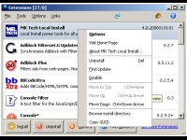
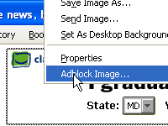
Browser
http://www.mozilla.com/firefox/
Also: http://www.flock.com/

Slide 3
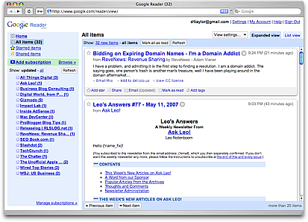
RSS Reader
http://www.google.com/reader
Also: http://www.bloglines.com/
http://en.wikipedia.org/wiki/Aggregator

Slide 4
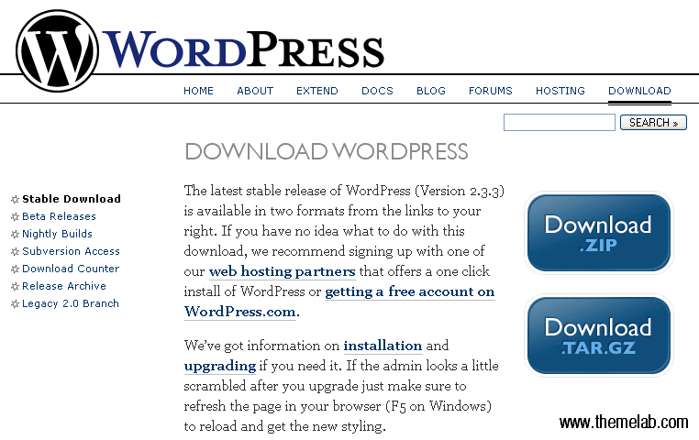
Blogger
http://www.blogger.com
http://wordpress.org/

Slide 5
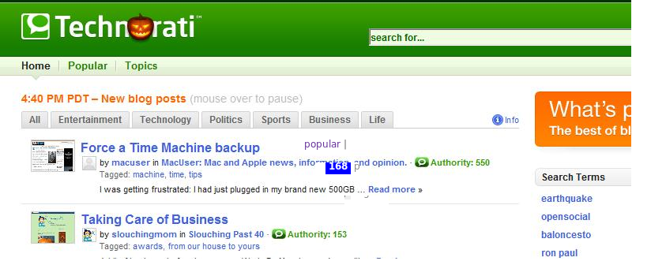
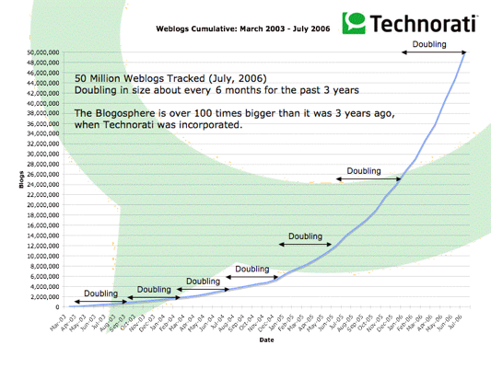
Aggregating
http://technorati.com/

Slide 6
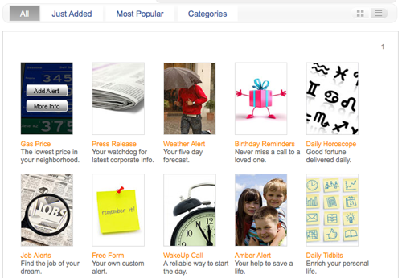
Alerts
http://www.google.com/alerts
http://www.alerts.com/

Slide 7
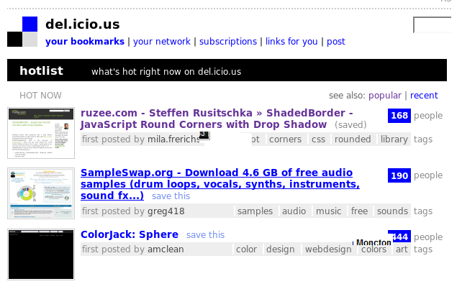
Bookmarking
http://delicious.com/
Also: http://digg.com/ http://www.diigo.com http://www.twine.com/

Slide 8
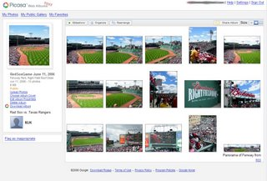
Photos
Also:
Photo editing
Photo groups
http://www.flickr.com/

Slide 9
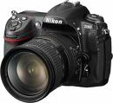
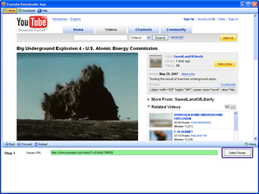
Video
http://www.youtube.com/
http://www.blip.tv/
http://www.theflip.com/

Slide 10
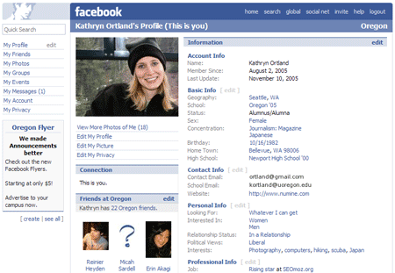
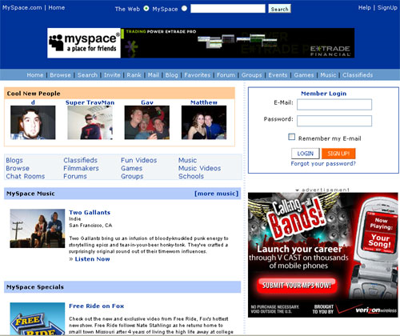
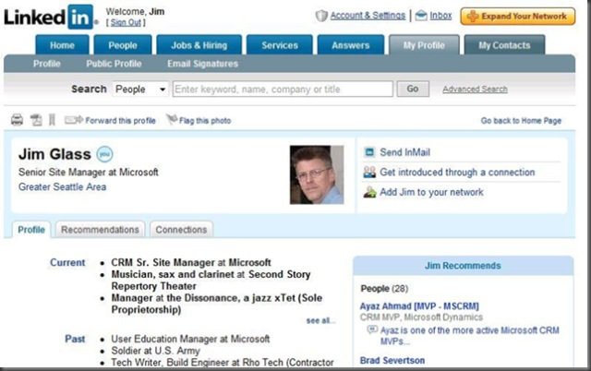
Social Network
http://www.facebook.com http://www.myspace.com http://www.linkedin.com

Slide 11
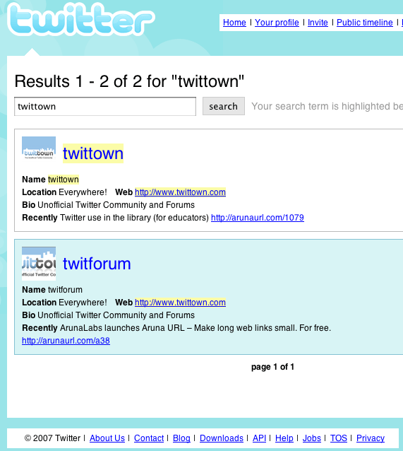
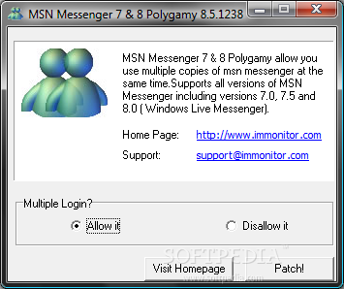
Messaging
http://messenger.msn.com
#hashtag
@message
http://twitter.com/

Slide 12
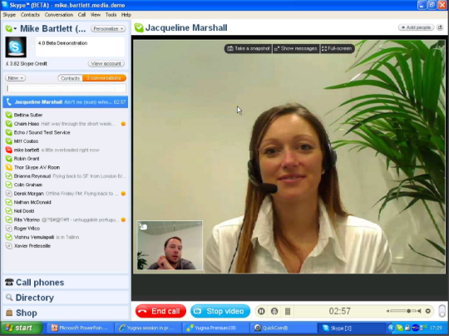
Calling
http://www.skype.com
Recording:
http://www.pamela.biz/
http://www.oovoo.com/

Slide 13
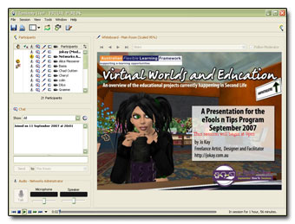
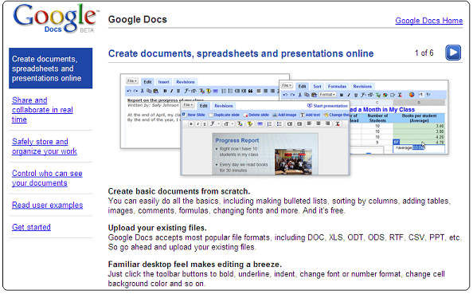
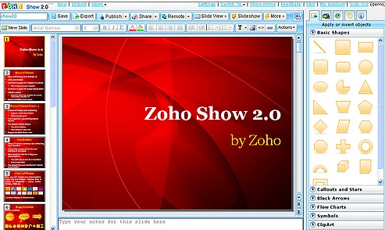
Collaborating
http://www.zoho.com/ http://docs.google.com http://www.elluminate.com/

Slide 14
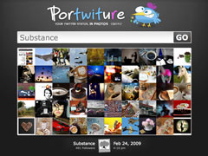
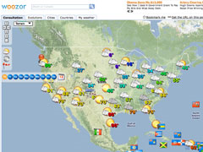
Mashups
http://mashupawards.com/winners/
http://mashable.com/

