Slide 1
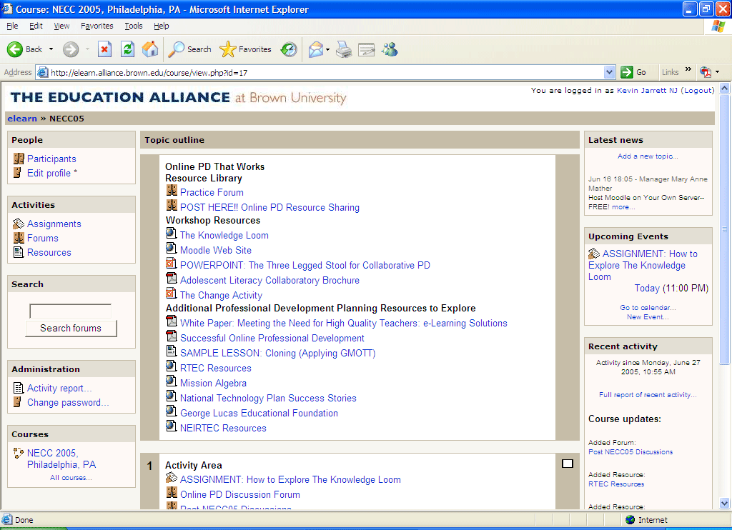
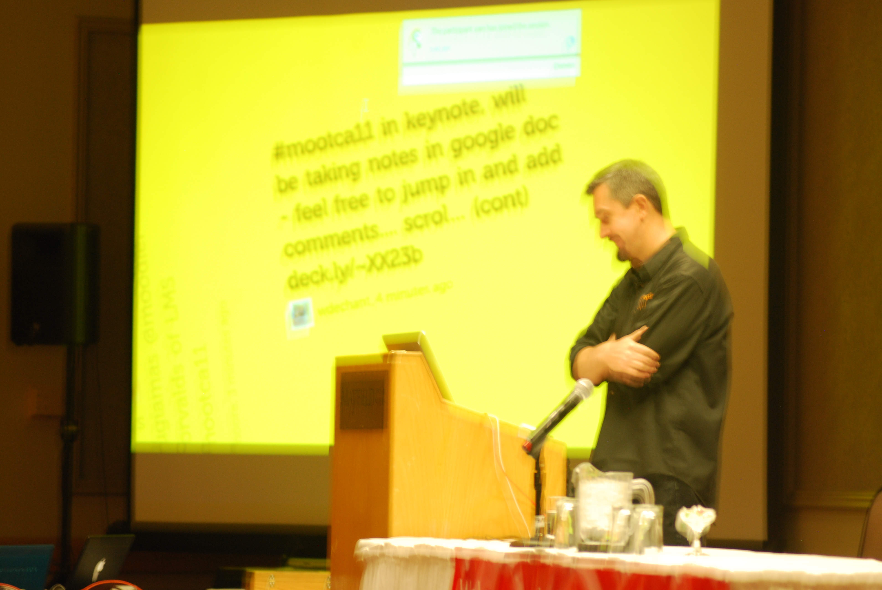
After
Moodle
Stephen Downes
Moodle Moot Canada
Edmonton, Alberta
May 4, 2011

Slide 2

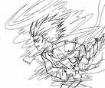

A Timeline…
Stephen’s Guide to the Logical Fallacies
Muddog Mud
1994
1995
1996
Athabaska BBS
Painted Porch
MAUD
Maximus

Slide 3

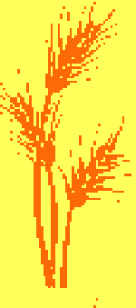
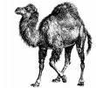
Future of Online Learning
CAE
Learning
Objects
modules
1997
1998
1999
Online Learning Environment
OLe
The Brandon Pages

Slide 4





Knowledge
Learning
Community
2000
2001
2002
PEGGAsus
OLDaily
The Learning Marketplace
MuniMall

Slide 5
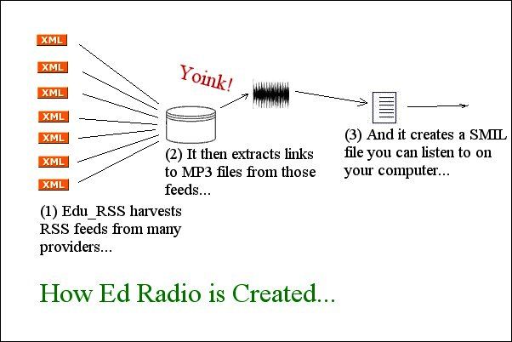
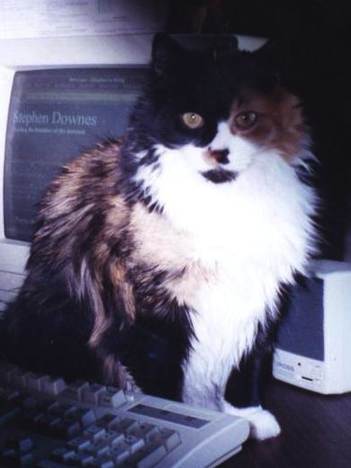
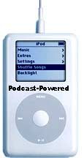
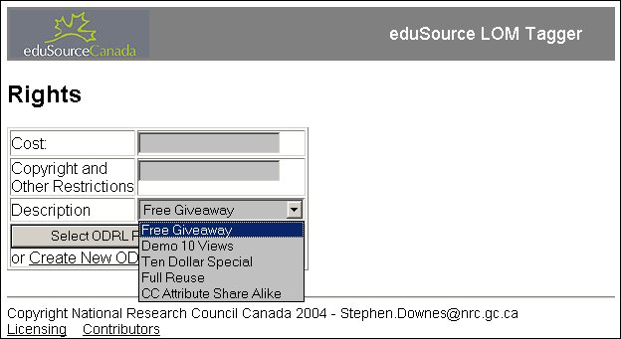

2003
2004
2005
Edu-RSS
Ed Radio
Podcasting
DDRM

Slide 6

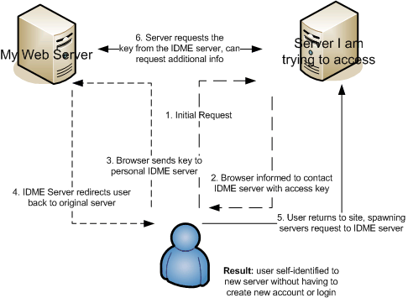
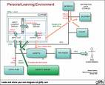
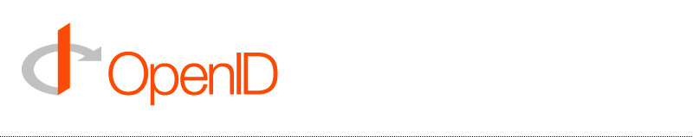
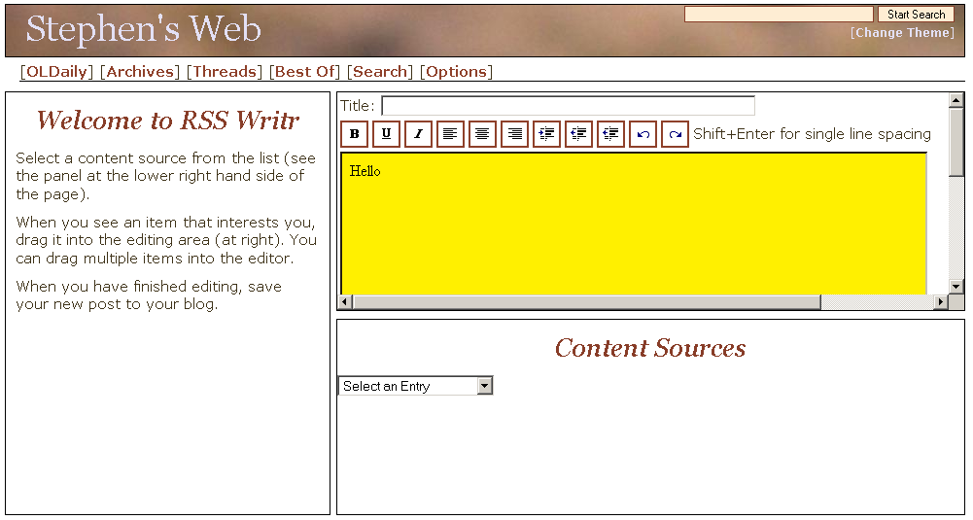
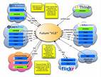
E-Learning 2.0
Learning
Networks
mIDm
2006
2007
Educational
Blogging
RSS Writr

Slide 7
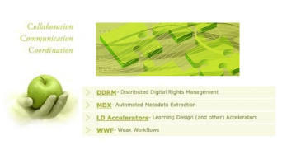

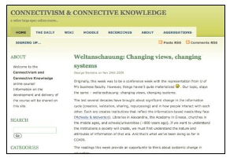
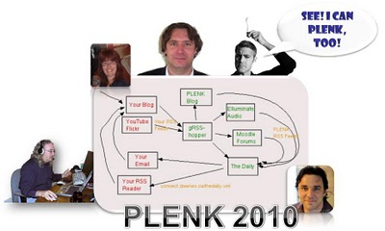
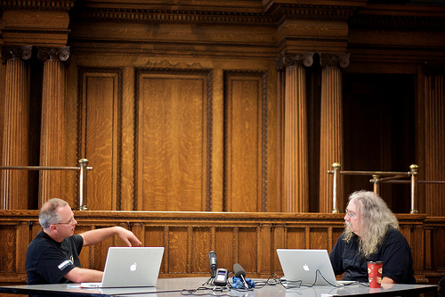

Synergic3
Connectivism
2008
2009
2010
CCK08
OERs

Slide 8

Three Themes
Open Learning
Connectivism
Personal Learning Environment (PLE)

Slide 9
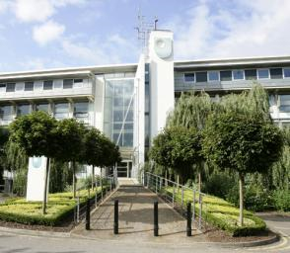
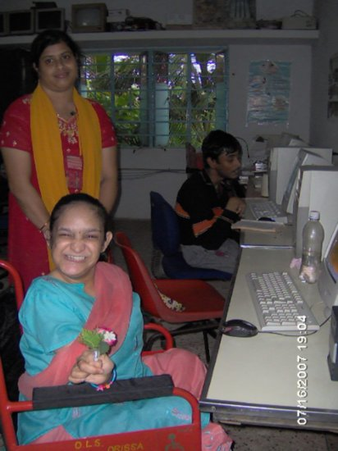
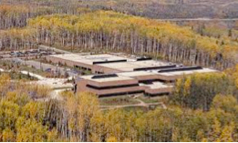
The Idea of Open Learning...
http://www.open.ac.uk/
http://www.open.edu.au/
इंदिरा गाँधी राष्ट्रीय मुक्त विश्वविद्यालय
http://www.ignou.ac.in/
http://www.athabascau.ca/

Slide 10

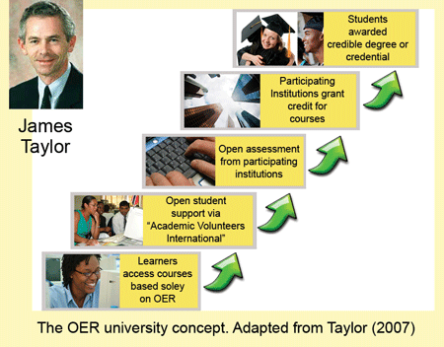
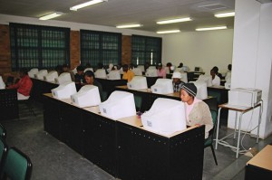
Phases of Openness?
http://www.col.org/blog/Lists/Posts/Post.aspx?ID=134
http://www.col.org/blog/Lists/Posts/Post.aspx?ID=130

Slide 11
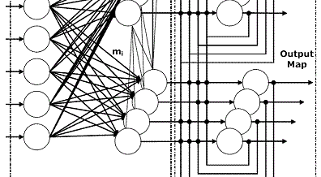
Connectivism
Connectivism is the thesis that knowledge is formed through the creation of connections

Slide 12
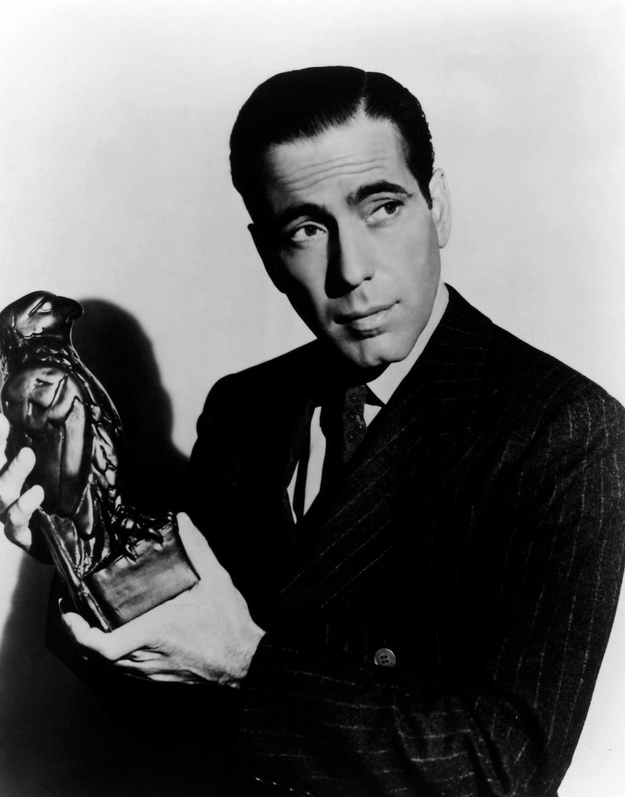
Connectivism
There is no curriculum, no theory, no body of knowledge
  or, more accurately, the curriculum is the McGuffin

Slide 13
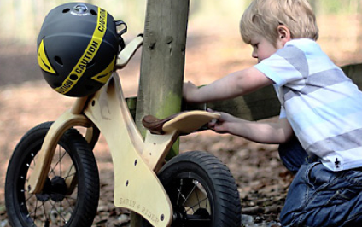
The product is not the knowledge, it is the learner
It is not that there is nothing to learn
It is complex and needs to be navigated…

Slide 14
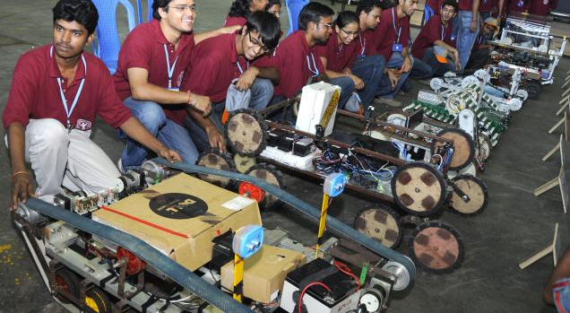
Learning as Immersion
Image: http://www.thehindu.com/education/article876093.ece

Slide 15
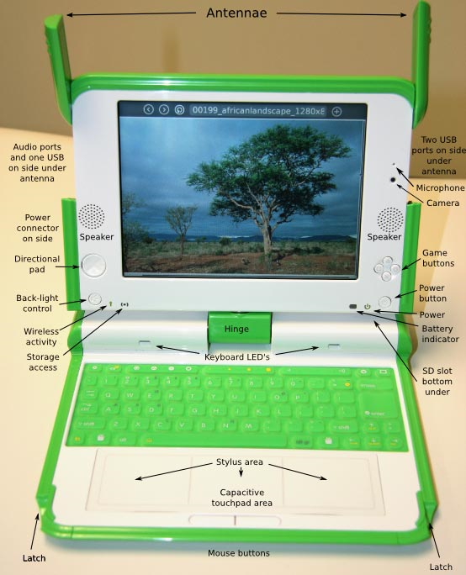
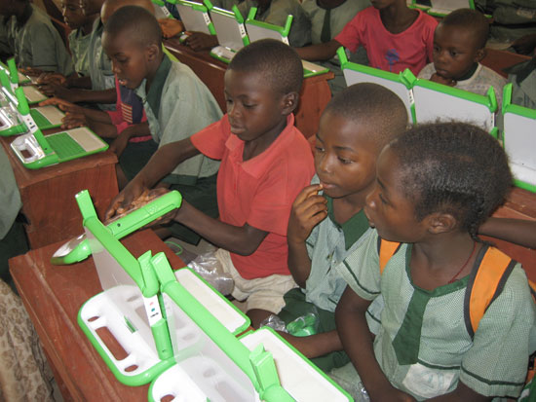
Learning as Immersion
Image: http://one.laptop.org/

Slide 16
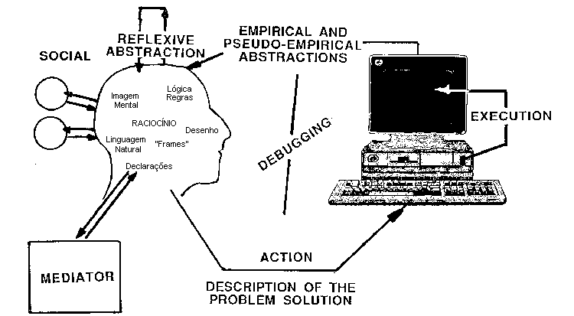
Constructionism
Image: http://eurologo.web.elte.hu/lectures/valente.htm

Slide 17
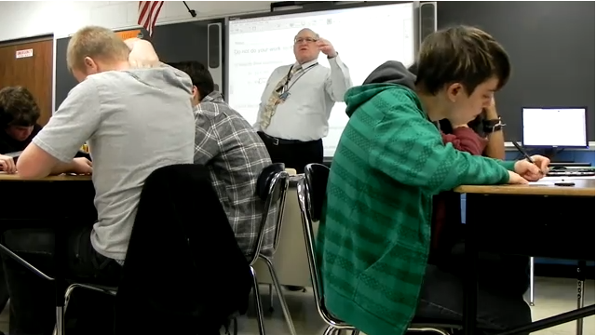
Connectivism
The connectivist method: Aggregate…. Remix… Repurpose…. Feed Forward

Slide 18
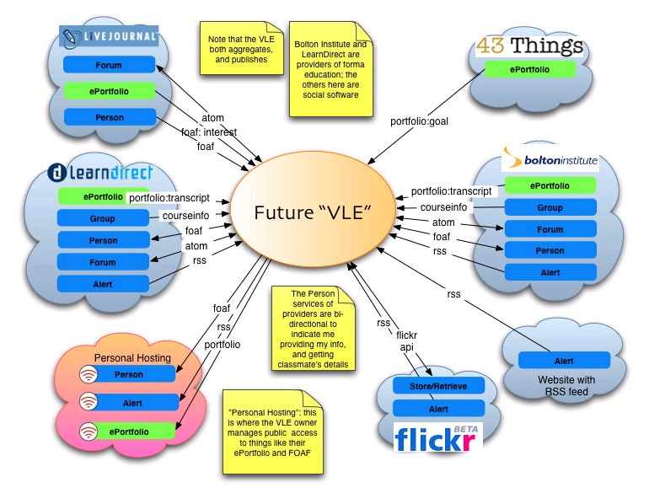
The Idea of the PLE

Slide 19
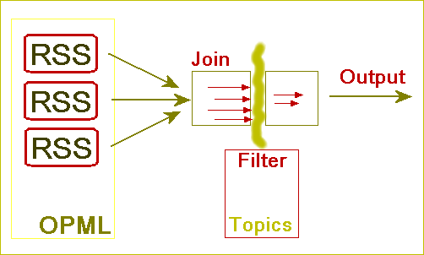
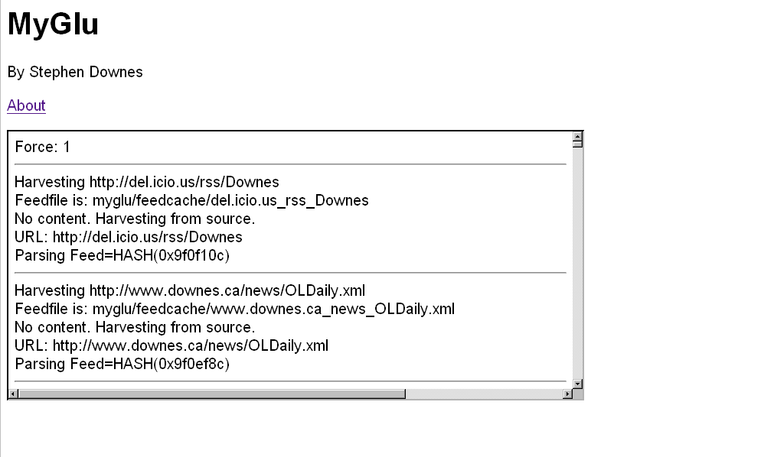
Aggregation and Remixing
http://www.downes.ca/mygluframe.htm

Slide 20
The Connectivism Courses

Slide 21
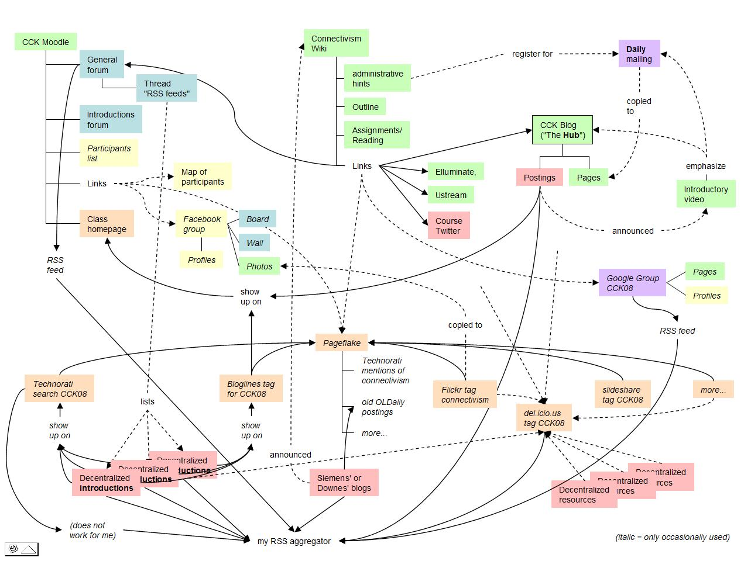
The Connectivism Courses

Slide 22
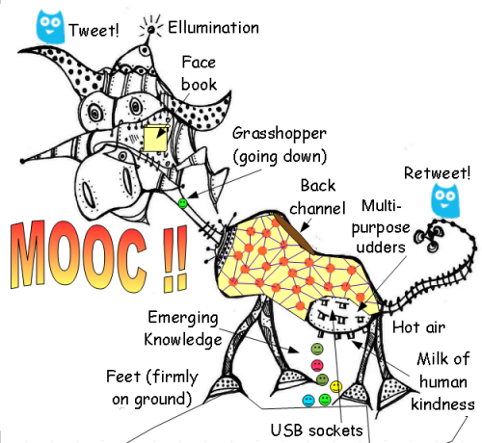
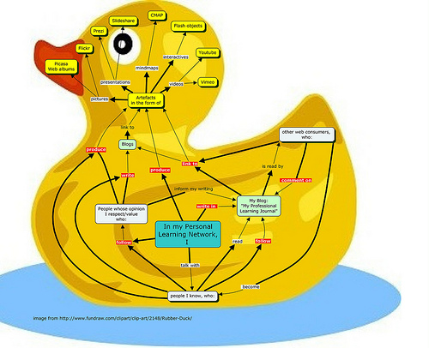
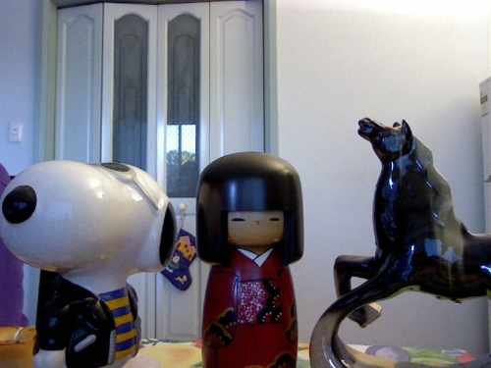
The Connectivism Courses
http://www.mooc.ca
http://cck11.mooc.ca
http://suifaijohnmak.wordpress.com/2011/03/10/cck11-how-to-explain-connectivism-mooc-and-plepln/

Slide 23
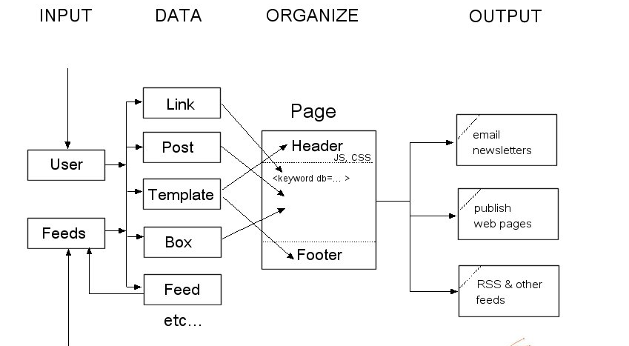
gRSShopper

Slide 24
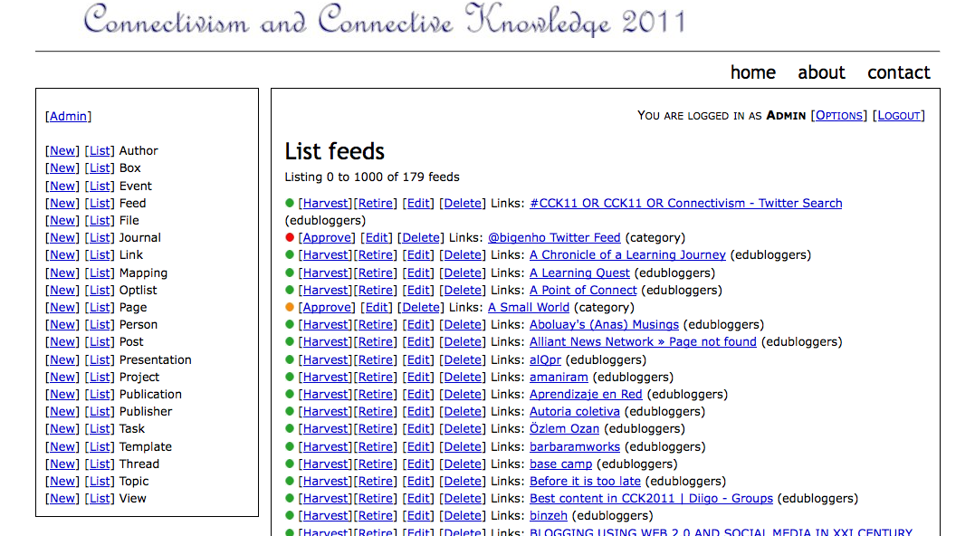
Feeds

Slide 25
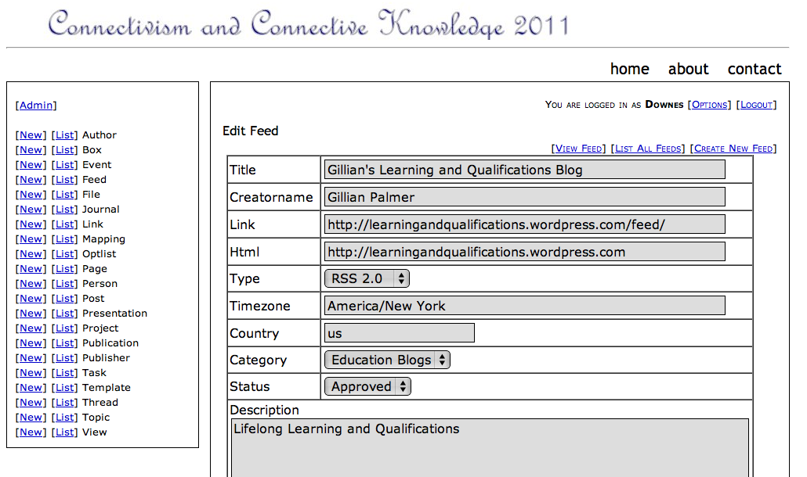
Feed Management

Slide 26
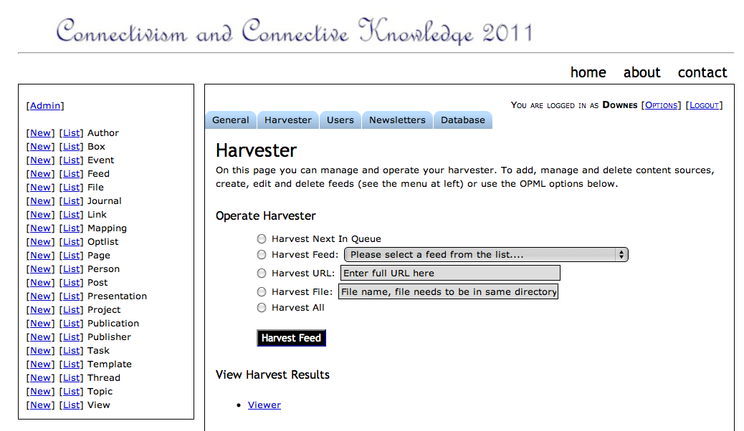
Harvester

Slide 27
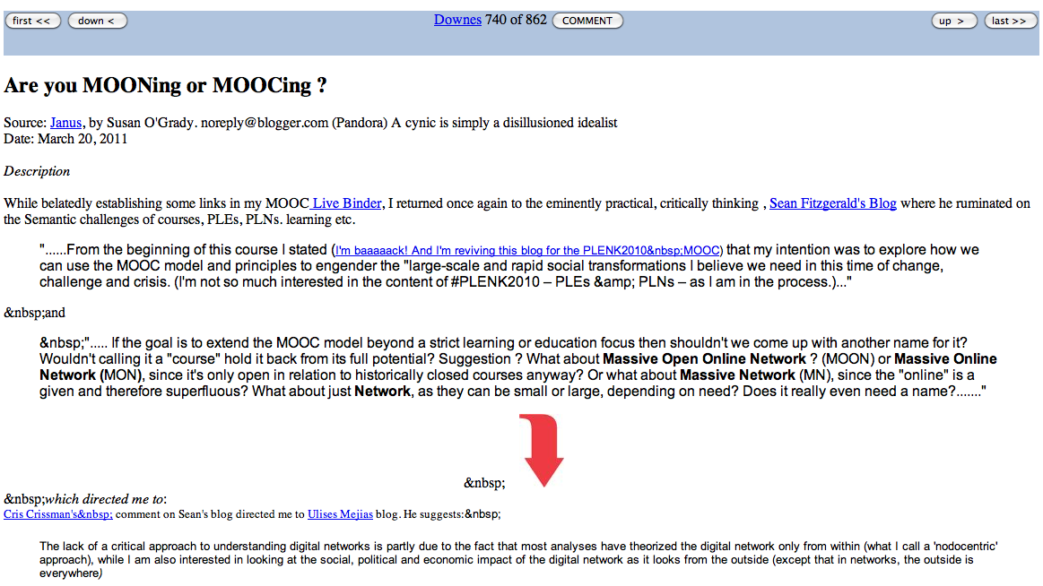
Viewer

Slide 28
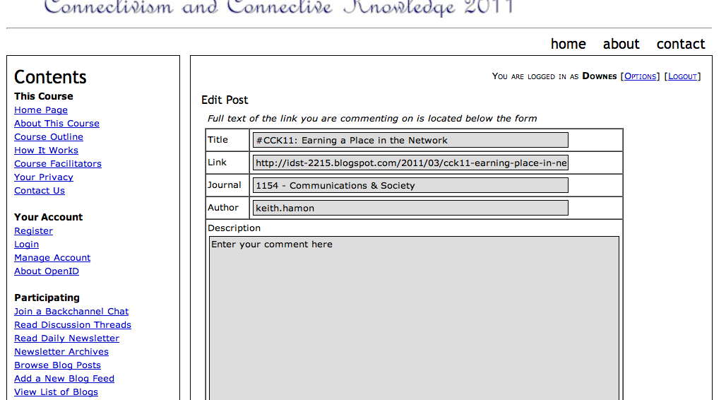
Commenter

Slide 29
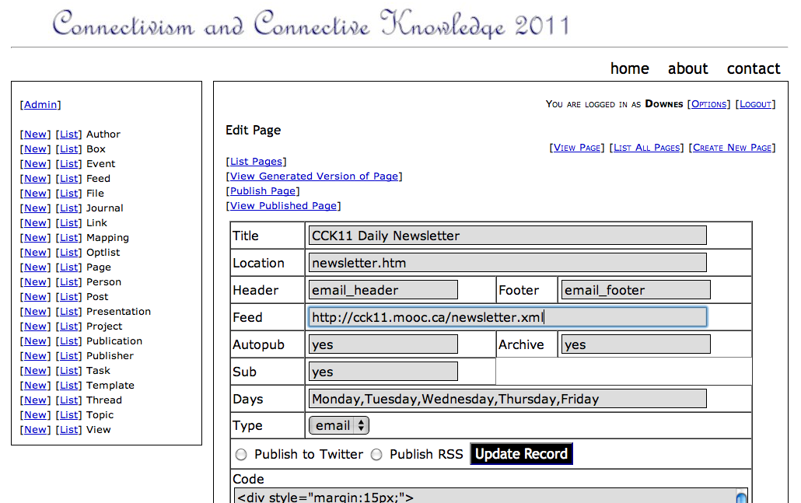
Newsletter

Slide 30
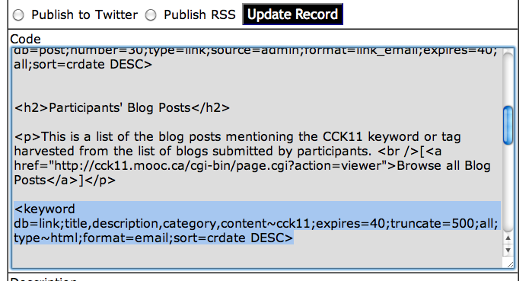
Page Design Code

Slide 31
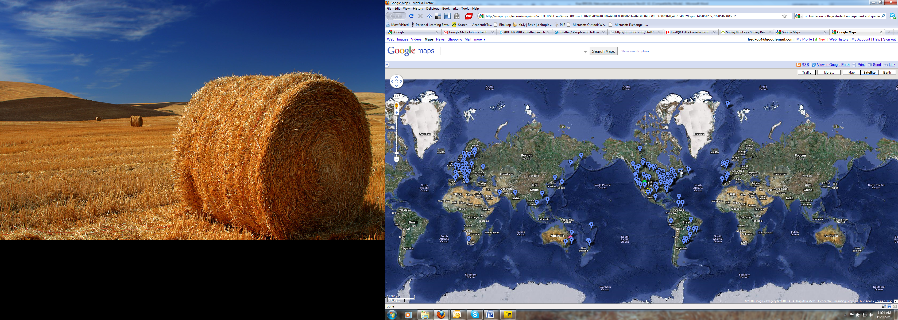
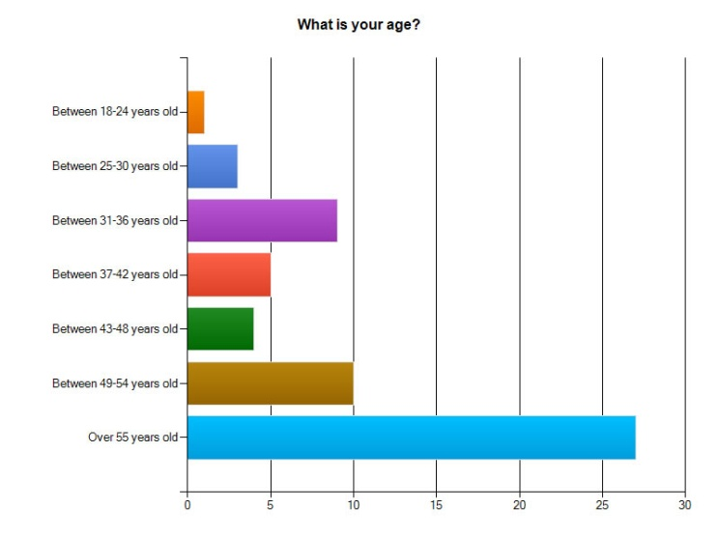
Our Experience
Kop and Fournier, Connecting the Dots, CIDER, 2011

Slide 32
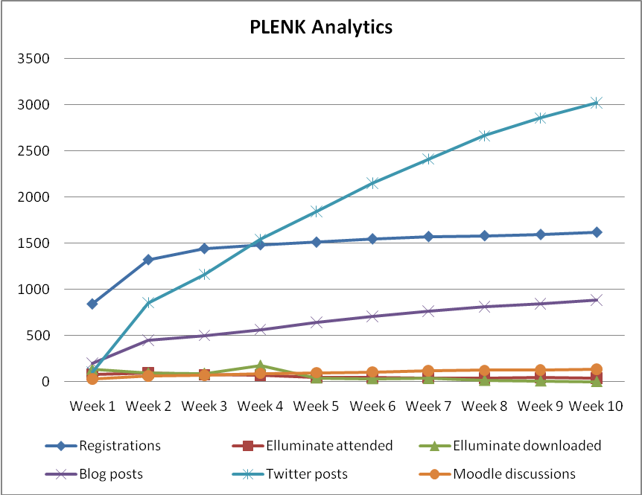
Our Experience
Kop and Fournier, Connecting the Dots, CIDER, 2011
PLENK participation rates
Notes:
Challenges of analyzing and visualizing participation on the course. When the course started, 846 had registered, which steadily increased to 1641 at the end of the course, as shown in Chart 2. People took part in the twice weekly meeting sessions that were hosted on Elluminate, once a week with an invited speaker and once as a discussion session amongst the group and facilitator(s). Actual presence at these synchronous sessions decreased over the weeks from 97 people in week two, when attendance was the highest, to 40 in the final week and there was a similar trend in the access of the recordings.
Global participation and multiple time zones influenced who were present and who accessed the Elluminate recordings. A high number of blog posts were generated related to the course (949) and an even higher number of Twitter contributions (3459). The #PLENK2010 identifier facilitated the easy aggregation of blog posts, del.icio.us links and Twitter messages produced by participants, which highlighted a wide number of resources and links back to participant’s blogs and discussion forums, and thus connecting different areas of the course. Although the number of course registrations was high, an examination of contributions across weeks (i.e., Moodle discussions, blogs, Twitter posts marked with #PLENK2010 course tag, and participation in live Elluminate sessions) suggested that about 40-60 individuals on average contributed actively to the course on a regular basis by producing blog posts and discussion posts, while others’ visible participation rate was much lower.

Slide 33
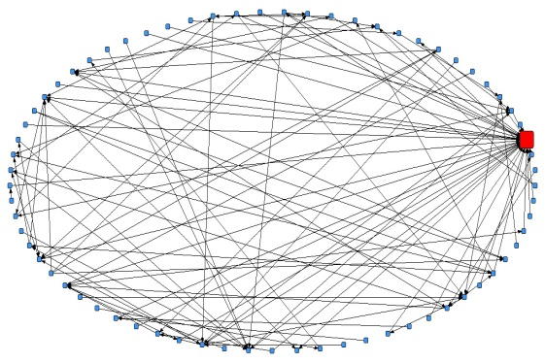

Our Experience
The complex network a facilitator's post generated
Kop and Fournier, Connecting the Dots, CIDER, 2011
Relationships between topics in a discussion in week 1
Notes:
The chart on the last slide shows the number of times people used particular tools but does not show how these interactions took place and we have been experimenting with several analytics tools, such as social network analysis tool SNAPP used as a bookmarklet to the browser. The activation of the SNAPP tool results in an online network visualization and the results of these interactions have been exported to both VNA (Edgelist format) and GraphML formats and used in the NetDraw tool to create network visualizations to understand the role that an actor plays in a particular discussion.
The figure on the left shows that the facilitator is important (the red dot), but that there are other participants with a strong influence on the network through their connections with others. In addition, the second figure shows the relationship between some of the course topics of discussion.

Slide 34



Our Experience
Plenkers in Twitter
Tweets for a week: Tweets, retweets, replies
Kop and Fournier, Connecting the Dots, CIDER, 2011

Slide 35

Our Experience
Twitter PLENK connections to hash-tag networks
Kop and Fournier, Connecting the Dots, CIDER, 2011
#tags related to Twitter posts in the PLENK Daily - six weeks duration
Notes:
And the two images here show the connections of the people on PLENK while using Twitter. The one on the right represents, over a six week period, to what other communities people sent tweets. A #tag can be used as an identifyer of a particular subject, in this case a course, and as you can see PLENK participants also sent messages and links to these other #tag communities. It doesn’t tell anything about the quality of the interactions, but it shows the connectedness.
The image on the left shows Twitter communications within PLENK and it shows that some people are ‘information hubs’ while others did not communicate much.

Slide 36

Assessment and Analytics
It makes no sense to rely on quizzes and tests
Big Data, Web of Data, Semantic Web, RSS, Geo, FOAF…
Mash-ups, APIs, the Cloud, Social Network

Slide 37


Learning Outcomes
We are using one of these
To create one of these
Personal knowledge consists of neural connections, not facts and data

Slide 38
Learning Outcomes
Learning a discipline is a total state and not a collection of specific states
It is obtained through immersion in an environment rather than acquisition of particular entities
It is expressed functionally (can you perform ‘as a geographer’?) rather than cognitively (can you state ‘geography facts’ or do ‘geography tasks’?)

Slide 39
Learning Outcomes
We recognize this
By perfomance in this
There are not specific bits of knowledge or competencies, but rather, personal capacities
(more on this later)

Slide 40

The PLE
Martin: The PLE is just the device I am using…

Slide 41
The Challenge
How can an educational application support, integrate within, and measure the total state?
How can the learner maintain his/her identity and integrity from environment to environment?

Slide 42
The Network in the LMS
Browser
Moodle
Robot Car
D2L

Slide 43
The Network in the LMS
Browser
Moodle
D2L
Data
Data
Identity
Services
Identity
Services
SIS/MIS Banner
Content and Services

Slide 44
The PLE in the Network
PLE
Moodle
SIS/MIS/Banner
Content & Services
D2L
Robot car
Data
Identity
Posts
Papers
Photos
Name / ID
Credentials
Social Network
Friends
Groups

Slide 45

Plearn Components

Slide 46

Plearn Functionality

Slide 47

Plearn Network

Slide 48
Plearn Rollup

Slide 49

Plearn Panes

Slide 50

Success Factors
What sort of decentralized network will best support learning-as-growth?

Slide 51

Network Democracy
Image: http://www.iiav.nl/ezines/web/WomenLearningPartnership/2007/No17/learningpartnership/programfocus-print=1.htm

Slide 52

Network Democracy
http://video.google.com/videoplay?docid=-4126240905912531540#

Slide 53

Diversity
You need a mixture of materials – you cannot grow organically from carbon alone, or water alone

Slide 54

Openness
Closed systems become stagnant
Raw materials are depleted
The system becomes clogged with the ‘creative product’ of its members

Slide 55

Autonomy
The simple cloning of entities does not allow for progress or development
Each individual entity must manage its own grown in its own way

Slide 56

Interactivity
A system cannot grow unless its parts interact – flowers need bees, cows need grain, beavers need trees
Growth is created not by accumulation but by flow, by constant activation and interaction

Slide 57

http://www.youtube.com/watch?v=X0iI0pgTUx0
http://www.downes.ca
Free Learning
Stephen Downes

