Slide 1
Elements of Connectivism
Stephen Downes
CMC11 - SUNY Empire State College
September 22, 2011

Slide 2
What Connectivism Is
The theory that knowledge consists of the connections between entities in a network, and
The theory that learning consists of developing and traversing these networks

Slide 3
Principles of Connectivism
Learning is a process of connecting entities
Nurturing and maintaining connections is needed to facilitate continual learning.
Ability to see connections between fields, ideas, and concepts is a core skill.
Capacity to know more is more critical than what is currently known
Decision-making is itself a learning process

Slide 4
VLE vs PLE
We are in a process of migrating from:
Virtual Learning Environment (a.k.a. Learning Management System (LMS))
To:
Personal Learning Environment (PLE)
This is not only a shift in technology, but also a shift in how we view learning itself.

Slide 5
Traditional Online Learning
Institution Based
Online courses, learning management system
Content ‘federations’ – closed network
Product Based
Content packaging and CD-ROM delivery
Digital rights and authentication
Content Based
The idea of courseware, course packs
Learning design and sequencing

Slide 6
Learning Networks
Not Institution Based
Resource based, learning integration
Open access, content networks
Not Product Based
Web based, content not packaged but agregated
Identity used to enable access, not restrict it
Not Content Based
E-learning as engagement, conversation
Focus on services and interaction

Slide 7
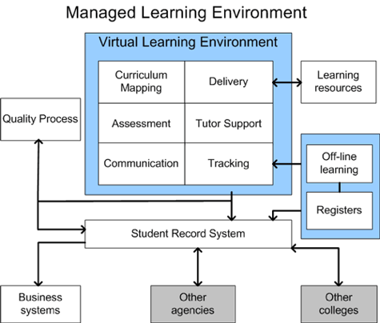
The VLE – Managing Learning
Image: http://dougbelshaw.com/blog/tag/information-technology/
The central purpose of the VLE is to manage learning (whatever that means)

Slide 8
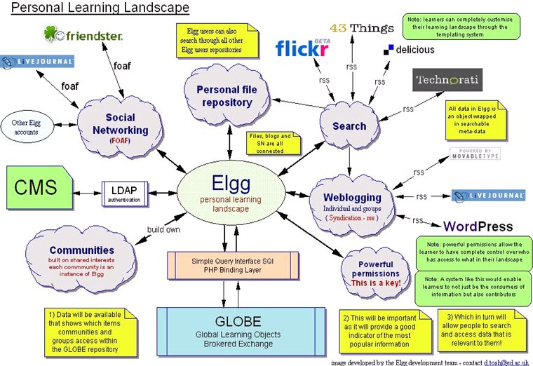
The PLE – Manage Connections
Image: http://tesl-ej.org/ej34/m1.html Via: http://edtechpost.wikispaces.com/PLE+Diagrams

Slide 9
Two Kinds of Knowledge
Knowledge in the VLE (Typically):
Static
Declarative
Authority-based
Knowledge in the PLE (Typically):
Dynamic
Tacit / Non-Declarative
Constructed

Slide 10
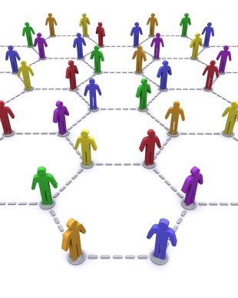
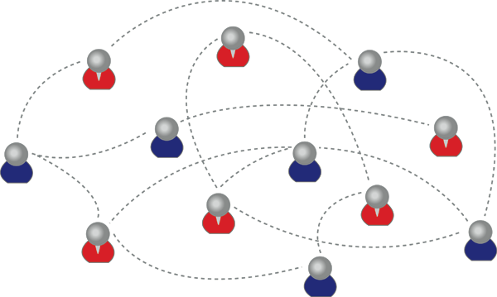
Social Networks
Image: http://www.mguhlin.org/2009/12/rethinking-blogging-social.html
Image: http://www.relenet.com/

Slide 11
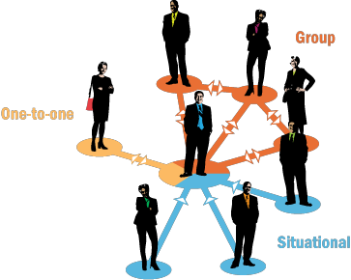
Social Learning
The next step in such a discussion is usually to describe a theory of social learning, depicting learning as an external process (or set of processes)

Slide 12
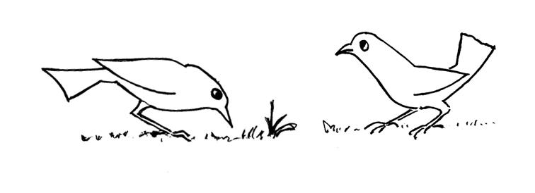
Some Forms of Social Learning
Behaviourism / Instructivism
Interaction & Interaction Theory (Moore)
Social Constructivism (Vygotsky)
Problem-Based Learning (Johnasson)
Image: http://ibis.tau.ac.il/twiki/bin/view/Zoology/Lotem/MyResearch

Slide 13
Aspects of Social Learning
Externally-Based Definitions
Learning objectives, Body of Knowledge
Externally-Based Processes
Learning activities, Processes and conversations
Interaction and communication
External Systems
Classes, networks, groups, collaboration
External Evaluation

Slide 14
Personal vs Social
Social knowledge is not personal knowledge
Personal Knowledge management = Learning
Social Knowledge Management = Research
The product of the educational system is not a social outcome (knowledge, skill, problem, community) but a personal outcome

Slide 15
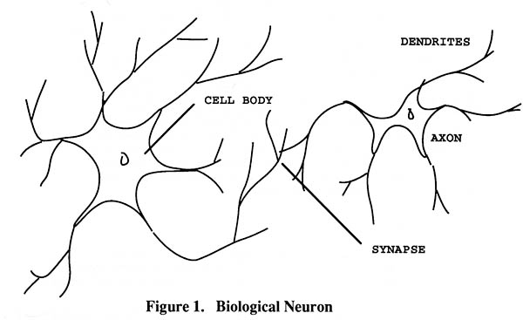
Personal Knowledge
We are using one of these
To create one of these
Personal knowledge consists of neural connections, not social connections

Slide 16
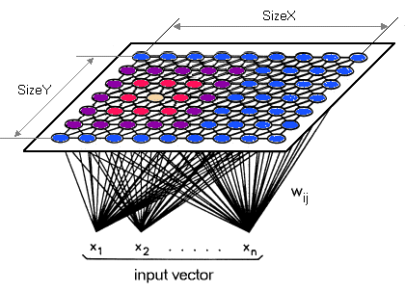
Learning Outcomes
Simple vs complex – text vs network
“Paris is the capital of France”
vs

Slide 17
Learning Outcomes (2)
It’s the difference between:
‘Knowing’ that ‘Paris is the capital of France’ or even some sort of ‘knowing how’ (these are external definitions of this knowledge) and
What it feels like to have geographical knowledge; what it feels like to be a speaker of a language
Learning a discipline is a total state and not a collection of specific states

Slide 18
Learning Outcomes (3)
Learning a discipline is a total state and not a collection of specific states
It is obtained through immersion in an environment rather than acquisition of particular entities
It is expressed functionally (can you perform ‘as a geographer’?) rather than cognitively (can you state ‘geography facts’ or do ‘geography tasks’?)

Slide 19
Learning Outcomes (4)
We recognize this
By perfomance in this
There are not specific bits of knowledge or competencies, but rather, personal capacities
(more on this later)

Slide 20
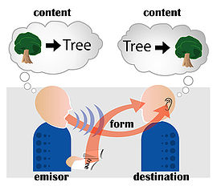
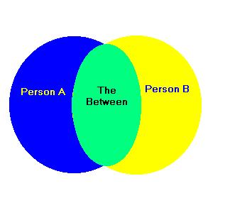
Shared Understandings
Interactivity vs commonality
Communication is not this:
This is not biologically or physically possible!
Image: http://faculty.evansville.edu/dt4/301/Dialogue.html
Image: http://www.answers.com/topic/communication

Slide 21
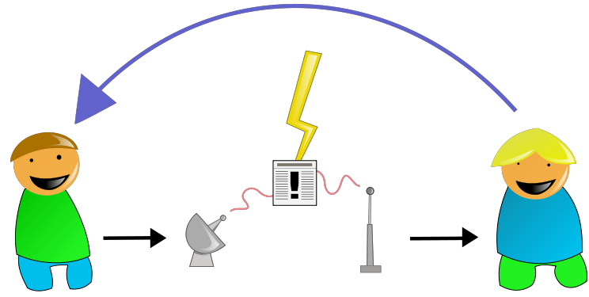
Communication
Communication is more like this:
Context
Syntax
Semantics
Context
Semantics

Slide 22
Cooperation vs Collaboration
Groups vs Networks
Collaboration assumes (the fiction) that we share goals, objectives, methods, etc.
But these are semantic properties, and hence irreducibly individual and complex
Cooperation assumes only the interaction at the point of interactivity – a syntax of words, objects, artifacts, but personal goals, objectives, methods, etc

Slide 23
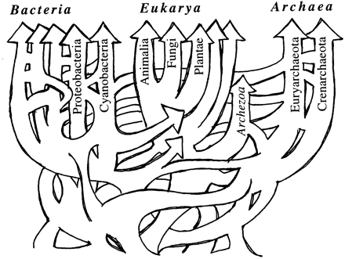
Social Construction
Social construction is at best the collaborative creation of social artifacts (such as naming conventions)
It can be:
Process driven
Results oriented
Consensus-based
Deliberative
Mechanical

Slide 24
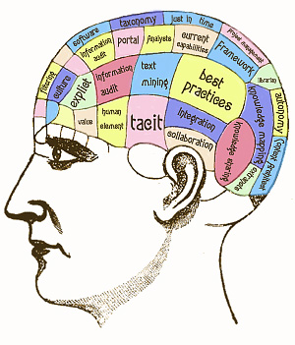
Personal Knowledge
Is not ‘constructed’
You do not ‘make meaning’ for yourself
It is a matter of organic growth
This is important because it means that developing personal knowledge is more like exercising than like inputting, absorbing or remembering
(Totally not what personal knowledge is)
(How do I know this? Research on how neural networks grow, develop)

Slide 25
PLE as Exercise Machine
A PLE is a tool intended to immerse yourself into the workings of a community
Once immersed, you then practice being one of the people characteristic of the community
For example, you would learn philosophy by practicing ‘being a philosopher’ in a philosophical community
Your personal growth develops as a consequence of the interactions with that community

Slide 26
Connectivist Learning Design
Based on the principles of network semantics
i.e., the principles that define effective networks
In practice, amount to the design principles for the creation of massive open online courses

Slide 27
PLE (From a Knowledge Perspective)
The PLE is an environment for a person to manage connections (whatever that means)
Knowledge (conceived as dynamic, tacit, grown or constructed) consists of a set of connections.
Thus
The PLE is an environment for a person to manage knowledge (whatever that means)

Slide 28
PLE as Knowledge Management
Image: http://halfanhour.blogspot.com/2006/10/ple-diagram.html

Slide 29
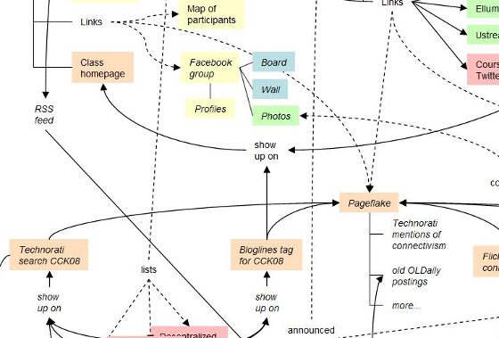
gRSShopper
A tool for managing connections
Used in Connectivism course

Slide 30
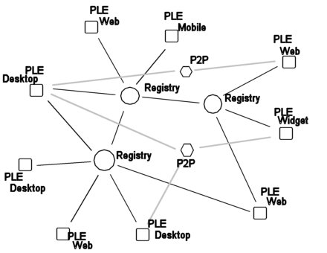
PLEs in a Network
PLEs are envisioned as working as a network

Slide 31
Network Design Principles
Specify how networks differ from traditional learning
The idea is that each principle confers an advantage over non-network systems
Can be used as a means of evaluating new technology

Slide 32
Principles of Effective Design (1)
Syntactic (structural) principles :
Decentralize – mesh, not star
Distribute – across different locations
Disintermediate – direct connections
Disaggregate – unbundle content
Disintegrate – stand-alone components
Dynamize – activity, plasticity
Desegregate – one big mesh

Slide 33
Elements of Network Semantics
Context
Localization of entities in a network
Each context is unique – entities see the network differently, experience the world differently
Context is required in order to interpret signals
Salience
The relevance or importance of a message = the similarity between one pattern of connectivity and another
Meaning is created from context and messages via salience
In other words: knowledge is shared understanding (and not copied understanding)

Slide 34
Elements of Network Semantics (2)
Emergence
The development of patterns in the network
A process of resonance, synchronicity, not creation
Example: commonalities in patterns of perception
Requires an interpretation to be recognized
Memory
Persistence of patterns of connectivity
Other elements: stability, weighting…

Slide 35
Principles of Effective Design (2)
Semantic (intentional) principles:
Autonomy
Diversity
Openness
Interactivity

Slide 36
Autonomy
Factors affecting mental states
Empirical, cognitive, psychological
Capacity to act on mental states
Physical, social, structural, resources
Scope and range of autonomous behaviour
Expression, association, selection, method…
Effects of autonomous behaviour
Impact, improvement
http://halfanhour.blogspot.com/2010/11/model-of-autonomy.html

Slide 37
Diversity
Composition
Many types of entities
Intention
Different goals, desires (Mill)
Perspective
Uniqueness of point of view, language
Mathematics of diversity
Multiple inputs produce mesh networks
http://lemire.me/fr/abstracts/DIVERSITY2008.html
http://www.huffingtonpost.com/stephen-downes/democratizing-education_b_794925.html

Slide 38
Diversity (2)
Putnam, Florida, and the rest of it
Homophily and associationism
Teaching what we have in common instead of our differences? No
http://www.downes.ca/post/53544
http://profesorbaker.wordpress.com/2011/01/30/homophily-and-heterophily-what-fires-together-wires-together-cck11/
http://secondlanguagewriting.com/explorations/Archives/2007/August/TheDownsideofDiversity.html

Slide 39
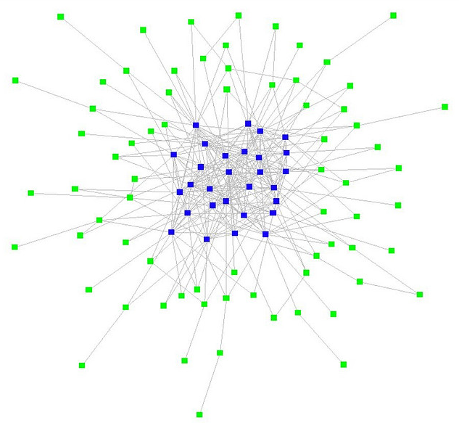
Openness
Open education
Open content, teaching, assessment
Stages of openness and terminal path
Open networks
Clustering instead of grouping
Flow
Input, output, feedback
plasticity
http://www.flickr.com/photos/ross/2916958593/

Slide 40
Interactivity
Influence vs emergence
Thought-bubbles – “we perceive wholes where there are only holes”
‘Scope’ vs ‘Level’
http://www.downes.ca/post/42066
Ontology of emergence
Ontological (real) vs perceptual (recognized)
Connection to complexity & chaos
http://www.downes.ca/post/55001
http://connect.downes.ca/post/44222

Slide 41
Stephen Downes
http://www.downes.ca

