Slide 1
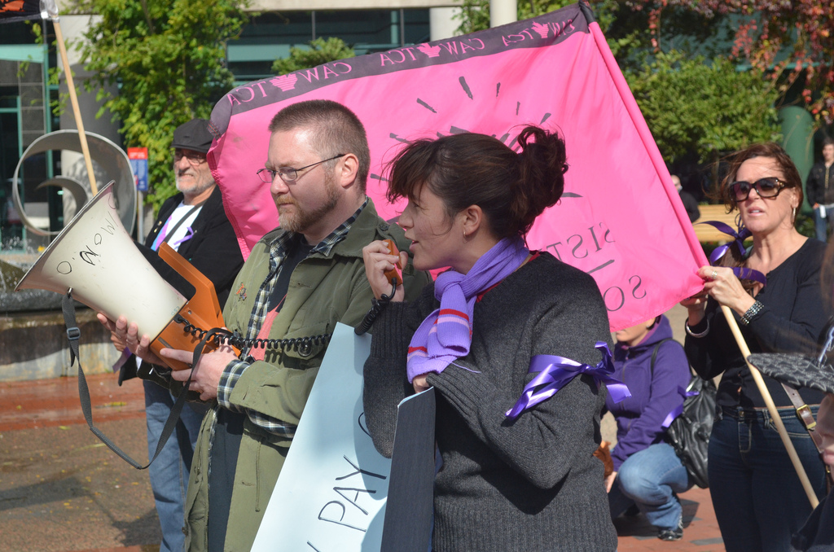
Connectivism and Personal Learning
Stephen Downes, October 17, 2011

Slide 2
Thesis of this Talk
Connectivism as a pedagogical theory is typically thought of in terms of networks – the making and traversing of connections.
But the major practical implication of connectivism occurs in the organization of learning events and resources.
Unlike traditional educational modalities, in which people work collaboratively, in a connectivist model, people work cooperatively.

Slide 3
Context: Current Work
new instructional media, web software and design http://www.synergic3.com
open educational content, content repositories and content syndication http://www.downes.ca/news/OLDaily.htm
design and development of massive open online courses http://change.mooc.ca
semantic web and structured descriptions
network theory as it applies to the design of learning environments

Slide 4
Introduction to this theme
Introductory article
http://spomocnik.rvp.cz/clanek/14151/
Collaboration: everybody works together in a coordinated fashion on a single objective
Cooperation: people work independently on individual objectives, but in a shared environment or with shared resources

Slide 5
Dillenbourg et al. (1995) make a distinction between cooperation and collaboration. They define cooperative work as"... accomplished by the division of labor among participants, as an activity where each person is responsible for a portion of the problem solving..." They define collaboration as "...mutual engagement of participants in a coordinated effort to solve the problem together"
http://en.scientificcommons.org/57759749

Slide 6
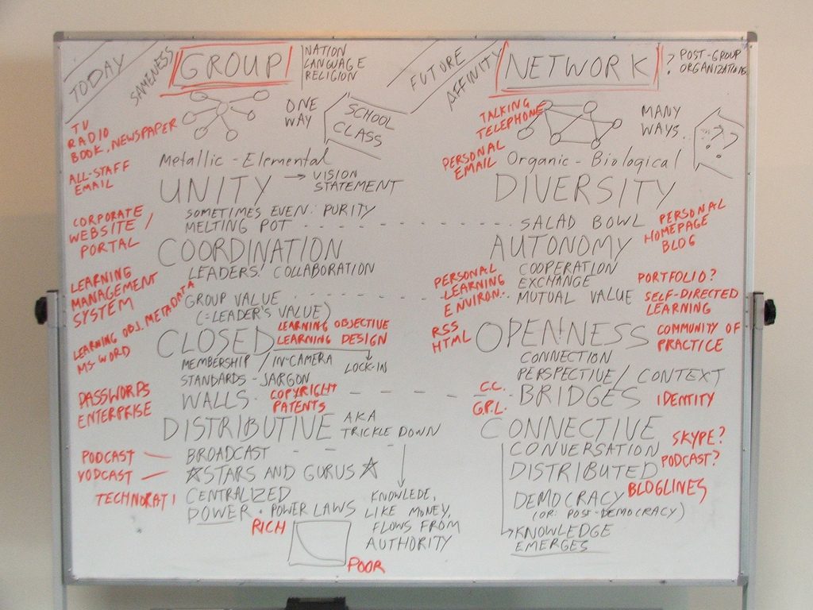
Elements of Cooperation
COLLABORATION
COOPERATION

Slide 7
The Effect of Connectivism
School becomes personal learning
There is not a single body of content to be learned
Students learn not the same thing but different things
The emphasis is on the communication and interaction
The process is what Papert called ‘constructionism’

Slide 8
The building of the PLE
This is essentially the task of the instructor (among many other roles)
Similar to the process of building a MOOC
Support for the various stages of connectivist learning: aggregate, remix, repurpose, feed forward

Slide 9
Personal Professional Development
Most important to manage your own professional development
The phrase in English is “eat your own dog food” – use the practices to teach yourself
Form, create, and work with networks of other professionals
Downes on Personal Professional Development
http://www.downes.ca/presentation/217

Slide 10
The Importance of Open Educational Resources
Enables people to pursue their own personal interests in their own way
But, more importantly, OERs become the medium of communication
We need to view OERs, not as resources created by publishers at great cost, but as created by learners to interact with each other
The role of professionals and publishers becomes the production of ‘seed OERs’

Slide 11
Education and Democracy
Education is not about remembering a body of predefined content
It is about the citizens communicating what they know with each other
If follows that OERs are necessary for this democratic vision of education
The owners of education are the citizens of a society, not the governments and corporations
Papert and Freire on the Future of School
http://www.papert.org/articles/freire/freirePart1.html

