Slide 1
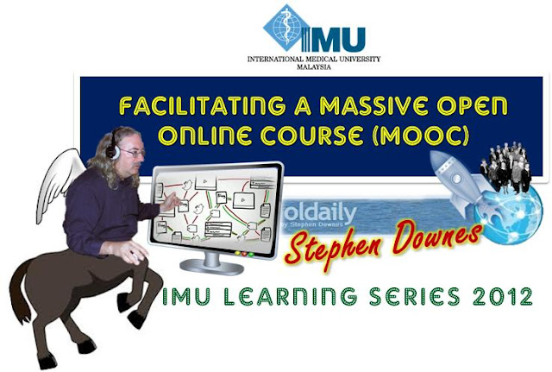
Facilitating a Massive Open Online Course
Stephen Downes
February 21, 2012

Slide 2
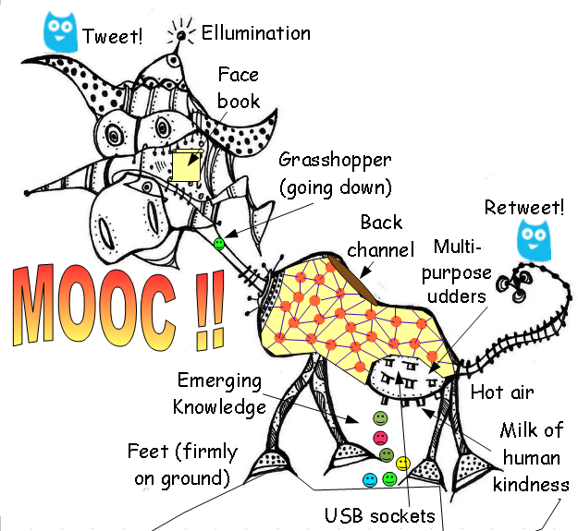
What is a MOOC?

Slide 3
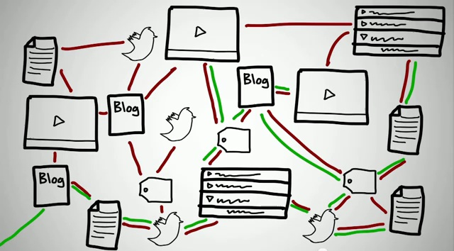
Elements of a MOOC

Slide 4
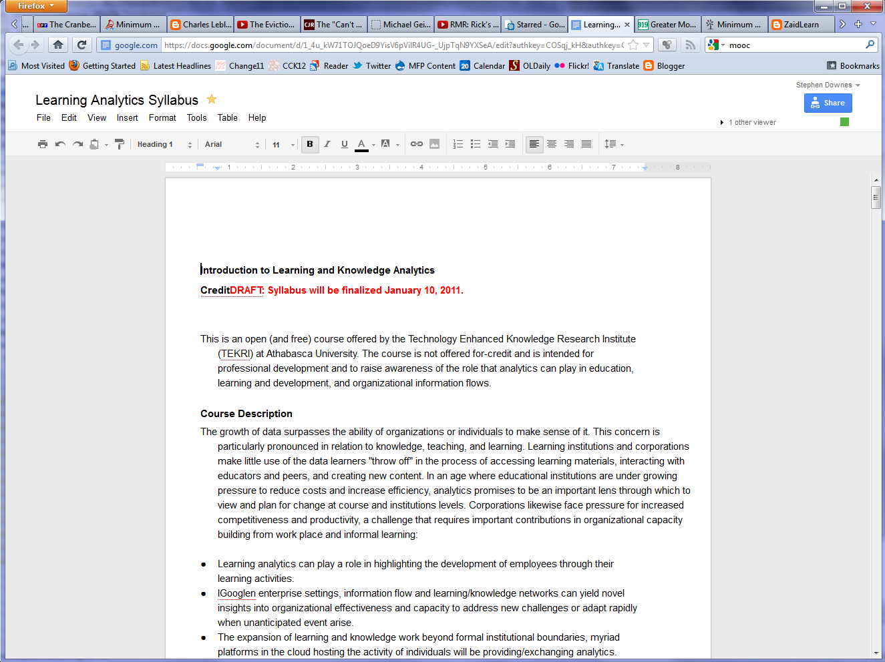
Syllabus
Description
Tag
Audience
Outcomes
Facilitators
Resources
Technologies
We’ve used wiki software eg. http://pbworks.com
And also Google Docs

Slide 5
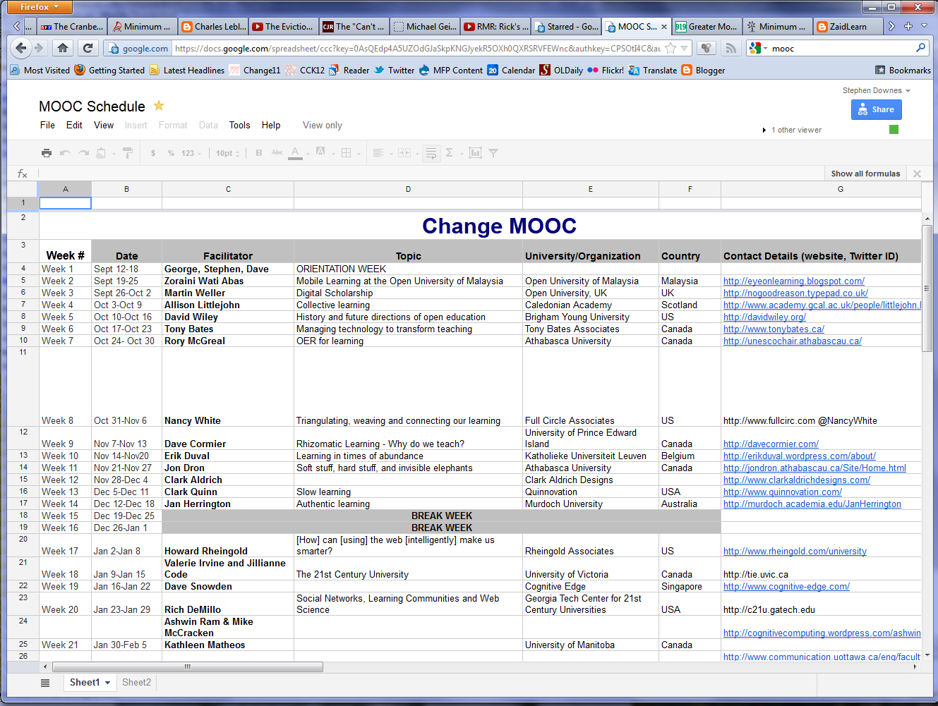
Outline & Schedule
Deadlines
Class Sessions
Topics
Guests
Assignments
We used a Google Docs spreadsheet for internal purposes, but I really recommend using a Google Calendar for external purposes

Slide 6
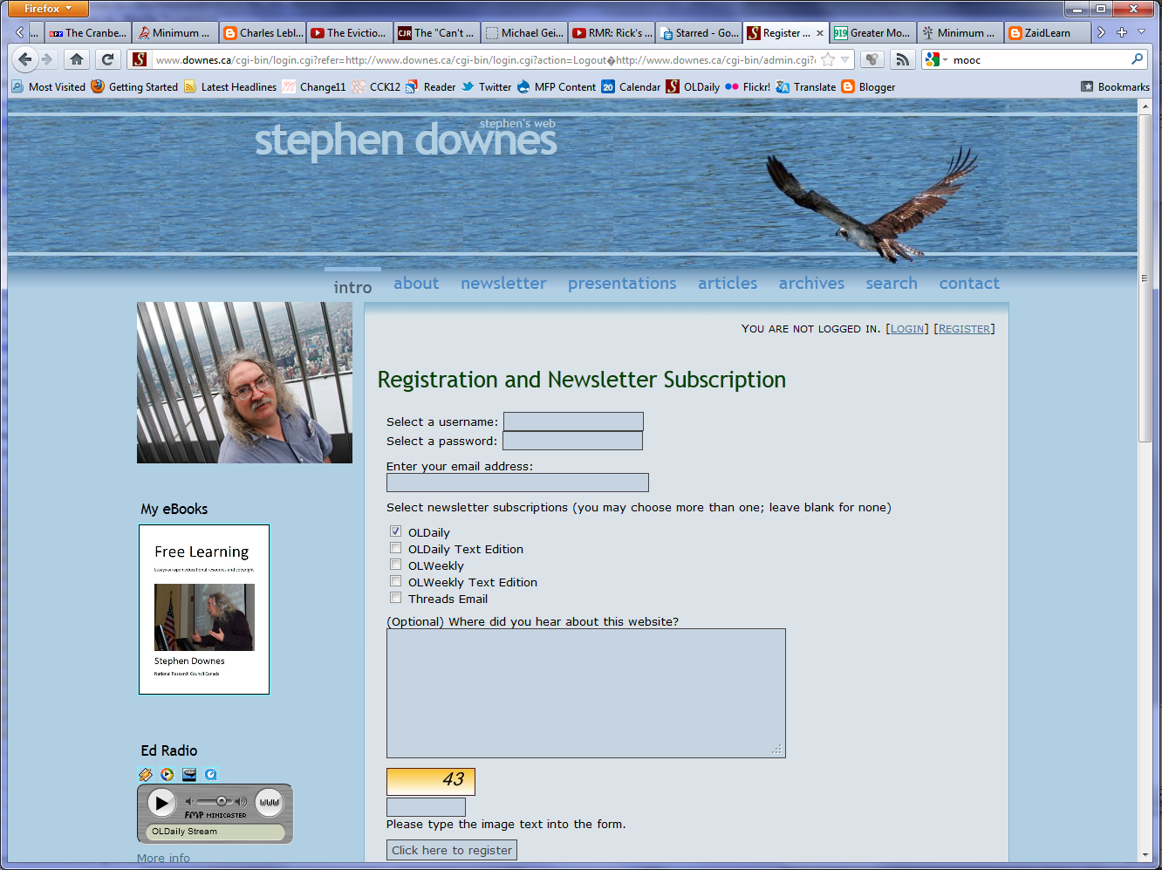
Registration Page
gRSShopper
Google Docs Spreadsheet
Google Group signup
Etc.

Slide 7
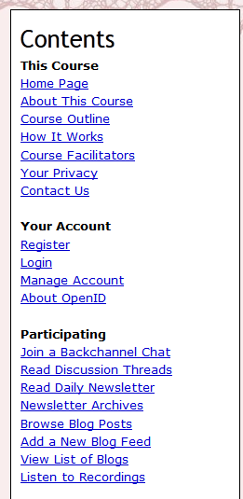
Course Pages
Home page
Calendar
About This Course
Course Outline
Course Facilitators
Your Privacy
Contact Us

Slide 8
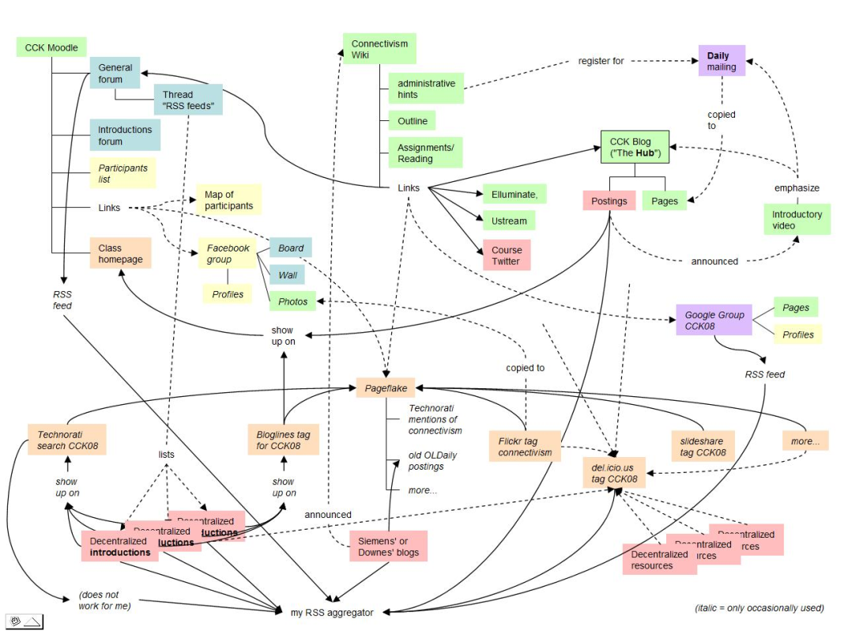
Software / Services Used
Moodle
Google Groups
WordPress
Diigo
Twitter
Facebook
Second Life
Other tools

Slide 9
Preparing for the MOOC

Slide 10
How the MOOC Works
How this Course Works http://change.mooc.ca/how.htm
What is a MOOC? www.youtube.com/watch?v=eW3gMGqcZQc8
Success in a MOOC www.youtube.com/watch?v=r8avYQ5ZqM01
Knowledge in a MOOC www.youtube.com/watch?v=bWKdhzSAAG01
Change MOOC 11 - an introduction and an invitation www.youtube.com/watch?v=mqnyhLfNH3I11

Slide 11
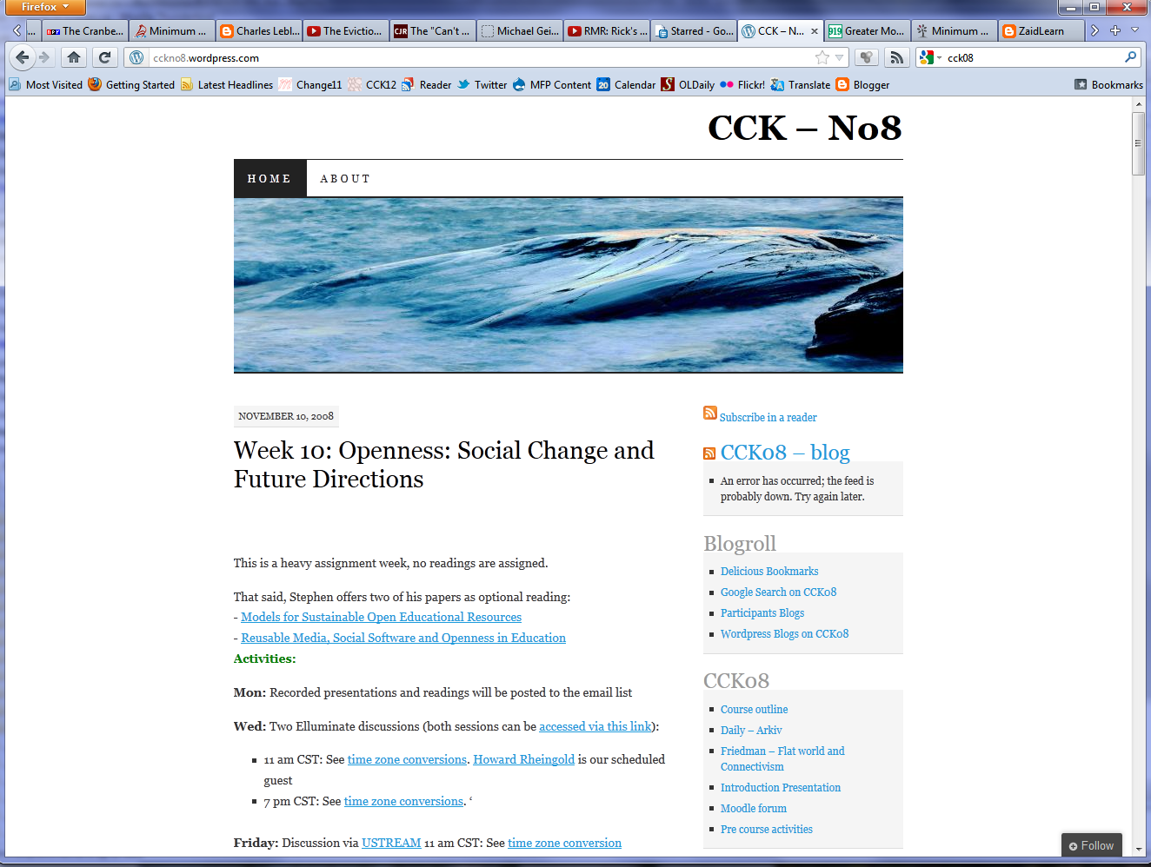
Student Websites
Blogger
WordPress
Tumblr
Posterous

Slide 12
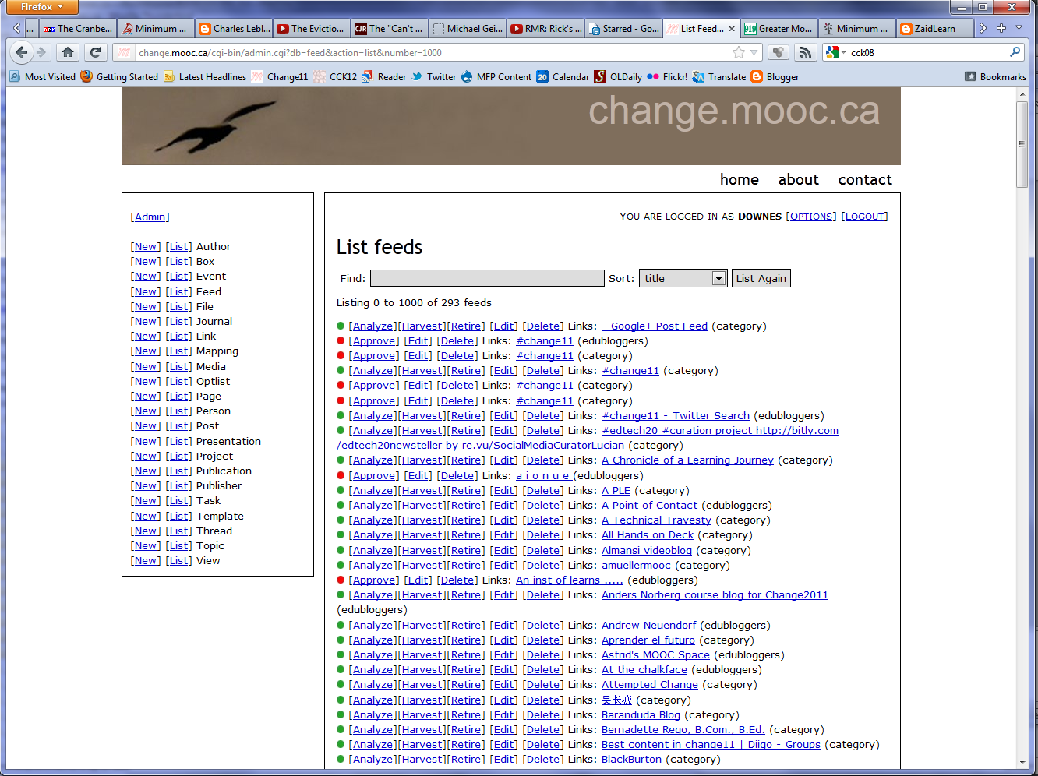
RSS Harvest
Find RSS Feeds
Submit RSS Feed
Create Aggregator:
gRSShopper
Google Reader
WordPress

Slide 13
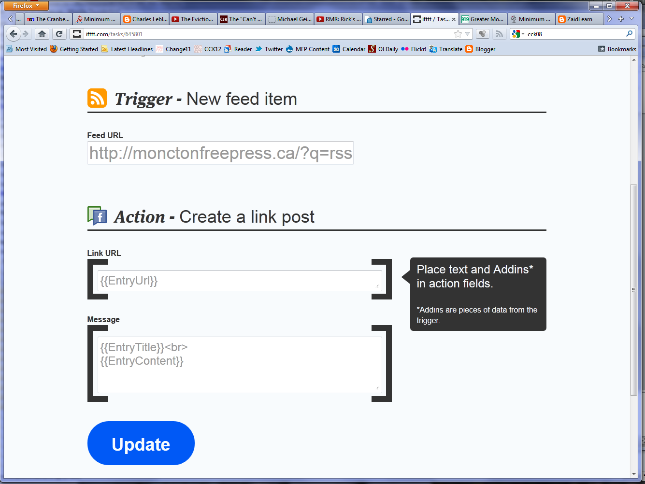
Specialized Harvest
Twitter
Diigo
Delicious
Google Groups
Ifttt.com
feed43.com

Slide 14
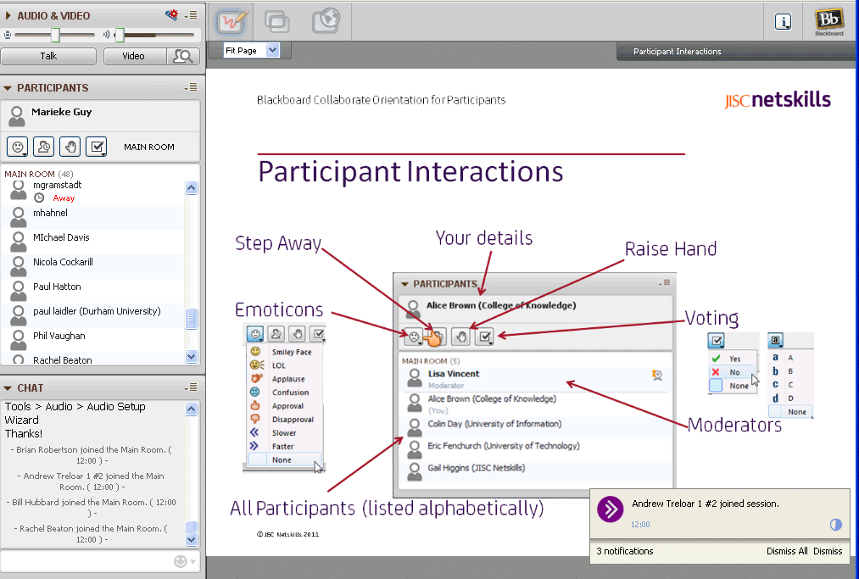
Synchronous Environment
Blackboard Collaborate (Elluminate)
Adobe Connect
Big Blue Button
WizIQ
Fuze
WebX
Webcasting – web radio

Slide 15
Newsletter or Feeds
gRSShopper
Facebook Page
Twitter
WordPress - http://www.wpbeginner.com/wp-tutorials/create-a-free-email-newsletter-service-using-wordpress/
Designing Email Newsletters: http://www.smashingmagazine.com/2010/01/19/design-and-build-an-email-newsletter-without-losing-your-mind/

Slide 16
Research Group
Create research group
Google Groups
Google Docs
Set Up Research Ethics
Will be needed on registration
Surveys
Survey Monkey
LimeSurvey
Server Logs / Other data?

Slide 17
Running the MOOC

Slide 18
Launch
Advertise / PR
Send welcome newsletter
Set up research
Open Registration Page

Slide 19
Preparing for a Week
Confirm at least a week ahead with guest speaker
Sent intro email explaining process & describing expectations
Line up resources – background, etc
Prepare and assemble materials

Slide 20
Weekly Routine
Create a new ‘author’ listing for the author Add new readings for the week (see ‘Adding Resources’ below), scheduling them if necessary (George)
Add new event listings for the week
Add weekly activities
Create weely page and update home page
Database Magic

Slide 21
Daily Routine
Check and Approve New Feeds
Check Newsletter / Send newsletter
Cron / autosend

Slide 22
Event Preparation
Send review letter for guest
Open event site ½ hour ahead
Prepare recording
Audacity audio
Camtasia?
In-app recording

Slide 23
Event follow-up
Post audio/video/other recordings
Prepare event page
Update recordings page
Update other course pages
Send thank-you email

