Slide 1

Publishing Paradigms of the Future: Where are We Headed?
Stephen Downes
Canadian Association of Learned Journals
Congress of the Canadian Federation of Humanities and Social Sciences
May 27, 2012

Slide 2
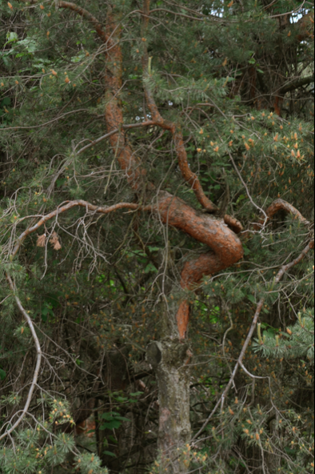
What’s Coming?
Open
Digital
Distributed

Slide 3
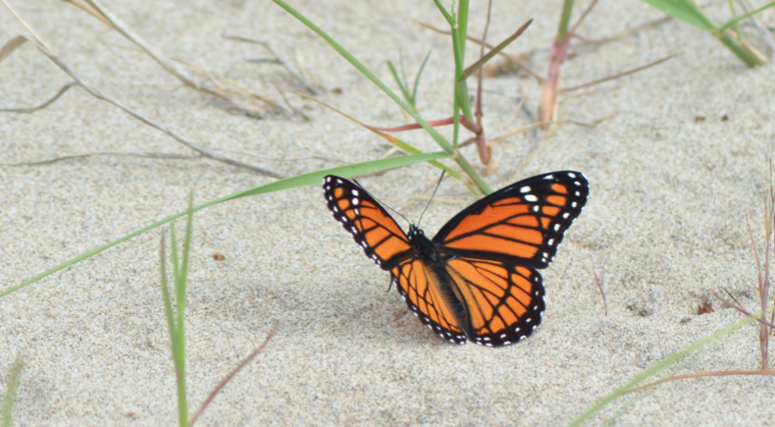
1. Trends

Slide 4
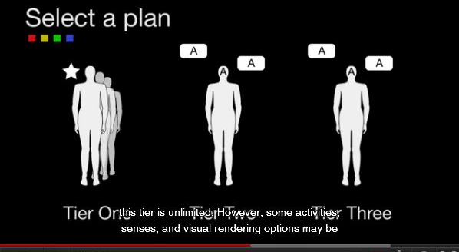
Welcome to Your Death
http://www.tomscott.com/life/
http://www.downes.ca/post/58146

Slide 5
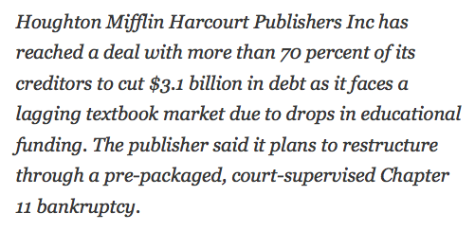
And so it begins
http://www.downes.ca/post/58190
http://opencontent.org/blog/archives/2329

Slide 6
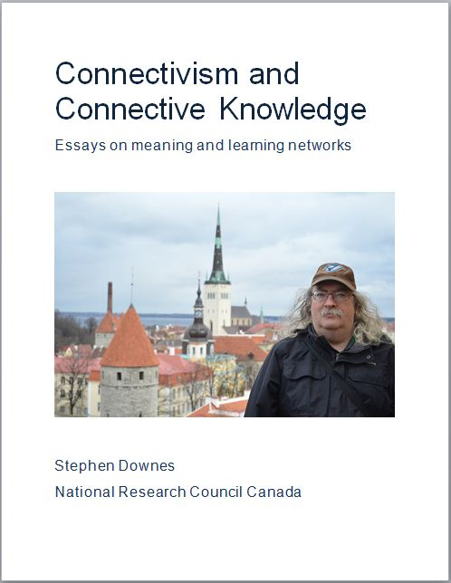
Connectivsm and Connective Knowledge
http://www.downes.ca/post/58207 - http://www.downes.ca/archive/me/mybooks.htm

Slide 7
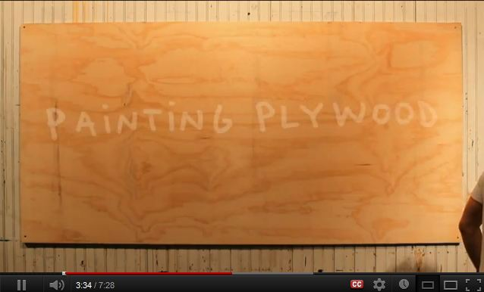
Love Letter to Plywood
http://www.youtube.com/watch?&v=NZU1B8kb8EQ
http://www.downes.ca/post/58164
Notes:
Tom Sachs, YouTube, May 16, 2012.
This short video, a tribute to plywood, is getting rave reviews. It's an educational video, but one that leaves one viewer "weeping in the building materials aisle at Home Depot." Me, I've spent a lot of time with plywood, and so I get that.
http://www.downes.ca/post/58164

Slide 8
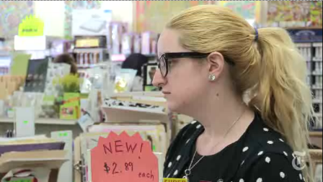
The university system won’t last
http://www.openculture.com/2012/05/why_the_university_system_as_we_know_it_cant_last.html
http://www.downes.ca/post/58132
Notes:
Why the University System, as We Know It, Won’t Last …. and What’s Coming Next
Dan Colman, Open Culture, May 14, 2012.
Dan Colman points to two trends that, to him, signal the end of the university system as we know it:
First, Silicon Valley is finally focusing on e-learning. Udacity, Coursera, Kahn Academy, EdX — they’re all looking to lift e-learning out of a long period of stagnation.
Second, paying for a college education is getting unsustainable - as noted by the New York Times this weekend and Planet Money in audio.
"And then," he writes, "you consider this. Many universities seem indifferent to the difficulties students face, if they’re not intentionally exacerbating the problem."

Slide 9
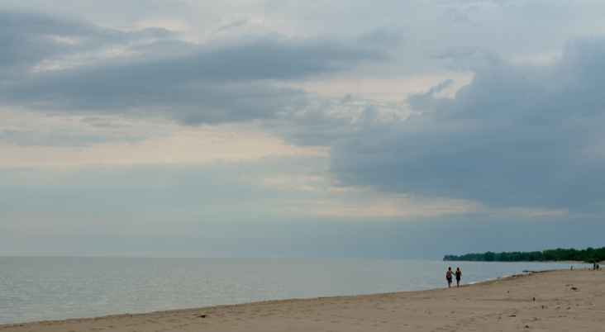
2. Open

Slide 10

The push toward open: costs
http://www.ottawacitizen.com/opinion/op-ed/Canada/6575890/story.html
http://www.downes.ca/post/58136
Notes:
With protests in the street in Montreal, rising student loan debts, and increasing government austerity, the university is under more pressure than ever to do the impossible: deliver a quality education to all at a price that will neither bankrupt students nor bankrupt nations. "Universities will inevitably adapt and modify, as they have for the past 800 years, because they will have to do so to survive. The trick will be to do so without destroying all the good things they have achieved for Canadians, and the world, over the last half century.”

Slide 11
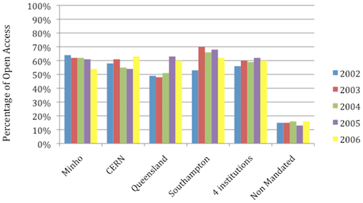
Mandated Open Access
http://thefinchandpea.com/2012/05/18/mandating-open-access-science-publishing/
Notes:
the public pays for research and thus deserves access. - response: “most of the technical articles published in scientific journals are of little utility to members of the general public, and generally those who can parse the technical articles can get access with the minor inconvenience of going to the local university library. (In the case of news organizations large enough to hire science journalists, they should be able to pay for subscriptions to the top tier journals.) “
it’s better for science and the scientific community.
its a very practical way to distribute manuscripts among scientists, making it easier to post manuscripts on lab web pages, to post links to papers on blogs that are read by scientists or science savvy readers.
- increases citation impact – “Self-Selected or Mandated, Open Access Increases Citation Impact for Higher Quality Research” - http://www.plosone.org/article/info:doi/10.1371/journal.pone.0013636 - The OA advantage is greater for the more citable articles, not because of a quality bias from authors self-selecting what to make OA, but because of a quality advantage, from users self-selecting what to use and cite, freed by OA from the constraints of selective accessibility to subscribers only.
Mechanisms
place immediately
place 6 or 12 months after publication – eg NIH - http://grants.nih.gov/grants/guide/notice-files/NOT-OD-08-033.html

Slide 12
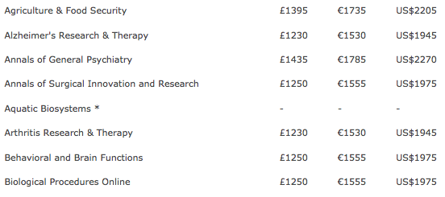
Sustainability
http://www.biomedcentral.com/about/apcfaq/howmuch
Notes:
author pay – eg. BioMed Central – “BioMed Central's standard article-processing charge for BMC subject journals is £1230(€1530 /US$1945). “ - http://www.biomedcentral.com/about/apcfaq/howmuch - also eg. “Open Access Option” from PNAS (Proceedings National Academy of Sciences USA) - http://www.pnas.org/site/subscriptions/open-access.shtml
Pays for:
Immediate, worldwide open access to the full article text
Developing and maintaining electronic tools for peer review and publication
Preparation in various formats for online publication
Securing inclusion in PubMed as soon as possible after publication
Securing full text inclusion in a number of permanent archives such as INIST (France), Koninklijke Bibliotheek (The Netherlands) and arXiv.org (USA)
Securing inclusion in CrossRef, enabling electronic citation in other journals that are available electronically
eg. – pubmed central http://www.ncbi.nlm.nih.gov/pmc/ - “PMC is a free full-text archive of biomedical and life sciences journal literature at the U.S. National Institutes of Health's National Library of Medicine (NIH/NLM).”
1078 full participation journals – “the journal commits to depositing the complete contents of each issue or volume, starting with a particular volume/issue or publication date.”
302 NIH portfolio journal – “the journal commits to depositing all NIH-funded articles”
1726 selective deposit journals – “used by publishers who offer a hybrid publishing model, i.e., a traditional subcription-based journal in which only selected articles are made open access. These journals deposit just their open access articles in PMC.”

Slide 13

Sherpa
http://www.sherpa.ac.uk/index.html
Notes:
http://www.sherpa.ac.uk/index.html
SHERPA Services
RoMEO - Publisher's copyright & archiving policies
JULIET - Research funders archiving mandates and guidelines
OpenDOAR worldwide Directory of Open Access Repositories
SHERPA Search - simple full-text search of UK repositories
SHERPA Resources
SHERPA speaking events - for future events see CRC
Guidance on depositing material; copyright; and open access for authors
Advocacy Materials for administrators, including past SHERPA presentations
Links to other initiatives and related background information

Slide 14
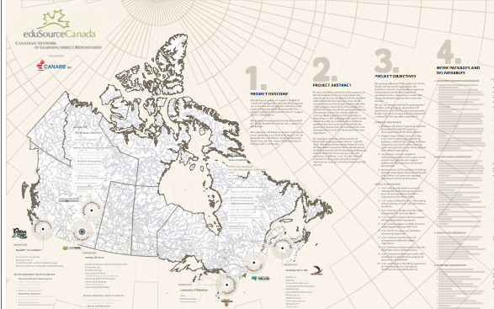
Pan-Canadian network
An online opportunity for Canadian universities
http://www.theglobeandmail.com/news/opinions/opinion/an-online-opportunity-for-canadian-universities/article2436343/
http://www.downes.ca/post/58218

Slide 15
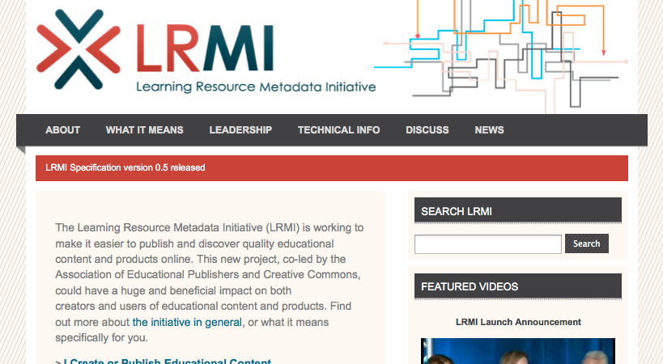
Learning Resource Metadata Initiative
http://www.creativecommons.org.uk/blog/tabid/84/EntryId/23/Learning-Resource-Metadata-Initiative-by-Phil-Barker-JISC-CETIS.aspx
http://www.downes.ca/post/58217

Slide 16

Yes, it takes more than Access
http://scholarlykitchen.sspnet.org/2012/05/23/intellectual-access-it-takes-more-than-accessibility/
http://www.downes.ca/post/58238
Notes:
“they add essential value to published research via their editorial and publication process, and thus they need subscription fees to stay in business.” http://thefinchandpea.com/2012/05/18/mandating-open-access-science-publishing/
It takes more than access - Intellectual Access — It Takes More Than Accessibility
Kent Anderson, The Scholarly Kitchen, May 23, 2012. http://www.downes.ca/post/58238

Slide 17
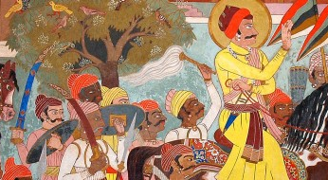
The Tyranny of Openness
http://jennymackness.wordpress.com/2012/05/15/scholarship-and-the-tyranny-of-openness/
http://www.downes.ca/post/58191

Slide 18
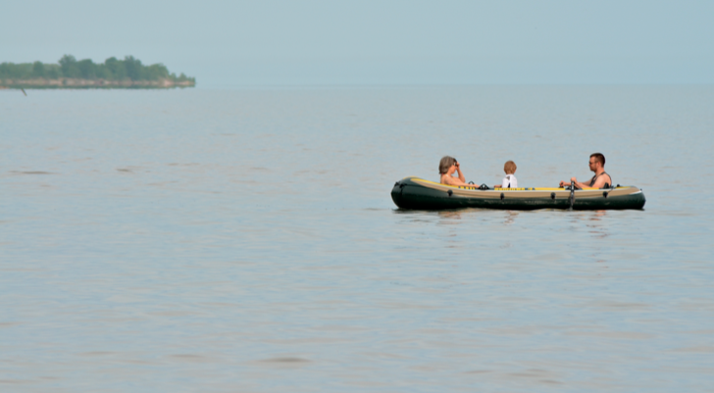
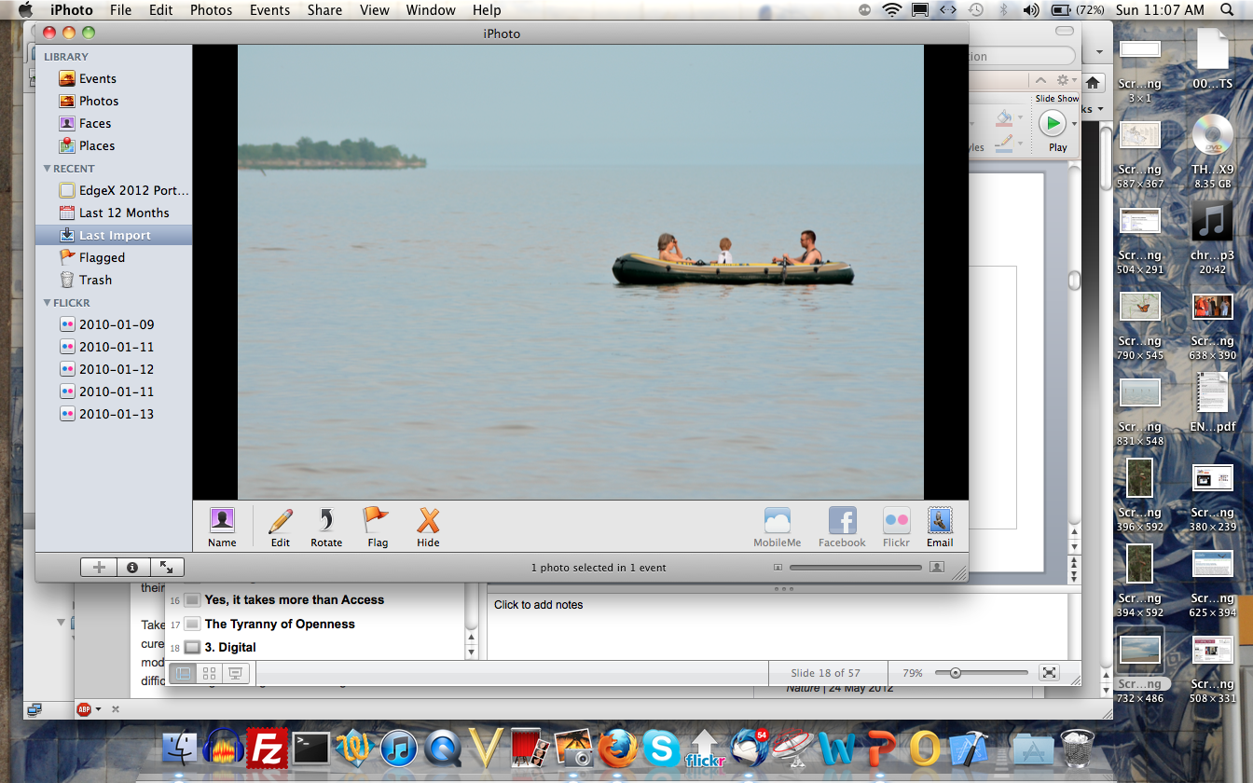
3. Digital

Slide 19
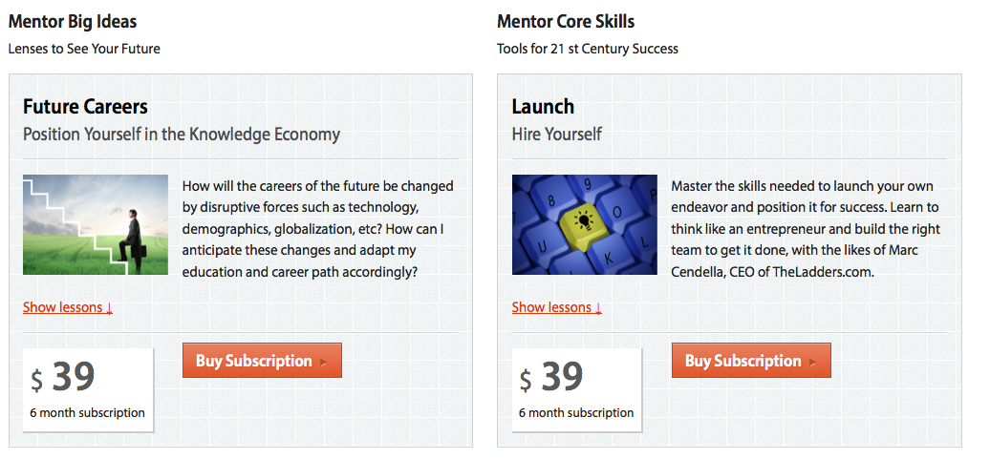
The Big Think – A Blend
http://edge.bigthink.com/
Notes:
eg. Big Think Edge - http://edge.bigthink.com/
‘Mentor’ & ‘Pro’ – http://edge.bigthink.com/mentor
supported (marketed) with blog / magazine - http://bigthink.com/think-tank/me-all-the-time-the-epidemic-of-narcissism (similar to Nature eg. http://www.nature.com/news/finding-the-true-value-of-us-climate-science-1.9993 )

Slide 20
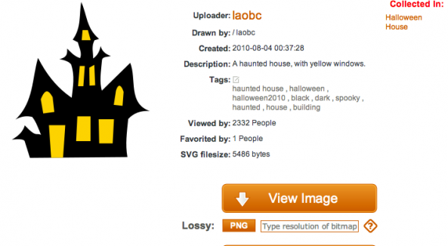
Beyond Academic Resources
http://dougpete.wordpress.com/2012/05/14/open-clip-art-gallery/
http://www.downes.ca/post/58152
Notes:
The open clipart directory

Slide 21
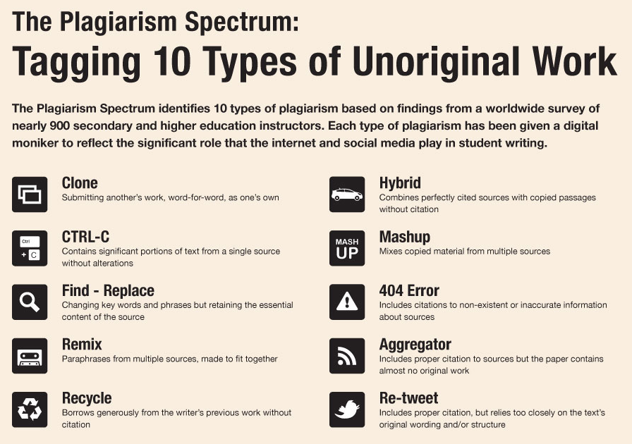
Turn It In
http://www.dontwasteyourtime.co.uk/elearning/turnitin-10-types-of-unoriginal-work-turnitin-edtech/
http://www.downes.ca/post/58134
Notes:
career development toolkit delivering interactive multimedia courses to equip you with the real world skills you need to achieve your highest career goals. Mentor will give you guidance on topics ranging from how to spot and realize career opportunity at every level of your career to how to ace your next job interview.

Slide 22
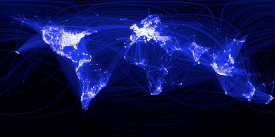
The Nature of Digital Influence
http://ryan2point0.wordpress.com/2012/05/14/the-nature-of-digital-influence/
http://www.downes.ca/post/58135
Notes:
he 3 determinants of digital influence
So, if your aim is to influence e-learning on a continental scale, how do you go about it?
In light of my ruminations, I propose the following three determinants:
1. Intend to change other people’s behaviour.
2. Leverage social media to expand your sphere of influence.
3. Produce original content.
As for measuring digital influence, objectivity is a false idol. While particular metrics may characterise influencers, they are by no means indicative and their role in comparative analysis is questionable.

Slide 23
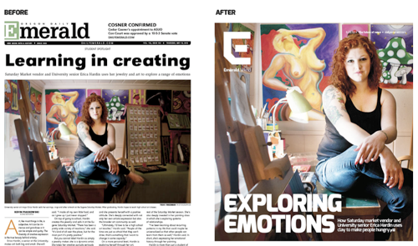
Why We Killed Our Paper (Version)
http://www.pbs.org/mediashift/2012/05/why-we-killed-our-college-daily-paper-for-a-more-digital-future145.html
http://www.downes.ca/post/58252
Notes:
Hyper-Local
As a former student journalist I watch the affairs of campus media with a close eye, which is only one of the reasons why it's interesting to see student newspapers shutting down or reducing their print versions and going online. It's a challenge, because their exclusive distribution - it was always so easy to just pick up a copy of the paper on the way to class - becomes a much greater challenge in the online world. Still, student newspapers are hyper-local, which (in my mind) is a key to success in today's online media environment. "In the newsroom, daily is too slow. We will report in real-time on the web, mobile and social media. To do this, we made digital news its own team and set aside money to equip them with new iPads and video cameras to report live from the field.”
“This is about delivering on our mission to serve our community and prepare our student staff for the professional world. Here's how we plan to do that:
Print: Two weekly print editions -- Emerald Monday and Emerald Weekend -- modeled after alternative weeklies, such as Willamette Week in Portland and The Stranger in Seattle.
Web and mobile: Real-time news, community engagement, photo galleries and video on the web, mobile and social media. New web and mobile apps that make students' lives richer and more entertaining.
Events: A promotions and events division -- Emerald Presents -- to sponsor political debates, football watch parties, and student music festivals.
Advertising and marketing: A full suite of marketing services that combines print, web, mobile, social media and street team services.”

Slide 24
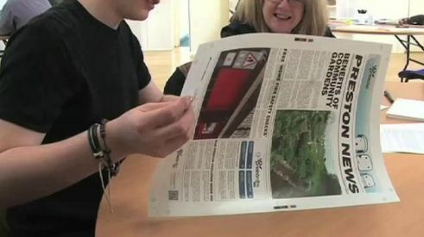
Smart Touch
http://rossdawsonblog.com/weblog/archives/2012/05/researchers-develop-smart-touch-responsive-internet-enabled-newspaper.html
http://www.downes.ca/post/58220
Notes:
We are developing an entirely new platform for community news and information by connecting paper to the internet to create what is believed to be the world’s first internet-enabled newspaper.
…
The aim of the new technology is to bridge the digital gap, giving people access to the internet through a new platform, and also to encourage new forms of community news, communication and social engagement.
The platform is capable of ‘capacitive touch interactions’ – which means that by touching various parts of the page readers can activate content ranging from audio reports to web polls or advertising – all contained within the paper itself.
But the developments in printed electronics do not stop there. Digital devices and microphones, buttons, sliders, colour -hanging fibres, LED text displays and mobile communication can all be used in an interactive newspaper.

Slide 25
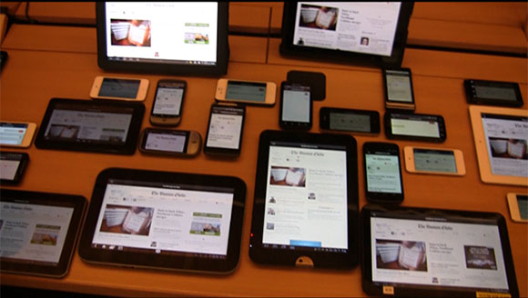
Adaptive Images
http://www.webmonkey.com/2012/05/ready-or-not-adaptive-image-solution-is-now-part-of-html/
http://www.downes.ca/post/58188
Notes:
One of the (few) really neat things about OpenPublish on Drupal is the image system. Here, you upload an image once, and the system creates several versions of the image, which can be used by a device-aware system (which OpenPublish isn't) to put small images on small screens and bigger images on the large screens. As Webmonkey says, "web authors use a variety of hacks to (incompletely) work around this problem, but to really solve it the web likely needs new tools." Using HTML, for example, that will read information from the head of the document to serve the right image.

Slide 26
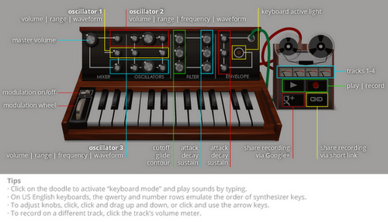
The Moog Doodle
http://educationaltechnologyguy.blogspot.com/2011/12/google-doodles-site-updated-find-your.html
http://educationaltechnologyguy.blogspot.ca/2012/05/google-doodle-honors-bob-moog-inventor.html
http://www.downes.ca/post/58247

Slide 27
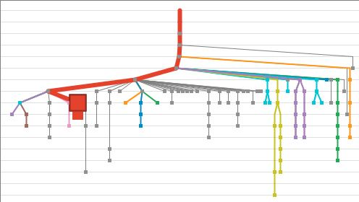
Turning Docs Into Pictures
http://www.pbs.org/idealab/2012/05/how-the-aps-overview-turns-documents-into-pictures144.html
http://www.downes.ca/post/58254

Slide 28
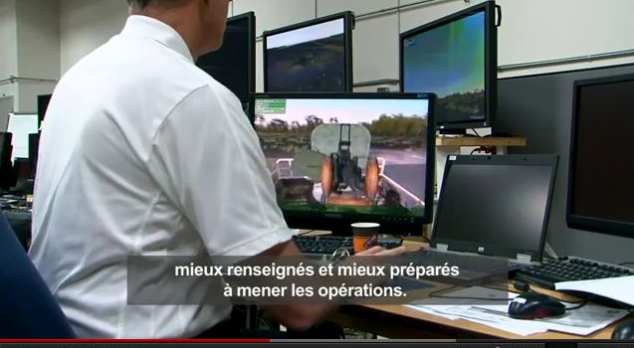
Virtual Exercises
http://www.downes.ca/post/58219

Slide 29
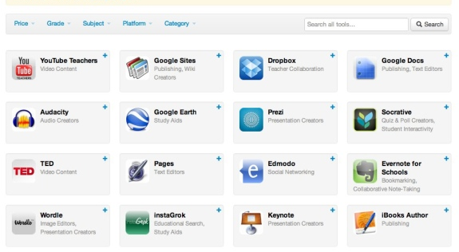
Edshelf
Notes:
An Educational App Directory for Teachers

Slide 30
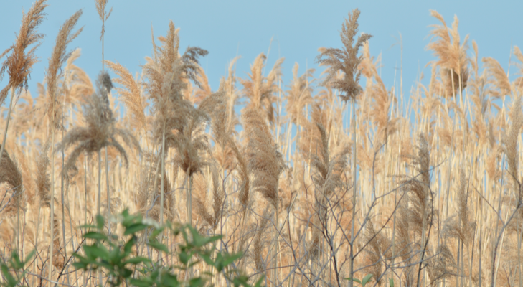
4. Distributed

Slide 31
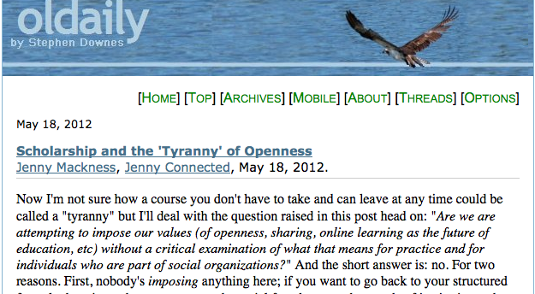
OLDaily
http://www.downes.ca/archive/12/05_18_news_OLDaily.htm

Slide 32
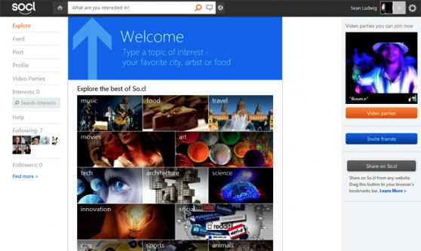
So.cl
http://venturebeat.com/2012/05/20/microsoft-socl-launches/
http://www.downes.ca/post/58203

Slide 33
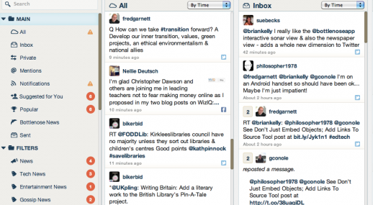
The Twitter Signal Channel
http://ukwebfocus.wordpress.com/2012/05/14/how-bottlenose-helps-turn-twitter-into-a-high-signal-channel/
http://www.downes.ca/post/58133
Notes:
Bottlenose is an application that will convert Twitter into a personalized dashboard and newspaper. "The Bottlenose name was inspired by the dolphin, which is reflected in its primary feature known as Sonar – a visual representation of your online conversation." To be sure, more and more people are using such services to aggregated the news - as Brian Kelly says, who needs Rupert Murdoch? On the other hand, it's better to get some perspective and comment on your forwarded link (as in this newsletter), isn't it? "it has been suggested that 'Twitter, like blogging, needs an edge, a voice, a riskiness'" - that's my feeling, and why the automated systems I think will in the end prove less than satisfactory.

Slide 34
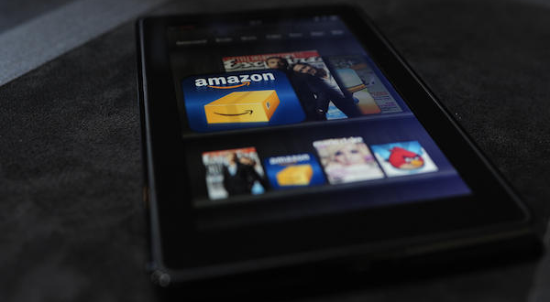
Beware of Amazon
http://ccarts.ca/in-the-news/articles/beware-of-amazon/
http://www.downes.ca/post/58249
Notes:
Publishers and authors are being warned, beware of Amazon. I'm trying to feel sorry for the commercial press, but really, their experience of negotiating with Amazon is like many an author's negotiations with publishers. "The “negotiating” consisted of Amazon stating that they wanted a markedly increased discount, which would see both the publishers involved and their authors lose close to a tenth of their revenue, including revenue from both books in print and in e-book form... Then they learned about “negotiating” with Amazon. The gun-to-the-head Amazon style led to the threat that IPG had to agree to the proposed terms, or all of their e-book titles would be pulled off the Amazon site. That is precisely what happened in the middle of February. And that is the situation today."

Slide 35
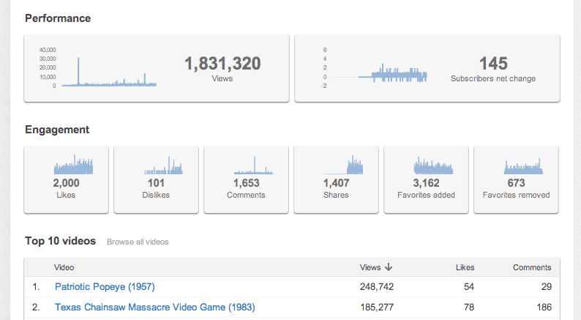
Fear of a YouTube Planet
http://bavatuesdays.com/fear-of-a-youtube-planet/
http://www.downes.ca/post/58245
Notes:
http://www.downes.ca/post/58245
Jim Groom, bavatuesdays, May 24, 2012.
It looks like we're in for another round of video deletions on YouTibe. As Jim Groom says, "I’ve probably had around 50 copyright complaints, and they have been coming fast and furious as of late. There must be some crackdown in the office of YouTube." What I don't understand is why the creators (or, more accurately, the copyright holders) of a film like The Wild Bunch don't understand that their property becomes more valuable when people use a clip of it as part of their everyday vocabulary. Oh well. I guess it's back to cat videos - they'll never become illegal (unless Disney decides it owns the rights to cat videos).

Slide 36
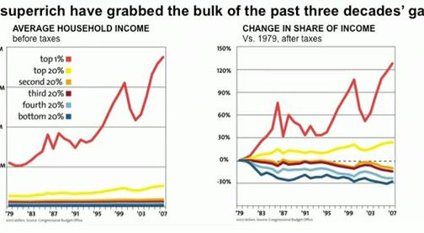
The Dangers of Centralization
http://www.businessinsider.com/nick-hanauer-ted-presentation-about-why-rich-people-arent-job-creators-2012-5
http://www.downes.ca/post/58187
Notes:
Here's The TED Presentation About Rich People That TED Doesn't Want You To See
Grace Wyler, Business Insider, May 18, 2012.
Normally people with these sorts of views would never be allowed near a TED stage. But a millionaire slipped through the cracks and as the National Journal reports, TED's Chris Anderson is refusing to publish a talk given on its stage by venture capitalist Nick Hanauer. As Time reports, Anderson's explanation is that the talk was “too political” to be posted during an election year, and that "a lot of business managers and entrepreneurs would feel insulted" by some of Hanauer’s arguments. Alas for Anderson, the video has surfaced at YouTube, so the rich will be insulted no matter what. Anyhow, you can read Hanauer's radical arguments on that beacon of socialism, Bloomberg. Or read the full text of the talk here. Meanwhile, you can read the discussion at TED where members are shocked - shocked! - to discover that TED wasn't the open marketplace of ideas they thought. People who read me know I have been critical of this aspect of TED for a long time. Maybe now, a few more eyes will be opened.

Slide 37
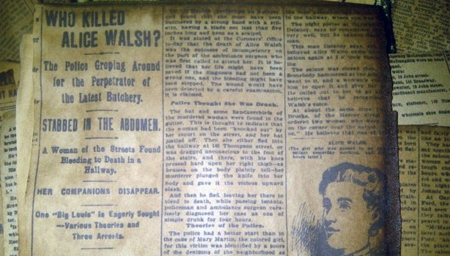
The Case of Wikipedia and Reddit
http://www.theatlantic.com/national/archive/2012/05/how-the-professor-who-fooled-wikipedia-got-caught-by-reddit/257134/
http://www.downes.ca/post/58159
Notes:
How the Professor Who Fooled Wikipedia Got Caught by Reddit
Yoni Appelbaum, The Atlantic, May 16, 2012.
Good story about T. Mills Kelly's course, Lying About the Past. The idea here is to engage students by having them create a fabricated hostory and attempt to fool a community with it. Their first attempt succeeded in planting a false Wikipedia article. But their efforts from the current year, including one that was undone on Reddit in a mere matter of minutes. What's really inteersting about the article is the anaysis of why Wikipedia was fooled and Reddit wasn't. "One answer lies in the structure of the Internet's various communities. Wikipedia has a weak community, but centralizes the exchange of information. It has a small number of extremely active editors, but participation is declining, and most users feel little ownership of the content." As Wikipedia editors gain more authority and nfluence, as they have over the last few years, the ability of the site to detect errors and falsehoods actually decreases. Of course - this Atlantic article may also be a deception. Who's to know?

Slide 38
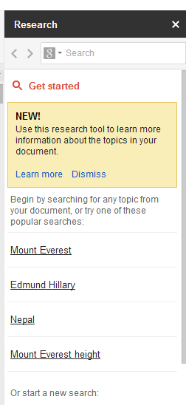
The Research Sidebar
http://www.downes.ca/post/58163
http://googlesystem.blogspot.ca/2012/05/research-sidebar-in-google-docs.html
Notes:
Microsoft recently introduced online research support in its office suite and Google has announced a similar service in its 'Research Sidebar'. This post from Google Operating System (not an official Google weblog) covers the basics. "The sidebar includes the top Google search results, image search results, facts, maps, reviews and famous quotes. Click the icon from the search box to restrict the results to images and quotes." My question is, do we really want pages and pages of 'hotel deals' listings in the sidebar of our Google documents?

Slide 39
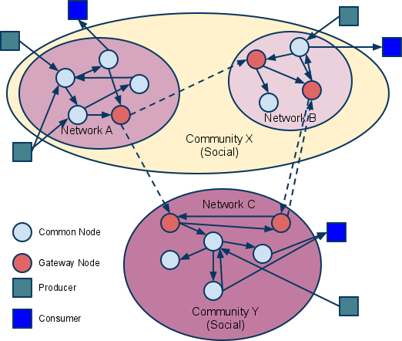
SPAWS
paradata recipes -
http://www.downes.ca/post/58221
use case - http://www.downes.ca/post/58255
Notes:
Scott Wilson helps us all understand SPAWS (Sharing Paradata Across Widget Stores) with a new use case. "Paradata – reviews by users, ratings and ‘likes’, and aggregate download statistics – is collected separately by each store. Sharing this paradata between stores will add value for users of all the stores." Basically, then, it's like sharing metadata created by users (or as I called it, second party metadata) - except that the metadata is shared (as I could see from the paradata cookbook) in JSON rather than XML. meanwhile, related to another educational metadata initiative (LRMI), Phil Barker asksthe all-importnat question: Will using schema.org metadata improve my Google rank?

Slide 40
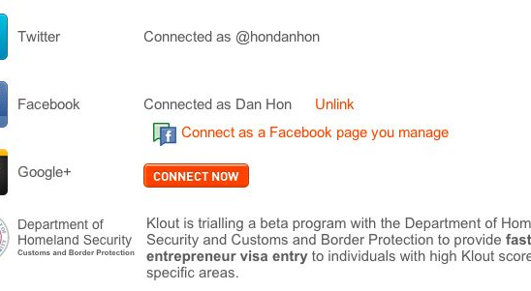
Oauth is Your Future
http://www.downes.ca/post/58186
Notes:
OK, this doesn't exist, but it is imaginable that we could read something like this in the near future: "Klout is trialling a beta program with the Department of Homeland Security and Customs and Border Protection to provide fast-track entrepreneur visa entry to individuals with high Klout scores in specific areas." Now - I know the first reaction is to say how bad this is. But is it unreasonable for government to have as much information on you as some company? Is it unreasonable for us to use it in some practical way, like crossing borders? And maybe - just maybe - if it becomes used in this way, maybe we'll have some rights to access it, use it ourselves, and ensure it is correct. Because right now none of that is the case.

Slide 41
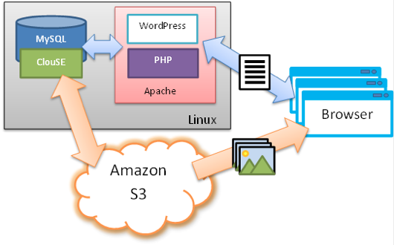
Cloud Storage for the People
http://www.readwriteweb.com/cloud/2012/05/s3-storage-for-wordpress-blogs.php
http://www.downes.ca/post/58189

Slide 42
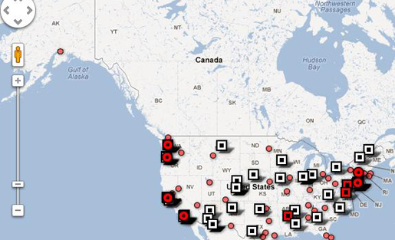
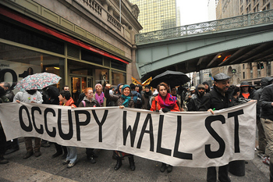
The Emergence of the Internet Constituency
http://www.themediaconsortium.org/
people are forming their own media consortia.
http://www.pbs.org/mediashift/2012/05/the-media-consortium-inside-our-may-day-collaboration145.html
http://www.hyperorg.com/blogger/2012/05/24/11874/
Notes:
LEssons: Don’t underestimate the power of social media to bring prople together to have a voice on issues. Second, SOPA happened only 18 months. We’re seeing a dramatic shift. The full consequences have not yet played out.
The third lesson is pessimistic. If this is the year that the Internet fought back, the battle may have been won but the fight continues. E.g., CETA, Trans Pacific Partnership (copyright tyranny), etc. There are reasons for optimism, but we have a long struggle ahead.
ries

Slide 43
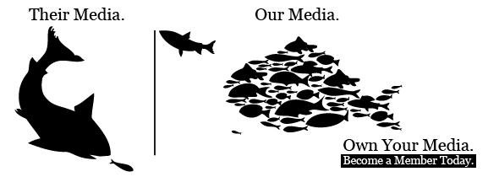
Media Co-ops
http://www.mediacoop.ca/
http://freemoncton.pbworks.com/w/page/48617539/Alternative%20Media
http://freemoncton.pbworks.com

Slide 44
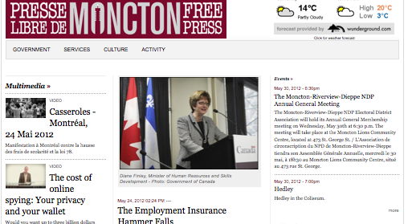
Moncton Free Press
http://monctonfreepress.ca/

Slide 45
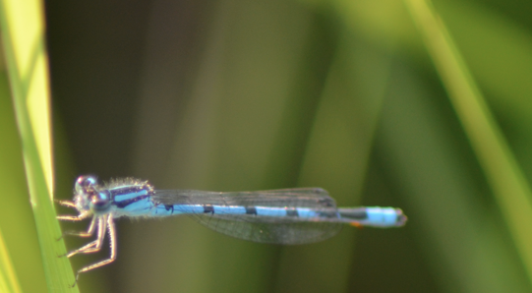
5. The Open Learning Phenomenon

Slide 46

The Big Schools
http://www.michaelgeist.ca/content/view/6499/135/
http://www.downes.ca/post/58206
Notes:
Michael Geist writing about the revolution in education, citing examples like Stanford and MIT, and saying "there are serious doubts whether Canada is ready for these changes."

Slide 47
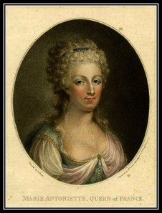
New Model, Same Old Story?
Let them eat MOOC
http://www.downes.ca/post/58235
Notes:
Coverage of some resistance being expressed by academics over MOOCs (and in particular, the Thomas Friedman version of MOOCs). Jonathan Rees, for example, writes, "don’t think that your exalted status as a college professor will cause anyone planning to make money off the corpse of your career to lose a wink of sleep." Mark Brown argues, "it’s disgusting to present MOOCs as a solution to the crisis in public funding for higher education." There's a lot more reaction covered in this article, and while I understand the concerns I don't think the academics interviewed have come to grips with the problems inherent in the existing system and how MOOCs (the real kind, not the Friedman kind) were designed to solve them.

Slide 48
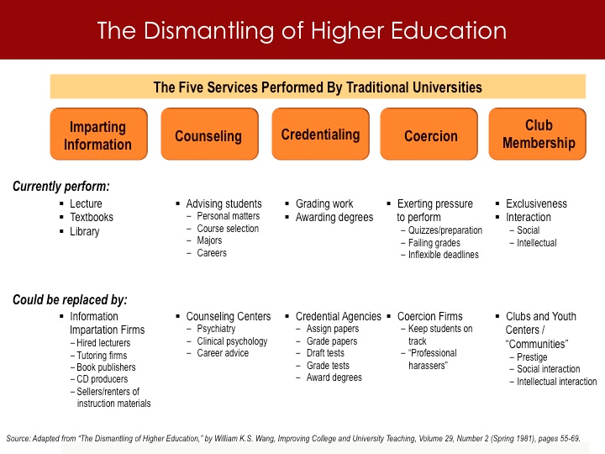
Unbundling Education
http://www.insidehighered.com/blogs/stratedgy/foundations-strategy-part-3-technology
http://www.downes.ca/post/58176

Slide 49
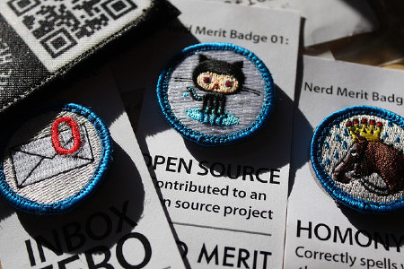
Schoolers, Edupunks and Makers
http://radar.oreilly.com/2012/05/schoolers-edupunks-makers-learning.html
http://www.downes.ca/post/58205
Notes:
DIY learning: Schoolers, Edupunks, and Makers challenge education as we know it
Schoolers are applying new tools to traditional goals to crack open the case on the traditional schoolhouse. With laptops, tablets, and cell phones, students no longer wait to be spoon-fed information, but reach out beyond the walls of the classroom for images, information, and insights at the moment the question arises for them.

Slide 50
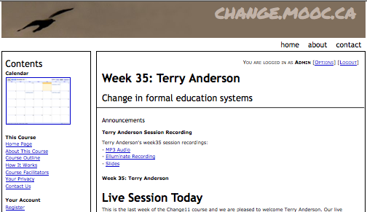
Our MOOCs
http://change.mooc.ca/

Slide 51
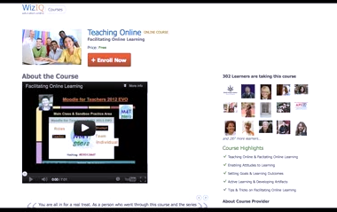
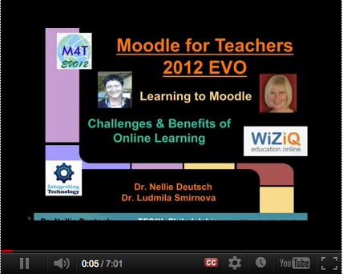
Open Online Learning – the MOOC
http://www.downes.ca/post/58175
Notes:
http://www.wiziq.com/course/4264-teaching-online
UMW Faculty academy - http://www.downes.ca/post/58248
-

Slide 52
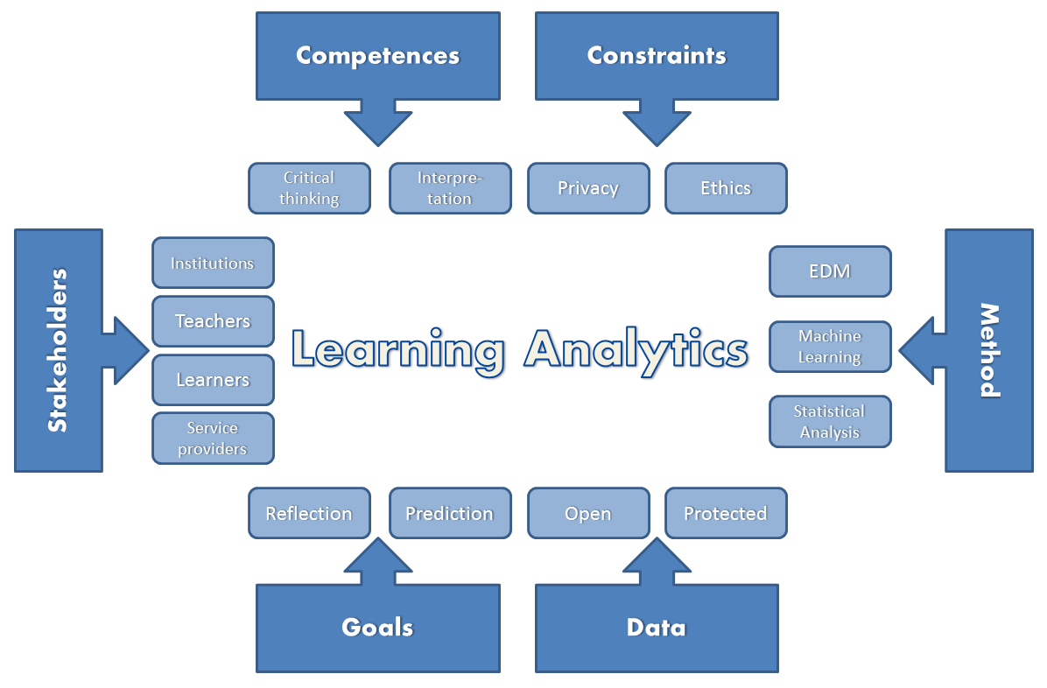
The Qualified Self
http://www.downes.ca/post/58148
Notes:
"I think the learning analytic research should move from the current practice of doing quantitative data analyses to include in it qualitative analyses," says Teemu Leinonen. "The quantified self should be expanded to be qualified self." But what does that mean, particularly given to be swayed by the philosophy "if you can't measure it, you can't manage it." Take Leinonen's example: "Most of us do not have a clue about the amount of calories we eat, but most of us know whatever our diet is healthy or not." We can represent the healthiness of the diet as qualitative, but what makes it healthy is the having of x grams of Vitamin A or y grams of fibre. That said, "combining quantitative and qualitative data analyses," as he suggests, does make sense. It resists the urge to privilege some types of easily measured data.

Slide 53

Personal Learning
http://dmlcentral.net/blog/howard-rheingold/diy-u-interview-anya-kamenetz
http://www.downes.ca/post/58150
Notes:
Howard Rheingold searches for the new in Anya Kamenetz's Edupunk's Guide, suggesting that what has been added is the idea of the personal learning plan to the personal learning network. "Making a public commitment to something is going to increase your accountability," says Kamenetz. Rheingold writes, "Her work serves as a bridge between blended learning and peeragogy. I previously wrote about Shelly Terrell and personal learning networks" and asks here what it takes for a group to self-organize. Kamanetz responds that there needs to be a common understanding of the goal - of course, this would be the outcome of self-organization, not what makes it possible.

Slide 54

Life portfolio
http://leelearning.wordpress.com/2012/05/17/life-portfolio/
http://www.downes.ca/post/58174
Notes:
"I finally finished my research study," writes Lee D. Ballantyne. "This is a summary of the outcomes: a framework for e-portfolio implementation. Full pdf paper here. The result is a good 52-page study of the subject. "Fundamental to these ideas of digital identity and a personal learning environment is the ability to create a personalised space. The benefits of personalisation are twofold. Firstly, a guiding principle behind reflective e-portfolio development – learner control – should apply to the tools learners use as well as to the content. The ability to customise the e-portfolio (process), to integrate the learner' own choice of tools (tools or systems), and, ultimately, create a digital identity (product) is incredibly important to learners. Secondly, personalisation allows learners to take responsibility for their own learning: developing metacognitive skills and promoting autonomy."

Slide 55

Experts on tap, not on top
http://opencontent.org/blog/archives/2326
http://www.downes.ca/post/58149

Slide 56

We’ll never turn back
http://www.downes.ca/post/58137

Slide 57

Stephen Downes
http://www.downes.ca

