Slide 1
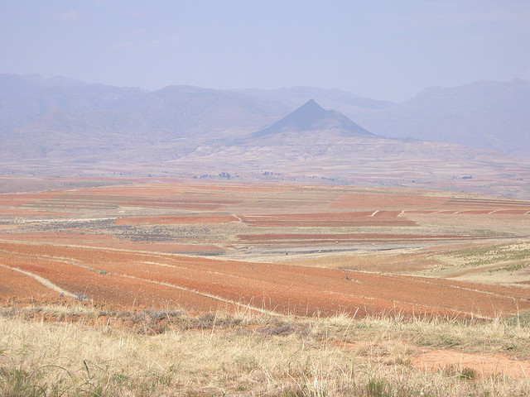
MOOCs in Context the re.mooc in Africa
Stephen Downes
11 February 2013

Slide 2
address the intersection of Mobile devices + MOOCs
and investigate how this combination can support and extend education in ways not possible before in Africa.
focus is on the design and development of a “mobile app for re.mooc,” targeting the African after school student community in general, and local instructors in particular
Notes:
(1) http://www.swissinfo.ch/eng/science_technology/ Swiss_have_lots_to_learn_from_Gulf_region.html?cid=1316694
(2) In the context of Africa, mobile devices, because of their wide- spread availability, constitute a platform for augmentation of learning experiences and knowledge access through the creation and distribution of educational materials, reading support, enabling of peer- to-peer learning and remote tutoring through social networking services, but also by improving exchange possibilities, community building and allowing feedback collection.
(3) In Kenya eight out of ten parents pay tuition for courses outside school. [...] In Nigeria Intel brought together MTN, a telecom carrier, and Cinfores, a local publisher, to provide exam-preparation tools over mobile phones, a service that has become hugely popular. [...] In Ghana reading skills improved measurably among 350 children that had been given Kindle e-readers by Worldreader, a charity. [...] In Ethiopia researchers found that even in the absence of teachers, children figured out how to use tablets provided to them by One Laptop Per Child, another charity, to teach themselves to read. [...] (source “The Economist”)

Slide 3
re.mooc
Hacking the material coming from MOOCs and enabling a local instructor to create a different learning experience.
In the context of the after school community, re.mooc means: to create a different schedule and re-announce a course using part of the material coming from several different MOOCs and integrate it with local sources, annotating and localizing the content, but also enriching it with sensor data coming from measurements on the field.

Slide 4
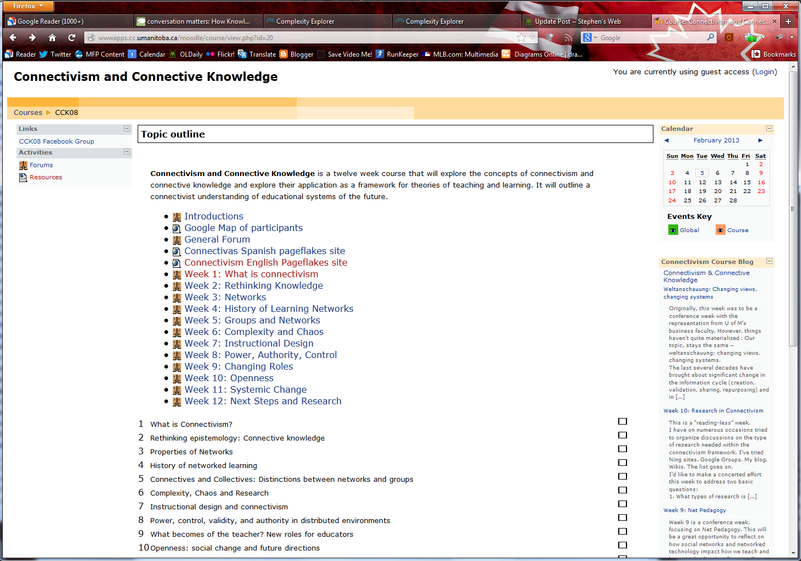
CCK08
2300 students
http://wwwapps.cc.umanitoba.ca/moodle/course/view.php?id=20
http://connect.downes.ca/cgi-bin/archive.cgi?page=thedaily.htm

Slide 5
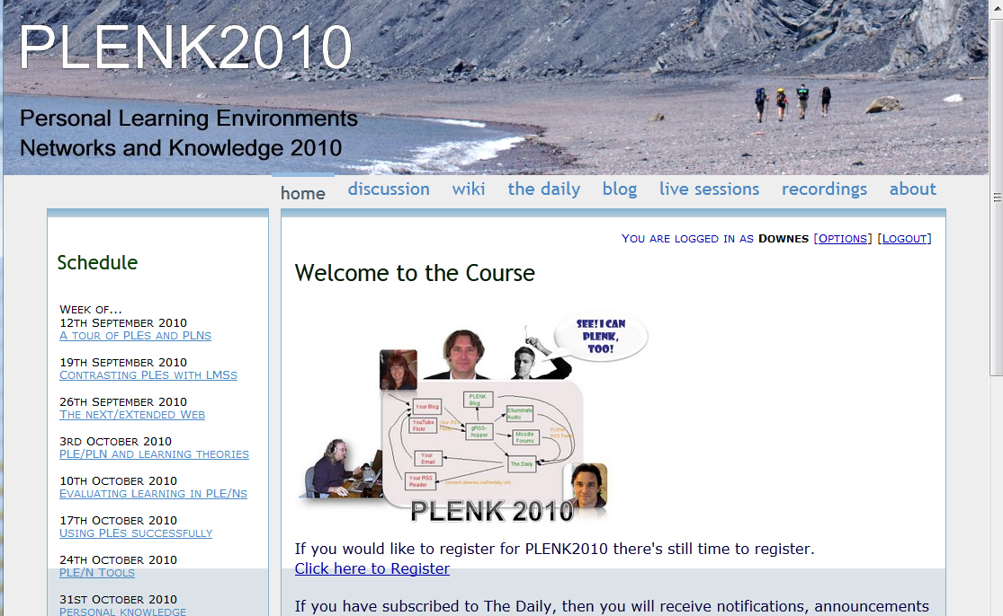
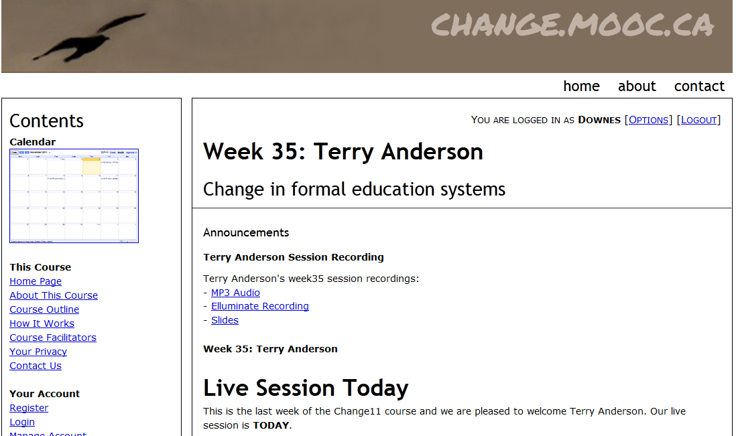
Other Courses
1800 students
http://connect.downes.ca/
2800 students
3000 students
http://change.mooc.ca/
http://edfuture.net/

Slide 6
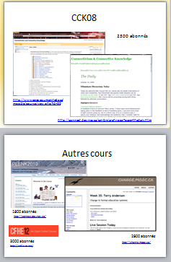
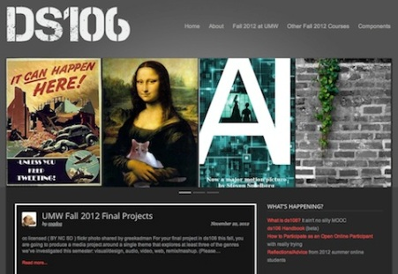
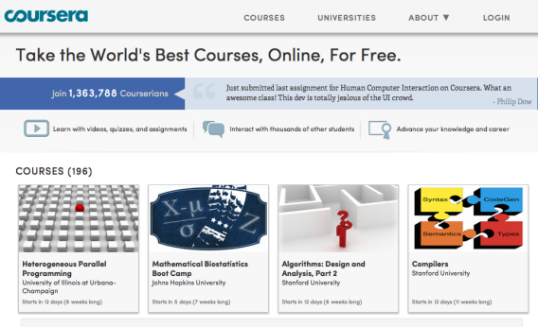
cMOOC vs xMOOC
networks
tasks
contents
https://www.ai-class.com/
http://ds106.us/history/
https://www.coursera.org/
http://lisahistory.net/wordpress/2012/08/three-kinds-of-moocs/

Slide 7
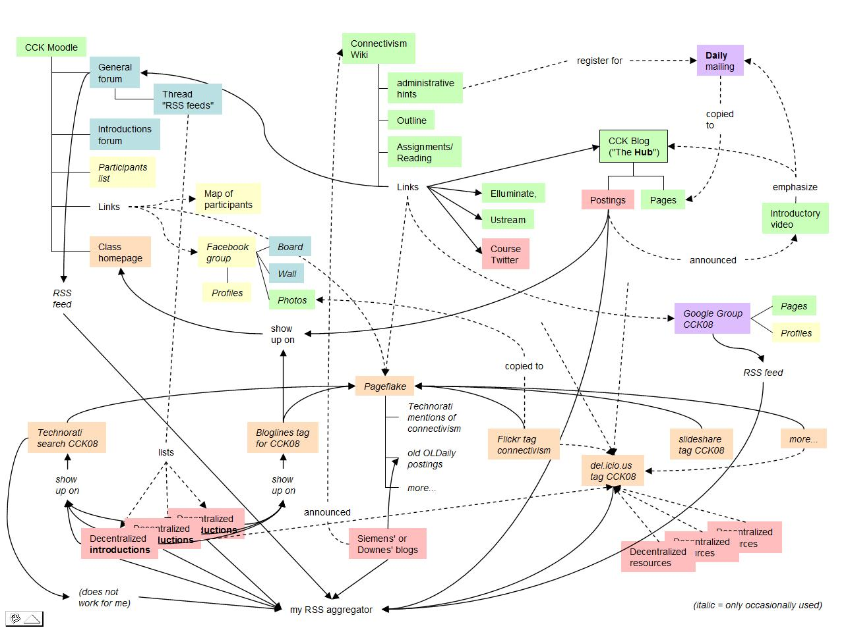
Connectivist MOOCs
http://x28newblog.blog.uni-heidelberg.de/2008/09/06/cck08-first-impressions/

Slide 8
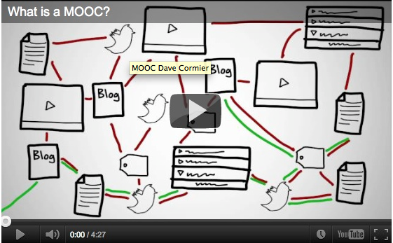
How to Learn in a cMOOC
un processus d'immersion dans une communauté sachant
http://www.tonybates.ca/2012/03/03/more-reflections-on-moocs-and-mitx/

Slide 9
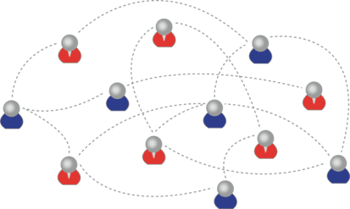
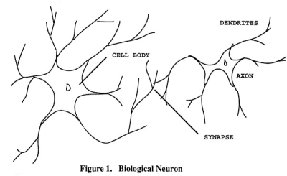
How to Create a cMOOC
It’s like creating a network
Don’t centralize
Concentrate on the creation of links
We use social networks...
… to create personal knowledge

Slide 10
Why Open Educational Resources?
Learning activities are essentially conversations
OERs are the words used in those conversations
http://www.downes.ca/presentation/233

Slide 11
Success Factors
What sort of decentralized network will best support learning-as-growth?

Slide 12
Network Democracy
Image: http://www.iiav.nl/ezines/web/WomenLearningPartnership/2007/No17/learningpartnership/programfocus-print=1.htm

Slide 13
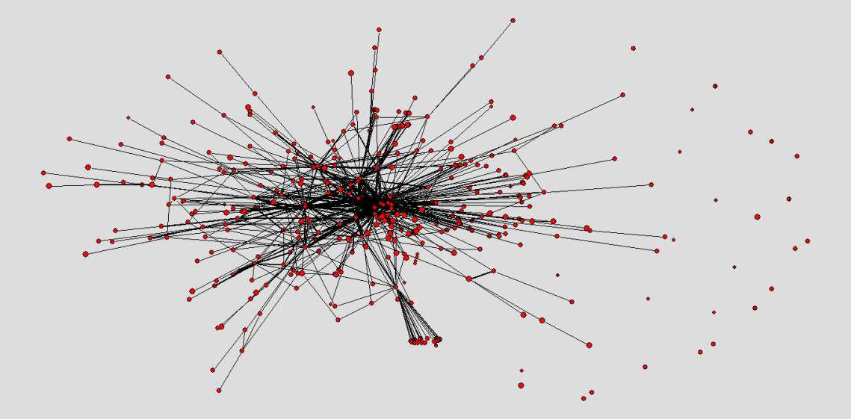
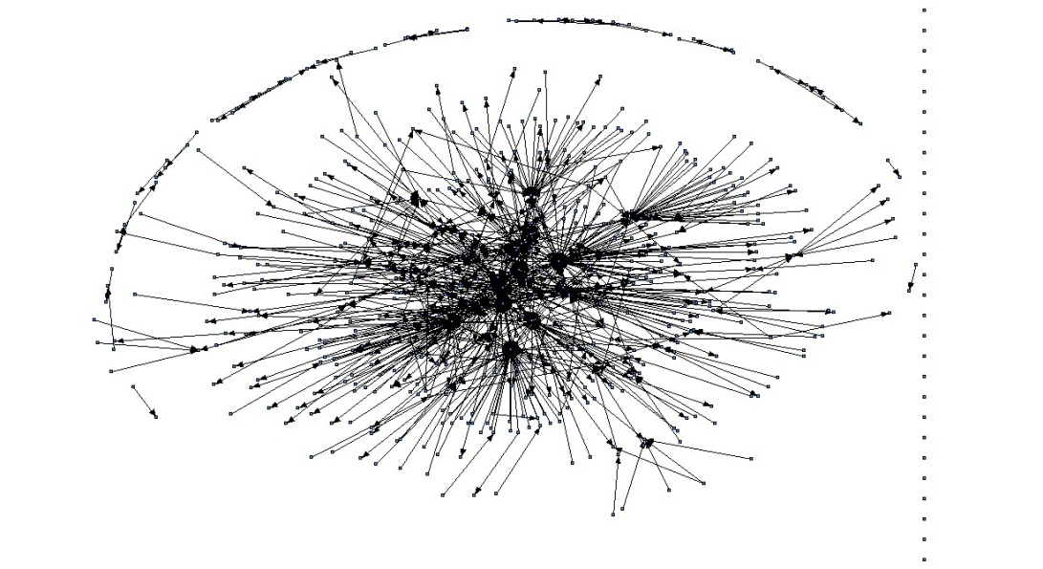
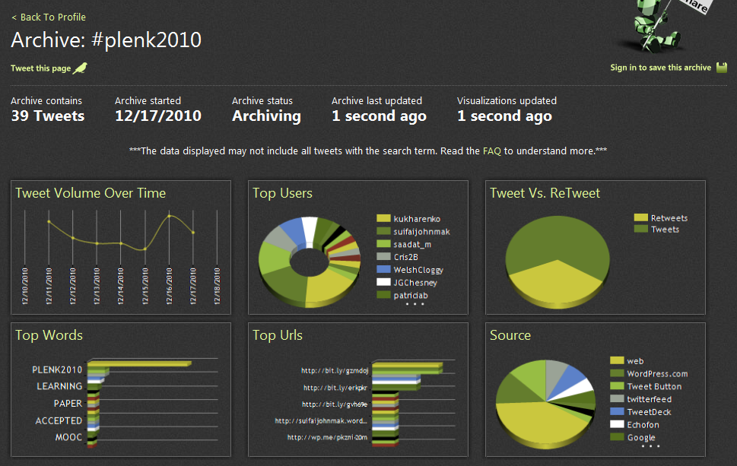
The Semantic Condition
Autonomy, diversity, openness, interactivity
These conditions are the conditions for a constructive dialogue…
And are thus the design principles for a MOOC
http://itforum.coe.uga.edu/paper92/paper92.html

Slide 14
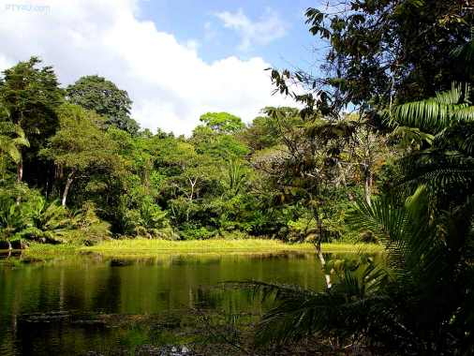
Diversity
You need a mixture of materials – you cannot grow organically from carbon alone, or water alone

Slide 15
Openness
Closed systems become stagnant
Raw materials are depleted
The system becomes clogged with the ‘creative product’ of its members

Slide 16
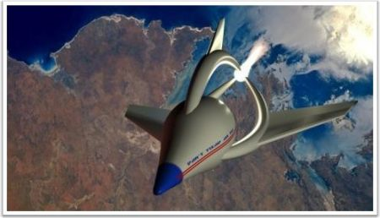
Autonomy
The simple cloning of entities does not allow for progress or development
Each individual entity must manage its own grown in its own way

Slide 17
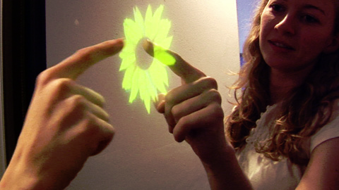
Interactivity
A system cannot grow unless its parts interact – flowers need bees, cows need grain, beavers need trees
Growth is created not by accumulation but by flow, by constant activation and interaction

Slide 18
How to Evaluate Learning
Learning is not possession of a collection of facts, it’s the expression of a capacity
Learning is recognized by a community of experts in a network
Learning analytics
We recognize our understandings…
…by the way we use them in our social network

Slide 19
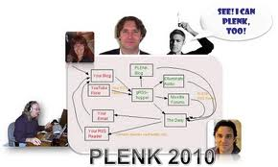
Aggregated Conversations

Slide 20
gRSShopper
http://grsshopper.downes.ca

Slide 21
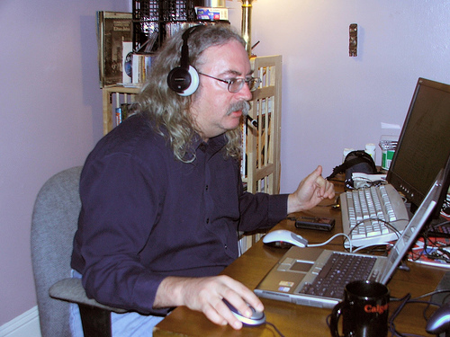
http://www.downes.ca

