Slide 2
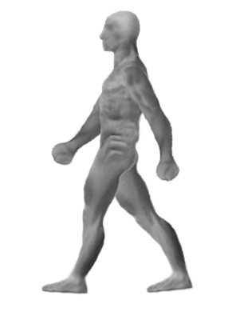
Images: http://afaucher2001.blogspot.ca/ and http://moreorlessbunk.wordpress.com/2012/03/10/a-wondrous-new-machine/

Slide 3
Image: http://www.michaelbransonsmith.net/blog/2012/12/19/day-of-the-mooc-now-animated/

Slide 4
Image: http://theextinctionprotocol.wordpress.com/2011/01/29/rage-hard-sun-unleashes-twin-massive-explosions/

Slide 5
Images: http://www.rdvemploi-orlyparis.com/jeunes-diplomes-salaries and http://ageheureux.centerblog.net

Slide 6
Image: http://chickgeekgames.com/2011/12/gamer-cat-playing-with-perpetuum-online.html

Slide 7
Image: http://svc249.bne152v.server-web.com/surveys/survey_div_css.asp

Slide 8
Image: http://jitp.commons.gc.cuny.edu/

Slide 9
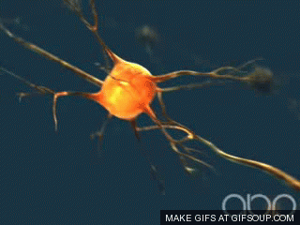
Image: http://gifsoup.com/view/2304989/neurons.html

Slide 10
Image: http://www.tumblr.com/tagged/tumblr%20language

Slide 11
Image: http://melindarsmith.com/most-merciless-muse

Slide 12
Image: http://alodj.com/viet-remix-hay-khoc-di-em-remix-2013-s195.html

Slide 13
Image: http://lifeinauthoring.tumblr.com/post/50495928196/why-does-my-editor-joke-about-on-twitter-with-his-other

Slide 14
Image: http://im9.eu/animation/publish-how-the-net-works

Slide 15
Image: http://bavatuesdays.com/classic-twilight-zone-animated-vintage-clipart/

Slide 16
Image: http://www.ofs.edu.sg/learning-apps/

Slide 17
Image: https://lh5.googleusercontent.com/-8XSBdS099jU/T5QbrWhLvsI/AAAAAAAAMFc/YhQZyQfrqrA/w500/IBWqm.gif

Slide 18
Image: http://aforgrave.ca/detritus/tag/ds106/

Slide 19
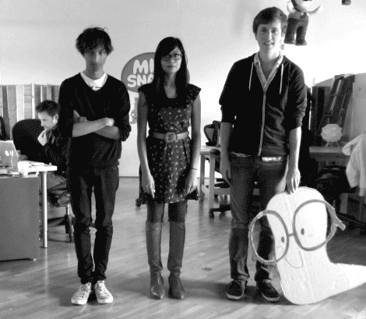
Image: http://ihogeek.com/2012/01/24/want-to-learn-another-language-mindsnacks-to-the-rescue/

Slide 20
Image: http://en.wikipedia.org/wiki/Nilgiri_Mountain_Railway and http://lv.wikipedia.org/wiki/In%C5%BEenierija

Slide 21
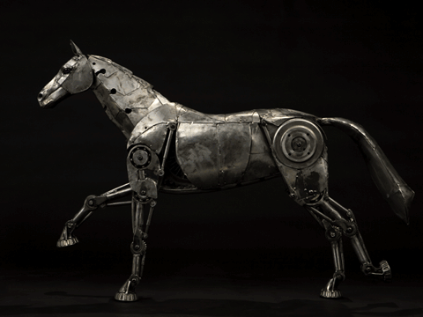
Image: http://www.ixiqi.com/archives/24493

Slide 22
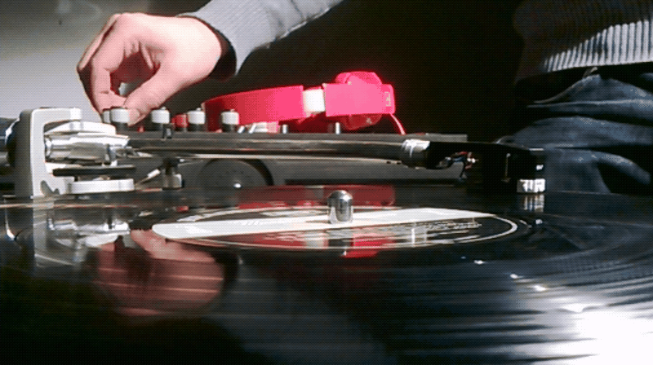
Image: http://socialmediaweek.org/blog/2013/02/going-social-meet-nokias-brad-spike/

Slide 23
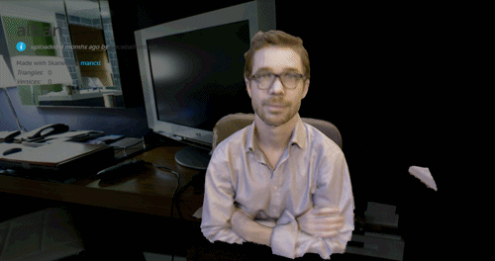
Image: http://rhizome.org/editorial/2013/mar/18/prosthetic-knowledge-picks-webgl/

Slide 24
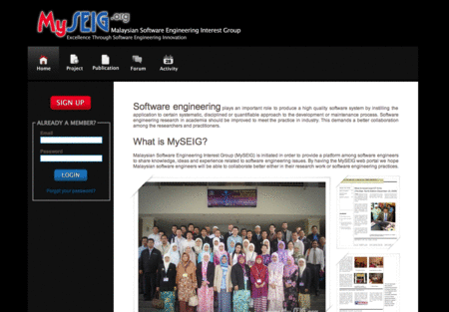
Image: http://www.kliquey.com/

Slide 25
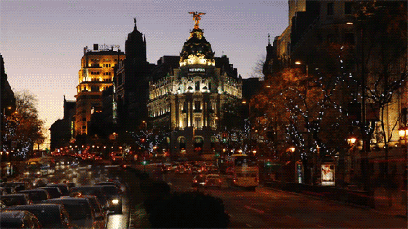
Image: http://favim.com/image/371402/

Slide 26
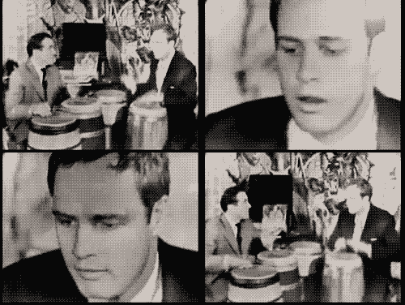
Image: http://15991471.wwww.fanpop.com/clubs/marlon-brando/images/32437165/title/marlon-playing-bongos-fanart

Slide 27
Image: http://en.root-top.com/toplist/beauxbatons/elementy,2421.html

Slide 28
Image: http://www.powerfulintentions.org/profile/Jkada

Slide 29
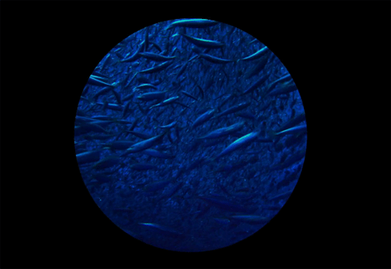
Image: http://www.powerfulintentions.org/profile/Jkada

Slide 30
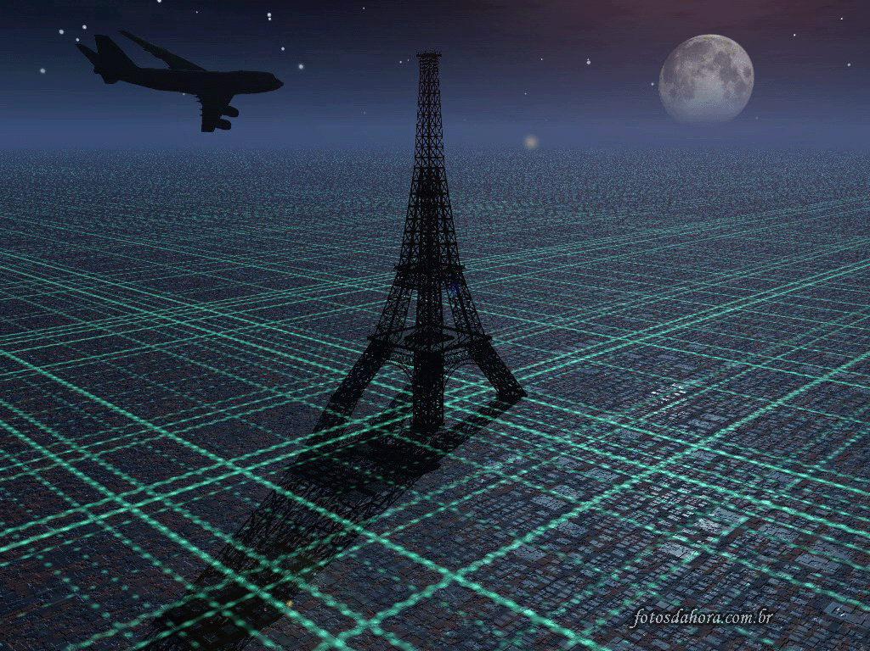
Image: http://kentoster.deviantart.com/art/Walking-Animation-165680217 and http://www.papeldeparede.imagensdahora.com.br/papeisdeparede/2578/torre_eiffel/

Slide 31
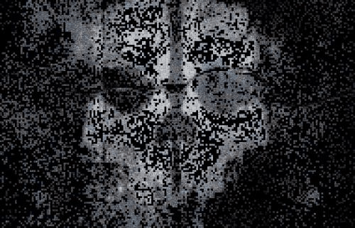
Image: http://www.joblo.com/forums/showthread.php?p=3675040

Slide 32
Image: http://ladyannarielle.tumblr.com/post/39494188698

Slide 33
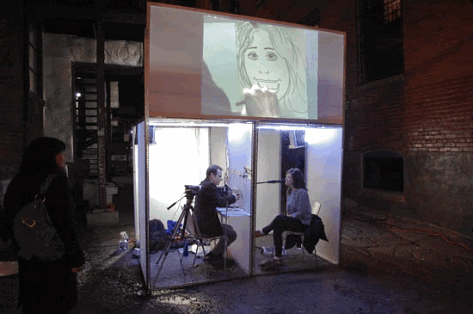
Image: http://www.thegridto.com/culture/arts/nuit-blanche-animated/3/

Slide 34
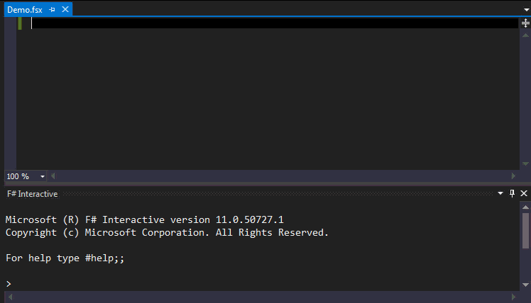
Image: http://open.bekk.no/utforskende-programmering-med-fsharp-type-providers/

Slide 35
Image: http://members.ozemail.com.au/~dekker/orgnets.html

Slide 36
www.downes.ca

