Slide 1
Life-Long Learning
Stephen Downes
June 4, 2013

Slide 2
What do we think of when we think of life-long learning? Classrooms?
Image: Judy Loftin http://mylifeismylab.wordpress.com/2008/05/01/may-is-social-networking-month-at-the-lifelong-learning-lab/

Slide 3
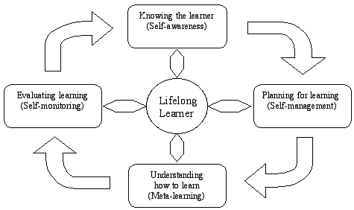
We think of life-long learning as an ongoing process, not a static event.
Image, adapted from Garrison, Barbara Stäuble http://otl.curtin.edu.au/professional_development/conferences/tlf/tlf2005/refereed/stauble.html

Slide 4
We think of learning as an active process where we try things out and make sense of the experience
Image: http://annekcam.blogspot.ca/2011/09/reflecting-on-e-learning-theories-and.html

Slide 5
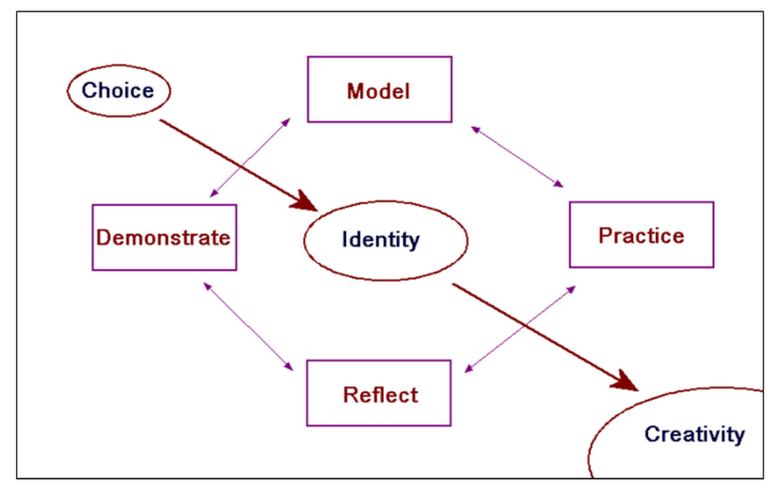
To teach is to model and demonstrate, to learn is to practice and reflect
Image, adapted from Garrison, Barbara Stäuble http://otl.curtin.edu.au/professional_development/conferences/tlf/tlf2005/refereed/stauble.html

Slide 6
There are two sides to the learning equation; this presentation is focused on learning
Open Courses
MOOC
(gRSShopper)
Model and demonstrate
Practice and reflect
PLE
(Plearn)
Personal Learning
Image, adapted from Garrison, Barbara Stäuble http://otl.curtin.edu.au/professional_development/conferences/tlf/tlf2005/refereed/stauble.html

Slide 7
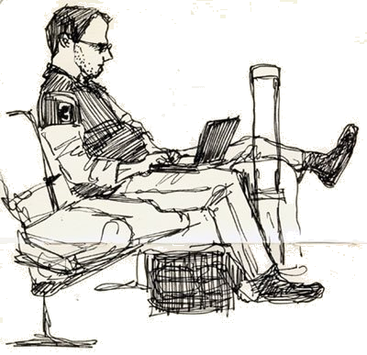
In this presentation, I invite you to think about how you learn
Image: http://sarahgraphic.wordpress.com/2008/03/

Slide 8
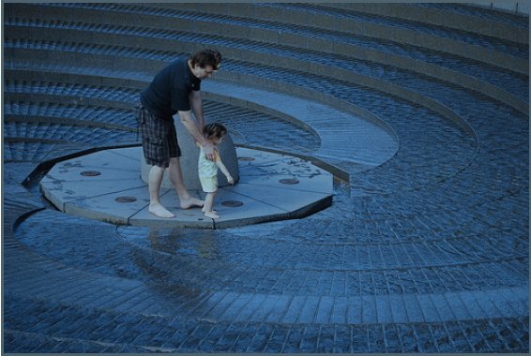
Three principles
Interaction
Usability
Relevance

Slide 9
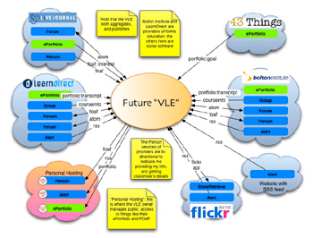
Interaction: participation in a learning community (or a community of practice) (or a network)
Image: Scott Wilson

Slide 10
Interaction: how to get it

Slide 11
Interaction: participation in a learning community (or a community of practice) (or a network)
Image, adapted from Garrison, Barbara Stäuble http://otl.curtin.edu.au/professional_development/conferences/tlf/tlf2005/refereed/stauble.html

Slide 12
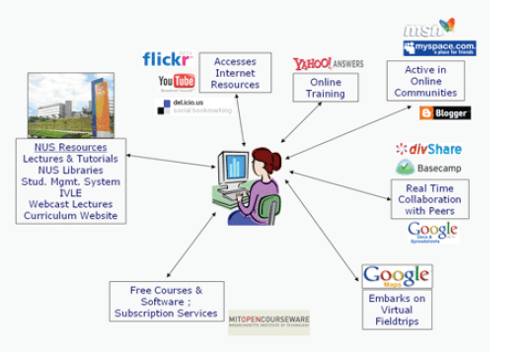
Build your own interaction network, and place yourself at the center
Image, http://edtechpost.eikispaces.com/PLE+Diagrams?f=print

Slide 13
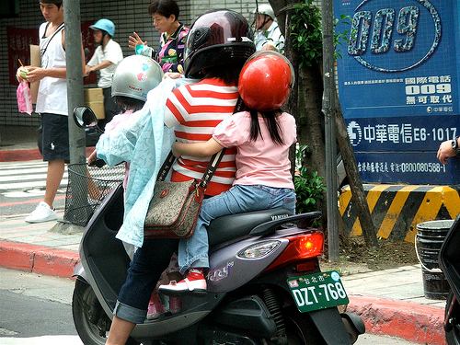
Usability: simplicity and consistency

Slide 14
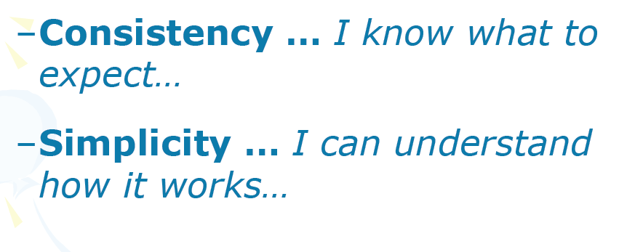
Elements of usability

Slide 15
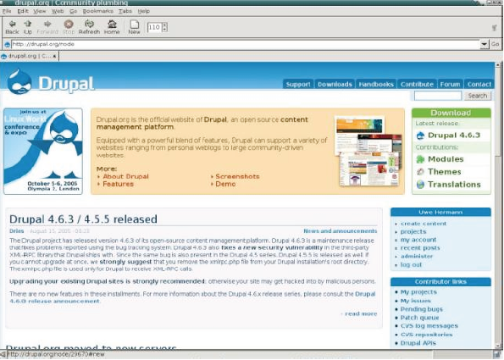
Consistency: organize your knowledge

Slide 16
Simplify the message

Slide 17
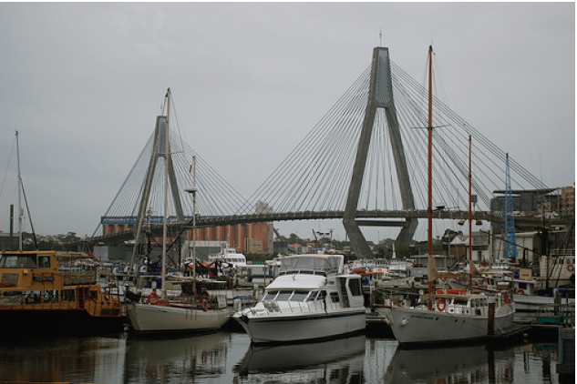
Relevance: learning that is important to you now

Slide 18
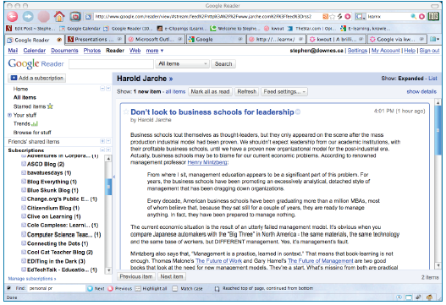
Step One: maximize your sources
RSS, Twitter, Facebook, Google+ and so on (don’t forget email)
Image, http://theoldreader.com/

Slide 19
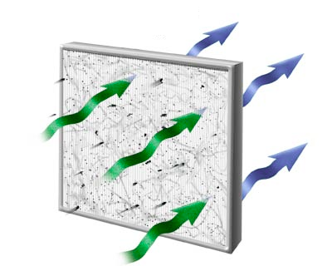
Step Two: filter ruthlessly
Image, http://www.walgreens.com/marketing/library/contents.jsp?doctype=10&docid=000554

Slide 20
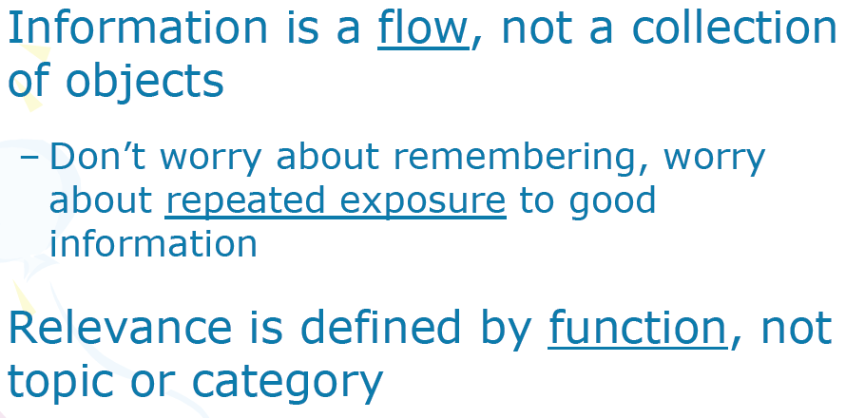
Remember…
Image, http://edtechpost.eikispaces.com/PLE+Diagrams?f=print

Slide 21
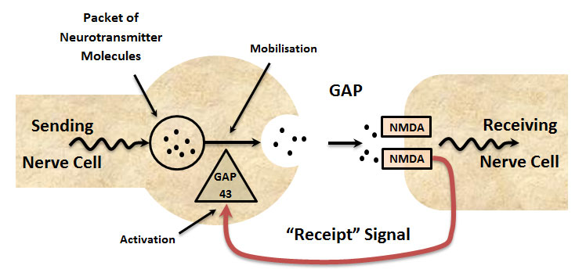
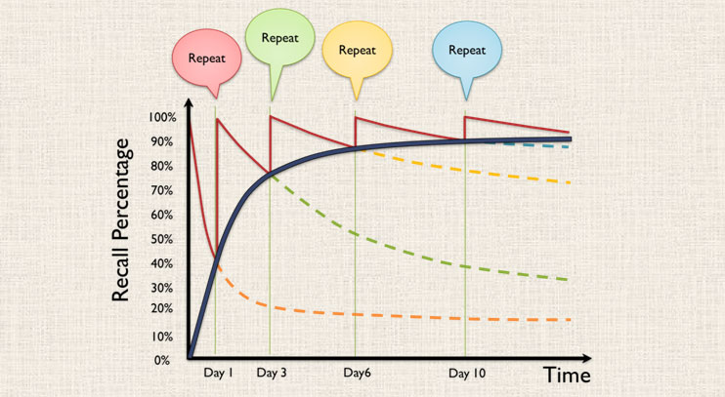
Keep in mind how we learn: repeated exposure, formation of habits
Image, http://www.skillsconverged.com/TrainingTutorials/TraintheTrainer/WhatisTryPracticeDemonstrate.aspx

Slide 22
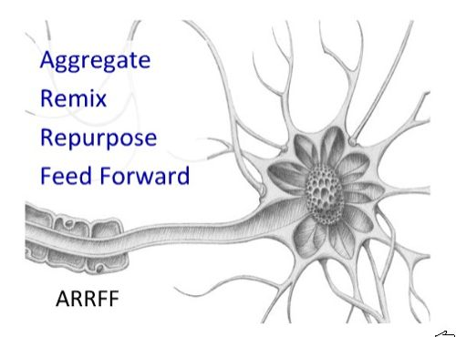
Personal learning methodology
Image, http://www.skillsconverged.com/TrainingTutorials/TraintheTrainer/WhatisTryPracticeDemonstrate.aspx

Slide 23
http://www.downes.ca

