Slide 1
A Personal Learning Framework
Stephen Downes
February 8, 2014
Learning and Performance Support Systems

Slide 2
Organizations aren’t thinking about the ‘networked individual’ – the networking choices and patterns of individual Internet users. They’re still focused on their own organizational information systems and traditional institutional networks.
William H. Dutton
http://papers.ssrn.com/sol3/papers.cfm?abstract_id=1767870

Slide 3
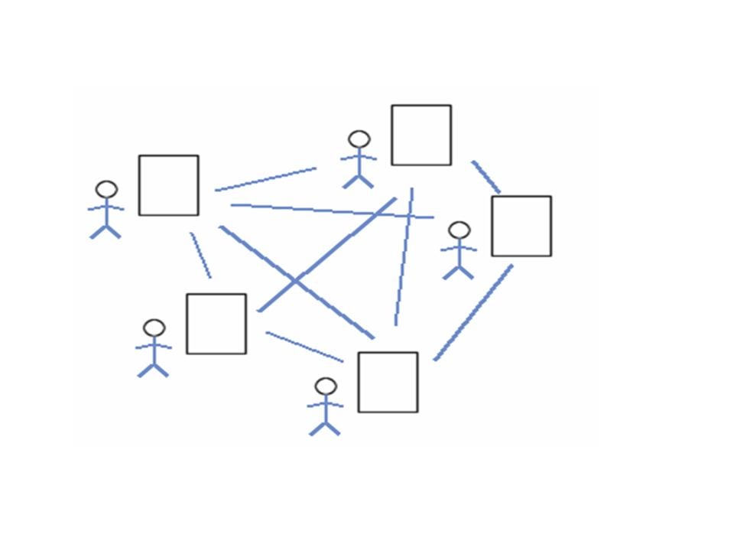
Collective Connective Intelligence
We are still in a world of mass, of masses of people, votes, ideas
These are the properties of the individual, applied to the whole
Is the power of the brain in the neuron? Really?
http://www.downes.ca/post/43456

Slide 4
Connectivism
“At its heart, connectivism is the thesis that knowledge is distributed across a network of connections, and therefore that learning consists of the ability to construct and traverse those networks.”
What Connectivism Is
http://halfanhour.blogspot.com/2007/02/what-connectivism-is.html

Slide 5
Typical Workplace Learning:
Demand driven
Employer driven
Content driven
It’s no coincidence that the dominant workplace e-learning technology is based on military training manuals

Slide 6
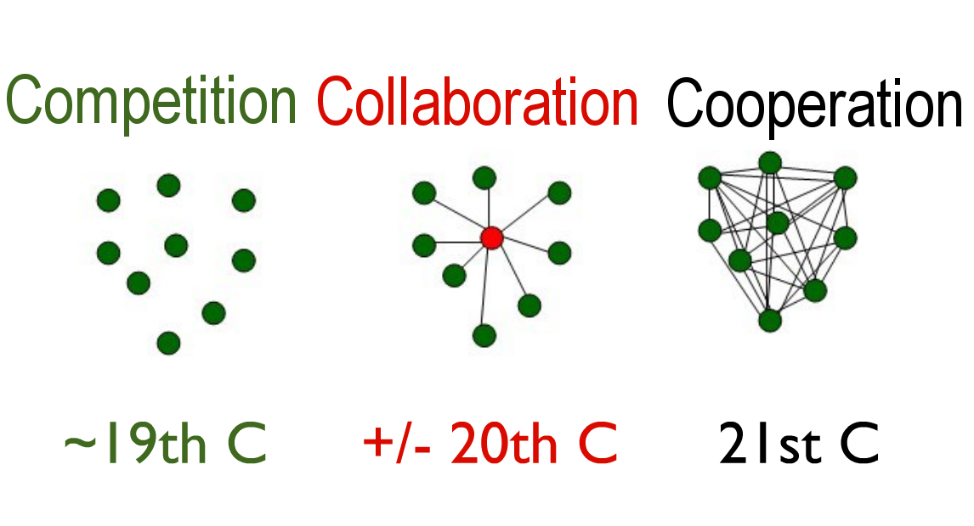
Vs Demand Driven
The Evolving Organization
Adapted from: http://www.slideshare.net/jarche/working-smarter-hr-exec-council?from=ss_embed

Slide 7
Community = Interactions
Not ‘spreading the word’
Not ‘amplification’
But rather, the creation of our own society, together
emergent from the free actions of each of us
not based on the ideas of one (or a small number) of individuals

Slide 8
New Roles for Research

Slide 9
New Models for Schools

Slide 10
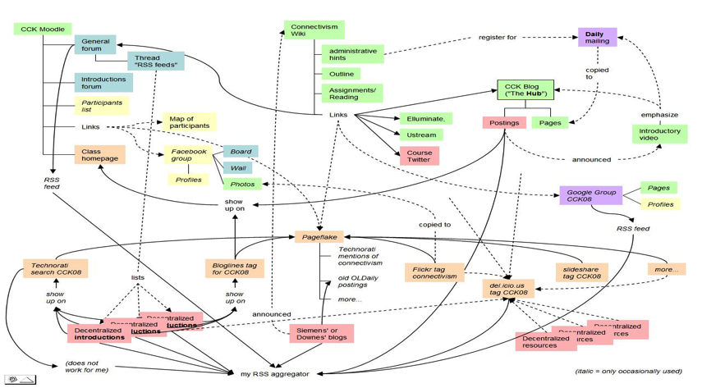
A Map of the Community
Connectivism: A Theory of Personal Learning
Stephen Downes, December 3, 2008, Educational Development Centre, Ottawa
http://www.downes.ca/presentation/208

Slide 11
The MOOC Model
MOOC: Massive Open Online Course
There is no central core feature – no core content, group, etc
Course design is a network, or a map, or a community
Resources are distributed, and aggregated
Participants are encouraged to create their own resources, communities, groups

Slide 12
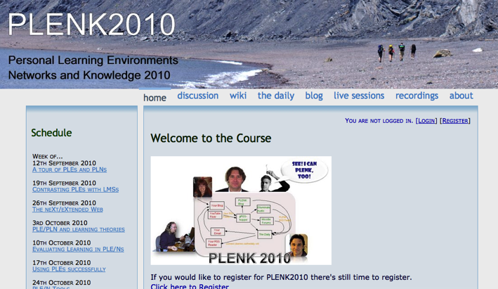
PLENK 2010 involved a significant research effort
http://connect.downes.ca/

Slide 13
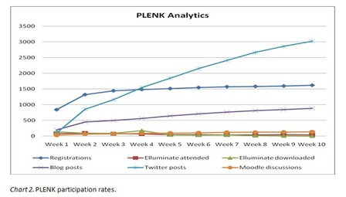
PLENK Analytics
Rita Kop
Supporting ongoing MOOC participation
http://www.irrodl.org/index.php/irrodl/article/view/882

Slide 14
Critical Literacies
Understanding how we use artifacts to communicate in online and other learning networks
http://www.downes.ca/presentation/232

Slide 15
“Students, as they are increasingly posed with problems relating to themselves in the world and with the world, will feel increasingly challenged and obliged to respond to that challenge… Their response to the challenge evokes new challenges, followed by new understandings; and gradually the students come to regard themselves as committed.”
Paulo Freire
http://www.marxists.org/subject/education/freire/pedagogy/ch02.htm

Slide 16
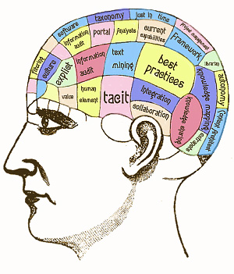
Personal Knowledge
Is not ‘constructed’
You do not ‘make meaning’ for yourself
It is a matter of organic growth
This is important because it means that developing personal knowledge is more like exercising than like inputting, absorbing or remembering

Slide 17
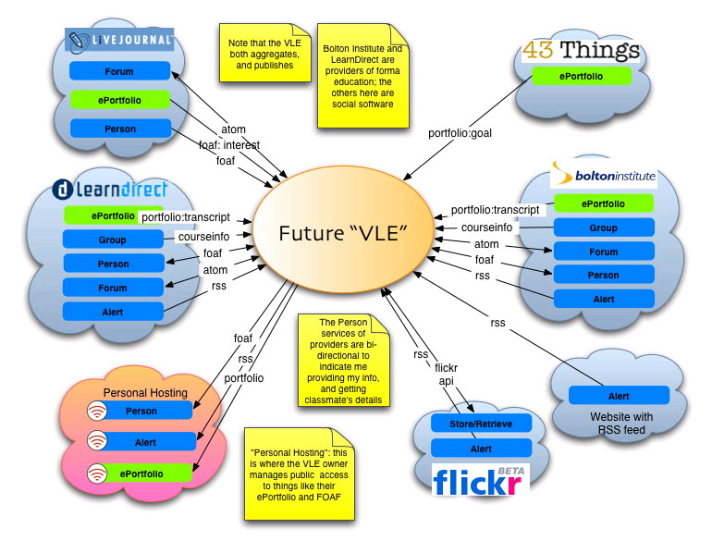
The Main Idea
The web of the future isn’t about visiting sites, it’s about connecting resources.

Slide 18
Organization
We’re trying to understand society by collecting individuals
But a sand castle isn’t just a pile of sand
Image: http://pixdaus.com/single.php?id=25529
http://www.downes.ca/presentation/257

Slide 19
Connectivism
Knowledge is distributed across a network of connections
Learning is the ability to traverse and grow those networks
http://www.downes.ca/post/38653

Slide 20
Engagement and Empowerment
There is no curriculum, no body of knowledge - McGuffin
The product of learning is the learner
Fernando Flores
Emotional Fortitude
21st century skills
Image: http://www.masternewmedia.org/news/2008/06/01/making_sense_of_new_technologies.htm
http://www.downes.ca/post/51122

Slide 21
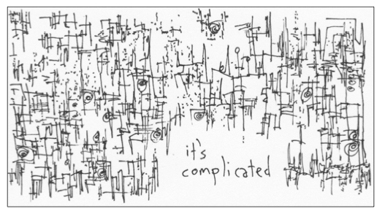
Complexity
It’s not that there’s nothing to learn
But that it’s complex, and needs to be navigated
Not memorized
Image: http://www.gapingvoid.com/complicated128.jpg
http://www.downes.ca/post/48669

Slide 22
A tool for learning networks
It functions as a node
Not as part of a mass
http://grsshopper.downes.ca/

Slide 23
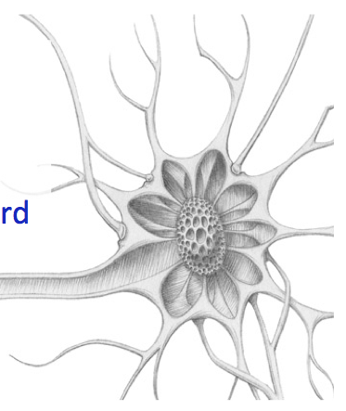
Learning is Immersive
We function as nodes in the network
Aggregate, remix, repurpose, feed forward
Craig Newmark: listen to people, repeat what they say, and then get out of the way.
http://ple.elg.ca/course/?p=18

Slide 24
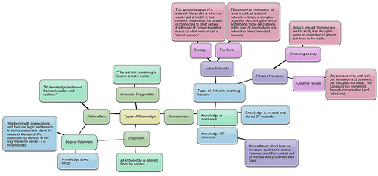
Networks, Network Theory
Two kinds of knowledge
– personal knowledge
– social, or public knowledge
Networks in general
A common set of principles
Image: http://techticker.net/2008/09/16/types-of-knowledge/
http://www.downes.ca/post/33034

Slide 25
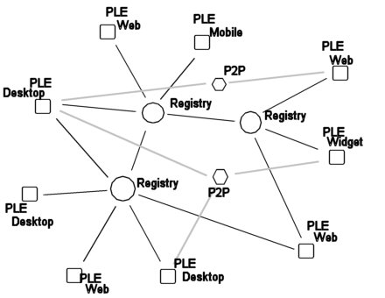
The Design of a PLE

Slide 26
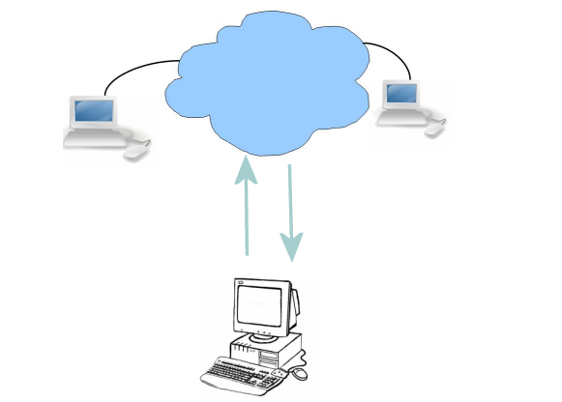
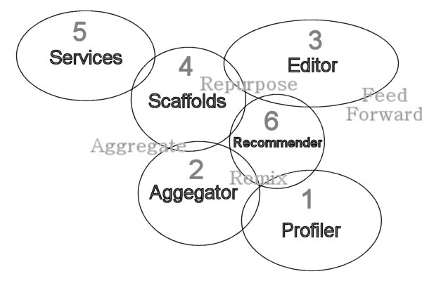
Plearn

Slide 27
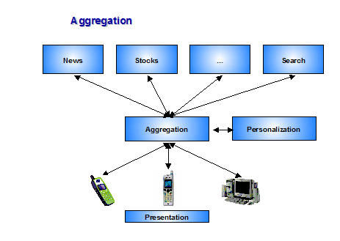
Aggregation

Slide 28
Resource Profiles

Slide 29
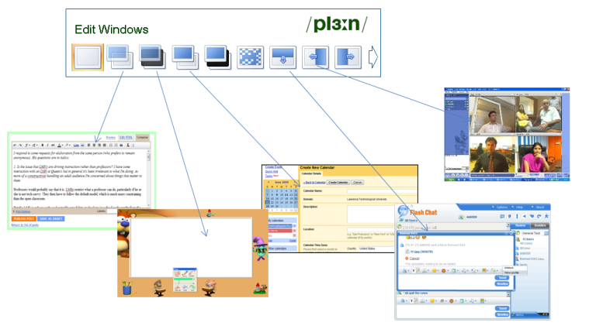
Scaffolds and Third Party Services

Slide 30
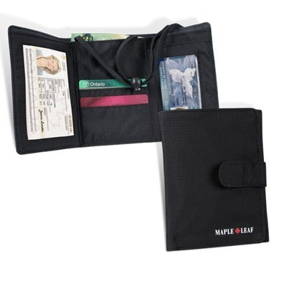
Learning and Performance Support Systems
Single point of access to all skills development and training needs

Slide 31
It’s personal and you carry it with you
It’s a network – we don’t put everything in one package, but develop an infrastructure that links relevant resources
Different types of things, not just courses:
Access to learning resources
Calling cards and communication tools
Credentials, permits and licenses

Slide 32
Individual learning path
Context-aware support
Searchable and verifiable
Tailored to industry needs
Always available
Point of need performance support

Slide 33
Learning and Performance Support System: Core Technology Development Projects
Learning services network and marketplace
Automated skills development and recognition
Lifetime management of learning and training records and credentials
Personal learning assistant to view, update and access training
Resource Network
Learning Assistant
Automate Skills Dev.
Personal Learning Records
Learning as a cloud service and deep integration with external systems
Notes:
the solution would consist of the main components as shown on the slide
Learning as a Cloud Service - will create a distributed learning layer, which is mechanism for working with data no matter where it is stored, through desktop, mobile and other devices.
Resource Repository Network – will create a resource graph from multiple sources and multiple formats including live and dynamic data such as oilfield data, refinery instrumentation, or Oil and Gas market information.
Personal Learning Record - this project will define how we represent, capture, and leverage user activity, including ratings, test results, performance measures, and the like, in a distributed learning and work environment.
Automated Competence Development And Recognition – whereas existing recommender systems depend on manually defined metrics, this system will detect new and emerging competences and automatically assess employee performance.
Personal Learning Assistant – this project will develop an integrated learning appliance, a mechanism for looking up or finding references or resources inside other programs or environments.

Slide 34
Technical and scientific requirements
User / Data / Knowledge / Access Management
Workflow Management / Recommender Engines
Analytics / Search / Profiling Tools
Intelligent Tutoring / Adaptive Learning / EPSS
Educational / Learning Sociology / Psychology / Technology / Policies
Skills / Competency / Proficiency Framework
HCI / HMI (Human Computer / Machine Interaction)
Modeling / Simulations for learning
Input / Output Modalities and Edge connections

Slide 35
Program Design and Scope
WAVE
Workflow Analysis, Visualization and Enhancement
MOOC-REL
Massive Open Online Course Ressources Éducatives Libres
MINT Multimodal INteractive Trainer
RRN
PCL
PLR
ACDR
PLA
WORLD
DATA
EXTERNAL DATA Services
EXTERNAL APPS
COMMON PLATFORM
Services, Communications, Management
MATS Program
Technologies
NRC Programs Government
Departments
Blue: Core technology projects
Orange: Implementation projects with commercial clients
Grey: Infrastructure, other NRC programs, external services
Notes:
NRC’s LPSS program proposes to shift the perspective from static courses and classes to personal learning as a dynamic and ongoing process. The objective is two-fold: to reduce cost, and increase effectiveness by changing learning from something that you drop everything to go somewhere and do, to something that is an ongoing part of your life and work. The LPSS is not a single product. It represents an evolution in learning technology from today’s proprietary closed-platform model of online learning to one that crosses organizational boundaries to create a learning network. It is an infrastructure, like the water distribution network, or the electrical grid, made up of producers, transformers, delivery systems and applications, designed to deliver learning access and resources precisely when and where needed.
LPSS is built on what we call a Common Platform (thrust 1). This is the minimum set of applications and functions needed to support end-to-end functionality in the learning and performance support system. It is a structure that enables employees to access resources and materials, work with them and store documents and data, to compile a record of their own learning over a career, to be assessed, certified and credentialed, and be guided by a learning assistant from one learning objective to the next.
The Common Platform is a type of precompetitive infrastructure employed by companies seeking to create a common marketplace. The World Wide Web itself is an example of such a platform, building on existing internet technologies, and establishing basic protocols such as HTTP and HTML. In learning technology, the Instructional Management System (now IMS Global) recently established the Learning Tools Interoperability and Common Cartridge frameworks, collaborating with learning technology development companies and user groups such as the U.S. military to develop a set of reference implementations to serve as the minimum set of applications and functions needed to support end-to-end learning content delivery functionality. In turn, the LPSS Common Platform extends learning support beyond the corporate intranet and into each person’s work environment, wherever they happen to be.
The Common Platform is further extended through Commercial Projects (thrust 2). This name reflects the idea that in addition to addressing immediate training and development needs in the O&G sector, we are creating with our technology partners, applications that will have much wider application, and therefore can be marketed to other verticals. We have identified five such products, and each of these is associated with a separate project within the LPSS program:
The Resource Repository Network (RRN). This project addresses the way we acquire, organize and distribute resources in general. These are resources that will be accessed by personal devices as needed and include not only books and publications but also shared files and data sources within the corporate infrastructure. This is an aspect of the project that must be industry-driven, as resource producers are reluctant to share a common marketplace with each other otherwise.
Learning as a Cloud Service (LCS). This project addresses how individuals manage their learning data, including their notes, personal library, documents and reports, and everything else. This data needs to be available anywhere a person is, so it needs to be synchronized across devices. But not everything on every device; that’s not practical. And what a person needs will shift from day to day in any case. This project isn’t simply about putting everything in the cloud and accessing it remotely - it's about creating a dynamic, living and current archive of relevant material on each device, all working together in a coordinated fashion.
The Personal Learning Record (PLR). Also referred to as ‘paradata’, the information contained in a personal learning record is not limited to test results and credentials, but it rather represents a record of all a person’s educational activities. What is needed here is a way to record what a person produces, what a person does, what a person says, what he or she thinks, and what that person accomplishes. Creating a personal learning record must balance two major objectives: on the one hand, creating utility through data sharing, while at the same time, keeping personal records personal and outside the grid.
Automated Competence Development and Recognition (ACDR or ACD/ACR). Our objective is to essentially eliminate or reduce the need for tests by employing a method similar to that which an expert would perform when evaluating for a skill or competence. It depicts the assessment process as a recognition process. It is composed of two parts: one, a pattern-creation process, which creates a baseline or idealized picture of a skill or competence. It’s like creating a skills inventory, but using a cluster-recognition process instead of a team of experts to compile the definitions. The second part is a pattern matching process, where we determine the degree of fit between the target individual performance, and the previously identified skill or competence.
Personal Learning Assistant (PLA). This project will develop a mechanism for finding the appropriate resource for the right person at the right time. This is a two-part problem: first, selecting the appropriate data - the facts, knowledge, process, skill or information needed to perform the task; and second, selecting the appropriate learning framework in which to present that data. In addition to being sensitive to the data and the view, the selection system needs to be context sensitive as well - sometimes it's OK to give a long and detailed explanation of how a substation works, but when you're in -40° degree weather, you might want the basics, quickly. So these problems combined become the personal learning assistant project.

Slide 36
Thank you
Stephen Downes
Program Leader, LPSS
Stephen.Downes@nrc-cnrc.gc.ca stephen@downes.ca
www.nrc-cnrc.gc.ca www.downes.ca
36

