Slide 1
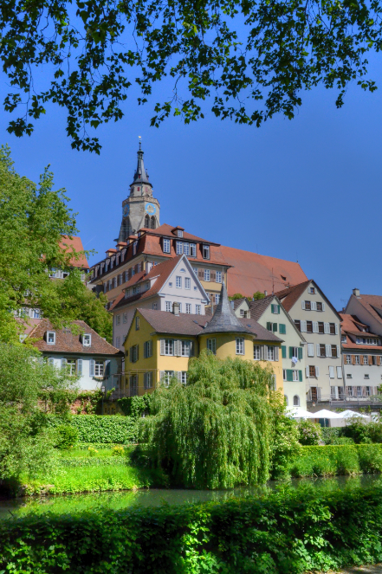
Collaboration and Cooperation
Workshop on “Mass Collaboration and Education”
Leibniz-Institut für Wissensmedien
Knowledge Media Research Centre
Tübingen, Germany
Stephen Downes
National Research Council Canada
May 22, 2014

Slide 2
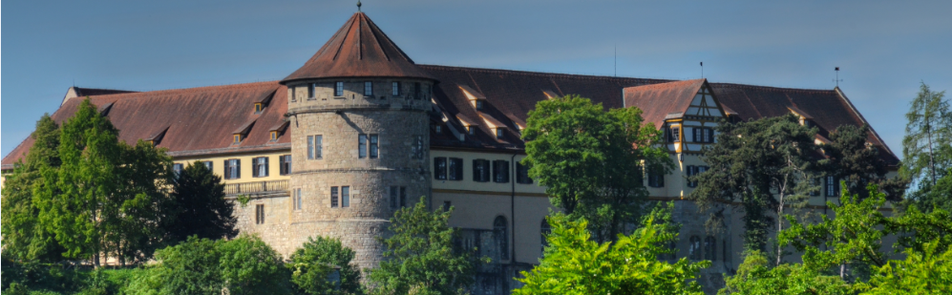
Proposition…
That mass collaboration, properly so-called, is not possible
  (or, to the extent that it is possible, it is so undesirable we would prefer to avoid it)
And that instead we should be exploring mass cooperation as an alternative objective

Slide 3
The Evolution of Cooperation
Robert Axelrod asks, "Under what conditions will cooperation emerge in a world of egoists without central authority?“
Pierre Dillenbourg: "In cooperation, partners split the work, solve sub-tasks individually and then assemble the partial results into the final output. In collaboration, partners do the work 'together'."
http://www-ee.stanford.edu/~hellman/Breakthrough/book/pdfs/axelrod.pdf
http://halshs.archives-ouvertes.fr/docs/00/19/02/40/PDF/Dillenbourg-Pierre-1999.pdf

Slide 4
Stephanie D. Teasley and Jeremy Roschellel: "Collaboration is a coordinated, synchronous activity that is the result of a continued attempt to construct and maintain a shared conception of a problem... Cooperative work is accomplished by the division of labour among participants, as an activity where each person is responsible for a portion of the problem solving." What's important in collaboration is the creation of a shared model. "Our perspective has characterised collaboration as a process of constructing and maintaining a Joint Problem Space."
http://umdperg.pbworks.com/f/RoschelleTeasley1995OCR.pdf

Slide 5
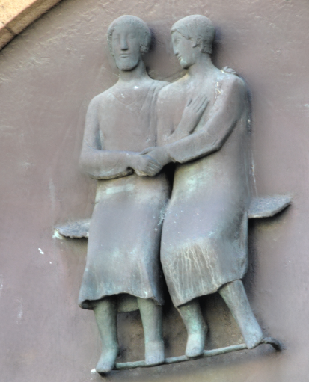
Let’s draw the distinction…
When collaborating, people work together (co-labor) on a single shared goal.
When cooperating, people perform together (co-operate) while working on selfish yet common goals.
Heavily borrowed from http://cloudhead.headmine.net/post/3279118157/cooperation-vs-collaboration

Slide 6
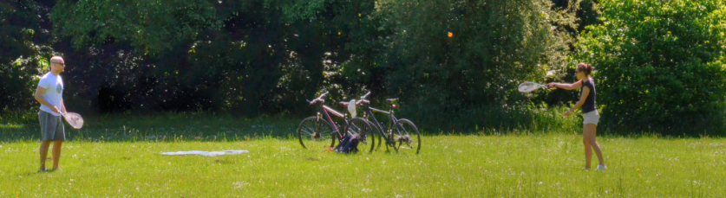
Collaboration
The idea of shared goals, shared values…
like an orchestra which follows a script everyone has agreed upon
like a team playing a game against a common opponent

Slide 7
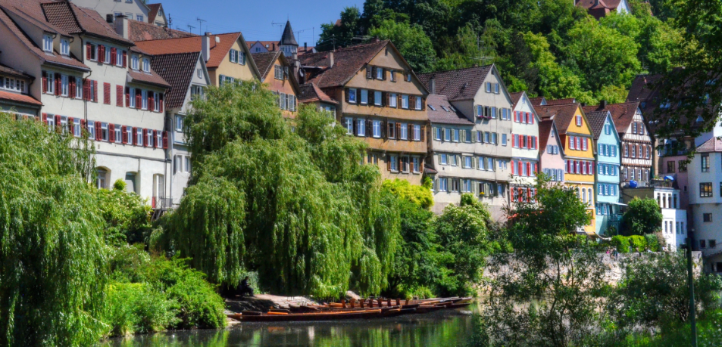
Cooperation
The idea of separate goals interacting for mutual gain
like a marketplace with competing but cooperating vendors
like the internet

Slide 8

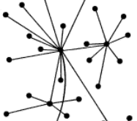
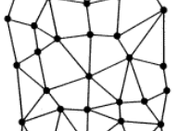
Individuals compete | Collectives collaborate | Connectives cooperate
priority to the individual over the group no shared sense of identity pursuing own goals and competing against others | priority to the group over the individual members adopt a joint identity united them around their shared goal. | supports and encourages both simultaneously group and individual no shared sense of identity members busy pursuing their own goals

Slide 9
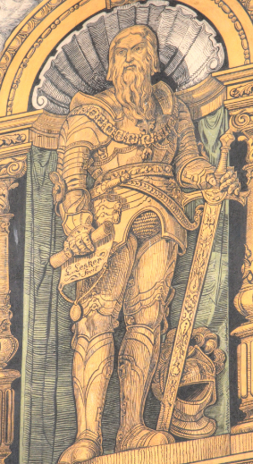
Collectives are breeding grounds for hierarchies and power struggles
  “Even with the best intentions, collaboration often encourages pyramids of power and authority. The higher up the pyramid you are in a collective, the more freedom you have to carve out your own individual identity and direct the group’s efforts towards your own goals.”
http://cloudhead.headmine.net/post/3279118157/cooperation-vs-collaboration

Slide 10
Wikipedia…
Is a collective
  Everybody is working toward a common goal
  There’s one article on a topic which people create jointly
  Wikipedia’s ‘rules’ are essentially prerequisites for collaboration
    “neutral’ (ie., ‘group’) point of view
    Referencing = rule for dedising on content
Hence the power struggles and hierarchies that have developed
See, eg., ‘The Decline of Wikipedia’ http://www.technologyreview.com/featuredstory/520446/the-decline-of-wikipedia/

Slide 11
Some (Post-Hoc) Antecedents
Simmel’s (1890) distinction between ‘groups’ (defined by some membership criterion) and ‘webs of affiliation’ (linked through specific types of connections) http://socio.ch/sim/index_sim.htm
‘anticategorical imperative’ (Emirbayer and Goodwin, 1994) which rejects explanations of ‘social behavior as the result of individuals’ common possession of attributes and norms rather than as the result of their involvement in structural social relations’. See http://depts.washington.edu/methods/readings/emirbayer.pdf
http://citeseerx.ist.psu.edu/viewdoc/download?doi=10.1.1.130.1129&rep=rep1&type=pdf

Slide 12
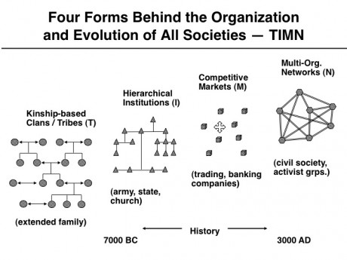
TIMN…
http://www.rand.org/content/dam/rand/pubs/papers/2005/P7967.pdf

Slide 13
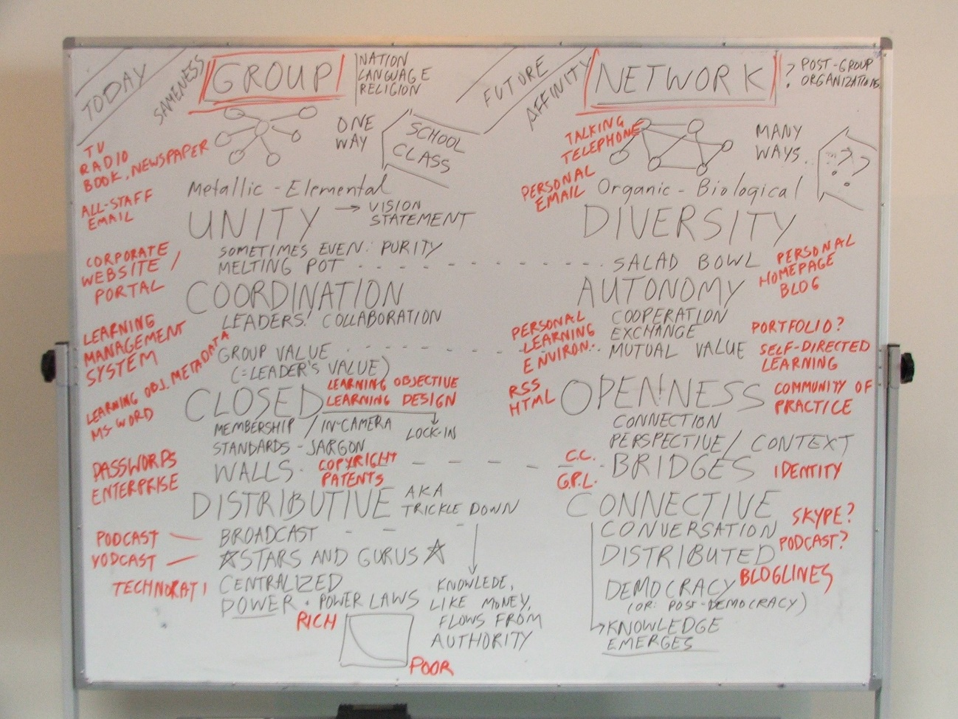
Groups vs Networks
= Collectives vs Connectives

Slide 14
Their Natures
A collective is a collection of entities or members according to their nature; what defines a group is the quality members possess and number
A connective is an association of entities or members via a set of connections; what defines a network is the extent and nature of this connectivity
From http://www.downes.ca/presentation/53

Slide 15
Elements and Ecologies
A collective is elemental, defined by mass and sameness – like an ingot of metal (Aside: traditional democracy is a collective phenomenon)
A connective is diverse and changing, defined by interactions – like an ecosystem
Can we achieve order, responsibility, identity in an ecosystem? Do we need the iron hand? (Aside: Solon, learning, justice)

Slide 16
Collective Unity
A collective must be cohesive, united, “out of many, one”… “the people, united, will never be defeated…” The melting pot… the encouragement is to conform, to be like the others
Collective technology appeals to the mass: television, radio, newspapers, books
Internet technology includes: all-staff email, corporate website, portal

Slide 17
Connective Diversity
A connective, by contrast, thrives on diversity … “to each his own” … the salad bowl… the encouragement is to be distinct, to create
Connective technology includes: talking, telephoning, writing letters, personal email
Internet technology: personal home pages, blogs

Slide 18
Collective Coordination
Collectives require coordination, a leader, someone who will show the way… and to be managed… a group will often be defined by its values (aka the leader’s values?) and then a way to get members to follow, to share the vision, will define standards - members belong to a collective
Associated technology includes the Learning Management System, Learning Design, LOM, etc

Slide 19
Connective Autonomy
Connectives require autonomy, that is, that each individual operate independently according to his or her own values and interests – cooperation entails mutual exchange of value rather than follower and leader – members interact with a network
Associated technology: e-portfolios, personal learning environments

Slide 20
Collective Borders or Boundaries
Collectives are closed - they require a boundary that defines members and non-members – walls - membership, logins and passwords, jargon and controlled vocabulary, lock-in (staying on-message, speak as one)
Technology: enterprise computing, federated search, user IDs and passwords, copyrights, patents, trademarks, assertions of exclusivity

Slide 21
Connective Openness
Connectives require that all entities be able to send and receive messages both (a) in their own way and (b) without being impeded
In their own way: open source software, platform independence, APIs, RSS, communities of practice
Without being impeded: Creative Commons and GPL, distributed identity

Slide 22
Collective Centralization
Collectives are distributive – knowledge, information, money, etc., flows from the centre – an ‘authority’ and is distributed through to their members
Collective knowledge is representationally based
  Ie., it is based in a symbol system
  And it required a (shared) semantics
Associated technology: broadcast technologies, controlled vocabularies and ontologies

Slide 23
Connective Decentralization
Connectivists are emergentist – knowledge is generated as a consequence of the interactions among members
Connective knowledge is non-representational
  The knowledge is the structure; there is no requirement that the structure ‘stand for’ anything
  Interpretations of the structure are generated externally and are not inherent to the structure
Relevant technology: tagging systems, ‘Page Rank’

Slide 24
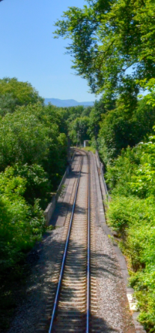
Why Connectives?
Nature of the knower: humans are more like connectives than collectives
Quality of the knowledge: collectives are limited by the capacity of the leader
Nature of the knowledge: collective knowledge is transmitted and simple (cause-effect, yes-no, etc) while network knowledge is emergent and complex

Slide 25
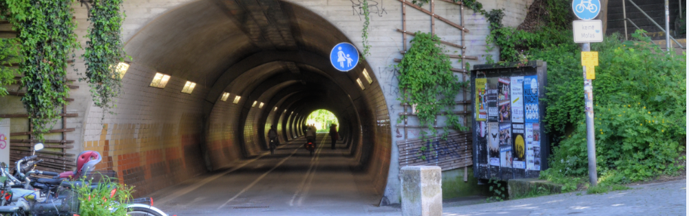
Harrison White. It's not an understatement to say that a lot of what I say here is anticipated years earlier in his work. "Social life is made up of endless chains and multiple overlapping nets, with no clear boundaries. It is long stings .... It is only a messy mesh or, rather, mush. Social reality is a terrain, a typology of networks and chains."
http://citeseerx.ist.psu.edu/viewdoc/download?doi=10.1.1.195.3584&rep=rep1&type=pdf

Slide 26
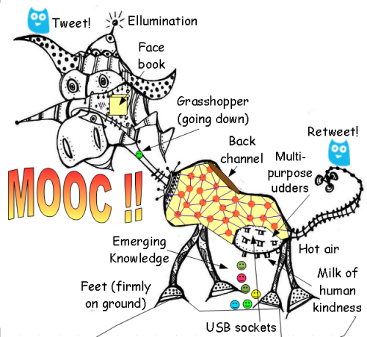
The MOOC
Massive – by design
Open – gratis and libre
Online – not blended, not wrapped
Courses – not communities, websites, video collections, etc

Slide 27
Massive Open Online Course
Site
A MOOC is a Web, not a Website

Slide 28

Design Principles
Autonomy
- Choice of contents
- Personal learning
- No curriculum
Openness
- Open access
- Open content
- Open activities
- Open assessment
Diversity
- Multiple tools
- Individual perspective
- Varied content
Interactivity
- Encourage communication
- Cooperative learning
- Emergent knowledge

Slide 29
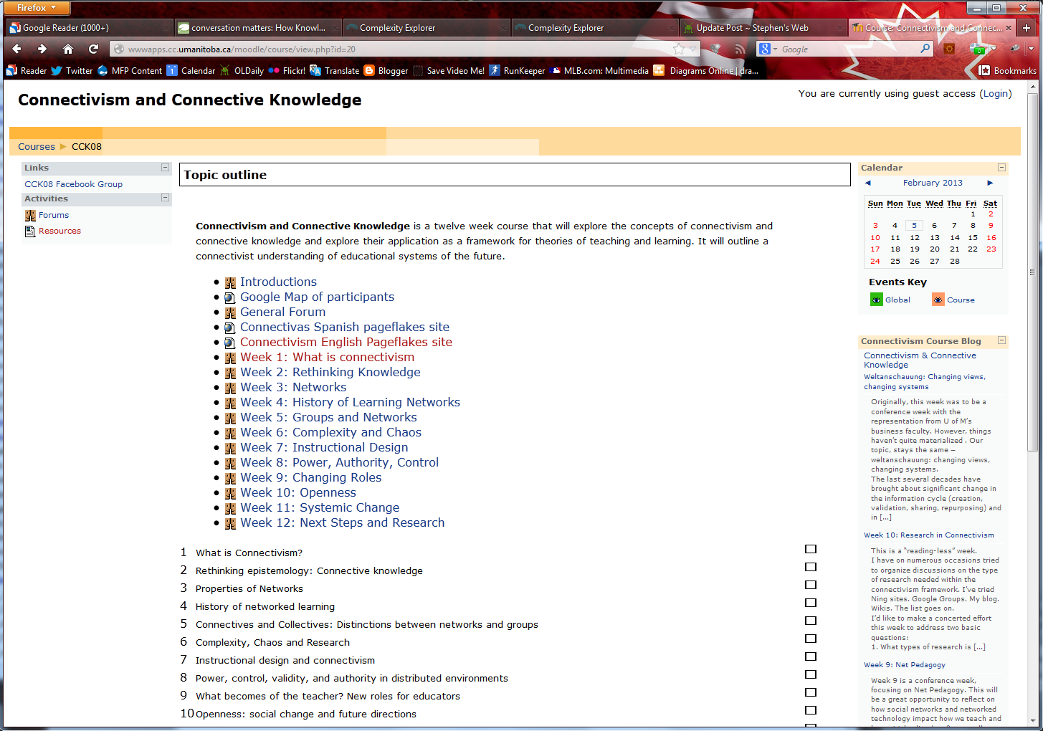
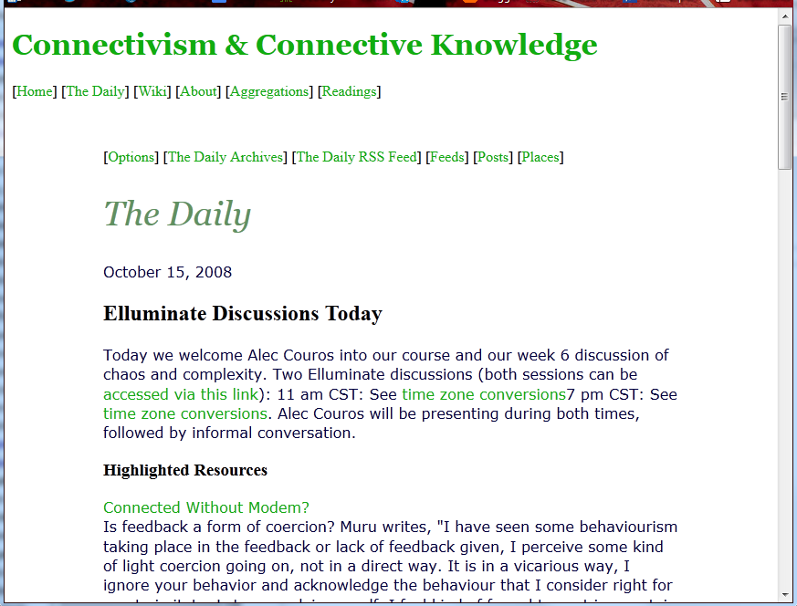
CCK08
http://wwwapps.cc.umanitoba.ca/moodle/course/view.php?id=20
2300 students
http://connect.downes.ca/cgi-bin/archive.cgi?page=thedaily.htm

Slide 30
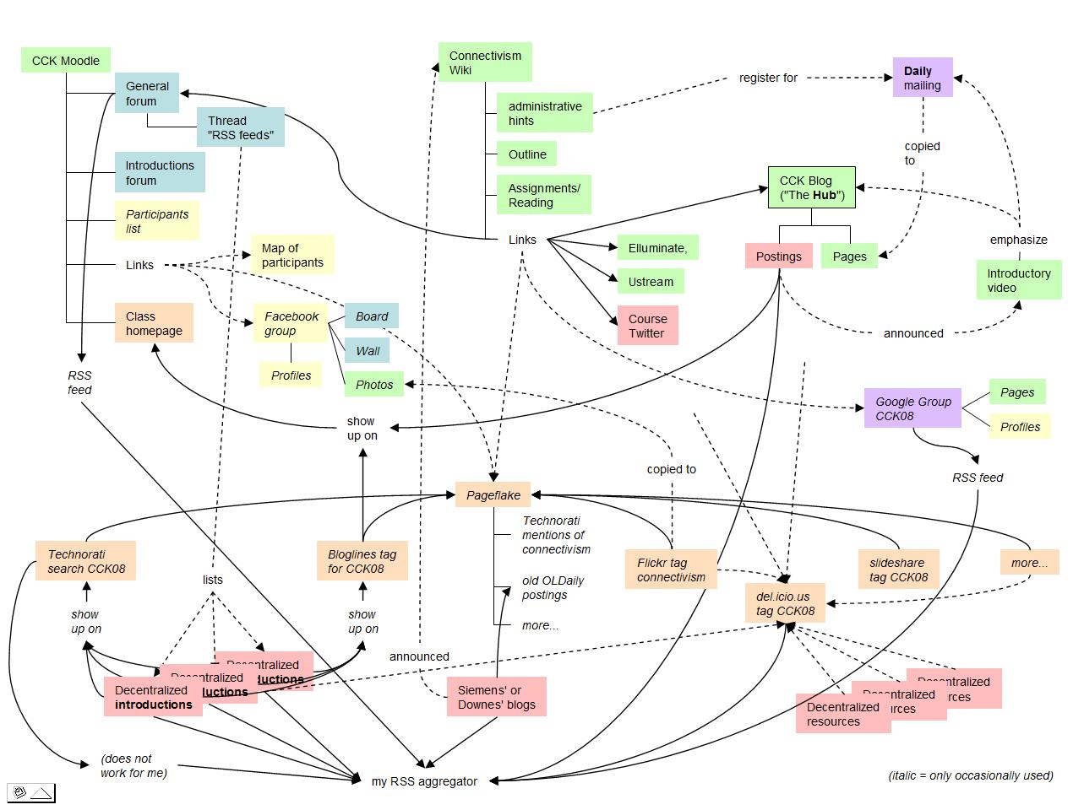
Connectivist MOOCs
http://x28newblog.blog.uni-heidelberg.de/2008/09/06/cck08-first-impressions/

Slide 31
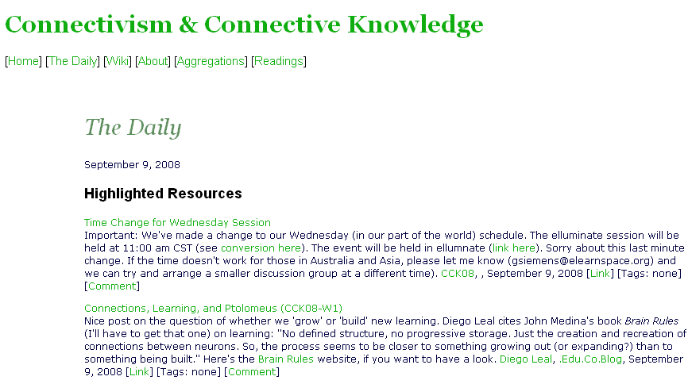
Course Components
http://connect.downes.ca/
The Daily
Notes:
31

Slide 32
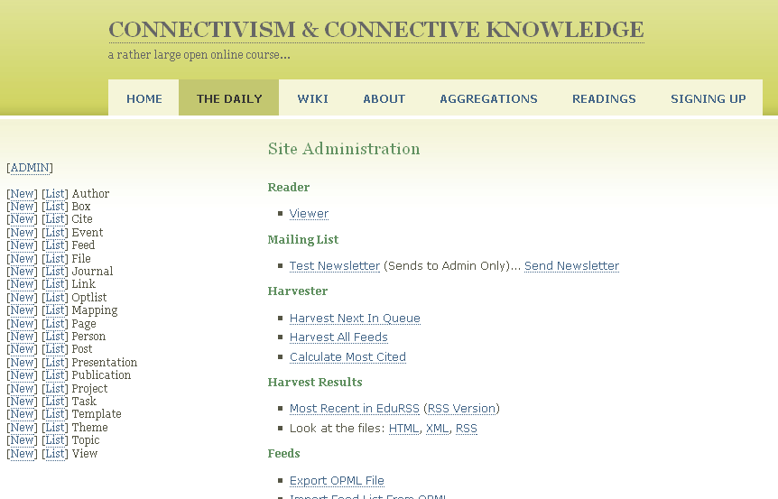
Course Components
Managing Content

Slide 33
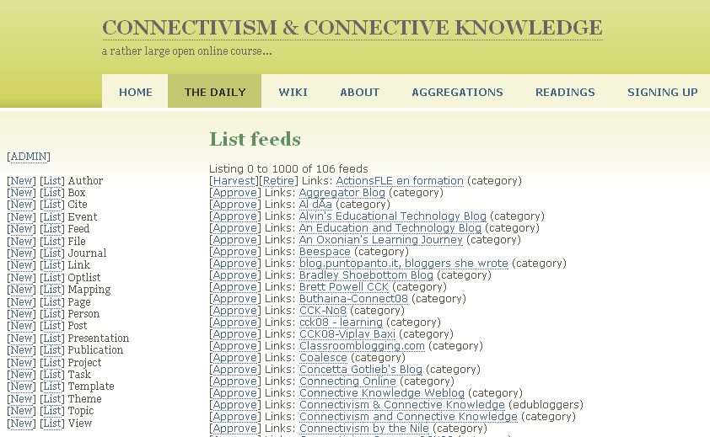
Course Components
Feed Harvesting

Slide 34
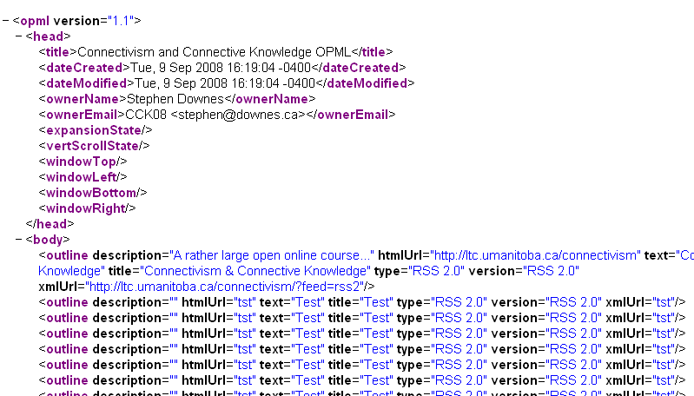
Course Components
OPML…

Slide 35
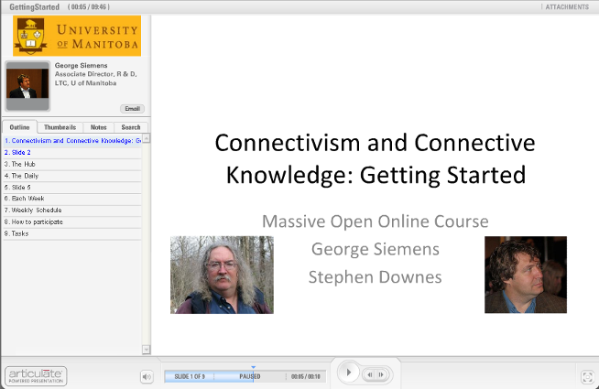
Course Components
Intro…

Slide 36
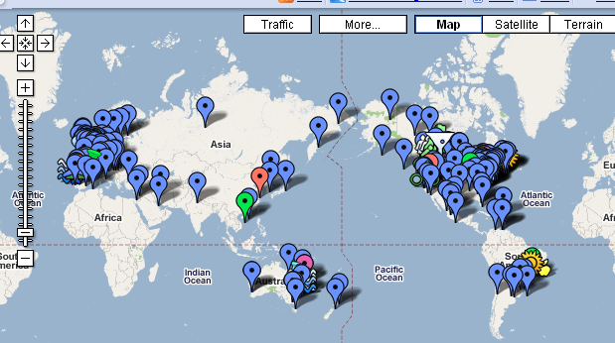
The Students
http://tinyurl.com/cck08map
The Other Course Map…

Slide 37

The Students
http://www.flickr.com/photos/25838481@N04/
Wordle…

Slide 38
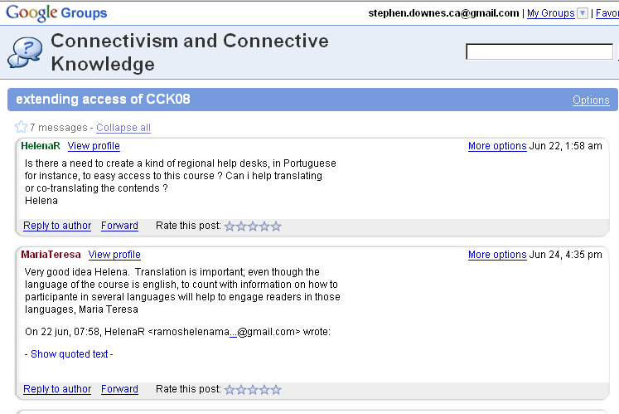
The Students
http://groups.google.com/group/connectivism
Google Groups

Slide 39
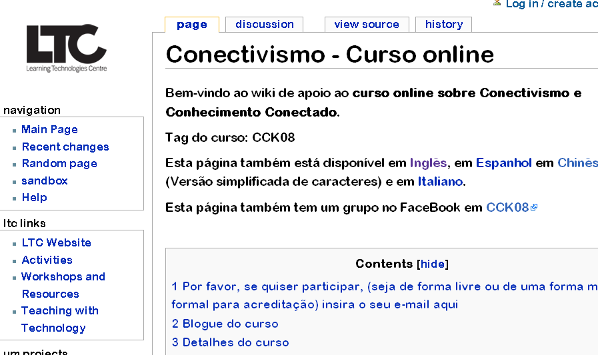
The Students
http://ltc.umanitoba.ca/wiki/Conectivismo_-_Curso_online
Translations…

Slide 40

The Students
Second Life…
Diigo…
de.l.icio.us
WordPress…

Slide 41
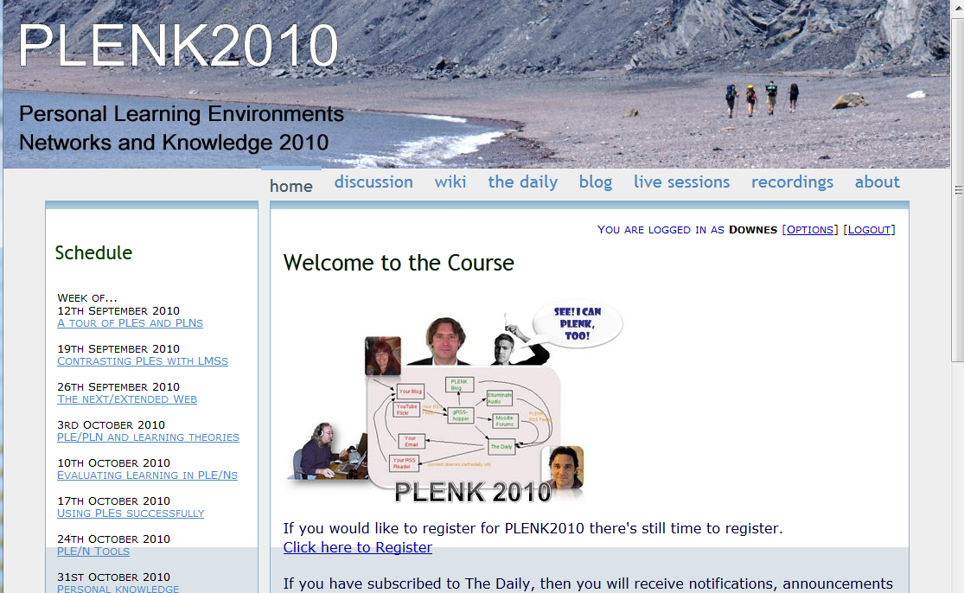
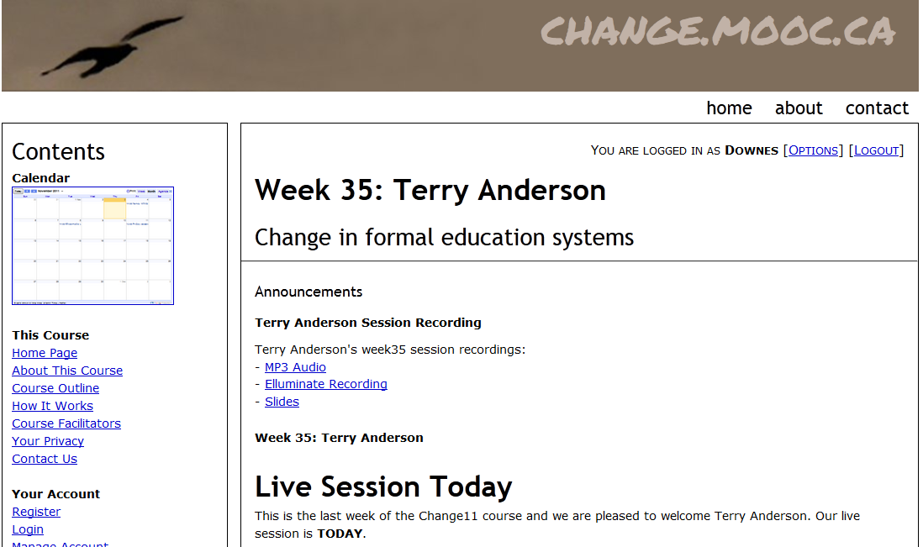

Other Courses
1800 students
http://connect.downes.ca/
2800 students
3000 students
http://change.mooc.ca/
http://edfuture.net/

Slide 42
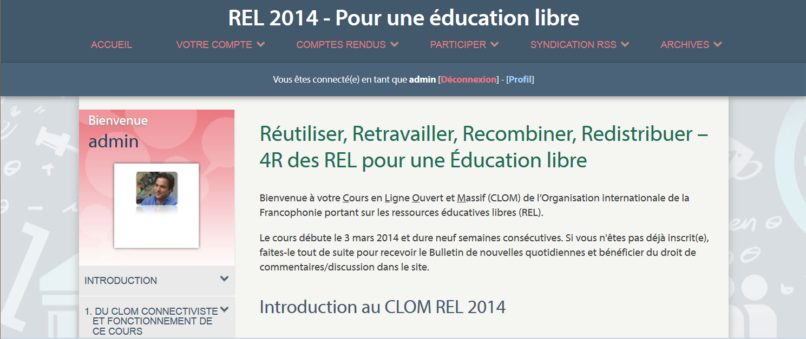
Most Recently
MOOC REL 2014
http://rel2014.mooc.ca

Slide 43
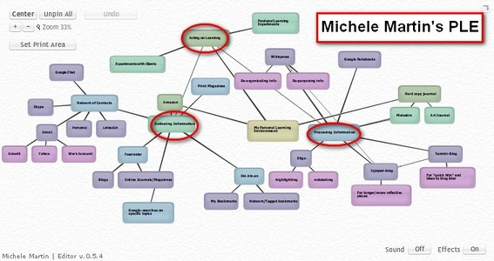
Personal Learning
http://dmlcentral.net/blog/howard-rheingold/diy-u-interview-anya-kamenetz
http://www.downes.ca/post/58150
Notes:
Howard Rheingold searches for the new in Anya Kamenetz's Edupunk's Guide, suggesting that what has been added is the idea of the personal learning plan to the personal learning network. "Making a public commitment to something is going to increase your accountability," says Kamenetz. Rheingold writes, "Her work serves as a bridge between blended learning and peeragogy. I previously wrote about Shelly Terrell and personal learning networks" and asks here what it takes for a group to self-organize. Kamanetz responds that there needs to be a common understanding of the goal - of course, this would be the outcome of self-organization, not what makes it possible.

Slide 44




The Student’s Perspective
Site
A range of different resources and services

Slide 45
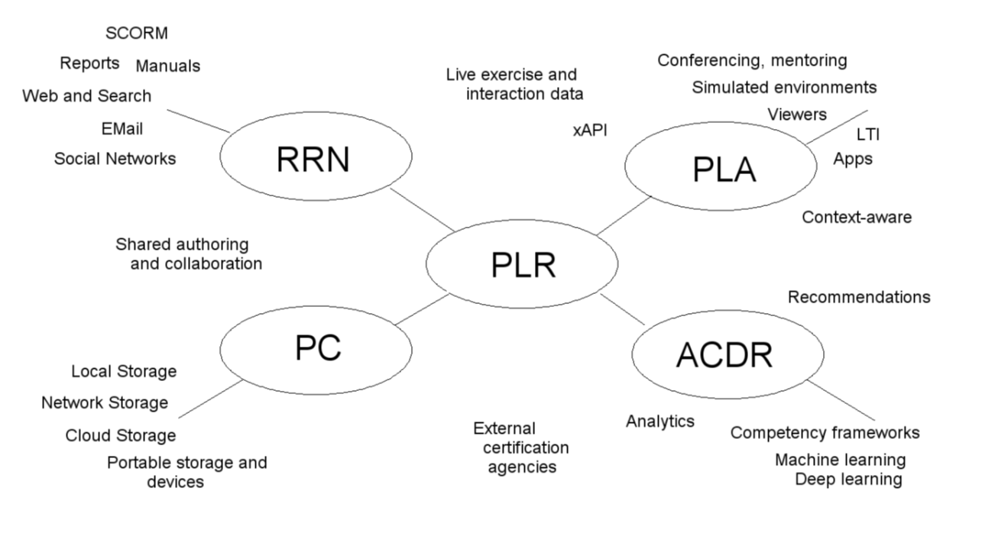
LPSS core technologies

Slide 46
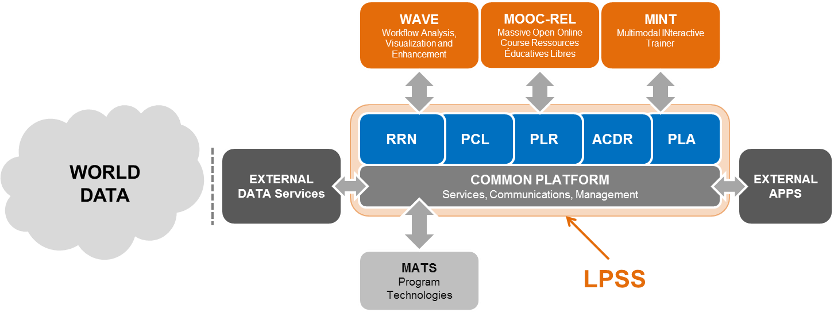
Learning and Performance Support
http://halfanhour.blogspot.com.es/2013/12/learning-and-performance-support-systems.html
http://www.nrc-cnrc.gc.ca/eng/solutions/collaborative/lpss.html

Slide 47
Core Lessons Here…
That, as I said, mass collaboration is either impossible or undesirable
  Which should lead you to question whether studies of eg. Wikipedia will take you to the places you want to go
And I’ve identified cooperation as an alternative model
  Especially as a model of organization
  But additionally as a model of learning
    Which has been tried and resulted in MOOCs

Slide 48

Stephen Downes
http://www.downes.ca

