Slide 1
Free Learning from a Development Perspective
Stephen Downes
National Research Council Cananada
July 18, 2014
Presented to Foreign Affairs, Trade and Development Canada

Slide 2
Some Background….
My expertise is focused around a few core areas:
educational theory - specifically, ways of describing how we learn, framed as 'network learning' or 'connectivism‘
educational technology - models and systems for supporting and distributing learning through technology
policy and process supporting free and open access to learning

Slide 3
Currently…
I have worked at the National Research Council since 2001
Previously: taught philosophy for University of Alberta, Athabasca University, Grande Prairie Regional College
Instructional technology developer for Assiniboine Community College and the University of Alberta
Currently serving as Program Leader for Learning and Performance Support Systems (LPSS) at NRC, $19 million to develop personal learning technology

Slide 4
My International and Development Focus
Experience in development education in Canada
with Arusha Centre and Development Education Coordinating Council of Alberta (Calgary)
Experience traveling to and teaching in First Nations communities in Northern Alberta, Manitoba
Work with projects internationally
supporting OOPS in Taiwan, EduCamp Colombia, francophonie MOOC, work with Arab League nations

Slide 5
Free Learning
The idea that learning should be freely and openly accessible to people around the world
Free as in gratis – the idea that there should be no cost, either in terms of money or information
Free as in libre – the idea that you can reuse and share the materials a d results of your learning experience
Open as in door – the idea that access to learning and learning resources is not limited by prior conditions, social status, etc.

Slide 6
Three Perspectives
What I would talk about is the idea of 'free learning' from three perspectives.
what can be done ('free learning' as a pedagogical approach, supported by learning theory)
what has been done (systems and technologies, such as open licensing, MOOCs and learning repositories, to support free learning)
what should be done (policy framework supporting free and open learning worldwide)

Slide 7
What Can be Done
Already occurring – the shift from instruction to engagement
Instruction based on behaviourist ideas of stimulus and reward, outcome based on memorization and rote
New constructivist pedagogies based on engagement in authentic problems, outcome based on creation of cognitive or conceptual understanding
Though vocal sceptics remain, constructivism is a proven approach and employed by world-leading countries (including Canad)

Slide 8
Connectivism
Knowledge is created by networks of connected entities
Can be personal knowledge, as in neural networks
Can be computational knowledge, as in connectionist software
Can be social, as in social network theory
Learning is the development of these networks
A focus on both personal experience and social networks
Learning is a matter of practice and reflection
To know is to recognize

Slide 9
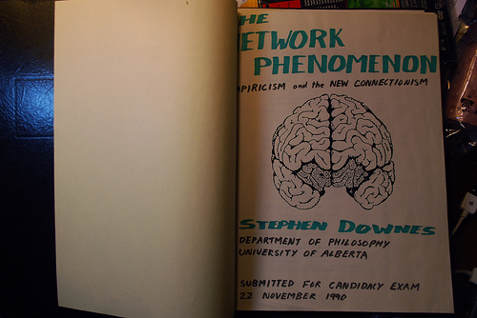

Slide 10
Network Development Principles
These inform both personal development and social development
They are based on underlying principles supporting dynamic and responsive networks (ie., networks that can learn):
Autonomy – each entity has its own values and objectives and decides for itself
Diversity – each entity in a network is unique, both in terms of internal constitution as well as in terms role, function and perspective
Openness – membership in the network is fluid; content (signals, messages) can enter and exit the network
Interactivity – knowledge in the network is created by the interactive process (as opposed to the content of signals propagated through the network)

Slide 11
Free Learning and Connectivism
These reinforce and depend on each other
For example, autonomy as a pedagogical principle creates a requirement for:
Access to learning materials and resources without cost or barriers
Connection with other learners by means of sending signals to other network entities (learners, instructors, friends and associates)
Open learning or the ability to join networks regardless of qualifications or social standing

Slide 12
The learning process
To learn is to practice and reflect; to teach is to model and demonstrate – each member of the network both learns and teaches
A rough outline of a learning process:
Aggregate – seek out connections and obtain resources through those connections
Remix – join the resources from multiple connections together
Repurpose – adapt the remixed resources
Feed Forward – send the newly created resources on to the next nodes in the network

Slide 13
What Has Been Done
Network theory is established in multiple domains
Foundation in mathematics, as graph theory
Computer science – connectionism and neural networks
Biology – ecology and ecosystems
Sociology – social network analysis
Physiology – perception, neuroscience
Philosophy – information theory, distributed representation

Slide 14
Examples of network in operation
Networks in nature, such as the murmuration
Social organization, such as corporate networks, political networks
Infrastructure, such as the electrical grid
The internet, a worldwide information network
Social networks, such as discussion boards, web sites, Facebook, Twitter

Slide 15
Identification of Network Principles
The internet – based on a distributed and connective architecture
Open Source Software as a form of organization (the Cathedral and the Bazaar)
Forms of organization – networks are conversations (the Cluetraion Manifesto) – small pieces loosely joined
Open Access and Open Archives Initiative

Slide 16
Open Educational Resources
A subset of open access in general, focused on learning resources
Defined as a concept by UNESCO in 2002
May be based in a set of educational standards defining learning resources specifically
The status of OERs may vary considerably depending on the licensing adopted
http://wikieducator.org/OER_Handbook/educator_version_one/Introduction/Defining_OER

Slide 17
Licensing Models
GPL or ‘viral’ licensing – enables free sharing of resource, on the consition that the license travels with the resource, even if the resource is adapted – for documents, GFDL
Creative Commons – a set of licences supporting free sharing, with ‘some rights reserved’ by the author
Attribution, Share-Alike, Non-Commercial, No-derivatives
Open access, rights reserved – copyright content enabled for free access (eg. YouTube videos) but not licensed for reuse or sharing
http://legacy.earlham.edu/~peters/fos/overview.htm

Slide 18
OERs in Traditional Courses
Course components or entire course packages are created and made available online, suitable for discovery and redistribution
Rice University’s Connections – a course building resource
WikiEducator / OERu– OERs built using a wiki system (also: Wikiversity, Curricki)
MIT OpenCourseware – learning resources only
Open University OpenLearn – complete learning packages
The focus iss on reuse by educators or other teachers, who would access these materials and adapt them to local use

Slide 19
The OERu Logic Model
Taylor, J.C. 2007. Open courseware futures: Creating a parallel universe. e-Journal of Instructional Science and Technology (e-JIST), Vol 10, No. 1. Online: http://www.ascilite.org.au/ajet/e-jist/docs/vol10_no1/papers/full_papers/taylorj.htm

Slide 20
Criticism of the Logic Model
Traditional Curricular based approach
a focus on articulation & credit transfer
closed federation of traditional institutes
Tight link to traditional credentials
The Black Box problem – ‘open’ this or that (eg. ‘open business model’) unstudied and undeveloped

Slide 21
The Connectivist MOOC (cMOOC)
Instead of seeing a course as a series of contents to be presented, envisions a course as a network of participants who find and exchange resources with each other (2008)
An initial structure is developed and ‘seeded’ with custom-built or (preferably) existing OERs
Participants are encouraged to use their own sites to create or share resources
A mechanism (gRSShopper) is employed to connect these disparate sits with the course core and distributed participant sites
http://www.connectivistmoocs.org/what-is-a-connectivist-mooc/
http://change.mooc.ca/how.htm

Slide 22
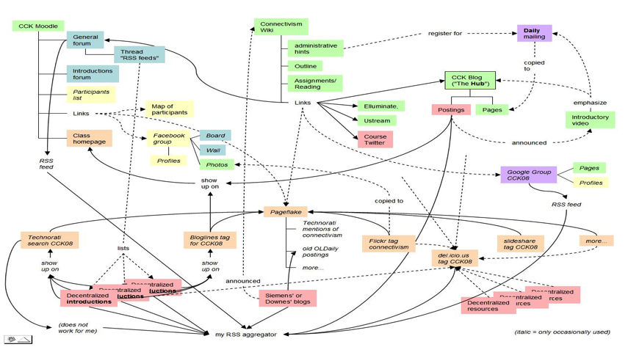
A Map of the Community
Connectivism: A Theory of Personal Learning
Stephen Downes, December 3, 2008, Educational Development Centre, Ottawa
http://www.downes.ca/presentation/208

Slide 23
The eXtended MOOC (xMOOC)
Combines open access and traditional course structure
First such was Stanford’s AI course (2011)
Content tends to be open access only and is bespoke created
Spawned a number of highly visible initiatives
Coursera, Udacity launched by Stanford AI founders
EdX created by a consortium of eastern universities (MIT, etc)
Open University launched FutureLearn
Existing LMS companies have created ‘open’ versions of their platforms
Numerous other initiatives (eg. Codeacademy)

Slide 24
What We Know
There is a huge pent-up demand for open online learning (market projected to have 58% CARG)
This demand is world-wide (initial results notwithstanding)
The widespread adoption of open online learning will require both infrastructure and policy initiatives

Slide 25
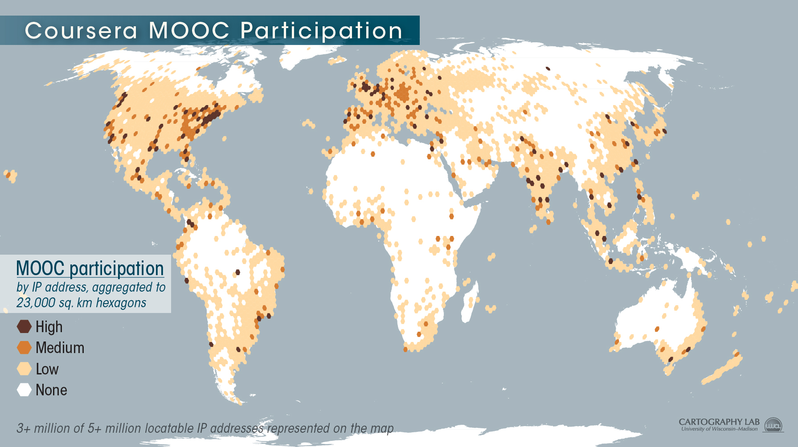
http://www.insidehighered.com/blogs/globalhighered/mapping-courseras-global-footprint#sthash.gim8di2J.dpbs

Slide 26
What Should be Done
Criticisms of MOOCs (and expecially xMOOCs)
Content is often open access only, and cannot be shared
Traditional course structure is instructivist in nature
They serve mostly educated professionals from the developed world who already have degrees
Significant internet overhead required to provide access

Slide 27
A Connectivist System
We began by applying connectivism to courses only
Ultimately, network learning is best supported with a connectivist system
This has a basis in personal learning rather than the existing community focus
Note: not ‘personalized’ but actually personal
Personal learning is based on the needs of individuals, in the context of their actual community
It is an emphasis on informal and practical learning, such as performance support

Slide 28
The Old School 2.0
School 2.0 etoolkit http://etoolkit.org/etoolkit/

Slide 29
New Models for Schools

Slide 30
New Roles for Government
Communications and Education Infrastructure
Support for Open Educational Resources
Support for Free Learning
Management of assessments and credentialing

Slide 31
The Digital Infrastructure
Public high-speed backbone networks
used not only for education but for other public services: police, fire and emergency, hospital, municipalities, etc.
Local Access
eg. CAP Centres
Legal Framework
policy on digital rights and copyright
net neutrality and similar regulations

Slide 32
A Note on Sustainability
Whatever we really want is sustainable
Like, say, highways

Slide 33
Sustaining Infrastructure
Support for existing programs and services
cost reductions in communications overhead
improved efficiency of public service delivery
Overhead on entertainment and commercial infrastructure
similar to broadcast ‘CanCon’ requirements

Slide 34
Standards
Embrace standards that are syntactic in origin, resist standards that are semantic in origin
‘syntactic standards’ are mechanisms that support connection and communication (like the mechanisms for connecting phones, specification of how a lightbulb screws into the socket)
‘semantic standards’ address the content of the network (like the conversations people have on the phone system, like the type of bulb or colour of light it emits)

Slide 35
Open Educational Resources
Traditional Resources
Already developed and paid for by government
Open access initiatives
Public Policy Resources
design to serve a public end or objective
focus on basic literacies & community empowerment

Slide 36
Sustaining OERs
Redirection of existing resource allocations
eg. OA mandates for grants and programs
community outreach for existing agencies
eg, NASA
Support for community-based OER process
integration of OER development and use within publicly supported curricula
use of OERs in public services and programs
- Stephen Downes, Models for sustainable Open Educational Rsources, ijklo.org/Volume3/IJKLOv3p029-044Downes.pdf http://www.downes.ca/presentation/76
- OER Help with Keynote Slides, OER-Forum http://lists.esn.org.za/pipermail/oer-forum/2011-October/thread.html

Slide 37
Software and Service Support
Software and environment support
eg. Public Knowledge Project Open Journal Systems, Moodle, et
Service networks and support
JISC / CETIS, EdNA, etc.
Common Services - eFramework

Slide 38
Sustaining Support Systems
Development and systems research support
Public adoption of open licensing
FLOSS
GNU/GPL, BSD, etc
Creative Commons
directs resources toward multi-sector development
Community service requirement for commercially sourced software

Slide 39
Assessment and Credentialing
Major policy initiatives
separation of delivery and assessment
an end to Digital Diploma Mills
management of credentialing by professional associations under a regulatory framework
development of community-based assessment metrics and infrastructure
move away from simple testing, toward authentic community engagement and referrals

Slide 40
Assessment and Credentialing (2)
Support for Personal Learning
provision of personal learning environments and frameworks
promote lifelong learning
link to skills database, corporate training registries
direct support for employment and funding
personal portfolios and credential banks
voluntary, self-managed
optional identity frameworks

Slide 41
New Roles for Research

Slide 42
Community = Interactions
Not ‘spreading the word’
Not ‘amplification’
But rather, the creation of our own society, together
emergent from the free actions of each of us
not based on the ideas of one (or a small number) of individuals

Slide 43
Open Communities are Free
Dave Pollard, the Metamovement http://howtosavetheworld.ca/2011/10/20/the-metamovement-moving-beyond-marches-and-people-in-the-street/

Slide 44
I'll be clear at the outset that my expertise is not in the area of providing basic education. So there are aspects of what you do in your office that I will not be able to touch upon. Rather, my expertise is focused around a few core areas: - educational theory - specifically, ways of describing how we learn, framed as 'network learning' or 'connectivism' - educational technology - models and systems for supporting and distributing learning through technology - policy and process supporting free and open access to learning So, what I would talk about is the idea of 'free learning' from these three perspectives. In particular, the talk could break into three phases: - what can be done ('free learning' as a pedagogical approach, supported by learning theory) - what has been done (systems and technologies, such as open licensing, MOOCs and learning repositories, to support free learning) - what should be done (policy framework supporting free and open learning worldwide) How is that?

