Slide 1
What is Innovation in Education?
Stephen Downes
Ghent, Belgium
March 30, 2015

Slide 2
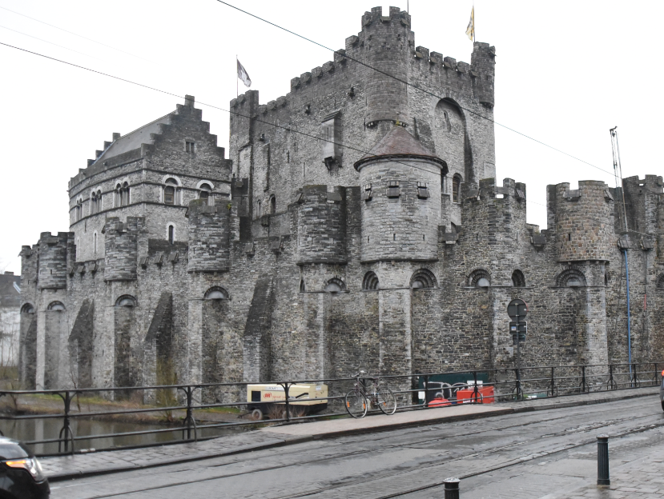
Logistics
Backchannel:
Go to http://www.downes.ca/chat
Select What is Innovation in Education?
--- OR ---
Use Twitter hashtag #ghent2015
Slides: http://www.downes.ca/presentation/359
--- OR ---
Slideshare: http://www.slideshare.net/Downes

Slide 3
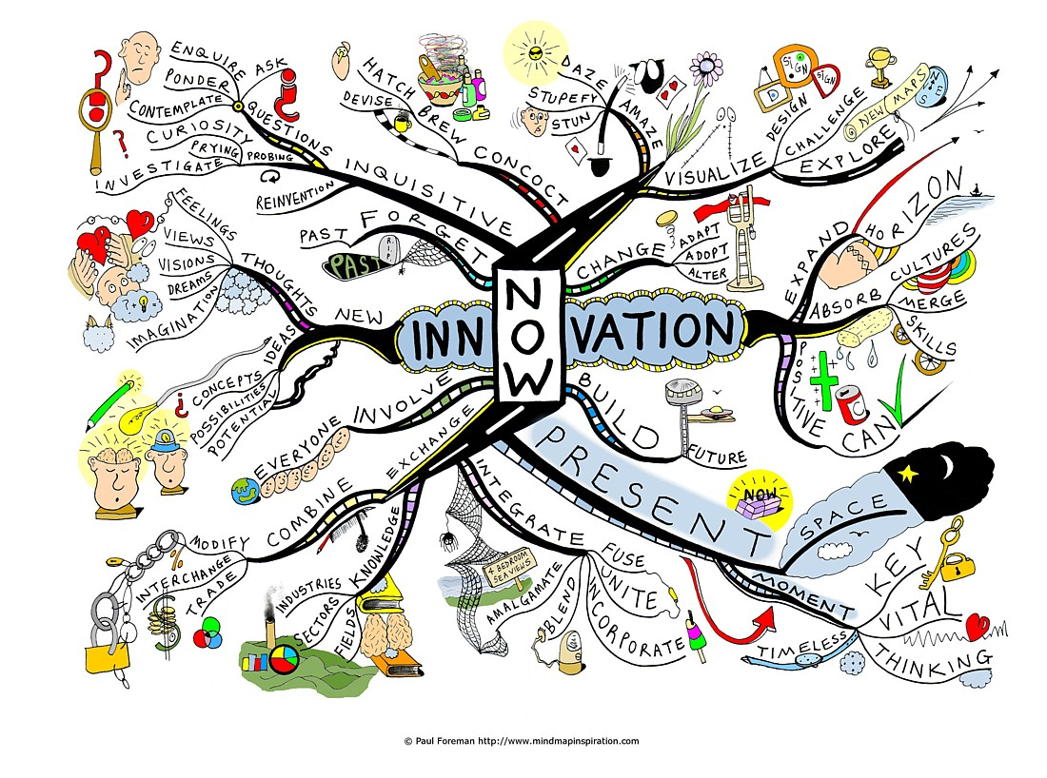
Innovation: Some Intuitions
Inquisitive
Visualize
Expanding
Integrate
New
http://c21u.gatech.edu/programs/hubs

Slide 4
Some Themes…
Connectivism
Open Online Learning
Personal Learning

Slide 5
The Meaning and Nature of Innovation
the action or process of innovating.
a new method, idea, product, etc.
synonyms: | change, alteration, revolution, upheaval, transformation, metamorphosis, breakthrough; new measures, new methods, modernization, novelty, newness; creativity, originality, ingenuity, inspiration, inventiveness;

Slide 6
Innovation: A perspective
The process of translating an idea or invention into a good or service that creates value or for which customers will pay.
To be called an innovation, an idea must be replicable at an economical cost and must satisfy a specific need.
http://www.businessdictionary.com/definition/innovation.html

Slide 7
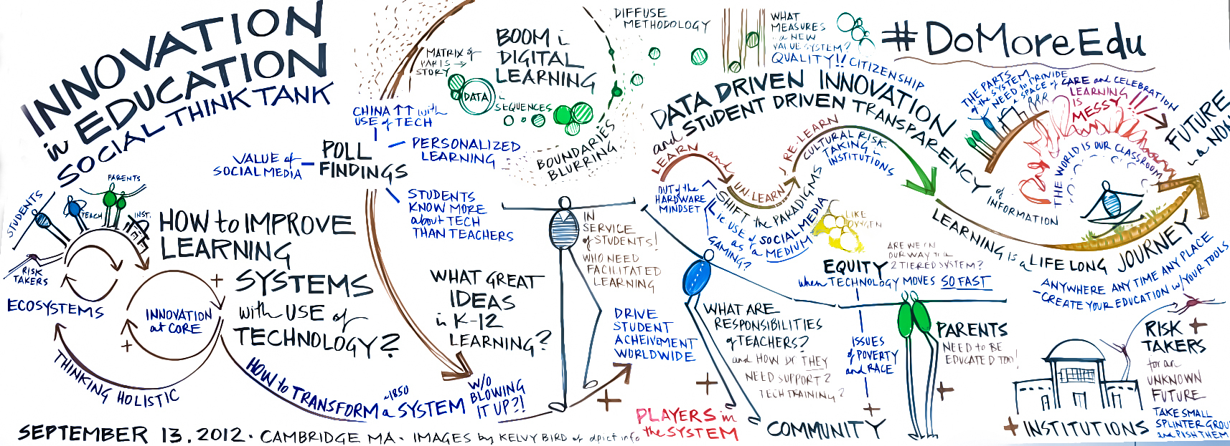
Innovation: Drivers
https://edtechdigest.files.wordpress.com/2012/09/innovation-in-education-social-think-tank-by-kelvy-bird.jpeg

Slide 8
Cause (push) and need (pull)
Cause: price pressures, digital technology, social media, globalization, change https://morethanaminute.com/the-six-drivers-of-innovation-and-change
Cause: talented people, motivating managers, relationships, leaders http://www.gallup.com/businessjournal/26068/four-drivers-innovation.aspx
http://www.newandimproved.com/newsletter/2120.php
Need: growth, sustainability, stability
https://hbr.org/2009/09/why-sustainability-is-now-the-key-driver-of-innovation

Slide 9
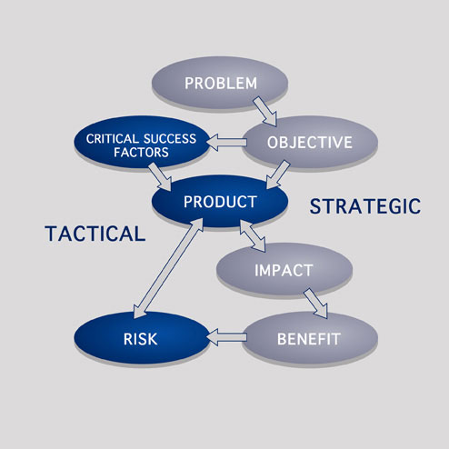
The Benefits Model
Need
Value
Impact
Risk
Benefit

Slide 10
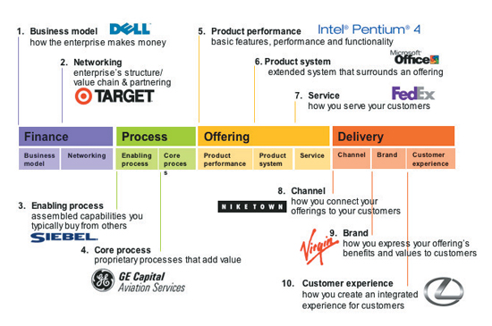
Aspects of Innovation
Finance
Process
Offering
Delivery
Impact
http://education4opportunity.com/national-education-innovation-summit

Slide 11
Innovation in Economy
Charter Schooling
Learning Marketplace
Open Learning
Unschooling / Chaos Pilots

Slide 12
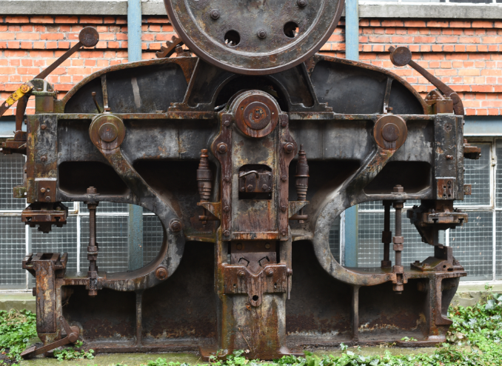
Innovation in Technology
Learning Management Systems
Learning Objects
Adaptive Learning
Learning Analytics

Slide 13
Innovation in Pedagogy
Liberation Pedagogy (Friere)
Deschooling (Illich)
Social Networks in Learning
Online Communities
Unschooling / MOOC

Slide 14
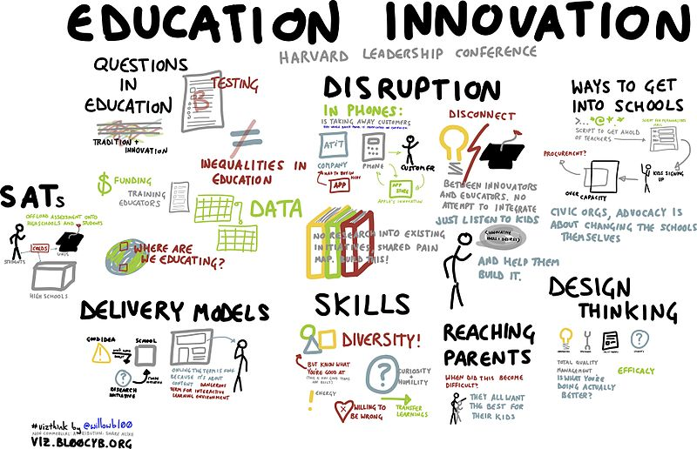
What Constitutes Progress?
Skills
Disruption
Design
Test Scores
Career
http://commons.wikimedia.org/wiki/File:Education_innovation_%2813013589595%29.jpg

Slide 15
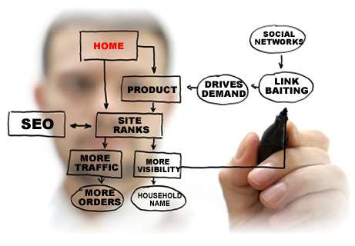
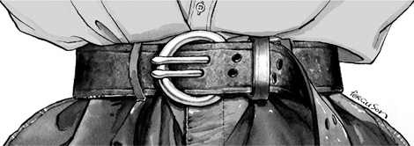
What Constitutes Retrenchment?
Product
Profit
Traffic
Margins
Austerity

Slide 16
The Way Forward (Larry Keeley)
Think big and stand in the future…Focusing too tightly on the status quo will force failures
Prototype a compelling model solution…Not because you will get it right, but instead because it is a shared idea
Co-construct, co-construct, co-construct…All of us are smarter than any of us; don’t be exclusionary

Slide 17
Avoid central control…It doesn’t work, it is woefully out of date, modern systems don’t need it
Start with what you have now…You will not ever have perfect conditions, so be adaptive and modular
Foster integrated platforms, not products…not just what we do, but how we do it, so that many independent participants can participate in the solution
http://education4opportunity.com/national-education-innovation-summit

Slide 18
Stephen Downes http://www.downes.ca

