Slide 1
LPSS Learning and Performance Support System Information & Communications Technologies (ICT) Portfolio
Stephen Downes
LPSS Program Leader
April 28, 2015
Stephen.Downes@nrc-cnrc.gc.ca

Slide 2
Performance Support
http://www.cognitiveadvisors.com/resources/mobile-performance-support-design-principles

Slide 3
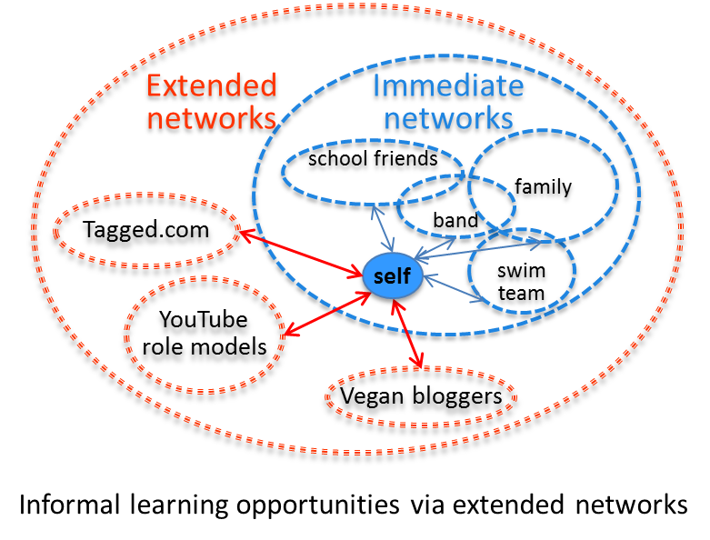
Learning in Context
Task-Focused
Network-based

Slide 4
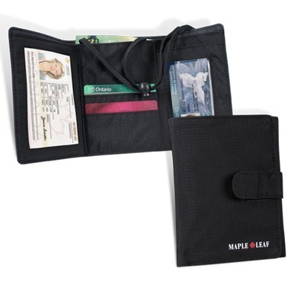
The Solution: Personal Learning and Performance Support
Single point of access to all skills development and training needs
Individual learning path
Context-aware support
Searchable and verifiable
Tailored to industry needs
Always available
Point of need performance support
Notes:
Emphasize that it’s personal and you carry it with you
Note that it’s a network – we don’t put everything in one package, but develop an infrastructure that links relevant resources
Different types of things, not just courses:
Access to learning resources
Calling cards and communication tools
Credentials, permits and licenses

Slide 5
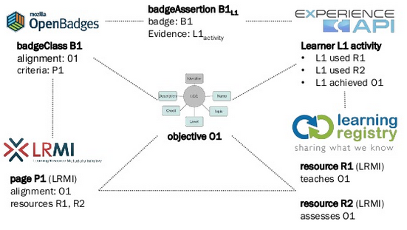
Personal Assistant for Learning
http://www.adlnet.org/adl-initiative-baa-new-submission-window-open-for-personal-assistant-for-learning-pal-proposals-2/index.html
http://www.slideshare.net/damonregan/regan-tla-infrastructureforfutureoflearningsintice2013

Slide 6
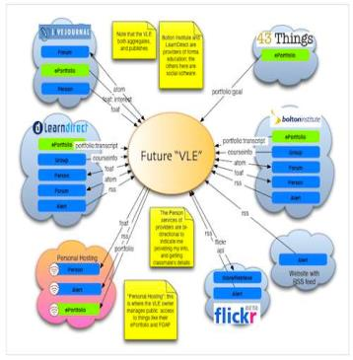
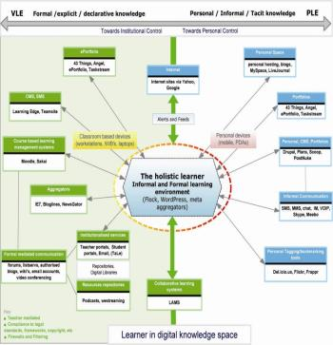
The design is based on putting the learner at the centre
Scott Wilson (left), Tim Hand (right)
https://www.google.com/search?q=ple+diagrams
http://www.edtechpost.ca/ple_diagrams/index.php/mind-map-3

Slide 7
Learning and Performance Support System: Core Technology Development Projects
Resource Network
Learning Assistant
Learning services network and marketplace
Automated skills development and recognition
Lifetime management of learning and training records and credentials
Personal learning assistant to view, update and access training
Personal Learning Records
Automate Skills Dev.
Learning as a cloud service and deep integration with external systems
Notes:
the solution would consist of the main components as shown on the slide
Resource Repository Network – will create a resource graph from multiple sources and multiple formats including live and dynamic data such as oilfield data, refinery instrumentation, or Oil and Gas market information.
Automated Competence Development And Recognition – whereas existing recommender systems depend on manually defined metrics, this system will detect new and emerging competences and automatically assess employee performance.
Personal Learning Record - this project will define how we represent, capture, and leverage user activity, including ratings, test results, performance measures, and the like, in a distributed learning and work environment.
Personal Learning Assistant – this project will develop an integrated learning appliance, a mechanism for looking up or finding references or resources inside other programs or environments.
Learning as a Cloud Service - will create a distributed learning layer, which is mechanism for working with data no matter where it is stored, through desktop, mobile and other devices.

Slide 8
Project Details
Data, Information Retrieval
Management Layer
Cleansing/Filtering/Profiling/Processing
Search/Recommendation Layer
Data Representation
Learning activity sequencing/modeling
Prototype Repository
RRN
CF
PLA
Standards/Communication protocols
PLR
Data Capture
Security Protocols
Security Protocols
Distributed Architecture
Personal Learning Record
PC
ACDR
Data synchronization
Personal Access to Network Storage
TROI (Training Return on Investment) analytics
Cloud Storage and Management
Performance Trends Algorithm
Competence Development
Automated Assessment

Slide 9
RRN Aggregation and Storage
Personal
Context
Article
Photograph
Video
Person
Author
Publisher
Organization
Job Opportunity
Competency
Cetrificate
Event
Location / Place
Time / Date
Email
RSS
OAI
Sharepoint
Facebook
Twitter
Monster
Government
Repositories
Desire2Learn
Coursera
EdX
etc
Parsing
Scraping
Analytics
etc
Storage
RELATIONS

Slide 10
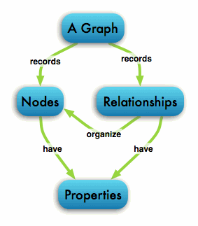
The Graph Database
http://neo4j.com/developer/graph-database/

Slide 11
Personal Learning Record
OERs
Portfolio, artifacts and evidence
Badges, certificates, credentials, competencies
Activity Record - LRS
PLR

Slide 12
Why is this Difficult?
It’s not one big thing…
… but a set of many small things
Tasks that are simple in an enterprise system…
Like data storage
Like content distribution
Like authentication
Like analytics
… become that much more difficult

Slide 13
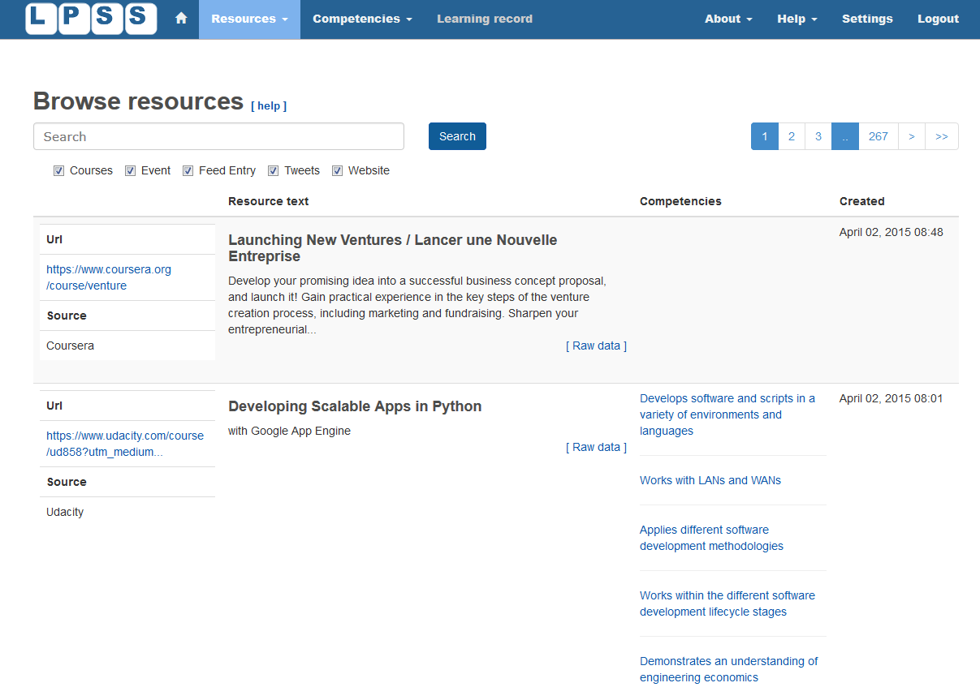
Website – LPSS.me

Slide 14
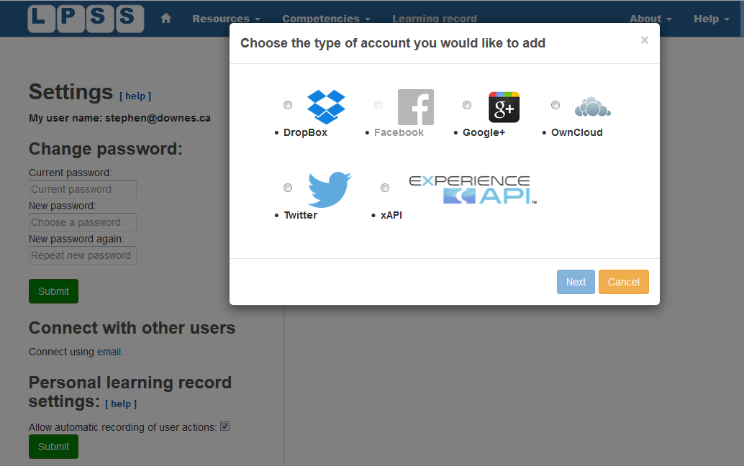
External Services

Slide 15
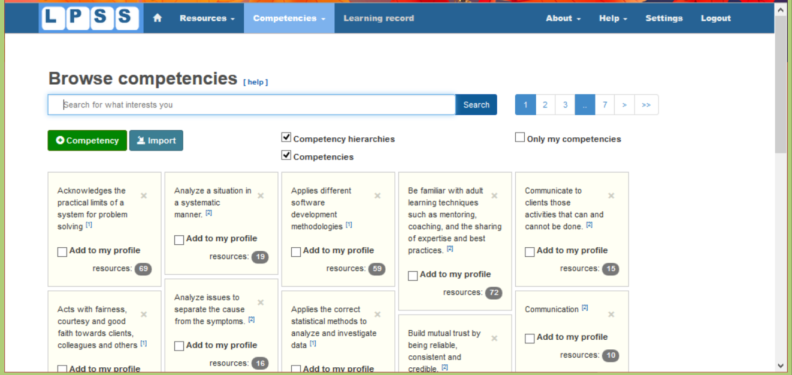
Competencies

Slide 16
LPSS: Some Case Studies

Slide 17
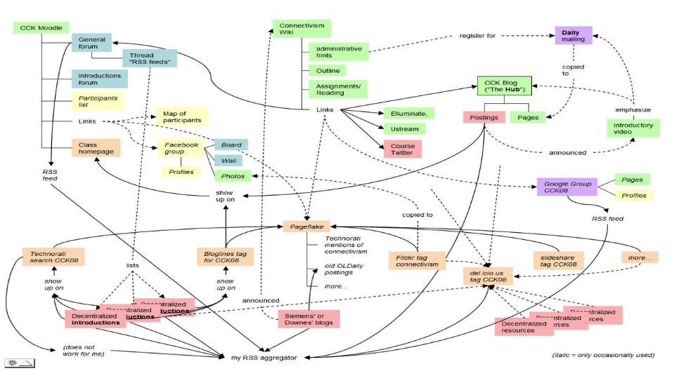
MOOC – CCK08
https://sites.google.com/site/themoocguide/3-cck08---the-distributed-course

Slide 18
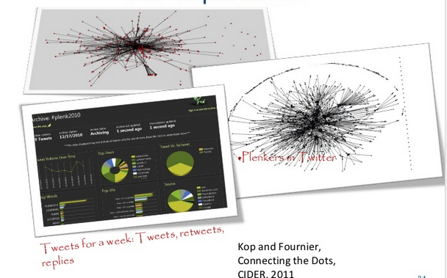
Plearn – Importance of the Graph
http://www.slideshare.net/Downes/after-moodle
http://www.slideshare.net/Ritakop/kopfourniercanadianinstitutedistanceeducationresearchple

Slide 19
OIF – MOOC-REL
http://rel2014.mooc.ca/

Slide 20
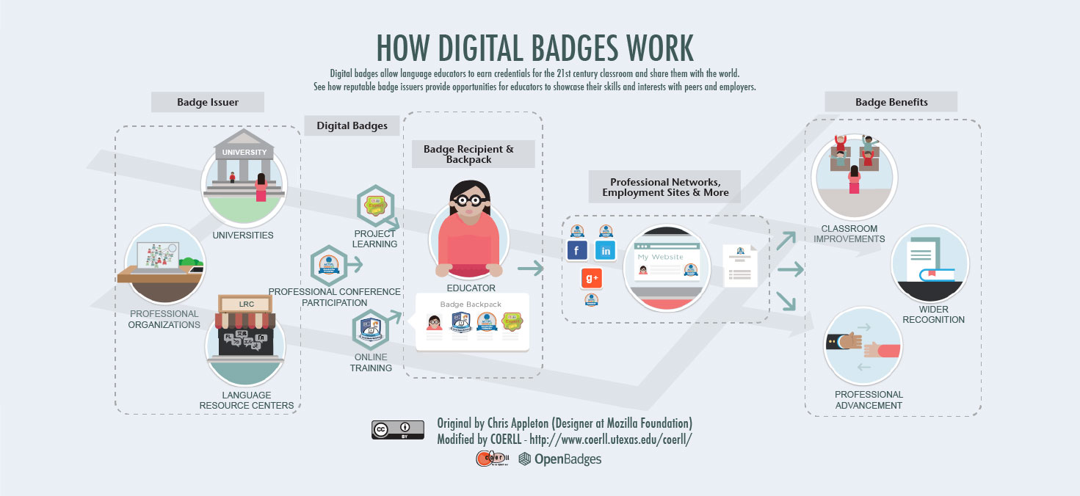
PCO Badges for Learning
http://www.downes.ca/post/63738

Slide 21
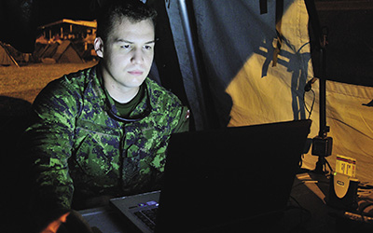
ONGARDE
http://www.journal.forces.gc.ca/vol14/no2/page70-eng.asp

Slide 22
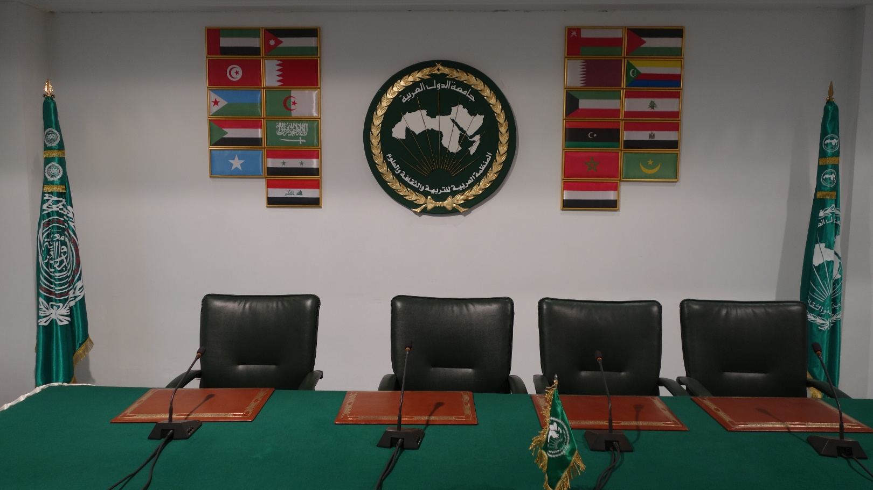
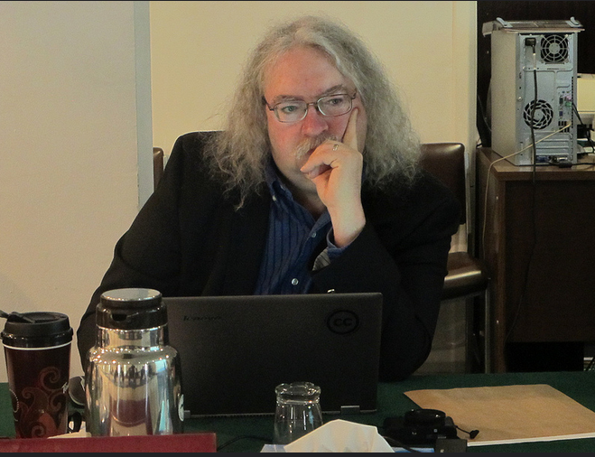
ALECSO – Capacity Building
http://www.downes.ca/presentation/337

Slide 23
MINT - Mobile INteractive Trainer
http://www.downes.ca/post/59876

Slide 24
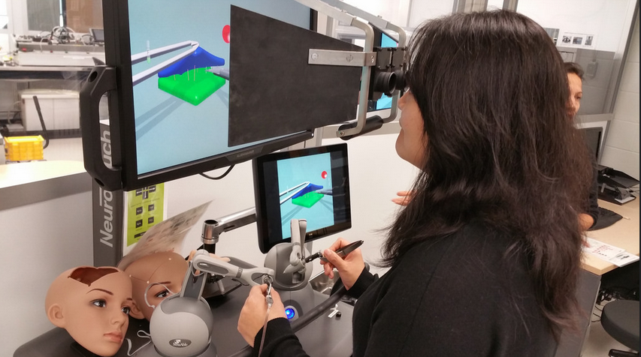
Collecting xAPI from Med Sims
https://www.flickr.com/photos/stephen_downes/15710336207/
http://www.nrc-cnrc.gc.ca/eng/rd/medical/

Slide 25
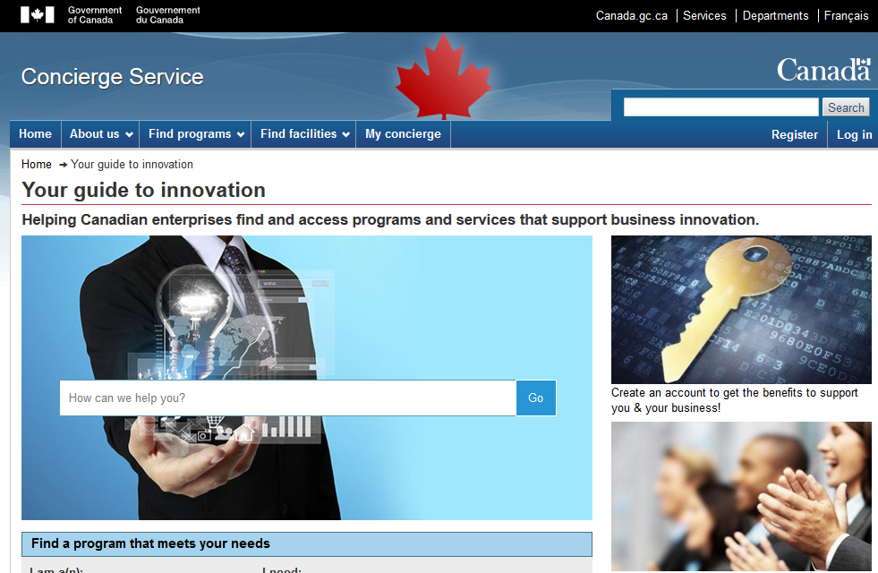
Concierge OMS
https://concierge.portal.gc.ca/

Slide 26
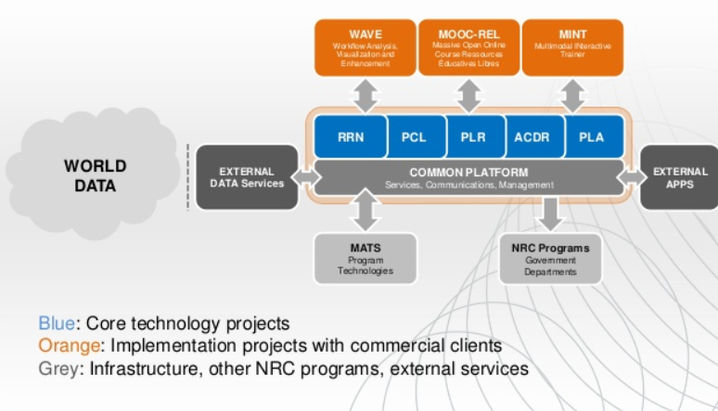
How to Engage
http://www.nrc-cnrc.gc.ca/eng/solutions/collaborative/lpss.html

Slide 27
Stephen Downes
LPSS program Leader
+1 (506) 861-0955
Stephen.Downes@nrc-cnrc.gc.ca
http://www.nrc-cnrc.gc.ca

