Slide 1
MOOCS and Social Learning Networks
Stephen Downes
Santiago de Compostela, Spain
July 21, 2015

Slide 2
In recent years the concept of the Massive Open Online Course (MOOC) has been reinterpreted to mean an open course with online videos, activities and tests. But the original formulation of MOOCs assigned a very important role to social learning networks. In this talk, one of the originators of the concept, Stephen Downes, discusses the role of social learning networks in open online learning. In his talk he will describe how social learning networks are used to identify and curate relevant resources supporting the course, which replaces a reliance on centrally produced and hosted videos. He also discusses the need to interactivity and discussion among course participants in order to support the localization of core concepts, the sharing of ideas and perspectives, and the use of the course as a platform to create new ideas and resources. Finally he discusses the role of the MOOC as central to practice in a discipline, and the importance of including practitioners as experts and resources who share their own experiences and lessons with participants.

Slide 3
Why Offer a MOOC?
Extending the reach of the institution and access to education
Building and maintaining brand
Improving economics by lowering costs or increasing revenues
Improving educational outcomes for both MOOC participants and on-campus students
Innovation in teaching and learning
Conducting research on teaching and learning.
MOOCS: Expectations and Reality
Devayani Tirthali, Fiona M. Hollands, Teachers College Columbia University
http://cbcse.org/wordpress/wp-content/uploads/2014/05/MOOCs_Expectations_and_Reality.pdf

Slide 4
The ‘Open’ in Open Learning
In the beginning… Open Archives
“If governments ignored publisher lobbying and did the arithmetic properly, they would immediately see that the interests of publicly funded research vastly eclipse those of the research publishing industry.” – Stevan Harnad
The Subversive Proposal at 20. Richard Poynder, Open and Shut?
http://poynder.blogspot.ca/2014/06/the-subversive-proposal-at-20.html
Budapest Open Access Initiative, 2001
http://www.budapestopenaccessinitiative.org/background

Slide 5
The Open Virus
Martin Weller:
“It is no coincidence that many of the MOOC pioneers had also been early adopters of open access, active bloggers, and advocates of open licenses. Creating open courses seemed the next logical step, because they were interested in the possibilities that openness offered and had seen the benefits elsewhere in their practice.”
The Open Virus, Martin Weller, The Ed Techie
http://nogoodreason.typepad.co.uk/no_good_reason/2014/05/the-open-virus.html

Slide 6
The Open Research Network
Beginnings of a proposal:
“Many regions around the world are investing in the development of repository networks. These networks have evolved in their specific local contexts and currently differ in a number of ways. However, the real value of repositories is when they are interconnected to provide unified access to research materials for researchers around the world.”
Aligning Repository Networks Meeting 2014, Confederation of Open Access Repositories (COAR)
https://www.coar-repositories.org/files/Aligning-Repository-Networks-Meeting-Report.pdf

Slide 7
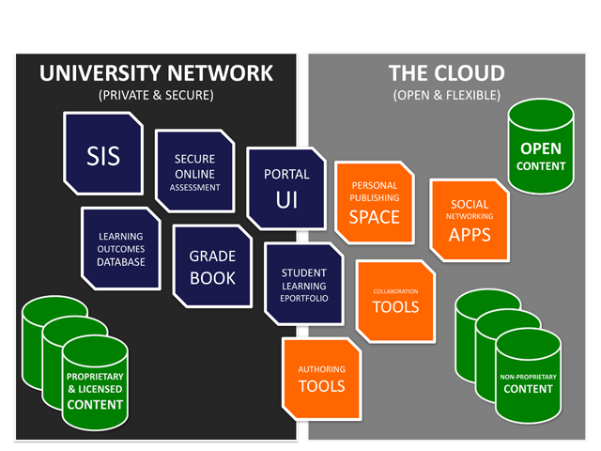
The Open Learning Network
Bridging the LMS and the PLE:
“The OLN is built on web services from the ground up. This facilitates authentication federation and data portability. It also allows for granular authentication and rights management within and across OLN modules.”
Jon Mott. Envisioning the Post-LMS Era: The Open Learning Network, Educause Review. http://www.educause.edu/ero/article/envisioning-post-lms-era-open-learning-network

Slide 8
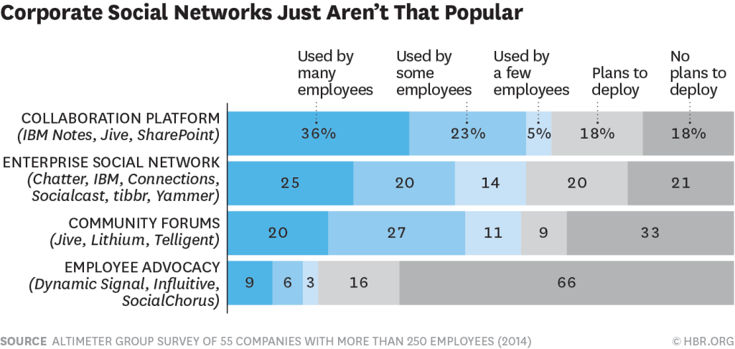
Social Networks
Why nobody is using the corporate social network
“Employees are smart—they won’t waste their time on stunts that are purely for show. Think about the types of engagements you want to have in digital channels—with whom, about what, and when.”
Charlene Li, Harvard Business Review
https://hbr.org/2015/04/why-no-one-uses-the-corporate-social-network

Slide 9
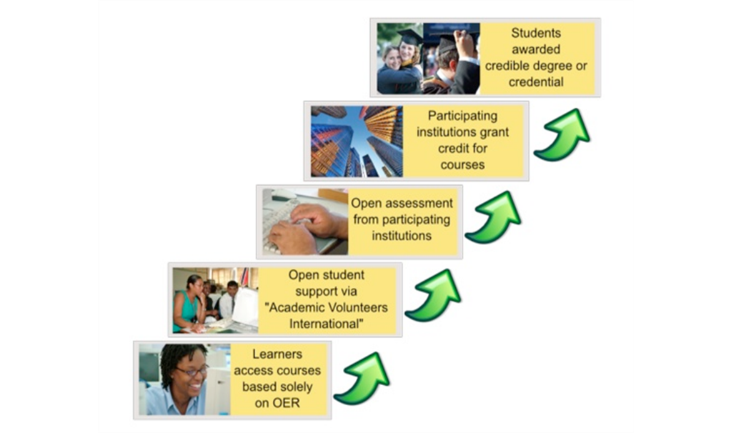
The Many Names of Open
Taylor, J.C. 2007. Open courseware futures: Creating a parallel universe. e-Journal of Instructional Science and Technology (e-JIST), Vol 10, No. 1. Online: http://www.ascilite.org.au/ajet/e-jist/docs/vol10_no1/papers/full_papers/taylorj.htm

Slide 10
Open Access
Originated in Open University, Athabasca University
No formal requirements for course admission
Issues: preparedness, completion
http://www.athabascau.ca/

Slide 11
Open Access Network
Wikipedia:
“…the business model that separates the physical access to the network from the delivery of services. In an OAN, the owner or manager of the network does not supply services for the network; these services must be supplied by separate retail service providers.”
https://en.wikipedia.org/wiki/Open-access_network

Slide 12
Open Access Social Network
They Loved Your G.P.A. Then They Saw Your Tweets
“Students’ social media and digital footprint can sometimes play a role in the admissions process,” says Christine Brown, the executive director of K-12 and college prep programs at Kaplan Test Prep. “It’s something that is becoming more ubiquitous and less looked down upon.”
Natasha Singer, New York Times
http://www.nytimes.com/2013/11/10/business/they-loved-your-gpa-then-they-saw-your-tweets.html

Slide 13
Open Source
Open Source Definition
“Open source software is software that can be freely used, changed, and shared (in modified or unmodified form) by anyone. Open source software is made by many people, and distributed under licenses that comply with the Open Source Definition.”
http://opensource.org/

Slide 14
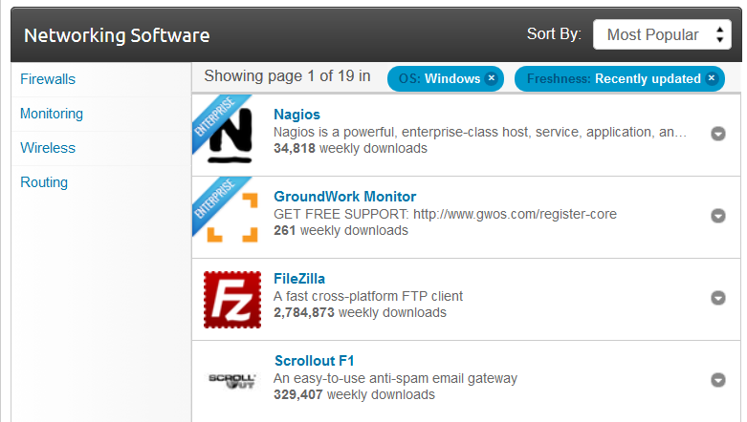
Open Source Network
SourceForge http://sourceforge.net/directory/system-administration/networking/os:windows/freshness:recently-updated/
GitHub https://github.com/opensource-socialnetwork/opensource-socialnetwork

Slide 15
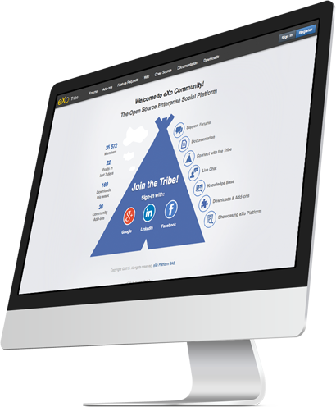
Open Source Social Network
eXo and Slack
“eXo Platform is an out-of-the-box social intranet solution. Rich collaboration features such as wikis, forums, calendars and documents are smartly integrated around activity streams, social networking and workspaces.” http://www.exoplatform.com/

Slide 16
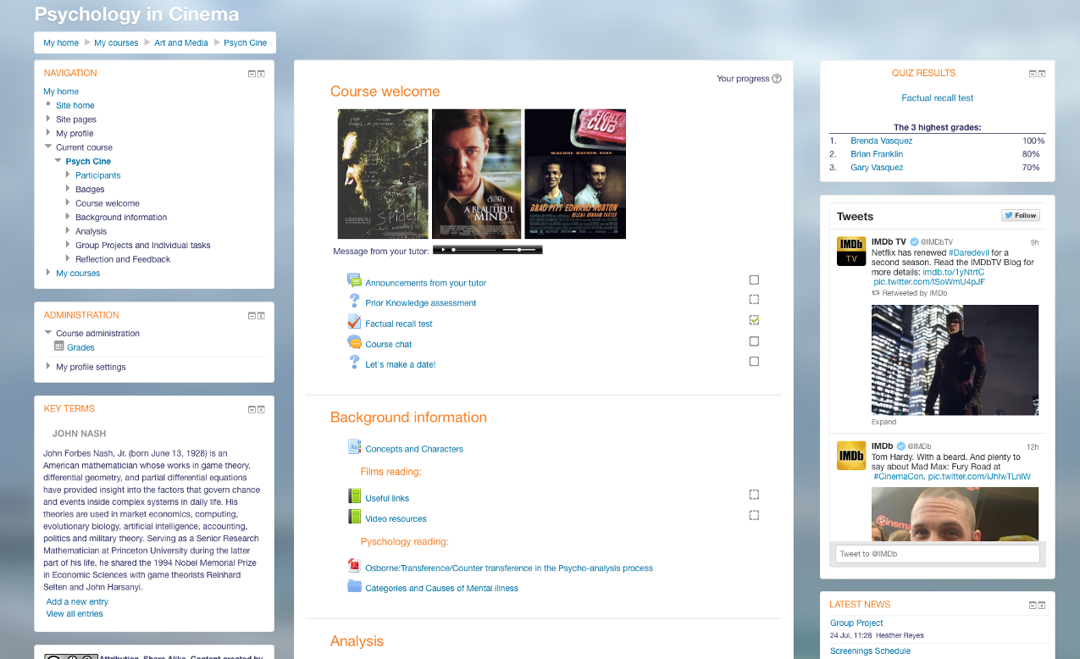
Is Slack the new LMS?
“Learning is constructed by what activities the students carry out; learning is about what they do, not about what we teachers do.”
Elgg - https://elgg.org/
Mathias Emrose, Medium | The Synapse https://medium.com/synapse/is-slack-the-new-lms-7d1c15ff964f

Slide 17
Open Content
Originally thought of as similar to open source
Creative Commons licenses – by, nc, sa, nd clauses
Open access versus open use

Slide 18
Open Content Network
SAP Community Network
“In the b1411 release, SuccessFactors introduced the Open Content Network for the SuccessFactors Learning product. This extension of the LMS allows for integration with a few select MOOC providers to incorporate a vendor’s courses into the organization’s LMS. This can allow organizations to present online learning courses from MOOC providers to employees within the LMS directly.”
EMMA – European MOOC Aggregator - http://platform.europeanmoocs.eu/
http://scn.sap.com/community/erp/hcm/blog/2015/03/05/craving-more-content-take-a-bite-out-of-the-open-content-network-in-successfactors-learning

Slide 19
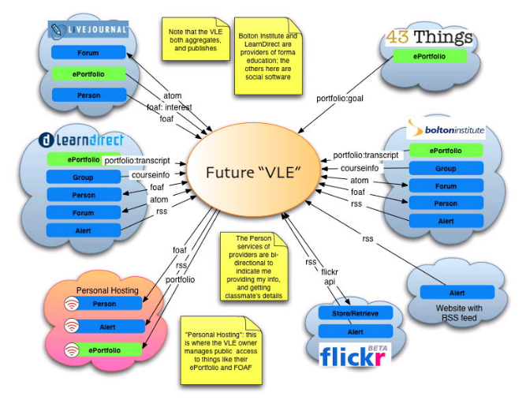
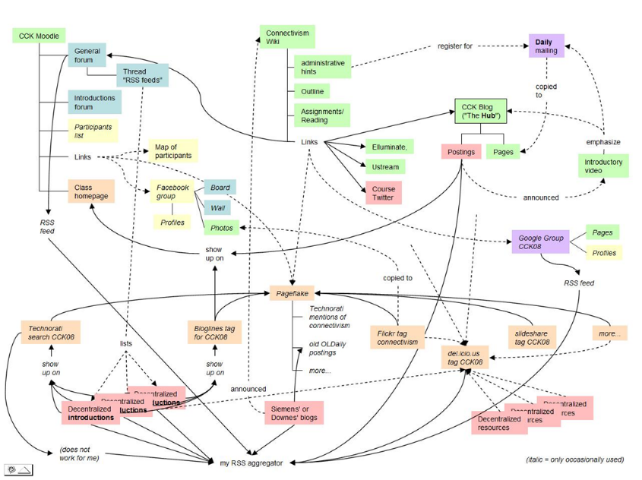
Open Content Social Network
Known
https://withknown.com/

Slide 20
Open Educational Resources
UNESCO Definition
“Open Educational Resources (OERs) are any type of educational materials that are in the public domain or introduced with an open license. The nature of these open materials means that anyone can legally and freely copy, use, adapt and re-share them.”
http://www.unesco.org/new/en/communication-and-information/access-to-knowledge/open-educational-resources/what-are-open-educational-resources-oers/

Slide 21
OER Network
Support for community-based OER process
integration of OER development and use within publicly supported curricula
use of OERs in public services and programs
OER Commons https://www.oercommons.org/
EdWeb - http://home.edweb.net/
Utopia
Reading and networking will become one and the same thing
“for instance, when a document in Utopia is opened, "a sidebar opens up on the right-hand side and fills with relevant data from external databases and services like Mendeley, SHERPA/RoMEO, and Wikipedia.” http://utopiadocs.com

Slide 22
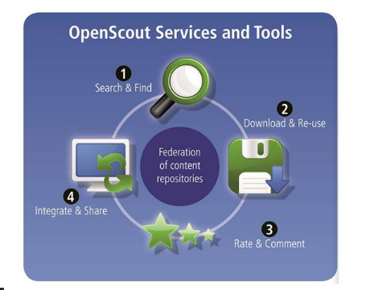
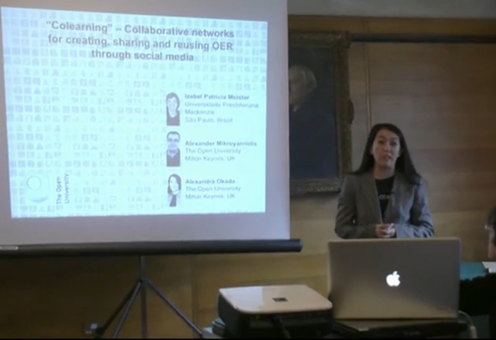
OER Social Network
"Colearning" - Collaborative networks for creating, sharing and reusing OER through social media… OpenScout
Alexandra Okada, http://presentations.ocwconsortium.org/uk2012_224_okada_collaborative_networks/

Slide 23
Open Instruction
“Open Instruction – here we refer to the ‘lecture’ portion of open learning, or rather, the internet analogue of the original lecture described at the top of this post, a series or sequence of activities undertaken by experts…” http://p2pfoundation.net/Open_Instruction
Early open instruction – the Couros course, the Wiley Wiki
MOOCs as open instruction
Elements of open instruction:
Resources
Lectures
Activities and projects

Slide 24
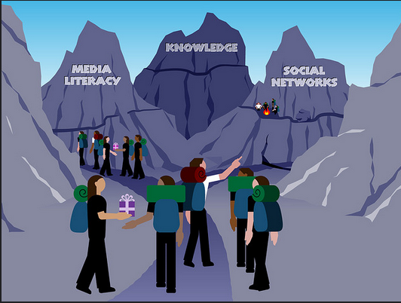
Open Instruction Network
Open Teaching
“The Downes-Siemens course has become a landmark in the small but growing push toward ‘open teaching.’”
Marc Parry, Chronicle of Higher Education
http://chronicle.com/article/Open-Teaching-When-the/124170/
Alec Couros - Open Teaching - Network Sherpa
The concept of "network sherpa" projects the role of teacher as one who knows "the terrain", guides students, but who is also led by student interests, objectives, and knowledge.
https://www.flickr.com/photos/courosa/3293199214/in/photostream/

Slide 25
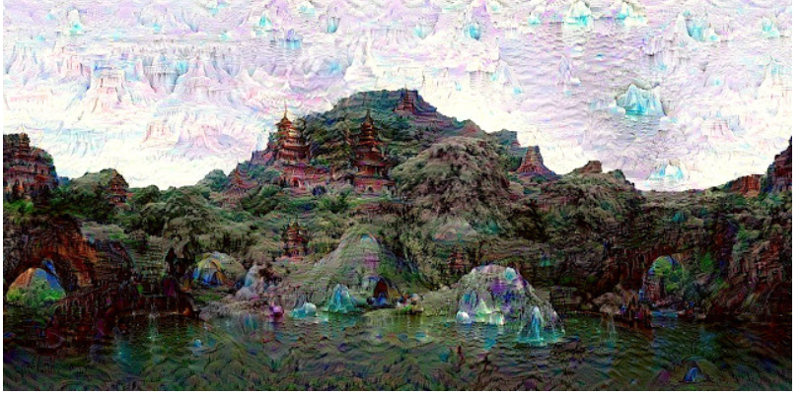
Sidebar…
What I found when searching for “Open Instruction Network”:
DeepDream - DeepDream - a code example for visualizing Neural Networks
http://googleresearch.blogspot.com.es/2015/07/deepdream-code-example-for-visualizing.html

Slide 26
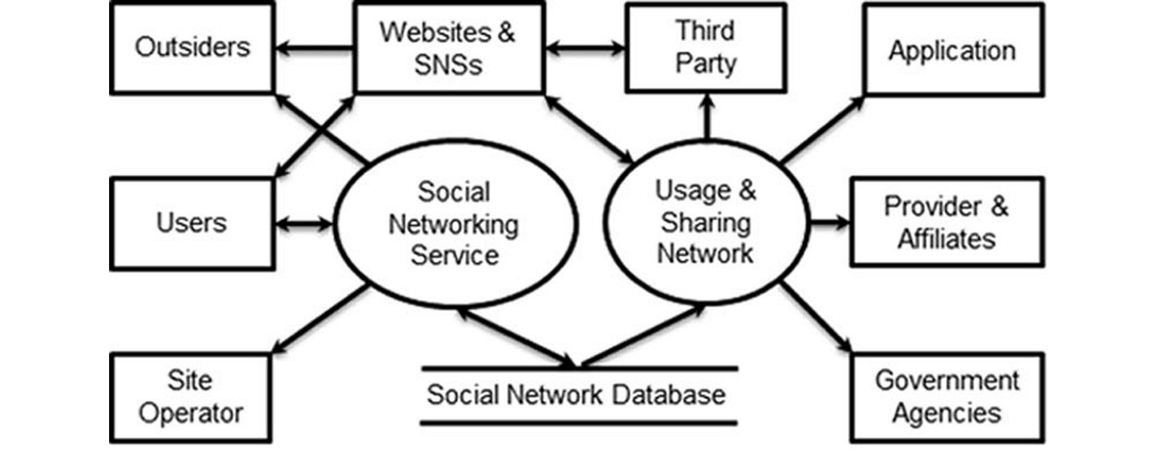
Open Instruction Social Network?
Examples are hard to come by
See, though, this example in health services
Jingquan Li, A Privacy Preservation Model for Health-Related Social Networking Sites
http://www.jmir.org/2015/7/e168/

Slide 27
Open Design
‘Learning Design’ = the organization and structure of a course – eg., IMS LD
Open design – enabling participants to create their own organization and structure
Example: touring a city vs being taken on a tour
The course as ‘environment’ rather than ‘book’
Open design in MOOCs
Learning Design: A Handbook on Modelling and Delivering Networked Education, By Rob Koper, Colin Tattersall (2005!)
http://jime.open.ac.uk/article/download/2005-18/262/

Slide 28
Open Educational Practices
...the Open Educational Practices movement, developed by Germany's Ulf-Daniel Ehlers and the UK's Gráinne Conole...
Also: Open Educational Practices and Resources
“It is important to note that current educational practices are decisive in determining whether – and how – digital educational content, tools and services will be deployed and utilised. If the prevailing practice of teacher-centred knowledge transfer remains intact, then OER will have little effect on making a difference in teaching and learning.”
http://www.olcos.org/cms/upload/docs/olcos_roadmap.pdf

Slide 29
Open Learning Design Network
Gráinne Conole - Cloudworks: Social networking for learning design
“Traditionally design has been an implicit process, how do we shift to a process of design that is more explicit and hence shareable? Different representations of design have different values and purposes, which representations are appropriate and when?”
Engeström (2005) – “The term 'social networking' makes little sense if we leave out the objects that mediate the ties between people… The fallacy is to think that social networks are just made up of people. They're not; social networks consist of people who are connected by a shared object.”
http://www.ascilite.org.au/conferences/melbourne08/procs/conole.pdf

Slide 30
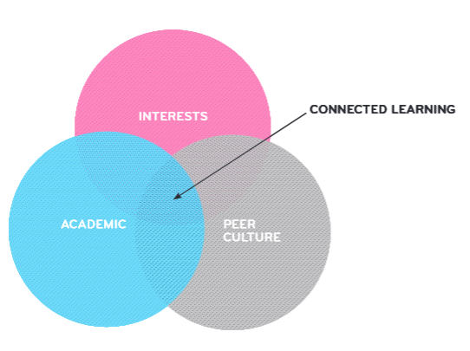
Open Learning Design Social Network
Connected Learning Research Network
“This model is based on evidence that the most resilient, adaptive, and effective learning involves individual interest as well as social support to overcome adversity and provide recognition.”
http://clrn.dmlhub.net/
http://dmlhub.net/wp-content/uploads/files/Connected_Learning_report.pdf
“Connected learning centers on an equity agenda of deploying new media to reach and enable youth who otherwise lack access to opportunity.”

Slide 31
Open Credentials
The argument for closed credentials
Badges?
‘You are what you do’
Privacy and security considerations

Slide 32
Open Credentials Network
Open Badges
“Collect badges from multiple sources, online and off, into a single backpack. Then display your skills and achievements on social networking profiles, job sites, websites and more.”
“Open Badges are information-rich. Each badge has important data built in that links back to the issuer, criteria and verifying evidence.”
http://openbadges.org/

Slide 33
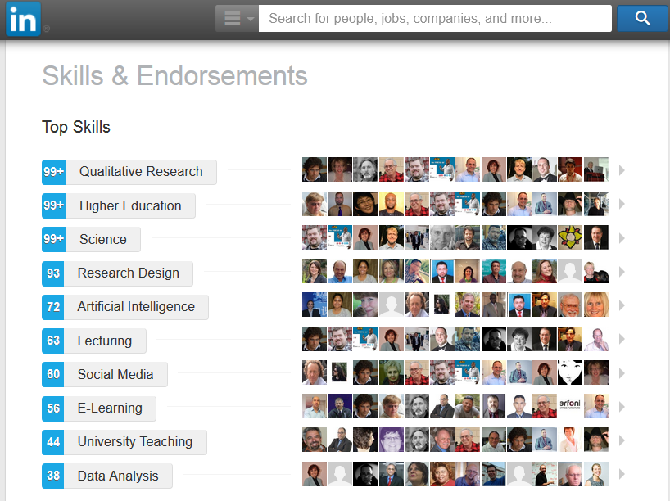
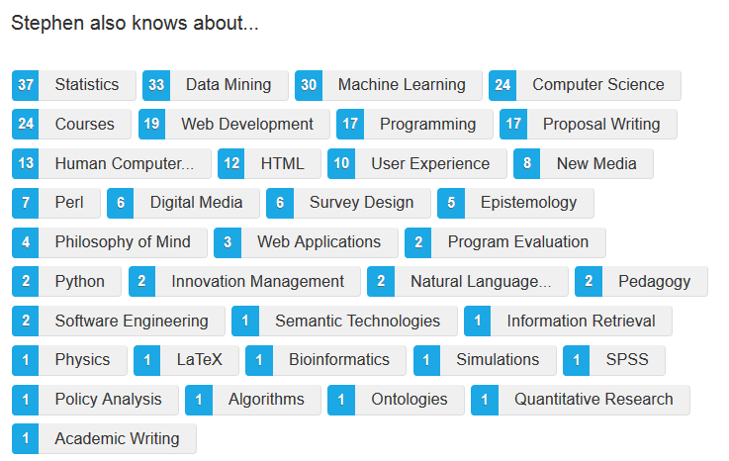
Open Credentials Social Network?

Slide 34
Open Assessment?
What is assessment? - Assessment Design Principles
“Many projects are enhancing the validity of their badges by having some expert other judge work before badges are awarded. This expert other could be a computer or a human. The projects feel that expert judgment gives the badge more weight.”
Learning Outcomes Assessment Communities
“groups, that usually meet in person, that you can join and network about learning outcomes and assessments…”
http://iudpd.indiana.edu/Assessment+Design+Principles#
http://www.learningoutcomeassessment.org/LOAcommunities.htm

Slide 35
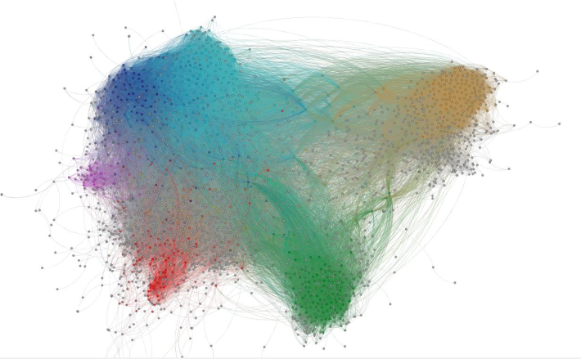
Open Assessment Networks?
The paucity of ‘learning contracts’
Assessment - criteria and metrics
Content based – formal learning
Task based – informal learning
“You decide what counts as success”

Slide 36
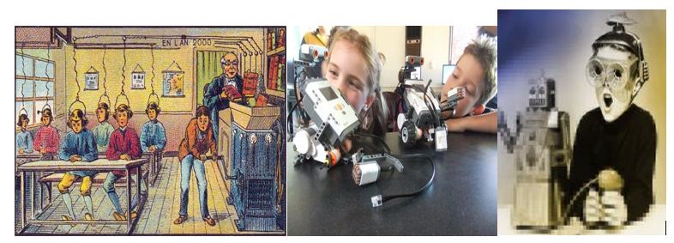
Open Assessments Social Network?
Will what we do in social networks become the ‘assessment’ of the 21st century?

Slide 37
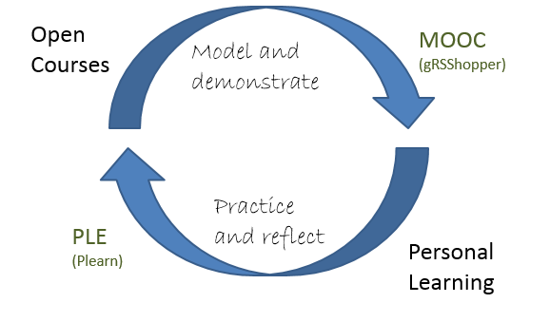

Slide 38
Stephen Downes
http://www.downes.ca

