Slide 1
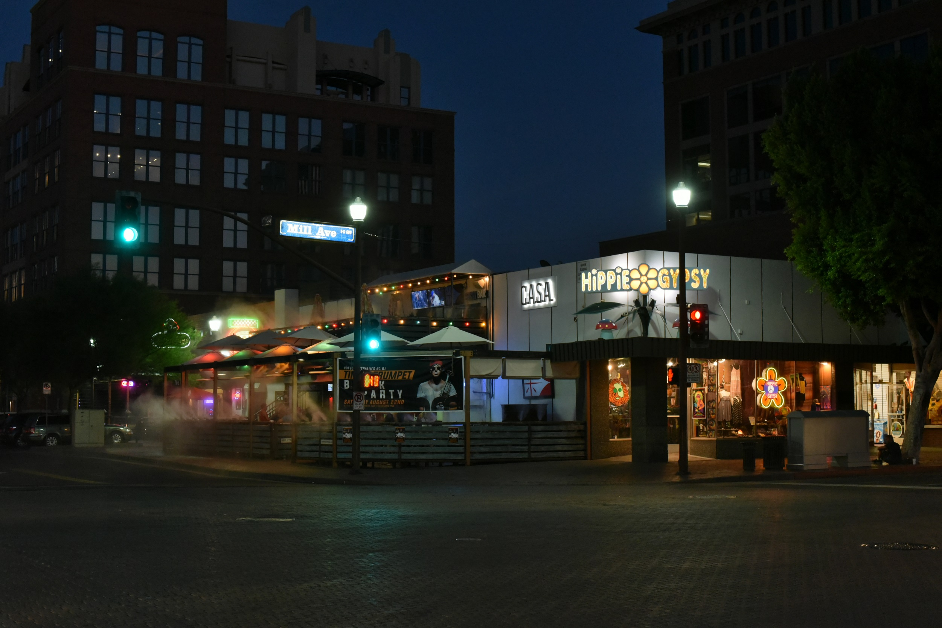
Open Education and Personal Learning http://www.downes.ca/presentation/362
Stephen Downes
Tempe, Arizona, August 20, 2015

Slide 2
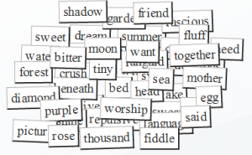
Think of OERs as words in a conversation
Notes:
I want you to think of open educational resources not as texts and lessons and such, but as words in a conversation.

Slide 3
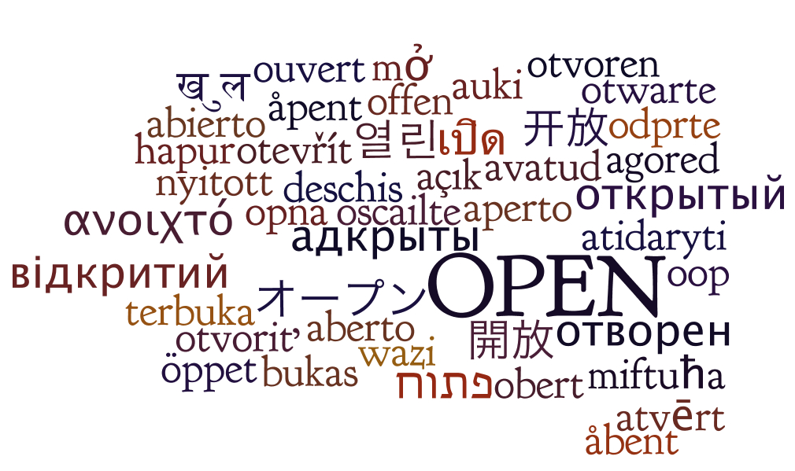
It forces us to think about how they can be used.
http://oerworkshop.pbworks.com/w/page/33932297/OER%20Workshop
Notes:
Why do I ask you to think of them this way? In part, it’s because I think that’s how they’re used. But more importantly, it forces us to think about how they can be used.

Slide 4
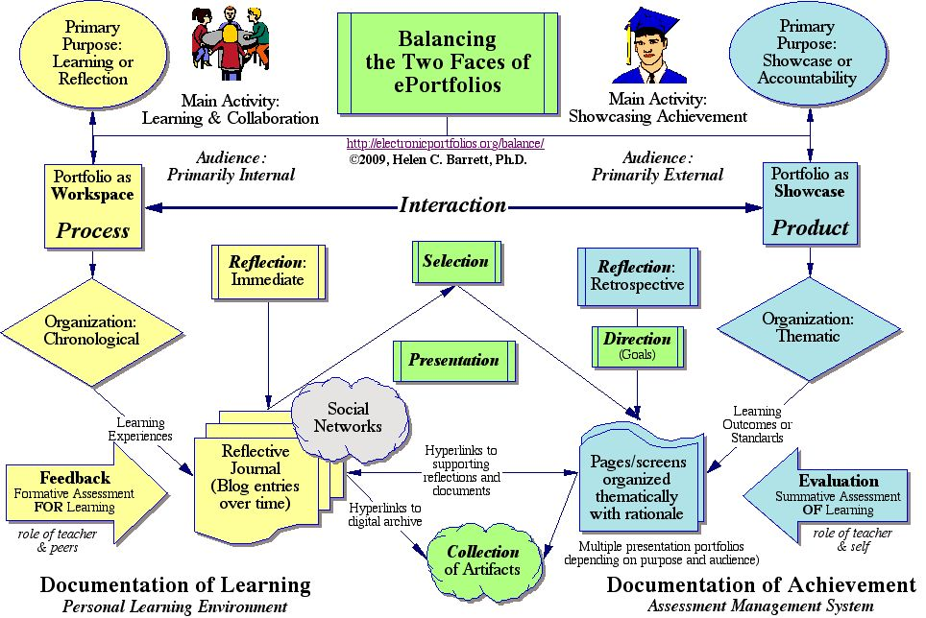
Consider how words are used in education.
http://electronicportfolios.org/balance/index.html
Notes:
Consider how words (the traditional kind, made up of letters and arranged in sentences) are used in education. A lecture, for example, is composed on words, a 10,000 word presentation in 55 minutes. They are defined, used to describe phenomena, to explain causes, to argue to conclusions. They are the tools of teaching.

Slide 5
We are constrained in so many ways
Limited to objectives and educational purpose
The words have to contain educational content
They must perform (say) one of Gagne’s tasks
That pedagogy is limited to one of knowledge transfer
Students are rendered essentially mute
http://citt.ufl.edu/tools/gagnes-9-events-of-instruction/
Notes:
If we think of these words as educational resources, then what we can do with them is sharply limited. We are constrained in so many ways:
The words have to follow from, and feed into, learning objectives and educational purpose
The words have to contain educational content, namely, facts, theories and principles that students are expected to learn
The words have to be organized to pedagogical purpose, that is, performing (say) one of Gagne’s tasks of gaining attention, providing feedback, assessing performance, etc.
That pedagogy is limited to one of knowledge transfer from authority to non-authority
Students, with the exception of responding to purpose, are rendered essentially mute
http://citt.ufl.edu/tools/gagnes-9-events-of-instruction/

Slide 6
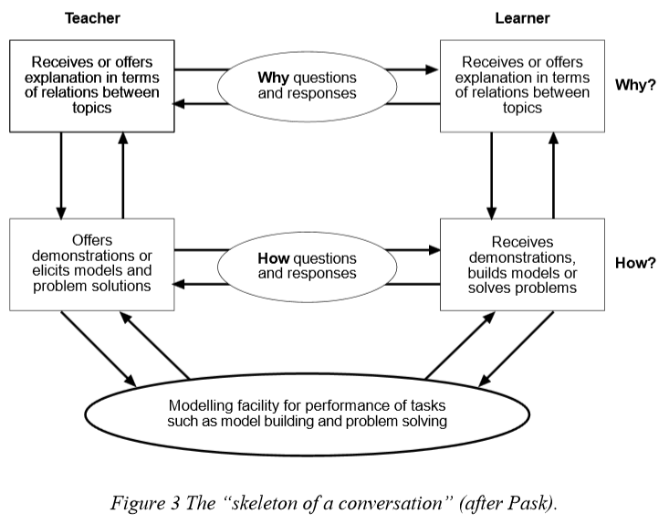
Pask: Conversational Theory
https://www.univie.ac.at/constructivism/pub/fos/pdf/scott.pdf
Notes:
That was the actual state of affairs in the classroom until recent decades. But through advances such as active learning, problem based learning, constructivism, and other new educational approaches, words in the classroom have been liberated.
Examples could be multiplied almost without end, but a typical case may be made using Gordon Pask’s conversational theory (CT) of learning. Using interrogation, the students can ask how a process takes place, request an explanation of why a process takes place, and inquire about the how and why of the topic itself, in the wider context of subject and the class.
https://www.univie.ac.at/constructivism/pub/fos/pdf/scott.pdf

Slide 7
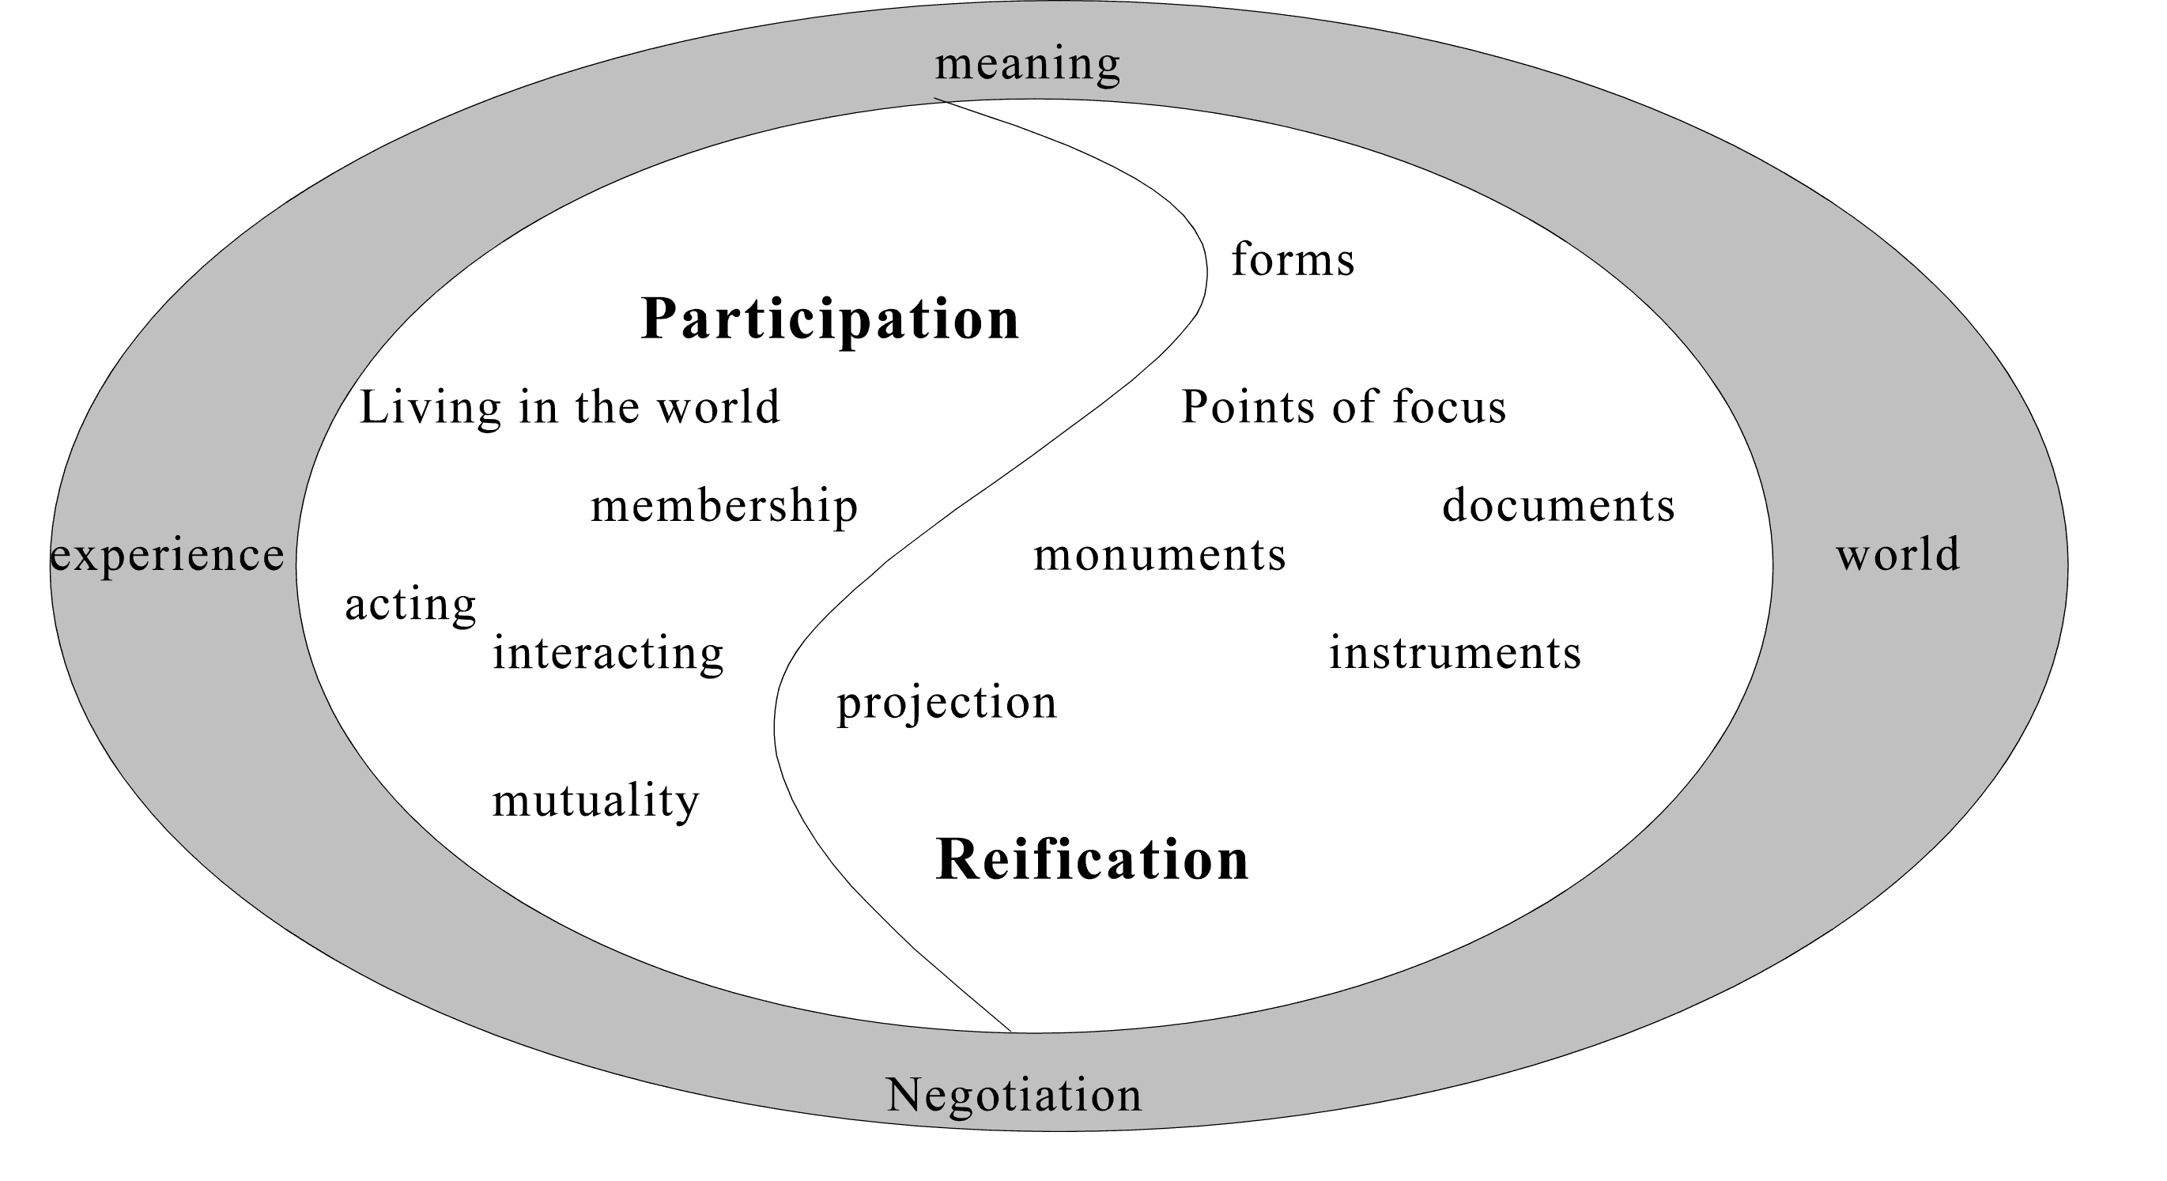
Knowledge is reified by, and is the product of, not only an individual, but of the wider community.
http://www.informationr.net/ir/8-1/paper142.html
Notes:
And from this recognition that students can speak it’s a small leap from students conversing with teachers to students conversing with each other. This forms the basis of now well-established approaches such as social constructivism, team learning, collaboration and project-building (there is some great literature on the idea of mathematics and scientific discovery as conversation) ranging from Vygotsky to Wenger. The understanding here is that knowledge is reified by, and is the product of, not only an individual, but of the wider community.
http://www.sonoma.edu/users/w/warmotha/epistemology.html
http://www.informationr.net/ir/8-1/paper142.html
http://www.slideshare.net/bonstewart/scholarship-in-abundance
http://bsrlm.org.uk/IPs/ip13-3/BSRLM-IP-13-3-13.pdf

Slide 8
What are OERs?
“OERs range from textbooks to curricula, syllabi, lecture notes, assignments, tests, projects, audio, video and animation.”
http://www.unesco.org/new/en/communication-and-information/access-to-knowledge/open-educational-resources/what-are-open-educational-resources-oers/
Notes:
We treat open educational resources, however, very differently. People focus on the distribution and the licensing of OERs, but few people spend any time on the latter half of the UNESCO definition: “OERs range from textbooks to curricula, syllabi, lecture notes, assignments, tests, projects, audio, video and animation.” This definition limits us in the same ways we were limited with educational words, above. And in particular, pedagogy is limited to knowledge transfer and students are rendered mute.
http://www.unesco.org/new/en/communication-and-information/access-to-knowledge/open-educational-resources/what-are-open-educational-resources-oers/

Slide 9
So what follows?
Deconstructing OERs
Representing knowledge and understanding
Students as authors of OERs
Notes:
So if we are to consider OERs to be like words in a conversation, what does this entail for our understanding of OERs?
There are the following major areas of importance:
In order to understand what was said, it is useful to deconstruct OERs and examine what sort of inferences or learning can be drawn from them
In order to understand what new knowledge was created, it is useful to understand how to describe knowledge and representation
And from this, we can form an understanding of how, and why, students can be the primary authors of OERs
This will form the remainder of the theoretical structure of this paper, and in the process of this discussion, we will examine some major elements of a personal learning environment, and then close with some case studies of preliminary work exploring this approach.

Slide 10
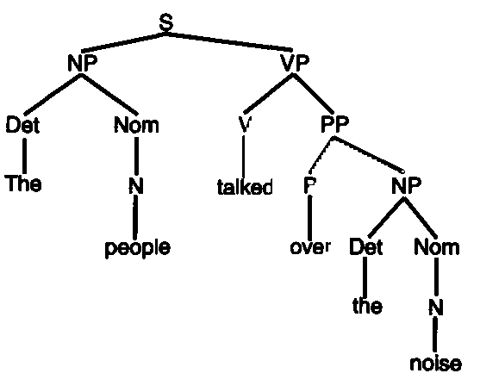
Deconstructing Sentences
A simple sentence has subject-object-verb
A complex sentence can have much more
http://language-theory.pl/language629.html
Notes:
When we analyze a sentence, as in for example a typical Chomsky phrase-structure grammar, we can observe a base structure of noun-verb-object, but in addition, so much more, including quantification, inference, causality, preposition, modality, and more. We also see additional factors, such as vagueness and ambiguity, context-sensitivity, idiom and metaphor, and ultimately, a rich conceptual environment populated with people, things, ideas and most everything else.
http://language-theory.pl/language629.html

Slide 11
Anatomy of a Tweet
Notes:
An analysis of social media takes this a step further, as social media exists in a rich community context, traces of which may remain in the media. A good example of this is the metadata provided in the common Tweet. In addition to the sender’s name and nickname we may have information about the conversation, an embedded image, a hashtag, embedded URLs or references to other people, geotags, time stamps, and more.
https://www.flickr.com/photos/27291024@N02/12525356184/

Slide 12
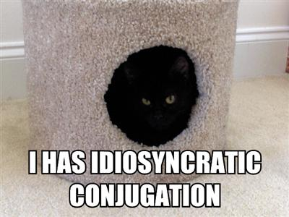
Understanding LOLcats & Memes
http://dashes.com/anil/2007/04/cats-can-has-gr.html
Notes:
It is important, I think, to understand that when a person who lives in a rich information environment receives communications absent these contextual cues, the content is not merely viewed as abstract and empty, it is viewed as irrelevant, a form of non-communication. The reason for this is that there is limited mechanisms available to comprehend this communication as a part of overall knowledge.
In any case, and additionally, a communication in a multimedia environment may contain in addition multiple layers of meaning (the term ‘layers’ is probably misapplied, but will suffice to make the point).
We see this in the case of the LOLcat or the internet meme, which typically juxtaposes three essential elements:
An image, either of a cat or a popular or iconic figure, or of something else easily recognized (often these pictures will be in prototypical poses, such as ‘facepalm’)
A sentence or phrase either expressing a sentiment of referring to some recent event (again often in a protypical format, such as kitty pidgin)
A social, cultural and communicative context in which this all makes sense.
http://dashes.com/anil/2007/04/cats-can-has-gr.html
http://the-toast.net/2014/02/06/linguist-explains-grammar-doge-wow/

Slide 13
Where Conversations Happen
http://profitecture.com/how-to-get-conversations-going-on-social-media-2/
Notes:
These aspects of an online communication are understood as well, or as intuitively, as more traditional aspects of communication (such as the ones we have just explored), which is to say, not equally well, and not without exposure and experience. For those who are in the know, however, understanding is instant and expert.
(CF Matt Bury, on learned learning styles)

Slide 14
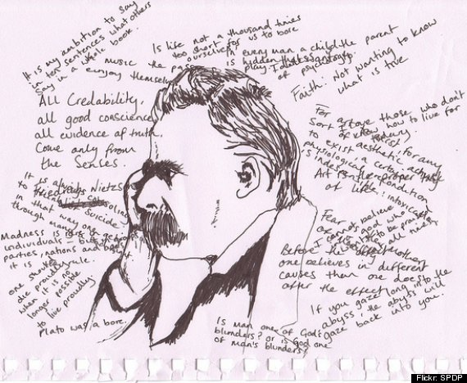
What Conversations Contain
http://www.huffingtonpost.com/2013/08/20/introverts-signs-am-i-introverted_n_3721431.html
Notes:
Additionally, because it is a conversation, it is unfocused and unrestricted. Though there will always be frustrated list managers hoping to keep comments “on topic”, the reality is that people say what they want to say on the internet, and if they cannot say it in on forum, they take it to another. As a result, despite the best efforts of services like Twitter, Facebook and Google, there is no ‘one’ place conversation takes place online.
From the perspective of educational technology, these observations force a rethinking of the design and distribution of OERs. Users will look for a context (and may place it incorrectly absent an obvious location). They will be looking for meaning and reference not only in the academic domain, but also from their social and cultural milieu.
http://forum.audacityteam.org/viewtopic.php?f=32&t=4524

Slide 15
RRN Aggregation and Storage
Personal
Context
Article
Photograph
Video
Person
Author
Publisher
Organization
Job Opportunity
Competency
Cetrificate
Event
Location / Place
Time / Date
Email
RSS
OAI
Sharepoint
Facebook
Twitter
Monster
Government
Repositories
Desire2Learn
Coursera
EdX
etc
Parsing
Scraping
Analytics
etc
Storage
RELATIONS
Notes:
In the LPSS Program, we approach these issues with a set of technologies creating what we call the ‘Resource Repository Network’ (RRN). The RRN has two major tasks, one obvious the other less obvious:
To discover recommend content relevant to the user’s interests, retrieving it for one of many remote locations, and storing either the metadata or the artifact itself in a location accessible to the user in the future, and
To assist the user in understanding the context, relevance and significant of the remote resource
Traditional approaches to OERs have focused on the creation and sustainability of OER ‘repositories’, without a lot of attention paid to how students access these resources and use them (probably mostly because the primary users of OER repositories are thought to be academic institutions and teachers).
An effective RRN, however, needs over time to (if you will) paint a picture of the user’s social, academic and professional landscape. In RRN, we employ the mechanism of a ‘source manager’ containing coordinates and access credentials for a range of remote resource repositories. But because we view OERs as words in a conversation, we aggregate resources from wherever a conversation may occur:
Social media such as Twitter, Facebook, LinkedIn, Google, etc
Personal communications tools such as email and instant messaging
Enterprise tools such as Sharepoint, Wiki or shared directories
Websites, RSS feeds, OAI repositories, Flickr, YouTube, TED, iTunes
Learning management systems, MOOCs, and other institutional sources
This list could be expanded almost indefinitely. It signifies that the sources of learning on the internet are not limited to academic institutions and online courses, but rather, extend far wider than these traditional resource repositories.
The second part of the RRN is the analysis on the incoming resources. Learners, especially novice learners, may not be able to comprehend the meaning and significance of resources, especially when there are a large number of resources, as in many cases of online learning. This has been commented upon by numerous critics. In traditional education, this mediating voice is provided by the instructor, however, in a conversation, no such mediating voice exists, and a participant must gradually become a knowing member of the community through practice and feedback.
Analysis can be grouped into two major tasks, which can be classed as ‘structural’ and ‘semantic’:
In structural analysis, we identify and extract the constituent entities referenced in the communication, as for example in the linguistic analysis or tweet analysis, identifying events, people, places, relations, and the like
In semantic analysis, we attempt to comprehend the meaning of the communication in context, identifying metaphors and hidden meanings, sentiments, gists, inferences and connotations, and the like
LPSS’s RRN currently performs elements of the first sort of analysis and will, by employing National Research Council programs such as text analytics, sentiment analysis and automatic translation, also develop mechanisms for the second.
In an ongoing (and probably never-ending) development process, RRN will assemble a set of components that analyze online communications directed toward an individual, and then from the person’s individual perspective, analyze and comprehend the types of entities referenced and the relations that hold between them.
http://www.nrc-cnrc.gc.ca/eng/solutions/collaborative/lpss.html
http://www.csun.edu/science/ref/reasoning/how-students-learn/2.html
http://www.nrc-cnrc.gc.ca/eng/solutions/advisory/text_analytics.html
http://www.umiacs.umd.edu/~saif/WebDocs/sentimentMKZ.pdf

Slide 16
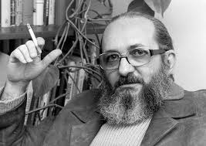
Understanding Knowledge
http://www2.webster.edu/~corbetre/philosophy/education/freire/freire-2.html
Notes:
In the traditional model of the open educational resource as “textbooks to curricula, syllabi, lecture notes, assignments, tests, projects, audio, video and animation” it is difficult to think of an individual’s knowledge and understanding from any other perspective than that Friere called the “Banking” model of learning. Education “becomes an act of depositing, in which the students are the depositories and the teacher is the depositor. Instead of communicating, the teacher issues communiques and makes deposits which the students patiently receive, memorize, and repeat.”
The major criticism of the banking model is that students cannot learn anything over and above what was taught. They cannot adapt the knowledge to their own context, they cannot understand the terms in their own way, and as Friere would argue, they are ultimately disempowered and oppressed by education, rather than liberated. “The banking approach to adult education, for example, will never propose to students that they critically consider reality… The "humanism" of the banking approach masks the effort to turn women and men into automatons -- the very negation of their ontological vocation to be more fully human.”
http://www2.webster.edu/~corbetre/philosophy/education/freire/freire-2.html

Slide 17
Knowing a Pile of Facts?
Image: http://www.rightattitudes.com/
Notes:
More seriously, however, is the picture of knowledge that results from a model of education based on the transmission of information. As the ‘banking’ metaphor suggests, this is a model based on an accumulation of facts – a person’s knowledge, in essence, could be reduced to an indefinitely long series of propositions (necessarily including rules and principles, because otherwise the complex and unplanned behaviours a person can undertake would be impossible).
Computationally, this is known as the physical symbol system hypothesis (PSSH), and it means that human understanding can be thought of literally as the manipulation of sentences and symbols, like a computer program. This perspective permeates educational theory today, and the pedagogy of open educational resources as carriers of (propositional) learning permeates our discussions and assumptions in the field (think of how often terms like ‘processing’ and ‘storage’ and ‘working memory’ are used).
This approach additionally characterizes the management of open educational resources and learning resources generally. The very best an individual student is allowed is to have a ‘course library’ or ‘publications library’. There is no sense that they would do anything more complex with them that to read them, remember them, and maybe store them.
http://ai.stanford.edu/~nilsson/OnlinePubs-Nils/PublishedPapers/pssh.pdf

Slide 18
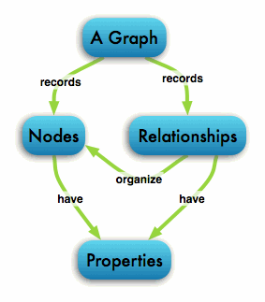
The Graph Database
http://neo4j.com/developer/graph-database/
Notes:
We view knowledge differently, and this difference extends to the core of LPSS design. While objects and artifacts may be stored off to the side in a library, the core of LPSS takes the entities identified by RRN and stores the references to them in a graph database. There are various graph database engines available, though we have been building our own in order to understand the functionality we require.
What is a graph database? “A graph database stores connections as first class citizens, readily available for any “join-like” navigation operation. Accessing those already persistent connections is an efficient, constant-time operation and allows you to quickly traverse millions of connections per second per core.” (Ibid)
There are many reasons to represent an individual’s data in a graph database. Here are a couple:
A graph database does not require predefined entities. This means we do not have to know in advance everything a student is going to need; we add entities, properties and relations as they are encountered.
A graph database supports distributed representation. What that means is that a concept is not represented as a series of self-contained sentences, but rather, as a set of connections throughout the graph.
A graph database recognizes context and connections. What someone knows about plaster might influence their thoughts about European cities. In a graph database, these concepts overlap, and an event changing the state of one, also changes the state of another
A graph database can be deeply personal. Each person experiences a unique set of entities and relations between them; though the symbols and images representing concepts may be used in common with other people, a graph database embodies the fact that each person’s understanding of these is individual
In LPSS, each person has their own graph database containing all the entities and relations they have encountered over a lifetime of learning. The graph database contains references to analyses of the open educational resources they have encountered, but also any other content related to their learning and development. Each person’s graph is individual, personal and private, just like their own thoughts and ideas.
http://neo4j.com/developer/graph-database/
http://www.slideshare.net/maxdemarzi/introduction-to-graph-databases-12735789?related=1
http://www.computerweekly.com/feature/Whiteboard-it-the-power-of-graph-databases

Slide 19
Quality & Narrative
Accuracy
Reputation of author/institution
Standard of technical production
Accessibility
Fitness for purpose
Really? These?
https://openeducationalresources.pbworks.com/w/page/24838164/Quality%20considerations
Notes:
Understanding the use of the OER in this way changes how we think about OERs – and educational resources generally – as resources in the support of learning. As currently conceived, each OER forms a part of a narrative structure, the sum total of which constitutes the content required to learn a discipline or skill. The ‘quality’ of a resource is related to how well it presents that educational content and how reliably it stimulates the memory of relevant facts or procedures, or competency in a given technique or skill.
A typical list of quality metrics (these can become complex and detailed) is offered by Wayne Macintosh: “The quality of learning resources is usually determined using the following lenses:
Accuracy
Reputation of author/institution
Standard of technical production
Accessibility
Fitness for purpose.”
https://openeducationalresources.pbworks.com/w/page/24838164/Quality%20considerations

Slide 20
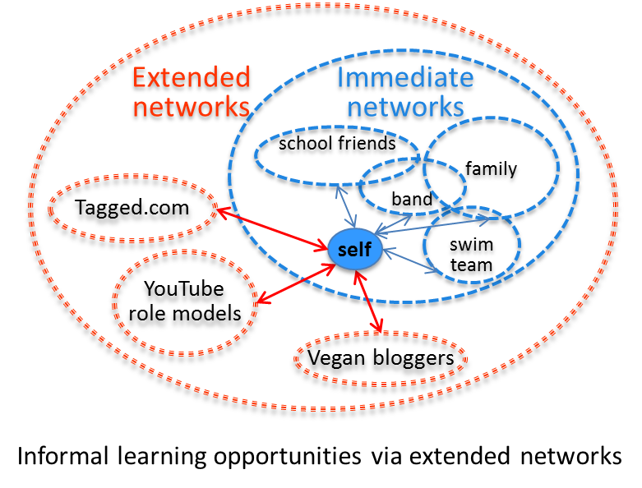
Learning in Context
Task-Focused
Network-based
Notes:
The difficulty of such a quality metric is that none of these can be determined independently; it is only by subjective the resource to the greater weight or a larger knowledge graph that we can even begin to assess any of these. ‘Reputation’, for example, is a standard that varies from place to place, person to person. ‘Technical production’ will be influenced not only by tastes and preference but also by accessibility requirements.
Indeed, it is arguable that it is impossible to determine a priori whether a resource is ‘quality’ or not (though perhaps with decades of experience we may eventually draw some inferences). Ultimately, with Mill, we have to say, “The only proof capable of being given that an object is visible, is that people actually see it. The only proof that a sound is audible, is that people hear it: and so of the other sources of our experience. In like manner, I apprehend, the sole evidence it is possible to produce that anything is desirable, is that people do actually desire it.”
https://www.gutenberg.org/files/11224/11224-h/11224-h.htm

Slide 21
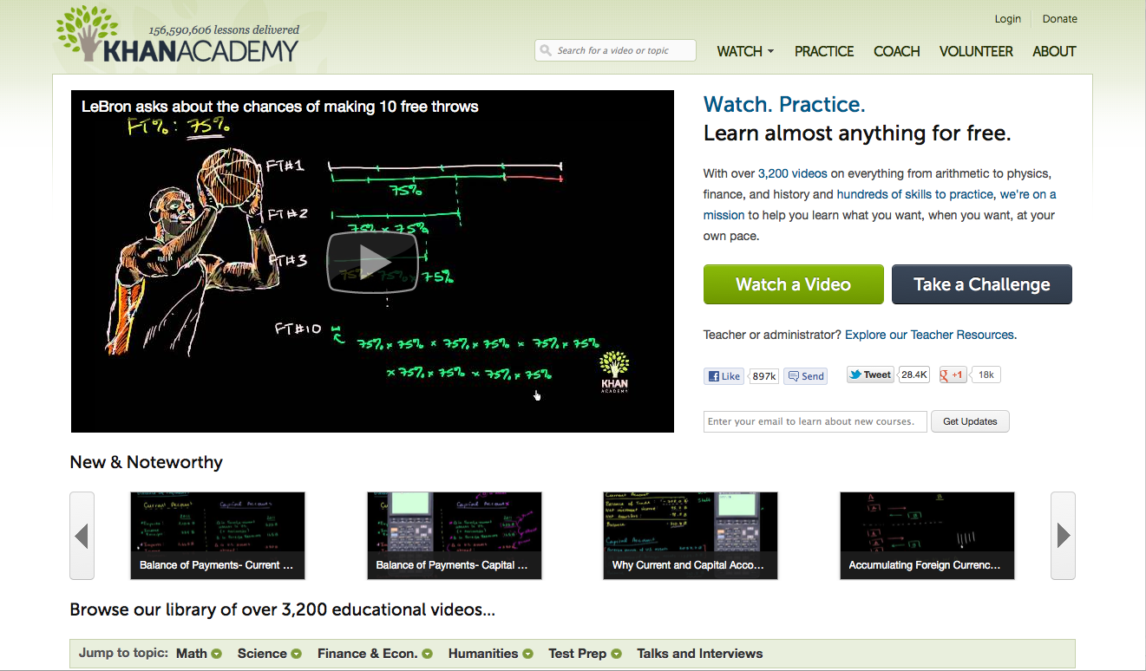
How OERs (Really) Begin
http://www.khanacademy.org/
Notes:
In a paper I presented to the OECD a decade ago on sustainability models for open educational resources I argued that the only sustainable model for OERs was to have then created and consumed by the same people, the students themselves.
“OERs may be supported using what might be called a co-producer model, where the consumers of the resources take an active hand in their production. Such an approach is more likely to depend on decentralized management (if it is managed at all), may involve numerous partnerships, and may involve volunteer contributors.” (Ibid)
In traditional education the typical approach to learning is to stop other activities, to go to a classroom or learning centre, to focus on learning a specific body of content, and then return to one’s ordinary life some days or some years later.
In LPSS we have focused on this as an undesirable and overly expensive approach to learning, and as the name of the program – “learning and performance support systems” – suggests, prefer to relocate the context of learning to authentic environments in this a person is attempting to meet some objective or complete a task (indeed, as Jay Cross says, in informal learning “the motivation level of the learner. Informal learning occurs when knowledge or a skill is needed in order to execute or perform a task. This means that the commitment of the learner is at the highest possible level as it is the inner drive that initiates the learning process. Also, learning takes place in connection to a specific situation or task.”)
What we find when we approach learning this way is that a person’s ‘learning environment’ extends to include a wider social network or community. This is the source of Etienne Wenger’s ‘communities of practice’, referenced earlier. In almost any domain one cares to consider, there is an active and engaged network of interested people exchanging information and resources on the internet.
These are the real open educational resources. These are the source of what is probably most learning in the world (it would be interesting to see a study evaluating the scale and pervasiveness of unauthoritative learning resources and support). Even some of the projects which have become paradigms of the open education movement, such as Khan Academy, began life this way.
http://www.oecd.org/edu/ceri/36781698.pdf
http://www.webanywhere.org/blog/informal-learning-vs-formal-learning-in-businesses-interview-with-jay-cross/
http://wenger-trayner.com/theory/
http://www.forbes.com/sites/michaelnoer/2012/11/02/one-man-one-computer-10-million-students-how-khan-academy-is-reinventing-education/

Slide 22
Performance Support
http://www.cognitiveadvisors.com/resources/mobile-performance-support-design-principles
Notes:
The development of performance support resources (PSRs) is not the same as the development of formal learning resources. Because these are accessed at the point of need, PSRs need to be convenient, user-friendly and relevant. This means many of the traditional stages of a learning event – gaining attention, assessment, etc. – are often absent. A person needing performance support will attend to the learning for only a short time, preferring to apply what was found immediately and to get back on task.
Performance support at the point of need is one stage in what can be described as a four stage process. In this process, the objective is not to provide the student with a body of knowledge to remember, but rather, to maximize the effectiveness of the performance support when it is needed. The steps (from Marty Rosenheck) are as follows:
Scenario-based learning – models and practice in simulations – long before
Planning, refreshing, running through demonstrations – right before
Decision and activity support – during
Action review and reflection –after
http://elearningindustry.com/performance-support-more-than-just-training
http://www.cognitiveadvisors.com/resources/mobile-performance-support-design-principles

Slide 23
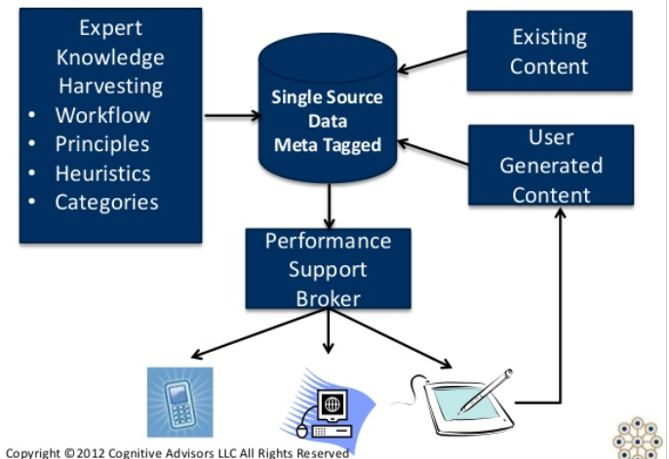
User-Generated OERs
Notes:
In the case of personal learning, the resources produced in the fourth step feed back into the first three steps. Two key activities take place (with respect to the resources) at this step. First, the resources that were used to prepare for performance support are reviewed, and either endorsed or critiques. Second, the process of review and reflection results in the creation of new resources which feed back into the performance support system. Rosenheck diagrams the process as follows:

Slide 24
Working Out Loud
http://johnstepper.com/2014/01/04/the-5-elements-of-working-out-loud/
Notes:
In a production and learning environment, the concept is sometimes referred to as ‘working openly’ or ‘working out loud’. John Stepper writes, “Working Out Loud starts with making your work visible in such a way that it might help others. When you do that – when you work in a more open, connected way – you can build a purposeful network that makes you more effective and provides access to more opportunities.”
http://johnstepper.com/2014/01/04/the-5-elements-of-working-out-loud/

Slide 25
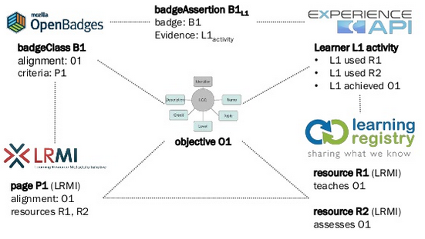
Personal Assistant for Learning
http://www.adlnet.org/adl-initiative-baa-new-submission-window-open-for-personal-assistant-for-learning-pal-proposals-2/index.html
http://www.slideshare.net/damonregan/regan-tla-infrastructureforfutureoflearningsintice2013
Notes:
The Advance Distributed Learning PAL project makes clear the constituent elements of an effective recommendation system. They are asking for the following:
customized content, a transparent user interface, persistent internet access
tracking learner experiences, adapting content, and integrating social media
knowledge and information capable of being shared across the environment
user’s profile, learning attributes, and competencies to provide a tailored, personalized experience
integrated with the physical world into a mixed reality learning suite
design and assessment principles for the next-generation learner
From this description it is evident that the point-of-learning support is engaged as much in the collecting of information as it is in the dissemination of information. This collection of information is vital both to provide raw materials for the recommendation of learning resources, and also to support the creation of new learning resources.
http://www.adlnet.org/adl-initiative-baa-new-submission-window-open-for-personal-assistant-for-learning-pal-proposals-2/index.html
http://www.slideshare.net/damonregan/regan-tla-infrastructureforfutureoflearningsintice2013

Slide 26
Personal Learning Record
OERs
Portfolio, artifacts and evidence
Badges, certificates, credentials, competencies
Activity Record - LRS
PLR
Notes:
Accordingly, in LPSS two major components are employed in order to support the reuse and generation of educational resources.
The first is the Personal Learning Record (PLR), which gathers information and provides a unique personal storage of the following:
activity logs, created through interactions with external resources, stored as elements of the graph database, and imported and exported from external systems using a subject-verb-object language like xAPI
a personal portfolio of works and artifacts; these are created by the user in the course of work and learning experiences, and include everything from papers and texts, artwork, videos and recordings of performance, messages and communications, and more
a collection of certificates and achievements, including for example the persons collection of badges awarded by various systems, certificates and credentials verified or authenticated by third party agencies, records of courses completed and challenges achieved
The production of open educational resources is therefore enabled as a part of learning assistance provided at point of need, and the authoring typically takes place during the action review and reflection stage. This stage is probably one of the more important learning interventions a learning support system can make, because it is the reflection on practice that creates feedback mechanisms.
http://ijebcm.brookes.ac.uk/documents/vol02issue1-paper-04.pdf

Slide 27
Informal OER Ecosystem
Notes:
In the informal learning ecosystem, it is these post-learning and post-practice reflections that form the bulk of online learning content – the vast underground repository of open educational resources untapped (and unmentioned) in traditional OER discussions. One example from the world of computer programming is Stack Overflow, which provides point-of-need advice on methods and algorithms. Another important (and often maligned) resource is WebMD. In another domain is the ‘Ask the Builder’ website. Artists turn to sites like deviant art to create and share their experiences. There’s even Vegan Black Metal Chef.
The LPSS Personal Learning Assistant is being designed with what we call an LPSS Toolkit in order to promote the capturing of learning experiences. Currently the tool supports the creation and publication of annotations and short notes. Composition takes place inside a single standard interface, and is published through any of a number of supported social media platforms. As is the case with harvesting, the development of PLA’s capturing and publishing tools in an ongoing and probably indefinite process.
http://stackoverflow.com/
http://www.webmd.com/
http://www.askthebuilder.com/
http://www.deviantart.com/
http://veganblackmetalchef.com/

Slide 28
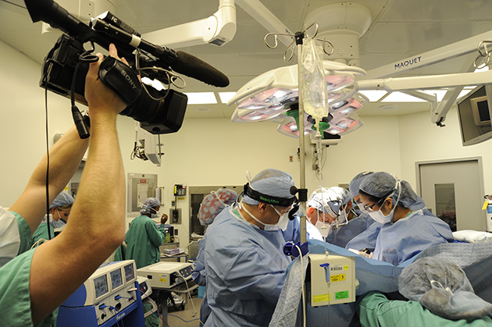
Creating Live OERs
Notes:
One of the benefits of employing a personal and distributed learning support system is that the learner is no longer limited to the specific learning management system.
This not only supports open publishing, which is necessary in order to create an ecosystem of learning support resources, it also enables the production of these resources from external learning systems and actual workplace environments. The gaming industry provides an example of this, where recording and rebroadcasting in-game events, either live or as videos, has become a popular and widespread activity.
We also see this practice increasingly being employed in high-tech hands-on fields such as medicine. It is important, from the perspective of promoting a system of open educational resources, that these types of activities be extended to include other domains, and that tools, support and assistance for the capturing of these experiences be developed.
http://mashable.com/2013/10/02/youtube-video-game-footage/
http://omicsonline.org/open-access/video-recording-the-laparoscopic-surgery-for-the-treatment-of-endometriosis-should-be-systematic-2161-0932.1000220.php?aid=26080

Slide 29
LPSS: Some Case Studies

Slide 30
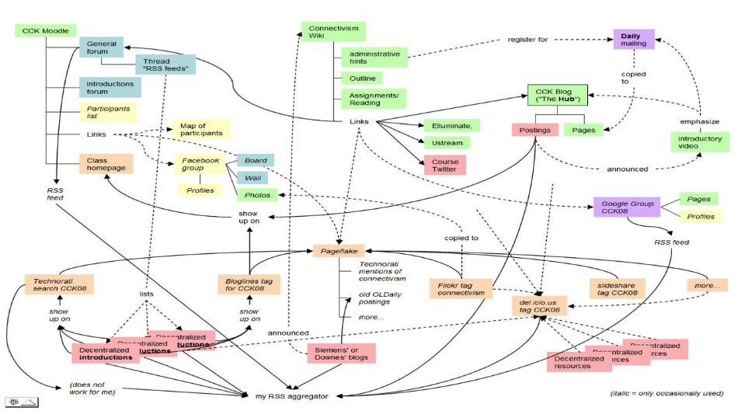
MOOC – CCK08
https://sites.google.com/site/themoocguide/3-cck08---the-distributed-course
Notes:
Massive Open Online Course – LPSS staff developed and researched the world’s first Massive Open Online Courses, beginning with Connectivism and Connective Knowledge in 2008. It was the first to incorporate open learning with distributed content, making it the first true MOOC. It attracted 2200 participants worldwide, 170 of whom participated by creating thwir own blogs and learning resources, which were harvested by the course aggregator, gRSShopper.
As I wrote when summarizing this course, “What this means is that course content is not located in one place, but may be located anywhere on the web. The course therefore consists of sets of connections linking the content together into a single network. Participants in the course were encouraged to develop their own online presence in order to add to this distributed resource network. The course authors then used a content aggregation tool in order to bring all the content in one place.”

Slide 31
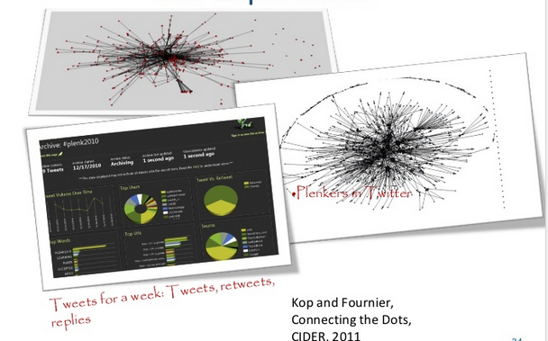
Plearn – Importance of the Graph
http://www.slideshare.net/Downes/after-moodle
http://www.slideshare.net/Ritakop/kopfourniercanadianinstitutedistanceeducationresearchple
Notes:
During the early run of MOOCs the National Research Council was engaged in an internal project called Plearn, which was a prototype personal learning environment. This work combined an analysis of the MOOC experience, much of which was published by Helene Fournier and Rita Kop. In Plearn the aggregator developed for the MOOC project was adapted for personal learning, personal learning databases were created, and mechanisms for interacting with learning resources and publishing to a network were explored.
http://www.slideshare.net/Ritakop/kopfourniercanadianinstitutedistanceeducationresearchple

Slide 32
OIF – MOOC-REL
http://rel2014.mooc.ca/
Notes:
An open online course devoted to examining open learning resources, conducted in French with support and co-operation from the Organisation international de la francophonie.

Slide 33
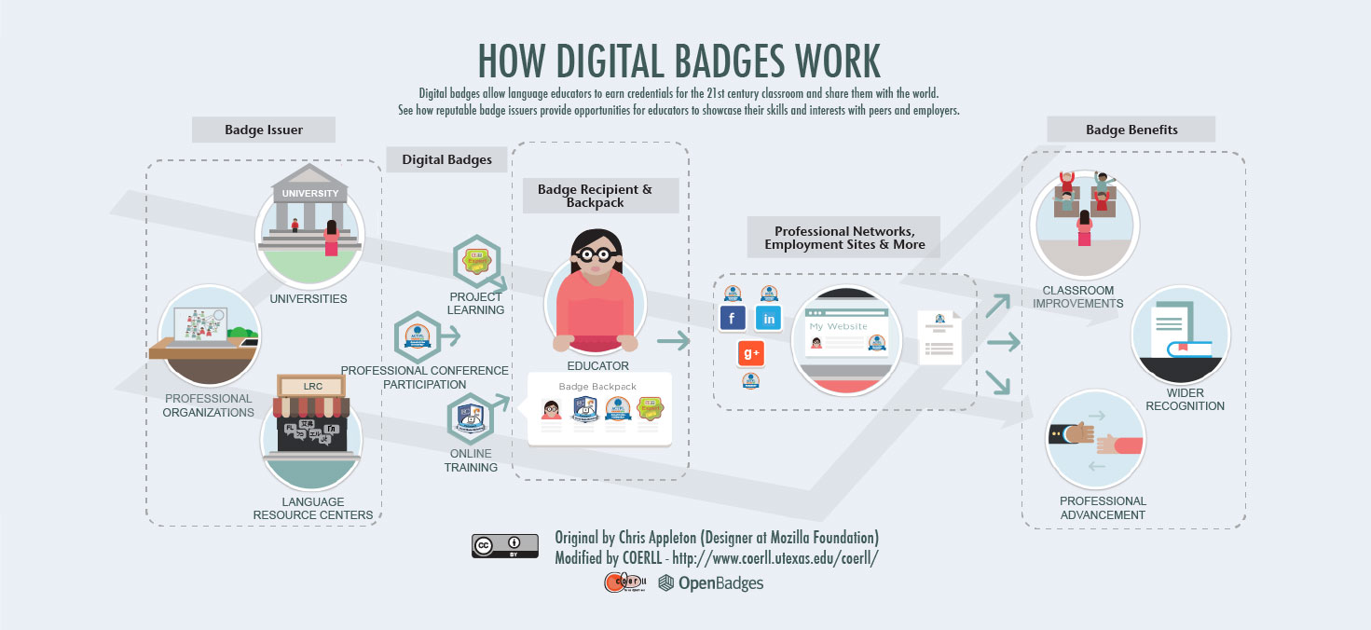
PCO Badges for Learning
http://www.downes.ca/post/63738
Notes:
Privy Council Office Badges for Learning – in this project we examined mechanisms for displaying badges earned inside a secure intranet environment in a person’s personal learning record outside that environment.

Slide 34
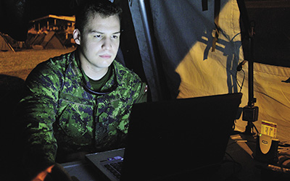
ONGARDE
http://www.journal.forces.gc.ca/vol14/no2/page70-eng.asp
Notes:
ONGARDE – sandbox for multiple security agencies

Slide 35
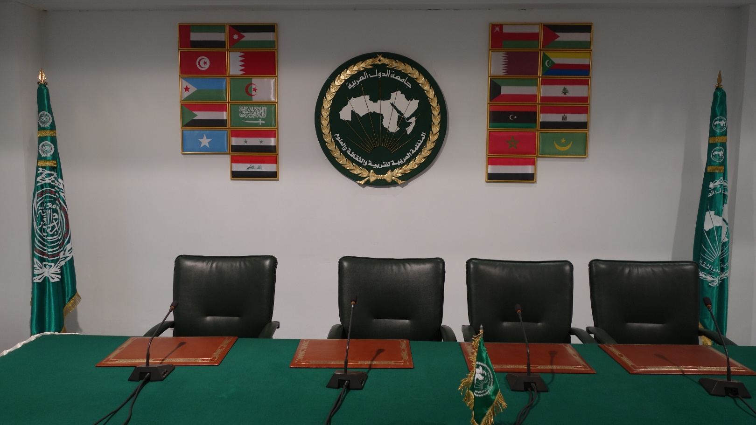
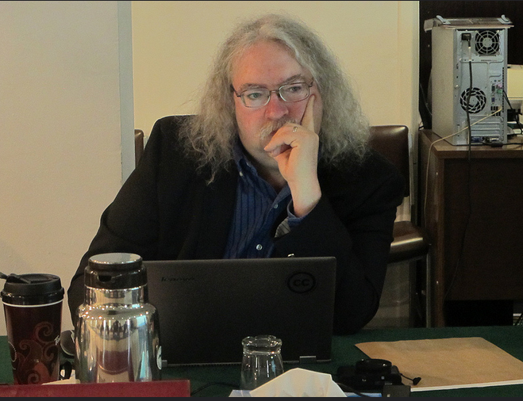
ALECSO – Capacity Building
http://www.downes.ca/presentation/337

Slide 36
MINT - Mobile INteractive Trainer
http://www.downes.ca/post/59876

Slide 37
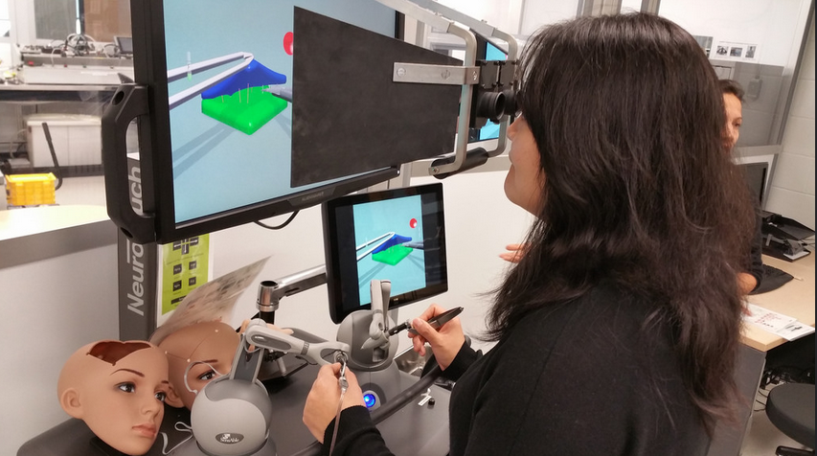
Collecting xAPI from Med Sims
https://www.flickr.com/photos/stephen_downes/15710336207/
http://www.nrc-cnrc.gc.ca/eng/rd/medical/

Slide 38
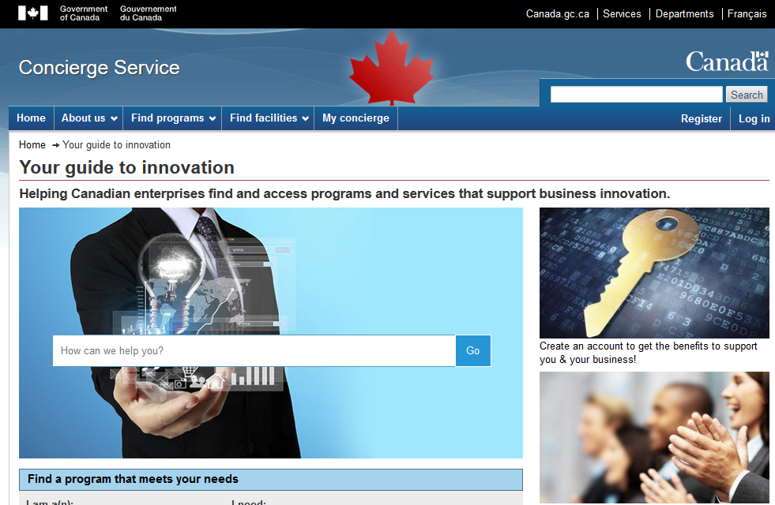
Concierge OMS
https://concierge.portal.gc.ca/

Slide 39
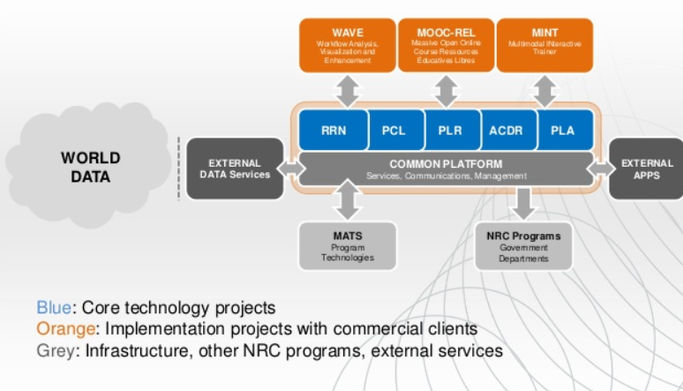
How to Engage
http://www.nrc-cnrc.gc.ca/eng/solutions/collaborative/lpss.html

Slide 40
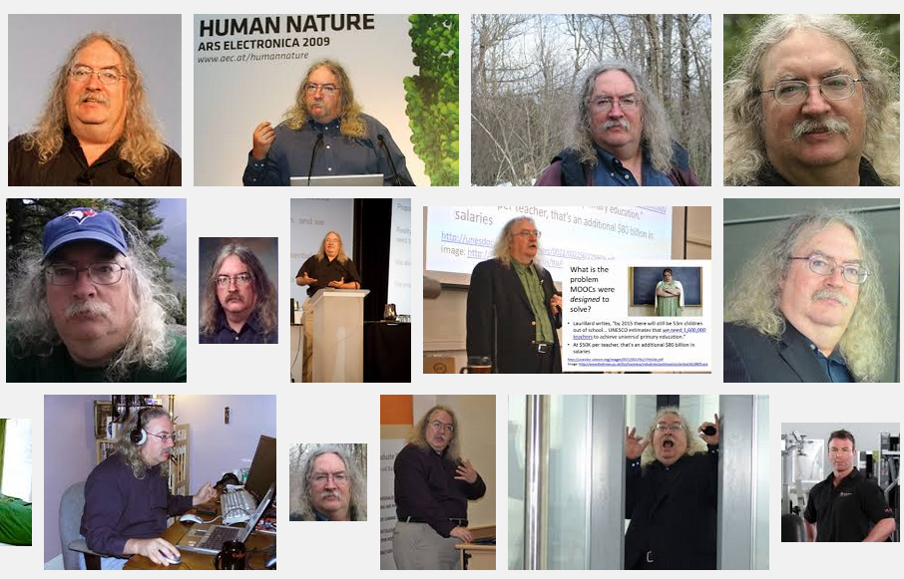
Stephen Downes
http://www.downes.ca

