Slide 1
The MOOC Ecosystem
Stephen Downes
AMEE 2015
Glasgow, Scotland
September 6, 2015

Slide 2
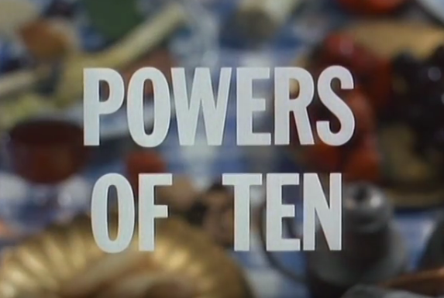
Ray Eames, 1977
http://www.eamesoffice.com/the-work/powers-of-ten /

Slide 3
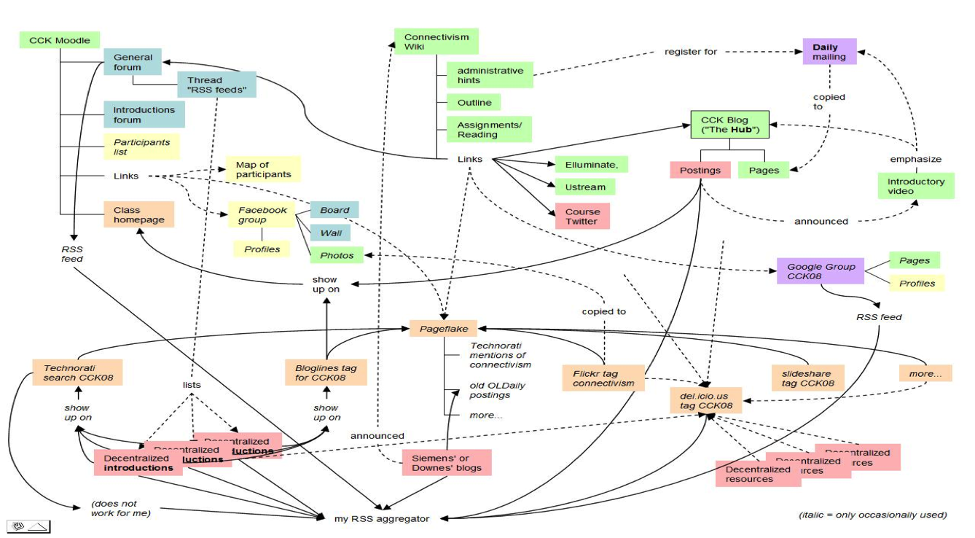
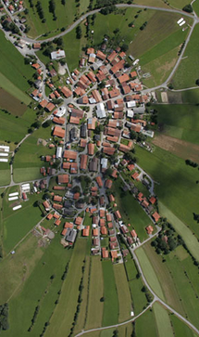
2,000
MOOC

Slide 4
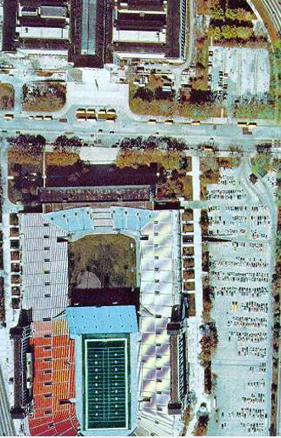
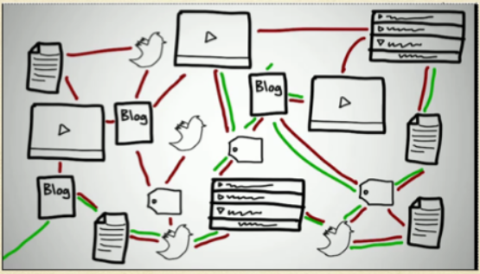
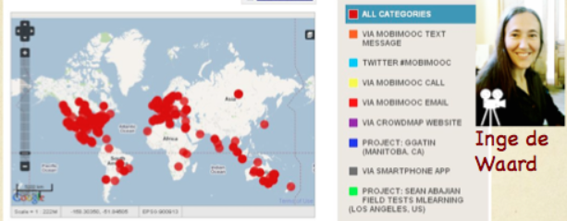
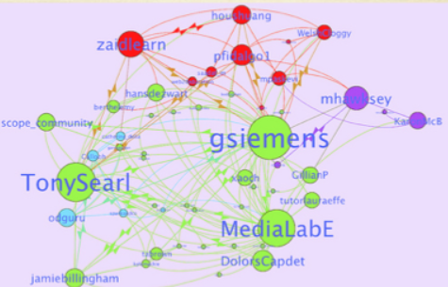
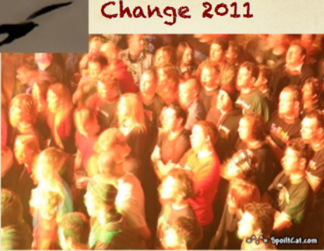
20,000
Series of MOOCs

Slide 5
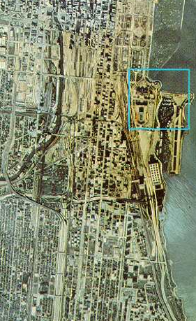
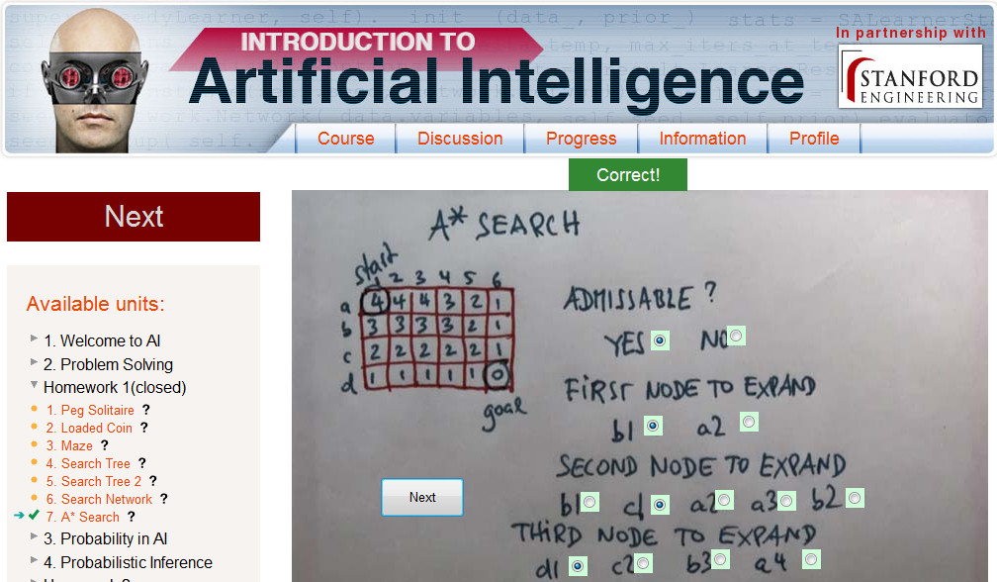
200,000
xMOOC
Notes:
Stanford AI course
- under the impact of large numbers
- video format
- automated grading
- little interaction

Slide 6
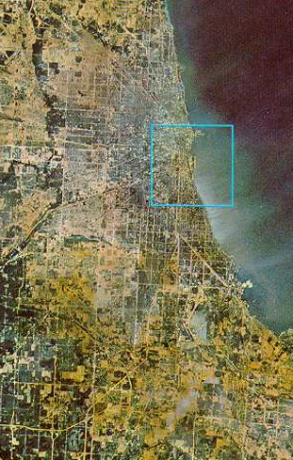
2,000,000
The Early MOOCisphere
Notes:
Multitude of MOOC providers
- challenge to traditional LMSs – the opening of learning
MOOC aggregation - EMMA

Slide 7
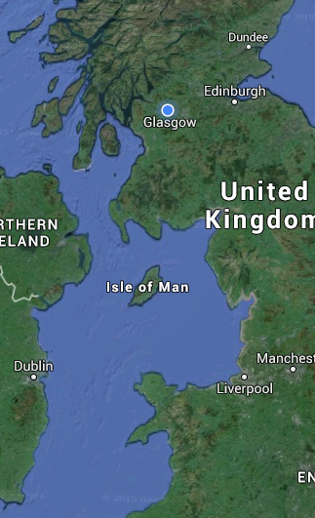
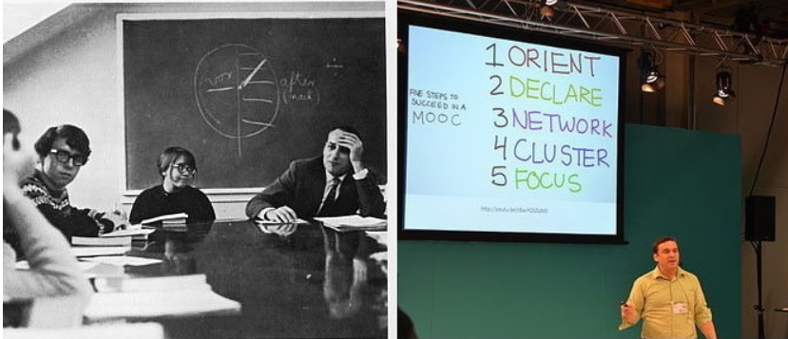
Image: https://www.dissentmagazine.org/online_articles/the-new-mooc-strategy-rise-of-the-higher-ed-empires
20,000,000
National MOOC Strategy
Notes:
National MOOC strategy – eg. US National College MOOC program
- first focus – national Access policy
- accreditation
- national MOOC standards?
- state participation in the creation of MOOC / OER content
- OERu

Slide 8
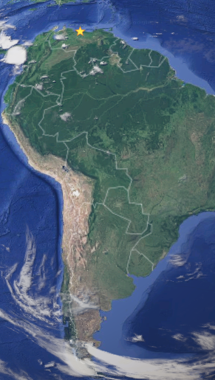
Image: http://culture-communication.fr/en/what-is-the-point-of-a-mooc-for-an-arts-organization/
200,000,000
MOOC and Culture
Notes:
Language and MOOCs – OIF, Clare and the use of MOOCs to preserve and promote culture
One method – to create MOOCs in a language – eg. ALECSO
Second method – promotion of culture within MOOCs

Slide 9
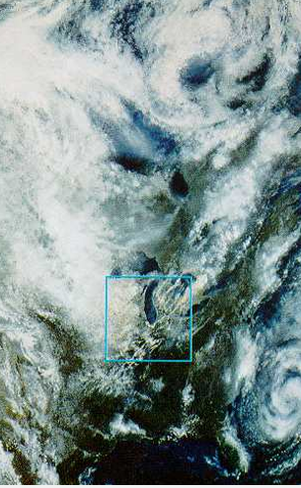
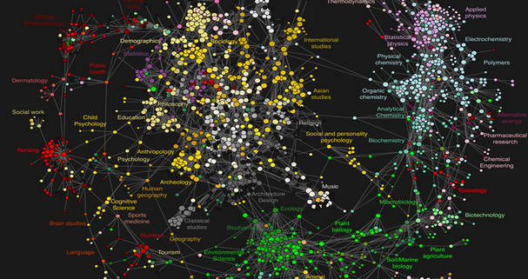
Image: http://blog.physicsworld.com/2009/03/12/the-atlas-of-science/
2 billion
MOOC World
Notes:
Lifelong learning
MOOCs / free learning as ubiquitous
A network of knowledge
Turning point – the idea of a single platform, single provider makes little sense

Slide 10
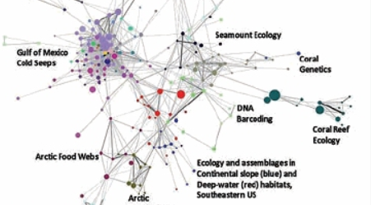
Image: http://www.infotoday.com/online/may12/Belter-Visualizing-Networks-of-Scientific-Research.shtml
200,000,000
Open Resource Network
Notes:
The world of OERs
- resources organized by topic, linked accordingly
Challenges:
Discoverability
Assessment / evaluation / quality controls
Peer or post-publication review?

Slide 11
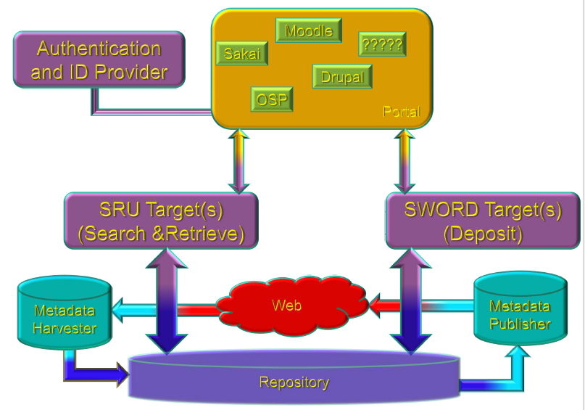
Image: https://www.dissentmagazine.org/online_articles/the-new-mooc-strategy-rise-of-the-higher-ed-empires
20,000,000
National Repositories
Notes:
National Resource Repositories
elements: authentication & ID provider (national? Corporate?) Sakai / Moodle / Drupal / OSP
Search & Retrieve systems
Deposit systems (eg. SWORD)

Slide 12
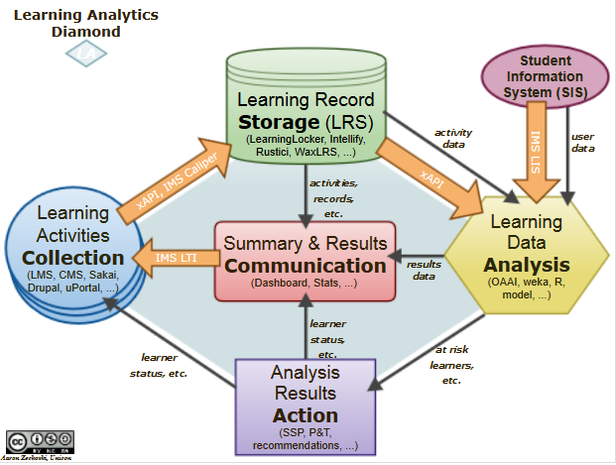
Image:https://confluence.sakaiproject.org/pages/viewpage.action?pageId=92176618
2,000,000
Collections and Systems
Notes:
Elements (ie., son of the Learning M<anagement System)
Learning activities
Learning Record Store (LRS)
Student Information System (SIS)
Communication system
Analytics

Slide 13
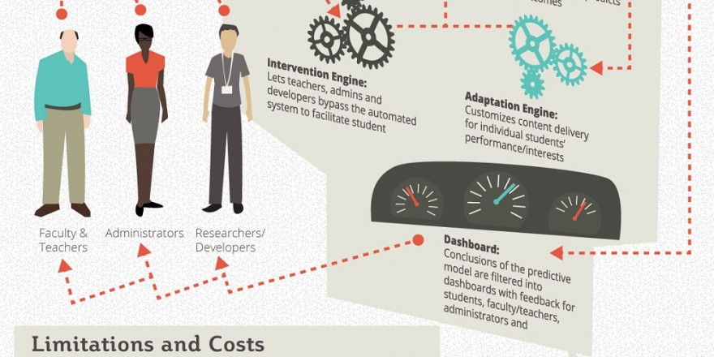
200,000
Learning Analytics
Notes:
Elements:
Dashboard (usage, successes, etc)
Adaptation engine – customizes for delivery (language, disability, etc)
Intervention Engine – direct faculty intervention
Methods
Text analysis
Clustering and collaborative filtering
Mass phenomenta

Slide 14
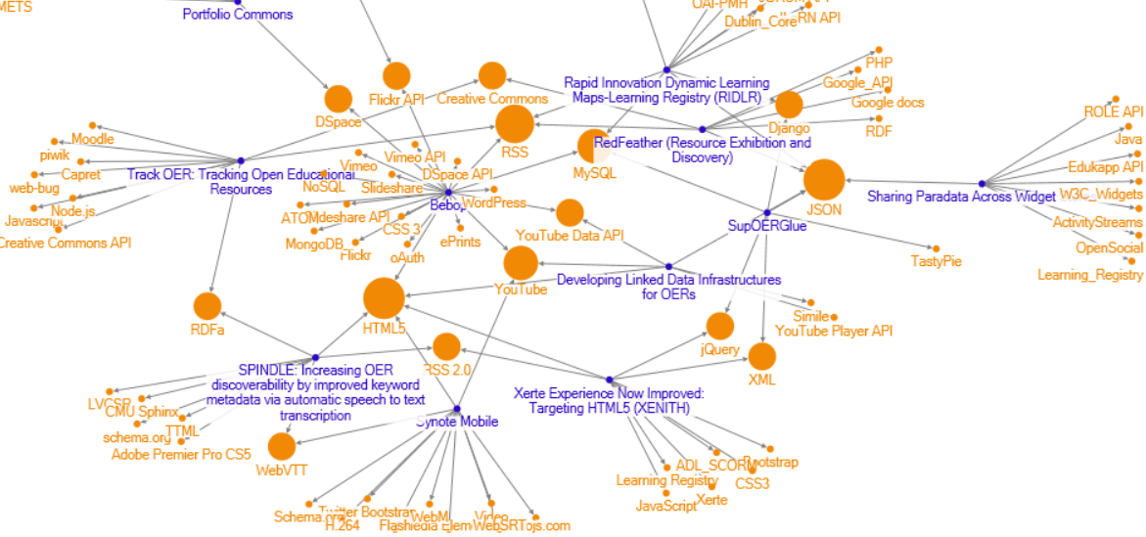
Image: https://mashe.hawksey.info/2012/10/jisc-oer-rapid-innovation-finding-the-technologystandards-themes/
20,000
Community of Practice
Notes:
Usually organized around a scientific community
Maybe a corporate intranet?
Technologies used to connect: RSS / JSON / ePub / RDFa
Systems: Django, Dspace, Portfolios, Widgets
Disciplinary skills – what counts as a problem, vocabulary, jargon, world views

Slide 15
Image: http://www.learningtimes.com/what-we-do/online-learning-services/cstp-level1/
2,000
Synchronous Event
Notes:
Online / Offline – talk, debate, panel, show
Technologies: Adobe Connect, Big Blue Button, Collaborate, WebEx
Megacourse

Slide 16
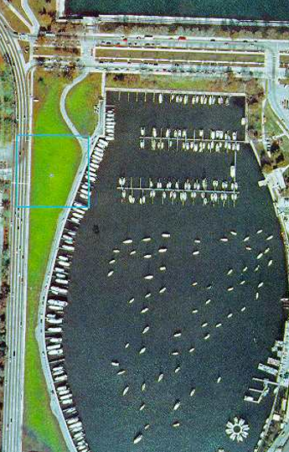
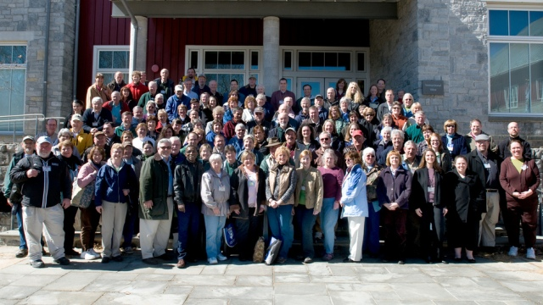
Image: http://www.learningtimes.com/what-we-do/online-learning-services/cstp-level1/
200
Dunbar’s Number(ish)
Notes:
Dunbar’s Number – the limit for community-based two-way communication
The extent of the effectiveness of groups / collaboration
After this befomes hierarchy / conformity / authority
Practical implications – the MOOC as a community of communities
Distributed networks – each community in their own space
‘Bridges’
The size of the course

Slide 17
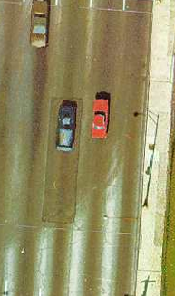
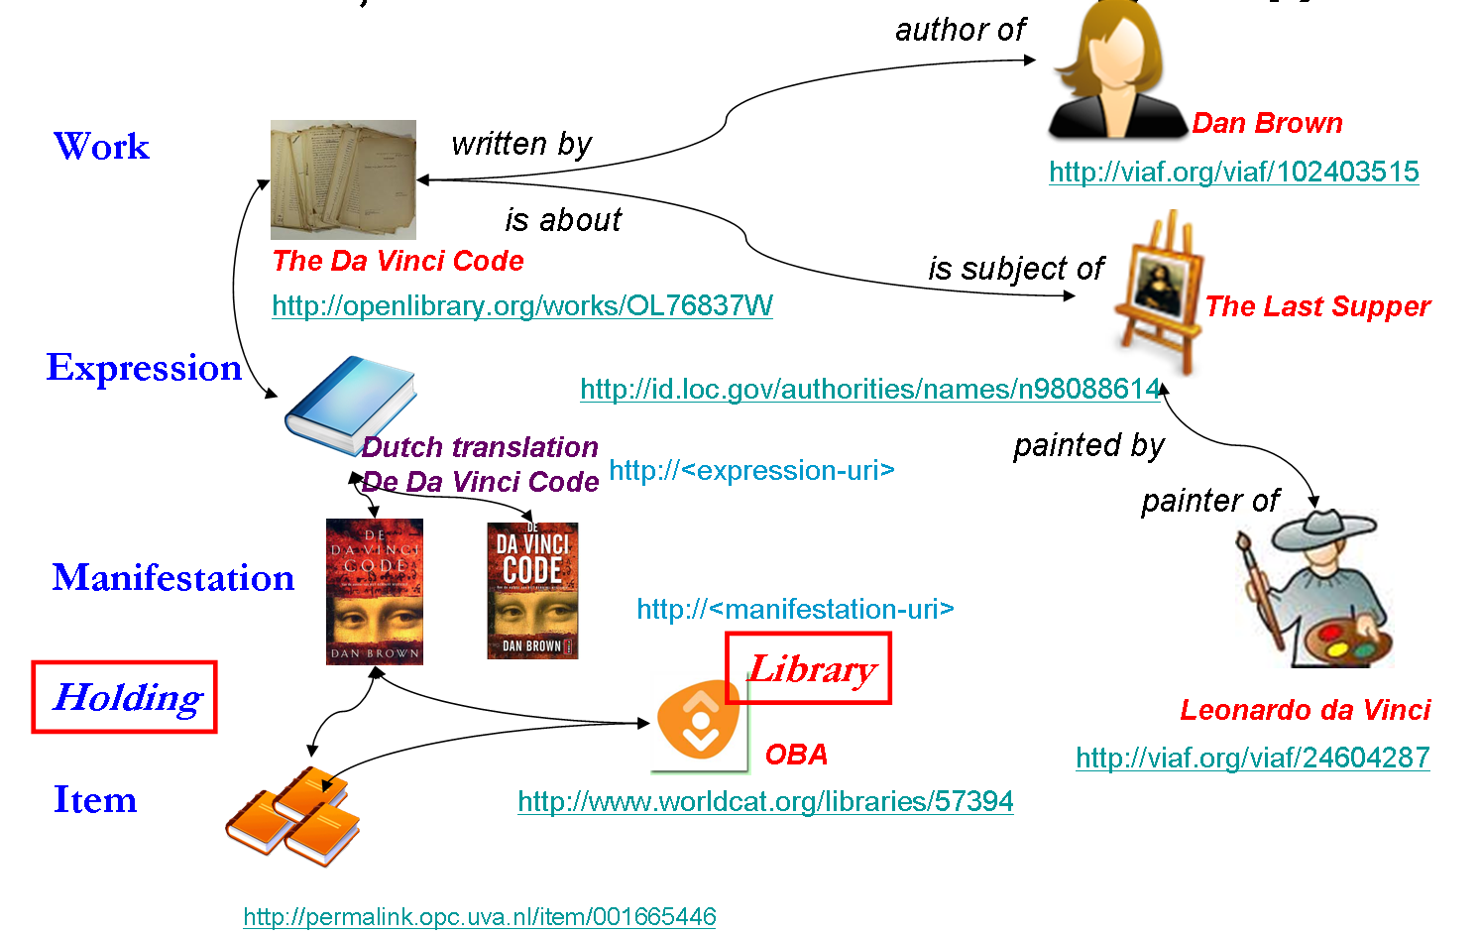
20
Linked Data
Notes:
The old world of RDF and the semantic web
Schemas, ontologies
The new world of loosely typed data
A proliferation of objects
No-SQL and Graph databases (eg. Neo4J)
Competencies, skills, traits, etc

Slide 18
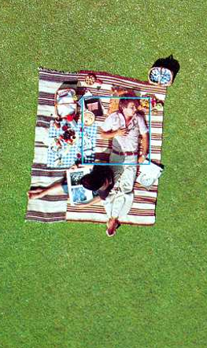
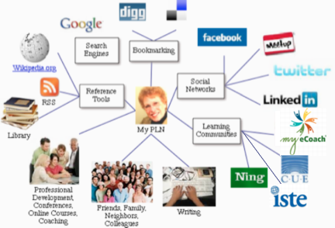
2
You (and a Friend)
Notes:
Personal Learning (vs Personalized Learning) – eg. custom vs customized
Personal Learning Network (PLN)
- communication technologies / social networks /groups and communities

Slide 19
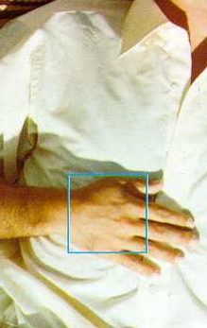
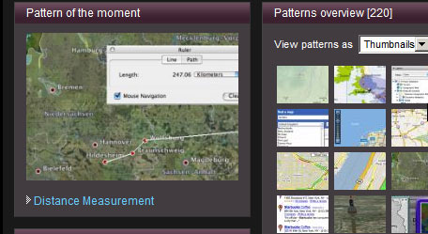
0.2
Interfaces
Notes:
Design Patterns (vs Learning Design)
Open-ended vs ‘programmed’
Usability, design elements, tropes
Interactivity – type, mouse, gestures, thought?
Modalities: dashboard / HUD, simulation, text & graphics
Interface Types
Web / Mobile / Wearable / Instrument

Slide 20
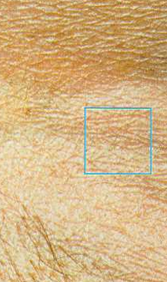
0.02
Language and Text
Notes:
Multi-languages – language of graphics, etc / LOLCats
Language as a tool for representation vs language as a tool for use / function
- meaning, if it operates at all, operates at this level

Slide 21
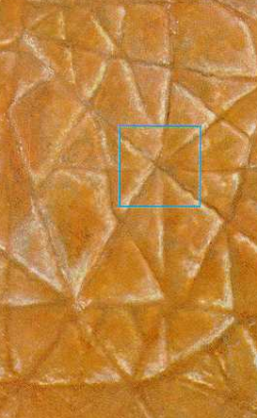
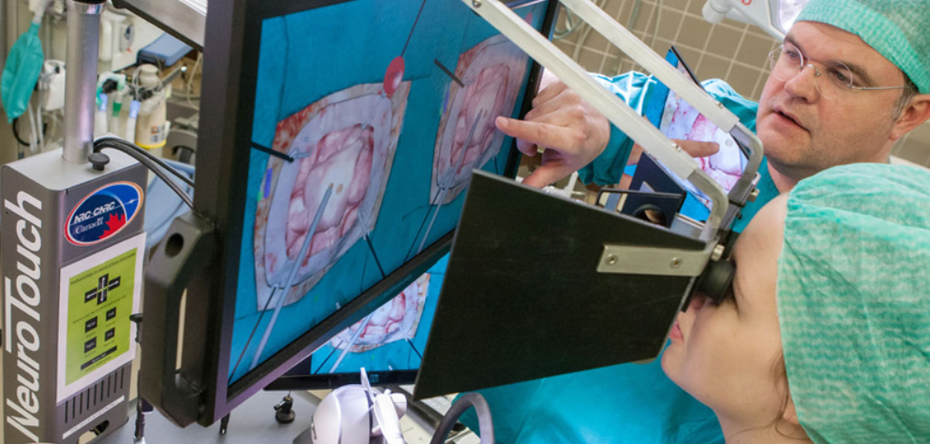
0.002
Touch
Notes:
Haptic interfaces – extending learning to tools and devices
The MOOC as an immersive experience – practice, not retention

Slide 22
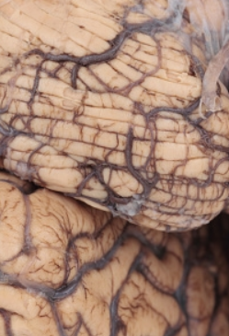
0.0002
Neural Network
Notes:
Connectivism – the idea that knowledge (in a person, in a society) is the system of connections in a network
Learning – to grow and traverse those networks

Slide 23
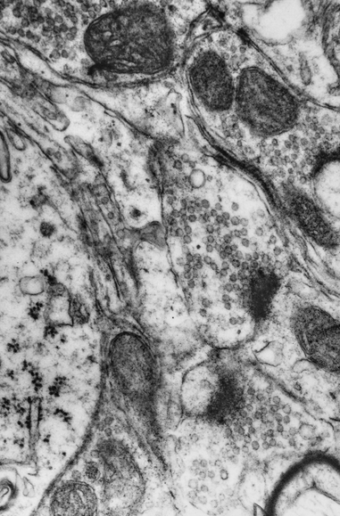
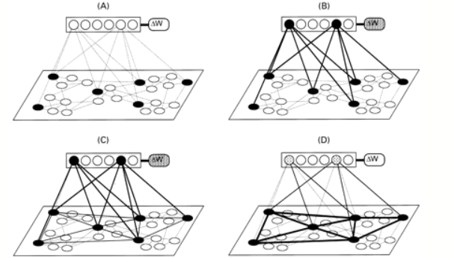
Image: http://brain.oxfordjournals.org/content/124/4/647
0.00002
Synapse
Notes:
Learning theories – associationism – Hebbian / Back Propagation / Boltzman

Slide 24
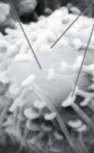
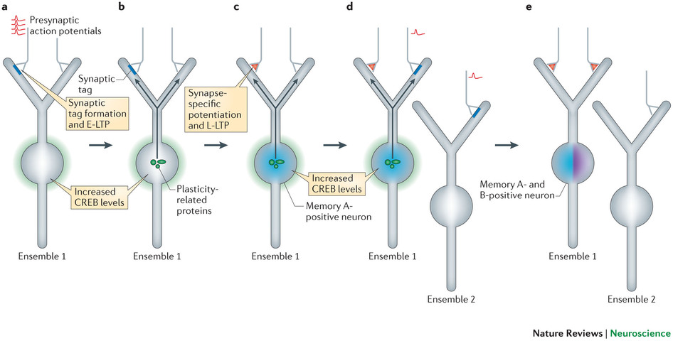
Image: http://www.slideshare.net/jamiehworkman/nervous-system-3-32538833
0.000002
Bit
Notes:
Propagation of signals, activation levels, weights, strength of connection

Slide 25
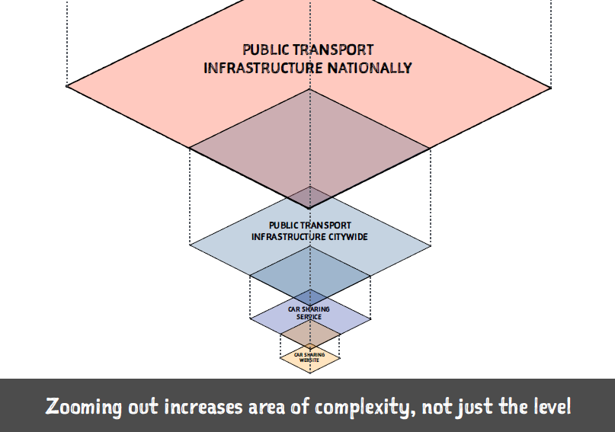
Lessons
Image: http://brain.oxfordjournals.org/content/124/4/647
Levels
Andy Polaine: http://www.slideshare.net/apolaine/design-to-the-power-of-ten
Notes:
Zooming in and out

Slide 26
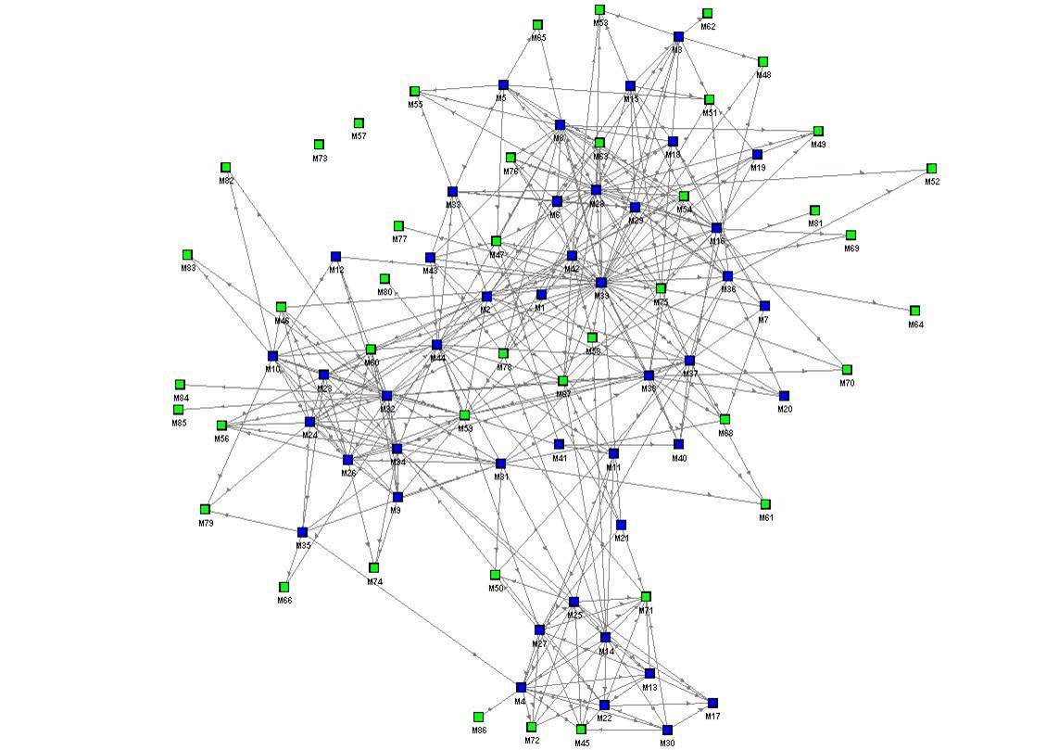
Levels
Levels
Andy Polaine: http://www.slideshare.net/apolaine/design-to-the-power-of-ten
Notes:
Zooming in and out is not a simple change of scale – concepts that apply at one level do not apply at another level
Not just rhetorically true – physically true as well
Eg. subatomic physics obeys rules of its own
Applies equally to folk-psychology
Laws of nature do not apply to language (Fodor: objective pull)
Meanings don’t apply to nature (constructivist pull)

Slide 27
Quine’s Two Dogmas of Empiricism
Downes’s Educationism
Reductionism is False
No Analytic-Synthetic Distinction
Notes:
Quine
One level is not ‘composed’ of another
‘knowledge’ is not composed of ‘competencies’
One level does not ‘represent’ another
‘models’ in one level not analytic at another level

Slide 28
Cognition
Emergence Recognition
Notes:
Instead of representation and reduction – emergence and recognition

Slide 29
Complex
Levels
Andy Polaine: http://www.slideshare.net/apolaine/design-to-the-power-of-ten
Notes:
No clearly identifiable levels –networks intermingle

Slide 30
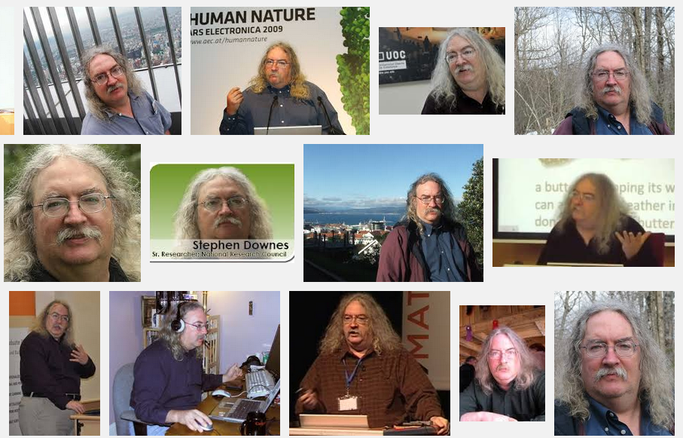
Stephen Downes http://www.downes.ca

