Slide 1
MOOCs, cLearning and cLearning
Stephen Downes
13 October 2015

Slide 2
Two Approaches…
Content
Practice
Practice
Content

Slide 3
Two Approaches…
Defines an ideal state
Defines a desired state
Content
Practice
Practice
Content
TEST
TRY
Person tests you
Person helps you

Slide 4
Two Approaches…
Defines an ideal state
Defines a desired state
Content
Practice
Correction
Iteration
GAP
Practice
Content
Opport-unity
TEST
TRY
Person tests you
Person helps you

Slide 5
Library Environment
Defines an ideal state
Defines a desired state
Content
Practice
Affordances
Correction
Requirements
Iteration
GAP
Practice
Content
Opport-unity
TEST
TRY
Person tests you
Person helps you

Slide 6
Personalized Personal We do for you You do for yourself
Defines an ideal state
Defines a desired state
Content
Practice
Affordances
Correction
Requirements
Iteration
GAP
Practice
Content
Opport-unity
TEST
TRY
Person tests you
Person helps you

Slide 7
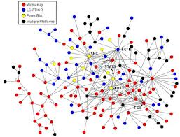
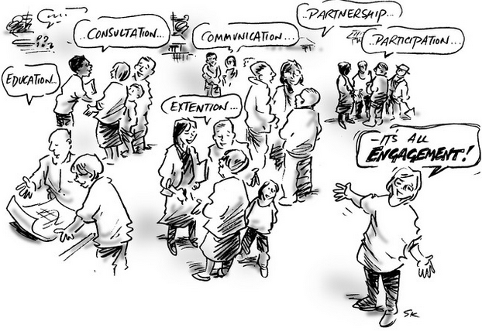
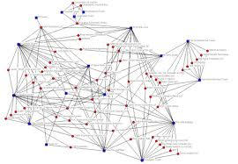
xLearning vs cLearning
contents
engagement
networks
http://www.corestandards.org/
http://www.magnet.edu/
http://lisahistory.net/wordpress/2012/08/three-kinds-of-moocs/

Slide 8
Personalized Personal We do for you You do for yourself
Defines an ideal state
Defines a desired state
Content
Practice
Affordances
Correction
Requirements
Iteration
GAP
Practice
Content
Opport-unity
TEST
TRY
Person tests you
Person helps you

Slide 9
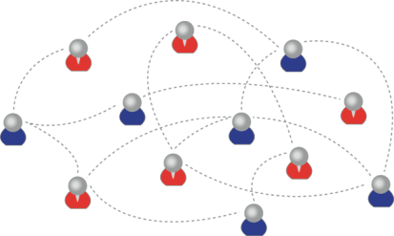
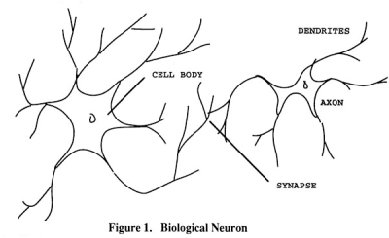
How to Create a cMOOC
It’s like creating a network
Don’t centralize
Concentrate on the creation of links
We use social networks...
… to create personal knowledge

Slide 10
LPSS (Learning & Performance Support Systems)
Data, Information Retrieval
Management Layer
Cleansing/Filtering/Profiling/Processing
Search/Recommendation Layer
Learning activity sequencing/modeling
Data Representation
RRN
CF
PLA
Prototype Repository
Standards/Communication protocols
PLR
Data Capture
Security Protocols
Security Protocols
Distributed Architecture
Personal Learning Record
PC
ACDR
Data synchronization
Personal Access to Network Storage
Cloud Storage and Management
Performance Trends Algorithm
Competence Development
Automated Assessment

Slide 11
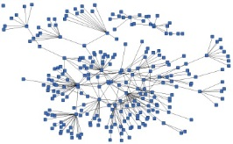
LPSS is Built Around the Personal Learning Record
This is a new type of data – we call it the personal graph.
Each person has their own private personal graph.
The PLR contains all a person’s learning records, including:
certificates, badges and credentials
activity records, test results, scores
Assignments, papers, drawings, things they create
Me

Slide 12
LPSS is Built Around the Personal Learning Record
Stuff Goes Out
Stuff Comes In
Learning Activities
I read and watch stuff
I play with toys
I make stuff
Things, Properties, Relations
Things I did
Stuff I make
Big stuff goes here
Me
Questions
Personal Library
Pictures
Books
Movies
Answers
Learning Analytics Services

Slide 13
RRN Aggregation and Storage
Personal
Context
Article
Photograph
Video
Person
Author
Publisher
Organization
Job Opportunity
Competency
Cetrificate
Event
Location / Place
Time / Date
Email
RSS
OAI
Sharepoint
Facebook
Twitter
Monster
Government
Repositories
Desire2Learn
Coursera
EdX
etc
Parsing
Scraping
Analytics
etc
Storage
RELATIONS

Slide 14
Personal Learning Record
OERs
Portfolio, artifacts and evidence
Badges, certificates, credentials, competencies
Activity Record - LRS
PLR

Slide 15
What is Learning?
Engagement and experience in professional networks
We grow our knowledge and capacities
We use social networks...
… to create personal knowledge

Slide 16
How to Evaluate Learning
Learning is not possession of a collection of facts, it’s the expression of a capacity
Learning is recognized by a community of experts in a network
Learning analytics
We recognize our understandings…
…by the way we use them in our social network

Slide 17
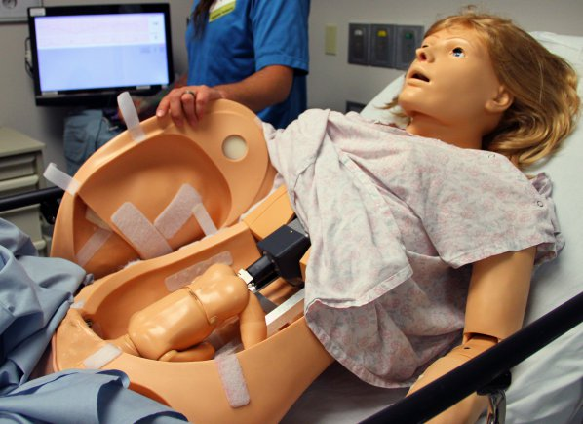
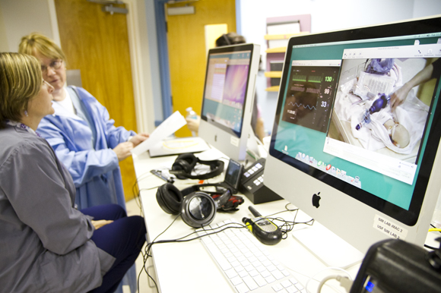
Medical Simulations
http://www.army.mil/article/127148/
http://www.83degreesmedia.com/features/camls011012.aspx

Slide 18
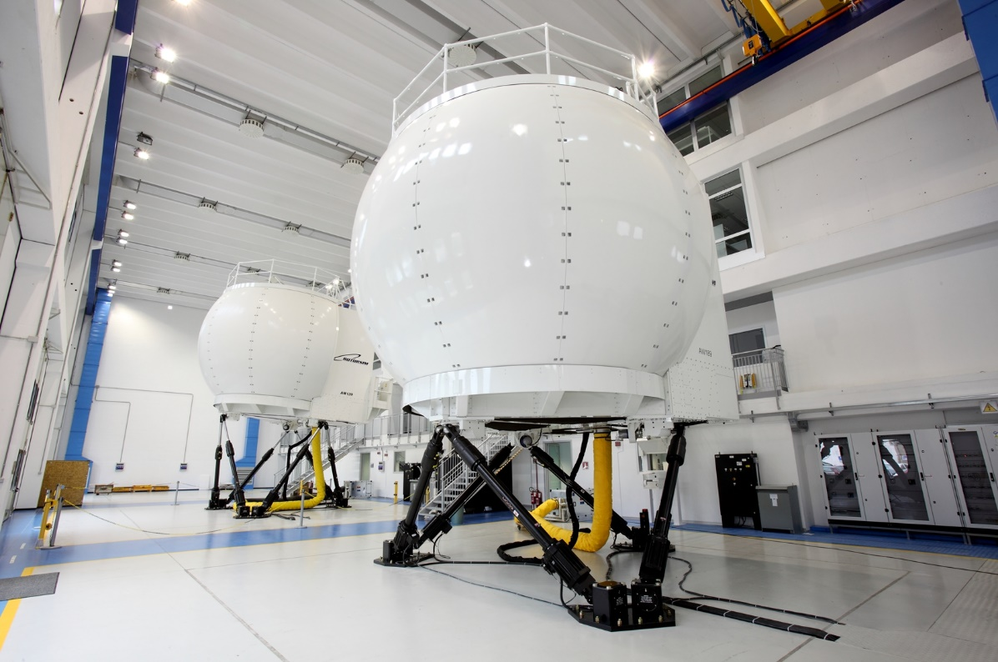
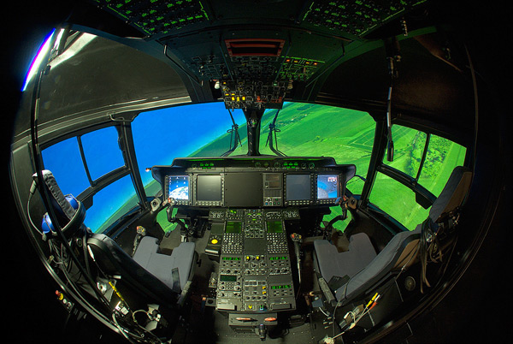
Flight Simulators
http://www.cae.com/World-s-first-AW189-full-flight-simulator-ready-for-training/
http://www.aiac.ca/canada-aerospace-industry/success-stories/cae-nh90-helicopter-simulator/
http://www.aiac.ca/canada-aerospace-industry/success-stories/cae-nh90-helicopter-simulator/

Slide 19
MINT - Mobile INteractive Trainer
http://www.downes.ca/post/59876

Slide 20
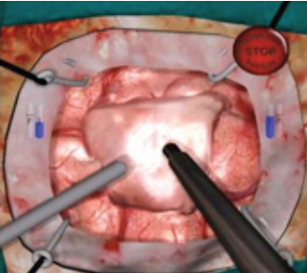
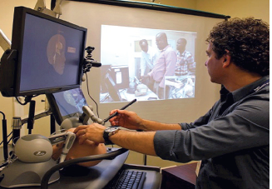
NeuroTouch Simulator

Slide 21
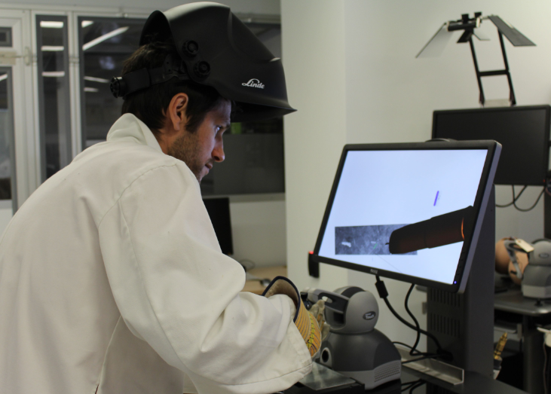
Sim-Welding

Slide 22
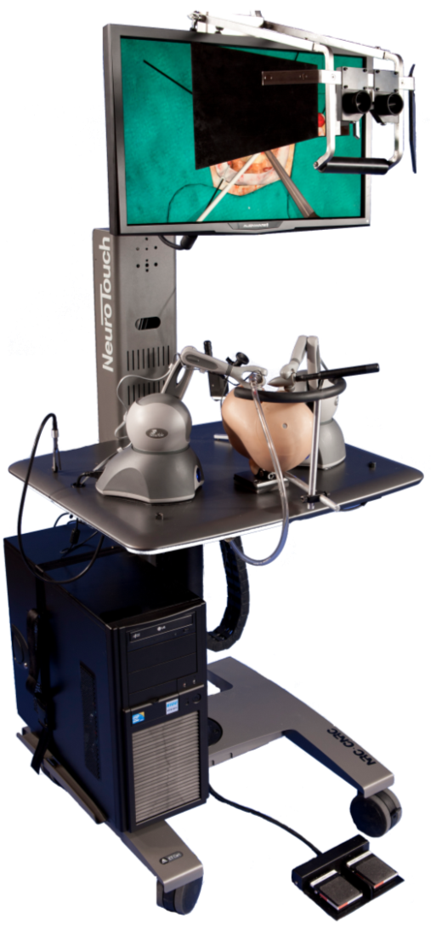
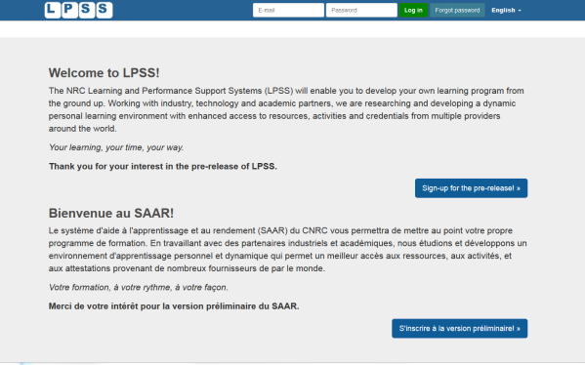
LPSS-Sim Project Overview
Simulation
Learning Space
(SLS)

Slide 23
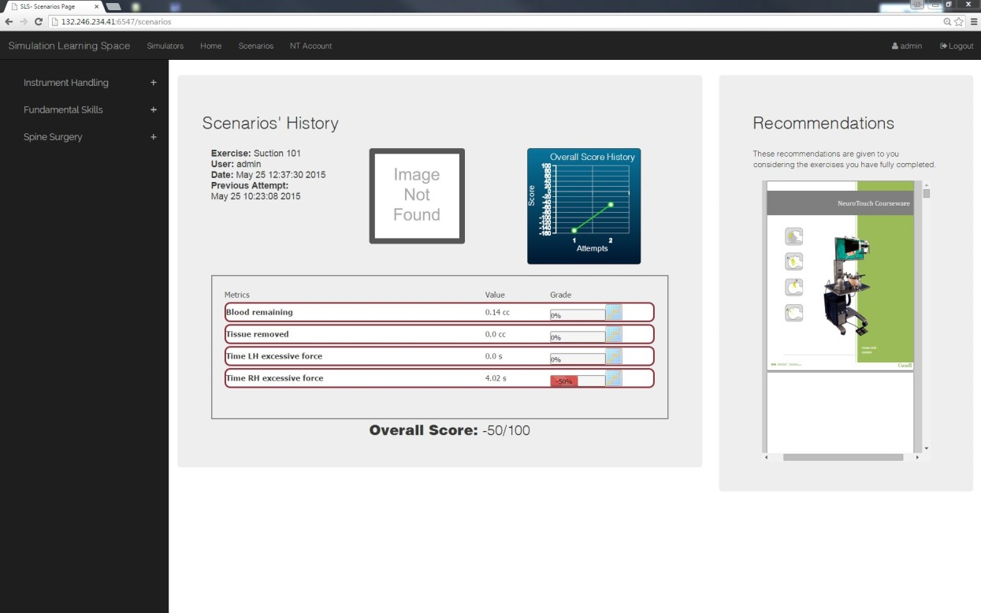
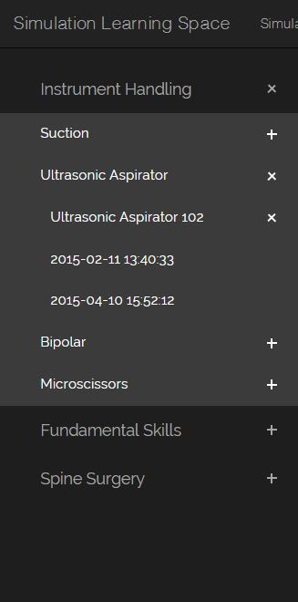
Combining Experiences
One place for all simulation experience
All performance results no matter where and when
they were carried out

Slide 24
Analytics and Big Data
Facebook
Twitter
EdX
Coursera
YouTube
Blackboard
Email
etc
Shallow
Tells us about the platform
Deep
Tells us about the person

Slide 25
Expanding LPSS
$20 Million Investment
NRC Technologies
Development Environment
$x + $y
Project
NRC
Funder
$y
Partner
University
Government
Development Agency
Foundation
UNESCO / UN
Corporate Partner
$x

Slide 26
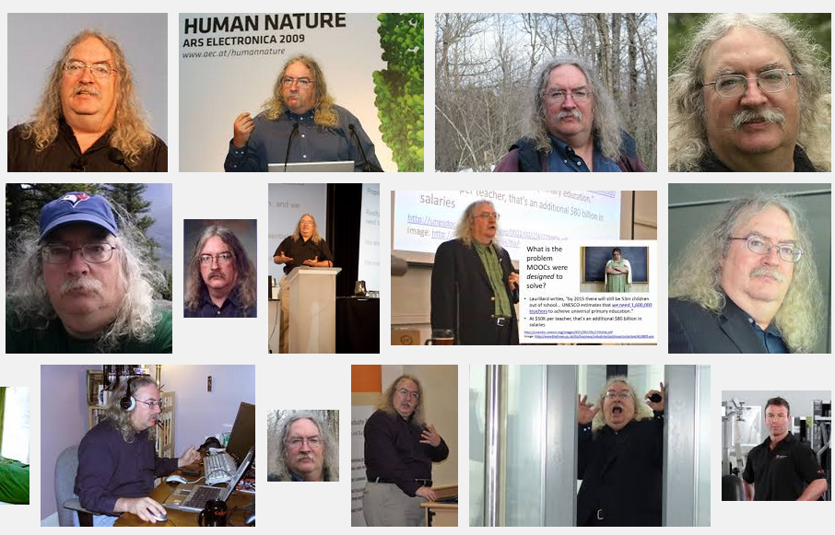
Stephen Downes
http://www.downes.ca

