Slide 1
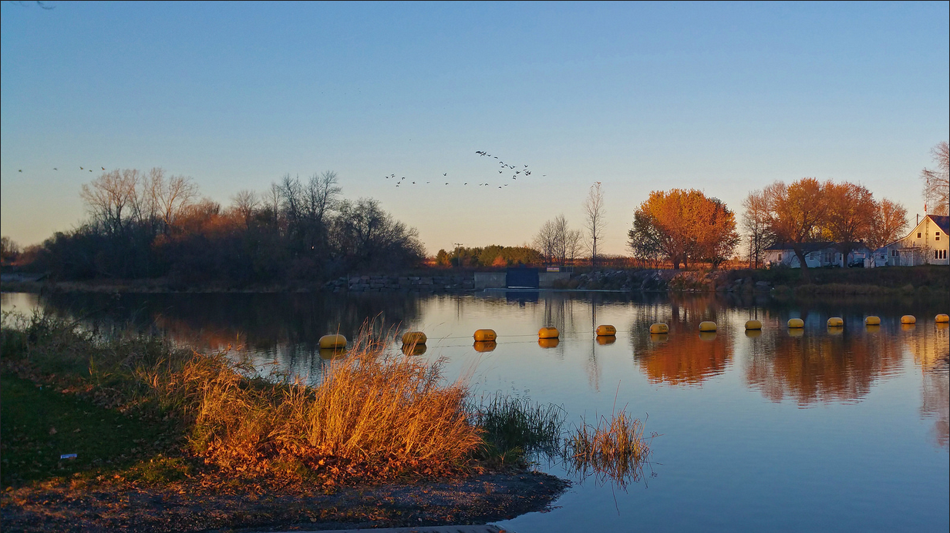
Inspire: Learning!
Stephen Downes
Inspire 2015
October 29, 2015

Slide 2
Learning Through Practice
When it really matters, we don’t simply trust classrooms and texts, we expect hands-on practice…

Slide 3
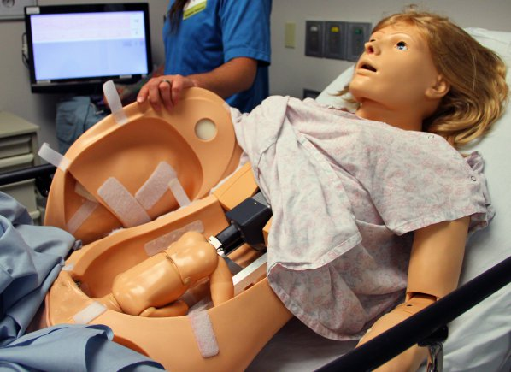
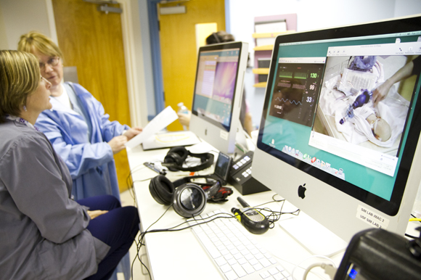
... For medical professionals
http://www.army.mil/article/127148/
http://www.83degreesmedia.com/features/camls011012.aspx

Slide 4
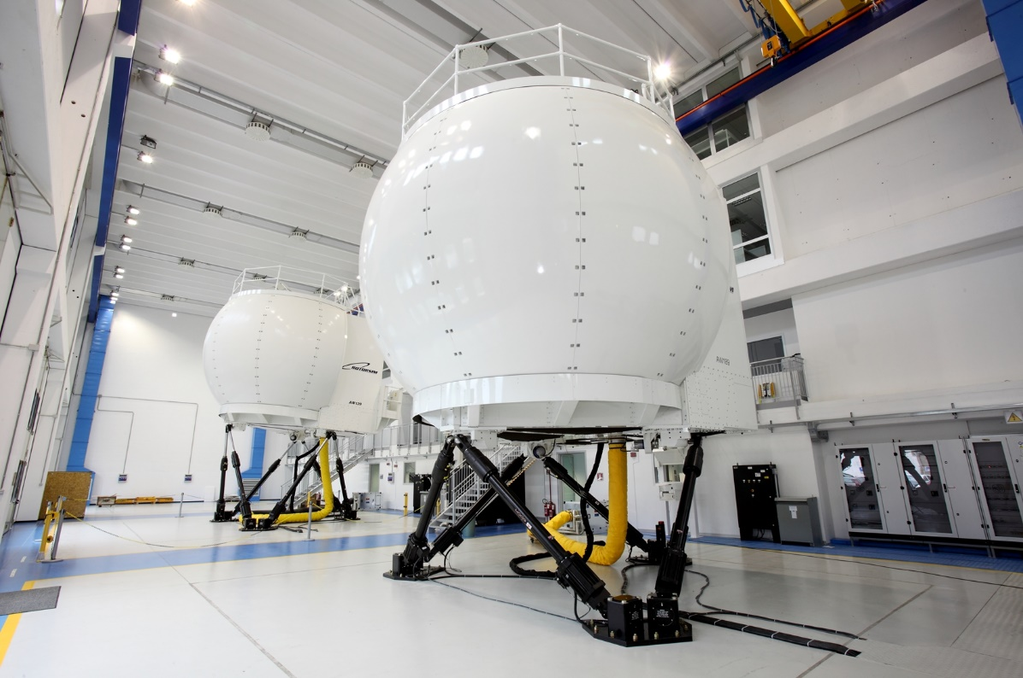
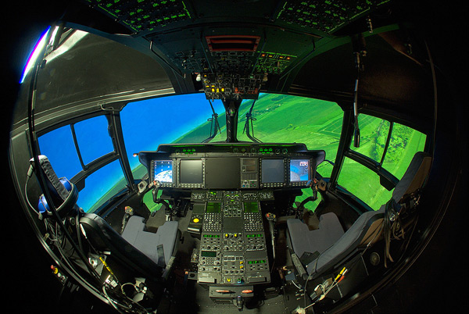
… for pilots and navigators
http://www.cae.com/World-s-first-AW189-full-flight-simulator-ready-for-training/
http://www.aiac.ca/canada-aerospace-industry/success-stories/cae-nh90-helicopter-simulator/
http://www.aiac.ca/canada-aerospace-industry/success-stories/cae-nh90-helicopter-simulator/

Slide 5
… for military and police
http://www.downes.ca/post/59876

Slide 6
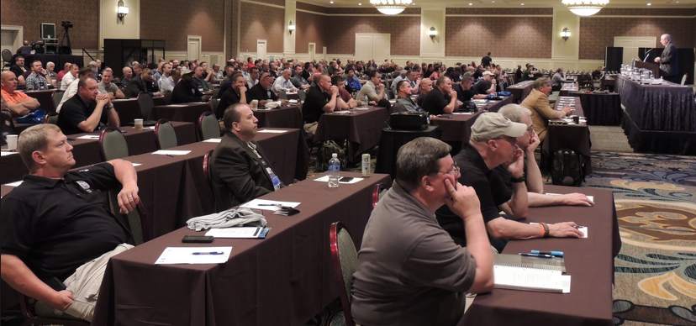
So why not the rest of us?
Image: https://www.iabti.org/itc

Slide 7
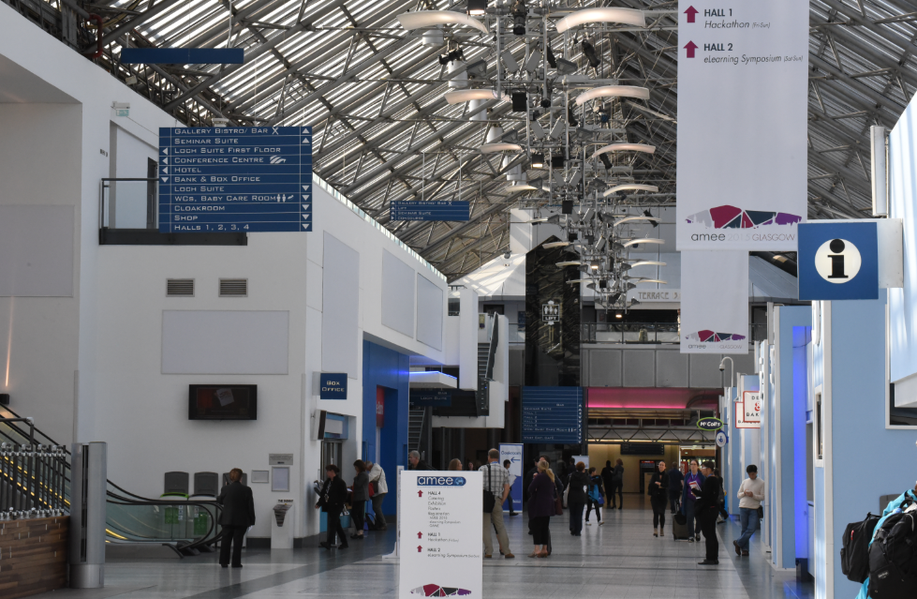
The Case of the MOOC

Slide 8
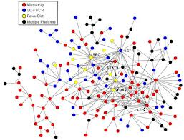
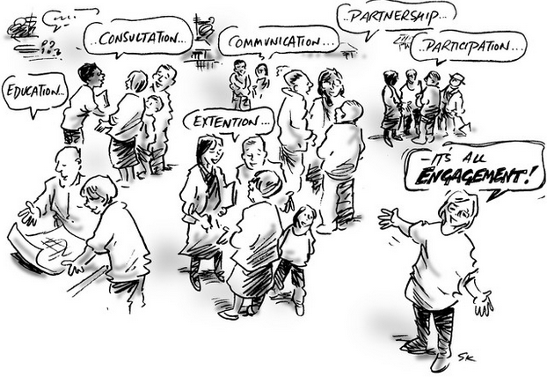
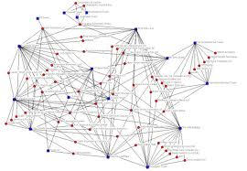
xLearning vs cLearning
contents
engagement
networks
http://www.corestandards.org/
http://www.magnet.edu/
http://lisahistory.net/wordpress/2012/08/three-kinds-of-moocs/

Slide 9
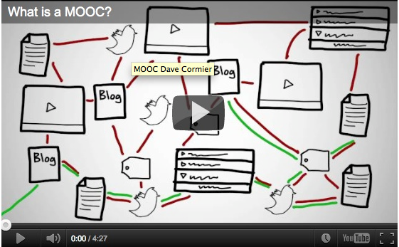
How to Learn in a cMOOC
Learning is a process of immersion into a knowing community
http://www.tonybates.ca/2012/03/03/more-reflections-on-moocs-and-mitx/

Slide 10
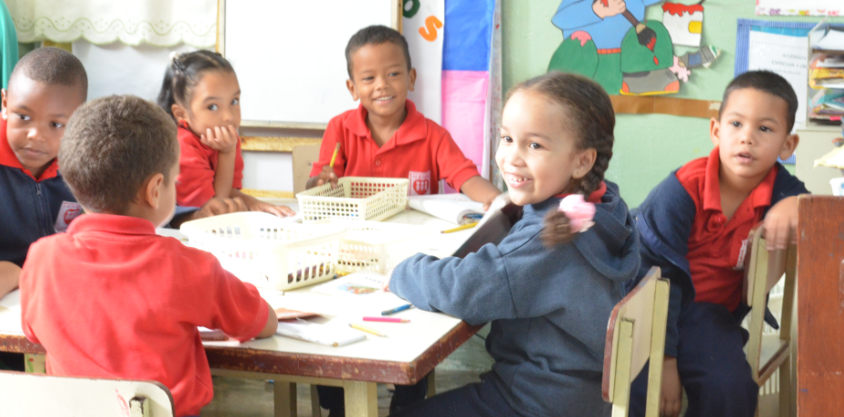
MOOC Design
Course structure – a series of topics
The instructors will not ‘teach’ the topics, they ‘investigate’ or ‘work through’ the topics (model and demonstrate)

Slide 11
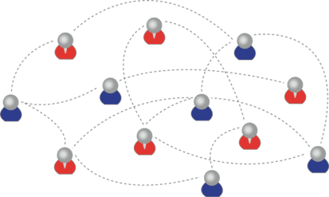
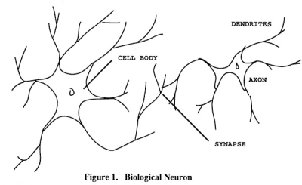
How to Create a cMOOC
It’s like creating a network
Don’t centralize
Concentrate on the creation of links
We use social networks...
… to create personal knowledge

Slide 12
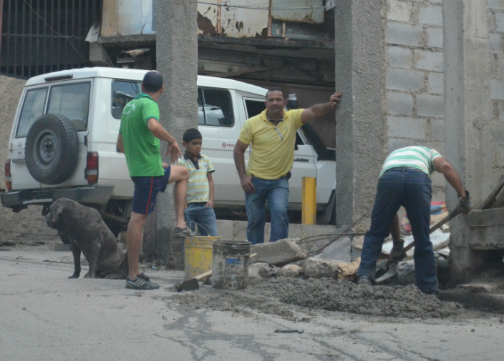
Learning is a process of recognizing and growing into or becoming an instantiation of those values…

Slide 13
Two Approaches…
Content
Practice
Practice
Content

Slide 14
Two Approaches…
Defines an ideal state
Defines a desired state
Content
Practice
Practice
Content
TEST
TRY
Person tests you
Person helps you

Slide 15
Two Approaches…
Defines an ideal state
Defines a desired state
Content
Practice
Correction
Iteration
GAP
Practice
Content
Opport-unity
TEST
TRY
Person tests you
Person helps you

Slide 16
Library Environment
Defines an ideal state
Defines a desired state
Content
Practice
Affordances
Correction
Requirements
Iteration
GAP
Practice
Content
Opport-unity
TEST
TRY
Person tests you
Person helps you

Slide 17
Personalized Personal We do for you You do for yourself
Defines an ideal state
Defines a desired state
Content
Practice
Affordances
Correction
Requirements
Iteration
GAP
Practice
Content
Opport-unity
TEST
TRY
Person tests you
Person helps you

Slide 18
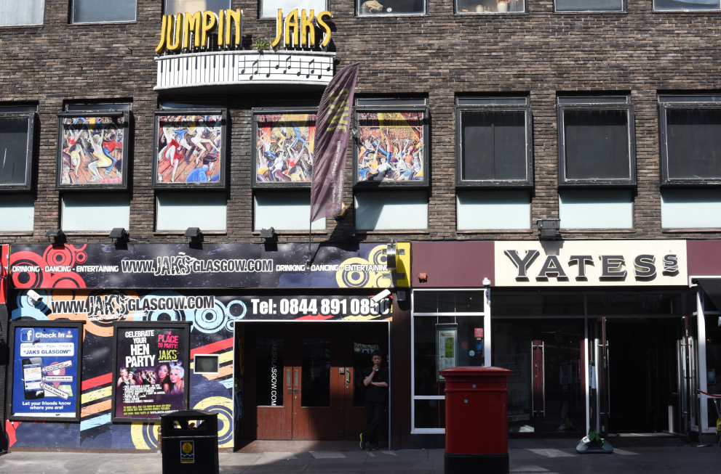
Personal Learning Environments

Slide 19
Course Provider Perspective
Subscribed
students
Student
content
Site
Course
content
Live online events
Event recordings

Slide 20
The Student’s Perspective
Site
A range of different resources and services

Slide 21
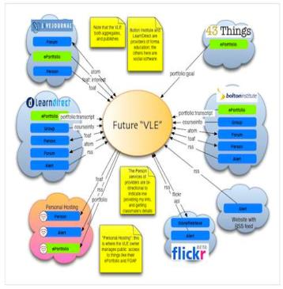
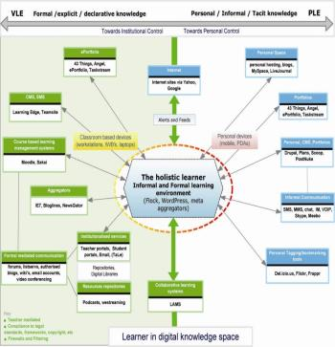
The design is based on putting the learner at the centre
Scott Wilson (left), Tim Hand (right)
https://www.google.com/search?q=ple+diagrams
http://www.edtechpost.ca/ple_diagrams/index.php/mind-map-3

Slide 22
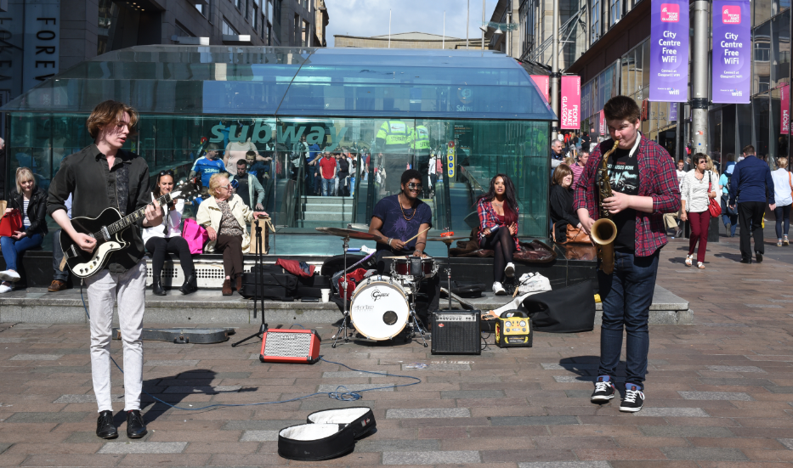
Learning and Performance Support Systems

Slide 23
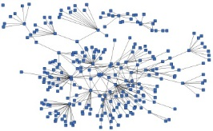
LPSS is Built Around the Personal Learning Record
This is a new type of data – we call it the personal graph.
Each person has their own private personal graph.
The PLR contains all a person’s learning records, including:
certificates, badges and credentials
activity records, test results, scores
Assignments, papers, drawings, things they create
Me

Slide 24
LPSS is Built Around the Personal Learning Record
Stuff goes out
Stuff Comes In
Learning Activities
I read and watch stuff
I practice & use simulations
I make stuff to share
Things, Properties, Relations
Things I did
Stuff I make
Big stuff goes here
Me
Questions
Personal Library
Pictures
Books
Movies
Answers
Learning Analytics Services

Slide 25
LPSS Details
Data, Information Retrieval
Management Layer
Cleansing/Filtering/Profiling/Processing
Search/Recommendation Layer
Learning activity sequencing/modeling
Data Representation
RRN
CF
PLA
Prototype Repository
Standards/Communication protocols
PLR
Data Capture
Security Protocols
Security Protocols
Distributed Architecture
Personal Learning Record
PC
ACDR
Data synchronization
Personal Access to Network Storage
Cloud Storage and Management
Performance Trends Algorithm
Competence Development
Automated Assessment

Slide 26
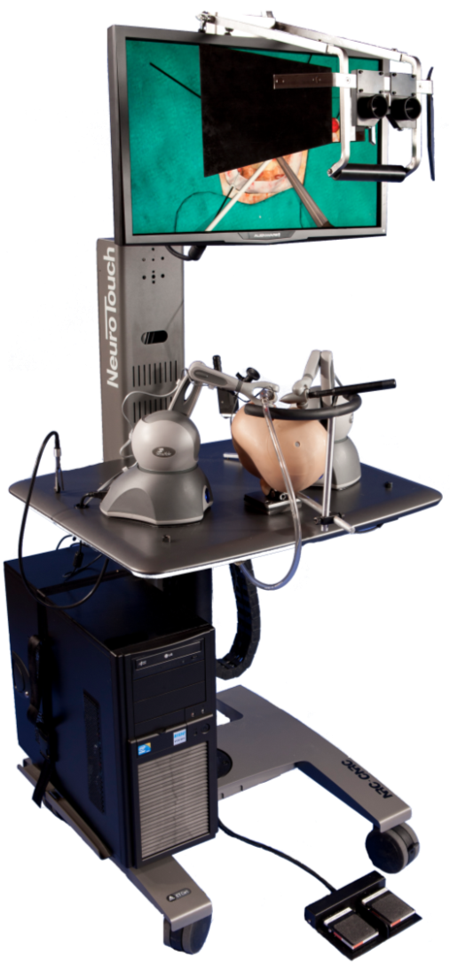
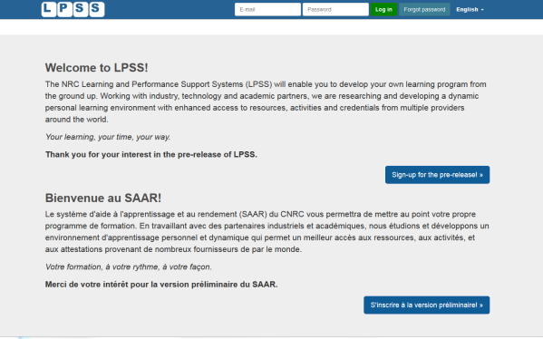
LPSS-Sim Project Overview
Simulation
Learning Space
(SLS)

Slide 27
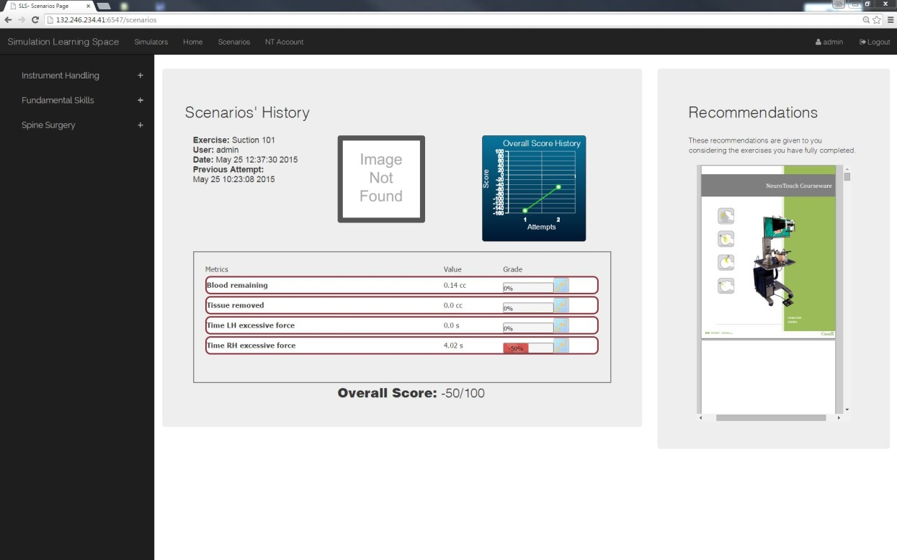
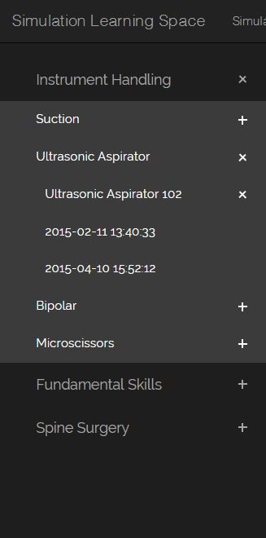
Combining Experiences
One place for all simulation experience
All performance results no matter where and when
they were carried out

Slide 28
OIF – MOOC-REL
http://rel2014.mooc.ca/

Slide 29
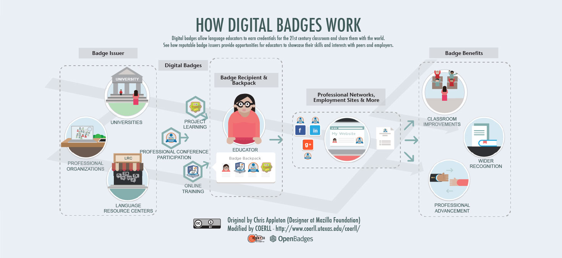
PCO Badges for Learning
http://www.downes.ca/post/63738

Slide 30
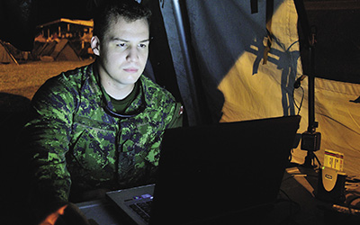
ONGARDE
http://www.journal.forces.gc.ca/vol14/no2/page70-eng.asp

Slide 31
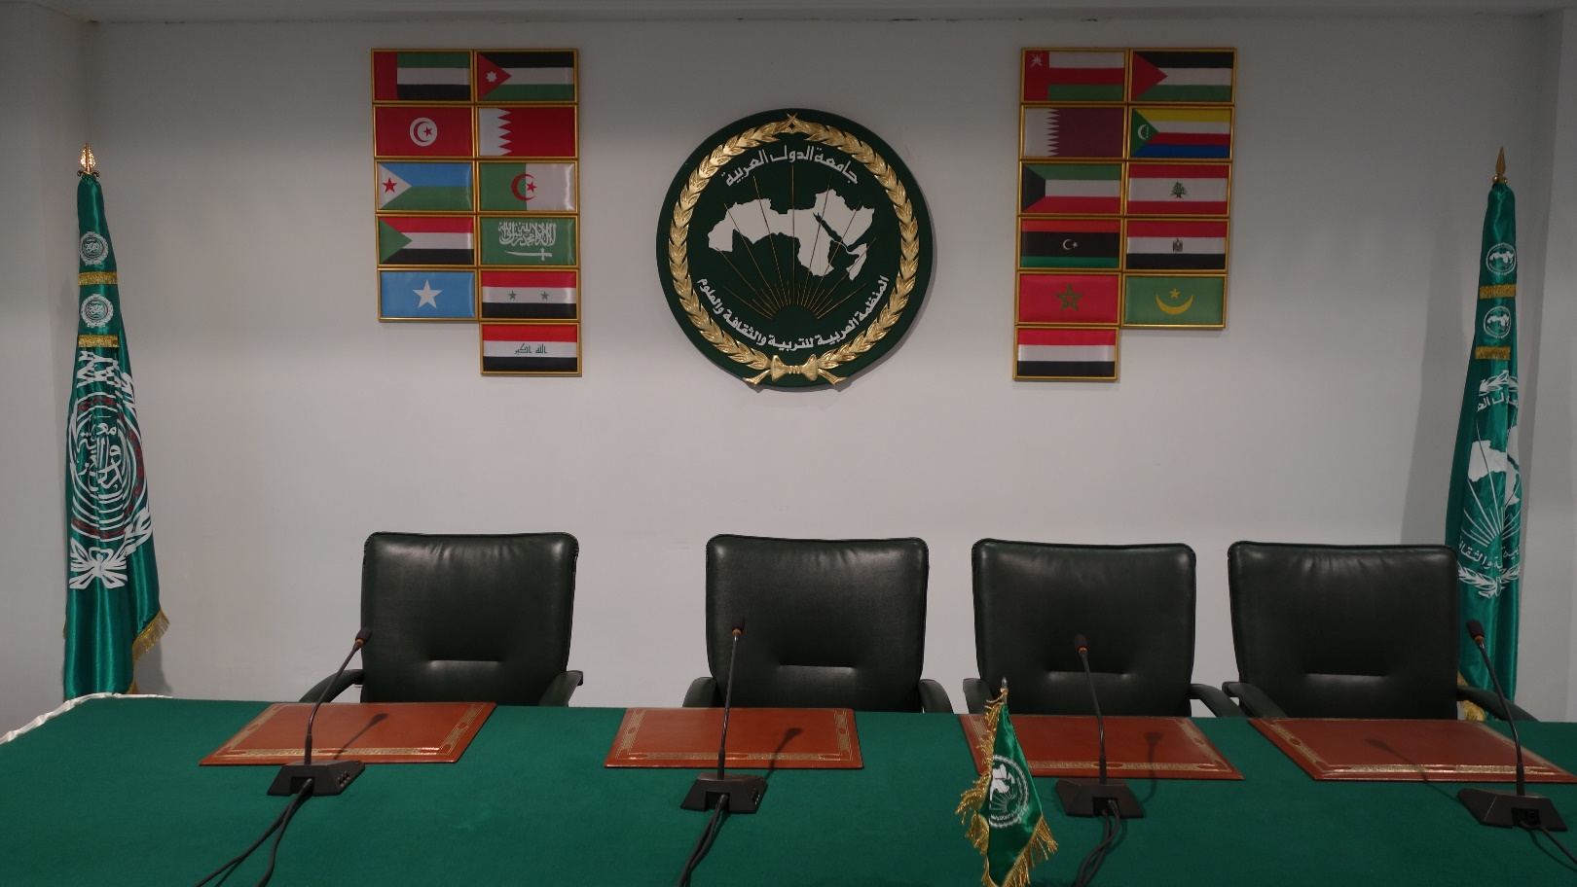
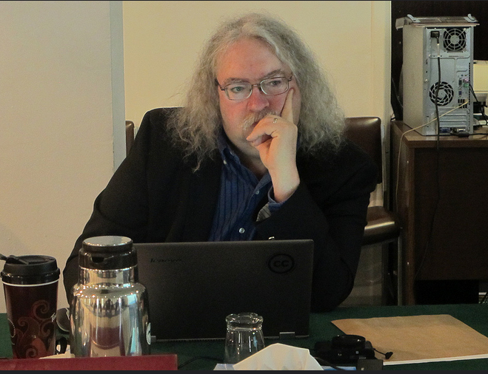
ALECSO – Capacity Building
http://www.downes.ca/presentation/337

Slide 32
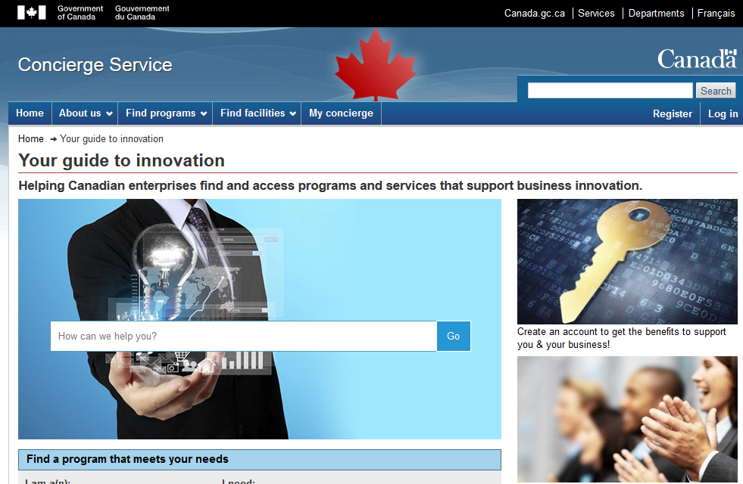
Concierge OMS
https://concierge.portal.gc.ca/

Slide 33
Expanding LPSS
$20 Million Investment
NRC Technologies
Development Environment
$x + $y
Project
NRC
Funder
$y
Partner
University
Government
Development Agency
Foundation
UNESCO / UN
Corporate Partner
$x

Slide 34
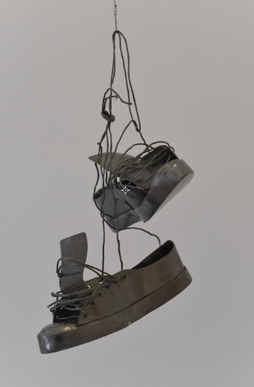
Possible Projects…
OERs, Repositories, Marketplaces
Badges, Credentials, Recognition
Simulations & Workplace Support
Matching People to Opportunities

Slide 35
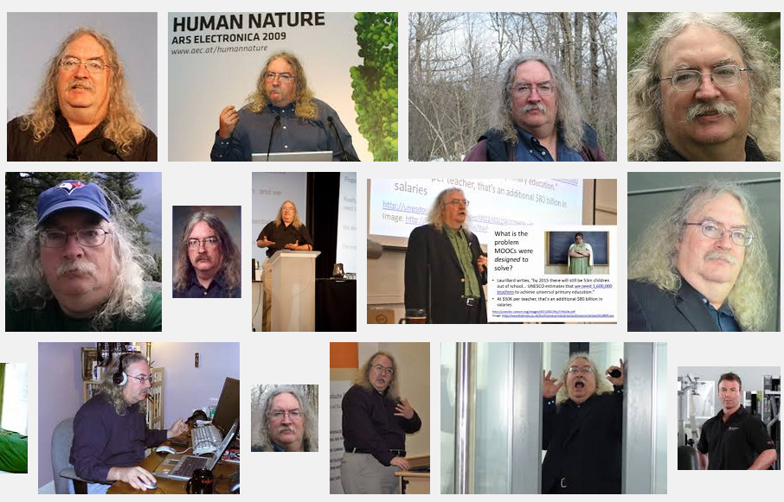
Stephen Downes
http://www.downes.ca

