Slide 1
Beyond Instructional Design: Open Spaces and Learning Places
Stephen Downes, National Research Council Canada
Presented to:
American Distance Education Consortium (ADEC)
October 21, 2015

Slide 2
What is Instructional Design Anyway?
“The practice of creating instructional experiences which make the acquisition of knowledge and skill more efficient, effective, and appealing.”
The process, in general:
determining the current state and needs of the learner,
defining the end goal of instruction,
and creating some "intervention" to assist in the transition.
Yes, I cited Wikipedia:
https://en.wikipedia.org/wiki/Instructional_design

Slide 3
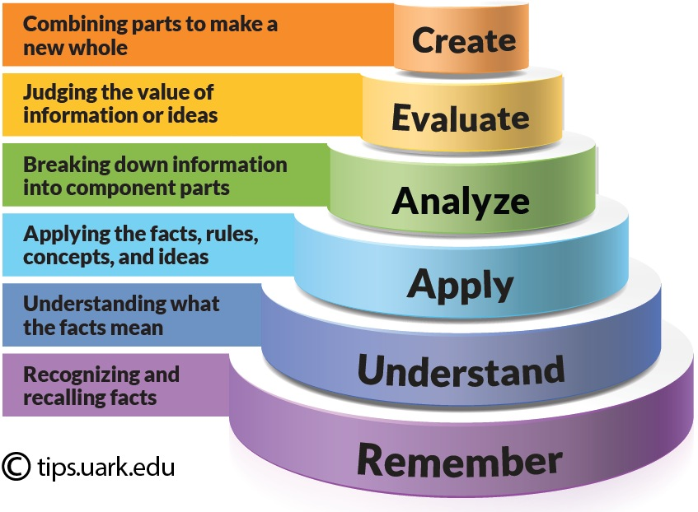
Some Core Concepts
Taxonomies and types of learning
The role of learning objectives (aka outcomes)
Types of outcomes, for example, Bloom’s Taxonomy
Yes, I’m still citing Wikipedia: https://en.wikipedia.org/wiki/Instructional_design
Image: http://tips.uark.edu/using-blooms-taxonomy/

Slide 4
Some Core Concepts
The ‘process’ of learning – learning step-by-step
For example, Gagne’s nine events
Pre-requisites – “ learners acquire prerequisite skills before attempting superordinate’s ones”
Yes, I’m still citing Wikipedia:
https://en.wikipedia.org/wiki/Instructional_design

Slide 5
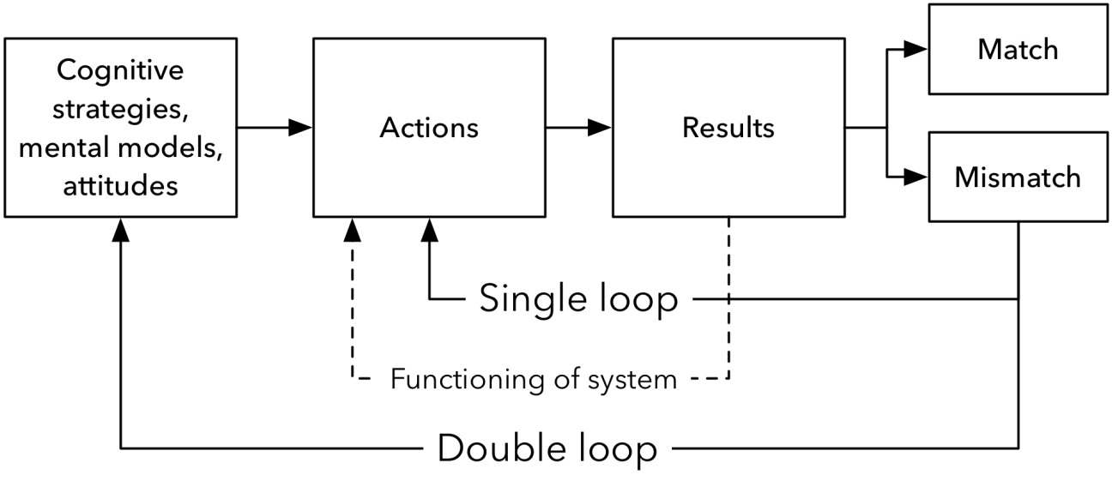
More Core Concepts
Instructional design process
ADDIE - analysis, design, development, implementation, and evaluation
Double Loop – learners’ performance informs the design of the instructional process
ADDIE: http://educationaltechnology.net/the-addie-model-instructional-design/
Double Loop from Argyris et al. 1985; see http://infed.org/mobi/chris-argyris-theories-of-action-double-loop-learning-and-organizational-learning/

Slide 6
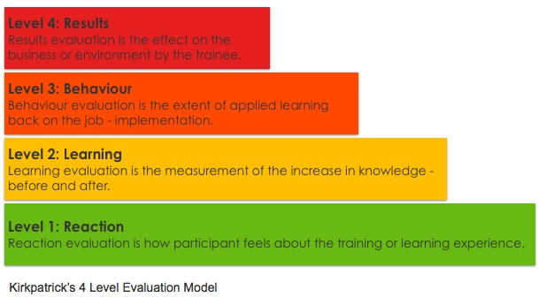
More Core Concepts
Transactional distance
M.G. Moore - “a psychological and communication space to be crossed, a space of potential misunderstanding between the inputs of instructor and those of the learner”.
Shaped by dialogue or interaction, structure of instruction
Assessment and Evaluation
Formative vs Summative assessment
Learning design assessment – Kirkpatrick’s scale
Moore: http://www.c3l.uni-oldenburg.de/cde/support/readings/moore93.pdf
Kirkpatrick: http://www.kirkpatrickpartners.com/OurPhilosophy/TheKirkpatrickModel
Image: https://www.td.org/Publications/Blogs/Healthcare-Blog/2015/01/Measuring-Training-Success-in-Healthcare

Slide 7
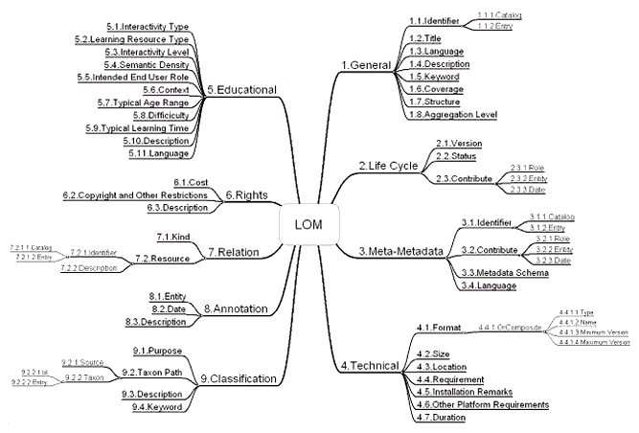
Some Contemporary Technologies
Learning Management Systems (LMS)
Support the ‘intervention’ in the form of learning materials, quizzes and tests, interactions
Learning Content Management System (LCMS)
Supports the creation of learning materials
Contents organized by taxonomies
For example, IMS Learning Object Metadata, Content Packaging
IMS LOM: https://www.imsglobal.org/metadata/index.html

Slide 8
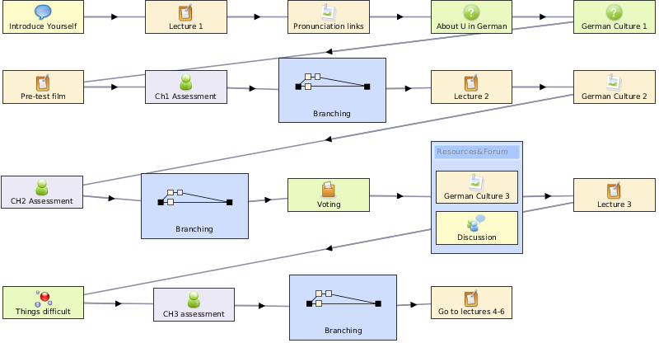
More Contemporary Technologies
Content Sequencing
Ordering learning contents in the desired sequence
Evolved into IMS ‘Learning Design’
Based on Rob Koper’s “Educational Modeling Language’
Learning Activity Management System (LAMS) and other ID tools
IMS Learning Design: http://www.imsglobal.org/learningdesign/index.html
LAMS: https://www.lamsfoundation.org/ LAMS Image: http://www.mychrisalexander.com/lamslearningdesigns.htm

Slide 9
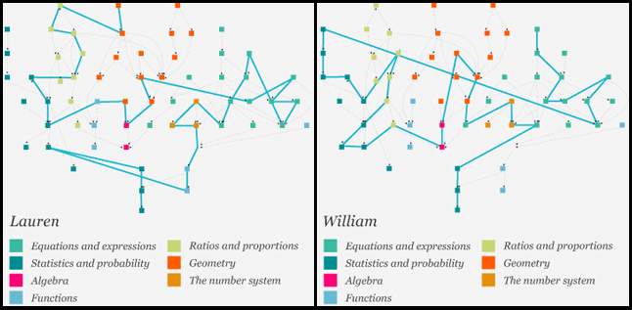
Still More Contemporary Technologies
Adaptive Learning
Orchestrates the provisioning of learning resources according to the individual needs of each learner
Elements or Models:
Expert model - The model with the information which is to be taught
Student model - The model which tracks and learns about the student
Instructional model - The model which actually conveys the information
Instructional environment - The user interface for interacting with the system
Image: Pearson http://www.englishinstructorexchange.com/2013/08/06/the-role-of-adaptive-learning-in-developmental-education/ See also: https://en.wikipedia.org/wiki/Adaptive_learning

Slide 10
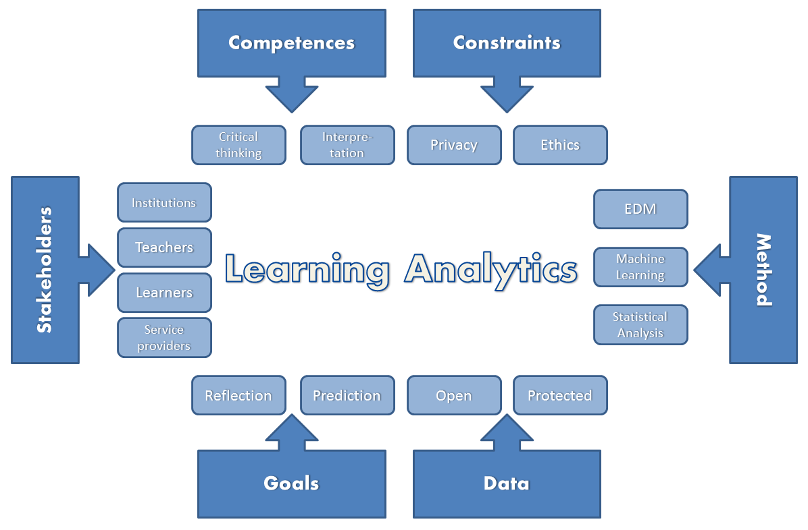
Still More Contemporary Technologies
Learning Analytics
Data collection used to support adaptive learning
LAK11: “the measurement, collection, analysis and reporting of data about learners and their contexts, for purposes of understanding and optimising learning and the environments in which it occurs.”
Predictive analytics – used to model likely learning outcomes and recommend interventions
LAK11: https://tekri.athabascau.ca/analytics/
Image: http://www.greller.eu/wordpress/?p=1467

Slide 11
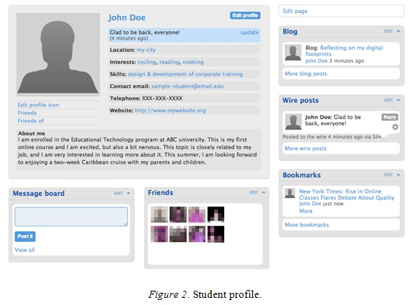
Today’s Technologies
Social Networks and Learning
Social networks as formal learning environments
Learning communities
MOOCs
xMOOC – content
cMOOC – social
Integrated Environments
IMS LTI
Knewton
Formal learning environments: http://www.irrodl.org/index.php/irrodl/article/view/1078/2077
Knewton: https://www.knewton.com/

Slide 12
Interlude: Types of Games
Quiz Games –question and answer format
Like Jeopardy, they test memory
Branch and Tree Games
Board games, for example
Snakes and Ladders, Monopoly
Early Video games
Eg. the LaserDisc games
Open-Ended Environment
Sports, like hockey, baseball, etc.
Pretty much every video game after the laser disc games
Clark Aldrich: http://www.clarkaldrichdesigns.com/
Laser Disc Games: https://en.wikipedia.org/wiki/Category:Laserdisc_video_games

Slide 13
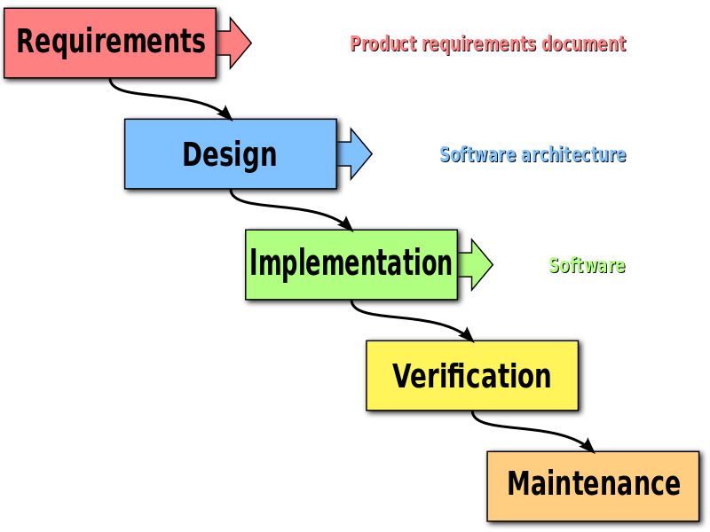
Planned versus Open-Ended Development
Waterfall: like ADDIE
Agile: like open-ended environments
Waterfall: https://en.wikipedia.org/wiki/Waterfall_model#/media/File:Waterfall_model.svg

Slide 14
Knowledge Translation
CIHR – “CIHR, knowledge translation (KT) is defined as a dynamic and iterative process that includes synthesis, dissemination, exchange and ethically-sound application of knowledge to improve the health of Canadians.”
CIHR, http://www.cihr-irsc.gc.ca/e/39033.html

Slide 15
Critcisms of Knowledge Translation
“research should move beyond a narrow focus on the ‘know–do gap’ to cover a richer agenda…”
situation-specific practical wisdom (phronesis)
tacit knowledge shared among practitioners (‘mindlines’)
complex links between power and knowledge; and
macro-level knowledge partnerships
Greenhalgh and Weiringa, http://jrs.sagepub.com/content/104/12/501.full

Slide 16
Design vs Envronment
Design Environment
Content
Practice
Practice
Content

Slide 17
Design vs Envronment
Defines a desired state
Defines an ideal state
Content
Practice
Practice
Content
TEST
TRY
Person tests you
Person helps you

Slide 18
Design vs Envronment
Defines an ideal state
Defines a desired state
Content
Practice
Correction
Iteration
GAP
Practice
Content
Opport-unity
TEST
TRY
Person tests you
Person helps you

Slide 19
Design vs Envronment
Defines a desired state
Defines an ideal state
Content
Practice
Affordances
Correction
Requirements
Iteration
GAP
Practice
Content
Opport-unity
TEST
TRY
Person tests you
Person helps you

Slide 20
Design vs Envronment
Personalized
Personal
Content
Practice
Affordances
Correction
Requirements
Iteration
GAP
Practice
Content
Opport-unity
TEST
TRY
Person tests you
Person helps you

Slide 21
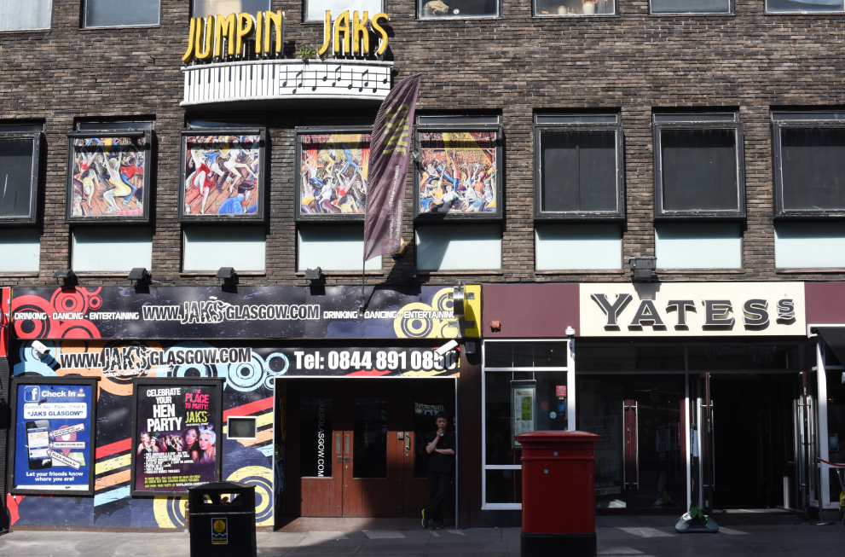
4. Personal Learning Environments

Slide 22
Personal Learning Environments
http://dmlcentral.net/blog/howard-rheingold/diy-u-interview-anya-kamenetz
http://www.downes.ca/post/58150
Notes:
Howard Rheingold searches for the new in Anya Kamenetz's Edupunk's Guide, suggesting that what has been added is the idea of the personal learning plan to the personal learning network. "Making a public commitment to something is going to increase your accountability," says Kamenetz. Rheingold writes, "Her work serves as a bridge between blended learning and peeragogy. I previously wrote about Shelly Terrell and personal learning networks" and asks here what it takes for a group to self-organize. Kamanetz responds that there needs to be a common understanding of the goal - of course, this would be the outcome of self-organization, not what makes it possible.

Slide 23
Underlying MOOC Support
1. First student creates resource and sends info to course
Site
2. Second student sees resource info in newsletter and RSS feed
3. Second student accesses the resource directly
4. Second student finds link to third student’s resource

Slide 24
Course Provider Perspective
Subscribed
students
Student
content
Site
Course
content
Live online events
Event recordings

Slide 25
The Student’s Perspective
Site
A range of different resources and services

Slide 26
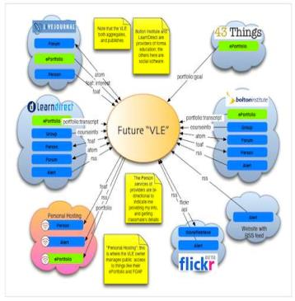
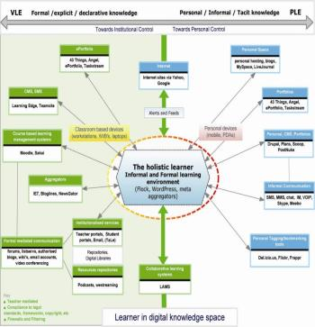
The design is based on putting the learner at the centre
Scott Wilson (left), Tim Hand (right)
https://www.google.com/search?q=ple+diagrams
http://www.edtechpost.ca/ple_diagrams/index.php/mind-map-3

Slide 27
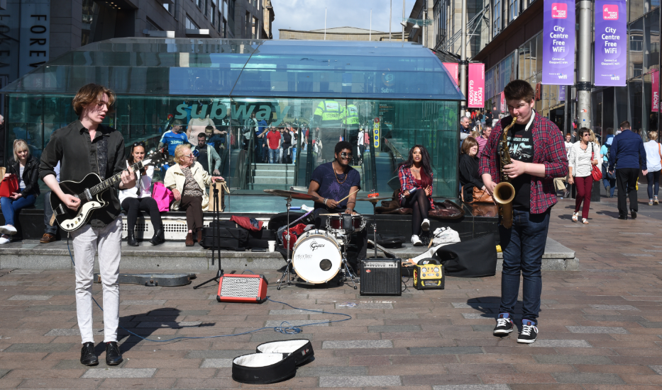
5. Learning and Performance Support Systems

Slide 28
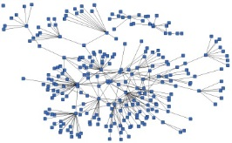
LPSS is Built Around the Personal Learning Record
This is a new type of data – we call it the personal graph.
Each person has their own private personal graph.
The PLR contains all a person’s learning records, including:
certificates, badges and credentials
activity records, test results, scores
Assignments, papers, drawings, things they create
Me

Slide 29
LPSS is Built Around the Personal Learning Record
Stuff Goes Out
Stuff Comes In
Learning Activities
I read and watch stuff
I play with toys
I make stuff
Things, Properties, Relations
Things I did
Stuff I make
Big stuff goes here
Me
Questions
Personal Library
Pictures
Books
Movies
Answers
Learning Analytics Services

Slide 30
LPSS Details
Data, Information Retrieval
Management Layer
Cleansing/Filtering/Profiling/Processing
Search/Recommendation Layer
Learning activity sequencing/modeling
Data Representation
CF
RRN
PLA
Prototype Repository
Standards/Communication protocols
Data Capture
PLR
Security Protocols
Security Protocols
Distributed Architecture
Personal Learning Record
PC
ACDR
Data synchronization
Personal Access to Network Storage
Cloud Storage and Management
Performance Trends Algorithm
Competence Development
Automated Assessment

Slide 31
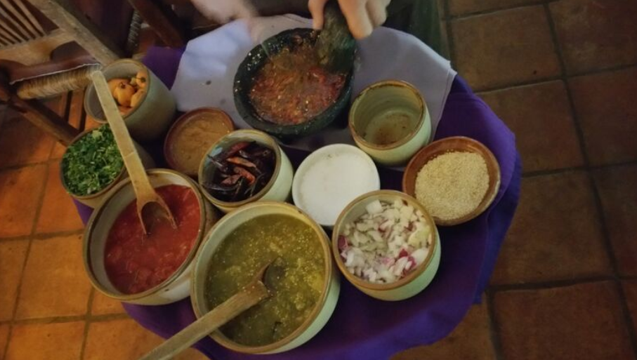
Resource Repository Network (RRN)
Assemble resources from multiple locations

Slide 32
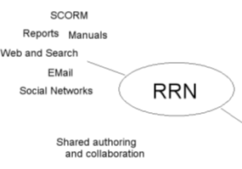
Resource Repository Network
Manage and discover list of sources and resources
Maintain authentication and credentials
Support APIs and metadata standards
Gather, analyze and sort resources and/or metadata

Slide 33
RRN Aggregation and Storage
Personal
Context
Article
Photograph
Video
Person
Author
Publisher
Organization
Job Opportunity
Competency
Cetrificate
Event
Location / Place
Time / Date
Email
RSS
OAI
Sharepoint
Facebook
Twitter
Monster
Government
Repositories
Desire2Learn
Coursera
EdX
etc
Parsing
Scraping
Analytics
etc
Storage
RELATIONS

Slide 34
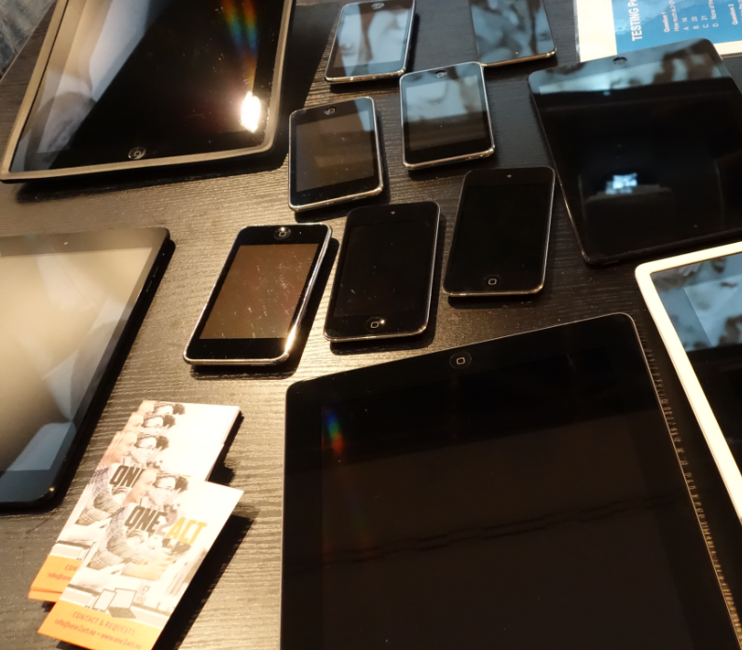
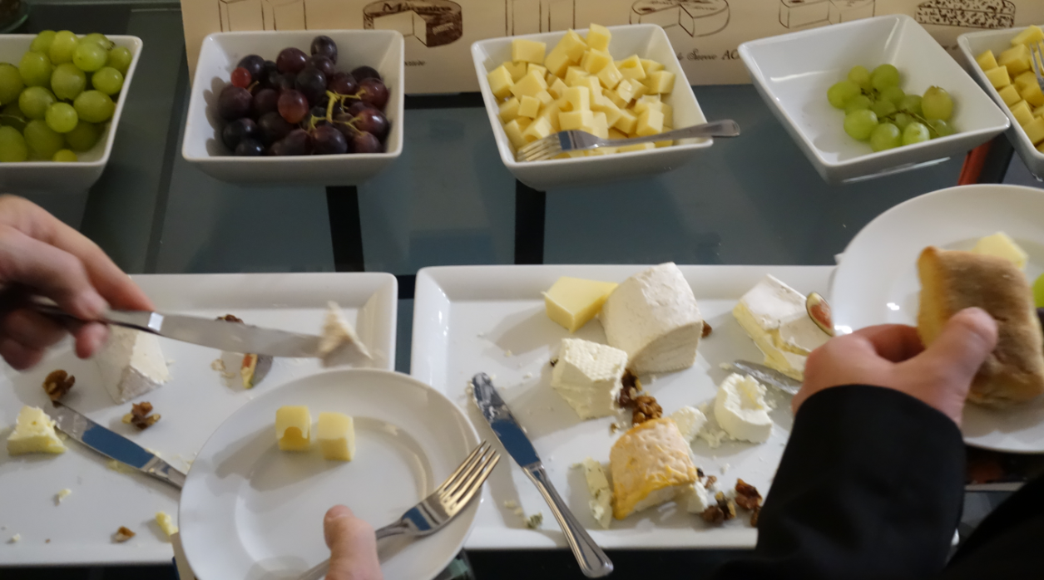
Personal Cloud
Synchronized cloud data services (including Owncloud) to support data portability

Slide 35
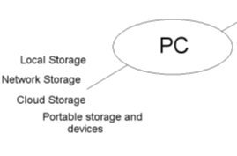
Personal Cloud
Manage list of local and remote storage systems
Maintain security, encryption, authentication and credentials
Include local or personal device storage
Manage and synchronize resource sets and data

Slide 36
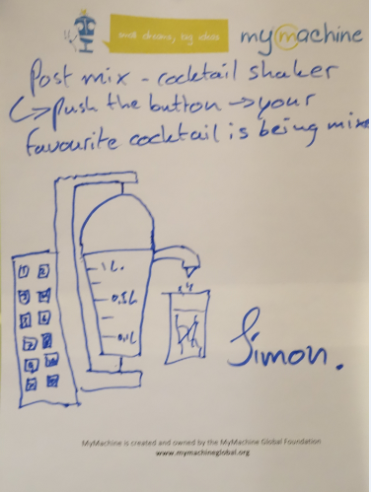
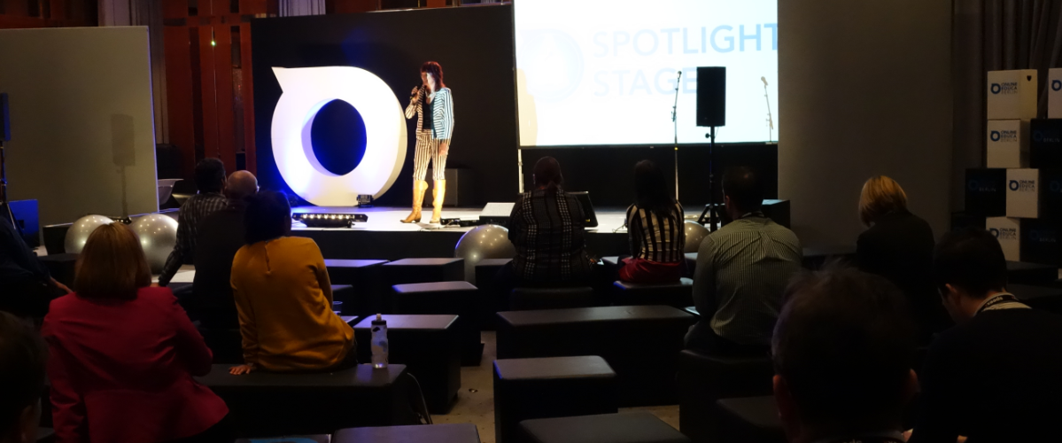
Personal Learning Assistant
Projection of learning services into multiple platforms

Slide 37
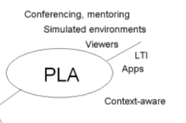
Personal Learning Assistant
Collect contextual information for system
Display resources of various formats, including SCORM, LTI, etc.
Support (scaffolded) authoring environments
Project LPSS capacity into external software and devices

Slide 38
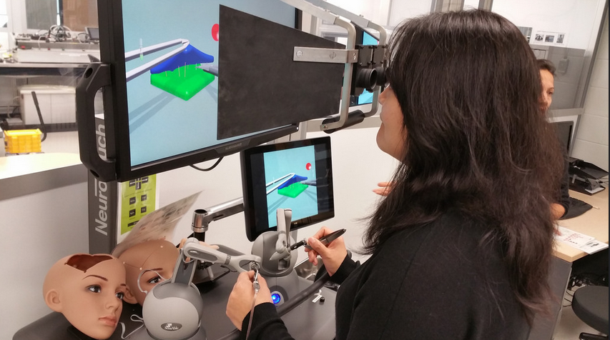
PLA: Collecting xAPI from Med Sims
https://www.flickr.com/photos/stephen_downes/15710336207/
http://www.nrc-cnrc.gc.ca/eng/rd/medical/

Slide 39
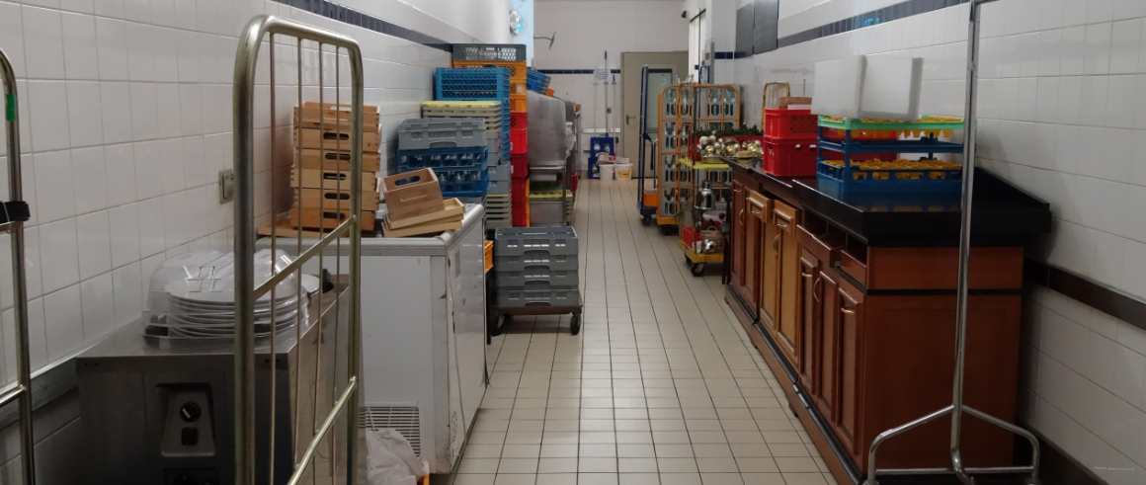
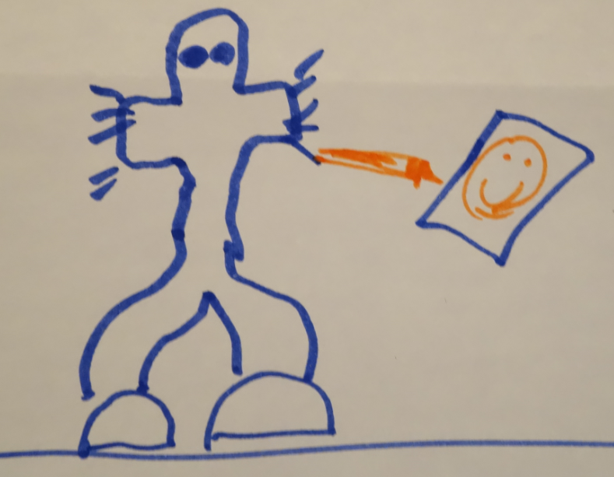
Automated Competency Recognition and Development

Slide 40
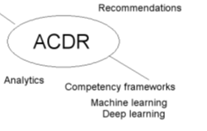
Automated Competency Recognition and Development
Import or create competency definitions
Analyze interactions for skills and learning gaps
Support development of learning plans
Provide resource and service recommendations

Slide 41
Personal Learning Record
The Personal Learning Record – data owned by the individual, shared only with permissions
http://halfanhour.blogspot.de/2014/12/eportfolios-and-badges-workshop-oeb14.html

Slide 42
Personal Learning Record
OERs
Portfolio, artifacts and evidence
Badges, certificates, credentials, competencies
Activity Record - LRS
PLR

Slide 43
Personal Learning Record
Collect full record of interactions with all resources, external systems
Support learning activity data exchange formats (eg. xAPI)
Collect and present a person’s personal portfolio
Display certifications and credentials (eg. badges)
Maintain 3rd party certification

Slide 44
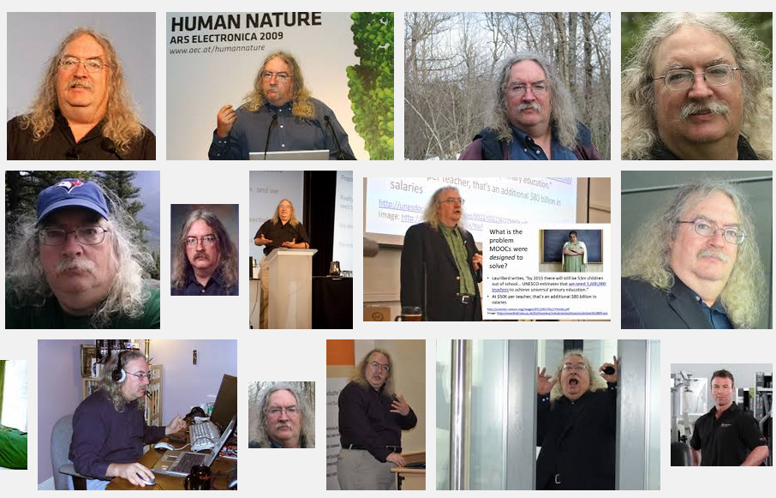
Stephen Downes
http://www.downes.ca

