Slide 1
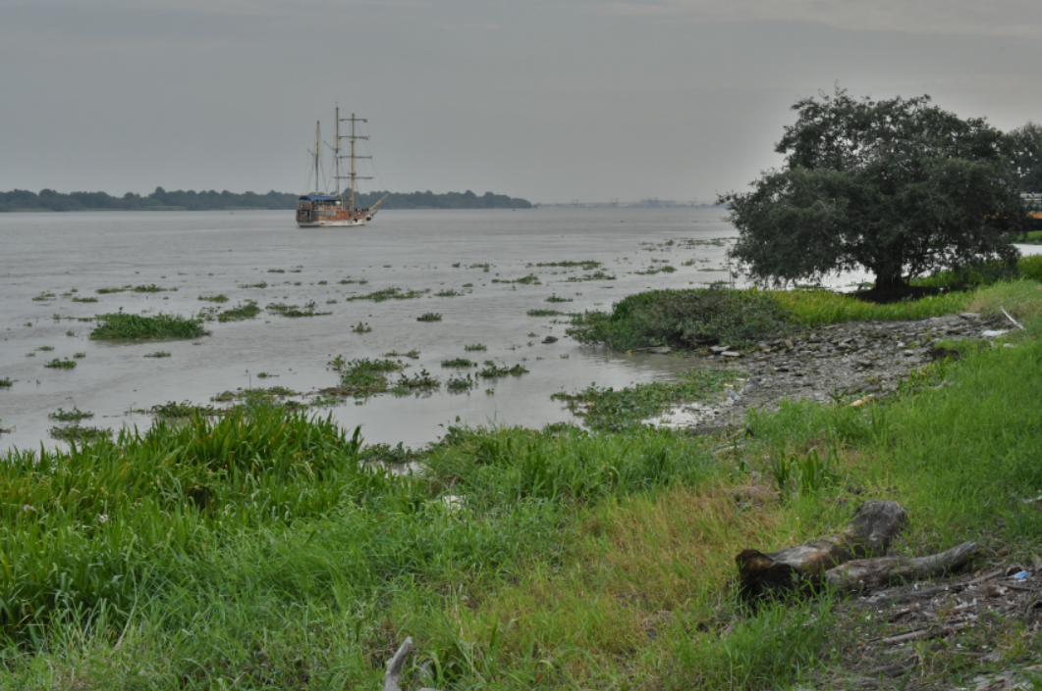
Personal Learning in Virtual Environments
Stephen Downes
Guayaquil, Ecuador
November 13, 2015

Slide 2
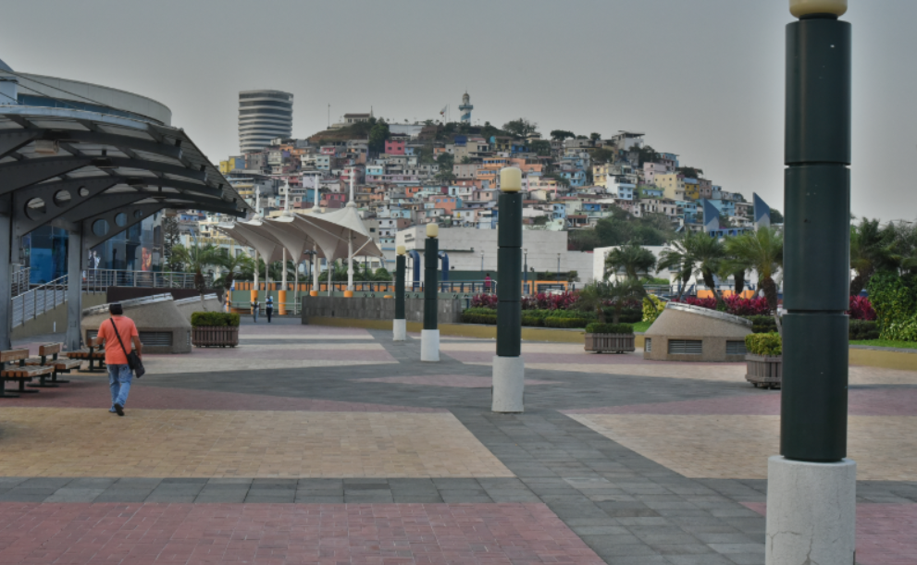
1. What I’ve Learned About Ecuador
Notes:
Cares about the environment and ecology
Values the health of its citizens
Values art and culture
Football team ☺

Slide 3
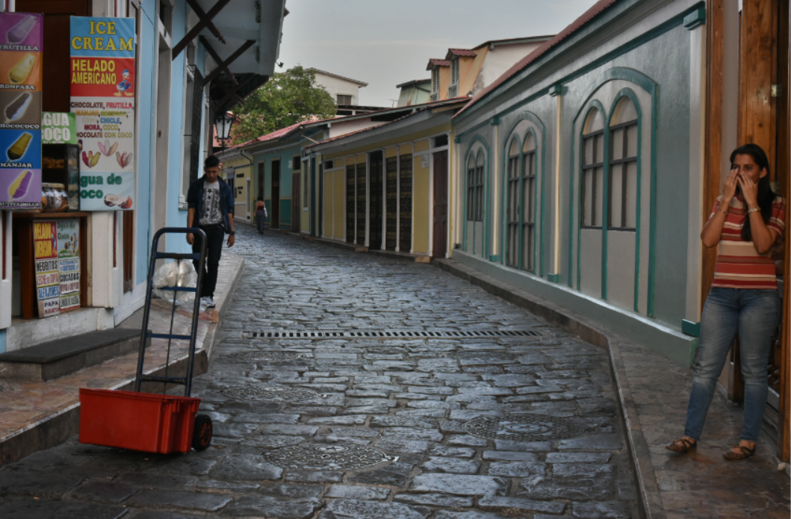
The Ecuador Project

Slide 4
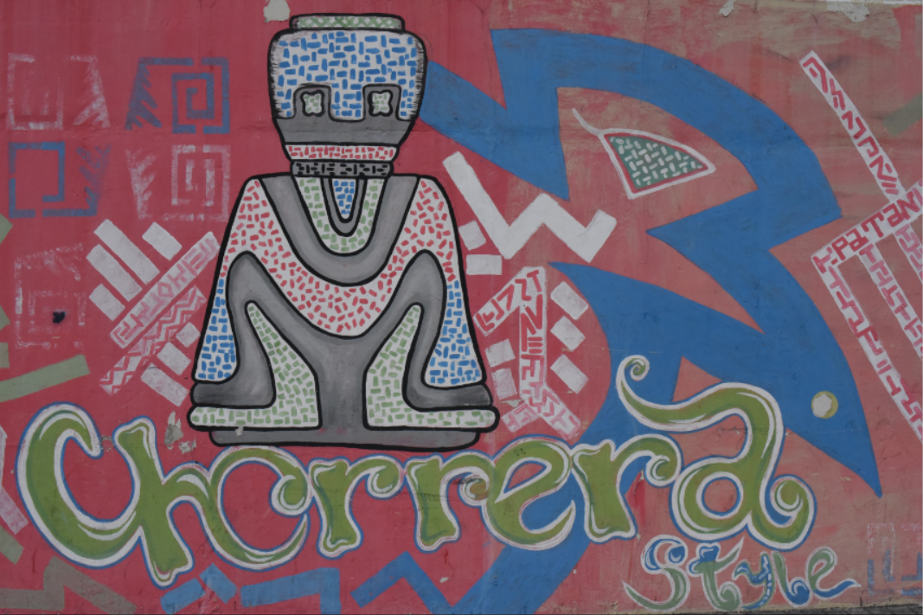
2. Learning Through Practice

Slide 5
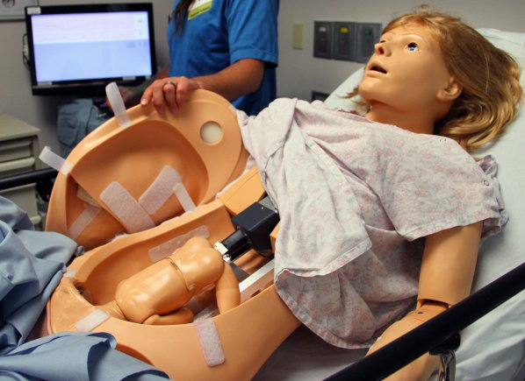
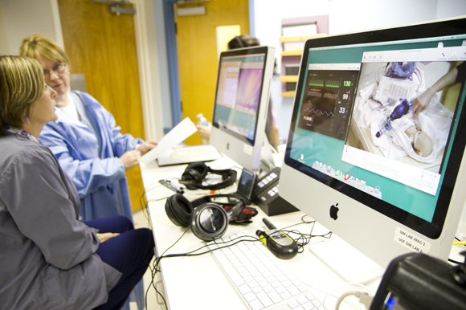
Medical Simulations
http://www.army.mil/article/127148/
http://www.83degreesmedia.com/features/camls011012.aspx

Slide 6
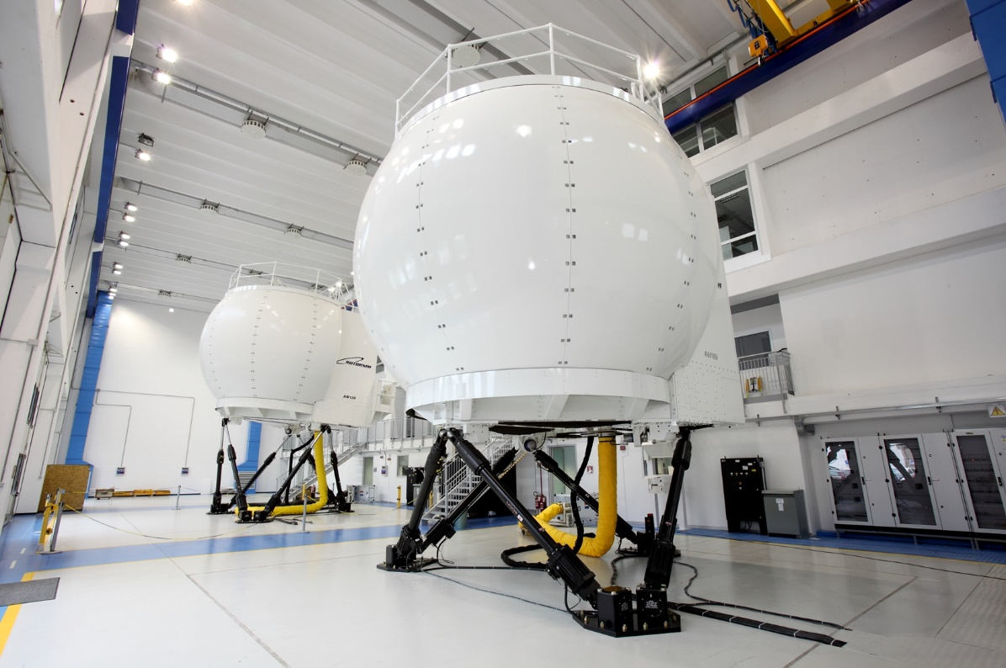
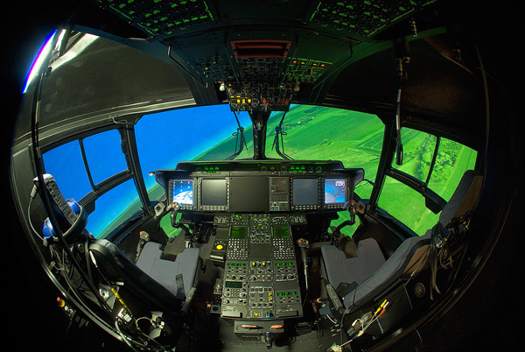
Flight Simulators
http://www.cae.com/World-s-first-AW189-full-flight-simulator-ready-for-training/
http://www.aiac.ca/canada-aerospace-industry/success-stories/cae-nh90-helicopter-simulator/
http://www.aiac.ca/canada-aerospace-industry/success-stories/cae-nh90-helicopter-simulator/

Slide 7
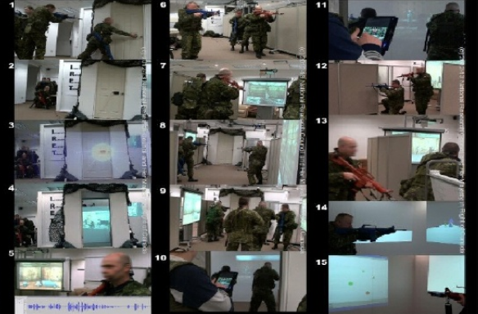
MINT - Mobile INteractive Trainer
http://www.downes.ca/post/59876

Slide 8
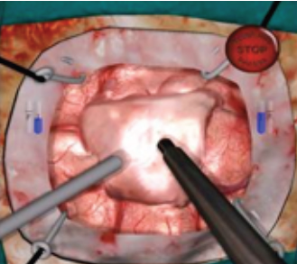
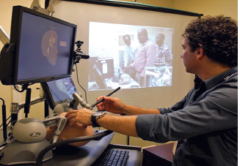
NeuroTouch Simulator

Slide 9
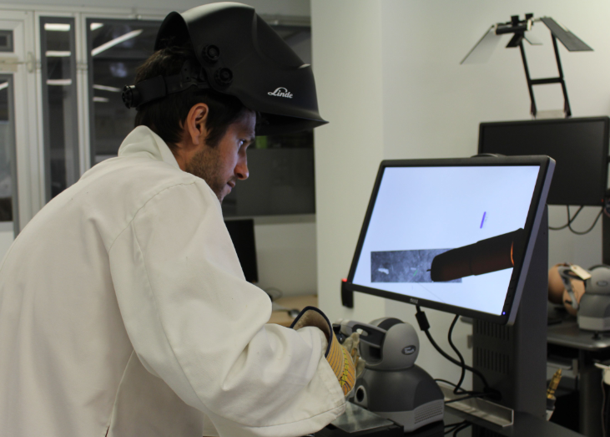

Sim-Welding

Slide 10
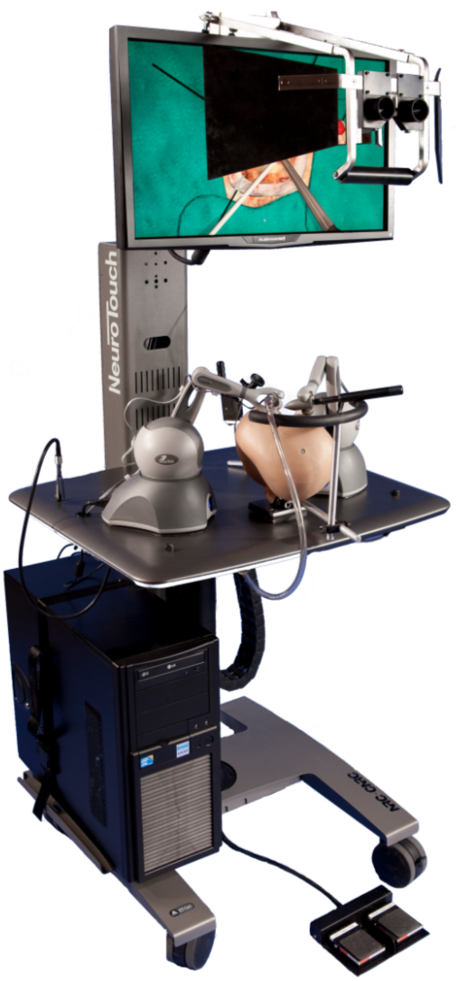
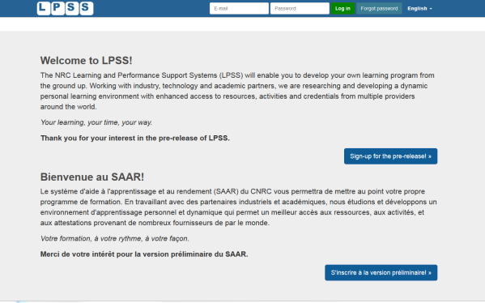

















LPSS-Sim Project Overview
Simulation
Learning Space
(SLS)

Slide 11
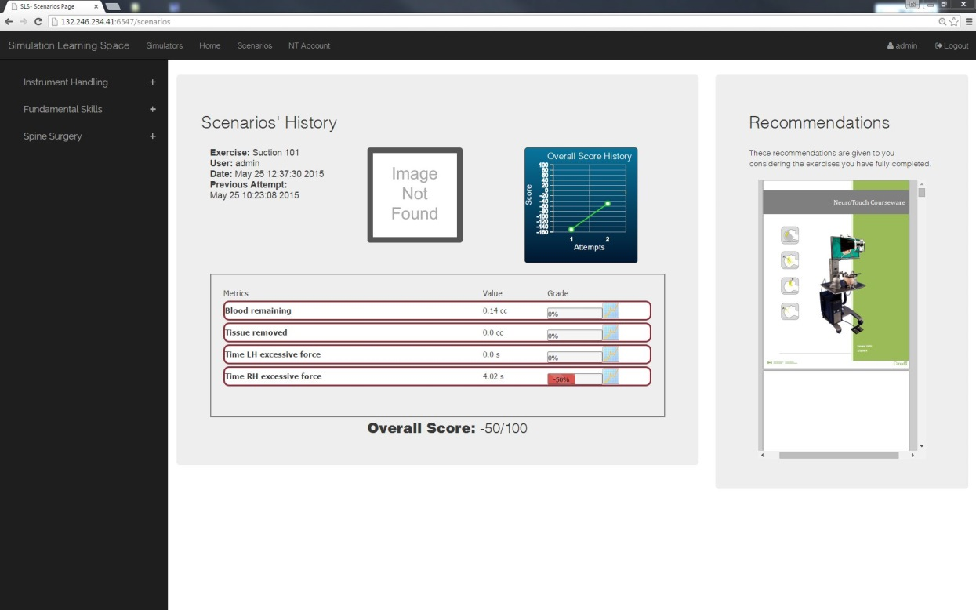
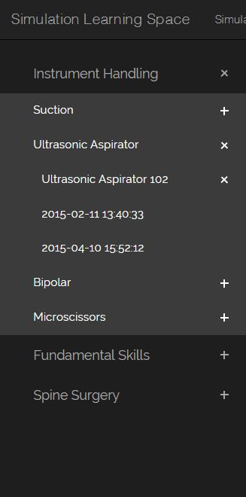
Combining Experiences
One place for all simulation experience
All performance results no matter where and when
they were carried out

Slide 12
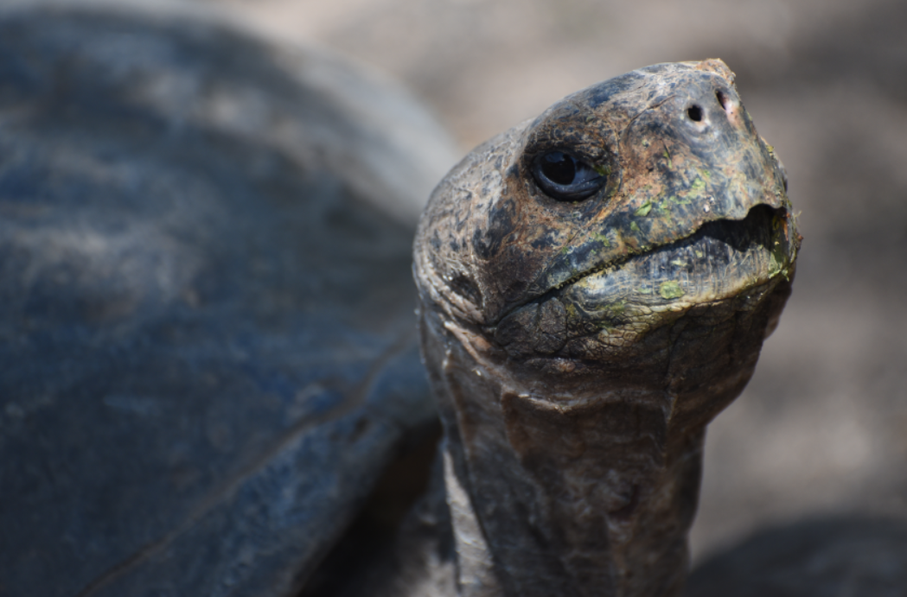
1. Content Knowledge vs Practice

Slide 13
Criticisms of a Focus on Content…
“research should move beyond a narrow focus on the ‘know–do gap’ to cover a richer agenda…”
  situation-specific practical wisdom (phronesis)
  tacit knowledge shared among practitioners (‘mindlines’)
  complex links between power and knowledge; and
  macro-level knowledge partnerships
Greenhalgh and Weiringa, http://jrs.sagepub.com/content/104/12/501.full

Slide 14

Immersive Environments…

Slide 15
Two Approaches…
Content
Practice
Practice
Content

Slide 16
Two Approaches…
Defines an ideal state
Defines a desired state
Content
Practice
Practice
Content
TEST
TRY
Person tests you
Person helps you

Slide 17
Two Approaches…
Defines an ideal state
Defines a desired state
Content
Practice
Correction
Iteration
GAP
Practice
Content
Opport-unity
TEST
TRY
Person tests you
Person helps you

Slide 18
Library Environment
Defines an ideal state
Defines a desired state
Content
Practice
Affordances
Correction
Requirements
Iteration
GAP
Practice
Content
Opport-unity
TEST
TRY
Person tests you
Person helps you

Slide 19
Personalized Personal
We do for you You do for yourself
Defines an ideal state
Defines a desired state
Content
Practice
Affordances
Correction
Requirements
Iteration
GAP
Practice
Content
Opport-unity
TEST
TRY
Person tests you
Person helps you

Slide 20
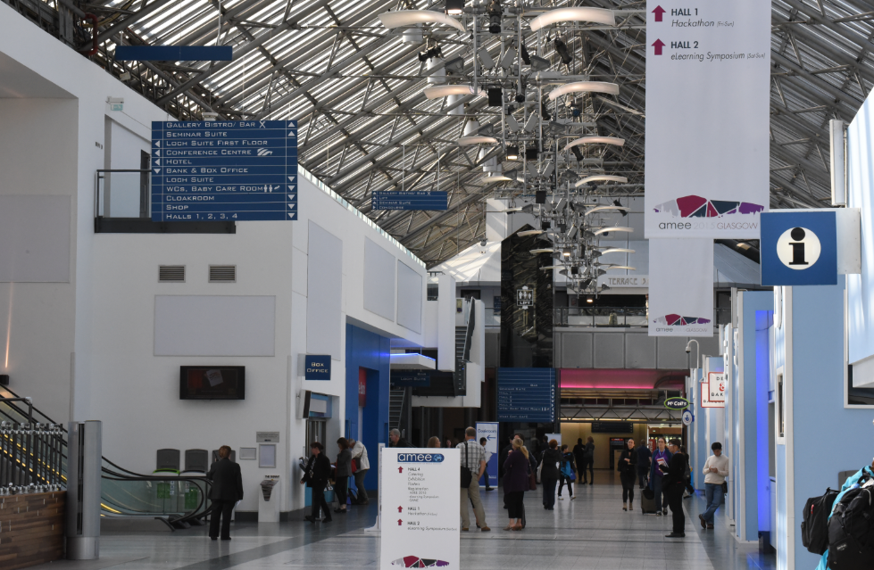
3. The Case of the cMOOC

Slide 21
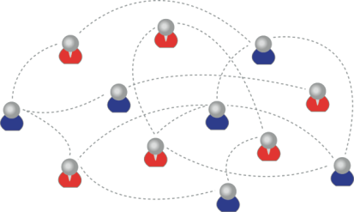
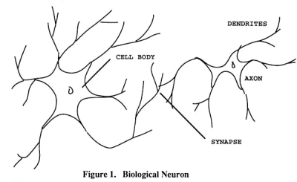
How to Create a cMOOC
It’s like creating a network
Don’t centralize
Concentrate on the creation of links
We use social networks...
… to create personal knowledge

Slide 22
Primary Course Components
  Wiki – to assist in planning, topics, guests, etc
  Email list – for announcements and mass communications
  Course Blog – for daily posts
  Synchronous Communications + Video

Slide 23
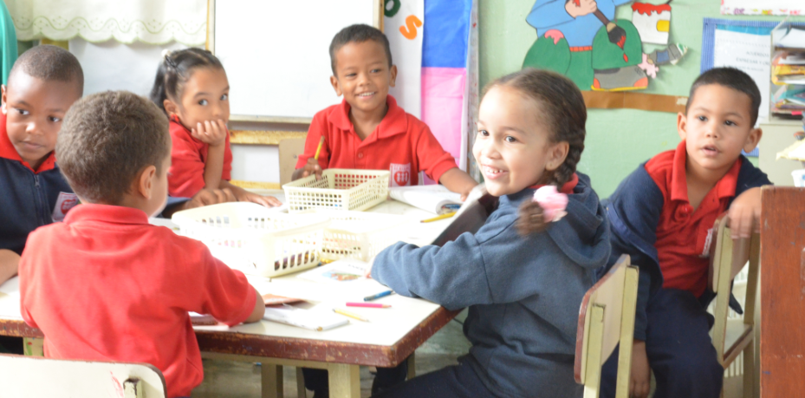
MOOC Design
Course structure – a series of topics
  The instructors will not ‘teach’ the topics, they ‘investigate’ or ‘work through’ the topics (model and demonstrate)

Slide 24
Additional Course Components
For Students – any online communications system, including
  Blogs – Blogger, WordPress, Tumblr
  Social Network – Facebook, Twitter, Google+
  Content site – Google Docs, Flickr, Instragram
  Aggregator – Feedly, OldReader, (new) Bli RSS

Slide 25
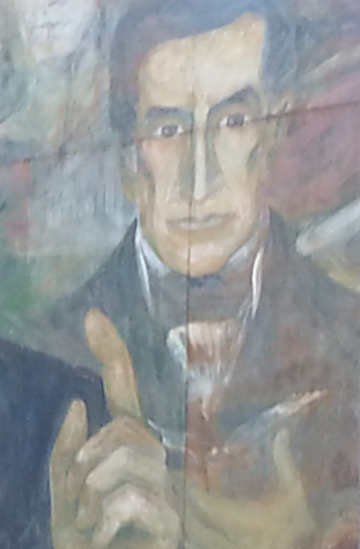
Process
Each Week
  Conversation or activity with guest
  Discussion and reflection
Each Day
  Aggregate student content
  Share via web site & newsletter

Slide 26
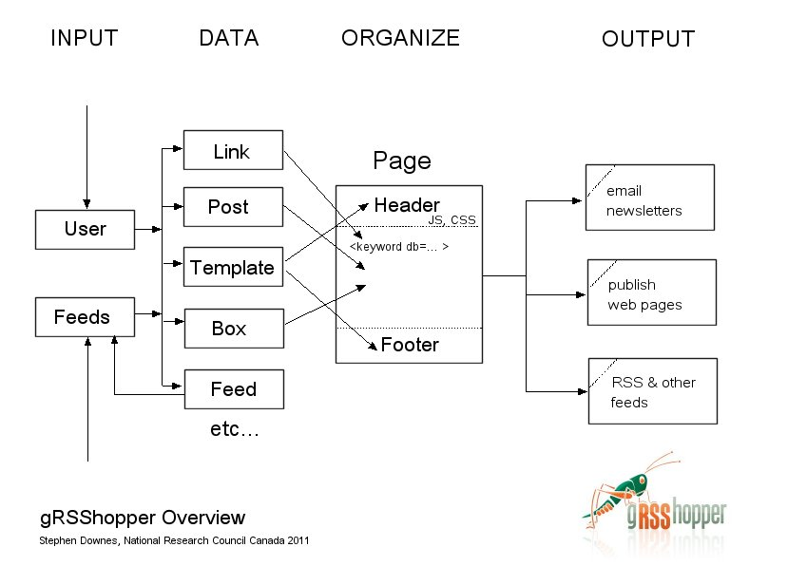
gRSShopper
http://grsshopper.downes.ca

Slide 27
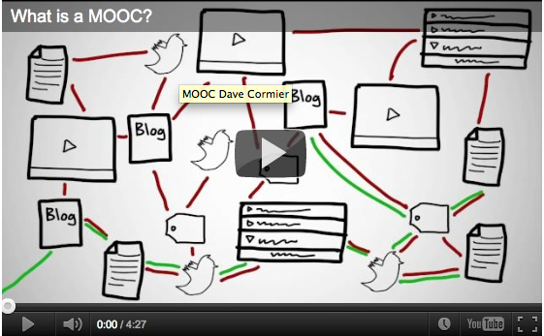
How to Learn in a cMOOC
Learning is a process of immersion into a knowing community
http://www.tonybates.ca/2012/03/03/more-reflections-on-moocs-and-mitx/

Slide 28
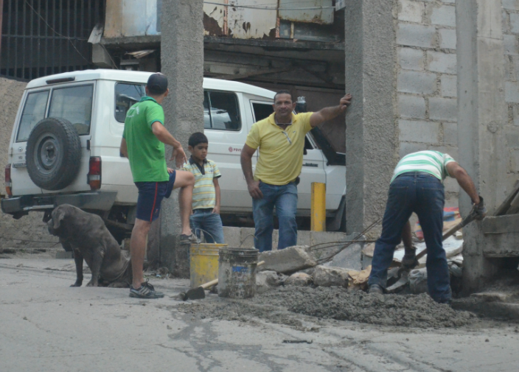
Learning is a process of recognizing and growing into or becoming an instantiation of those values…

Slide 29
How to Evaluate Learning
Learning is not possession of a collection of facts, it’s the expression of a capacity
Learning is recognized by a community of experts in a network
Learning analytics
We recognize our understandings…
…by the way we use them in our social network

Slide 30

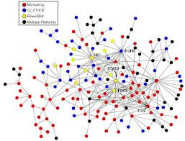
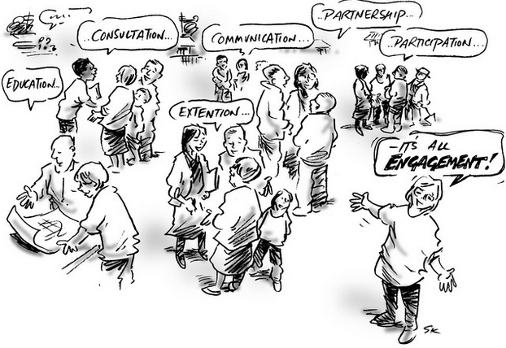

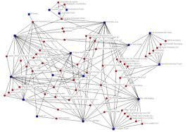
xLearning vs cLearning
contents
engagement
networks
http://www.corestandards.org/
http://www.magnet.edu/
http://lisahistory.net/wordpress/2012/08/three-kinds-of-moocs/

Slide 31
Personalized Personal
We do for you You do for yourself
Defines an ideal state
Defines a desired state
Content
Practice
Affordances
Correction
Requirements
Iteration
GAP
Practice
Content
Opport-unity
TEST
TRY
Person tests you
Person helps you

Slide 32

4. Personal Learning Environments

Slide 33
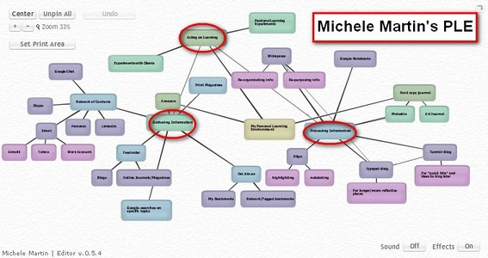
Personal Learning Environments
http://dmlcentral.net/blog/howard-rheingold/diy-u-interview-anya-kamenetz
http://www.downes.ca/post/58150
Notes:
Howard Rheingold searches for the new in Anya Kamenetz's Edupunk's Guide, suggesting that what has been added is the idea of the personal learning plan to the personal learning network. "Making a public commitment to something is going to increase your accountability," says Kamenetz. Rheingold writes, "Her work serves as a bridge between blended learning and peeragogy. I previously wrote about Shelly Terrell and personal learning networks" and asks here what it takes for a group to self-organize. Kamanetz responds that there needs to be a common understanding of the goal - of course, this would be the outcome of self-organization, not what makes it possible.

Slide 34

















Course Provider Perspective
Subscribed
students
Student
content
Site
Course
content
Live online events
Event recordings

Slide 35
The Student’s Perspective
Site
A range of different resources and services

Slide 36
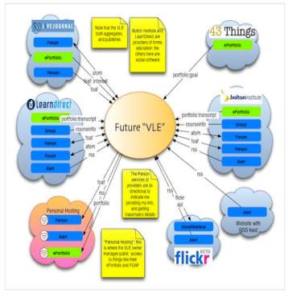
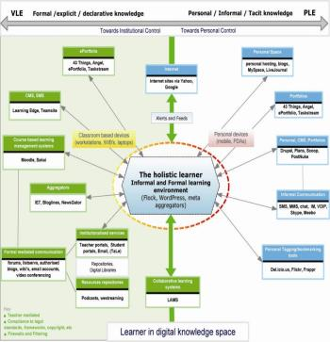
The design is based on putting the learner at the centre
Scott Wilson (left), Tim Hand (right)
https://www.google.com/search?q=ple+diagrams
http://www.edtechpost.ca/ple_diagrams/index.php/mind-map-3

Slide 37
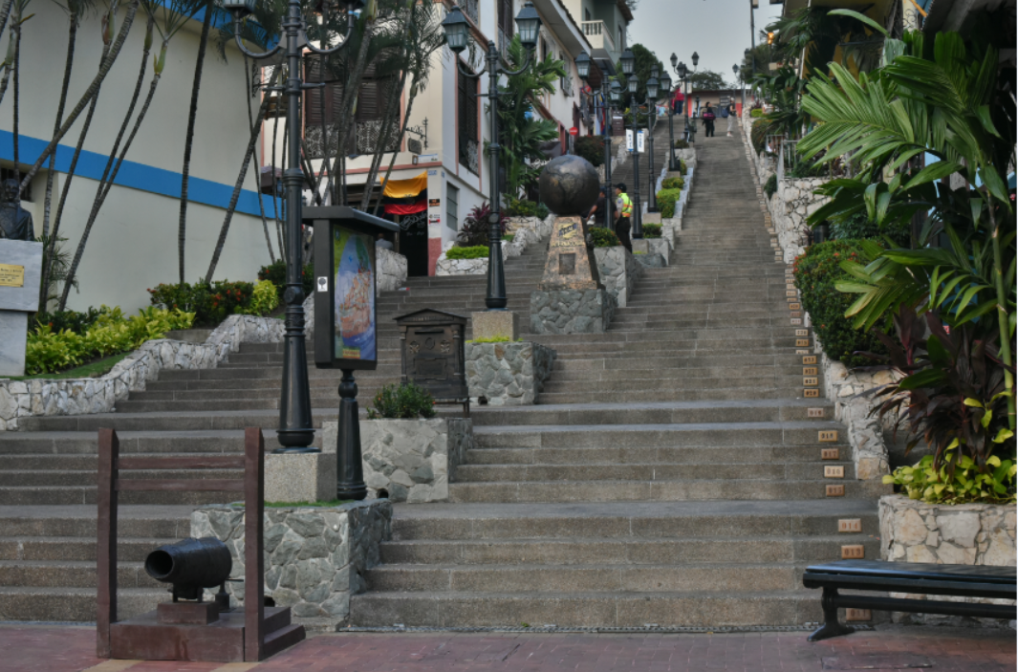
5. Learning and Performance Support Systems

Slide 38
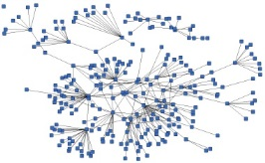
LPSS is Built Around the Personal Learning Record
This is a new type of data – we call it the personal graph.
Each person has their own private personal graph.
The PLR contains all a person’s learning records, including:
certificates, badges and credentials
activity records, test results, scores
Assignments, papers, drawings, things they create
Me

Slide 39
LPSS is Built Around the Personal Learning Record
Stuff Goes Out
Stuff Comes In
Learning Activities
I read and watch stuff
I play with toys
I make stuff
Things, Properties, Relations
Things I did
Stuff I make
Big stuff goes here
Me
Questions
Personal Library
Pictures
Books
Movies
Answers
Learning Analytics Services

Slide 40
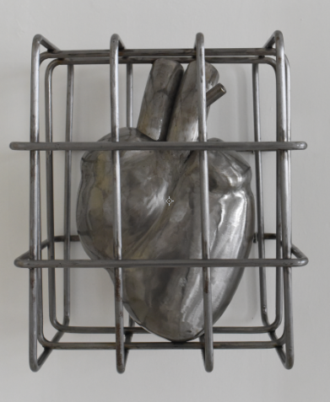
Personal Learning Record
The Personal Learning Record – data owned by the individual, shared only with permissions
http://halfanhour.blogspot.de/2014/12/eportfolios-and-badges-workshop-oeb14.html

Slide 41
Personal Learning Record
OERs
Portfolio, artifacts and evidence
Badges, certificates, credentials, competencies
Activity Record - LRS
PLR

Slide 42
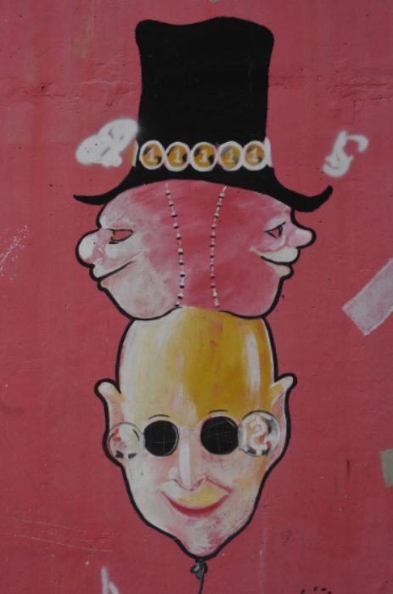
Resource Repository Network
Manage and discover list of sources and resources
Maintain authentication and credentials
Support APIs and metadata standards
Gather, analyze and sort resources and/or metadata

Slide 43
RRN Aggregation and Storage
Personal
Context
Article
Photograph
Video
Person
Author
Publisher
Organization
Job Opportunity
Competency
Cetrificate
Event
Location / Place
Time / Date
Email
RSS
OAI
Sharepoint
Facebook
Twitter
Monster
Government
Repositories
Desire2Learn
Coursera
EdX
etc
Parsing
Scraping
Analytics
etc
Storage
RELATIONS

Slide 44
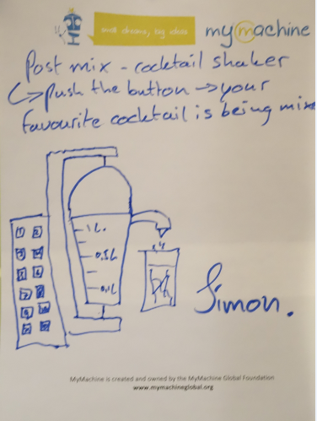
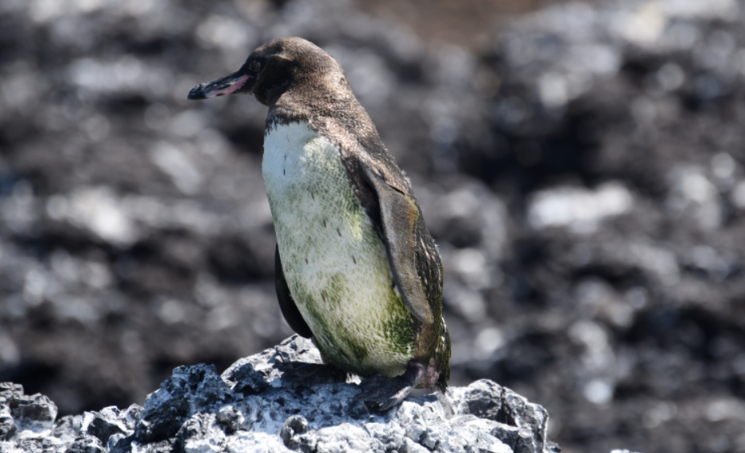
Personal Learning Assistant
Projection of learning services into multiple platforms

Slide 45
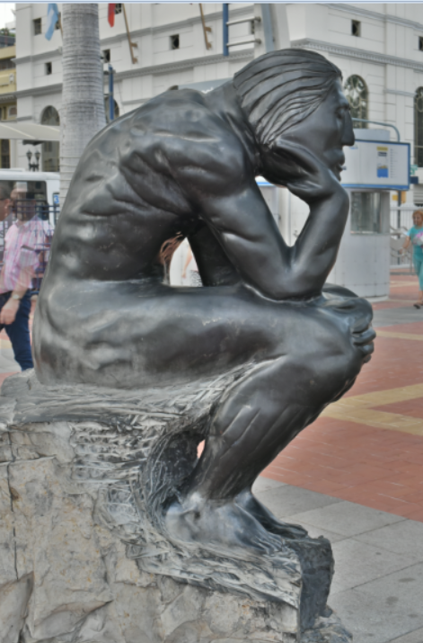
Personal Learning Assistant
Collect contextual information for system
Display resources of various formats, including SCORM, LTI, etc.
Support (scaffolded) authoring environments
Project LPSS capacity into external software and devices

Slide 46
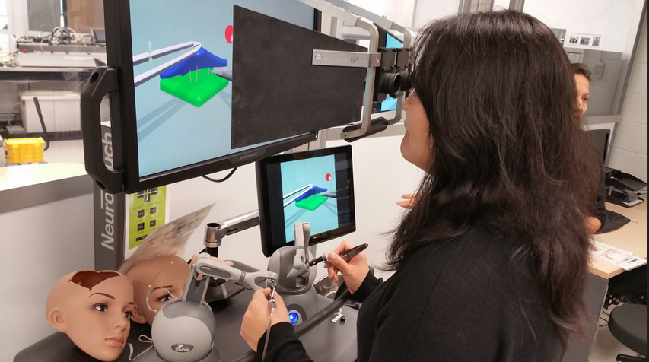
PLA: Collecting xAPI from Med Sims
https://www.flickr.com/photos/stephen_downes/15710336207/
http://www.nrc-cnrc.gc.ca/eng/rd/medical/

Slide 47
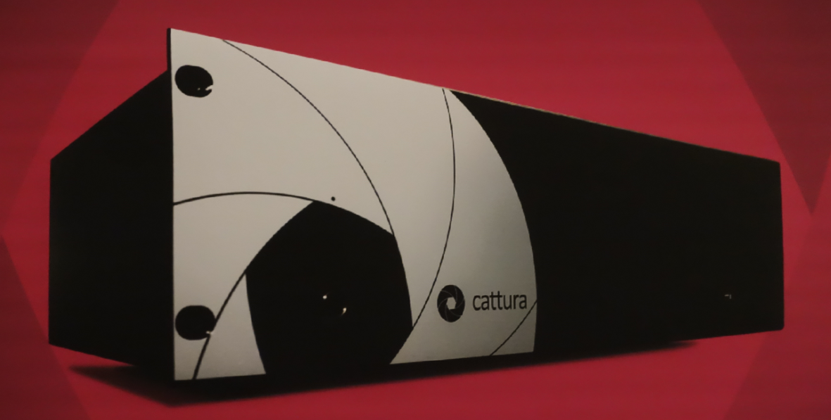
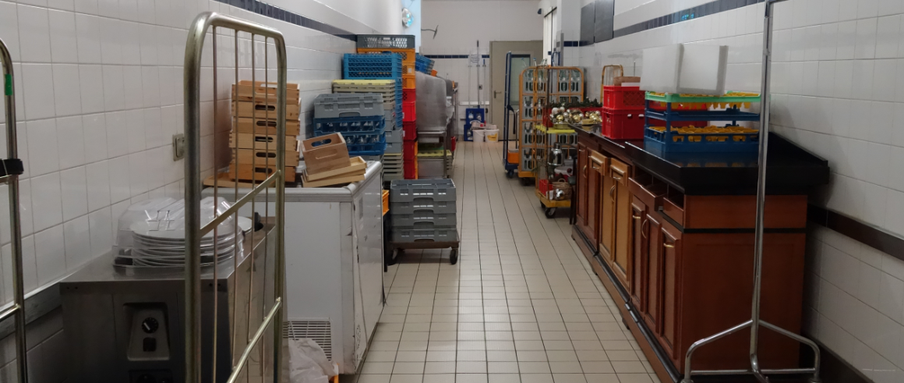
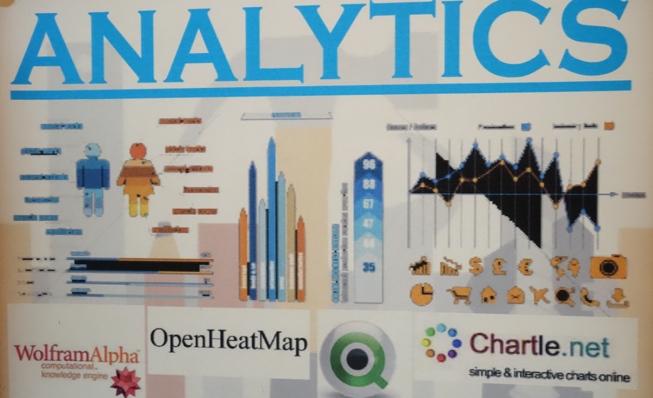
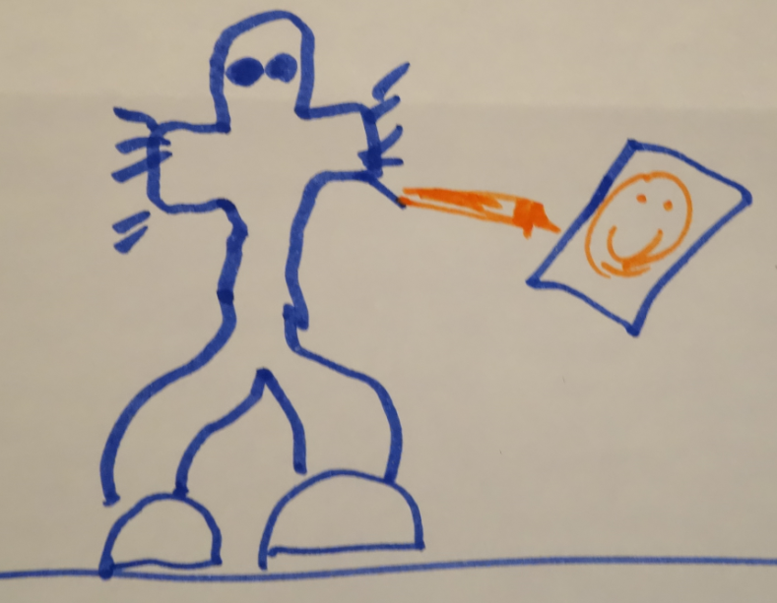
Personal Analytics

Slide 48
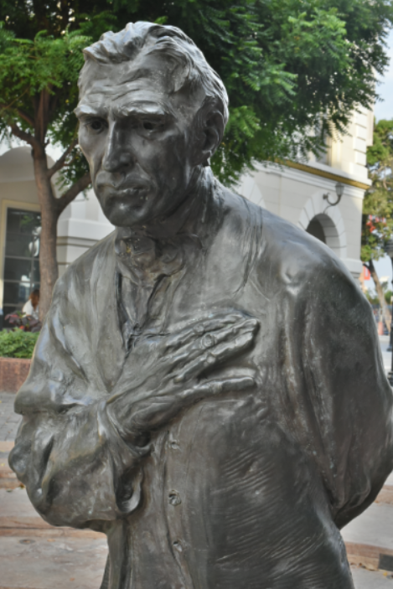
Automated Competency Recognition and Development
Import or create competency definitions
Analyze interactions for skills and learning gaps
Support development of learning plans
Provide resource and service recommendations

Slide 49

Analytics and Big Data
Facebook
Twitter
EdX
Coursera
YouTube
Blackboard
Email
etc
Shallow
Tells us about the platform
Deep
Tells us about the person

Slide 50
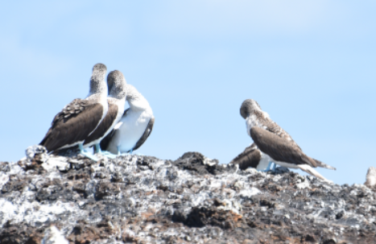
6. Expanding LPSS

Slide 51
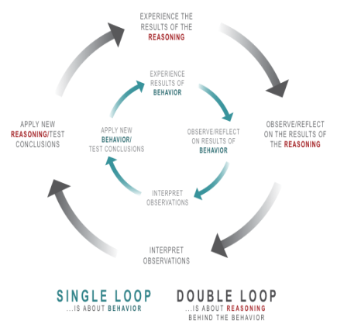
Implementation Projects
Ultimately, the objective is to support individual learning in a network
http://integralleadershipmanifesto.com/manifesto/making-subject-object/

Slide 52
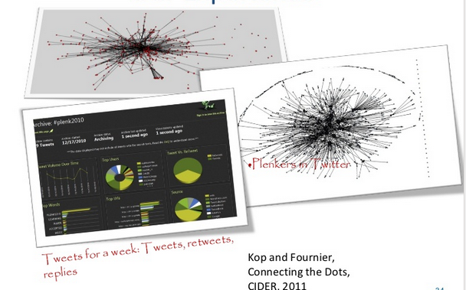
Plearn – Importance of the Graph
http://www.slideshare.net/Downes/after-moodle
http://www.slideshare.net/Ritakop/kopfourniercanadianinstitutedistanceeducationresearchple

Slide 53

OIF – MOOC-REL
http://rel2014.mooc.ca/

Slide 54
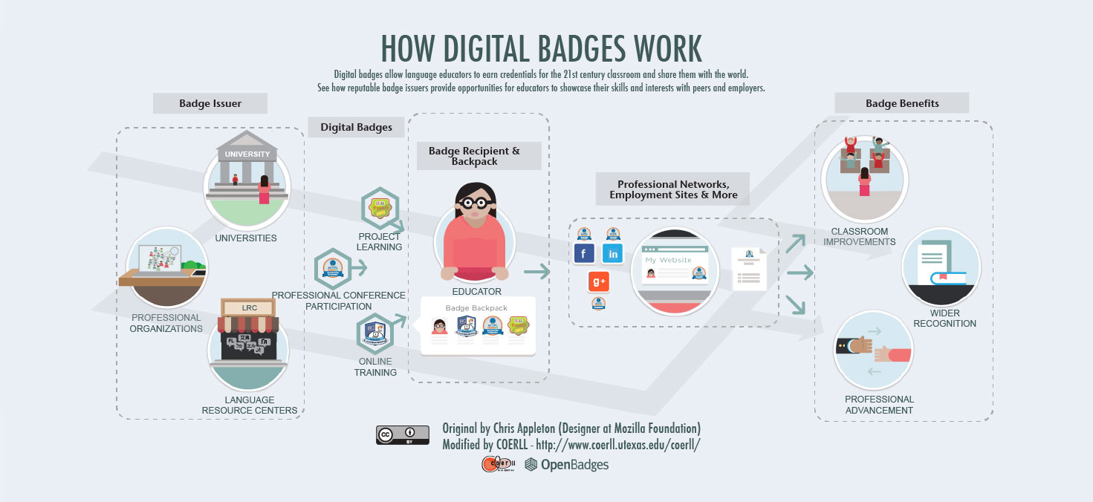
PCO Badges for Learning
http://www.downes.ca/post/63738

Slide 55
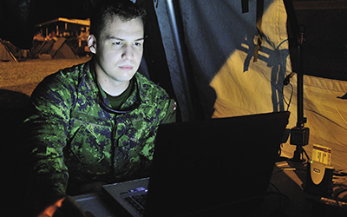
ONGARDE
http://www.journal.forces.gc.ca/vol14/no2/page70-eng.asp

Slide 56
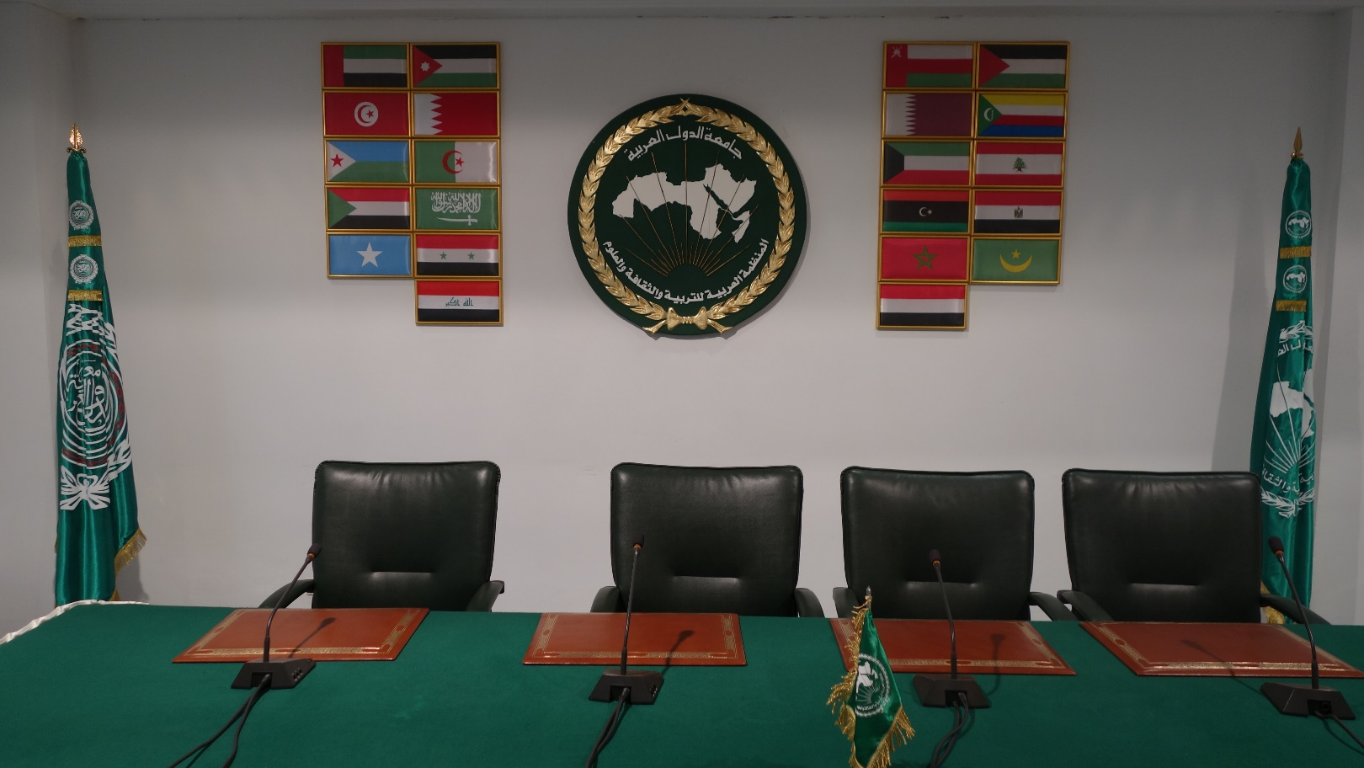

ALECSO – Capacity Building
http://www.downes.ca/presentation/337

Slide 57

Concierge OMS
https://concierge.portal.gc.ca/

Slide 58
Expanding LPSS
$20 Million Investment
NRC Technologies
Development Environment
$x + $y
Project
NRC
Funder
$y
Partner
University
Government
Development Agency
Foundation
UNESCO / UN
Corporate Partner
$x

Slide 59

Possible Projects…
OERs, Repositories, Marketplaces
Badges, Credentials, Recognition
Simulations & Workplace Support
Matching People to Opportunities
http://LPSS.ME

Slide 60

Stephen Downes
http://www.downes.ca

