Slide 1
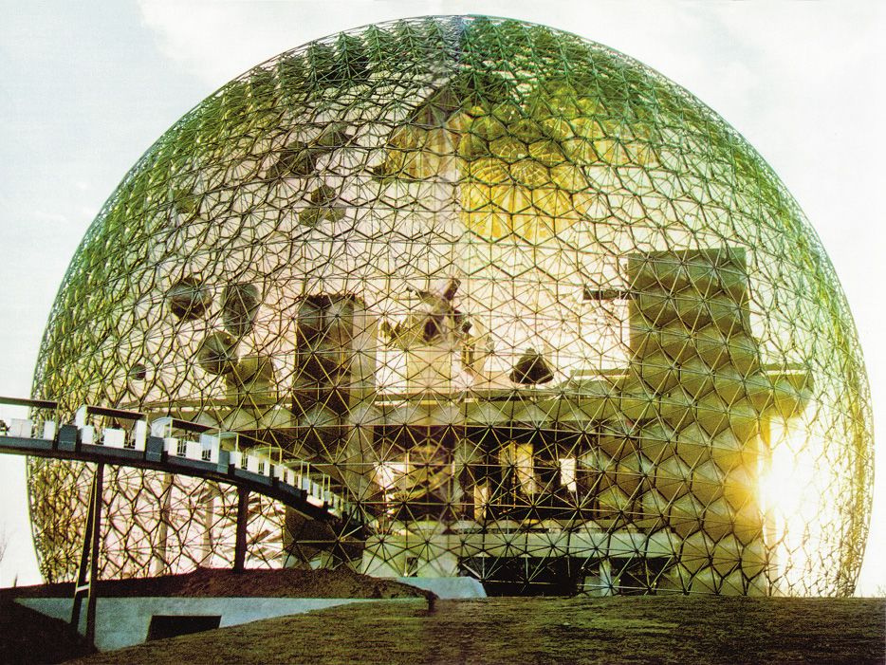
The Final Frontier: Space
Stephen Downes
SALTISE Montreal
June 3, 2016

Slide 2
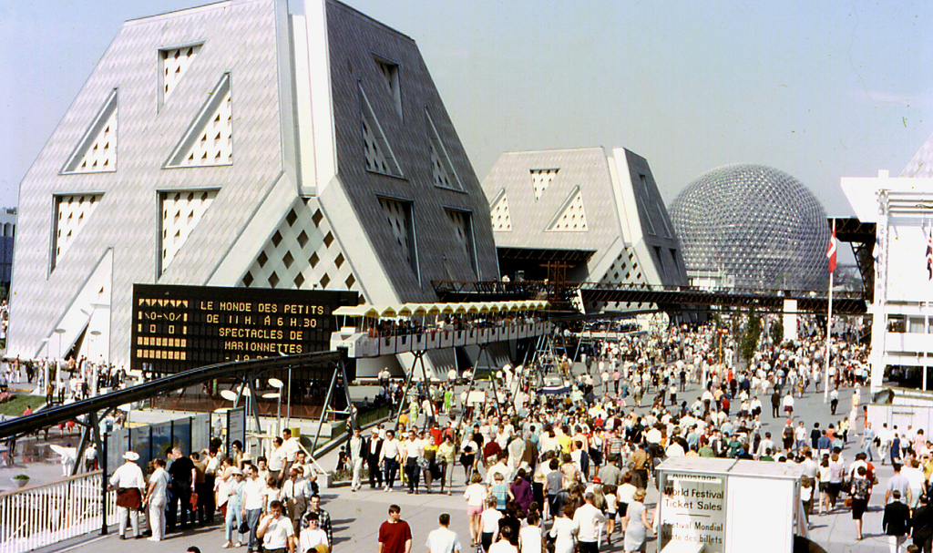
In 1967 I attended Expo 67 in Montreal

Slide 3
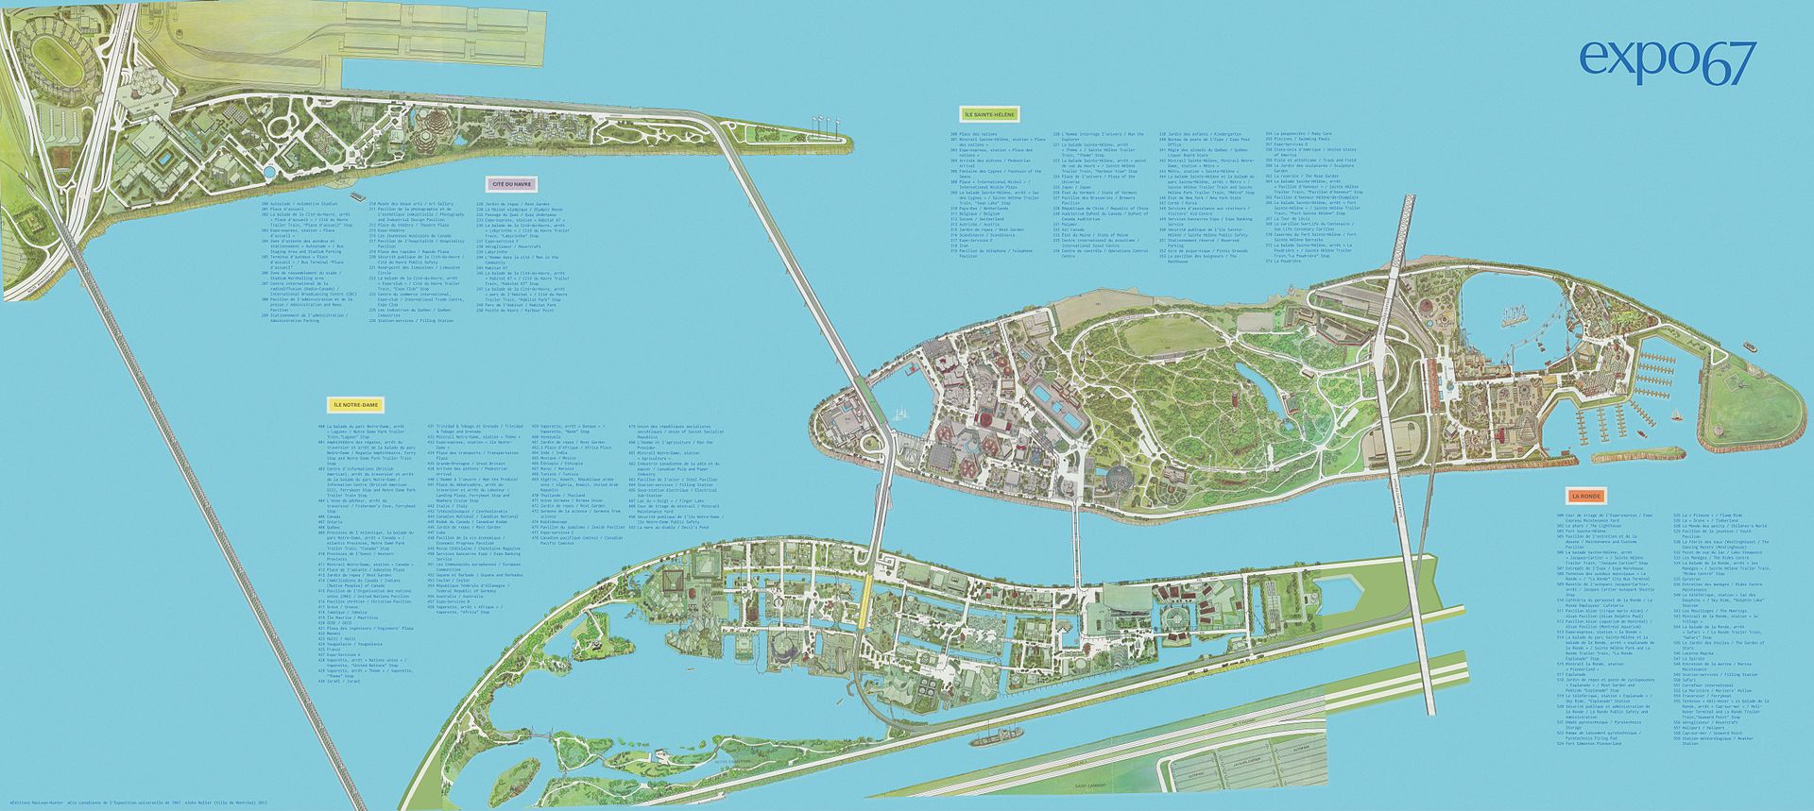
There were 60 Nations and 90 Pavilions
T

Slide 4
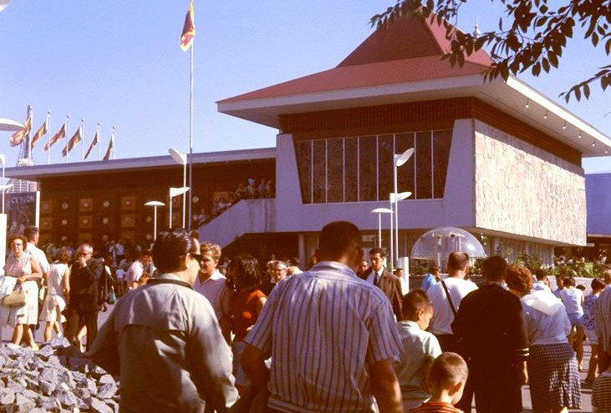
I remember the Ceylon Pavilion most of all
Could be me!
I learned about tea plantations!

Slide 5
Did we do it wrong?

Slide 6
Would this have been better?
MSC Module Structure https://www2.le.ac.uk/departments/education/distance-learning/mscli/images/copy_of_MScLIDL_structure1.png/view

Slide 7
Would this?
The ‘process’ of learning – learning step-by-step
For example, Gagne’s nine events
Pre-requisites – “ learners acquire prerequisite skills before attempting superordinate’s ones”
Yes, I’m citing Wikipedia:
https://en.wikipedia.org/wiki/Instructional_design

Slide 8
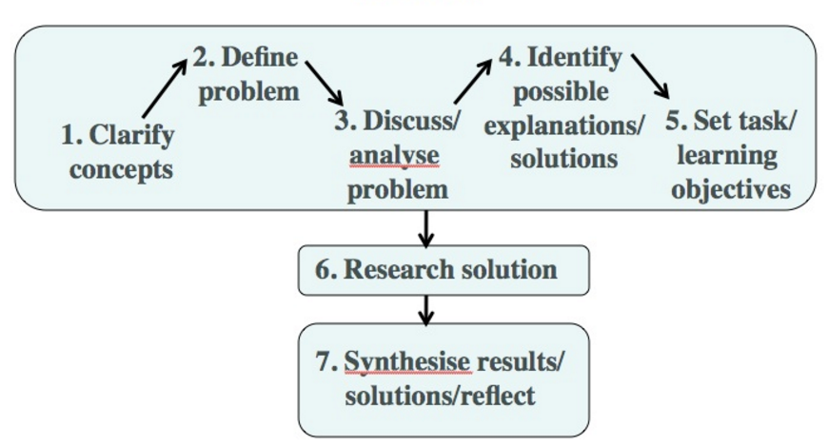
Would this?
The Maastricht seven-jump method for PBL turotials (derived from Gijeselaers, 1995). Via http://www.tonybates.ca/2014/12/01/can-you-do-experiential-learning-online-assessing-design-models-for-experiential-learning/

Slide 9
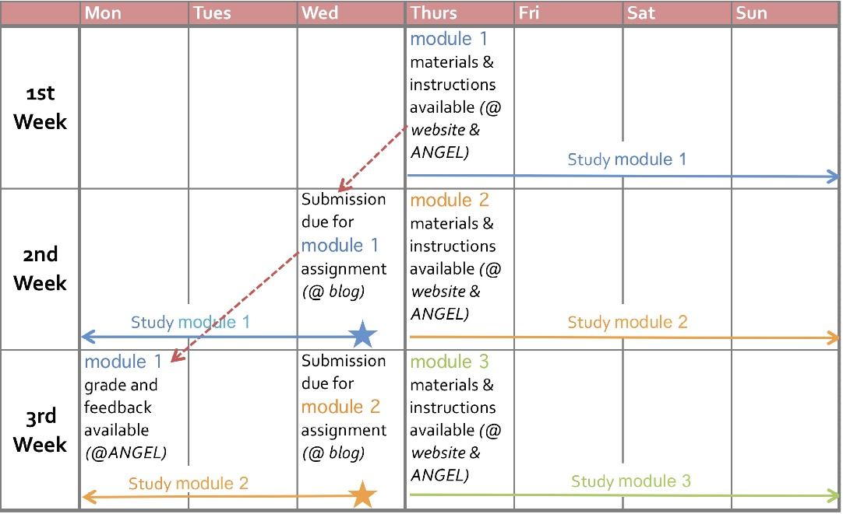
The dominant paradigm for learning today is time
Penn State https://www.e-education.psu.edu/geog030/node/431

Slide 10
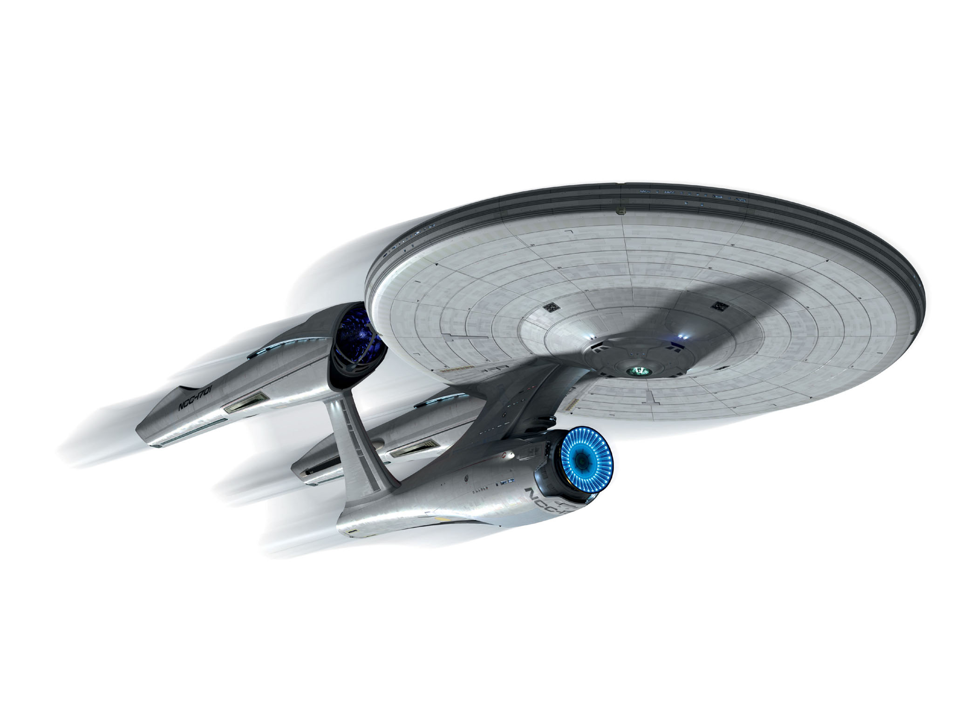
Even these people had a five year mission

Slide 11
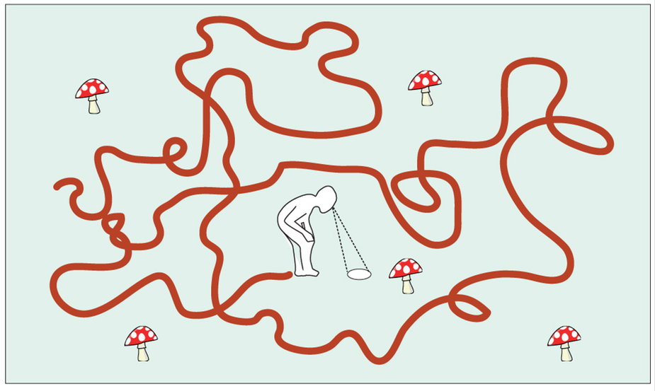
Let’s explore what it means to have time as our dominant metaphor….
Marie Chupeau, Olivier Bénichou & Raphaël Voituriez, Cover times of random searches. http://www.nature.com/nphys/journal/v11/n10/fig_tab/nphys3413_F1.html

Slide 12
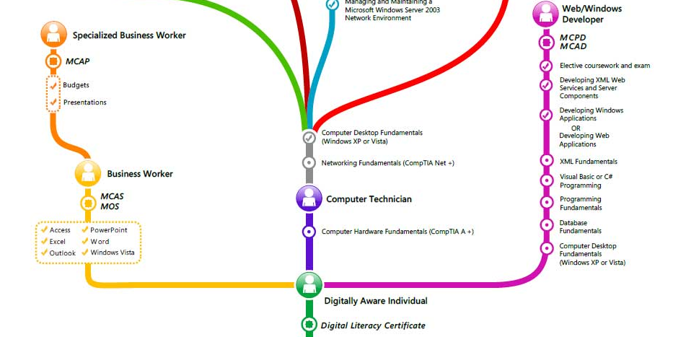
Path or Road
vs Field or Environment
Microsoft Certification Learning paths | ICT Curriculum Roadmap - Koenig-solutions.com - http://www.koenig-solutions.com/road-map-microsoft.htm

Slide 13
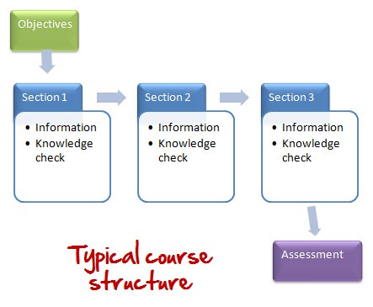
Course
vs Mapping

Slide 14
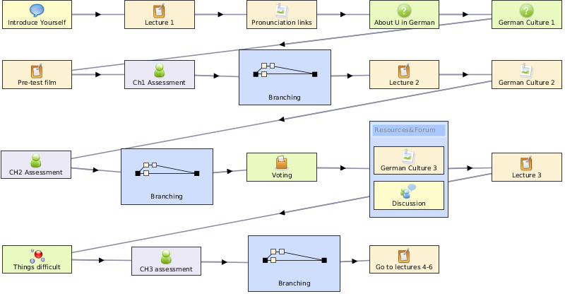
Sequence / Pre-requisites
vs Core / Periphry
IMS Learning Design: http://www.imsglobal.org/learningdesign/index.html
LAMS: https://www.lamsfoundation.org/ LAMS Image: http://www.mychrisalexander.com/lamslearningdesigns.htm

Slide 15
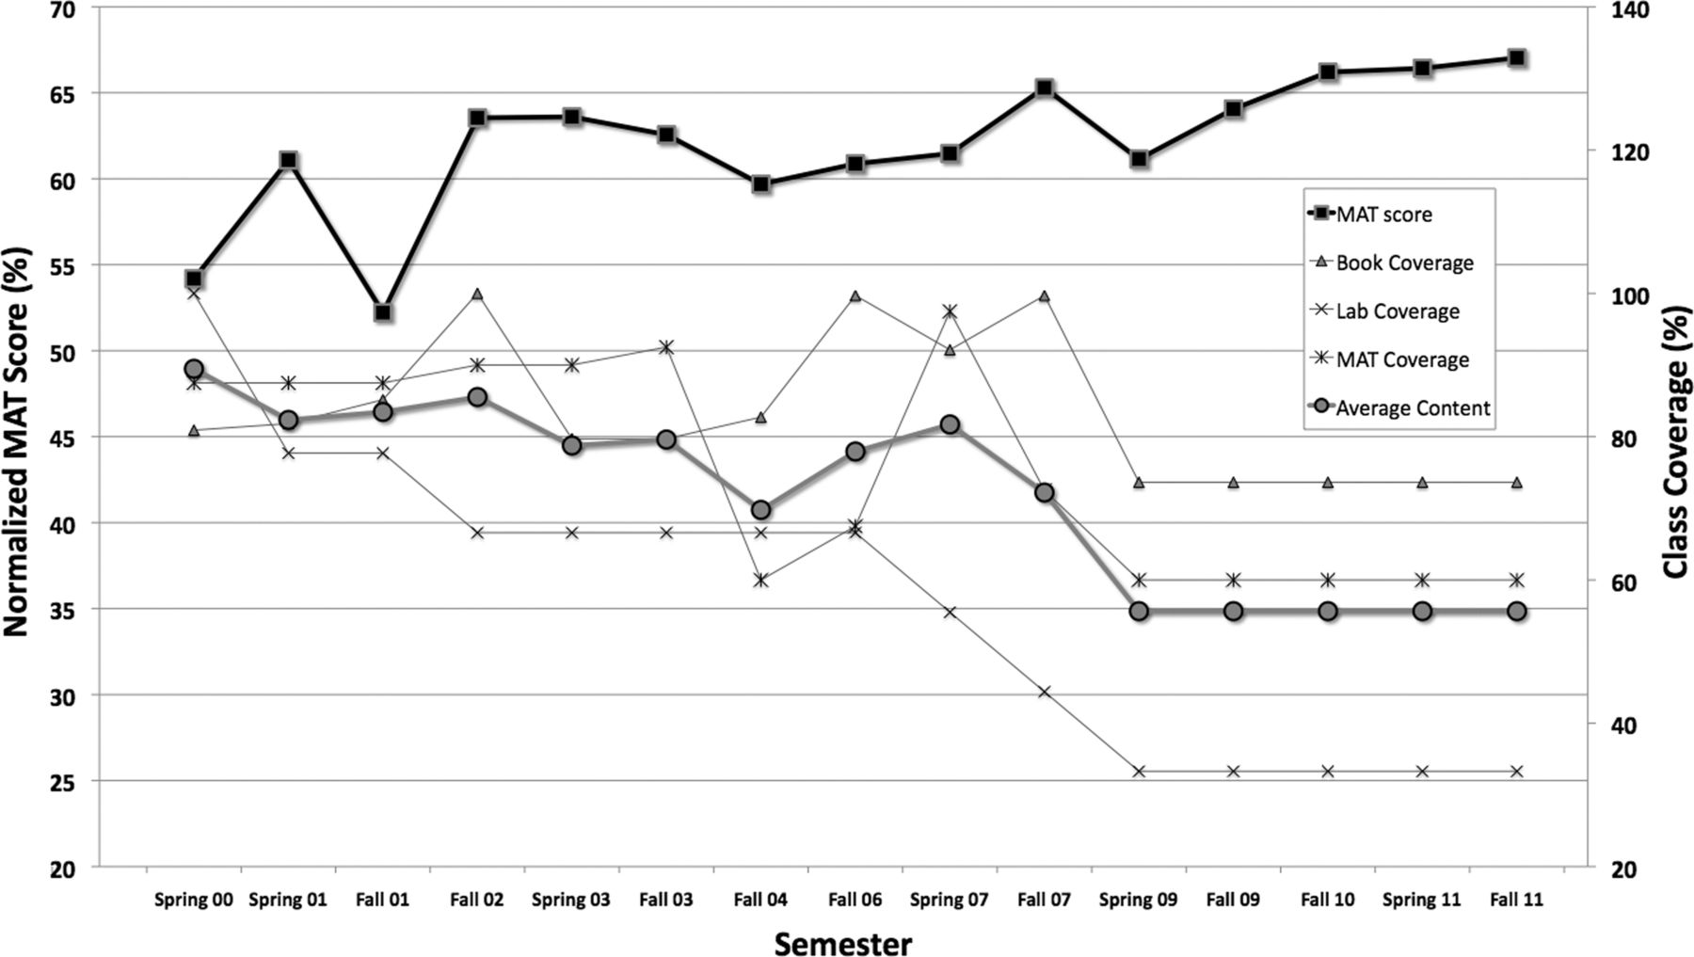
Movement / Coverage
Douglas B. Luckie, et. al. Less teaching, more learning: 10-yr study supports increasing student learning through less coverage and more inquiry. http://advan.physiology.org/content/36/4/325
vs Inquiry / Discovery

Slide 16
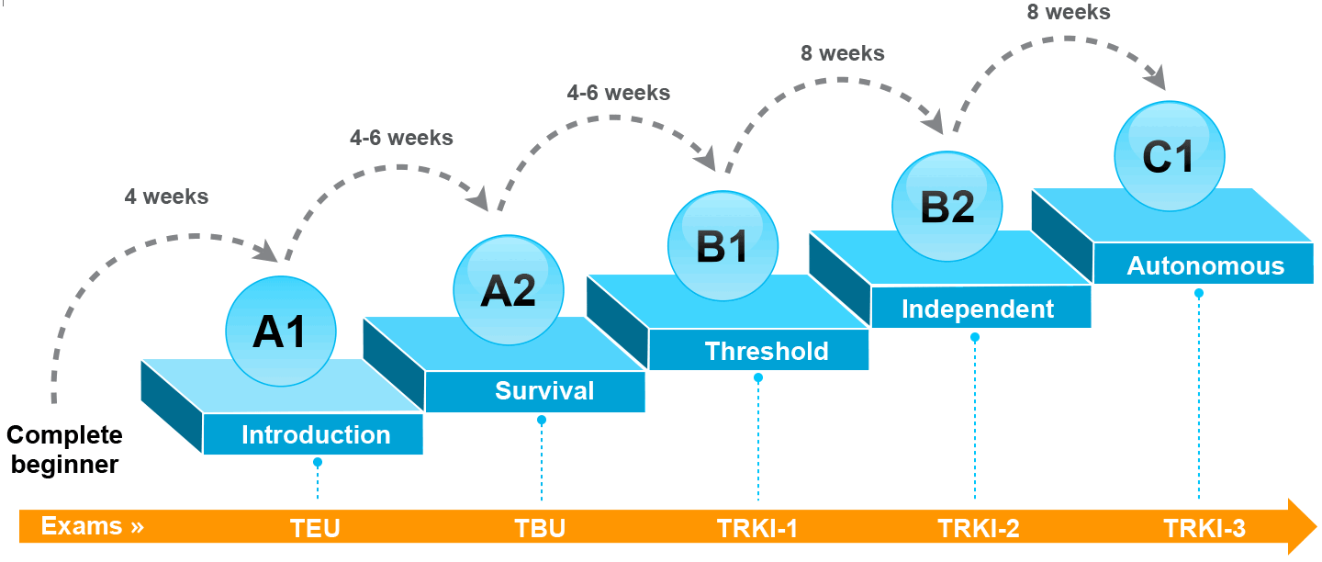
Thresholds / Levels
vs Coverage / Construction
Exlinguo https://www.exlinguo.com/en/objectives-levels-russian

Slide 17
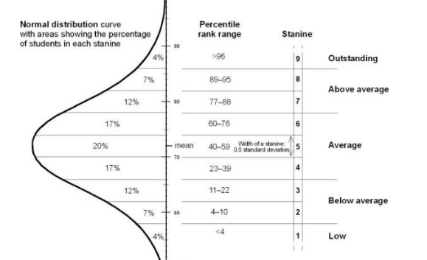
Position / Ranking
vs Clustering or grouping
https://specialedonthebellcurve.wordpress.com/2012/06/07/assessment-norms-percentiles-stanines-grade-equivalents-etc/

Slide 18
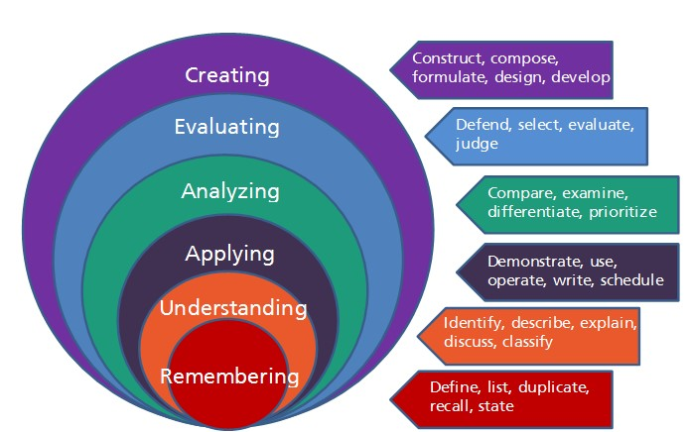
Objectives or outcomes
vs Serendipity or emergence
Davenport design. http://www.davenportdesign.com/blog/make-your-courses-bloom-with-blooms-taxonomy

Slide 19
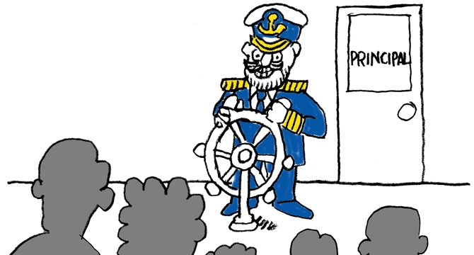
Leading / Led
vs Centered

Slide 20
Summary
Path | Field
Course | Curriculum (as in ‘mapping’)
Sequence / Prequisite | Core / periphery / foundation
Movement / covered | Inquiry / Discovery / Gaps
Threshold / Levels | Coverage / Construction
Positioning – first / last | Grouping / Clustering
Objective / target | Serendipity / emergence
Leading / Led | Centred
Carrie Paechter, Metaphors of Space in Educational Theory and Practice http://www.tandfonline.com/doi/pdf/10.1080/14681360400200202

Slide 21
Technologies for a Learning Space

Slide 22
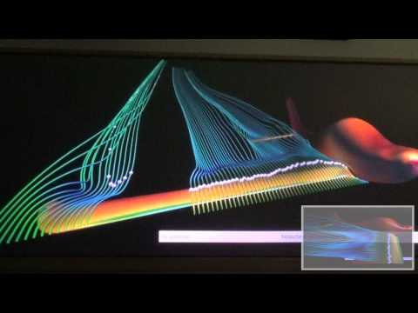
Field or Environment
Sophic Knowledge Environment. http://www.sophicalliance.com/Knowledge%20Environment.php
Visualization of simulation data in VR environment https://www.youtube.com/watch?v=PBJ98-txTBA

Slide 23
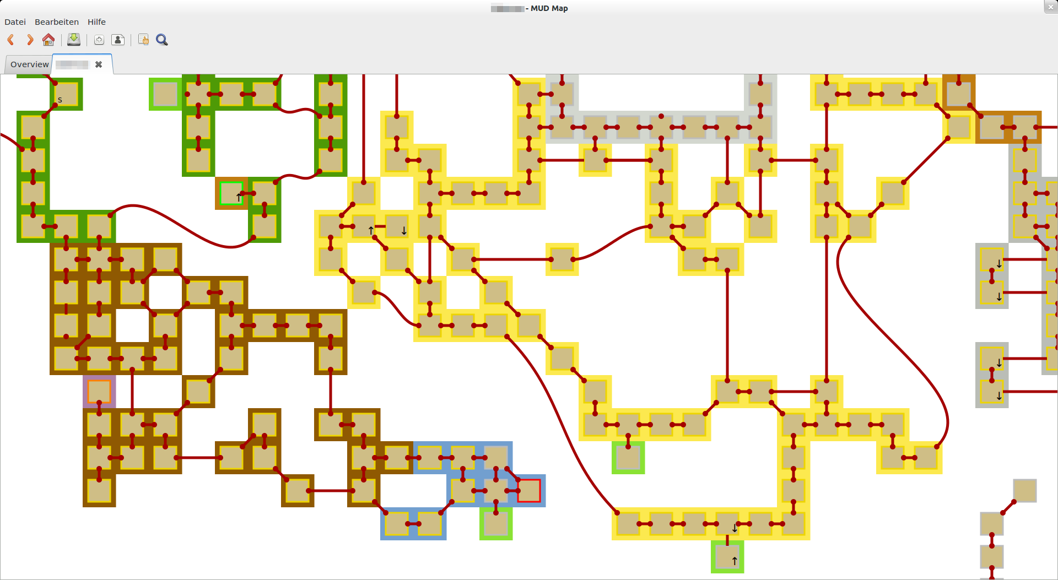
Mapping
MUD Map, A tool to create and organize user side maps
https://sourceforge.net/projects/mudmap/

Slide 24
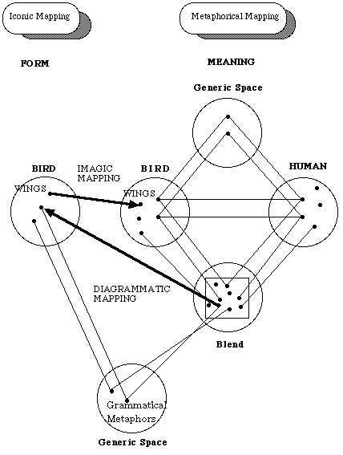
Mapping Tools
Concept maps
Graph Databases

Slide 25
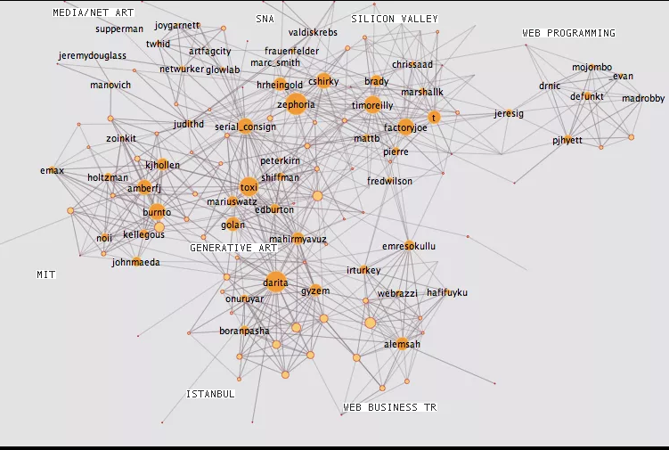
Core / Periphery
Social network formation / following
Network traversal tools
Graph analysis
Burak Arikan, Growth of a Twitter Graph http://burak-arikan.com/growth-of-a-twitter-graph

Slide 26
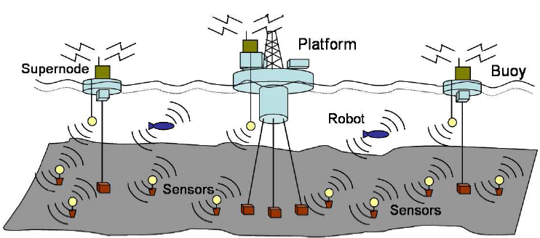
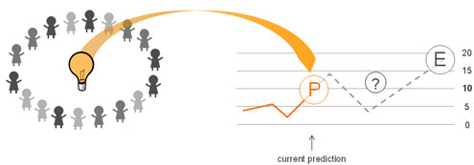
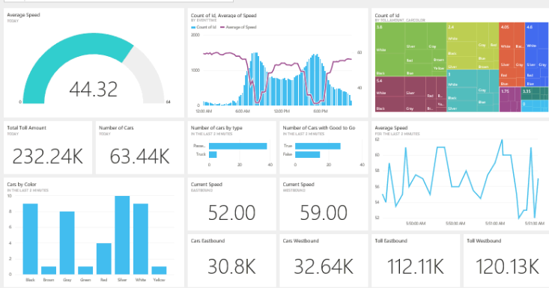
Inquiry / Discovery
Sandra de Blécourt, Essentials of the Scientific Method, http://centralsquares.com/2015/05/22/essentials-of-the-scientific-method/

Slide 27
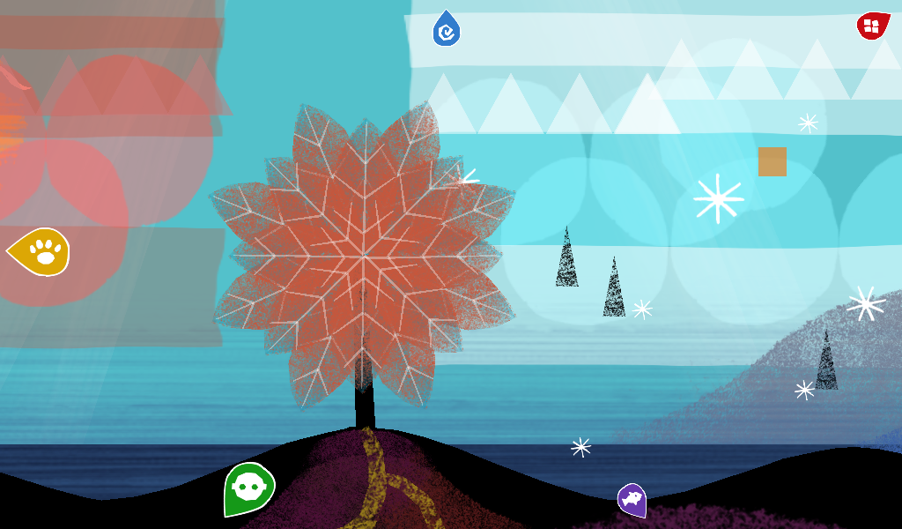
Coverage / Construction
Create
Create Explore Learn at RCH https://play.google.com/store/apps/details?id=com.mediasaints.rch

Slide 28
Clustering / Grouping
Rob Marvin, 5 Web Tools to Help You Stop Emailing, Start Collaborating, http://uk.pcmag.com/slack/74054/feature/5-web-tools-to-help-you-stop-emailing-start-collaborating

Slide 29
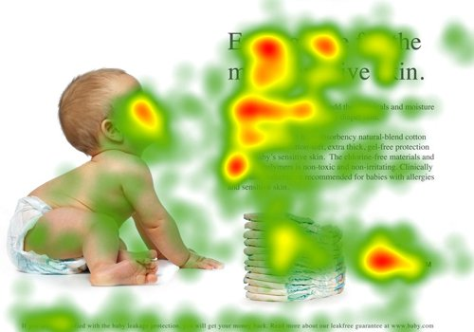
Serendipity / Emergence
The Wisdom of Crowds
Business intelligence

Slide 30
Centered
Lisa Marie Blaschke http://www.slideshare.net/lisamarieblaschke/selfdetermined-learning-creating-personal-learning-environments-for-lifelong-learning

Slide 31
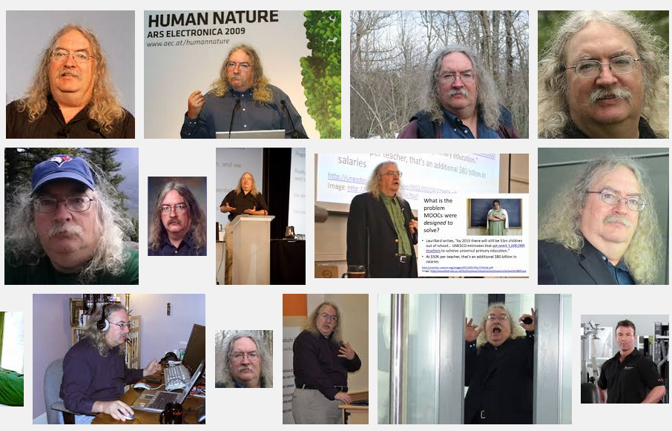
Stephen Downes
http://www.downes.ca

