Slide 1
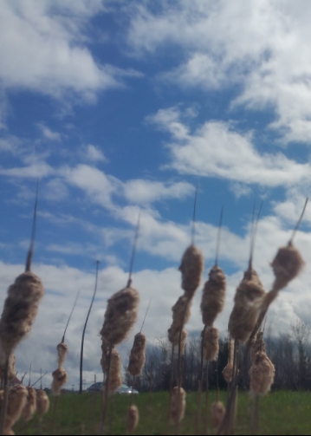
New Trends in Online Learning
Stephen Downes
June 8, 2016
Atlantic Universities and Colleges Technology Conference

Slide 2
The Inflexible Law of Learning
It's when we do stuff that we learn, not when stuff does something for us.

Slide 3
Part One. The Future in 2016
Machine learning and artificial intelligence
Handheld and Mobile Computing
Badges and Blockchain
Internet of Things
Games, Sims and Virtual Reality
Translation and Collaborative Technology
http://teachonline.ca/tools-trends/exploring-future-education/2016-look-future-online-learning-part-1
http://halfanhour.blogspot.com.tr/2016/03/the-2016-look-at-future-of-online.html

Slide 4
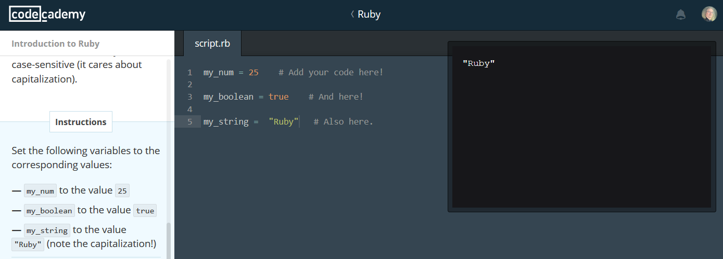
1. Machine learning and AI
Not simply for adaptive learning
The idea is to create an environment
https://www.codecademy.com/

Slide 5
Three Types of AI
decision engines - these are expert systems that are based on rule-driven strategies
pattern recognition - perceptual systems that identify patterns from partial or disorganized data
cluster detection - detecting nearest neighbours and categories of things
http://www.wtec.org/loyola/kb/c1_s1.htm
http://research.microsoft.com/en-us/um/people/cmbishop/prml/

Slide 6
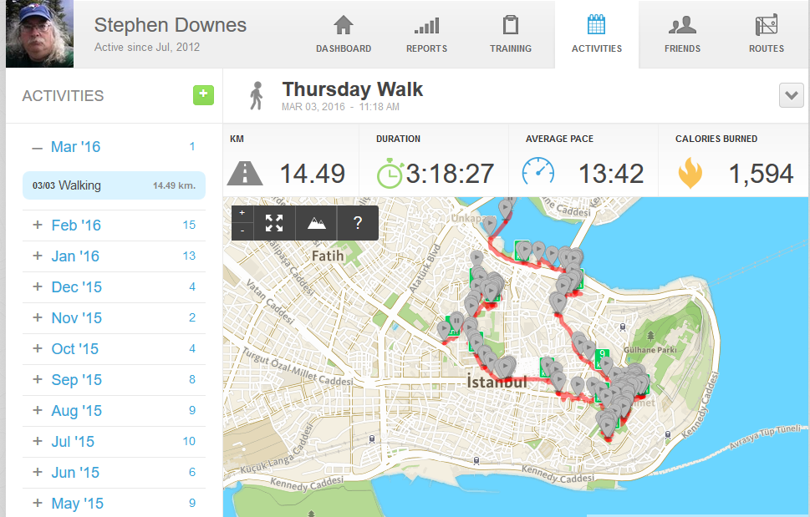
Learning Analytics
We talk about predictive analytics as though finishing a course is the problem
The real future is in the quantified self
http://quantifiedself.com/

Slide 7
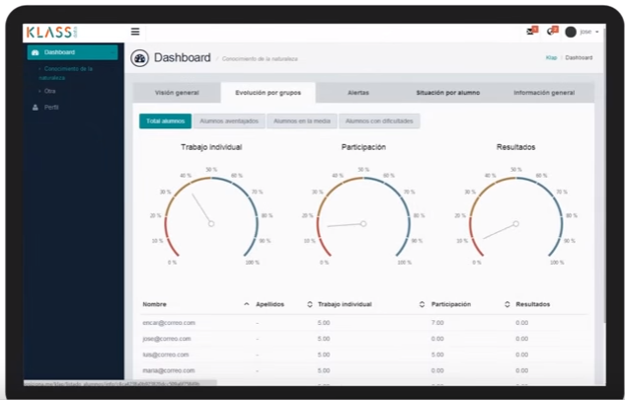
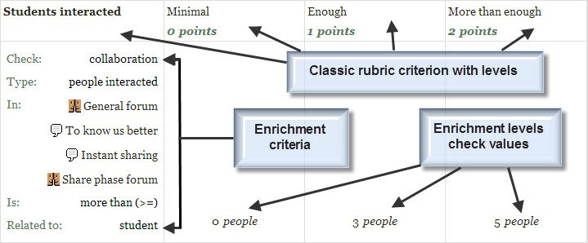
Predictive Analytics
Recognition Tasks
Notes:
Predictive Analytics - eg. SmartKlass https://moodle.org/plugins/local_smart_klass
Recognition Tasks – eg. Learning Analytics enriched rubrics - https://docs.moodle.org/30/en/Learning_Analytics_Enriched_Rubrics
See also: http://www.vteducation.org/en/articles/learner-data/introduction-learning-analytics

Slide 8
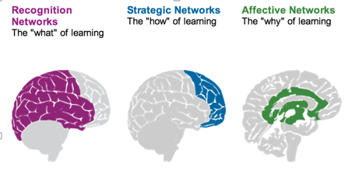
Personalized Learning
Rules-Based Events (like notifications)
User Models
Adaptive Learning
Notes:
- rules-based interactions – eg. Personalized Learning Designer (Blackboard / Moodlerooms) http://www.moodlerooms.com/3-rules-you-cant-live-without-the-personalized-learning-designer/

Slide 9
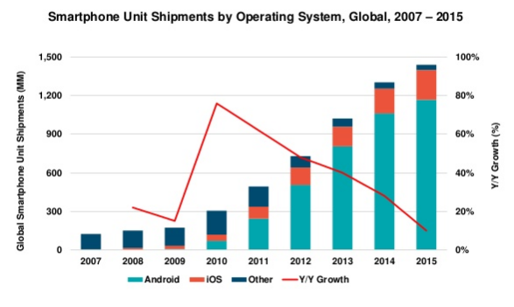
2. Handheld and Mobile Computing
Mary Meeker http://www.slideshare.net/kleinerperkins/2016-internet-trends-report?ref=http://www.kpcb.com/internet-trends

Slide 10
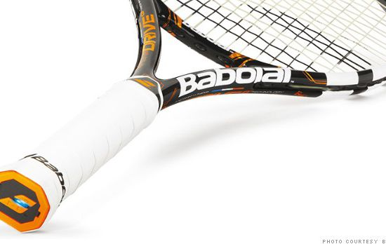
Performance Support
The future of learning isn’t the mobile phone
It’s in the integrated performance support system
http://fortune.com/2014/05/27/a-tennis-racquet-that-isnt-just-strung-but-wired/

Slide 11
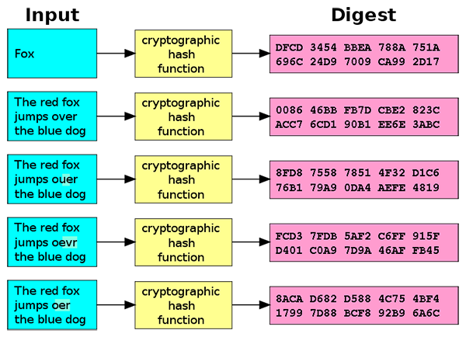
3. Badges and Blockchain
Doug Belshaw:
"If we used the blockchain for Open Badges," he writes, "then we could prove beyond reasonable doubt that the person receiving badge Y is the same person who created evidence X.
http://dmlcentral.net/blog/doug-belshaw/peering-deep-future-educational-credentialing
http://www.downes.ca/search/blockchain

Slide 12
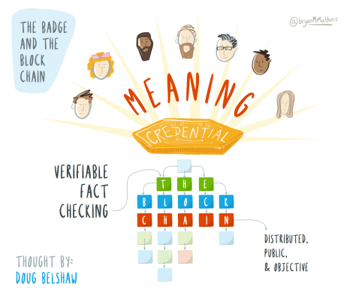
Credentials
Sony plans to launch a testing platform powered by blockchain and that IBM plans to offer 'blockchain-as-a-service,'"
Audrey Watters
http://hackeducation.com/2016/02/25/blockchain-edu1

Slide 13
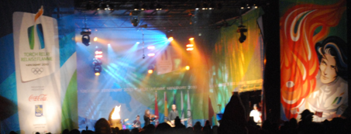
The Dao
Ethereum is a decentralized platform that runs smart contracts https://www.ethereum.org/
The Dao is a 'distributed corporation' that receives investments, chooses projects, and pays for their development; some of these projects return revenue to Dao and others don't. https://magazine.backfeed.cc/dao-alive-now-let-evolution-begin/

Slide 14
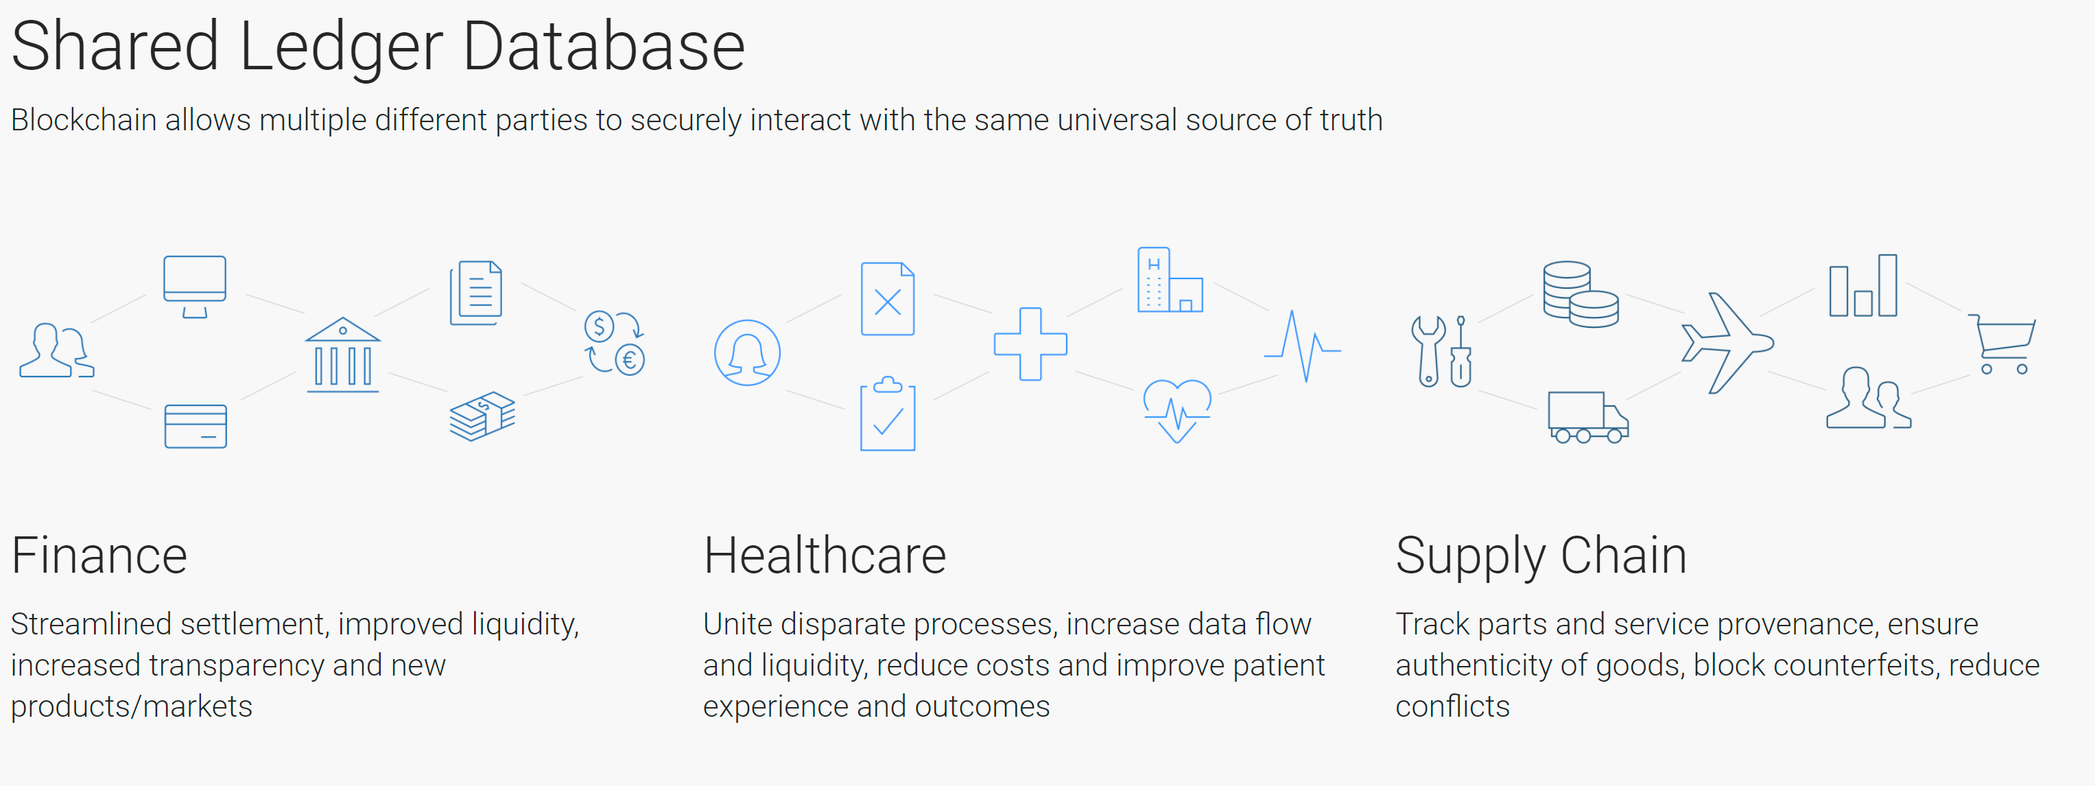
Hyperledger
Hyperledger - https://www.hyperledger.org/
MOOC on EdX - http://www.prnewswire.com/news-releases/hyperledger-launches-first-free-massive-open-online-course-mooc-on-edxorg-300532968.html

Slide 15
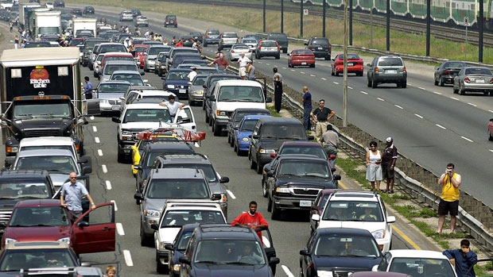
4. Internet of Things
What happens when companies know the state of all your devices?
http://www.cbc.ca/news/canada/car-tracking-devices-spark-privacy-concerns-1.1366687

Slide 16
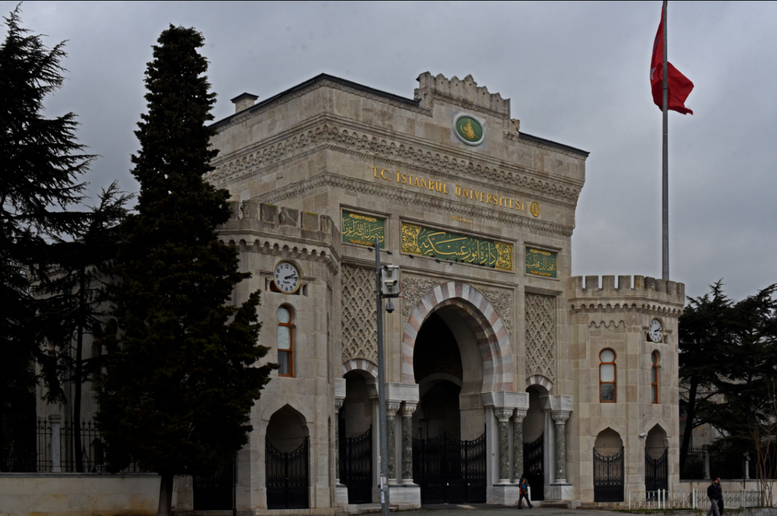
5. Games, Sims and Virtual Reality
‘Gamification’ – adds game elements to learning
‘Serious Games’ – employs a game to facilitate learning
https://badgeville.com/wiki/Gamification

Slide 17
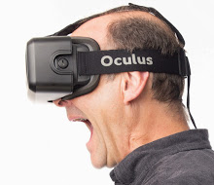
Oculus Rift
1. Freezers
2. Smilers
3. Grippers
4. Swayers
5. Screamers
6. Freak-outs
http://donaldclarkplanb.blogspot.ca/2014/11/oculus-rift-freezers-smilers-grippers.html
http://www.downes.ca/search/oculus

Slide 18
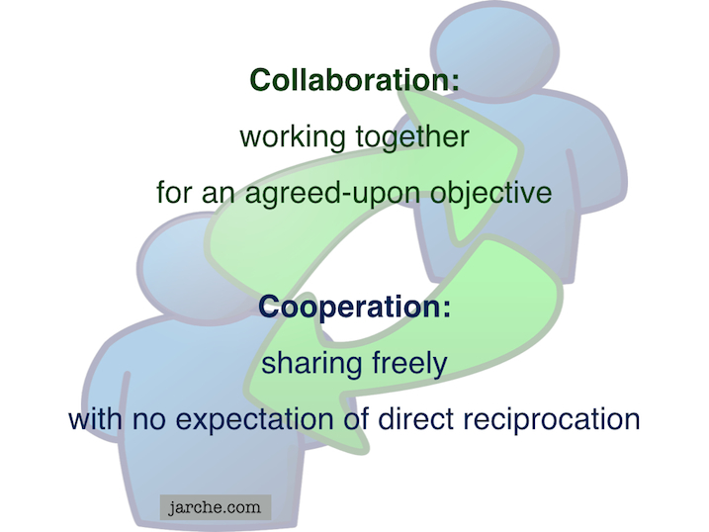
6. Translation and Collaborative Technology
Communication is and will be everywhere
But the future lies in cooperation, not collaboration
https://cyber.law.harvard.edu/research/cooperation
Image: http://Jarche.com

Slide 19
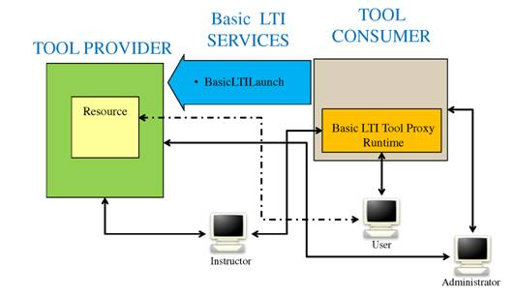
Learning Tools
LTI Producer – provides features
LTI Consumer – connects to features
https://www.imsglobal.org/specs/ltiv1p0/implementation-guide
Notes:
LTI Proivider plugin - https://moodle.org/plugins/local_ltiprovider
The LTI Provider is an application which provides features that other people want to and can connect to from their own LMS.
Provide access to full courses or single activities.
Single sign on
Change the navigation block of a course or activity for displaying information and links only regarding to your current course.
Send backs course or activity final grades to the LTI consumer tool
Modify the course or activity page for hiding the header, footer and left or right blocks
The LTI Consumer is an application which can connect to the 3rd party Provider system to avail of the features it has.
Eg. http://support.mediacore.com/customer/portal/articles/869178-configuring-a-lti-consumer

Slide 20
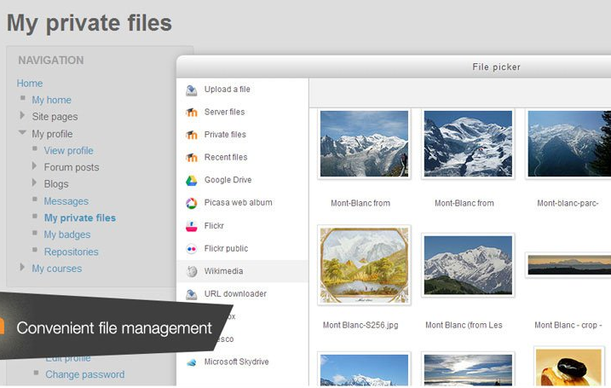
Cloud Storage
Cloud hosting of Moodle
File management
Notes:
MoodleCoud - https://moodle.com/cloud/
(includes BigBlueButton)
Cloud storage - https://docs.moodle.org/30/en/Working_with_files

Slide 21
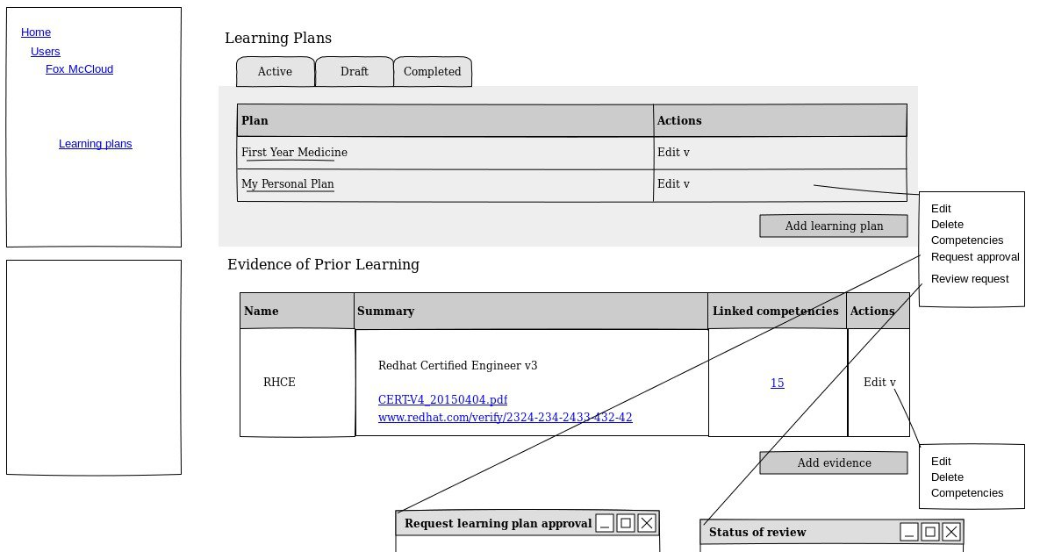
Outcomes and Competencies
Notes:
Competency Framework added in Moodle 3.1 - https://docs.moodle.org/dev/index.php?title=Competency_Based_Education
- Define competencies, learning plans, evidence of prior learning
Compentencies – eg. Compeencies Exabis - https://moodle.org/plugins/block_exacomp
The goal of this module is to bring competencies that have been provided (generate them at www.edustandards.org) into Moodle-courses. Competencies from a students' sight can be expressed as "I can”-statements (example: "I can use spreadsheet formulas to solve a mathematical problem”).

Slide 22
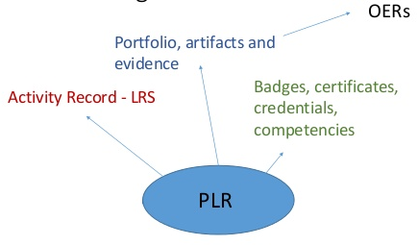
Personal Learning Records

Slide 23
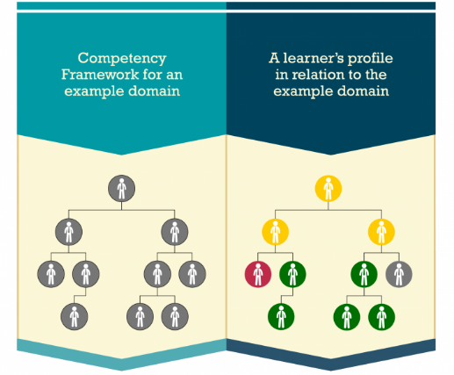
CASS
Competency and Skills System
https://www.adlnet.gov/introducing-the-next-big-thing-cass/

Slide 24
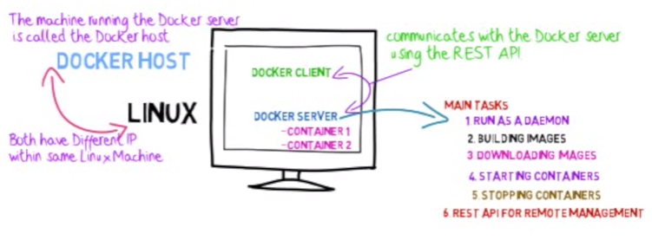
Docker
http://www.tomsitpro.com/articles/docker-enterprise-hub-orchestration,1-2375.html
Notes:
Image: http://www.tomsitpro.com/articles/docker-enterprise-hub-orchestration,1-2375.html
https://www.youtube.com/watch?v=pgiFwriExYg

Slide 25
Part Two. What Does Learning Become?
Context-Sensitive
Engaging
Personal

Slide 26
Any Time / Any Place?
It’s all about context
The airplane cockpit is no place for a two week course
Learning will be like water or electricity – or text
http://www.sciencedirect.com/science/article/pii/S1319157813000372

Slide 27
Engaging = Immersive + Wanted
Just because it’s interactive doesn’t make it engaging
We have to want to be there
And we have to believe that we’re there
http://www4.ncsu.edu/unity/lockers/users/f/felder/public/Columns/Active.pdf

Slide 28
Learning is Personal

Slide 29
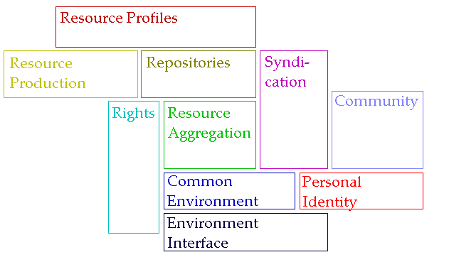
A Personal Learning Architecture
http://www.downes.ca/presentation/98

Slide 30
The New Institutional Perspective
From Management to Meaning
Don’t do things to people, do things with people, help people do things
If we have to ask “how do we motivate people” then we’re taking the wrong approach – Kohn
“Knowledge sharing is your job” – Buckman
Provide opportunities for autonomy, mastery, purpose – Pink
http://www.downes.ca/presentation/98

Slide 31
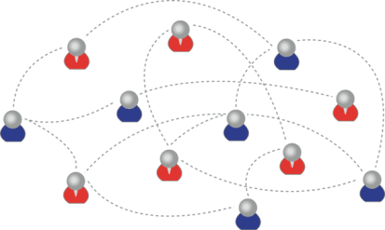
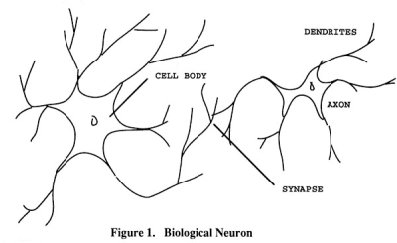
Learning Outcomes
We are using one of these
To create one of these
Personal knowledge consists of neural connections, not facts and data

Slide 32
Learning Outcomes
Learning a discipline is a total state and not a collection of specific states
It is obtained through immersion in an environment rather than acquisition of particular entities
It is expressed functionally (can you perform ‘as a geographer’?) rather than cognitively (can you state ‘geography facts’ or do ‘geography tasks’?)

Slide 33
Learning Outcomes
We recognize this
By perfomance in this
There are not specific bits of knowledge or competencies, but rather, personal capacities

Slide 34
The New Model of Work and Learning
Sharing - create linked documents, data, and objects within a distributed network
Contributing - employ social networking applications of the Web to facilitate group communication
Co-creating - work through networks that facilitate cooperative group work toward common goals
(Dutton, p. 12)

Slide 35
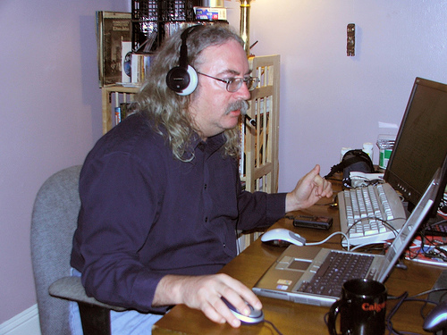
http://www.downes.ca

