Slide 1
Connectivism, MOOCs and Innovations in Future Learning
Stephen Downes
Chiang Mai, Thailand
July 25, 2016

Slide 2
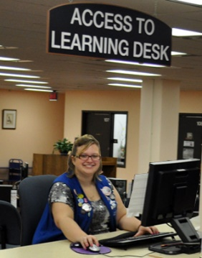
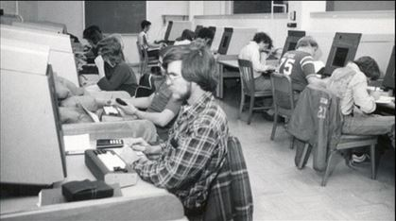
My work is focused around a few core areas:
educational theory - specifically, ways of describing how we learn, framed as 'network learning' or 'connectivism‘
educational technology - models and systems for supporting and distributing learning through technology
policy and process supporting free and open access to learning

Slide 3
Educational Theory
1

Slide 4
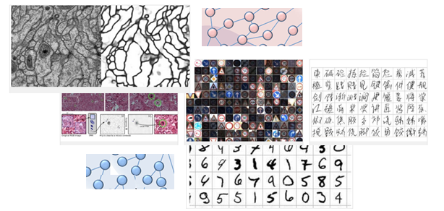
Reading the World:
I don’t see the world as neat and ordered, like logic and mathematics – I see it as messy and complex, like a language
I don't really think the answer to "do you understand?" is "let me demonstrate". It’s too easy to fake.
But there’s a sense in which knowing is about doing rather than some mental state

Slide 5
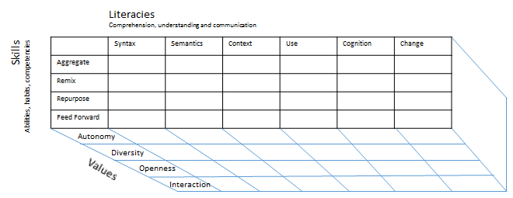
Method as Discovery:
You don’t learn a language, you discover it
To discover a language is to be immersed in it, to speak it and listen to people speaking in it
My scientific method (if it can be called that) is to go to the office each day and immerse myself in the world – to try listening, and to try speaking

Slide 6
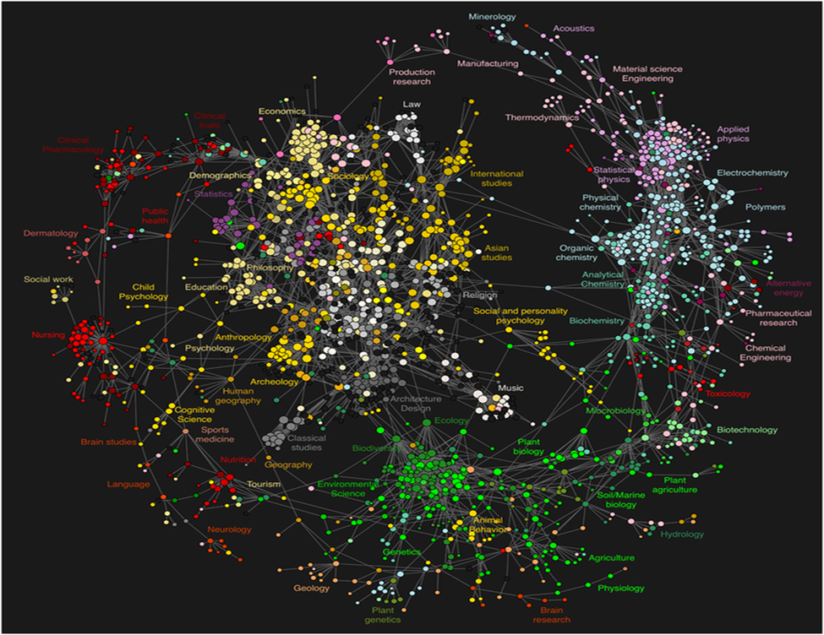
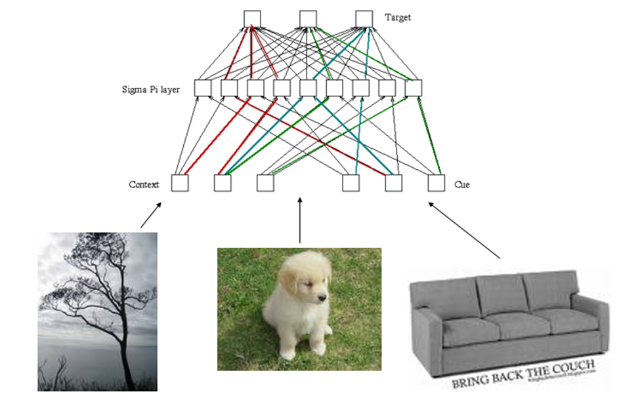
Knowledge:
is created by networks of connected entities
Can be personal knowledge, as in neural networks
Can be computational knowledge, as in connectionist software
Can be social, as in social network theory

Slide 7
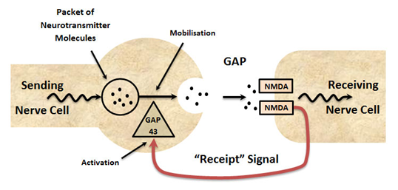
Personal knowledge: The organization of neurons
Public Knowledge: The organization of artifacts
- A common underlying logic: graph theory, connectionism, social network theory, etc.
- If a human mind can come to 'know', and if a human mind is, essentially, a network, then any network can come to 'know', and for that matter, so can a society.

Slide 8
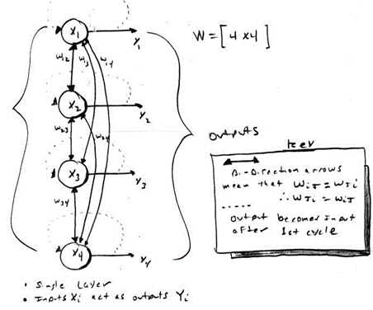
Network Learning
is the creation and strength of connections
Hebbian associationism, based on concurrency
Back propagation, based on desired outcome
Boltzman, based on ‘settling’, annealing
Learning:
is the development of these networks
A focus on both personal experience and social networks
Learning is a matter of practice and reflection
To know is to recognize

Slide 9
Learning Networks:
Networked learning is a process of developing and maintaining connections with people and information, and communicating in such a way so as to support one another's learning.
Instruction does not equate to learning. Curriculum is not driven by predefined inputs from experts. The community acts as the curriculum, spontaneously shaping, constructing, and reconstructing itself and the subject of its learning.

Slide 10
Educational Technology
2

Slide 11
Community and Connectives:
Nature of the knower: humans are more like connectives than collectives
Quality of the knowledge: collectives are limited by the capacity of the leader
Nature of the knowledge: collective knowledge is transmitted and simple (cause-effect, yes-no, etc) while network knowledge is emergent and complex

Slide 12
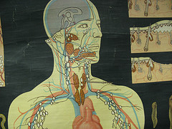
Network Development Principles :
Autonomy – each entity has its own values and objectives and decides for itself
Diversity – each entity in a network is unique in role, function and perspective
Openness – membership in the network is fluid; content (signals, messages) can enter and exit the network
Interactivity – knowledge in the network is created by the interactive process (as opposed to the content of signals propagated through the network)

Slide 13
A rough outline of a learning process:
Aggregate – seek out connections and obtain resources through those connections
Remix – join the resources from multiple connections together
Repurpose – adapt the remixed resources
Feed Forward – send the newly created resources on to the next nodes in the network

Slide 14
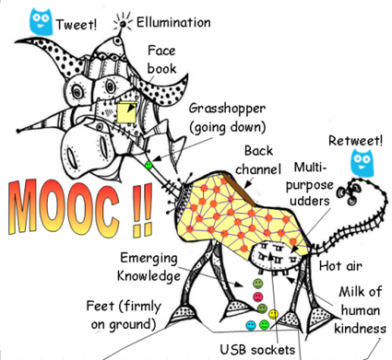
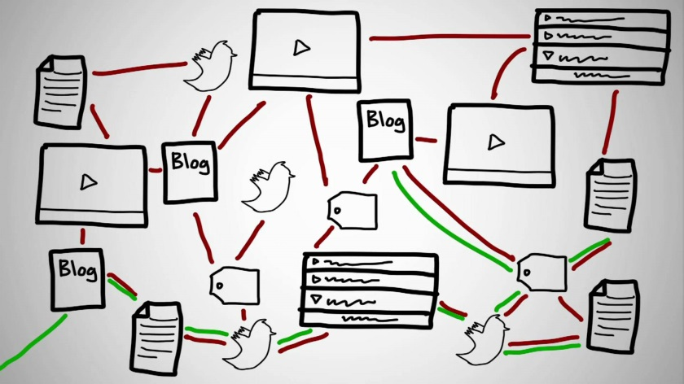
Massive Open Online Course (MOOC):
‘Massive’ by design - Network design avoids bottlenecks; scaling achieved by mesh
‘Open’ as in door - Free as in ‘beer’ and ‘libre’, Open as in ‘content’ and in ‘door’
‘Online’ as in online - Local events encouraged, but the course isn’t offline
‘Course’ (as opposed to community) - In the sense of ‘a course of lectures’

Slide 15
xMOOCs – the Big Elite Universities Way
Collections of centralized resources, Mass events (like videos, live events)
Automated grading etc.
cMOOCs – the Connectivist Way
Based on community, conversation, culture, Most importantly, are distributed

Slide 16
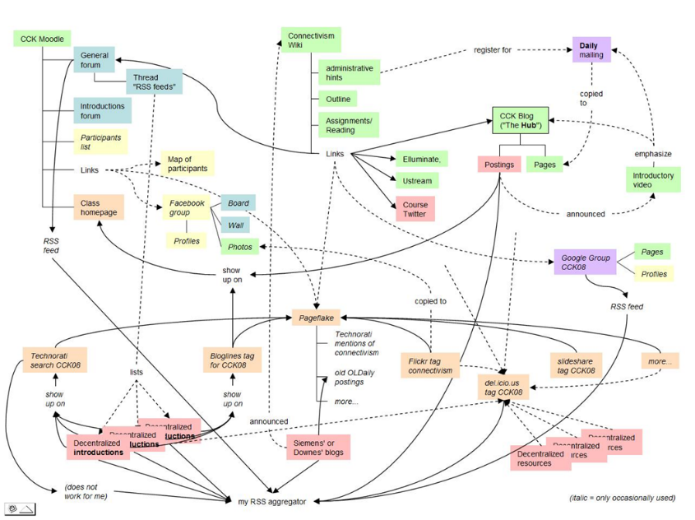
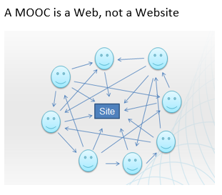
The Connectivist MOOC (cMOOC) Design:
Instead of seeing a course as a series of contents to be presented, envisions a course as a network of participants who find and exchange resources with each other (2008)
An initial structure is developed and ‘seeded’ with custom-built or (preferably) existing OERs
Participants are encouraged to use their own sites to create or share resources
A mechanism (gRSShopper) is employed to connect them

Slide 17
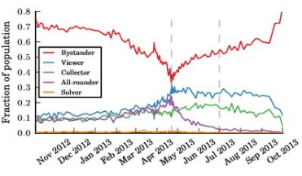
Criticisms:
Dropouts - characterize users by the impact they have on the system: uploaders, commenters, subscribers, viewers, and lurkers (Avi Wolfman-Arent)
Quality - MOOCs are not second rate and they are not disappearing of being absorbed or anything else. Yes, they are ‘disruptive’
Content - too much content, not enough time

Slide 18
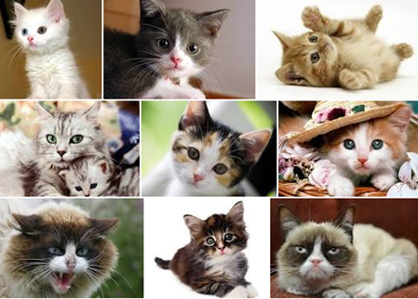
Content:
Weinberger: We don't feel overloaded by the effects of 1.3 million apple pie recipes or 7.6 million cute cat photos. Why not? Because we're not expected to master them. But with information it's different, because there used to be so much less that we could master all the information. But not any more.

Slide 19
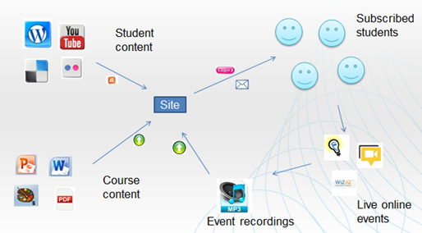
New Technology:
The structure of the MOOC is the structure of the network; the principles of the MOOC are the principles of the network
Explanations stem from analyses of patterns of relations… the autonomy of entities in the network, and … strong and weak ties

Slide 20
Free Learning
3

Slide 21
Free Learning and Connectivism:
These reinforce and depend on each other, for example, autonomy requires:
Access to learning materials and resources without cost or barriers
Connection with other learners by means of sending signals to other network entities (learners, instructors, friends and associates)
Open learning or the ability to join networks regardless of qualifications or social standing

Slide 22
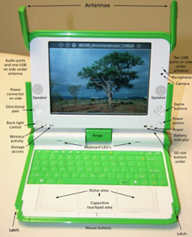
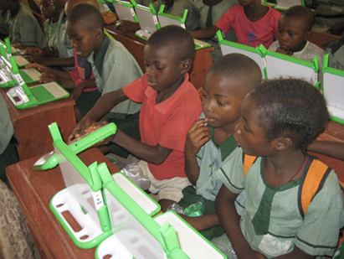
Open Access and Open Educational Resources:
Definition
OERs – UNESCO – “teaching, learning or research materials that are in the public domain or released with an intellectual property license that allows for free use, adaptation, and distribution.”
Open Archives Initiative – “interoperability standards that aim to facilitate the efficient dissemination of e-prints andmmmmmimmmimmimmmmmimmmmmmmmimmmmmmmmmmmimmmmimmmmmmmmmmmmmm other electronic content…”

Slide 23
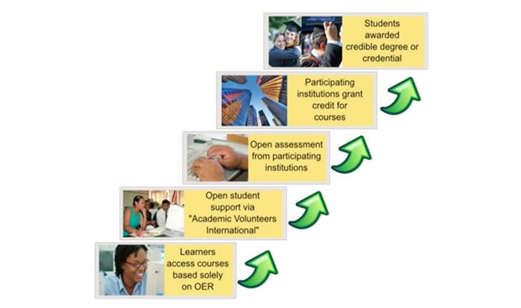
Open Education Logic Model:
Taylor, J.C. 2007. Open courseware futures: Creating a parallel universe. e-Journal of Instructional Science and Technology (e-JIST), Vol 10, No. 1. Online: http://www.ascilite.org.au/ajet/e-jist/docs/vol10_no1/papers/full_papers/taylorj.htmmmmmmmmmmmimmmmmmimmmmm

Slide 24
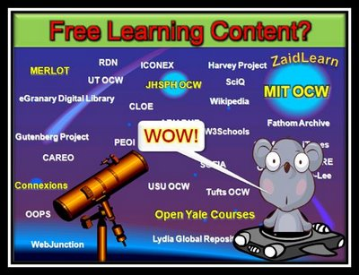
Why Open Educational Resources?
Learning activities are essentially conversations
OERs are the words used in those conversations
Open design – enabling participants to create their own organization and structure
Example: touring a city vs being taken on a tour
The course as ‘environment’ rather than ‘book’
Mmmimmmm

Slide 25
Innovations
4

Slide 26
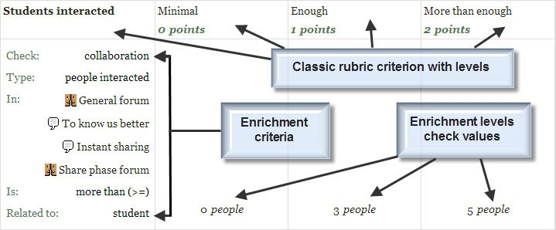
Machine learning and AI
decision engines - these are expert systems that are based on rule-driven strategies
pattern recognition - perceptual systems that identify patterns from partial or disorganized data
cluster detection - detecting nearest neighbours and categories of things

Slide 27
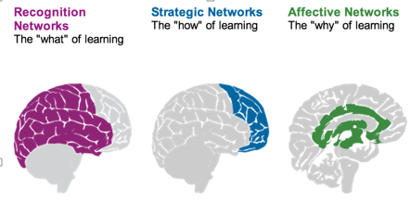
Personalized Learning
Rules-Based Events (like notifications)
User Models
Adaptive Learning

Slide 28
Handheld and Mobile Computing
Performance Support
The future of learning isn’t the mobile phone
It’s in the integrated performance support system

Slide 29
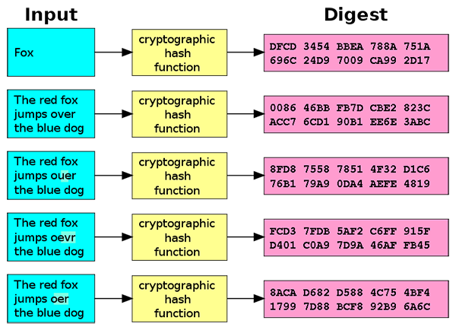
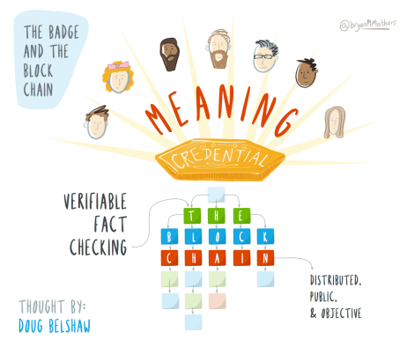
Badges and Blockchain
Belshaw: we could prove beyond reasonable doubt that the person receiving badge Y is the same person who created evidence X.
Sony plans to launch a testing platform powered by blockchain and that IBM plans to offer 'blockchain-as-a-service,'"

Slide 30
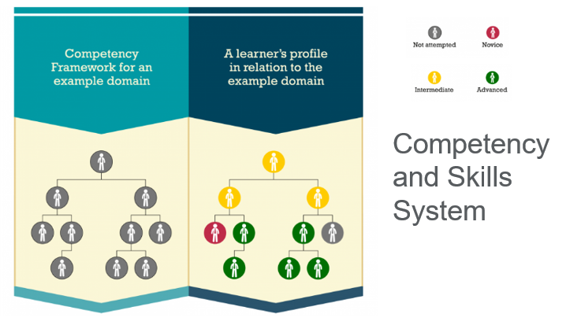
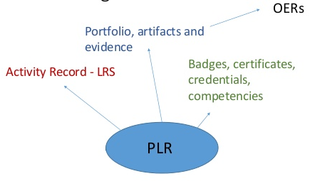
Competency and Skills System (CASS)

Slide 31
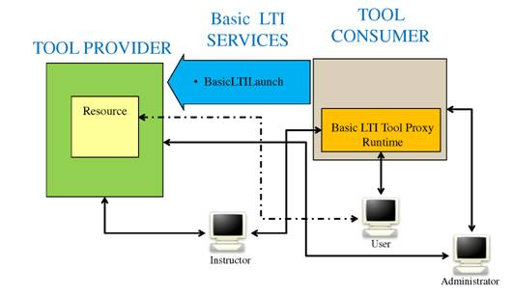
Games, Sims and Virtual Reality
‘Gamification’ – adds game elements to learning
‘Serious Games’ – employs a game to facilitate learning
What happens when companies know the state of all your devices?
Learning Tools
LTI Producer – provides features
LTI Consumer – connects to features

Slide 32
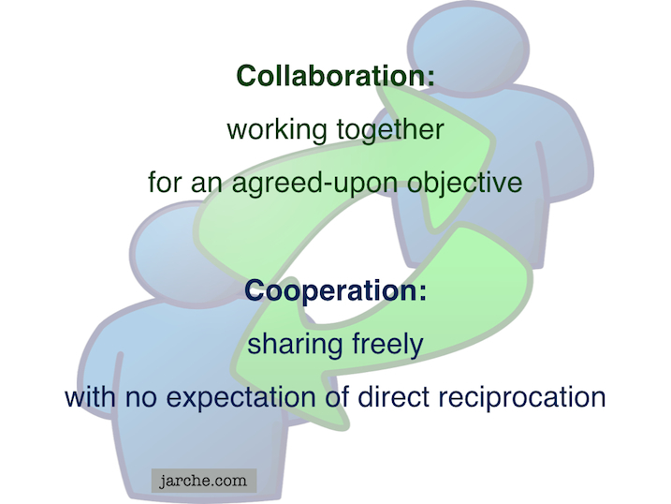
Translation and Collaborative Technology
Communication is and will be everywhere
But the future lies in cooperation, not collaboration
What happens when companies know the state of all your devices?

Slide 33
Transformation
5

Slide 34
Learning is Personal

Slide 35
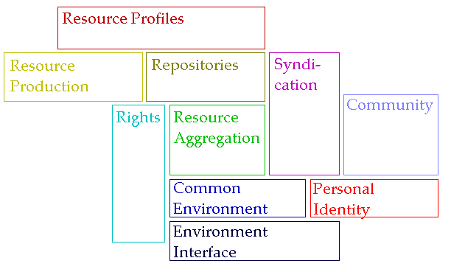
The New Institutional Perspective
From Management to Meaning
Don’t do things to people, do things with people, help people do things
If we have to ask “how do we motivate people” then we’re taking the wrong approach – Kohn; “Knowledge sharing is your job” – Buckman; Provide opportunities for autonomy, mastery, purpose – Pink

Slide 36
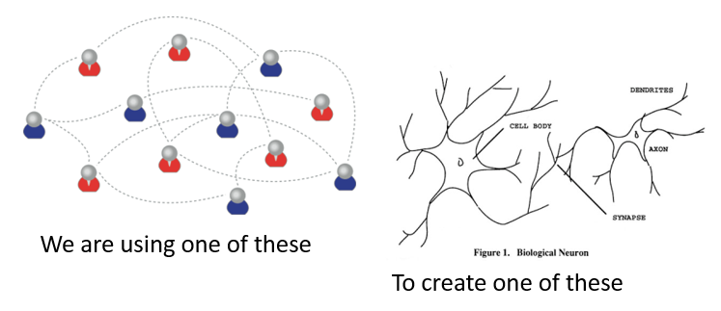
Learning Outcomes
Learning a discipline is a total state and not a collection of specific states
It is obtained through immersion in an environment rather than acquisition of particular entities
It is expressed functionally (can you perform ‘as a geographer’?) rather than cognitively (can you state ‘geography facts’ or do ‘geography tasks’?)

Slide 37
The New Model of Work and Learning
Sharing - create linked documents, data, and objects within a distributed network
Contributing - employ social networking applications of the Web to facilitate group communication
Co-creating - work through networks that facilitate cooperative group work toward common goals

Slide 38
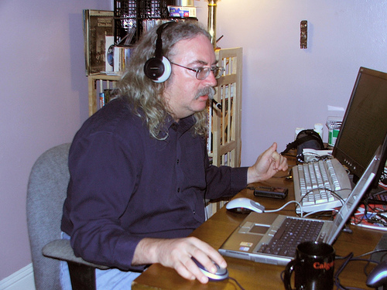
http://www.downes.ca

