Slide 1
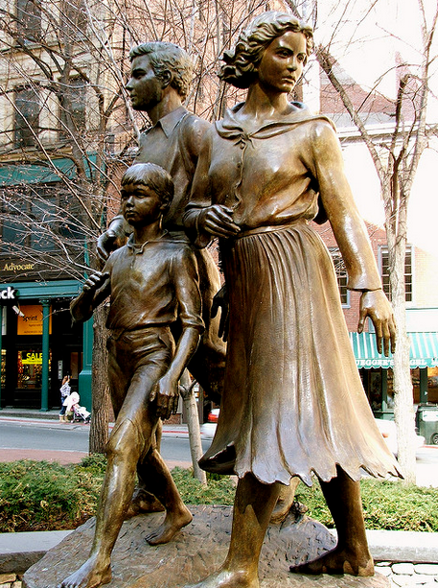
The Role of Incremental and Transformative Change in Future Prediction
Stephen Downes
Campus Technology 2016 Innovator Awards
Boston, Massachusetts
August 3, 2016
http://www.downes.ca/presentation/392
Boston, Massachusetts, 2007

Slide 2
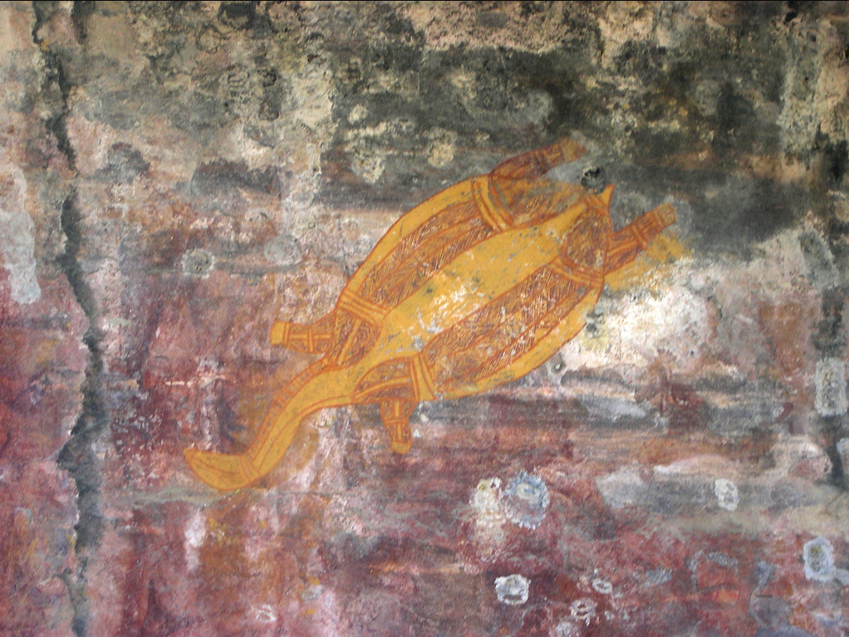
1. The Future
Kakadu, Australia, 2004

Slide 3
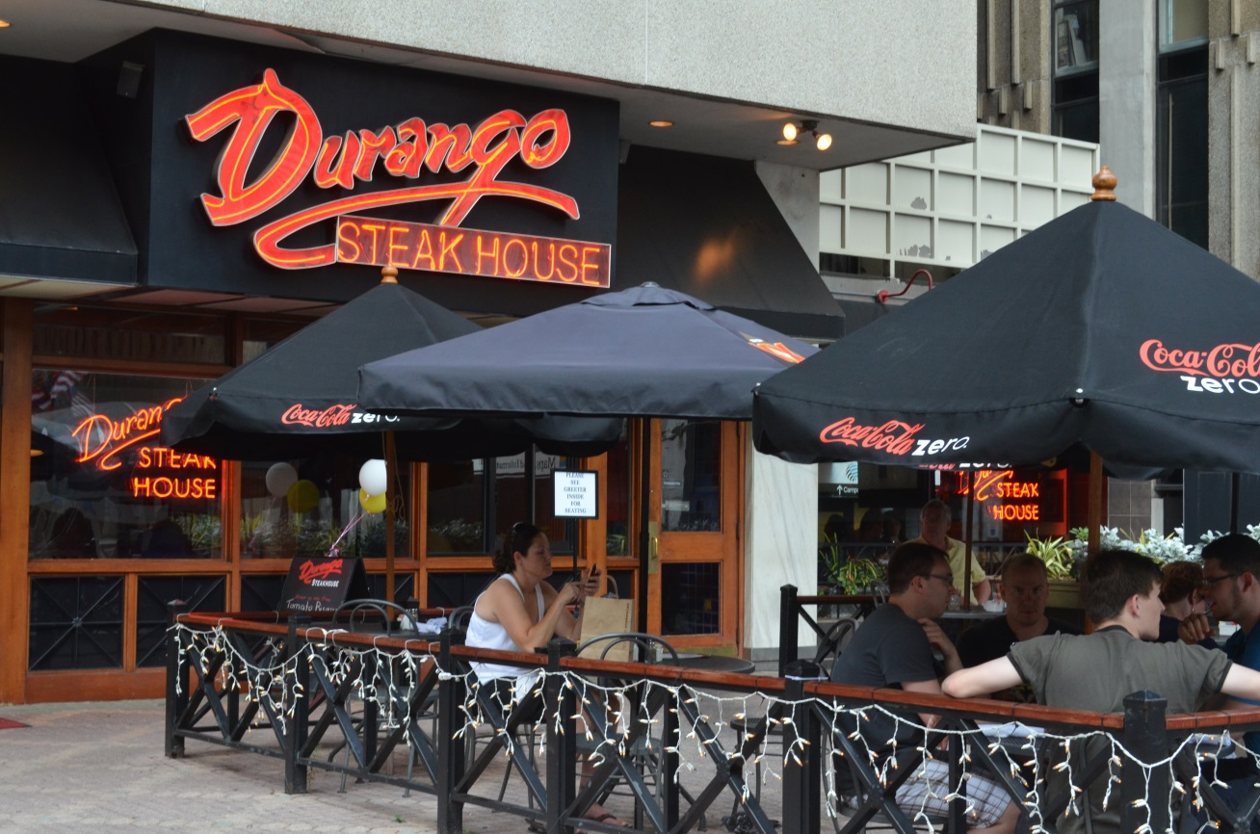
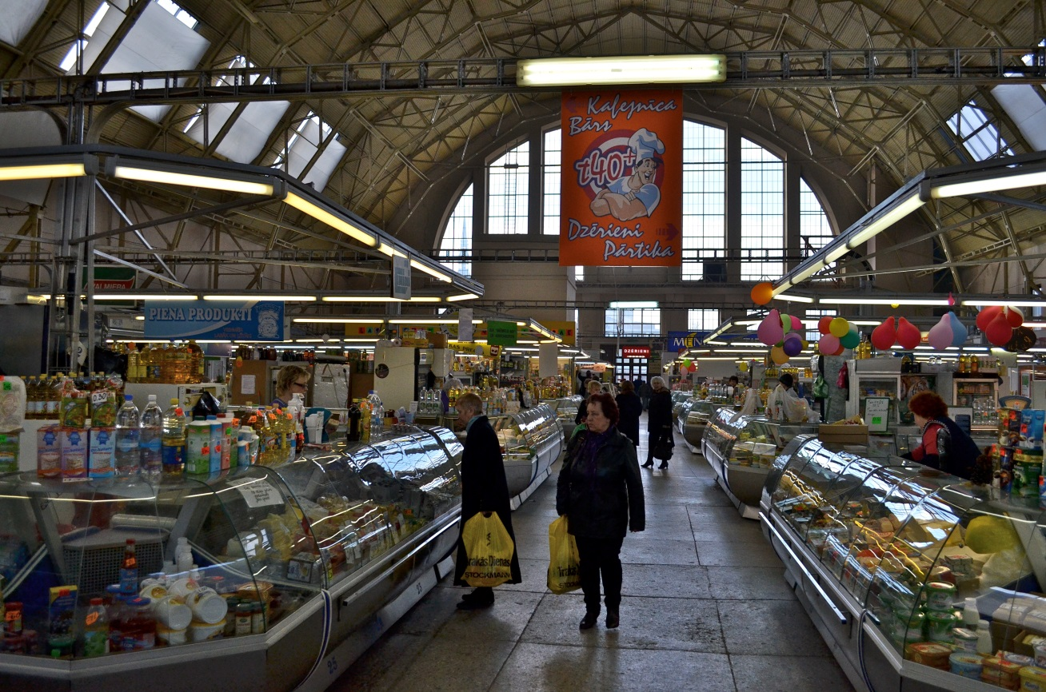
Nobody Can Predict the Future?
Let’s make some predictions together…
Riga, Latvia, 2014

Slide 4
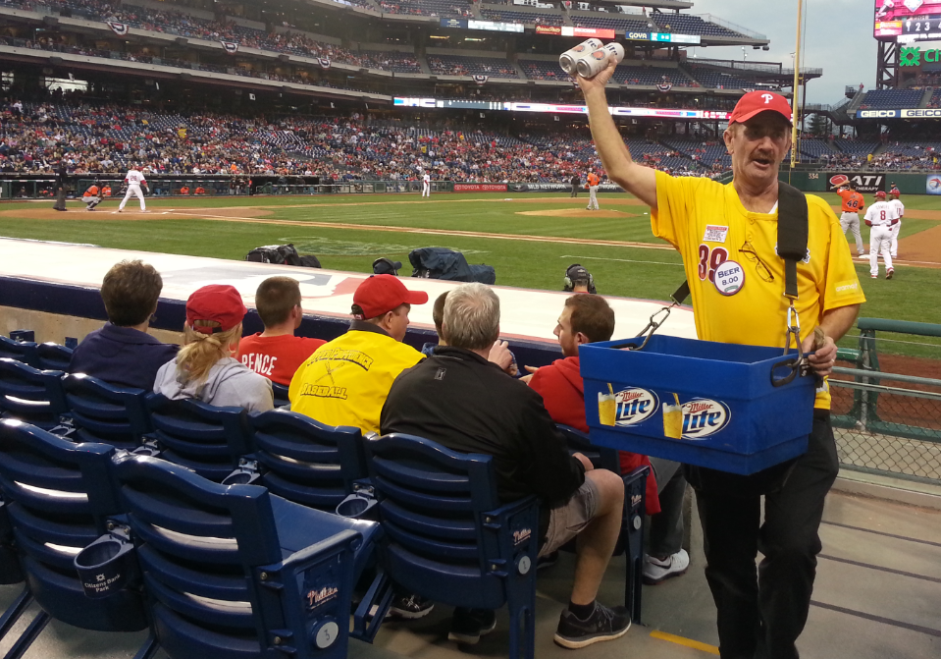
We Predict by Reading the Signs
Prediction isn’t magic, it’s a form of reasoning
Overall, it is an instance of recognition
Philadelphia, Pennsylvania, 2015

Slide 5
The Future and the Past
The future and the past are epistemologically equivalent (so are possibility and necessity)
Possibility
Future
Probability
Chance
You Are Here
Past
Necessity

Slide 6
2. Change
Riga, Latvia, 2012

Slide 7
Seeing Change
Nothing changes
Everything changes
Change = change to edge conditions
What counts as change depends on how you see the world
What you see (often) depends on what you’re looking for
What you’re looking for (often) depends on what you (currently) value

Slide 8
Directionality in Change
Possibility
Actuality
Necessity
I may/might have been walking
I may have walked
I may walk
I might have walked
I might walk
I could have walked
I can walk
competency
I could walk
I walk
affordance
I walked
action
I will walk
I was walking
I am walking
tradition
I am going to walk
I have been walking
obligation
I am going to have to walk
I should have walked
I should walk
I must have walked
I ought to walk
I must walk
Past Present Future

Slide 9
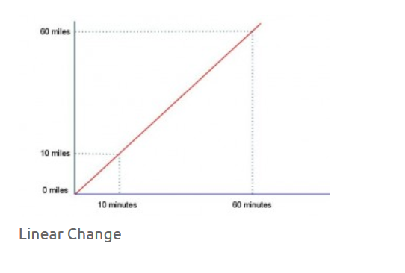
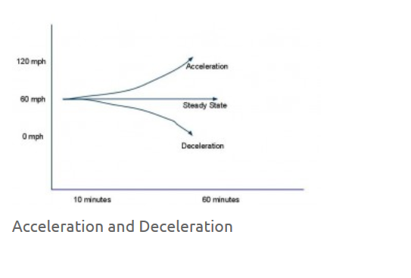
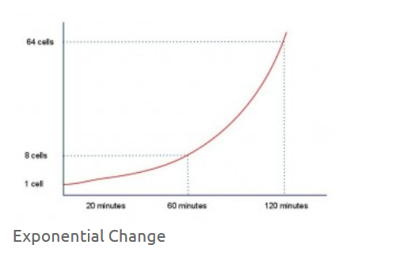
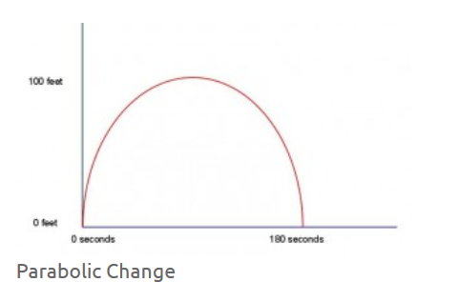
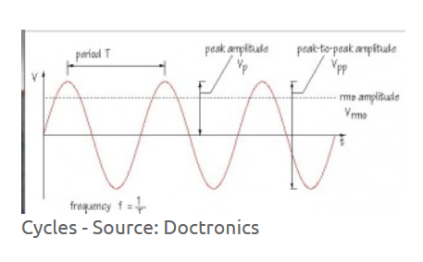
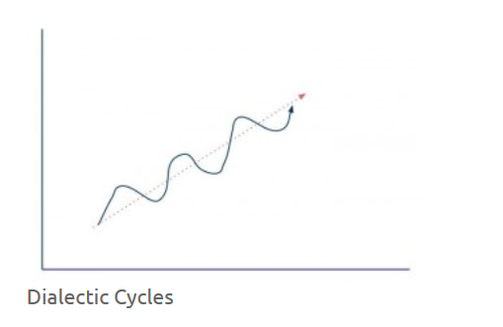
Patterns of Change

Slide 10
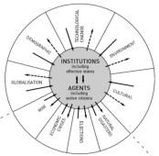
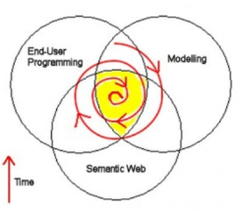
Causes of Change
Resistance
Drivers
Costs
Events
Crises
Inventions
Growth
Values
Goals
Desires
Needs
Attractors
Inertia
Notes:
ACCA, 2012, Drivers of Change in the U.S. http://www.accaglobal.com/content/dam/acca/global/PDF-technical/futures/pol-af-docus.pdf
Simon L. Dolan, Salvador García, Samantha Diegoli, Alan Auerbach. 2000. Organisational Values as "Attractors of Chaos”: An Emerging Cultural Change to Manage Organisational Complexity. http://www.econ.upf.edu/docs/papers/downloads/485.pdf
Donald L. Gilstrap. 2005. Strange Attractors and Human Interaction: Leading Complex Organizations through the Use of Metaphors. https://ejournals.library.ualberta.ca/index.php/complicity/article/viewFile/8727/7047

Slide 11
Change in Education
Many Changes in tech that changed learning were the result of drivers
Writing and publishing – print technology
Public education – social forces
Networks – electronic technology
They came from outside education
They impacted how we manage and deliver education
But they also reflected changes in what we value in education

Slide 12
Education Disruption
Everybody wants to ‘disrupt education’ without having the sense that this means ‘keep it the same, but with more benefits for me’
John Battelle. 2016. Want a Deep Dive on How Silicon Valley's Best Will Fix Education? Here's The Full Interview With Max Ventilla, CEO and Founder, AltSchool. https://www.linkedin.com/pulse/want-deep-dive-how-silicon-valleys-best-fix-education-john-battelle
Ilan Mochari. 2015. Inc. 16 Startups Poised to Disrupt the Education Market http://www.inc.com/ilan-mochari/16-startups-that-will-disrupt-the-education-market.html
Image: Larry Downes and Paul F. Nunes. 2013. Dig Bang Disruption. Harvard Business Review. c/o Accenture. https://www.accenture.com/t20150521T020819__w__/us-en/_acnmedia/Accenture/Conversion-Assets/Blogs/Documents/1/Accenture-Big-Bang-Disruption.pdf

Slide 13
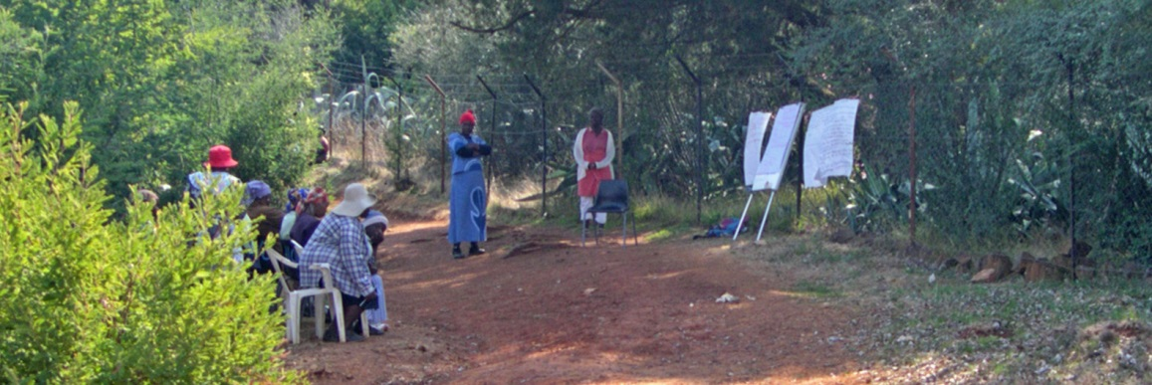
Change or Innovation?
What do we want to see in education: change, or innovation?
That depends very much on whether you’re winning or losing
Malealea, Lesotho, 2006
Rob Abel. 2013. What is Disruptive Innovation in Education? https://www.imsglobal.org/article/what-disruptive-innovation-education

Slide 14
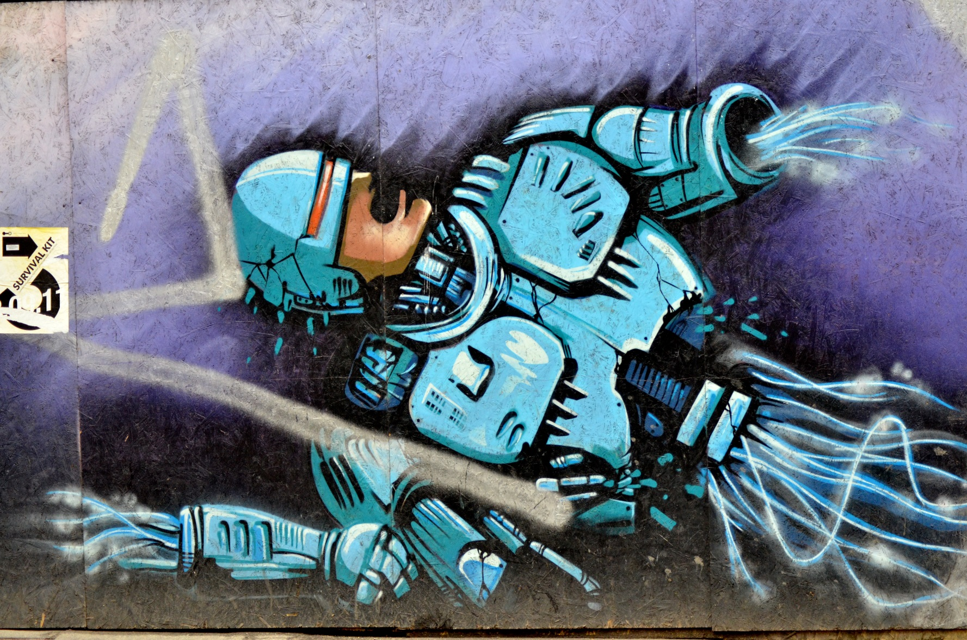
3. Innovation
Riga, Latvia, 2012

Slide 15
What is Innovation?
Idea + Execution + Benefit
innovation is defined “as change that creates a new dimension of performance” - Peter Drucker http://en.wikipedia.org/wiki/Innovation
“Innovation is then simply new technology, i.e. the systematic application of (new) knowledge to (new) resources to produce (new) goods or (new) services” - Maciej Soltynski at Innovation.cc
https://www.ideatovalue.com/inno/nickskillicorn/2016/03/innovation-15-experts-share-innovation-definition/
http://www.freshconsulting.com/what-is-innovation/

Slide 16
The Idea
Product innovation – a new type of product of service
Process innovation – change in the production function, eg. change in input mix
Organizational innovation – change in managerial procedures
Market innovation – eg. developing a new market for an existing product
Input innovation – new raw material, new energy source, etc
Jati Sengupta, 2014, Theory of Innovation: A New Paradigm of Growth, p. 4 (Schumpeterian model) http://www.springer.com/us/book/9783319021829

Slide 17
The Benefit (Sustaining)
Different ways of talking about direction
Better quality of experience
- eg. 4K – bigger pictures
‘student success’
Lower cost
Increased efficiency and productivity
Typically, ‘standards’
Solutions to problems
Access, engagement, completion

Slide 18
The Benefit (Disruptive)
Incumbents target high end customers
Disruptors target with product & price advantage:
low-end footholds
new market footholds
Not just product innovations;
Can be business model, etc.
Tbilisi, Georgia, 2014
Clayton M. Christensen, Michael E. Raynor, Rory McDonald, 2015. What is Disriptive Innovation? https://hbr.org/2015/12/what-is-disruptive-innovation

Slide 19
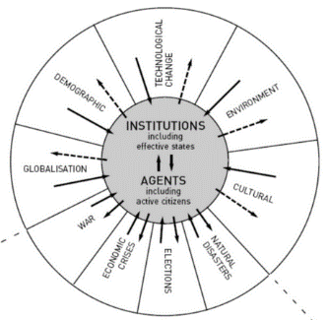
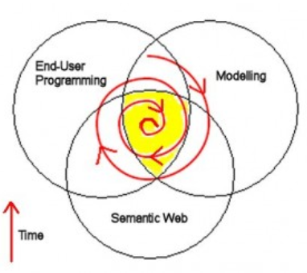
Innovation as an Attractor
We think of change an innovation as working in the same direction, but typically they are working in opposite directions:
Drivers: out from the centre, toward uncertainty and chaos
Attractors: toward the centre, toward order
And especially preserving what was
Sometimes: adaptation to change
Notes:
Images: driver: Duncan Green, 2016. https://oxfamblogs.org/fp2p/egypt-what-are-the-drivers-of-change/ attractor: Peter Hale (no longer extant)

Slide 20
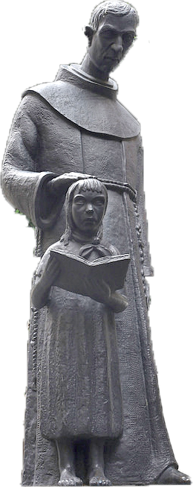
Innovation in Education
Is education “ripe for disruption”?
Changes in tech that didn’t change learning
TV, Video, overhead projectors
Portable classrooms
Learning management system
Clickers?
Second Life
Innovations but not disruptions
Mexico City, Mexico, 2016
Tony Bates. 2014. A Short History of Educational Technology. http://www.tonybates.ca/2014/12/10/a-short-history-of-educational-technology/

Slide 21
A Candidate for Disruption?
Online Learning (1995f) & The MOOC (2008f)
“Stalled efforts to push MOOCs through the institutional membrane that surrounds higher-education credentialing have cast doubt on whether large-scale free courses will end up disrupting anything.” Steve Kolowich
“The reality of online learning… a substantial increase even in years of financial pressures on enrollments.”
Jim Farmer, 2013, MOOCs: A Disruptive Innovation or Not? http://mfeldstein.com/moocs-a-disruptive-innovation-or-not/

Slide 22
What Counts as Innovation?
It depends on how the world sees you
Is there ‘demand’ for the new thing (eg., a market, buyers, users)
Is there a ‘business case’ for it? (Cost/value model)
Is there a ‘benefit’ for the customer (greater income, lower cost, amusement)?
What happens when these change?

Slide 23
4. Transformation
Gamboa, Panama, 2012

Slide 24
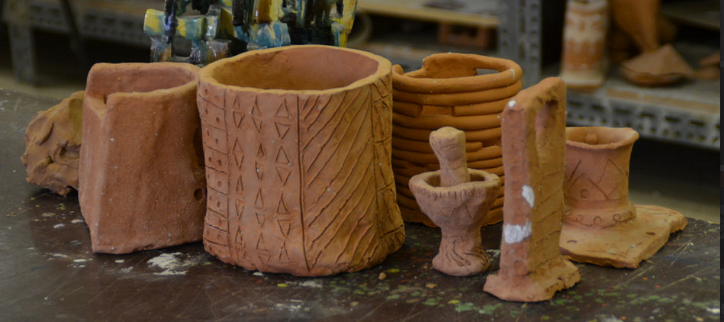
What are Research & Development?
Riyadh, Saudi Arabia, 2015
Science as a "combination of evaluating evidence, coordinating evidence and models, and arriving at evidence-based judgments that are communicated through argumentation."
Ronald W. Rinehart, et.al. 2016. Critical Design Decisions for Successful Model-Based Inquiry in Science Classrooms. https://scholarworks.iu.edu/journals/index.php/ijdl/article/view/20137/28269

Slide 25
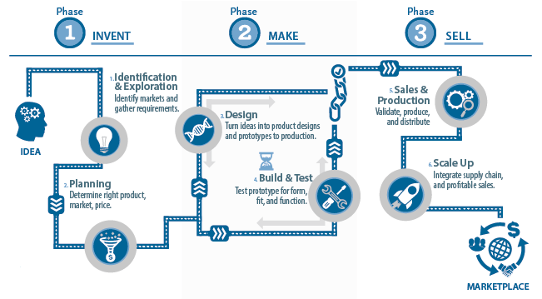
Stages of Innovation
Does selling really come after making?
Image: SD Manufacturing, http://www.sdmanufacturing.com/services/innovation/

Slide 26
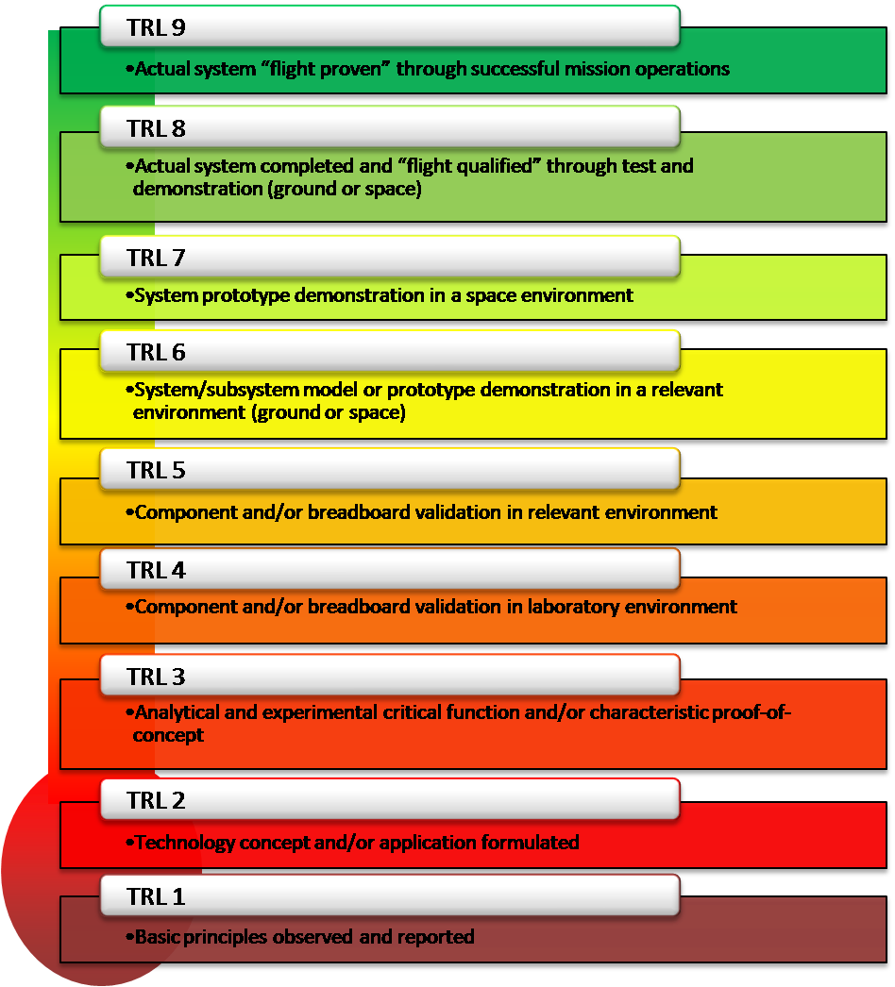
Technology Readiness Levels
From concept to prototype to qualification to proof…
Image: NASA https://www.nasa.gov/directorates/heo/scan/engineering/technology/txt_accordion1.html

Slide 27
Beyond Innovation
New
Idea + Execution + Benefit
Drivers
Attractors
=
Innovation
New
Benefit
Idea + Execution
=
Transformation

Slide 28
What is Transformation?
“In an organizational context, a process of profound and radical change that orients an organization in a new direction and takes it to an entirely different level of effectiveness.”
“Transformation implies a basic change of character and little or no resemblance with the past configuration or structure.”
Read more: http://www.businessdictionary.com/definition/transformation.html

Slide 29
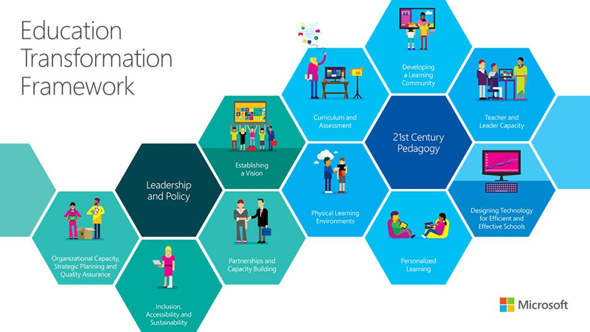
Microsoft’s Vision
Learning community
Teacher capacity
Efficient schools
Personalization
Physical learning environments
Curriculum & assessment
Is this really transformation?
Are these things we really want?
Microsoft, 2015. Education Transformation Toolkit. http://www.is-toolkit.com/education_transformation.html

Slide 30
Questions to Ask
What will new technology enable?
How will our wants and needs change?
Self-Actualization
Does Maslow speak for us?
Self-Esteem
Belonging
Safety and Security
WiFi
Physiological
Maslow, A. 1943. Hierarchy of Needs: A Theory of Human Motivation. http://psychclassics.yorku.ca/Maslow/motivation.htm

Slide 31
Transformation of Education
Now we’re asking the right kind of question
Look at how education has been transformed through the years based on changing definitions of need:
past needs: storytelling
present needs: ‘apprenticeship’ (aka child labour)
future needs: preparing for the factory
potential needs: the route to academia

Slide 32
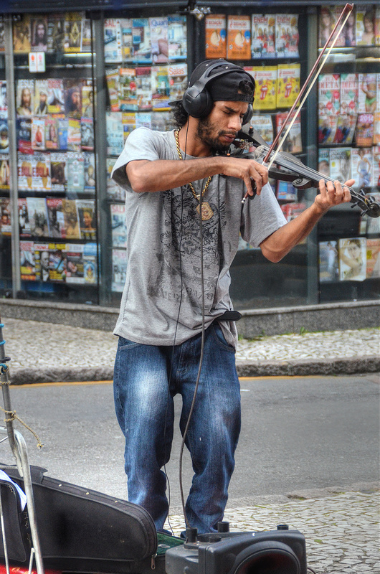
Who Speaks for Us?
Who defines innovation?
Who defines student success?
George Couros. 2016. Who is Defining Student Success? http://connectedprincipals.com/archives/12581
Curitiba, Brazil, 2015

Slide 33
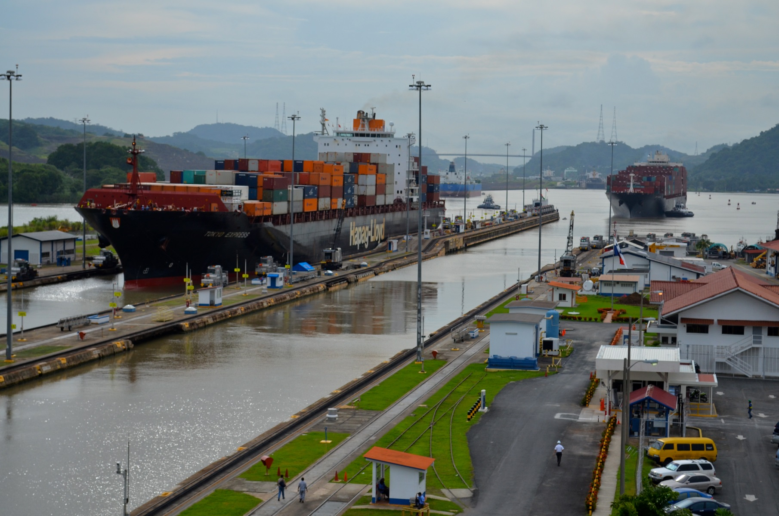
5. Execution
Panama Canal, Panama, 2012

Slide 34
Reframing the Issues in Education
Students must pay too much to study and learn
Assessment is unreliable and (often) unfair
Texts and resources are locked behind paywalls
Content is poorly communicated
Life as a student is incredibly stressful
Research studies are poorly designed.
Education science rarely replicates
http://www.vox.com/2016/7/14/12016710/science-challeges-research-funding-peer-review-process

Slide 35
New Models of Deployment
Conventional Wisdom |  | Big Bang Wisdom
Focus on one innovation (low cost, product, customer) | Strategic Discipline | Focus on all three at once
Target small group first, then mainstream | New-Product Marketing | Market to all at once, scale swiftly
Low cost feature-poor technologies | Innovation Method | Experimentation on popular platforms
Adapted from Larry Downes and Paul F. Nunes. 2013. Dig Bang Disruption. Harvard Business Review. c/o Accenture. https://www.accenture.com/t20150521T020819__w__/us-en/_acnmedia/Accenture/Conversion-Assets/Blogs/Documents/1/Accenture-Big-Bang-Disruption.pdf

Slide 36
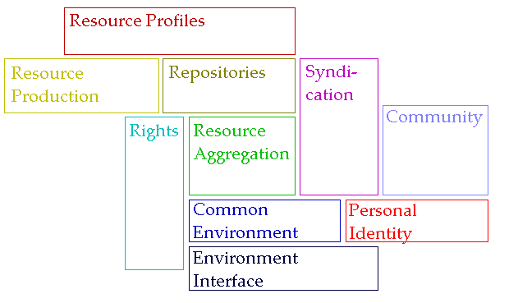
The New Institutional Perspective
Don’t do things to people, do things with people, help people do things
If we have to ask “how do we motivate people” then we’re taking the wrong approach – Kohn; “Knowledge sharing is your job” – Buckman; Provide opportunities for autonomy, mastery, purpose – Pink

Slide 37
New learning Paradigms
Path | Field
Course | Curriculum (as in ‘mapping’)
Sequence / Prequisite | Core / periphery / foundation
Movement / covered | Inquiry / Discovery / Gaps
Threshold / Levels | Coverage / Construction
Positioning – first / last | Grouping / Clustering
Objective / target | Serendipity / emergence
Leading / Led | Centred
Carrie Paechter, Metaphors of Space in Educational Theory and Practice http://www.tandfonline.com/doi/pdf/10.1080/14681360400200202

Slide 38
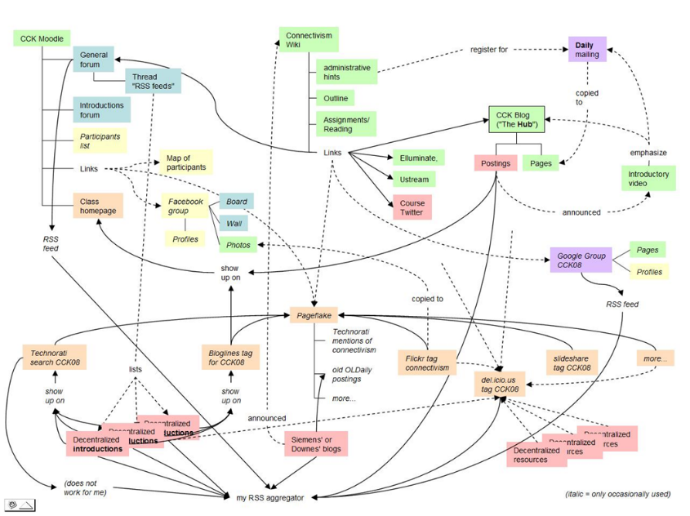
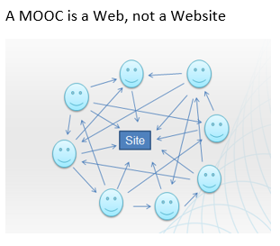
The Connectivist MOOC (cMOOC) Design
Instead of seeing a course as a series of contents to be presented, a course is a network of participants who find and exchange resources with each other
An initial structure is developed and ‘seeded’ with existing OERs
Participants encouraged to use their own sites to create or share resources
A mechanism (gRSShopper) is employed to connect them

Slide 39
Learning is Personal

Slide 40
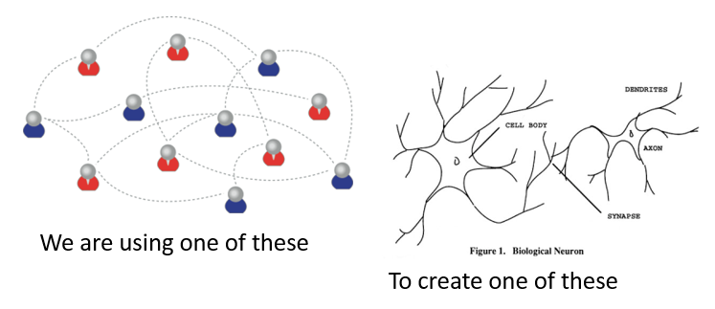
Learning Outcomes
Learning a discipline is a total state and not a collection of specific states
It is obtained through immersion in an environment rather than acquisition of particular entities
It is expressed functionally (can you perform ‘as a geographer’?) rather than cognitively (can you state ‘geography facts’ or do ‘geography tasks’?)

Slide 41
The New Model of Work and Learning
Sharing - create linked documents, data, and objects in a distributed network
Contributing - employ social networking applications of the Web to facilitate group communication
Co-creating - work through networks that facilitate cooperative group work toward common goals

Slide 42
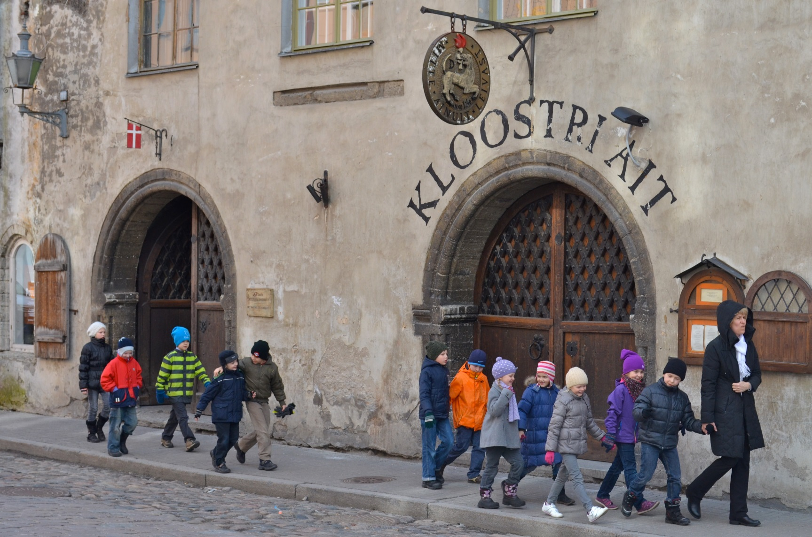
6. Strategies
Tallinn, Estonia, 2012

Slide 43
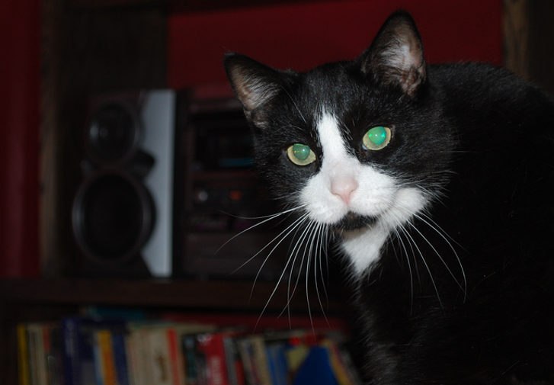
Find Patterns
forms: archetypes? Platonic ideals?
rules: grammar = logical syntax
operations: procedures, motor skills
regularities, substitutions (eggcorns, tropes)
feature similarities
I have an editorial comment
Bart the Intellectual

Slide 44
Look for Meaning
theories of truth / meaning / purpose / goal
Sense and reference (connotation and denotation)
Interpretation (Eg. In probability, Carnap; Reichenbach; Ramsey)
Wagering / strength of belief
Forms of association: Hebbian, contiguity, back-prop, Boltzmann
Decisions and decision theory: voting / consensus / emergence
Gananoque, Ontario, 2015

Slide 45
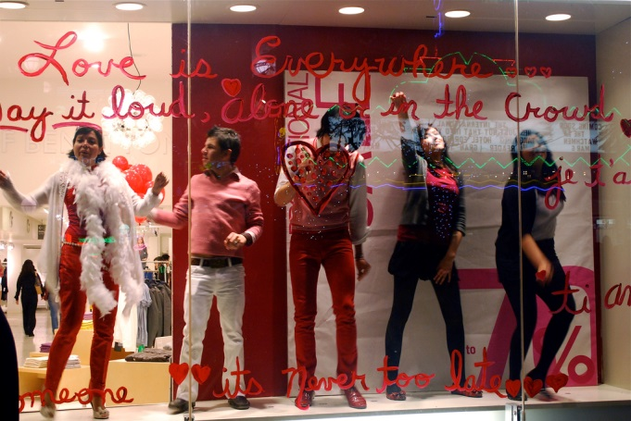
Observe Practice
What count as actions? What do they do?
Actions (J.L. Austin, Searle) assertives, directives, commissives, expressives, declarations (but also - harmful acts, harassment, etc)
Interrogation (Heidegger) and presupposition
Meaning (Wittgenstein - meaning as use)
Los Angeles, California, 2009

Slide 46
Make Projections
reasoning, inference and explanation
description - X (definite description, allegory, metaphor)
definition - X is Y (ostensive, lexical, logical (necess. & suff conds), family resemblance - but also, identity, personal identity, etc
argument - X therefore Y - inductive, deductive, abductive (but also: modal, probability (Bayesian), deontic (obligations), doxastic (belief), etc.)
explanation - X because of Y (causal, statistical, chaotic/emergent)

Slide 47
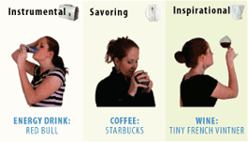
Consider Context
explanation (why versus why not?)
Hanson, van Fraassen, Heidegger)
meanings (culture, range of possibilities)
(‘Analytic hypotheses’, Quine)
vocabulary (ontologies, logical space)
(Carnap, Derrida);
frames and worldviews
(Lakoff)
Notes:
Image: http://www.occasionbasedmarketing.com/what-it-is - no longer extant

Slide 48
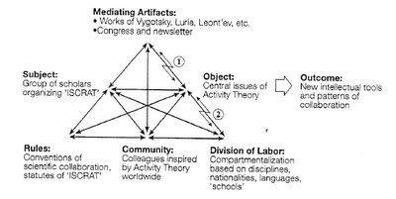
Manage Change
relation and connection: I Ching, logical relation
flow: Hegel - historicity, directionality; McLuhan - 4 things
progression / logic -- games, : quiz&points, branch-and-tree, database
scheduling - timetabling - events; activity theory / LaaN

Slide 49
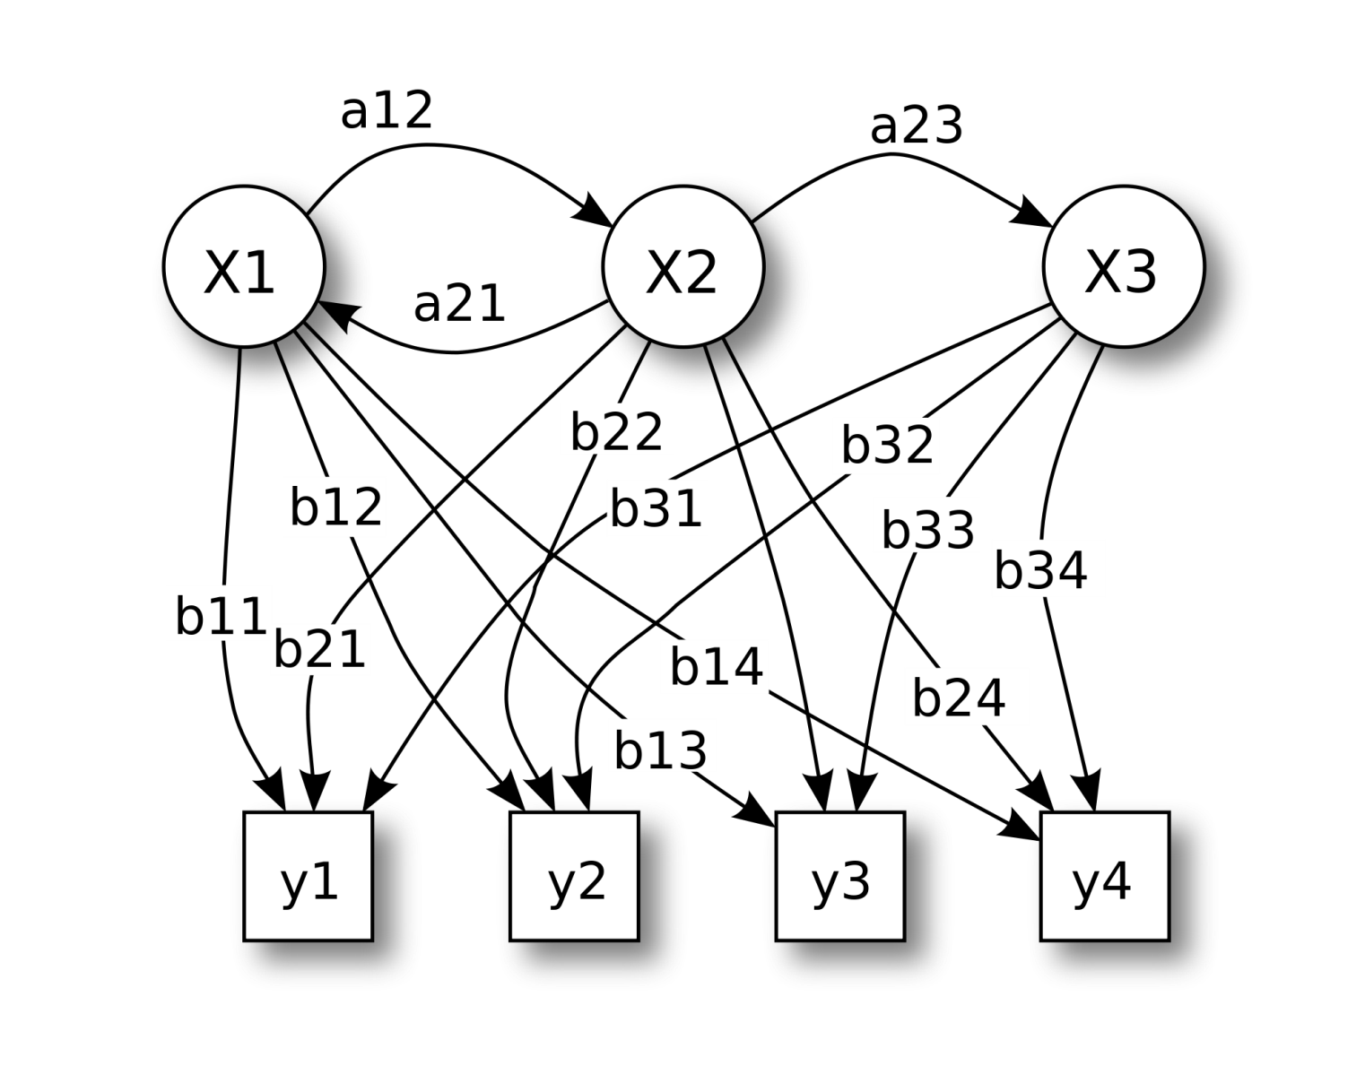
Knowledge as Recognition
Our conception of knowledge itself is insufficient to account for these various dimensions of literacy.
Image: https://en.wikipedia.org/wiki/How_to_Create_a_Mind
Notes:
The image is a hidden markov model - https://en.wikipedia.org/wiki/Hidden_Markov_model
The idea that the brain is a network of connections and we learn by forming connections
The contents of our mind do not ‘stand for’ or ‘represent’ phenomena in the work
Think of direct perception – JJ Gibson - http://ione.psy.uconn.edu/~cespaweb/docs/MC.pdf or http://ione.psy.uconn.edu/~cespaweb/docs/MC.pdf

Slide 50
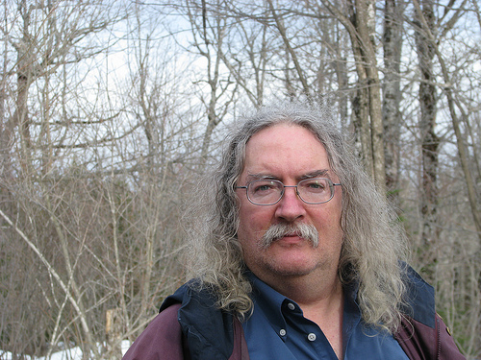
Stephen Downes
Moncton, Canada, 2005
http://www.downes.ca

