Slide 1
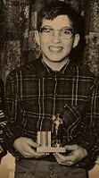
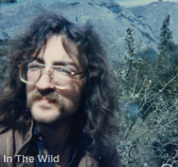
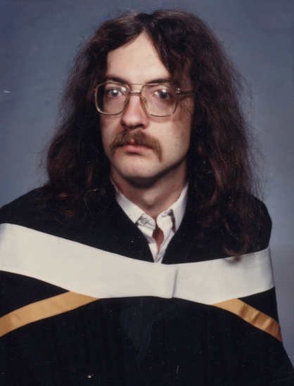
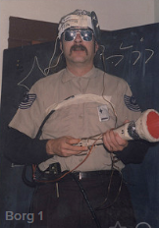
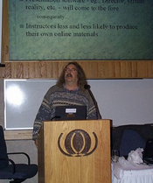
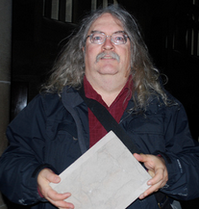
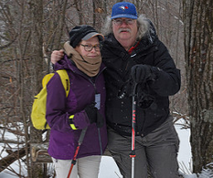
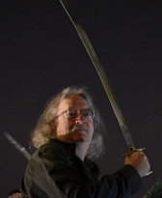
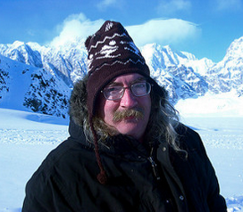
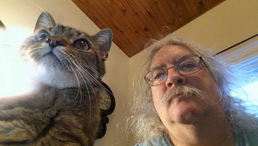
A Timeline
Stephen Downes
September 27, 2016

Slide 2
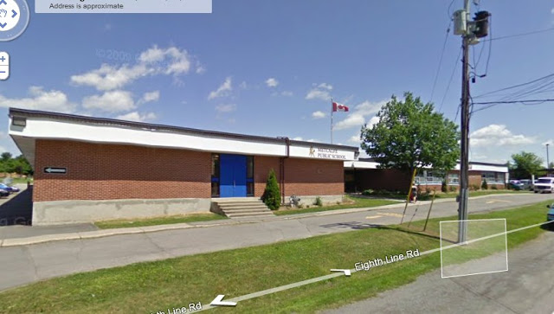
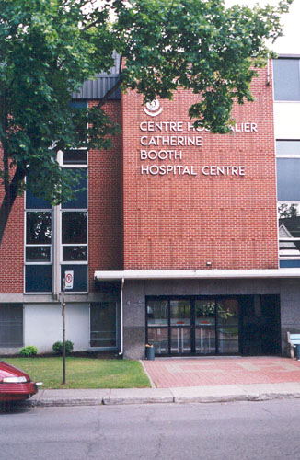
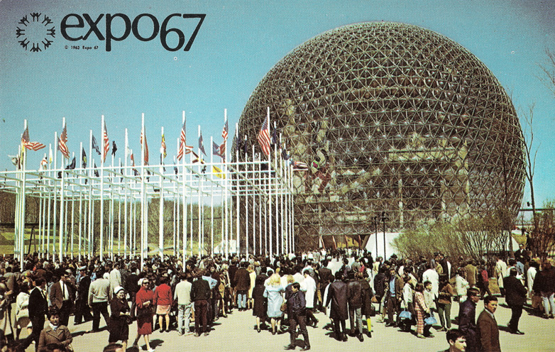
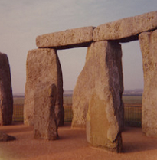
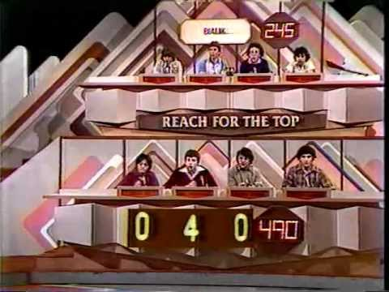
A Timeline…
Metcalfe
Osgoode Township High School
1959
1968
1975
Catherine Booth Hospital, Montreal
UK Tour

Slide 3
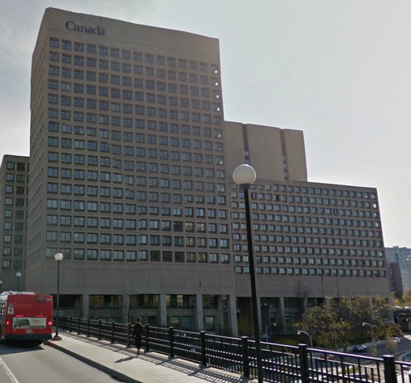
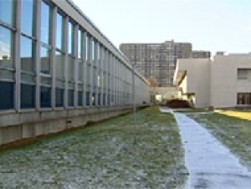
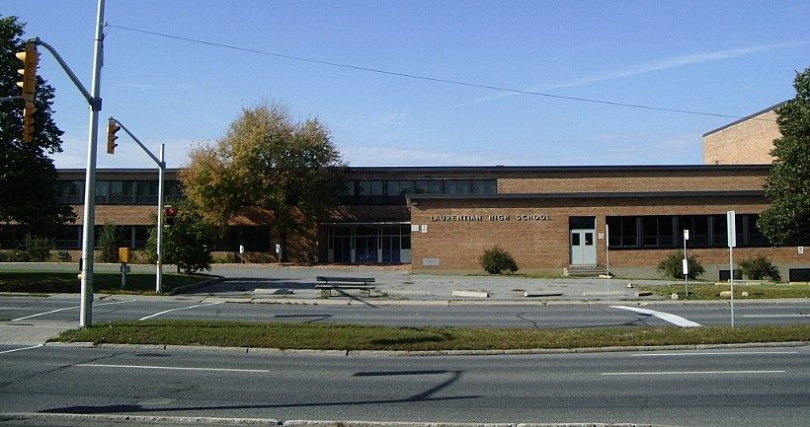
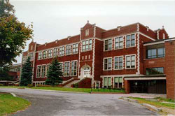
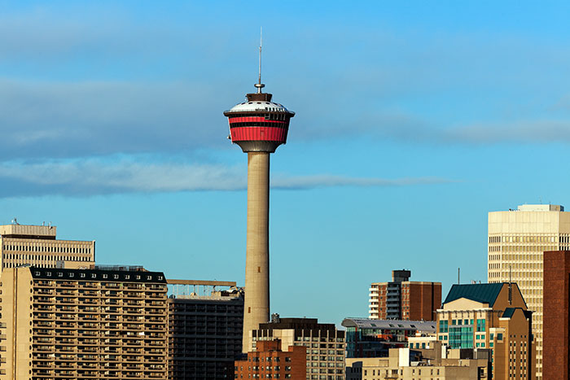
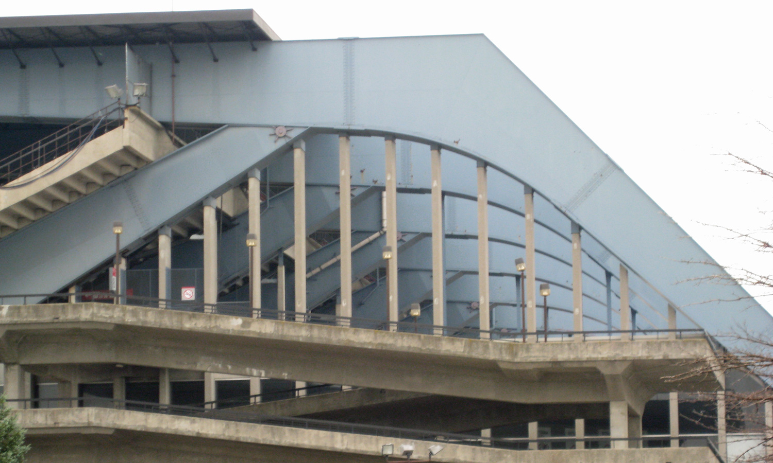
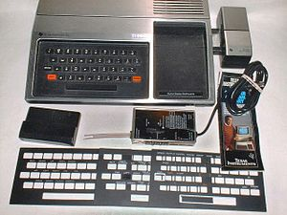
Nepean High School
Calgary
Algonquin College
(Rideau Campus)
Laurentian High School
1976
1977
1978
1979
1980
…several hundred really bad poems

Slide 4
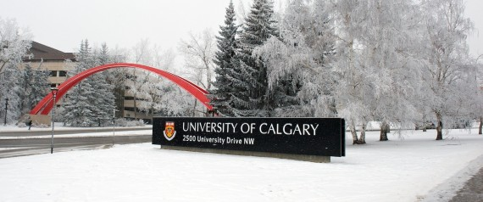
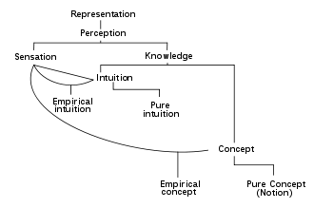
1981
1982
1983
1984
1985
BA (Hons 1st Class) – The Philosophy of David Hume

Slide 5
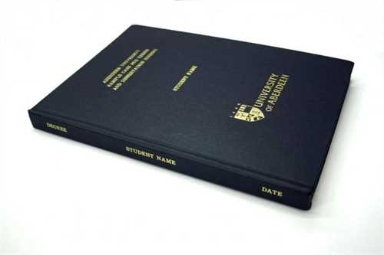
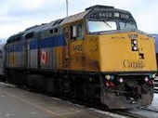
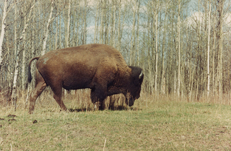
MA
Models and Modality
1986
1987
1988
1989
Athabasca University
Practical Graphic Design
Public Advocacy for Social Change
Fundraising
DECCA

Slide 6
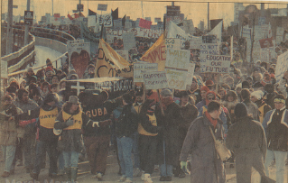
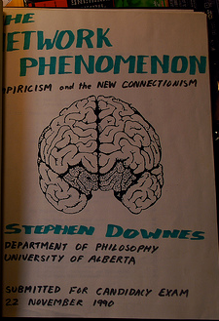
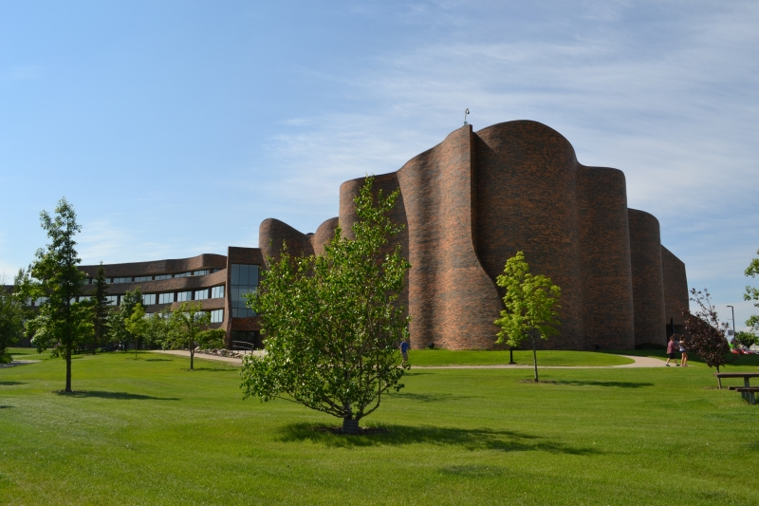
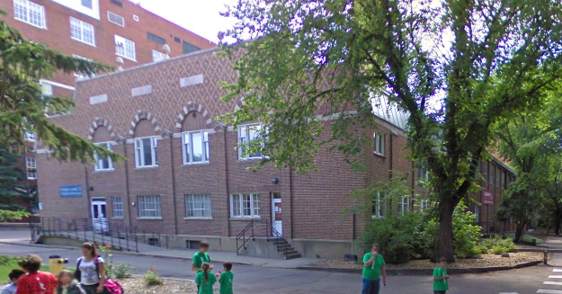
Graduate Students’ Association
Of the Alberta
1990
1991
1992
1993
Athabasca University

Slide 7
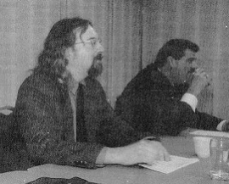
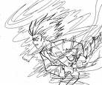
Brandon
Stephen’s Guide to the Logical Fallacies
Muddog Mud
Election 1995
Athabasca University
1994
1995
1996
Athabaska BBS
Painted Porch
MAUD
Maximus

Slide 8
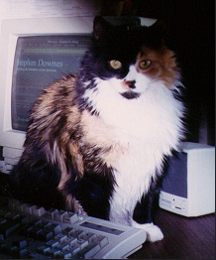
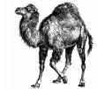
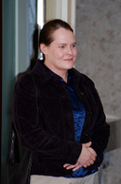
Future of Online Learning
CAE
Learning
Objects
modules
1997
1998
1999
Online Learning Environment
OLe
The Brandon Pages
Married, March 17-18, to Andrea

Slide 9
Knowledge
Learning
Community
2000
2001
2002
PEGGAsus
OLDaily
The Learning Marketplace
MuniMall

Slide 10
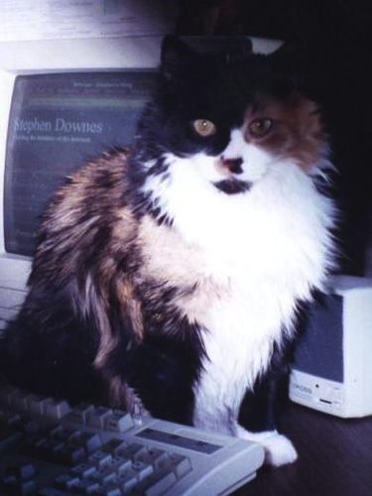
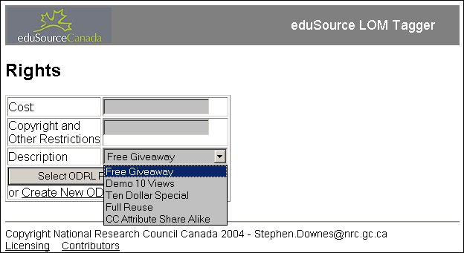
2003
2004
2005
Edu-RSS
Ed Radio
Podcasting
DDRM

Slide 11
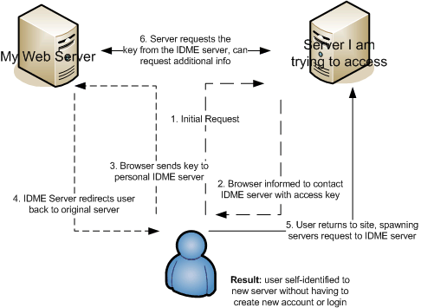
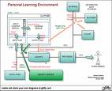
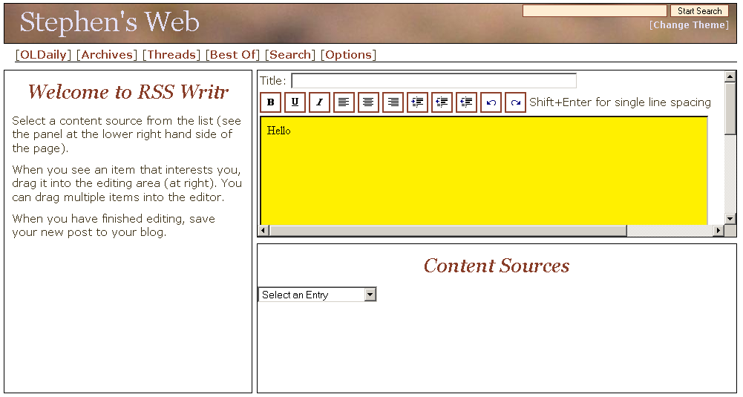
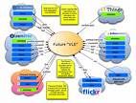
E-Learning 2.0
Learning
Networks
mIDm
2006
2007
Educational
Blogging
RSS Writr

Slide 12
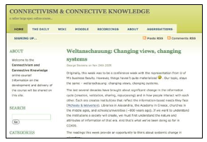
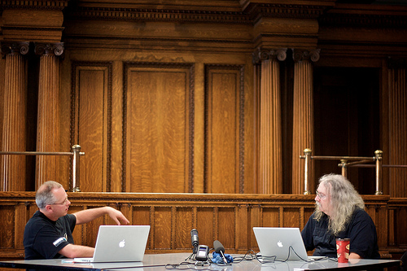
Synergic3
Connectivism
2008
2009
2010
CCK08
OERs

Slide 13
MOOCs…
2011
2012
2013

Slide 14
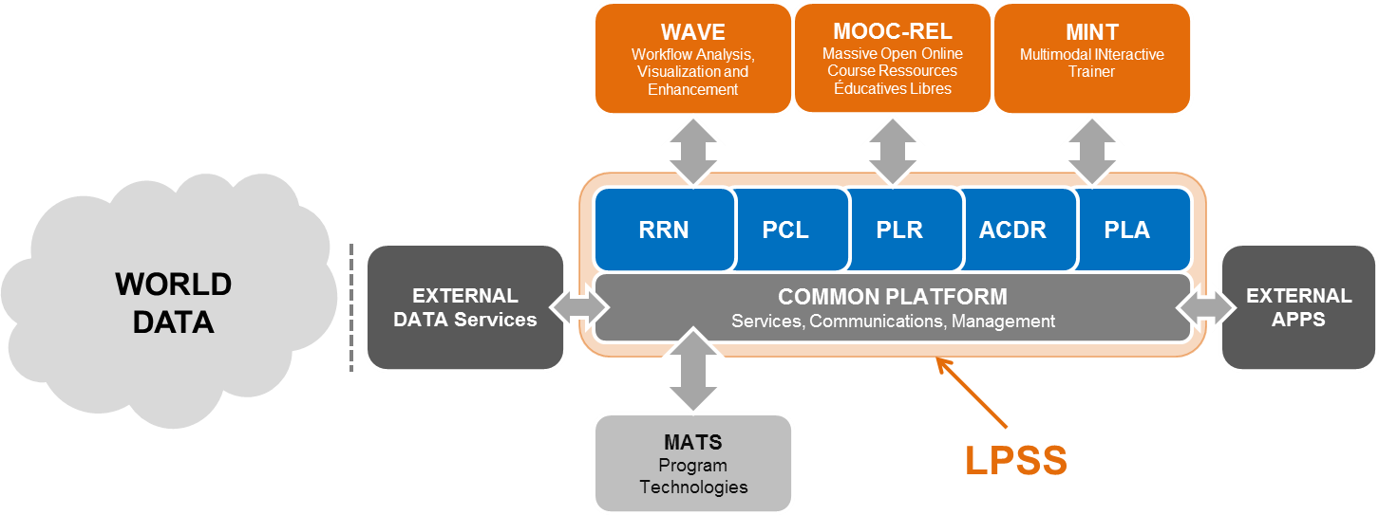
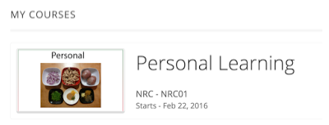
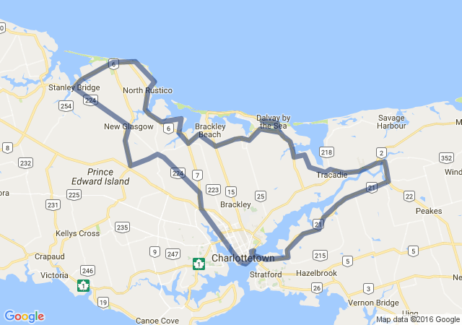
Workshop series
2014
2015
2016
TBA…

Slide 15
http://www.youtube.com/watch?v=X0iI0pgTUx0
http://www.downes.ca
Free Learning

