Slide 1
Personal Learning and Assessment
Stephen Downes
Beirut, Lebanon
November 8, 2016

Slide 2
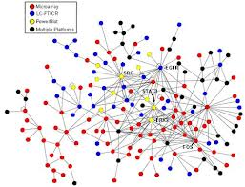
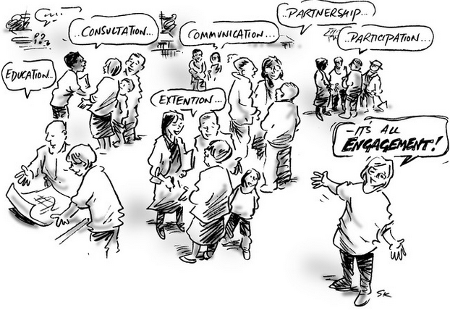
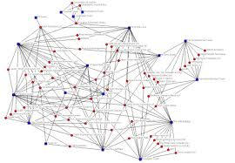
xLearning vs cLearning
contents
engagement
networks
http://www.corestandards.org/
http://www.magnet.edu/
http://lisahistory.net/wordpress/2012/08/three-kinds-of-moocs/

Slide 3
The Inflexible Law of Learning
It's when we do stuff that we learn, not when stuff does something for us.

Slide 4
Beyond Assessment as ‘Gap’ Analysis
situation-specific practical wisdom (phronesis)
tacit knowledge shared among practitioners (‘mindlines’)
complex links between power and knowledge; and
macro-level knowledge partnerships
Greenhalgh and Weiringa, http://jrs.sagepub.com/content/104/12/501.full

Slide 5
Personalization?
What is a personalized 21st century education - personalized education plan (developed by teacher) - adaptive learning via assessment - grouping by proficiency, not age - teacher = director of learning - cf Kettering Foundation, Individually Guided Education
Personalizing 21st Century Education: A Framework for Student Success Dan Domenech, Morton Sherman, John L. Brown Jossey-Bass, a Wiley Brand. 2016

Slide 6
2. Two Approaches…
Content
Practice
Practice
Content

Slide 7
Two Approaches…
Defines an ideal state
Defines a desired state
Content
Practice
Practice
Content
TEST
TRY
Person tests you
Person helps you

Slide 8
Two Approaches…
Defines an ideal state
Defines a desired state
Content
Practice
Correction
Iteration
GAP
Practice
Content
Opport-unity
TEST
TRY
Person tests you
Person helps you

Slide 9
Library Environment
Defines an ideal state
Defines a desired state
Content
Practice
Affordances
Correction
Requirements
Iteration
GAP
Practice
Content
Opport-unity
TEST
TRY
Person tests you
Person helps you

Slide 10
Personalized Personal We do for you You do for yourself
Defines an ideal state
Defines a desired state
Content
Practice
Affordances
Correction
Requirements
Iteration
GAP
Practice
Content
Opport-unity
TEST
TRY
Person tests you
Person helps you

Slide 11
Personal vs. Personalized
Compare between:
Personalized health care (something the National Health Service or Health Management Organization provides)
Personal health care (something you do for yourself)
Personal goals versus institutional goals
Practice versus content

Slide 12
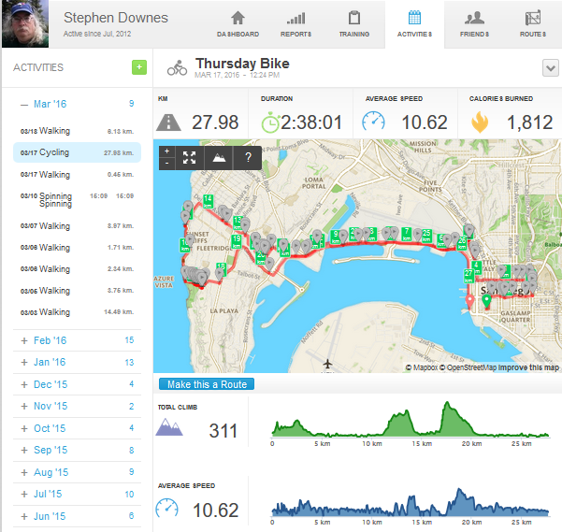
Exploring, not Following

Slide 13
The New Model of Work and Learning
Sharing - create linked documents, data, and objects within a distributed network
Contributing - employ social networking applications of the Web to facilitate group communication
Co-creating - work through networks that facilitate cooperative group work toward common goals
(Dutton, p. 12)

Slide 14
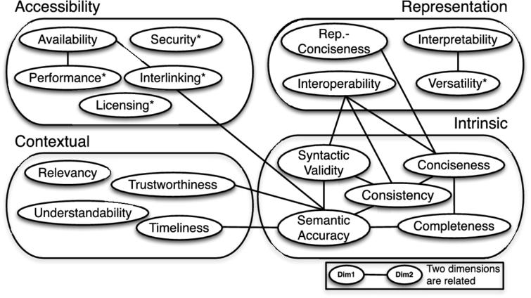
What does quality look like in student work?
Zaveri, Amrapalia; Rula, Anisab; Maurino, Andreab; Pietrobon, Ricardoc; Lehmann, Jensa; Auer, Sörend. 2016. A systematic literature review and conceptual framework. Ios Press. http://content.iospress.com/articles/semantic-web/sw175

Slide 15
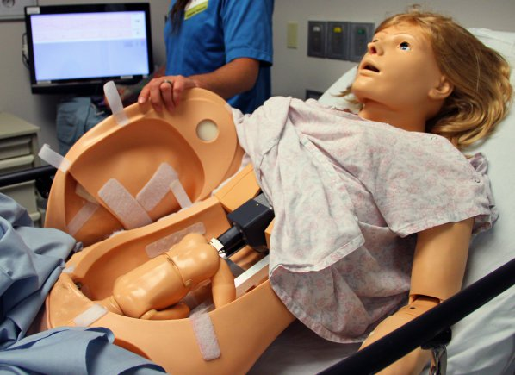
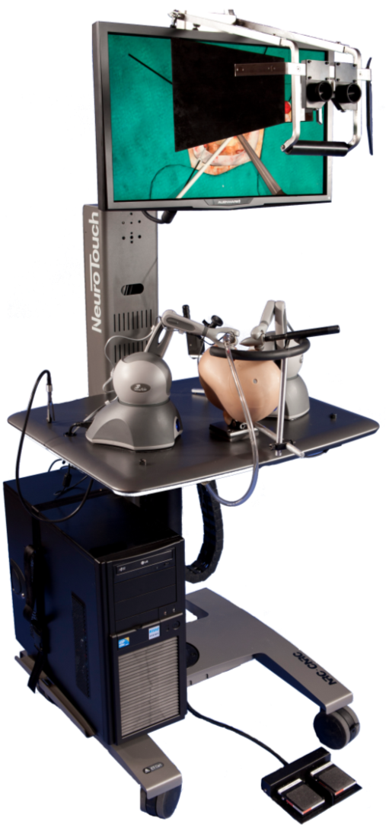
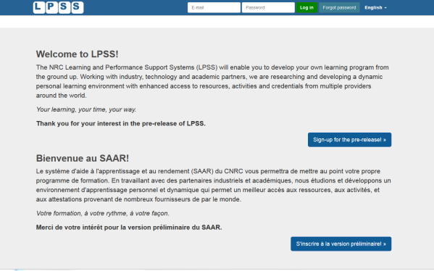
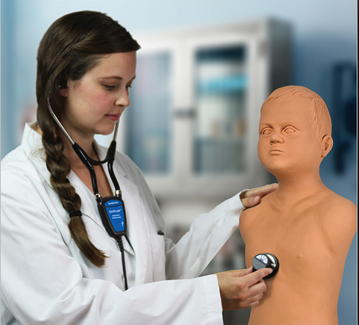
Personal Learning – The Concept
Simulation
Learning Space
(SLS)

Slide 16
Personal Learning Record
OERs
Portfolio, artifacts and evidence
Badges, certificates, credentials, competencies
Activity Record - LRS
PLR

Slide 17
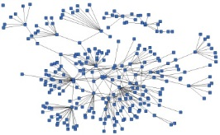
Everything is Built Around the Personal Learning Record
This is a new type of data – we call it the personal graph.
Each person has their own private personal graph.
The PLR contains all a person’s learning records, including:
certificates, badges and credentials
activity records, test results, scores
Assignments, papers, drawings, things they create
Me

Slide 18
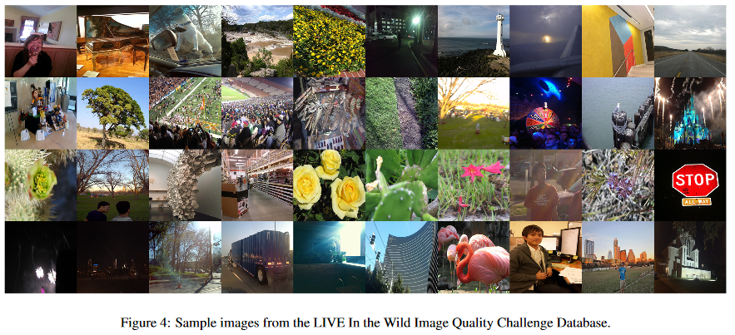
Network-Based Quality Assessment
Gibson, D. (2003). Network-based assessment in education. Contemporary Issues in Technology and Teacher Education [Online serial], 3(3). Retrieved from http://www.citejournal.org/volume-3/issue-3-03/general/network-based-assessment-in-education
S. Bianco, L. Celona, P. Napoletano, R. Schettini. (2016) On the Use of Deep Learning for Blind Image Quality Assessment. arXiv:1602.05531v3.

