Slide 1
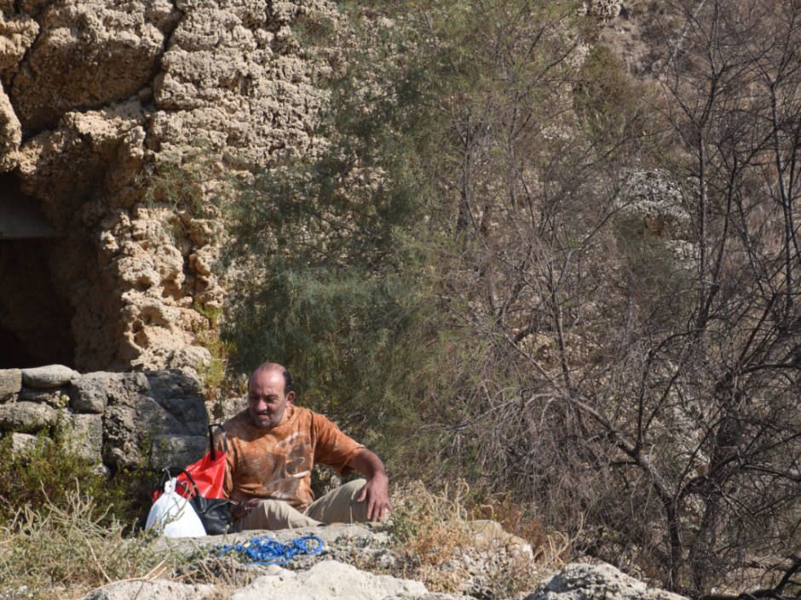
Learning with Open Resources
Stephen Downes
Beirut, Lebanon, November 9, 2016

Slide 2
What can we do with open resources? Some Case Studies

Slide 3
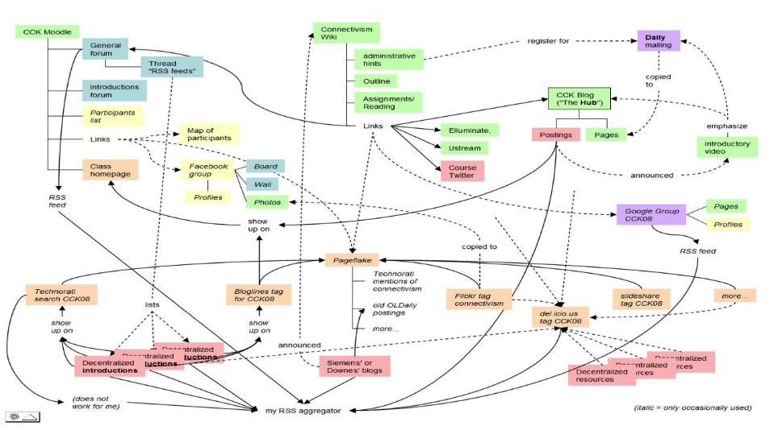
MOOC – CCK08
https://sites.google.com/site/themoocguide/3-cck08---the-distributed-course
Notes:
Massive Open Online Course – LPSS staff developed and researched the world’s first Massive Open Online Courses, beginning with Connectivism and Connective Knowledge in 2008. It was the first to incorporate open learning with distributed content, making it the first true MOOC. It attracted 2200 participants worldwide, 170 of whom participated by creating thwir own blogs and learning resources, which were harvested by the course aggregator, gRSShopper.
As I wrote when summarizing this course, “What this means is that course content is not located in one place, but may be located anywhere on the web. The course therefore consists of sets of connections linking the content together into a single network. Participants in the course were encouraged to develop their own online presence in order to add to this distributed resource network. The course authors then used a content aggregation tool in order to bring all the content in one place.”

Slide 4
OIF – MOOC-REL
http://rel2014.mooc.ca/
Notes:
An open online course devoted to examining open learning resources, conducted in French with support and co-operation from the Organisation international de la francophonie.

Slide 5
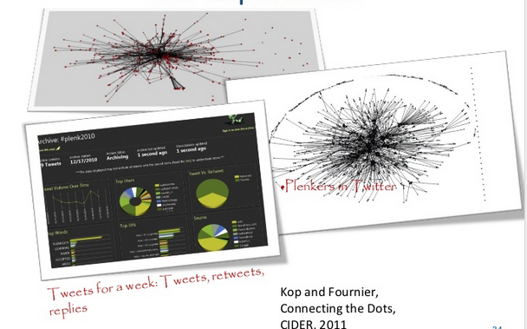
Plearn – Importance of the Graph
http://www.slideshare.net/Downes/after-moodle
http://www.slideshare.net/Ritakop/kopfourniercanadianinstitutedistanceeducationresearchple
Notes:
During the early run of MOOCs the National Research Council was engaged in an internal project called Plearn, which was a prototype personal learning environment. This work combined an analysis of the MOOC experience, much of which was published by Helene Fournier and Rita Kop. In Plearn the aggregator developed for the MOOC project was adapted for personal learning, personal learning databases were created, and mechanisms for interacting with learning resources and publishing to a network were explored.
http://www.slideshare.net/Ritakop/kopfourniercanadianinstitutedistanceeducationresearchple

Slide 6
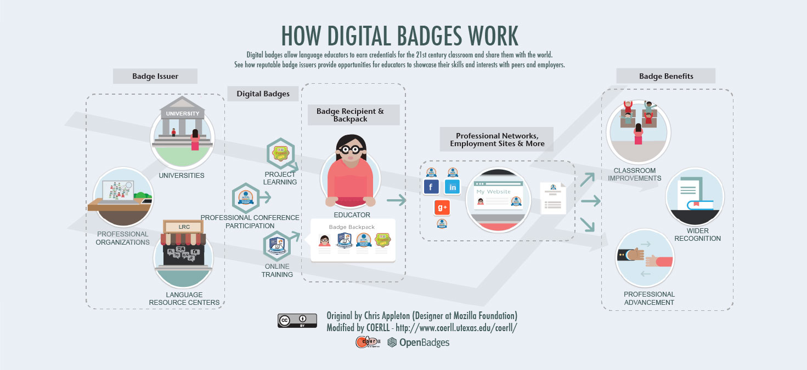
PCO Badges for Learning
http://www.downes.ca/post/63738
Notes:
Privy Council Office Badges for Learning – in this project we examined mechanisms for displaying badges earned inside a secure intranet environment in a person’s personal learning record outside that environment.

Slide 7
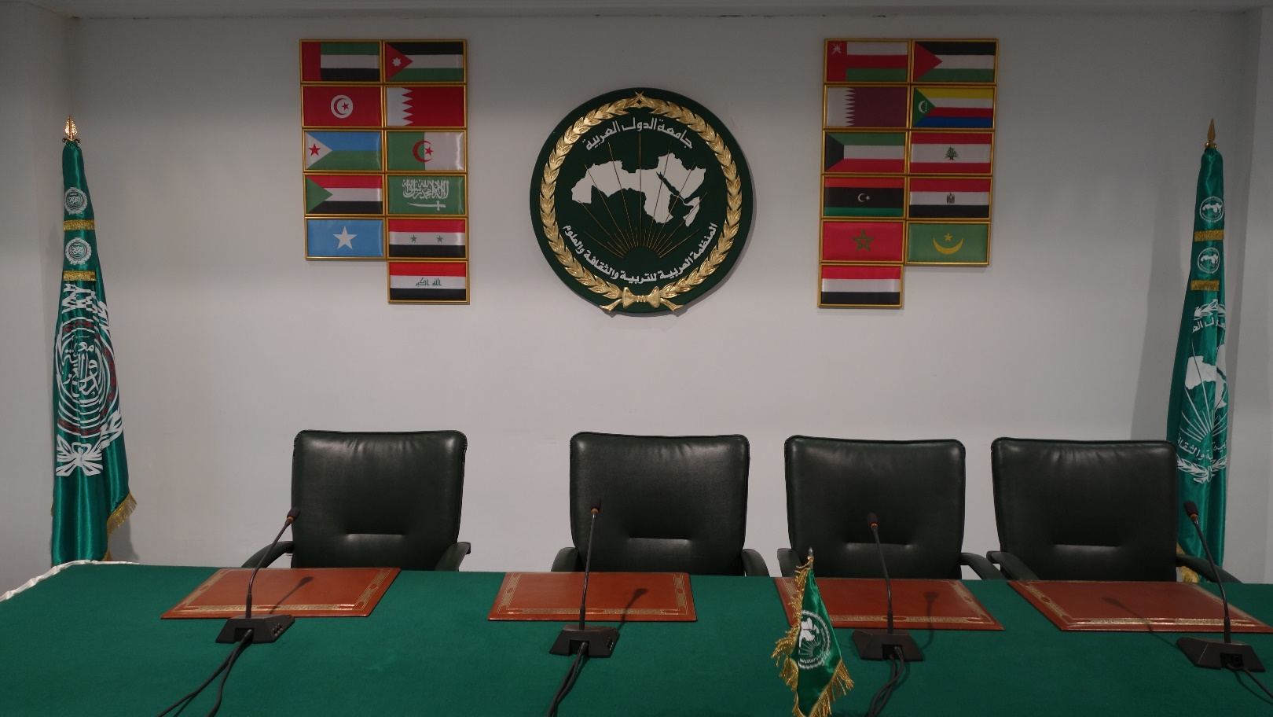
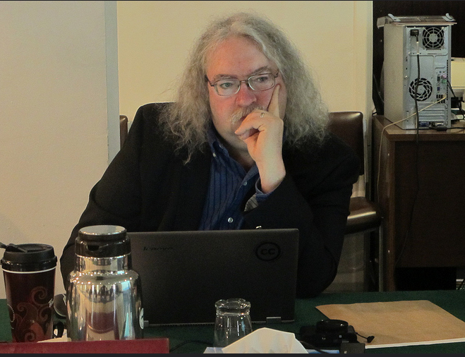
ALECSO – Capacity Building
http://www.downes.ca/presentation/337

Slide 8
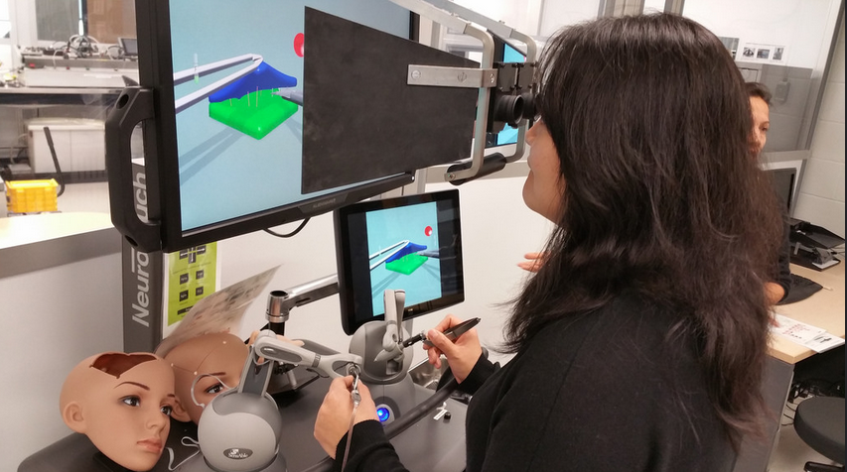
Collecting xAPI from Med Sims
https://www.flickr.com/photos/stephen_downes/15710336207/
http://www.nrc-cnrc.gc.ca/eng/rd/medical/

Slide 9
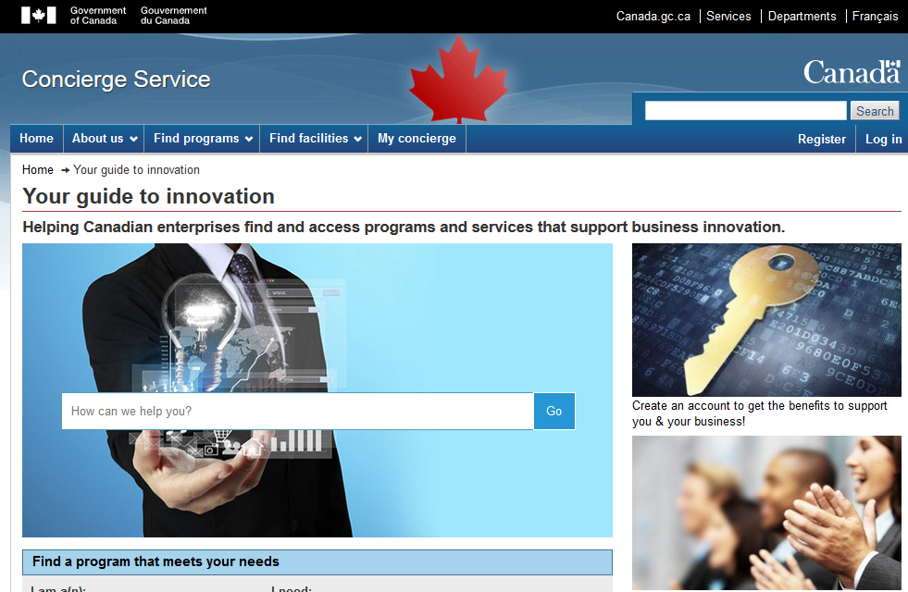
Concierge OMS
https://concierge.portal.gc.ca/

Slide 10
TBS Micromissions
http://www.theglobeandmail.com/news/politics/canadian-heritage-shows-how-public-service-seeks-to-foster-innovation/article29040565/

Slide 11
The ‘Open’ in Open Learning
In the beginning… Open Archives
“If governments ignored publisher lobbying and did the arithmetic properly, they would immediately see that the interests of publicly funded research vastly eclipse those of the research publishing industry.” – Stevan Harnad
The Subversive Proposal at 20. Richard Poynder, Open and Shut?
http://poynder.blogspot.ca/2014/06/the-subversive-proposal-at-20.html
Budapest Open Access Initiative, 2001
http://www.budapestopenaccessinitiative.org/background

Slide 12
What are OERs?
“OERs range from textbooks to curricula, syllabi, lecture notes, assignments, tests, projects, audio, video and animation.”
http://www.unesco.org/new/en/communication-and-information/access-to-knowledge/open-educational-resources/what-are-open-educational-resources-oers/
Notes:
We treat open educational resources, however, very differently. People focus on the distribution and the licensing of OERs, but few people spend any time on the latter half of the UNESCO definition: “OERs range from textbooks to curricula, syllabi, lecture notes, assignments, tests, projects, audio, video and animation.” This definition limits us in the same ways we were limited with educational words, above. And in particular, pedagogy is limited to knowledge transfer and students are rendered mute.
http://www.unesco.org/new/en/communication-and-information/access-to-knowledge/open-educational-resources/what-are-open-educational-resources-oers/

Slide 13
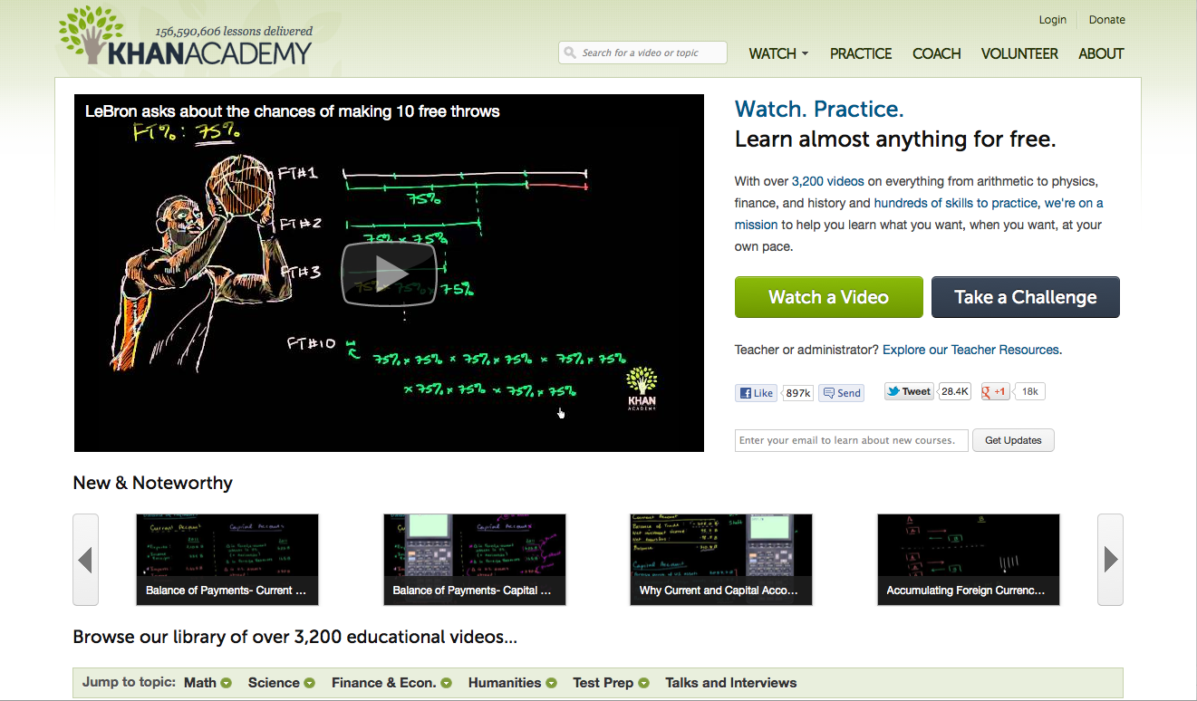
How OERs (Really) Begin
http://www.khanacademy.org/
Notes:
In a paper I presented to the OECD a decade ago on sustainability models for open educational resources I argued that the only sustainable model for OERs was to have then created and consumed by the same people, the students themselves.
“OERs may be supported using what might be called a co-producer model, where the consumers of the resources take an active hand in their production. Such an approach is more likely to depend on decentralized management (if it is managed at all), may involve numerous partnerships, and may involve volunteer contributors.” (Ibid)
In traditional education the typical approach to learning is to stop other activities, to go to a classroom or learning centre, to focus on learning a specific body of content, and then return to one’s ordinary life some days or some years later.
In LPSS we have focused on this as an undesirable and overly expensive approach to learning, and as the name of the program – “learning and performance support systems” – suggests, prefer to relocate the context of learning to authentic environments in this a person is attempting to meet some objective or complete a task (indeed, as Jay Cross says, in informal learning “the motivation level of the learner. Informal learning occurs when knowledge or a skill is needed in order to execute or perform a task. This means that the commitment of the learner is at the highest possible level as it is the inner drive that initiates the learning process. Also, learning takes place in connection to a specific situation or task.”)
What we find when we approach learning this way is that a person’s ‘learning environment’ extends to include a wider social network or community. This is the source of Etienne Wenger’s ‘communities of practice’, referenced earlier. In almost any domain one cares to consider, there is an active and engaged network of interested people exchanging information and resources on the internet.
These are the real open educational resources. These are the source of what is probably most learning in the world (it would be interesting to see a study evaluating the scale and pervasiveness of unauthoritative learning resources and support). Even some of the projects which have become paradigms of the open education movement, such as Khan Academy, began life this way.
http://www.oecd.org/edu/ceri/36781698.pdf
http://www.webanywhere.org/blog/informal-learning-vs-formal-learning-in-businesses-interview-with-jay-cross/
http://wenger-trayner.com/theory/
http://www.forbes.com/sites/michaelnoer/2012/11/02/one-man-one-computer-10-million-students-how-khan-academy-is-reinventing-education/

Slide 14
Performance Support
http://www.cognitiveadvisors.com/resources/mobile-performance-support-design-principles
Notes:
The development of performance support resources (PSRs) is not the same as the development of formal learning resources. Because these are accessed at the point of need, PSRs need to be convenient, user-friendly and relevant. This means many of the traditional stages of a learning event – gaining attention, assessment, etc. – are often absent. A person needing performance support will attend to the learning for only a short time, preferring to apply what was found immediately and to get back on task.
Performance support at the point of need is one stage in what can be described as a four stage process. In this process, the objective is not to provide the student with a body of knowledge to remember, but rather, to maximize the effectiveness of the performance support when it is needed. The steps (from Marty Rosenheck) are as follows:
Scenario-based learning – models and practice in simulations – long before
Planning, refreshing, running through demonstrations – right before
Decision and activity support – during
Action review and reflection –after
http://elearningindustry.com/performance-support-more-than-just-training
http://www.cognitiveadvisors.com/resources/mobile-performance-support-design-principles

Slide 15
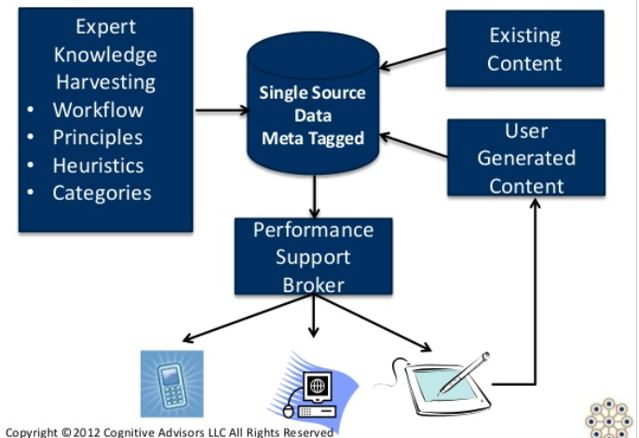
User-Generated OERs
Notes:
In the case of personal learning, the resources produced in the fourth step feed back into the first three steps. Two key activities take place (with respect to the resources) at this step. First, the resources that were used to prepare for performance support are reviewed, and either endorsed or critiques. Second, the process of review and reflection results in the creation of new resources which feed back into the performance support system. Rosenheck diagrams the process as follows:

Slide 16
Working Out Loud
http://johnstepper.com/2014/01/04/the-5-elements-of-working-out-loud/
Notes:
In a production and learning environment, the concept is sometimes referred to as ‘working openly’ or ‘working out loud’. John Stepper writes, “Working Out Loud starts with making your work visible in such a way that it might help others. When you do that – when you work in a more open, connected way – you can build a purposeful network that makes you more effective and provides access to more opportunities.”
http://johnstepper.com/2014/01/04/the-5-elements-of-working-out-loud/

Slide 17
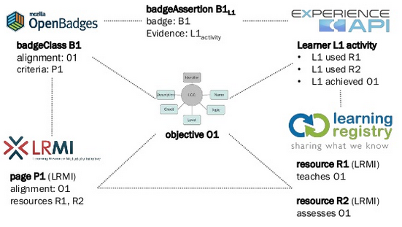
Personal Assistant for Learning
http://www.adlnet.org/adl-initiative-baa-new-submission-window-open-for-personal-assistant-for-learning-pal-proposals-2/index.html
http://www.slideshare.net/damonregan/regan-tla-infrastructureforfutureoflearningsintice2013
Notes:
The Advance Distributed Learning PAL project makes clear the constituent elements of an effective recommendation system. They are asking for the following:
customized content, a transparent user interface, persistent internet access
tracking learner experiences, adapting content, and integrating social media
knowledge and information capable of being shared across the environment
user’s profile, learning attributes, and competencies to provide a tailored, personalized experience
integrated with the physical world into a mixed reality learning suite
design and assessment principles for the next-generation learner
From this description it is evident that the point-of-learning support is engaged as much in the collecting of information as it is in the dissemination of information. This collection of information is vital both to provide raw materials for the recommendation of learning resources, and also to support the creation of new learning resources.
http://www.adlnet.org/adl-initiative-baa-new-submission-window-open-for-personal-assistant-for-learning-pal-proposals-2/index.html
http://www.slideshare.net/damonregan/regan-tla-infrastructureforfutureoflearningsintice2013

Slide 18
Personal Learning Record
OERs
Portfolio, artifacts and evidence
Badges, certificates, credentials, competencies
Activity Record - LRS
PLR
Notes:
Accordingly, in LPSS two major components are employed in order to support the reuse and generation of educational resources.
The first is the Personal Learning Record (PLR), which gathers information and provides a unique personal storage of the following:
activity logs, created through interactions with external resources, stored as elements of the graph database, and imported and exported from external systems using a subject-verb-object language like xAPI
a personal portfolio of works and artifacts; these are created by the user in the course of work and learning experiences, and include everything from papers and texts, artwork, videos and recordings of performance, messages and communications, and more
a collection of certificates and achievements, including for example the persons collection of badges awarded by various systems, certificates and credentials verified or authenticated by third party agencies, records of courses completed and challenges achieved
The production of open educational resources is therefore enabled as a part of learning assistance provided at point of need, and the authoring typically takes place during the action review and reflection stage. This stage is probably one of the more important learning interventions a learning support system can make, because it is the reflection on practice that creates feedback mechanisms.
http://ijebcm.brookes.ac.uk/documents/vol02issue1-paper-04.pdf

Slide 19
Informal OER Ecosystem
Notes:
In the informal learning ecosystem, it is these post-learning and post-practice reflections that form the bulk of online learning content – the vast underground repository of open educational resources untapped (and unmentioned) in traditional OER discussions. One example from the world of computer programming is Stack Overflow, which provides point-of-need advice on methods and algorithms. Another important (and often maligned) resource is WebMD. In another domain is the ‘Ask the Builder’ website. Artists turn to sites like deviant art to create and share their experiences. There’s even Vegan Black Metal Chef.
The LPSS Personal Learning Assistant is being designed with what we call an LPSS Toolkit in order to promote the capturing of learning experiences. Currently the tool supports the creation and publication of annotations and short notes. Composition takes place inside a single standard interface, and is published through any of a number of supported social media platforms. As is the case with harvesting, the development of PLA’s capturing and publishing tools in an ongoing and probably indefinite process.
http://stackoverflow.com/
http://www.webmd.com/
http://www.askthebuilder.com/
http://www.deviantart.com/
http://veganblackmetalchef.com/

Slide 20
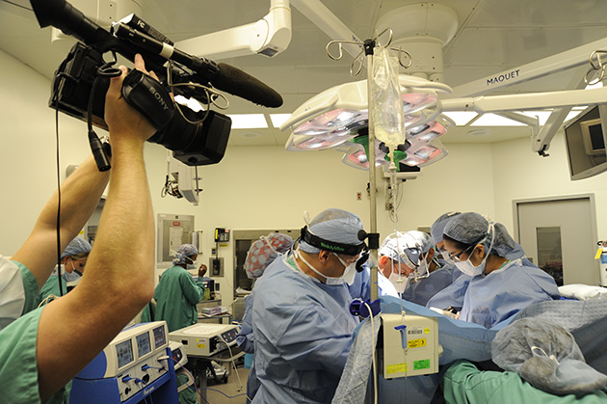
Creating Live OERs
Notes:
One of the benefits of employing a personal and distributed learning support system is that the learner is no longer limited to the specific learning management system.
This not only supports open publishing, which is necessary in order to create an ecosystem of learning support resources, it also enables the production of these resources from external learning systems and actual workplace environments. The gaming industry provides an example of this, where recording and rebroadcasting in-game events, either live or as videos, has become a popular and widespread activity.
We also see this practice increasingly being employed in high-tech hands-on fields such as medicine. It is important, from the perspective of promoting a system of open educational resources, that these types of activities be extended to include other domains, and that tools, support and assistance for the capturing of these experiences be developed.
http://mashable.com/2013/10/02/youtube-video-game-footage/
http://omicsonline.org/open-access/video-recording-the-laparoscopic-surgery-for-the-treatment-of-endometriosis-should-be-systematic-2161-0932.1000220.php?aid=26080

Slide 21
The Open Virus
Martin Weller:
“It is no coincidence that many of the MOOC pioneers had also been early adopters of open access, active bloggers, and advocates of open licenses. Creating open courses seemed the next logical step
The Open Virus, Martin Weller, The Ed Techie
http://nogoodreason.typepad.co.uk/no_good_reason/2014/05/the-open-virus.html

Slide 22
The Open Research Network
Beginnings of a proposal:
“The real value of repositories is when they are interconnected to provide unified access to research materials for researchers around the world.”
Aligning Repository Networks Meeting 2014, Confederation of Open Access Repositories (COAR)
https://www.coar-repositories.org/files/Aligning-Repository-Networks-Meeting-Report.pdf

Slide 23
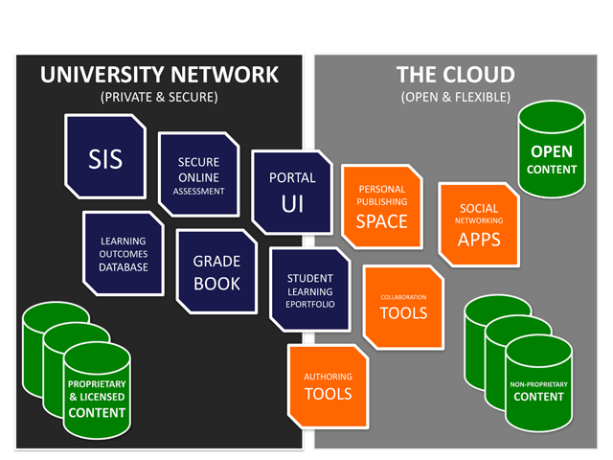
The Open Learning Network
Bridging the LMS and the PLE:
“The OLN is built on web services from the ground up. This facilitates authentication federation and data portability. It also allows for granular authentication and rights management within and across OLN modules.”
Jon Mott. Envisioning the Post-LMS Era: The Open Learning Network, Educause Review. http://www.educause.edu/ero/article/envisioning-post-lms-era-open-learning-network

Slide 24
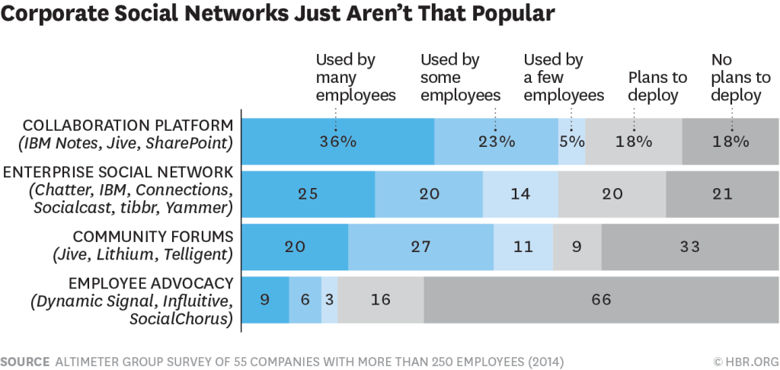
Social Networks
Why nobody is using the corporate social network
“Employees are smart—they won’t waste their time on stunts that are purely for show. Think about the types of engagements you want to have in digital channels—with whom, about what, and when.”
Charlene Li, Harvard Business Review
https://hbr.org/2015/04/why-no-one-uses-the-corporate-social-network

Slide 25
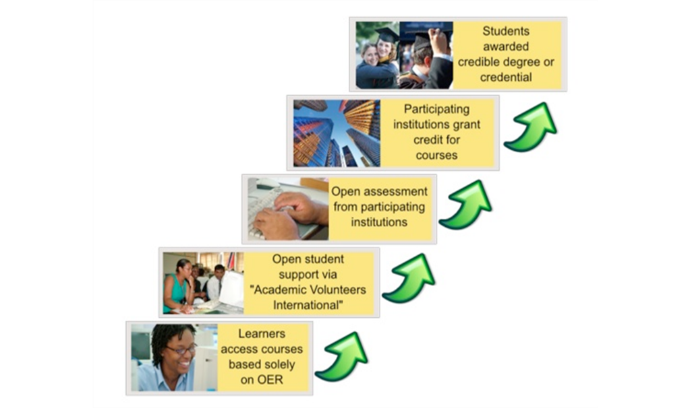
The Many Names of Open
Taylor, J.C. 2007. Open courseware futures: Creating a parallel universe. e-Journal of Instructional Science and Technology (e-JIST), Vol 10, No. 1. Online: http://www.ascilite.org.au/ajet/e-jist/docs/vol10_no1/papers/full_papers/taylorj.htm

Slide 26
Open Access
Originated in Open University, Athabasca University
No formal requirements for course admission
Issues: preparedness, completion
http://www.athabascau.ca/

Slide 27
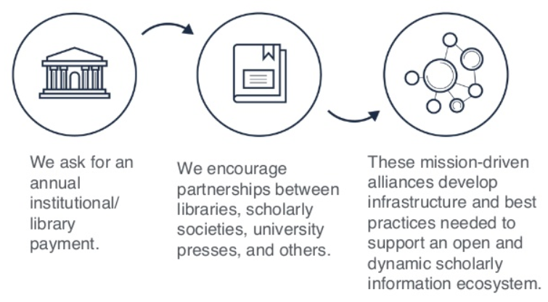
Open Access Network
http://www.slideshare.net/knconsultants/open-access-network-plan-b-dlf-forum-2015

Slide 28
Open Access Social Network
They Loved Your G.P.A. Then They Saw Your Tweets
“Students’ social media and digital footprint can sometimes play a role in the admissions process,” says Christine Brown, the executive director of K-12 and college prep programs at Kaplan Test Prep
Natasha Singer, New York Times
http://www.nytimes.com/2013/11/10/business/they-loved-your-gpa-then-they-saw-your-tweets.html

Slide 29
Open Source
Open Source Definition
“Open source software is software that can be freely used, changed, and shared (in modified or unmodified form) by anyone. Open source software is made by many people, and distributed under licenses that comply with the Open Source Definition.”
http://opensource.org/

Slide 30
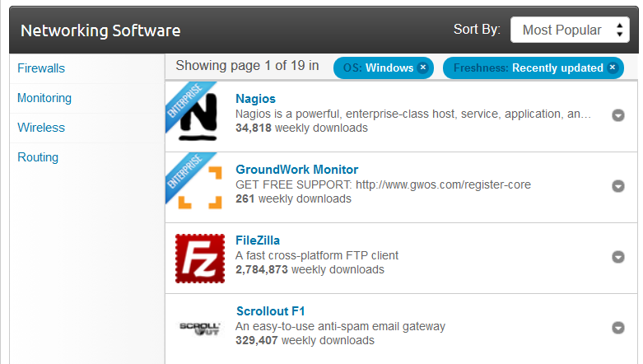
Open Source Network
SourceForge http://sourceforge.net/directory/system-administration/networking/os:windows/freshness:recently-updated/
GitHub https://github.com/opensource-socialnetwork/opensource-socialnetwork

Slide 31
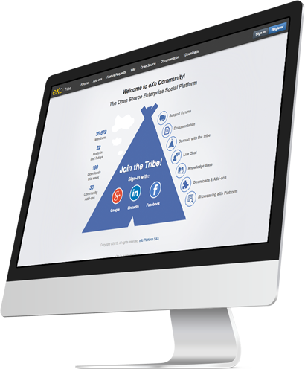
Open Source Social Network
eXo and Slack
“eXo Platform is an out-of-the-box social intranet solution. Rich collaboration features such as wikis, forums, calendars and documents are smartly integrated around activity streams, social networking and workspaces.” http://www.exoplatform.com/

Slide 32
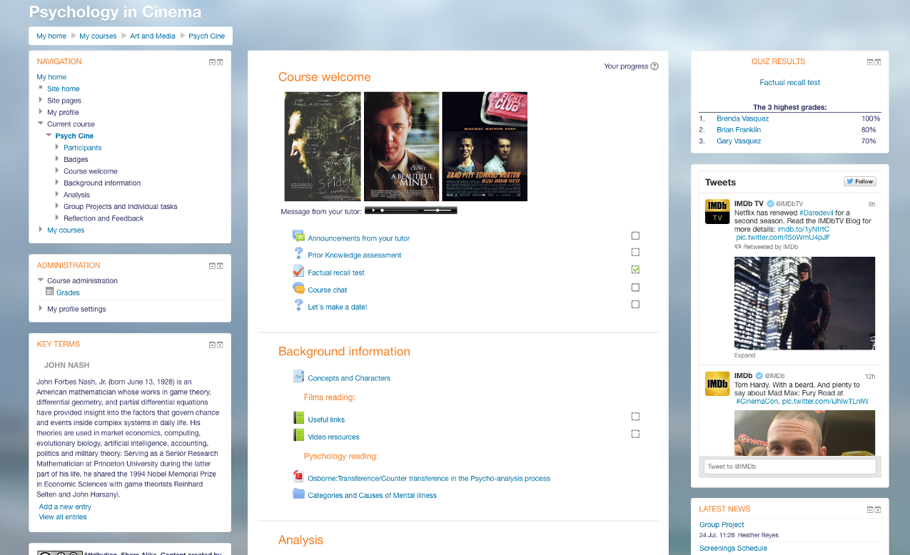
Is Slack the new LMS?
“Learning is constructed by what activities the students carry out; learning is about what they do, not about what we teachers do.”
Elgg - https://elgg.org/
Mathias Emrose, Medium | The Synapse https://medium.com/synapse/is-slack-the-new-lms-7d1c15ff964f

Slide 33
Open Content
Originally thought of as similar to open source
Creative Commons licenses – by, nc, sa, nd clauses
Open access versus open use

Slide 34
Open Content Network
SAP Community Network
“In the b1411 release, SuccessFactors introduced the Open Content Network for the SuccessFactors Learning product. This extension of the LMS allows for integration with a few select MOOC providers to incorporate a vendor’s courses into the organization’s LMS. This can allow organizations to present online learning courses from MOOC providers to employees within the LMS directly.”
EMMA – European MOOC Aggregator - http://platform.europeanmoocs.eu/
http://scn.sap.com/community/erp/hcm/blog/2015/03/05/craving-more-content-take-a-bite-out-of-the-open-content-network-in-successfactors-learning

Slide 35
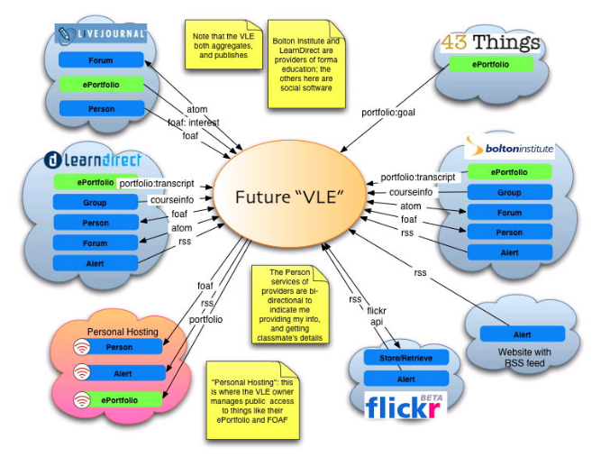
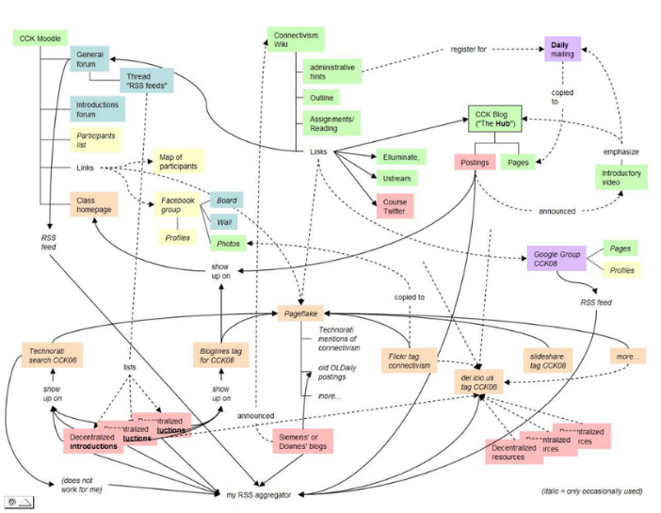
Open Content Social Network
Known
https://withknown.com/

Slide 36
Open Educational Resources
UNESCO Definition
“Open Educational Resources (OERs) are any type of educational materials that are in the public domain or introduced with an open license. The nature of these open materials means that anyone can legally and freely copy, use, adapt and re-share them.”
http://www.unesco.org/new/en/communication-and-information/access-to-knowledge/open-educational-resources/what-are-open-educational-resources-oers/

Slide 37
OER Network
Support for community-based OER process
integration of OER development and use within publicly supported curricula
use of OERs in public services and programs
OER Commons https://www.oercommons.org/
EdWeb - http://home.edweb.net/
Utopia
Reading and networking will become one and the same thing “for instance, when a document in Utopia is opened, "a sidebar opens up on the right-hand side and fills with relevant data from external databases and services like Mendeley, SHERPA/RoMEO, and Wikipedia.” http://utopiadocs.com

Slide 38
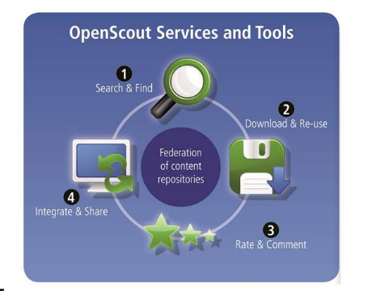
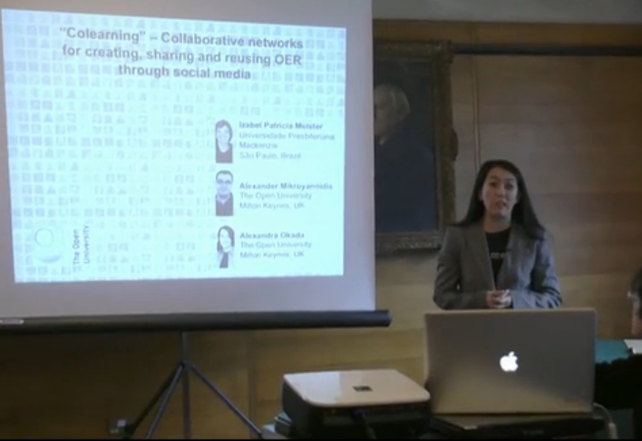
OER Social Network
"Colearning" - Collaborative networks for creating, sharing and reusing OER through social media… OpenScout
Alexandra Okada, http://presentations.ocwconsortium.org/uk2012_224_okada_collaborative_networks/

Slide 39
Open Instruction
“Open Instruction – here we refer to the ‘lecture’ portion of open learning, or rather, the internet analogue of the original lecture described at the top of this post, a series or sequence of activities undertaken by experts…” http://p2pfoundation.net/Open_Instruction
Early open instruction – the Couros course, the Wiley Wiki
MOOCs as open instruction
Elements of open instruction:
Resources
Lectures
Activities and projects

Slide 40
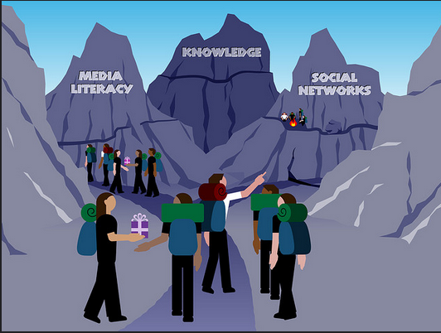
Open Instruction Network
Open Teaching
“The Downes-Siemens course has become a landmark in the small but growing push toward ‘open teaching.’”
Marc Parry, Chronicle of Higher Education
http://chronicle.com/article/Open-Teaching-When-the/124170/
Alec Couros - Open Teaching - Network Sherpa
The concept of "network sherpa" projects the role of teacher as one who knows "the terrain", guides students, but who is also led by student interests, objectives, and knowledge.
https://www.flickr.com/photos/courosa/3293199214/in/photostream/

Slide 41
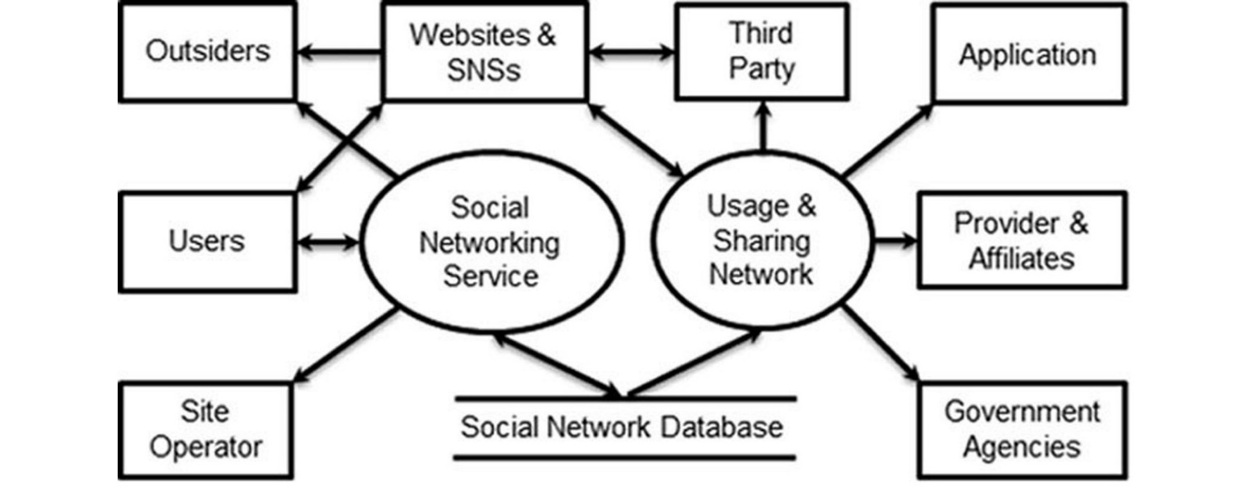
Open Instruction Social Network?
Examples are hard to come by
See, though, this example in health services
Jingquan Li, A Privacy Preservation Model for Health-Related Social Networking Sites
http://www.jmir.org/2015/7/e168/

Slide 42
Open Design
‘Learning Design’ = the organization and structure of a course – eg., IMS LD
Open design – enabling participants to create their own organization and structure
Example: touring a city vs being taken on a tour
The course as ‘environment’ rather than ‘book’
Open design in MOOCs
Learning Design: A Handbook on Modelling and Delivering Networked Education, By Rob Koper, Colin Tattersall (2005!)
http://jime.open.ac.uk/article/download/2005-18/262/

Slide 43
Open Educational Practices
...the Open Educational Practices movement, developed by Germany's Ulf-Daniel Ehlers and the UK's Gráinne Conole...
Also: Open Educational Practices and Resources
“It is important to note that current educational practices are decisive in determining whether – and how – digital educational content, tools and services will be deployed and utilised. If the prevailing practice of teacher-centred knowledge transfer remains intact, then OER will have little effect on making a difference in teaching and learning.”
http://www.olcos.org/cms/upload/docs/olcos_roadmap.pdf

Slide 44
Open Learning Design Network
Gráinne Conole - Cloudworks: Social networking for learning design
“Traditionally design has been an implicit process, how do we shift to a process of design that is more explicit and hence shareable? Different representations of design have different values and purposes, which representations are appropriate and when?”
Engeström (2005) – “The term 'social networking' makes little sense if we leave out the objects that mediate the ties between people… The fallacy is to think that social networks are just made up of people. They're not; social networks consist of people who are connected by a shared object.”
http://www.ascilite.org.au/conferences/melbourne08/procs/conole.pdf

Slide 45
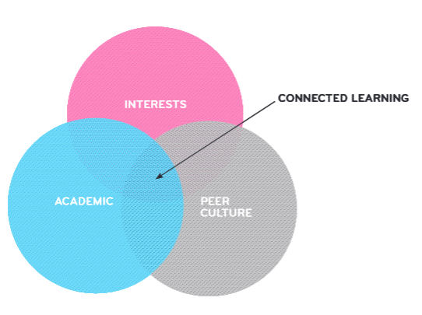
Open Learning Design Social Network
Connected Learning Research Network
“This model is based on evidence that the most resilient, adaptive, and effective learning involves individual interest as well as social support to overcome adversity and provide recognition.”
http://dmlhub.net/wp-content/uploads/files/Connected_Learning_report.pdf
“Connected learning centers on an equity agenda of deploying new media to reach and enable youth who otherwise lack access to opportunity.”
http://clrn.dmlhub.net/

Slide 46
Open Credentials
The argument for closed credentials
Badges?
‘You are what you do’
Privacy and security considerations

Slide 47
Open Credentials Network
Open Badges
“Collect badges from multiple sources, online and off, into a single backpack. Then display your skills and achievements on social networking profiles, job sites, websites and more.”
“Open Badges are information-rich. Each badge has important data built in that links back to the issuer, criteria and verifying evidence.”
http://openbadges.org/

Slide 48
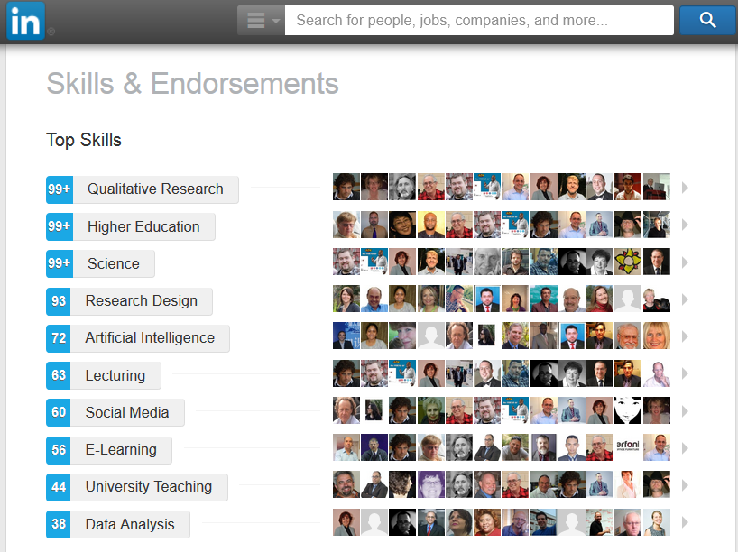
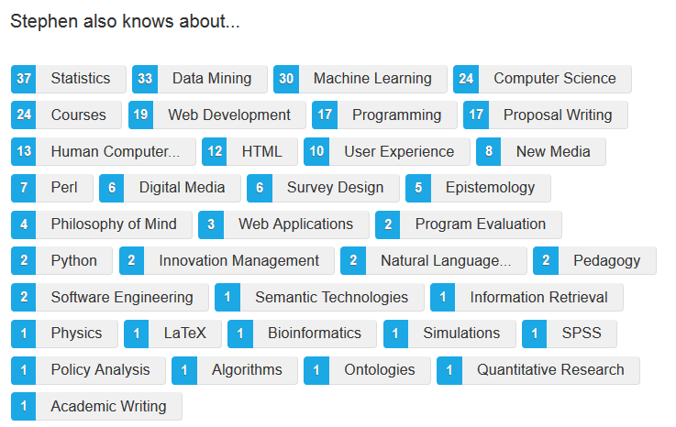
Open Credentials Social Network?

Slide 49
Open Assessment?
What is assessment? - Assessment Design Principles
“Many projects are enhancing the validity of their badges by having some expert other judge work before badges are awarded. This expert other could be a computer or a human. The projects feel that expert judgment gives the badge more weight.”
Learning Outcomes Assessment Communities
“groups, that usually meet in person, that you can join and network about learning outcomes and assessments…”
http://iudpd.indiana.edu/Assessment+Design+Principles#
http://www.learningoutcomeassessment.org/LOAcommunities.htm

Slide 50
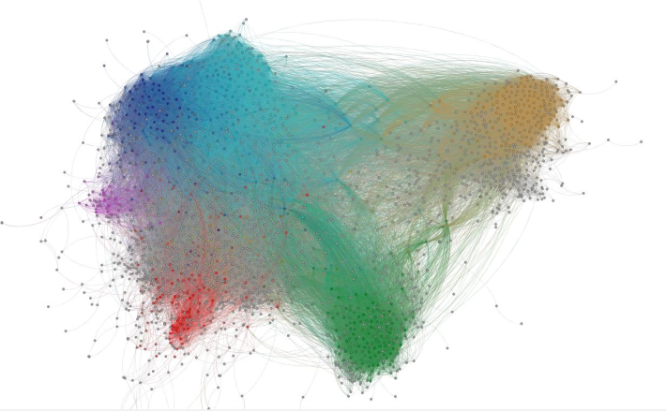
Open Assessment Networks?
The paucity of ‘learning contracts’
Assessment - criteria and metrics
Content based – formal learning
Task based – informal learning
“You decide what counts as success”

Slide 51
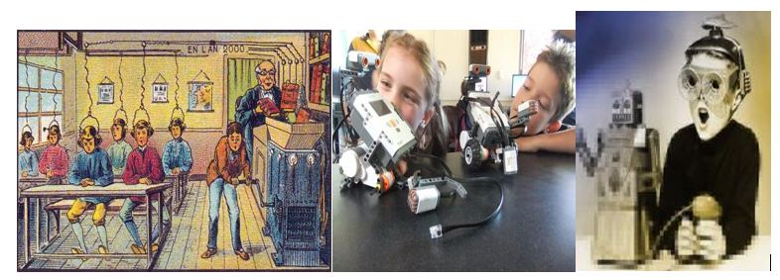
Open Assessments Social Network?
Will what we do in social networks become the ‘assessment’ of the 21st century?

Slide 52
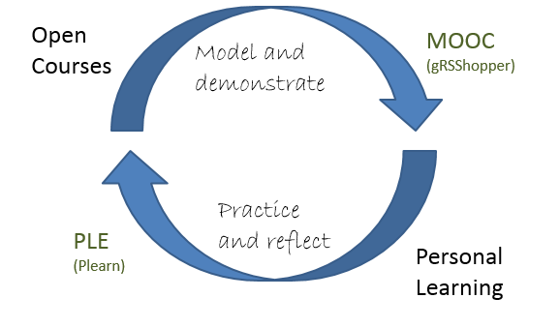
Open Learning Theory

Slide 53
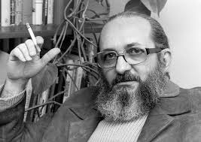
Understanding Knowledge
http://www2.webster.edu/~corbetre/philosophy/education/freire/freire-2.html
Notes:
In the traditional model of the open educational resource as “textbooks to curricula, syllabi, lecture notes, assignments, tests, projects, audio, video and animation” it is difficult to think of an individual’s knowledge and understanding from any other perspective than that Friere called the “Banking” model of learning. Education “becomes an act of depositing, in which the students are the depositories and the teacher is the depositor. Instead of communicating, the teacher issues communiques and makes deposits which the students patiently receive, memorize, and repeat.”
The major criticism of the banking model is that students cannot learn anything over and above what was taught. They cannot adapt the knowledge to their own context, they cannot understand the terms in their own way, and as Friere would argue, they are ultimately disempowered and oppressed by education, rather than liberated. “The banking approach to adult education, for example, will never propose to students that they critically consider reality… The "humanism" of the banking approach masks the effort to turn women and men into automatons -- the very negation of their ontological vocation to be more fully human.”
http://www2.webster.edu/~corbetre/philosophy/education/freire/freire-2.html

Slide 54
Knowing a Pile of Facts?
Image: http://www.rightattitudes.com/
Notes:
More seriously, however, is the picture of knowledge that results from a model of education based on the transmission of information. As the ‘banking’ metaphor suggests, this is a model based on an accumulation of facts – a person’s knowledge, in essence, could be reduced to an indefinitely long series of propositions (necessarily including rules and principles, because otherwise the complex and unplanned behaviours a person can undertake would be impossible).
Computationally, this is known as the physical symbol system hypothesis (PSSH), and it means that human understanding can be thought of literally as the manipulation of sentences and symbols, like a computer program. This perspective permeates educational theory today, and the pedagogy of open educational resources as carriers of (propositional) learning permeates our discussions and assumptions in the field (think of how often terms like ‘processing’ and ‘storage’ and ‘working memory’ are used).
This approach additionally characterizes the management of open educational resources and learning resources generally. The very best an individual student is allowed is to have a ‘course library’ or ‘publications library’. There is no sense that they would do anything more complex with them that to read them, remember them, and maybe store them.
http://ai.stanford.edu/~nilsson/OnlinePubs-Nils/PublishedPapers/pssh.pdf

Slide 55
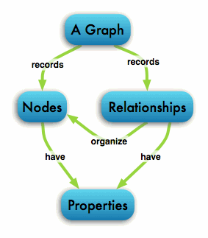
The Graph Database
http://neo4j.com/developer/graph-database/
Notes:
We view knowledge differently, and this difference extends to the core of LPSS design. While objects and artifacts may be stored off to the side in a library, the core of LPSS takes the entities identified by RRN and stores the references to them in a graph database. There are various graph database engines available, though we have been building our own in order to understand the functionality we require.
What is a graph database? “A graph database stores connections as first class citizens, readily available for any “join-like” navigation operation. Accessing those already persistent connections is an efficient, constant-time operation and allows you to quickly traverse millions of connections per second per core.” (Ibid)
There are many reasons to represent an individual’s data in a graph database. Here are a couple:
A graph database does not require predefined entities. This means we do not have to know in advance everything a student is going to need; we add entities, properties and relations as they are encountered.
A graph database supports distributed representation. What that means is that a concept is not represented as a series of self-contained sentences, but rather, as a set of connections throughout the graph.
A graph database recognizes context and connections. What someone knows about plaster might influence their thoughts about European cities. In a graph database, these concepts overlap, and an event changing the state of one, also changes the state of another
A graph database can be deeply personal. Each person experiences a unique set of entities and relations between them; though the symbols and images representing concepts may be used in common with other people, a graph database embodies the fact that each person’s understanding of these is individual
In LPSS, each person has their own graph database containing all the entities and relations they have encountered over a lifetime of learning. The graph database contains references to analyses of the open educational resources they have encountered, but also any other content related to their learning and development. Each person’s graph is individual, personal and private, just like their own thoughts and ideas.
http://neo4j.com/developer/graph-database/
http://www.slideshare.net/maxdemarzi/introduction-to-graph-databases-12735789?related=1
http://www.computerweekly.com/feature/Whiteboard-it-the-power-of-graph-databases

Slide 56
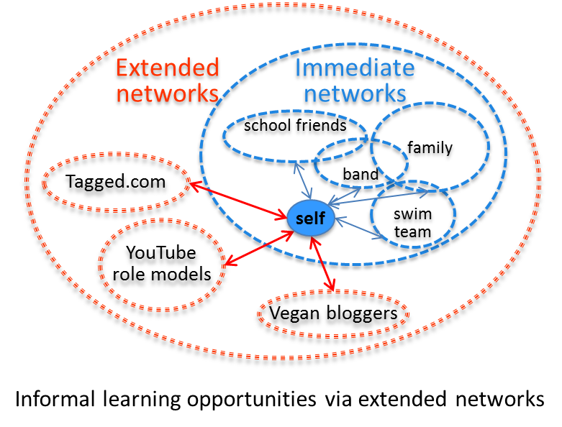
Learning in Context
Task-Focused
Network-based
Notes:
The difficulty of such a quality metric is that none of these can be determined independently; it is only by subjective the resource to the greater weight or a larger knowledge graph that we can even begin to assess any of these. ‘Reputation’, for example, is a standard that varies from place to place, person to person. ‘Technical production’ will be influenced not only by tastes and preference but also by accessibility requirements.
Indeed, it is arguable that it is impossible to determine a priori whether a resource is ‘quality’ or not (though perhaps with decades of experience we may eventually draw some inferences). Ultimately, with Mill, we have to say, “The only proof capable of being given that an object is visible, is that people actually see it. The only proof that a sound is audible, is that people hear it: and so of the other sources of our experience. In like manner, I apprehend, the sole evidence it is possible to produce that anything is desirable, is that people do actually desire it.”
https://www.gutenberg.org/files/11224/11224-h/11224-h.htm

Slide 57
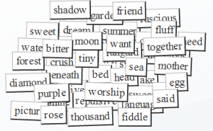
Think of OERs as words in a conversation
Notes:
I want you to think of open educational resources not as texts and lessons and such, but as words in a conversation.

Slide 58
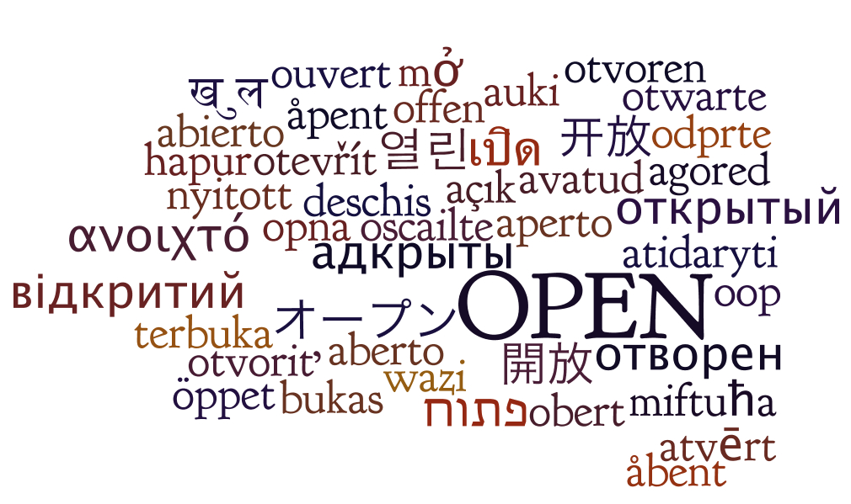
It forces us to think about how they can be used.
http://oerworkshop.pbworks.com/w/page/33932297/OER%20Workshop
Notes:
Why do I ask you to think of them this way? In part, it’s because I think that’s how they’re used. But more importantly, it forces us to think about how they can be used.

Slide 59
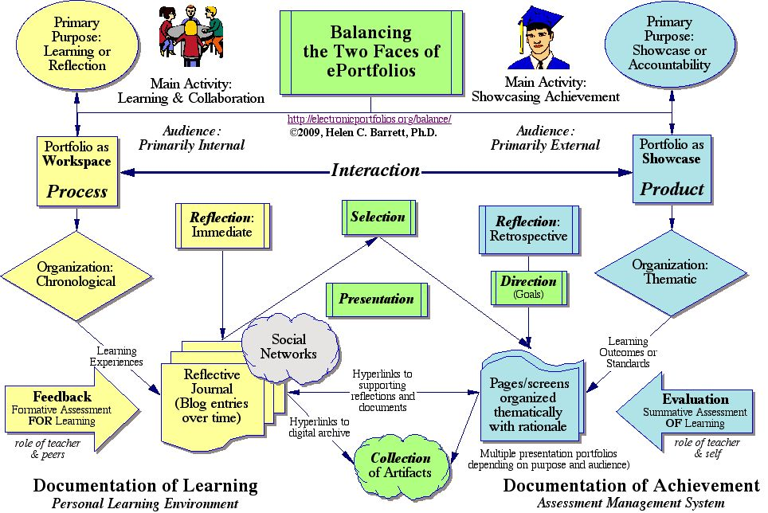
Consider how words are used in education.
http://electronicportfolios.org/balance/index.html
Notes:
Consider how words (the traditional kind, made up of letters and arranged in sentences) are used in education. A lecture, for example, is composed on words, a 10,000 word presentation in 55 minutes. They are defined, used to describe phenomena, to explain causes, to argue to conclusions. They are the tools of teaching.

Slide 60
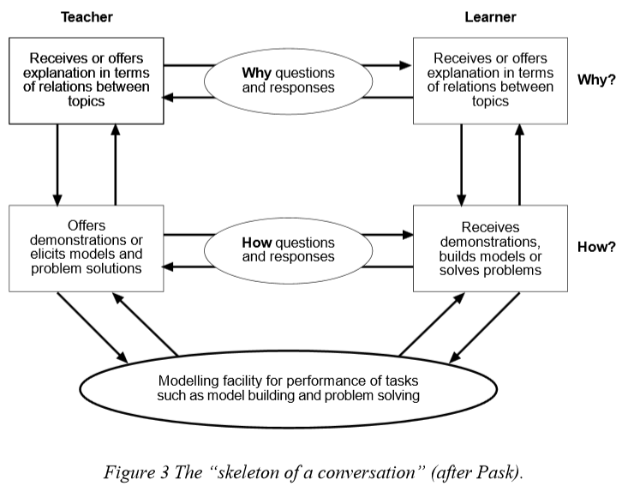
Pask: Conversational Theory
https://www.univie.ac.at/constructivism/pub/fos/pdf/scott.pdf
Notes:
That was the actual state of affairs in the classroom until recent decades. But through advances such as active learning, problem based learning, constructivism, and other new educational approaches, words in the classroom have been liberated.
Examples could be multiplied almost without end, but a typical case may be made using Gordon Pask’s conversational theory (CT) of learning. Using interrogation, the students can ask how a process takes place, request an explanation of why a process takes place, and inquire about the how and why of the topic itself, in the wider context of subject and the class.
https://www.univie.ac.at/constructivism/pub/fos/pdf/scott.pdf

Slide 61
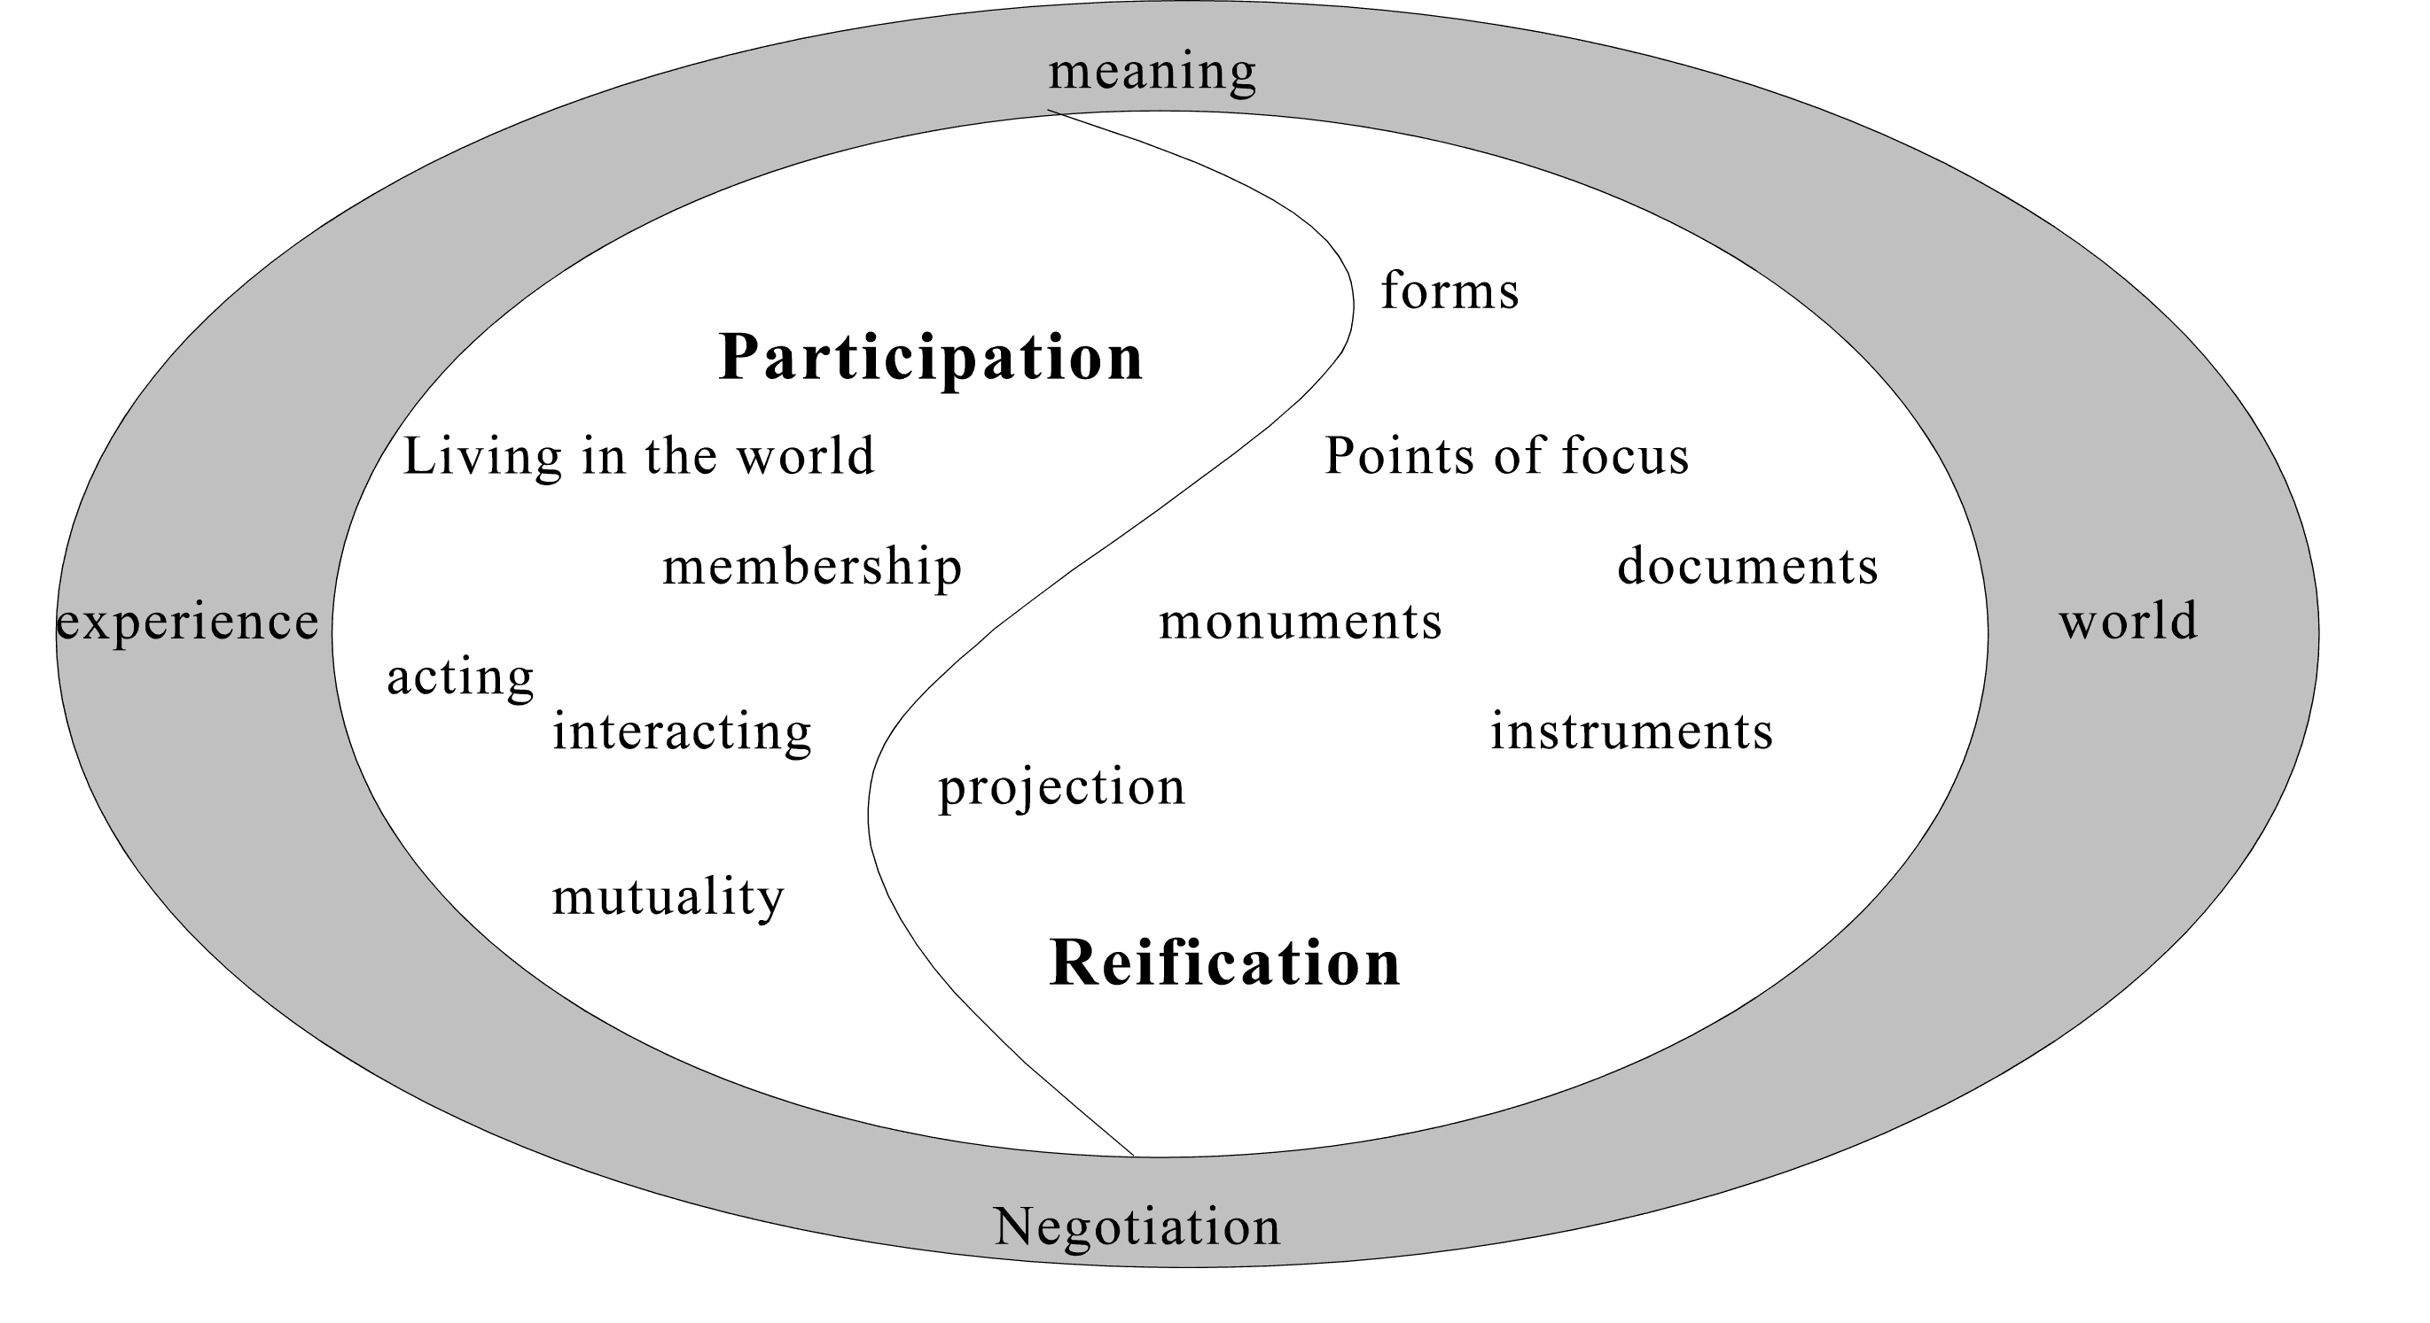
Knowledge is reified by, and is the product of, not only an individual, but of the wider community.
http://www.informationr.net/ir/8-1/paper142.html
Notes:
And from this recognition that students can speak it’s a small leap from students conversing with teachers to students conversing with each other. This forms the basis of now well-established approaches such as social constructivism, team learning, collaboration and project-building (there is some great literature on the idea of mathematics and scientific discovery as conversation) ranging from Vygotsky to Wenger. The understanding here is that knowledge is reified by, and is the product of, not only an individual, but of the wider community.
http://www.sonoma.edu/users/w/warmotha/epistemology.html
http://www.informationr.net/ir/8-1/paper142.html
http://www.slideshare.net/bonstewart/scholarship-in-abundance
http://bsrlm.org.uk/IPs/ip13-3/BSRLM-IP-13-3-13.pdf

Slide 62
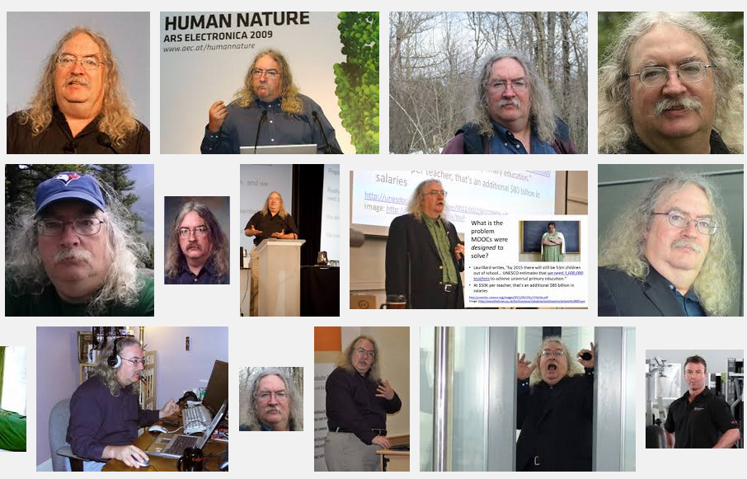
Stephen Downes
http://www.downes.ca

