Slide 1
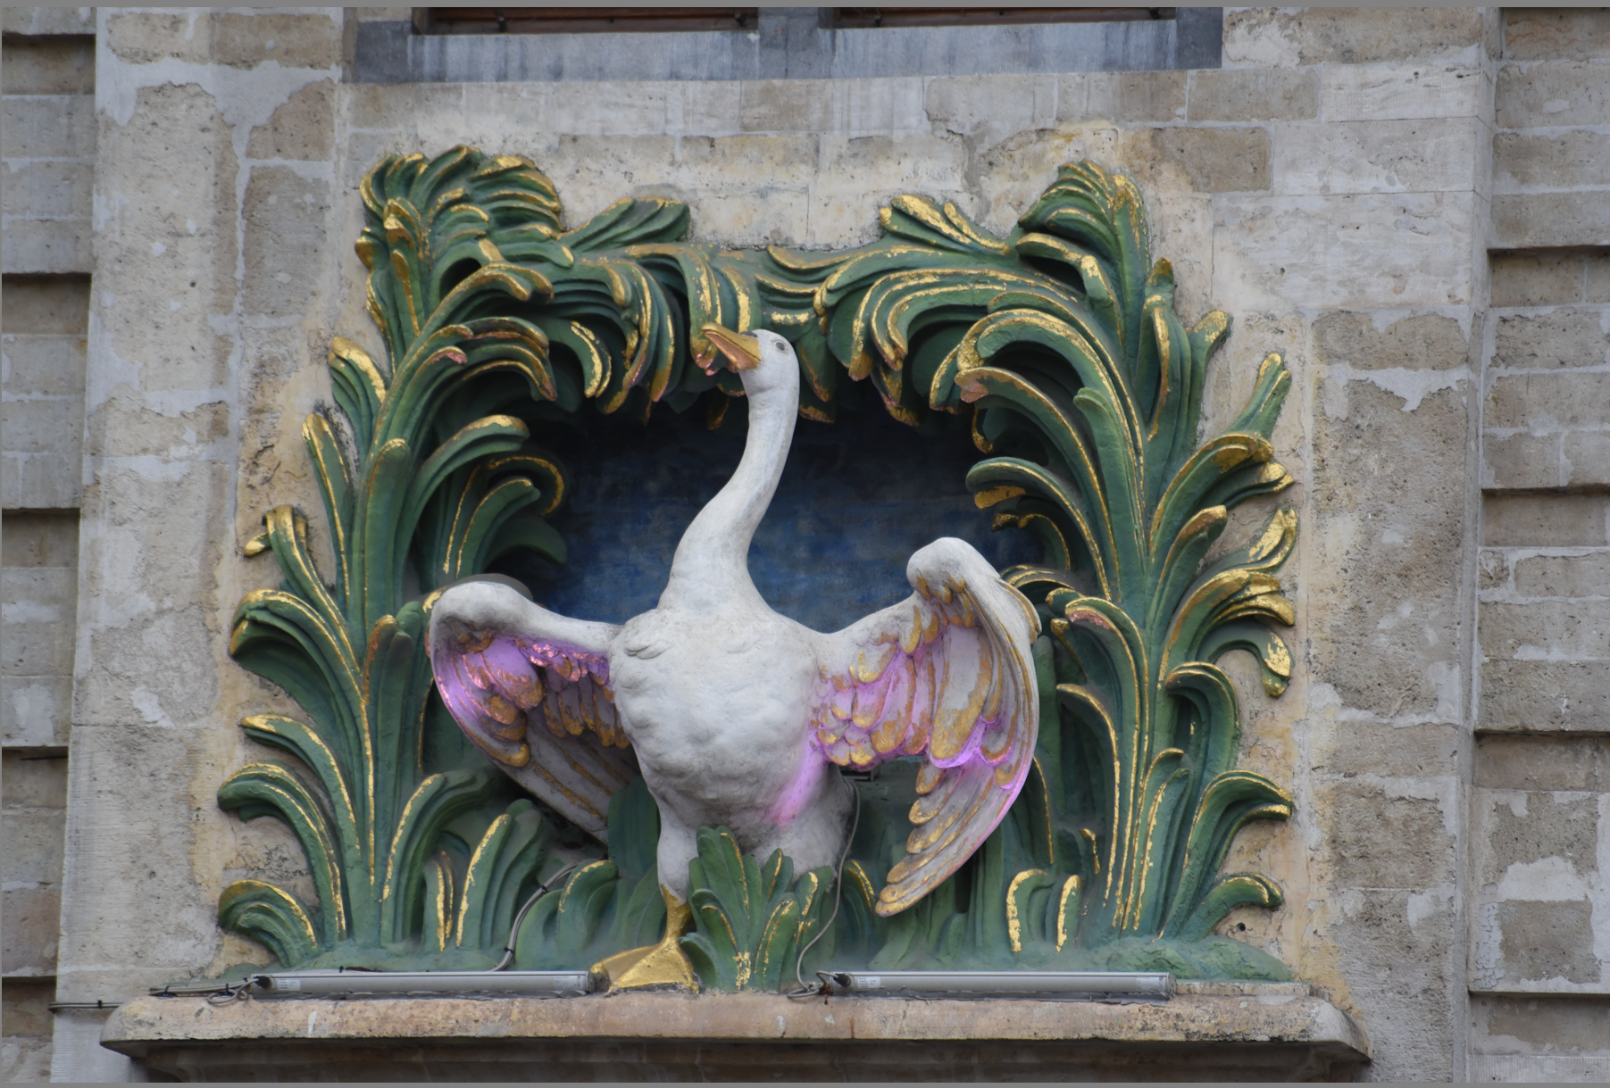
Trends in education Facts, Fads and Fiction
Stephen Downes
Brussels, Belgium
November 25, 2016

Slide 2
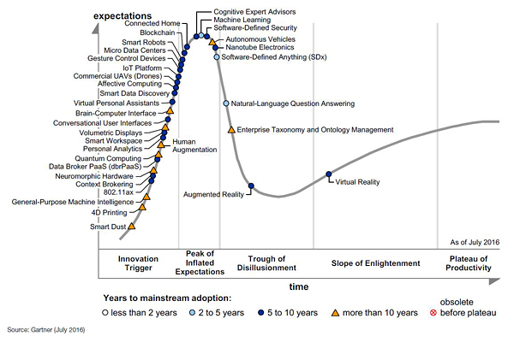
It’s harder to predict a failure than it is to predict a success
Everything on the upslope looks promising, but few products actually make it into the trough of disillusionment (which actually indicates they’re still worth talking about)
http://www.gartner.com/newsroom/id/3412017

Slide 3
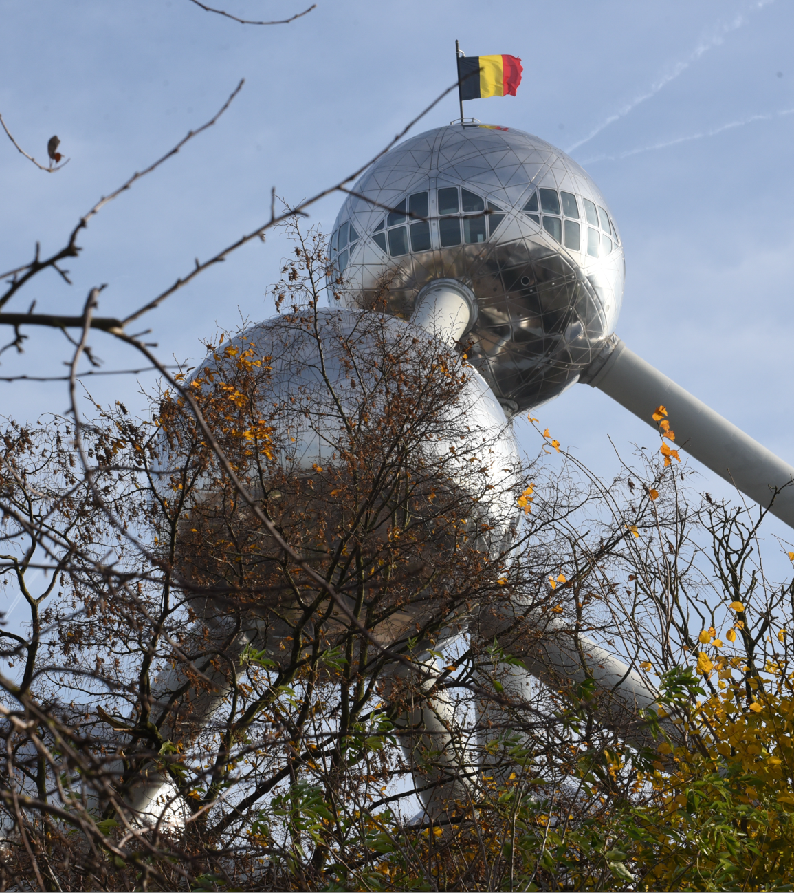
Some of the more promising candidates…
Open online learning
Learning analytics
Personalized learning
Competencies
Digital badges
Blockchain security
Virtual personal assistants
Internet of things

Slide 4
MOOCs and open online learning
A lot of scepticism today… but more people took MOOCs in 2015 than in all previous years combined

Slide 5
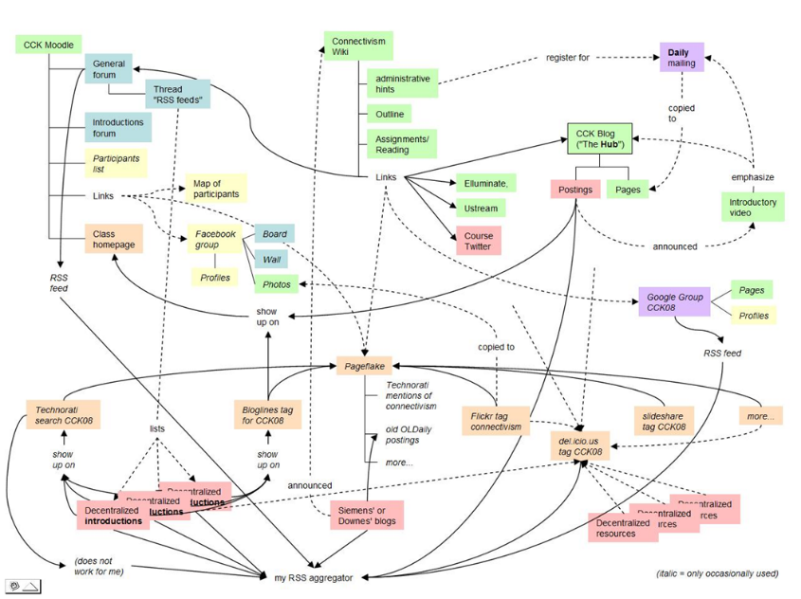
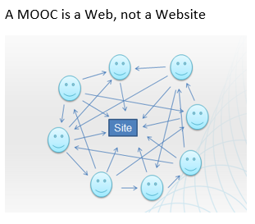
The Connectivist MOOC (cMOOC) Design
Instead of seeing a course as a series of contents to be presented, a course is a network of participants who find and exchange resources with each other
An initial structure is developed and ‘seeded’ with existing OERs
Participants encouraged to use their own sites to create or share resources
A mechanism (gRSShopper) is employed to connect them

Slide 6
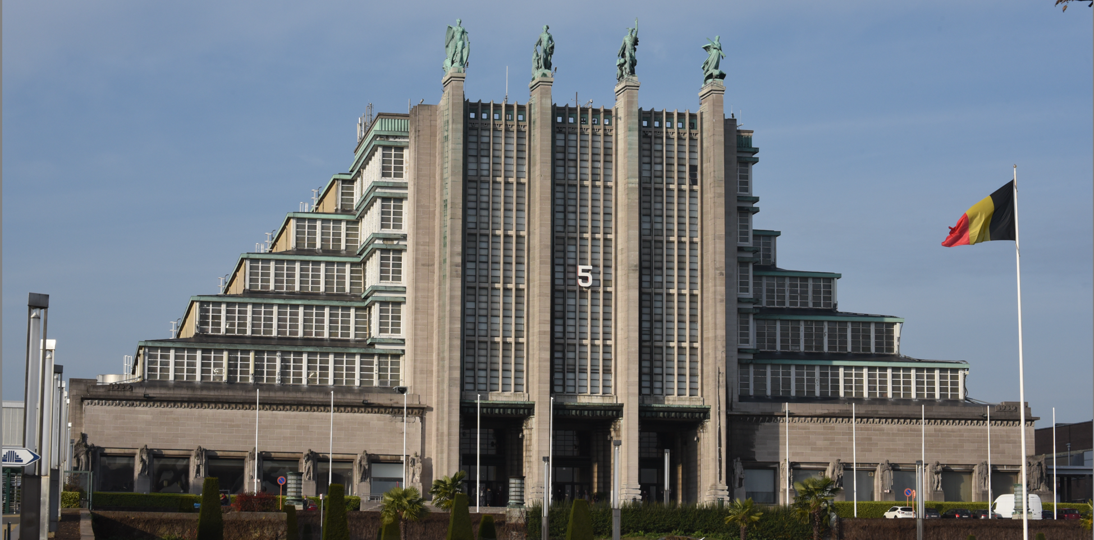
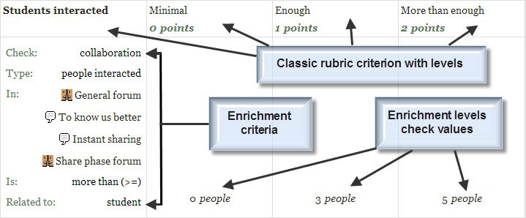
Machine learning and analytics
decision engines - these are expert systems that are based on rule-driven strategies
pattern recognition - perceptual systems that identify patterns from partial or disorganized data
cluster detection - detecting nearest neighbours and categories of things

Slide 7
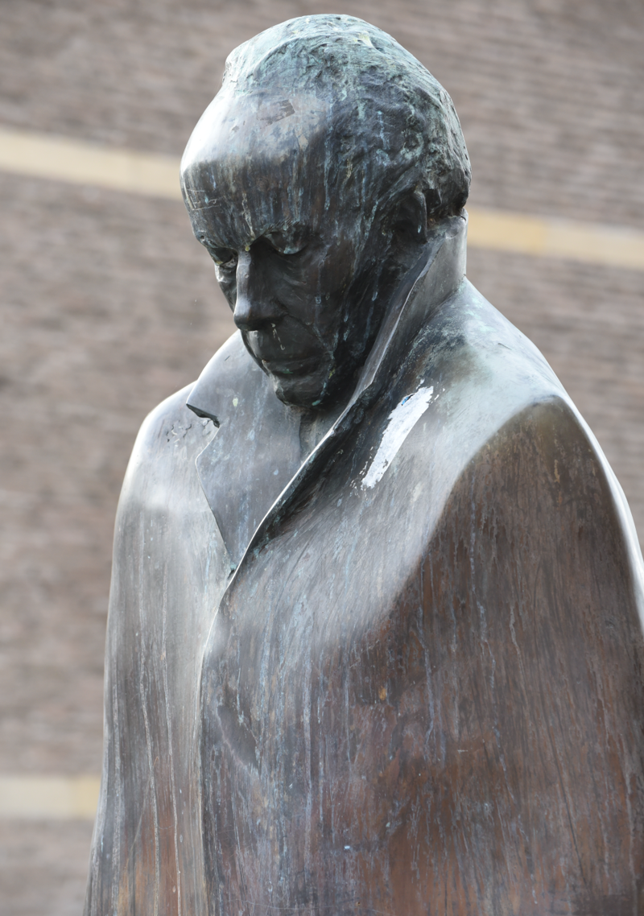
Learning analytics
patterns of behaviour for individual learners
predictors of students requiring extra support
to help teachers and support staff plan
improve current courses or develop new offerings
Marketing, efficiency and effectiveness measures
http://publications.cetis.org.uk/wp-content/uploads/2012/12/Institutional-Readiness-for-Analytics-Vol1-No8.pdf

Slide 8
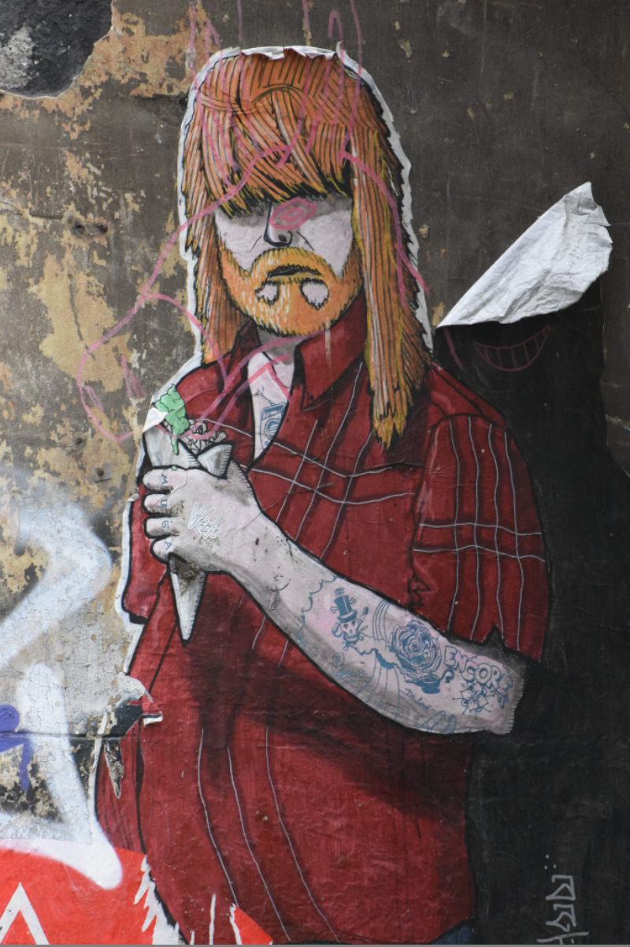
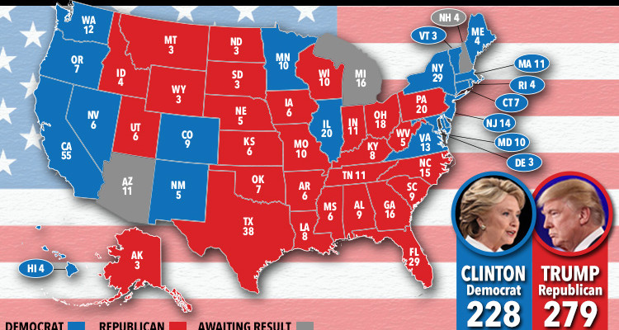
Learning analytics
“Data literacy is going to be a fundamental limiter on the uptake of data-driven educational technology products.” – Michael Feldstein
http://mfeldstein.com/analytics-literacy-is-a-major-limiter-of-ed-tech-growth/

Slide 9
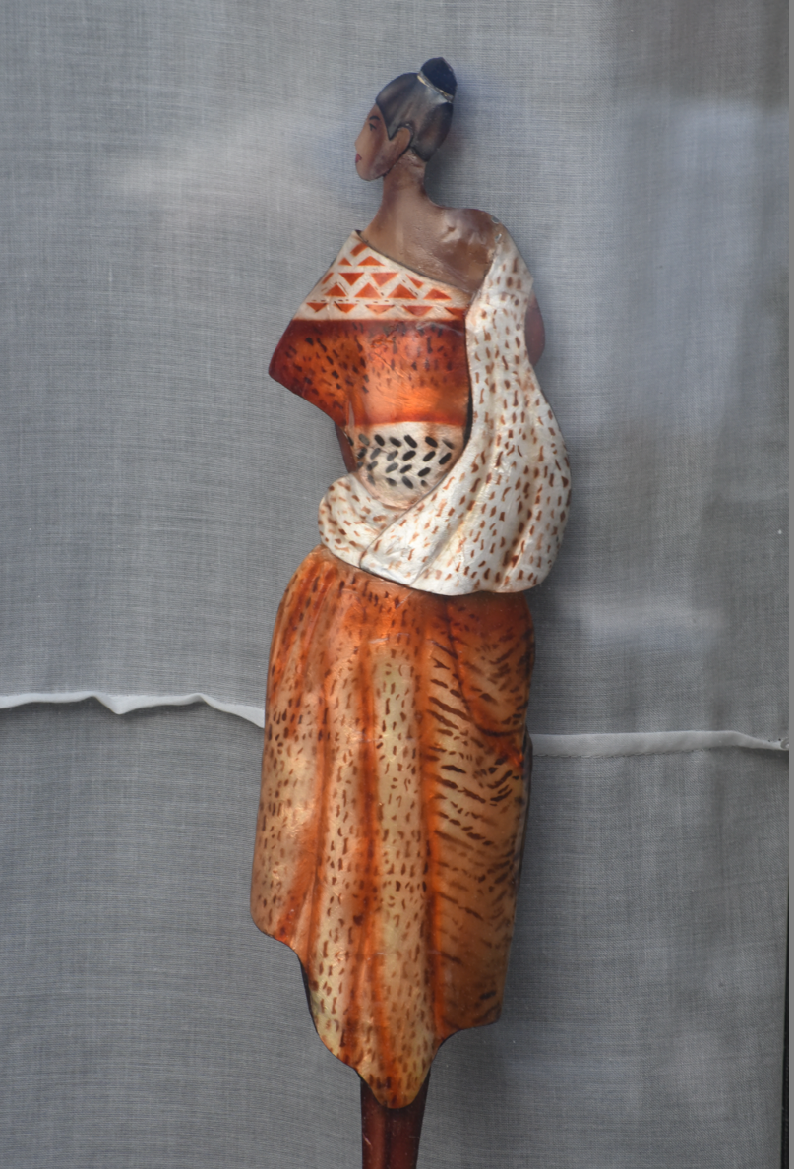
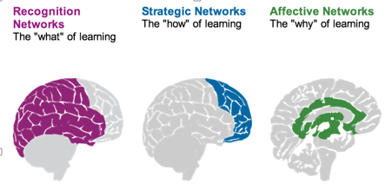
Personalized learning
Rules-Based Events (like notifications)
User Models
Adaptive Learning

Slide 10
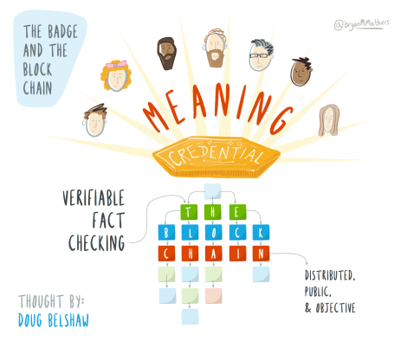
Badges and Credentials
Sony plans to launch a testing platform powered by blockchain and that IBM plans to offer 'blockchain-as-a-service,'"
Audrey Watters
http://hackeducation.com/2016/02/25/blockchain-edu1

Slide 11
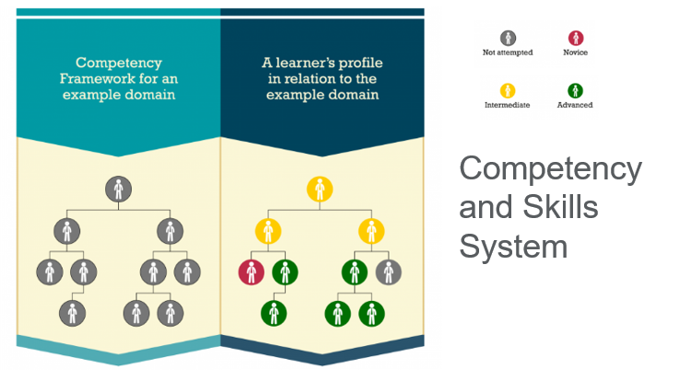
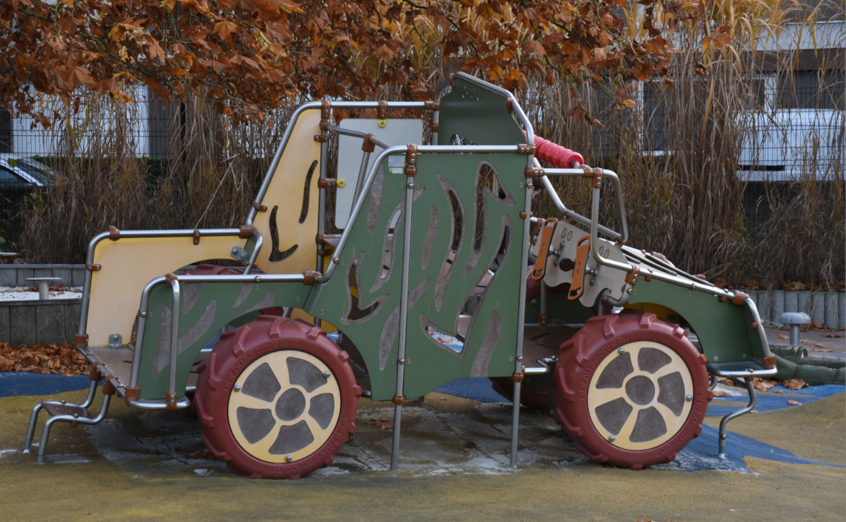
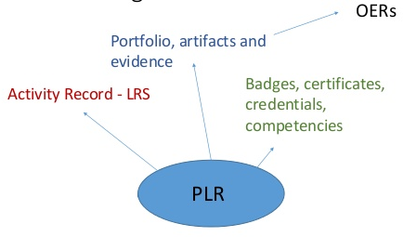
Competency and Skills System (CASS)
https://www.adlnet.gov/introducing-the-next-big-thing-cass/

Slide 12
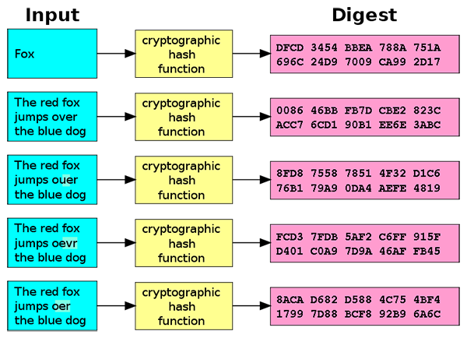
Badges and Blockchain
"If we used the blockchain for Open Badges then we could prove beyond reasonable doubt that the person receiving badge Y is the same person who created evidence X.
Doug Belshaw
http://dmlcentral.net/blog/doug-belshaw/peering-deep-future-educational-credentialing
http://www.downes.ca/search/blockchain

Slide 13
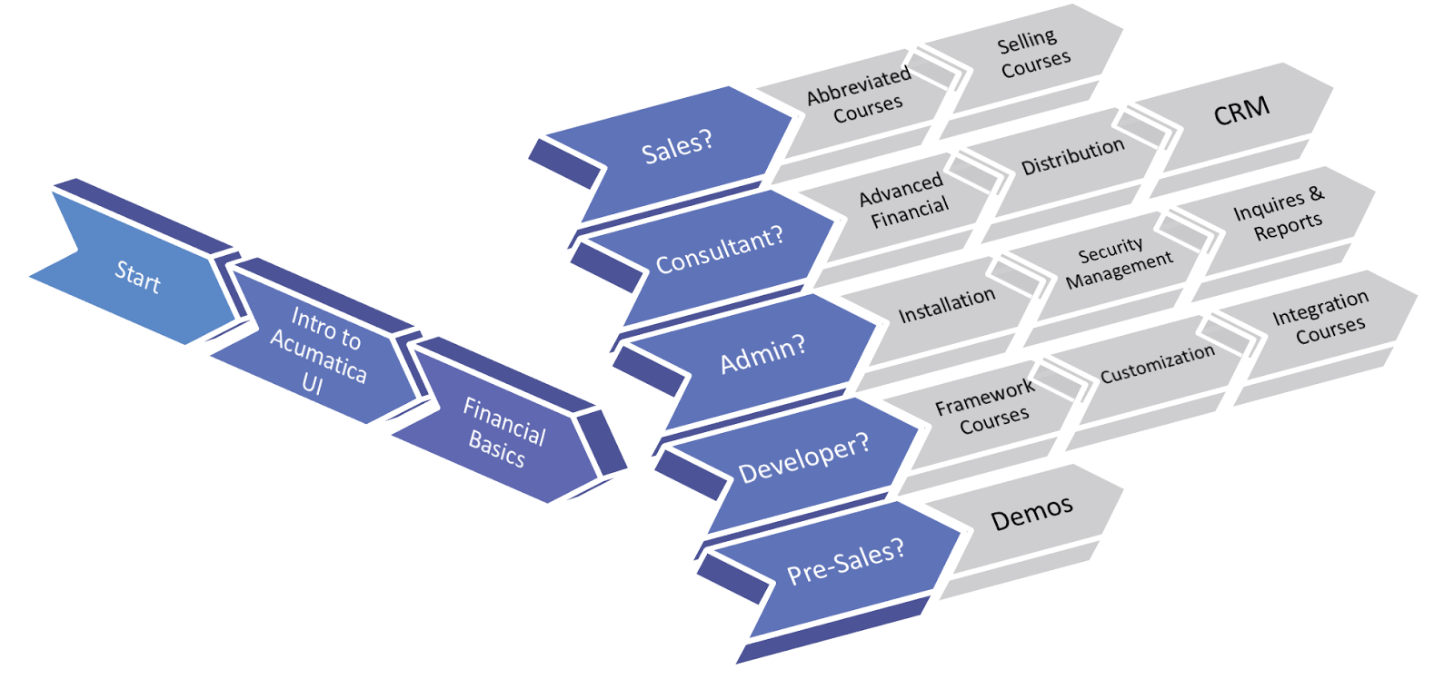
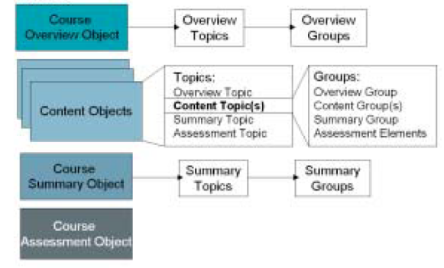
Learning processes / learning paths
The objective is to create the ‘ideal learning path’ for the student
The fixed point for all of these is the learning objective, as defined by the competencies
http://asiablog.acumatica.com/2016/02/acumatica-learning-paths.html
Notes:
Image: http://www.learningsolutionsmag.com/articles/315/prudentials-lcms-implementation-learning-strategy-objects-and-the-design-process-part-1-of-2-parts/page2
Eg. Group Actuvities - https://teaching.unsw.edu.au/moodle-group-activity

Slide 14
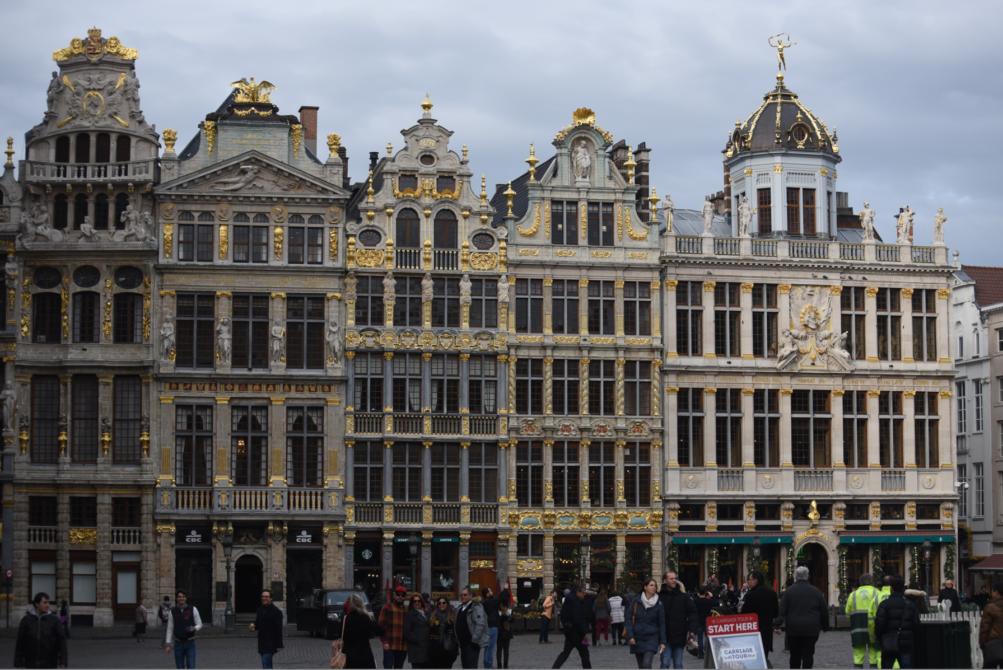
What is Education?
Science as a "combination of evaluating evidence, coordinating evidence and models, and arriving at evidence-based judgments that are communicated through argumentation."
Ronald W. Rinehart, et.al. 2016. Critical Design Decisions for Successful Model-Based Inquiry in Science Classrooms. https://scholarworks.iu.edu/journals/index.php/ijdl/article/view/20137/28269

Slide 15
Design vs Environment
Path | Field
Course | Curriculum (as in ‘mapping’)
Sequence / Prequisite | Core / periphery / foundation
Movement / covered | Inquiry / Discovery / Gaps
Threshold / Levels | Coverage / Construction
Positioning – first / last | Grouping / Clustering
Objective / target | Serendipity / emergence
Leading / Led | Centred
Carrie Paechter, Metaphors of Space in Educational Theory and Practice http://www.tandfonline.com/doi/pdf/10.1080/14681360400200202

Slide 16
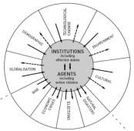
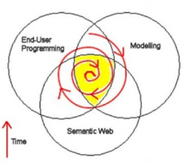
Causes of Change
Resistance
Drivers
Costs
Events
Crises
Inventions
Growth
Values
Goals
Desires
Needs
Attractors
Inertia
Notes:
ACCA, 2012, Drivers of Change in the U.S. http://www.accaglobal.com/content/dam/acca/global/PDF-technical/futures/pol-af-docus.pdf
Simon L. Dolan, Salvador García, Samantha Diegoli, Alan Auerbach. 2000. Organisational Values as "Attractors of Chaos”: An Emerging Cultural Change to Manage Organisational Complexity. http://www.econ.upf.edu/docs/papers/downloads/485.pdf
Donald L. Gilstrap. 2005. Strange Attractors and Human Interaction: Leading Complex Organizations through the Use of Metaphors. https://ejournals.library.ualberta.ca/index.php/complicity/article/viewFile/8727/7047

Slide 17
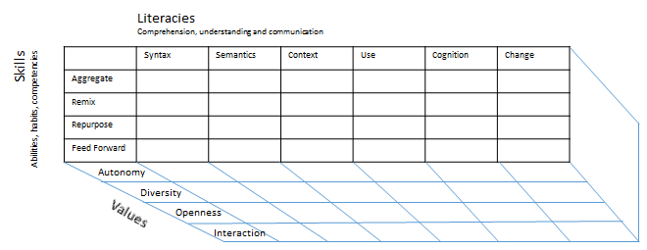
Method as Discovery:
You don’t learn a language, you discover it
To discover a language is to be immersed in it, to speak it and listen to people speaking in it
My scientific method (if it can be called that) is to go to the office each day and immerse myself in the world – to try listening, and to try speaking

Slide 18
Learning is Personal

Slide 19
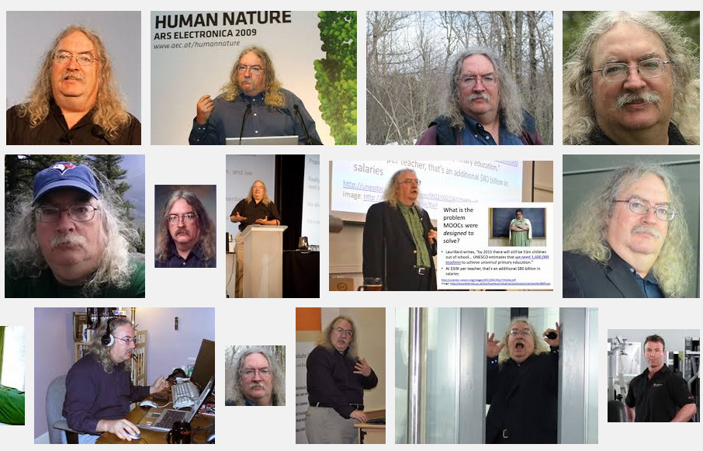
Stephen Downes
http://www.downes.ca

