Slide 1
Personal learning environments and technologies
Stephen Downes
Berlin, Germany
November 30, 2016

Slide 2
Current Focus in Learning Technology
Competency Frameworks
Personalized Learning
Innovation & Skills Development
This demand-driven and outcomes-driven approach may not best serve student needs
http://www.personalizelearning.com/2015_02_01_archive.html

Slide 3
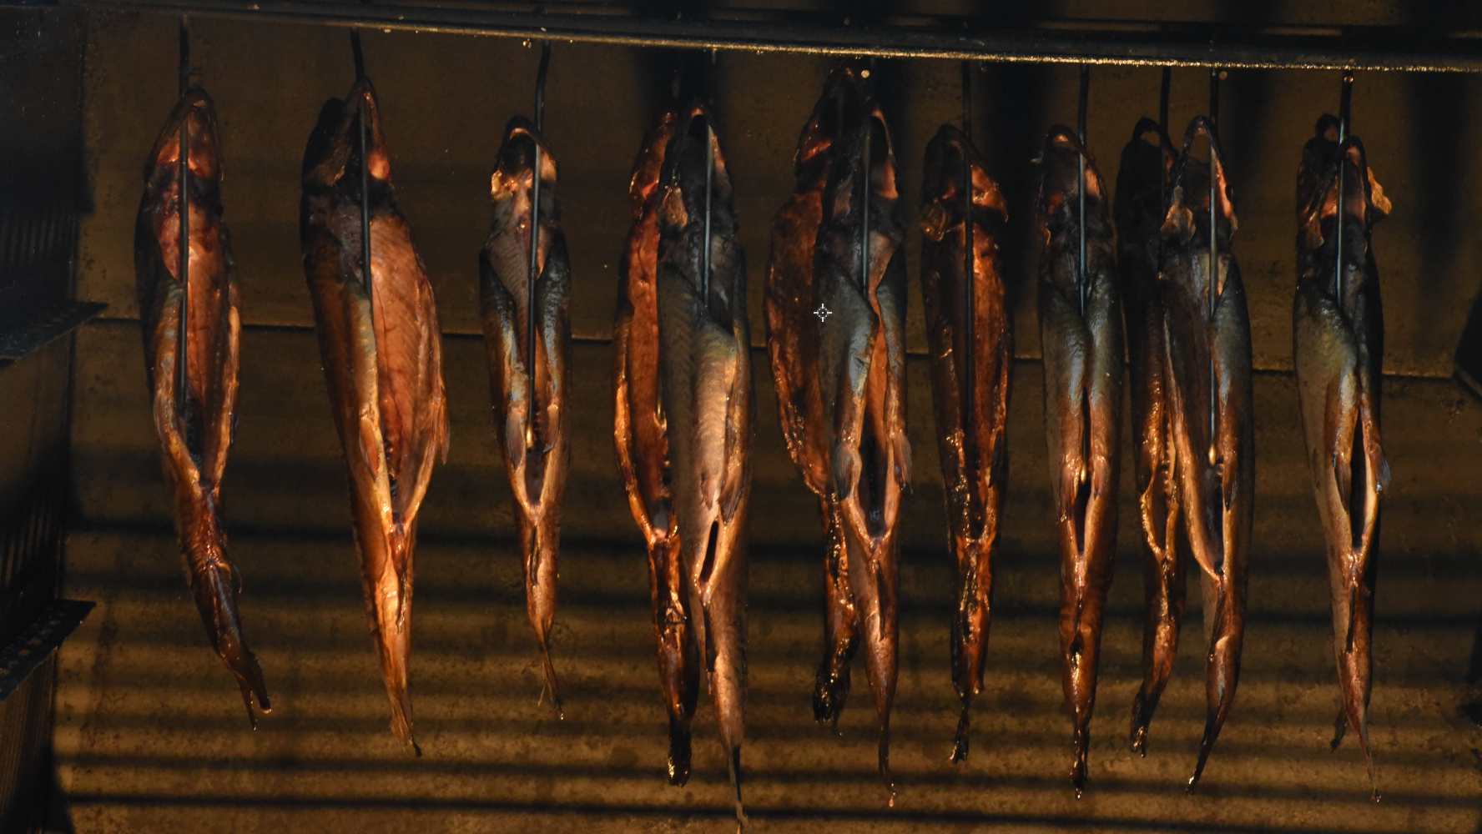
Competency Frameworks

Slide 4
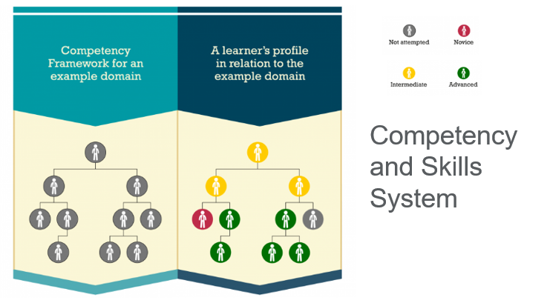
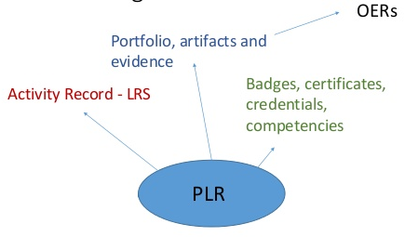
Competency and Skills System (CASS)

Slide 5
Competency Framework
Learning outcomes,
learning objectives but also traits, etc., can be represented
Asserts – include roll-up rules
Assertions – assertions of individual competency
Includes ‘who said so’ – source
Degree of confidence
Permissions, privacy and security model
https://participatoryartslearning.wordpress.com/the-framework/what-is-a-competency-framework/

Slide 6
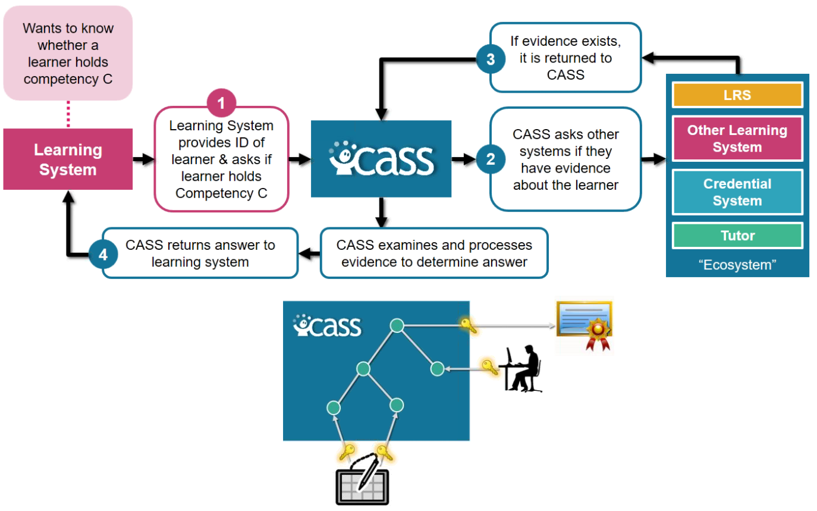
ADL and CASS
Primary use of CASS is through REST APIs
Refer to competencies through globally unique GUIDs
Import / Export in standard formats
Robby Robson / Eduworks / FGDLA - Federal Government Distance Learning Association / http://www.fgdla.us/

Slide 7
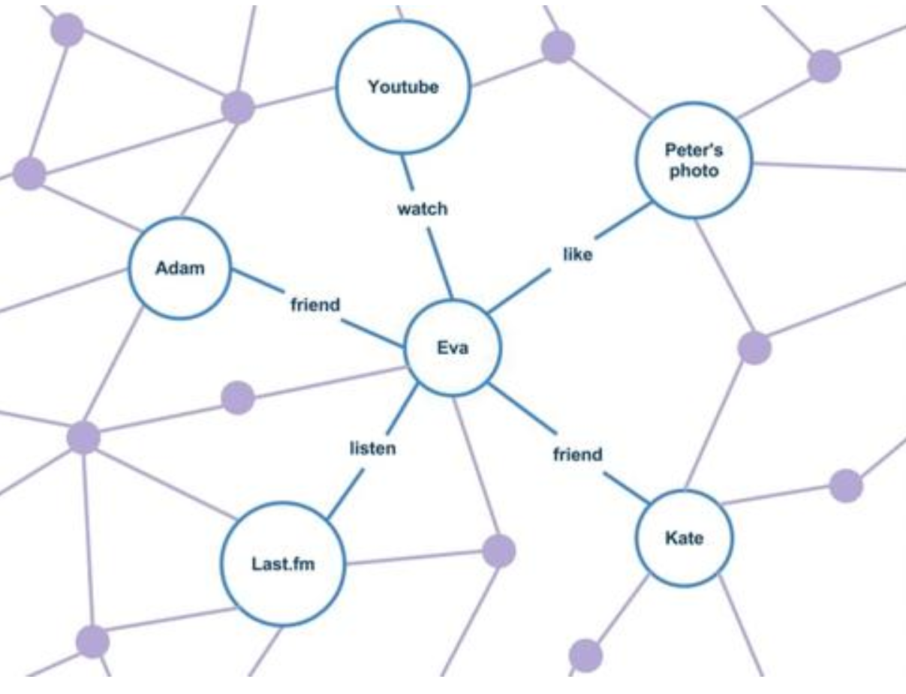
Whither the Semantic Web
The web of obsoledge
Old paradigms of documents, knowledge and keyword search.
Documents - only a small sliver of the stuff that matters
Information needs to find us, when we need it
https://gigaom.com/2013/11/03/three-reasons-why-the-semantic-web-has-failed/
http://www.informationweek.com/software/information-management/semantic-web-business-going-nowhere-slowly/d/d-id/1113323

Slide 8
Personalized Learning

Slide 9
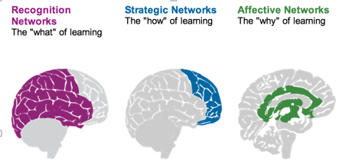
Personalization
What we learn
How we Learn
Why we learn
Rules-Based Events (like notifications)
User Models
Adaptive Learning

Slide 10
Two Approaches…
Content
Practice
Practice
Content

Slide 11
Two Approaches…
Defines an ideal state
Defines a desired state
Content
Practice
Practice
Content
TEST
TRY
Person tests you
Person helps you

Slide 12
Two Approaches…
Defines an ideal state
Defines a desired state
Content
Practice
Correction
Iteration
GAP
Practice
Content
Opport-unity
TEST
TRY
Person tests you
Person helps you

Slide 13
Library Environment
Defines an ideal state
Defines a desired state
Content
Practice
Affordances
Correction
Requirements
Iteration
GAP
Practice
Content
Opport-unity
TEST
TRY
Person tests you
Person helps you

Slide 14
Personalized Personal We do for you You do for yourself
Defines an ideal state
Defines a desired state
Content
Practice
Affordances
Correction
Requirements
Iteration
GAP
Practice
Content
Opport-unity
TEST
TRY
Person tests you
Person helps you

Slide 15
Innovation and Skills Development

Slide 16
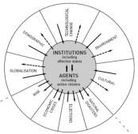
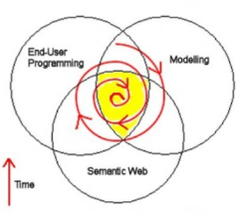
Causes of Change
Resistance
Drivers
Costs
Events
Crises
Inventions
Growth
Values
Goals
Desires
Needs
Attractors
Inertia
Notes:
ACCA, 2012, Drivers of Change in the U.S. http://www.accaglobal.com/content/dam/acca/global/PDF-technical/futures/pol-af-docus.pdf
Simon L. Dolan, Salvador García, Samantha Diegoli, Alan Auerbach. 2000. Organisational Values as "Attractors of Chaos”: An Emerging Cultural Change to Manage Organisational Complexity. http://www.econ.upf.edu/docs/papers/downloads/485.pdf
Donald L. Gilstrap. 2005. Strange Attractors and Human Interaction: Leading Complex Organizations through the Use of Metaphors. https://ejournals.library.ualberta.ca/index.php/complicity/article/viewFile/8727/7047

Slide 17
Beyond Innovation
New
Idea + Execution + Benefit
Drivers
Attractors
=
Innovation
New
Benefit
Idea + Execution
=
Transformation

Slide 18
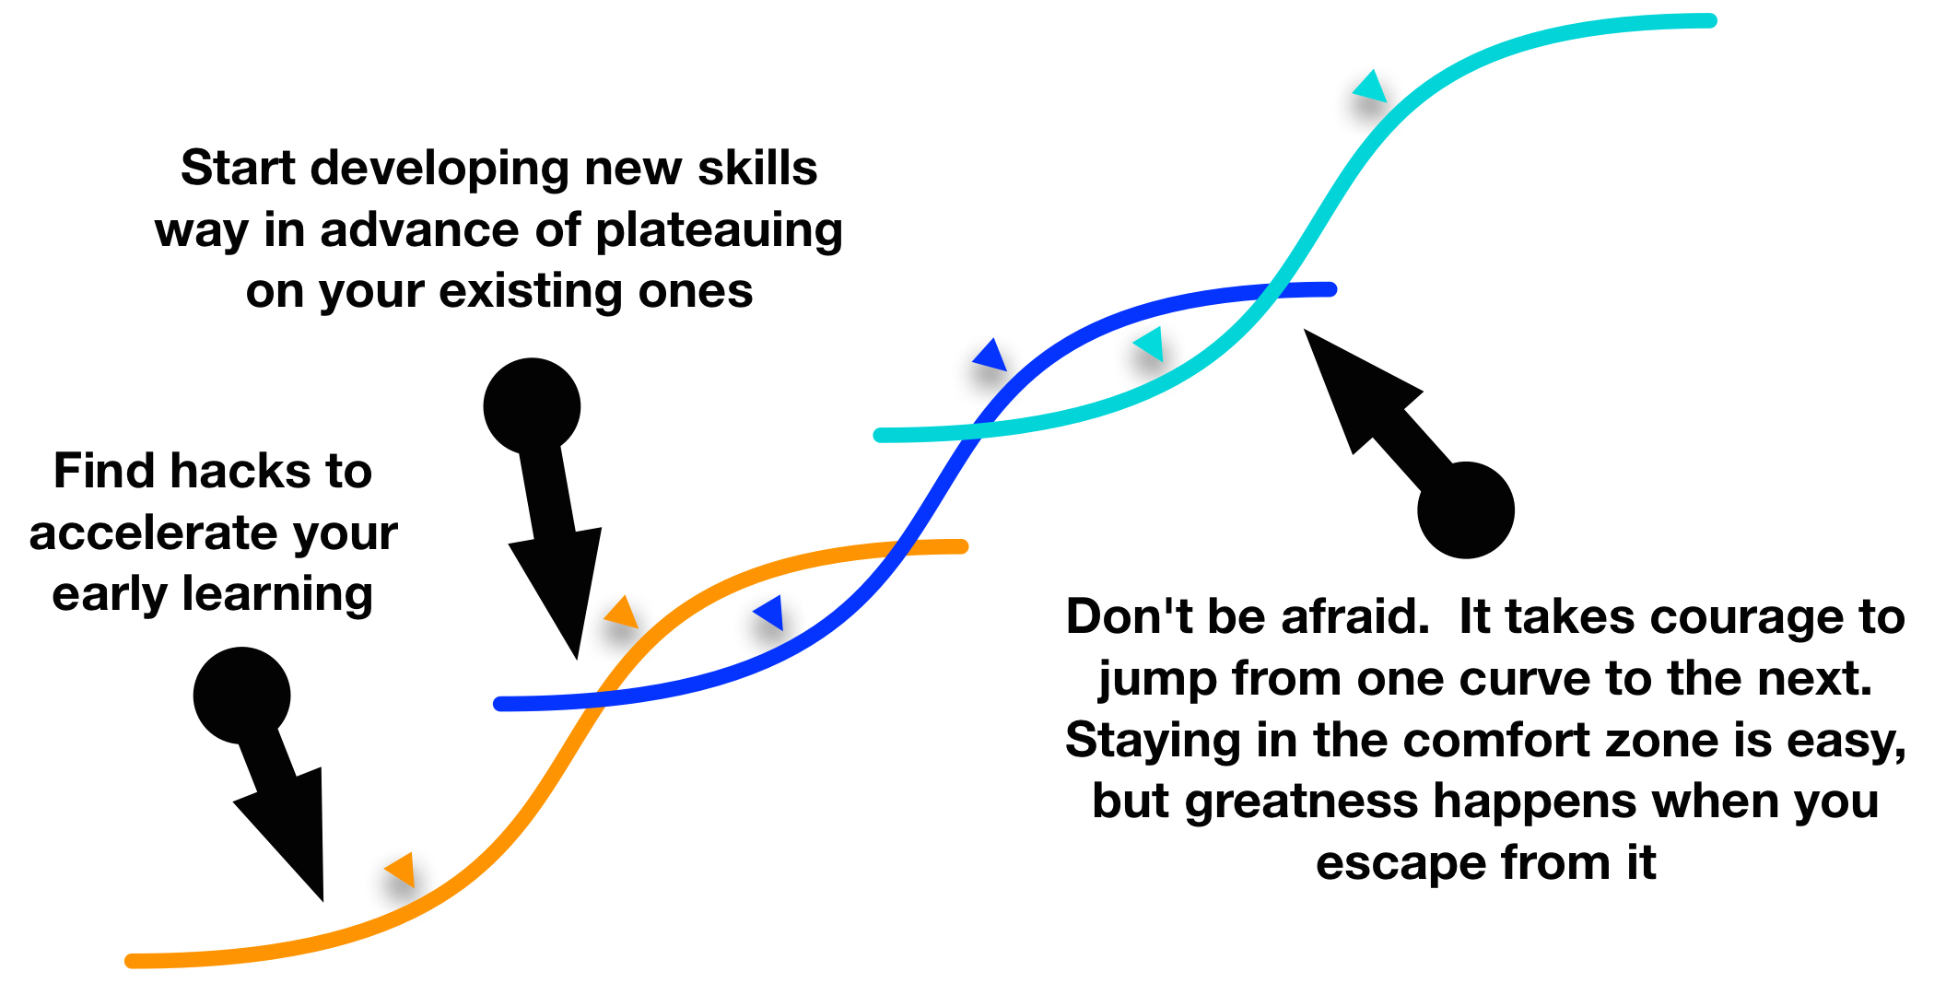
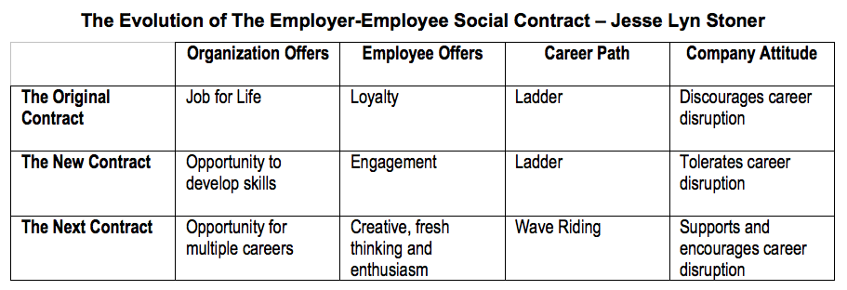
What is the new Benefit? An Example
Employees are expecting new results from workplace learning
http://seapointcenter.com/support-career-disruption/

Slide 19
The New Model of Work and Learning
Sharing - create linked documents, data, and objects within a distributed network
Contributing - employ social networking applications of the Web to facilitate group communication
Co-creating - work through networks that facilitate cooperative group work toward common goals
William H. Dutton, https://www.researchgate.net/publication/24086062_The_Wisdom_of_Collaborative_Network_Organizations_Capturing_the_Value_of_Networked_Individuals

Slide 20
Some of the more promising trends…
Open online learning
Learning analytics
Personalized learning
Competencies
Digital badges
Blockchain security
Virtual personal assistants
Internet of things
Virtual Reality
Games and Gamification

Slide 21
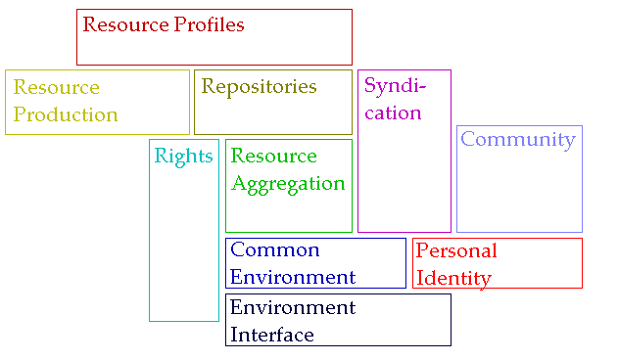
The Personal Learning Architecture
Don’t do things to people, help people do things
If we have to ask “how do we motivate people” then we’re taking the wrong approach
Provide opportunities for autonomy, mastery, purpose – Pink

Slide 22
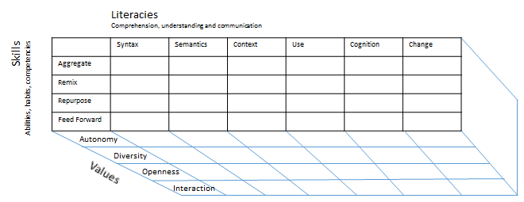
Method as Discovery:
To discover something is to be immersed in it, to speak it and listen to people speaking in it
To immerse oneself in the world is to try listening and to try speaking

Slide 23
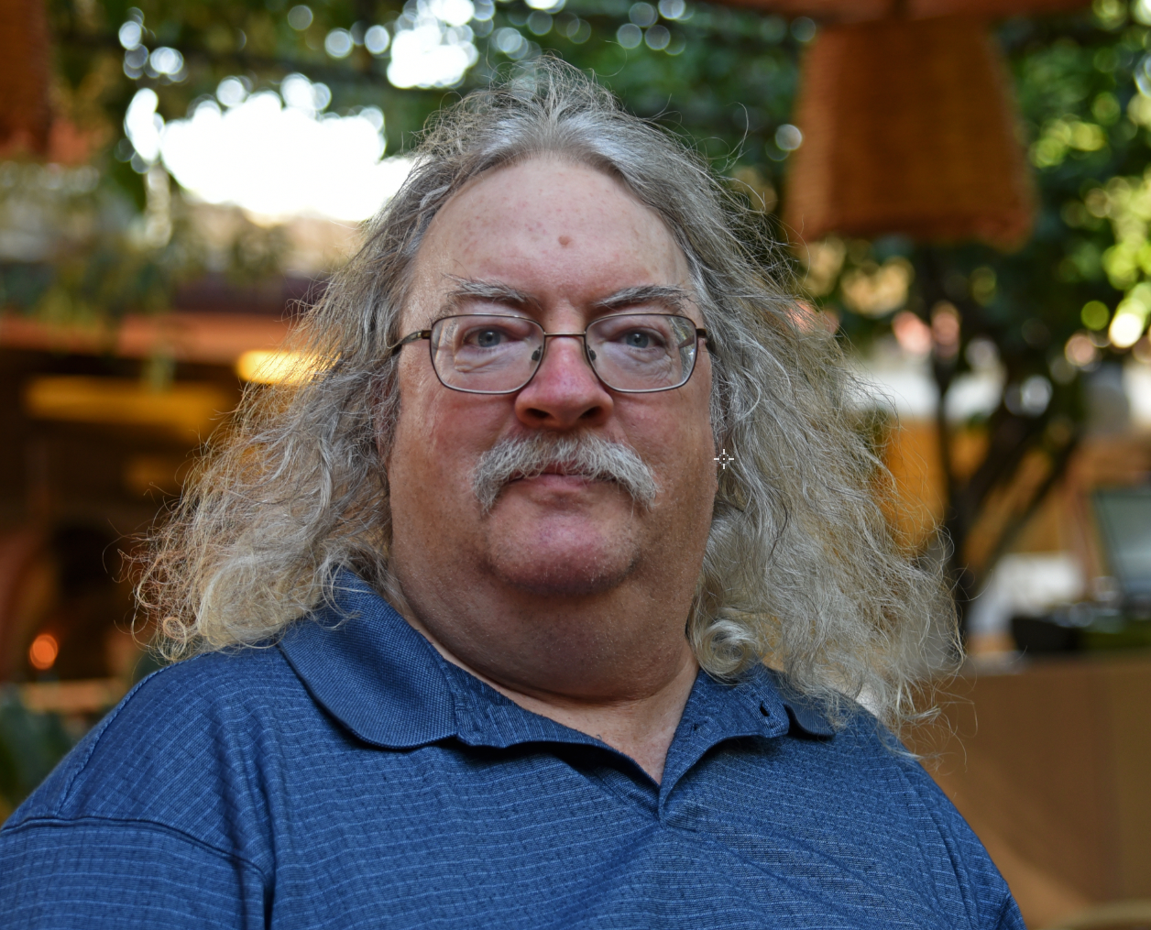
Stephen Downes http://www.downes.ca

