Slide 1
Current State of Learning Technologies
National Research Council Canada
Conseil national de recherches Canada

Slide 2
Objectives of the Session
The purpose of the project as a whole is to map the state of the art at CSPS with that of the field as a whole
The long term outcome will be suggestions for a description and roadmap for future modernization of CSPS offerings

Slide 3
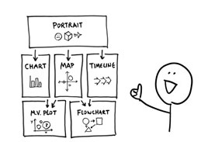
Outline
Mobile Learning
Personalized Learning
Shared Learning Space / Crowd-Sourcing
Virtual Library
Integration with Social and Collaboration Platforms
For each:
25 minutes of presentation
20 minutes of discussion
Short break

Slide 4
Methodology
Academic literature search in relevant areas
Trade literature and product identification
Hands-on experience with many of the technologies
LPSS projects with deep dive in some subject areas

Slide 5
Part One: Mobile Learning

Slide 6
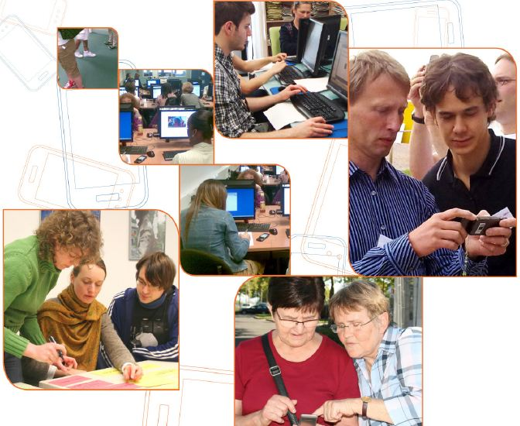
1.1 What is Mobile Learning?
The mobility of the device - includes learning enabled with mobile phones, tablets, laptops, and other devices
The mobility of the learner - includes the “embeddedness of the learner in the real environment or in context”
The mobility of the information - includes the concepts of just-in-time learning and performance support

Slide 7
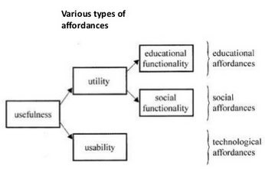
What does mobile make you think of…?
personal, spontaneous, opportunistic
informal, pervasive, situated
private, context-aware
bite-sized, and portable
Jari Laru

Slide 8
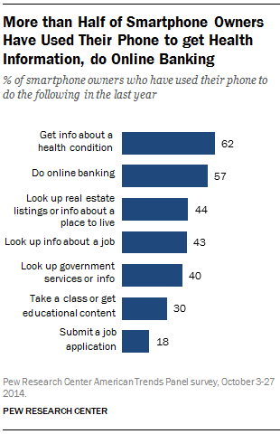
Adoption of Mobile Learning
30% or more of smartphone owners used their device to access a class (Pew)
74% of learners used mobile devices for eLearning (Ambient)
Mobile learning is one of the top three learning priorities for companies in the coming year
But companies are lagging; 30 percent have limited mobile learning while 25% have none at all (Brandon Hall)

Slide 9
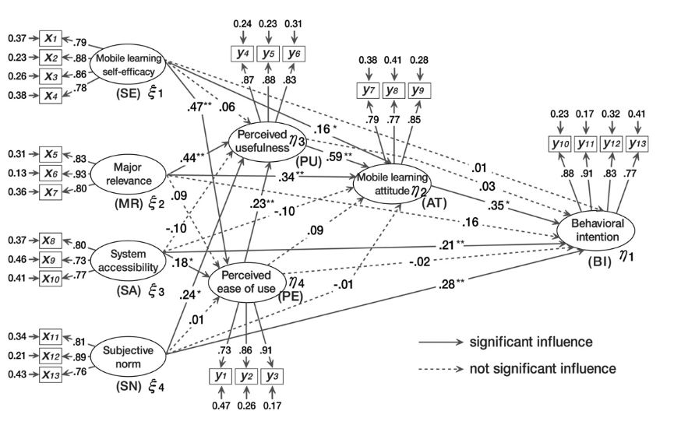
What factors are relevant to technology acceptance of mobile learning?
Park, Nam and Cha

Slide 10
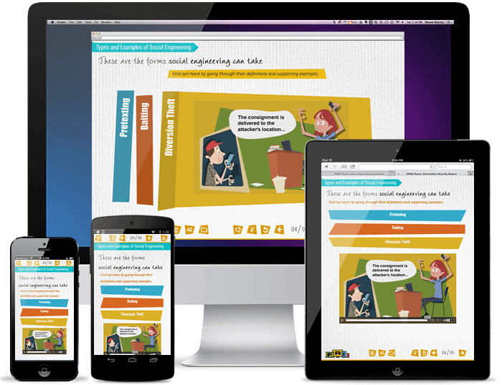
Mobile Learning Policy Framework
Rationale
Roadmap
Partnerships
Access and Security
Devices
Pedagogy
Resources
Assessment
Administration

Slide 11
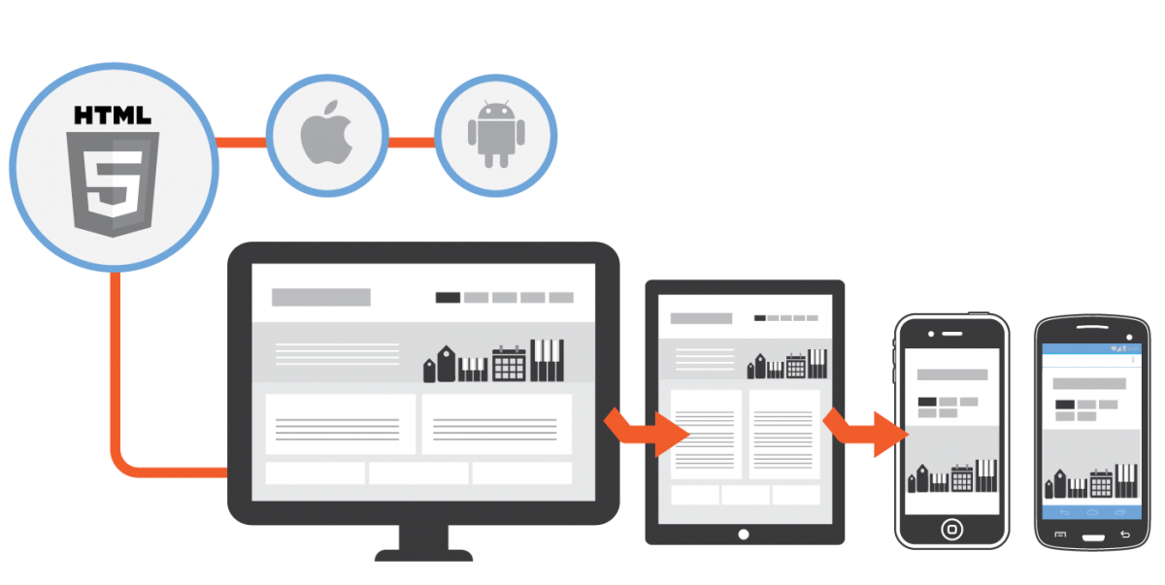
Mobile Development and Delivery Standards
Delivery:
IEEE 802.11 (wifi)
3G, 4G, LTE (mobile)
Development:
iOS (Apple)
Android (Google)
Windows (Microsoft)
Web / HTML5

Slide 12
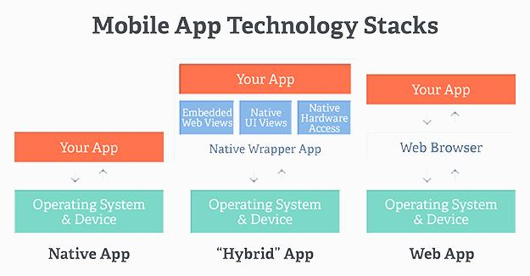
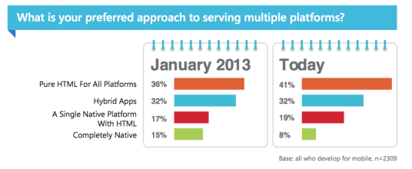

Slide 13
Mobile Device Management
WindowsIT Pro
BYOD - Bring Your Own Device
COPE (CYOD) - Corporate Owned Personally Enabled
DBYOD - Don’t Bring Your Own Device

Slide 14
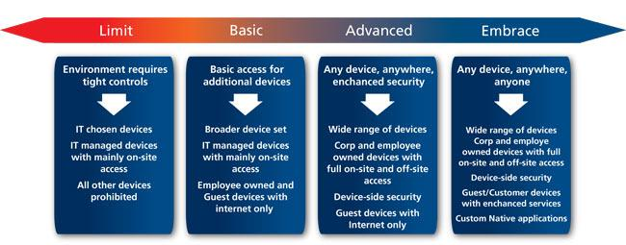
BYOD policies will vary across departments and institutes
Mobile learning policies will need to anticipate and adapt to a wide range of devices and associated policies
Global Knowledge

Slide 15
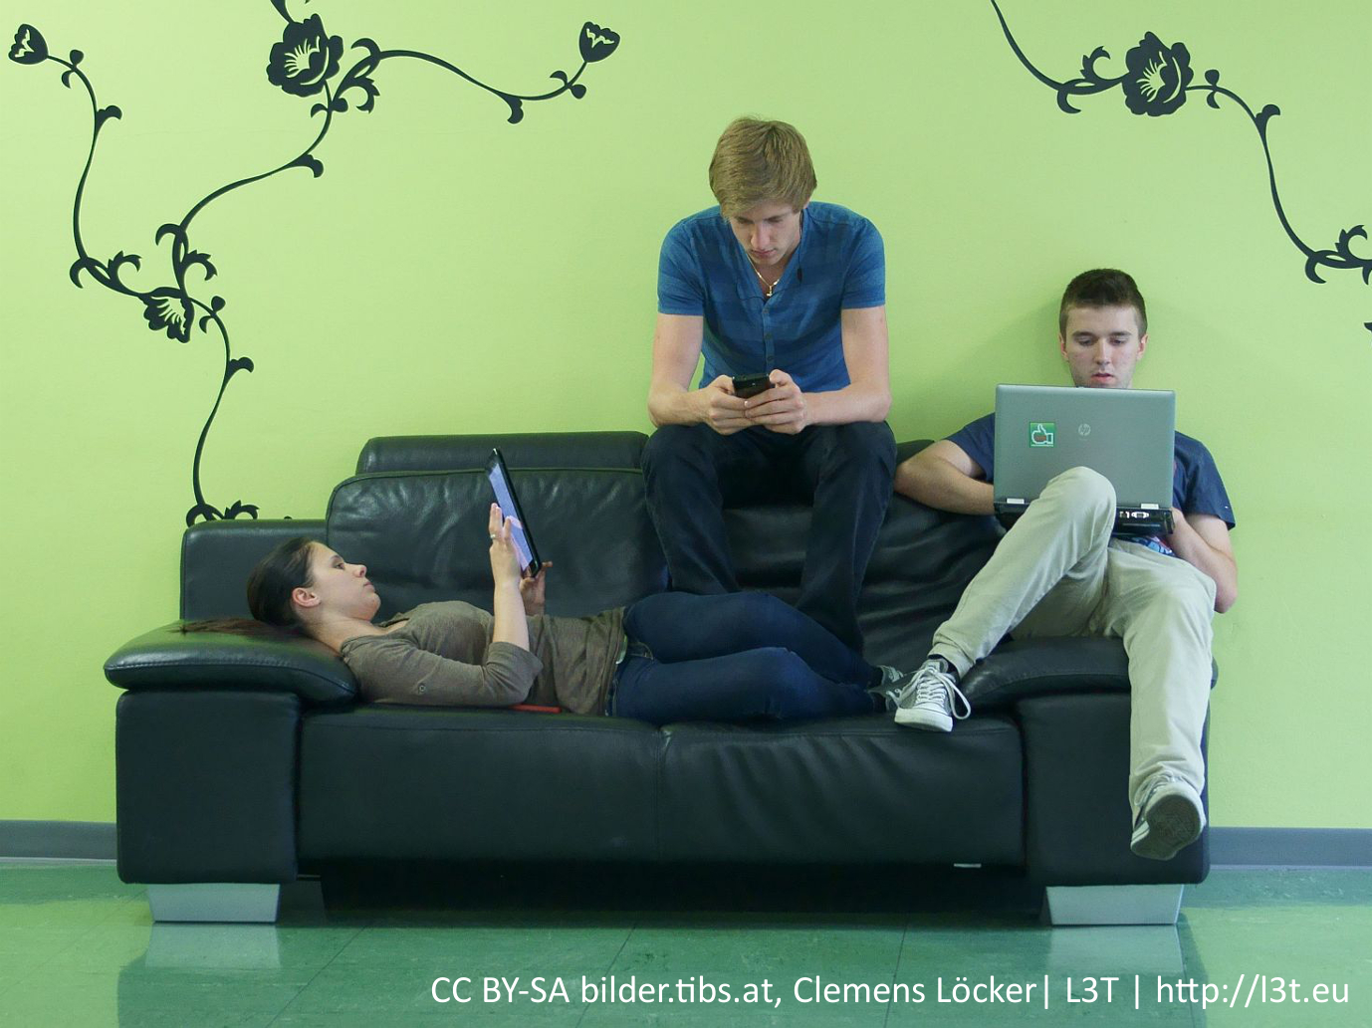
Learning With Mobile Technology
Students cannot be assumed to have mobile-learning skills based on their experience with other forms of learning.

Slide 16
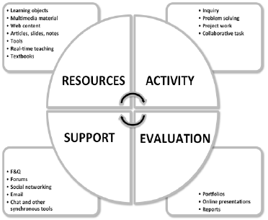
Planning learning experiences
Using personal mobile devices professionally and safely
Initiating dialogue
Establishing networking activities
Creating learning activities on the go
Deepening reflection
Considering issues of time and place
Churchill, Fox & King, 2013
Mobile Learning Framework

Slide 17
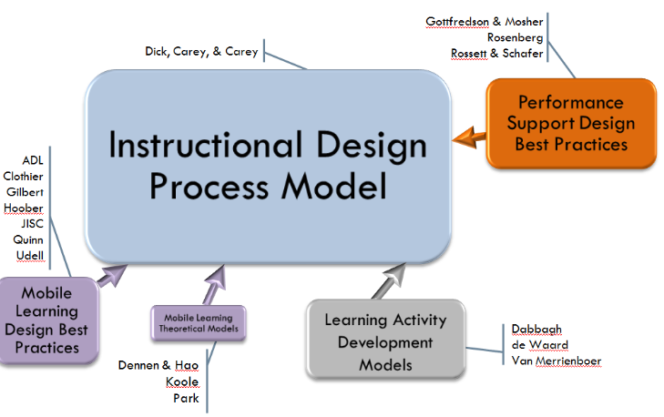
Content Authoring for Mobile
Mobile Learning Resource Authoring Systems Adobe Captivate Articulate Storyline 360 Composica Elucidat iSpring Suite Lectora Inspire / Online Microsoft (LCDS) Raptivity Xerte - Apereo Foundation
Berking & Haag, 2015

Slide 18
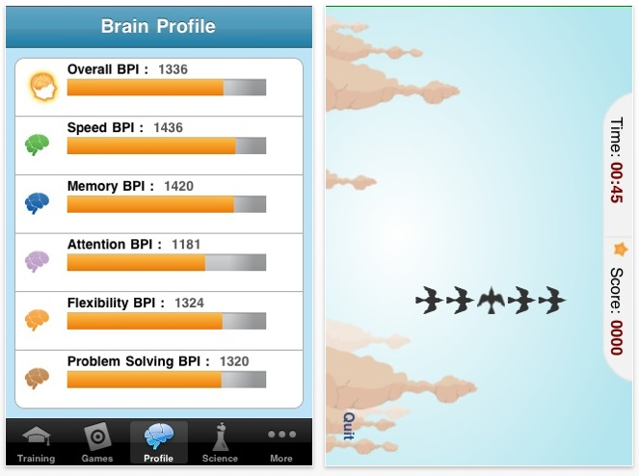
Criticisms and Failures
Need to verify learning effect
Questionable claims by vendors
Need learner-generated content
Need to structure student experiences
Lumosity, 2010

Slide 19
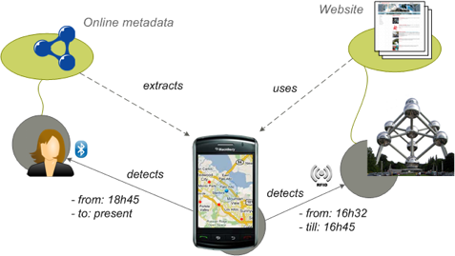
Future of Mobile Learning
Development of context-based applications
Embedding of mobile technology in applications
WISE Research group, 2017

Slide 20
Research Questions
What elements defined mobile learning for CSPS?
What data is there on mobile device employment in the Canadian public service
Are mobile policy frameworks in place, or, what would the process be for developing one?
Has CSPS adopted mobile delivery standards? Are others extance in the Canadian public service?
Do the resources exist for device provision, or can accommodations be made for BYOD (Bring Your Own Device)?
What pedagogical principles inform CSPS, and are they consistent with mobile delivery?
Does CSPS have the capacity and tools to author for mobile (eg., for Apps? for HTML5)?
Do existing CSPS assessment and quality control standards map to mobile learning?
Does CSPS have the capacity to adapt to future technologies, such as embedded software or context-aware devices?

Slide 21
Part Two: Personalized Learning
Gates Foundation

Slide 22
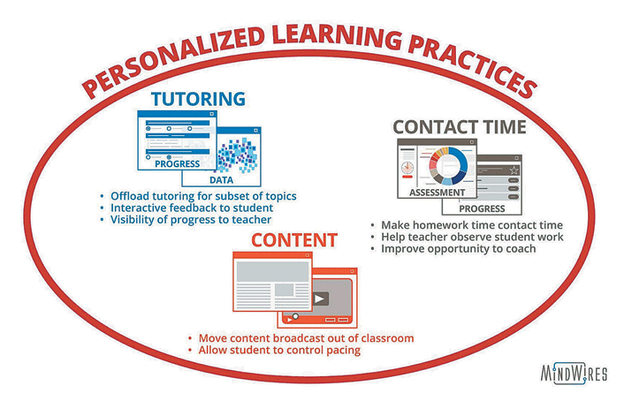
What is Personalized Learning?
Practices:
Moving content broadcast out of the classroom
Turning homework time into contact time
Providing tutoring
“…a delicate balance between student autonomy and instructor-led direction and scaffolding…”
Feldstein & Hill (2016)

Slide 23
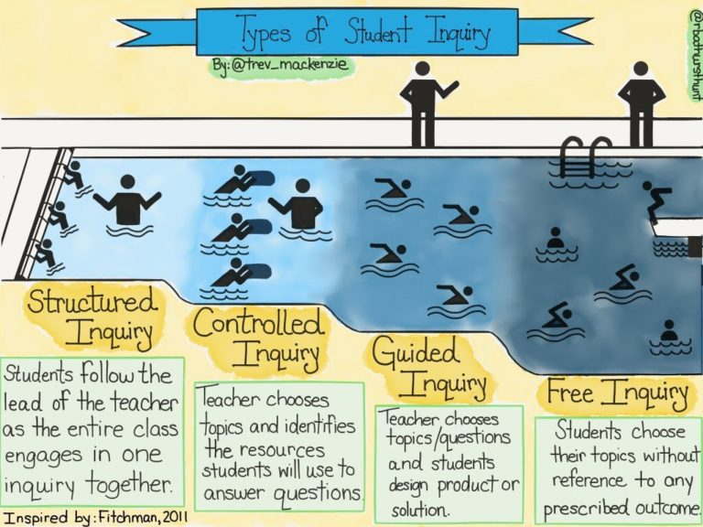
A range of approaches (after Dana Fichtman, Thomas & Boynton, 2011, Inquiry: a districtwide approach to staff and student learning)

Slide 24
Innovation and Investment Drivers
more frequent employee check-ins
better employee/manager communications
increased peer-to-peer feedback and engagement
addition of more social and informal feedback support
improved goal visibility
PERFORMANCE
TOOLS
new tools for coaching and mentoring, for social and video-based learning
new platforms that support the capture and sharing of recognition moments and/or foster wellness

Slide 25
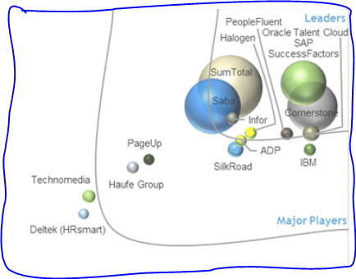
Competencies and Talent Management
Composed of four or more of the following applications:
Workforce Planning
Recruiting and Onboarding
Performance and Goal Management
Learning Management
Career and Succession Planning
Compensation Management

Slide 26
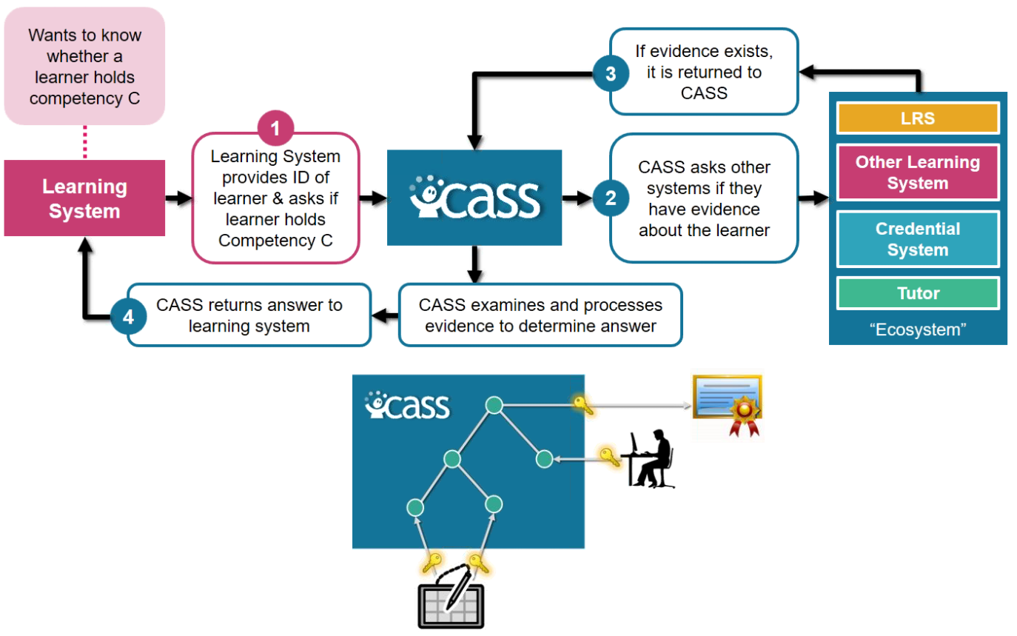
CASS: Competencies and Skills Systems
ADL, 2016

Slide 27
Competency Frameworks
Australian qualifications framework General capabilities in the Australian Curriculum Australian curriculum NRC Competency Profiles OECD Core Competency Framework - (Also) European Competency Framework IEEE Software Engineering Competency Model - Presentation IBM Kenexa Competency Frameworks ONet Online & CareerOneStop Competency Model Clearinghouse CareerOneStop pyramid model National Occupational Classification 2011 the authoritative resource on occupational information in Canada Mission essential competencies. Air force- Marine operations TRADEM-SEM - - validate domain and expert models Association of American Colleges & Universities - Value Rubrics

Slide 28
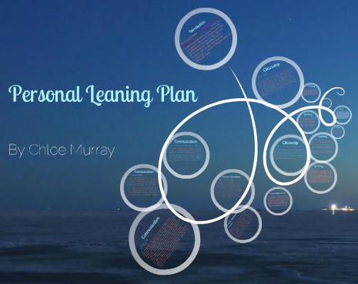
Personal Learning Plan & Learning Path
Illuminate Education - data-based learning path
FilterED Global Filter - specializes in rapid personal path creation
MiCLUES - creates personal learning paths through museums and exhibits
ItsLearning - learning platform
Apereo OpenSSP - student success plan
Chloe

Slide 29
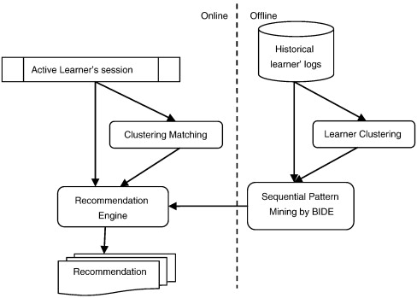
Resource Recommendation
Collaborative filtering
Human cognitive modeling
Content analysis
Self-assessment
Sensor & data analysis
Salehi, 2013

Slide 30
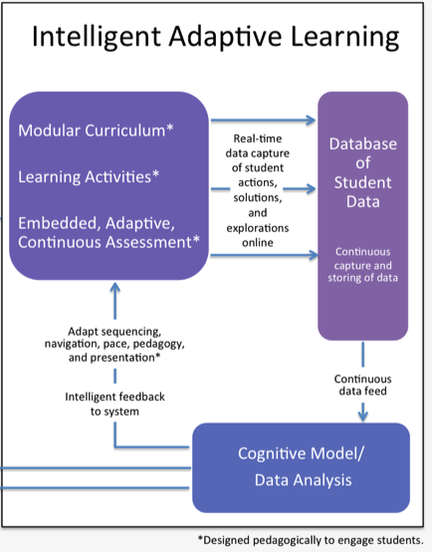
Adaptive Learning
- Prodigy - math game that adjusts questions (Prodigy Blog, 2016)
- ClassK12 - prepare for standardized tests such as SBAC, PARCC
- McGraw-Hill - has included products like ALEKS and Connect
- Knewton - adaptive learning path platform
- Brightspace LeAP - spots difficulties and recommends resources
- Dreambox - presentation of materials based on student input
- LoudCloud - collaborative open content recommendation
- RealizeIt - mastery-based personal learning path
- Fulcrum - competency-based premium content

Slide 31
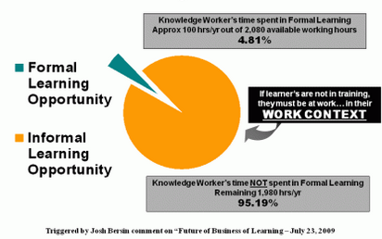
Informal Learning
Jarche, 2012

Slide 32
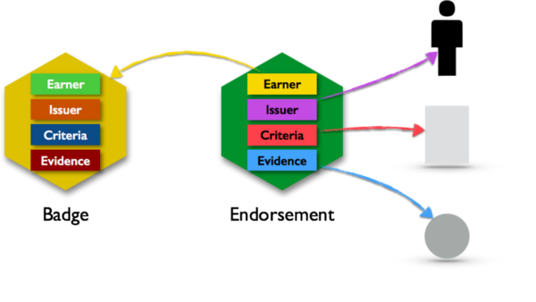
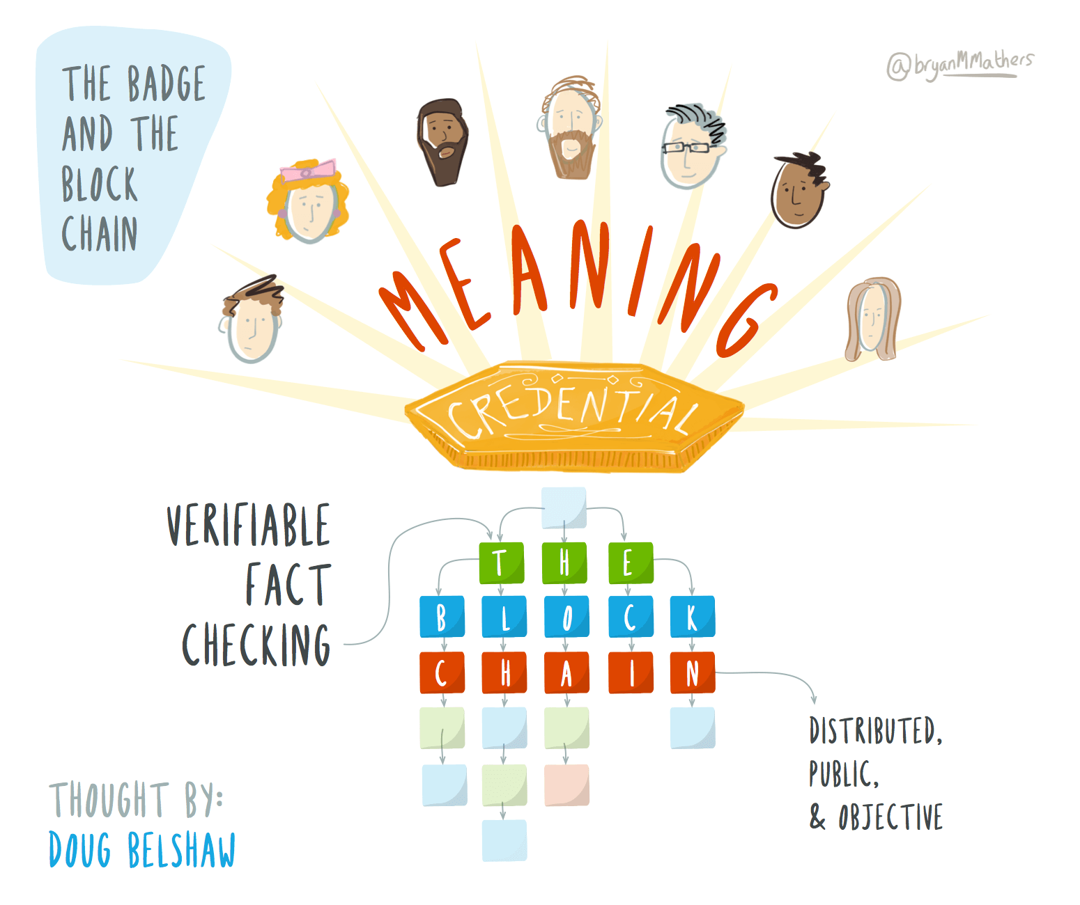
Credentials and Badges
Open Badges are the substratum from which ePortfolios grow organically, like a beehive out of the activity of the bees — bee-badges for hive-portfolios!
Ravet, 2016
Mathers, 2016

Slide 33
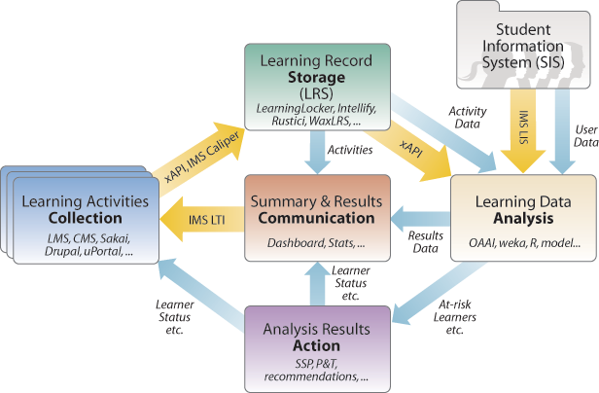
Personal Learning Records
Gilbert, 2015

Slide 34
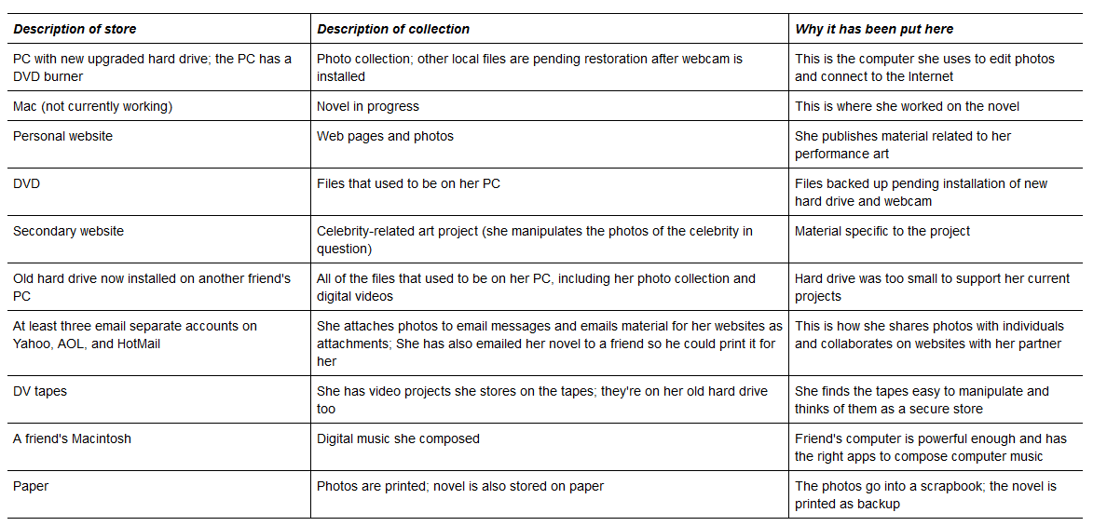
Personal Digital Archiving
Marshall, 2008

Slide 35
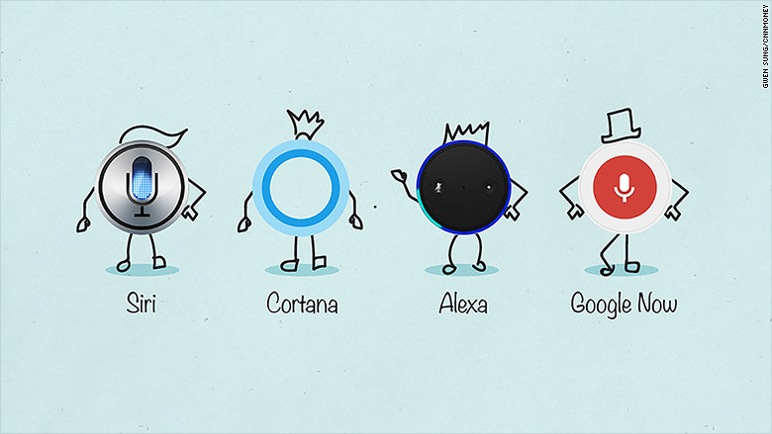
PLE and Personal Assistant
CNN, 2015

Slide 36
Research Questions
how does CSPS define personalized learning, or is there a working definition in place?
what existing tools does CSPS employ for performance management, and learning and development?
has CSPS adopted a talent management framework or management system?
what definitions or management frameworks (if any) for competencies does CSPS employ?
are CSPS talent and competency management systems linked to external services, such as job or placement-finding sites?
can CSPS support and manage personal learning plans or learning paths? Automated?
what approach to and/or technology does CSPS support for content & learning recommendations?
What support does CSPS currently provide to support informal learning?
does CSPS support personal learning records, and to what granularity (eg., do they store activity records? personal portfolios?)
does CSPS provide upload or storage for personal profiles or personal data archiving?
are there automated mechanisms in place for profile creation and assessment?

Slide 37
Shared Learning Space / Crowd-Sourcing
FT - Owen Humphreys/PA Wire

Slide 38
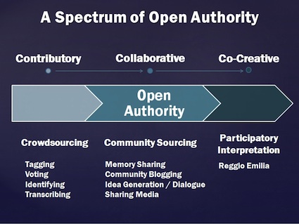
What is Shared and Crowdsourced Learning?
Open learning
Shared environments
Social networks
Co-production
Phillips, 2014

Slide 39
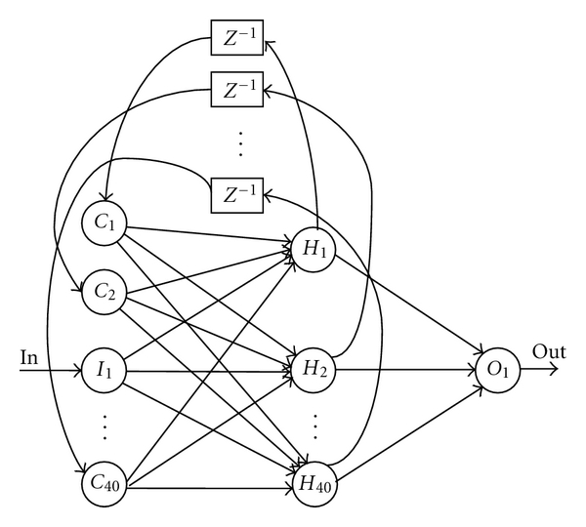
The Wisdom of Crowds

Slide 40
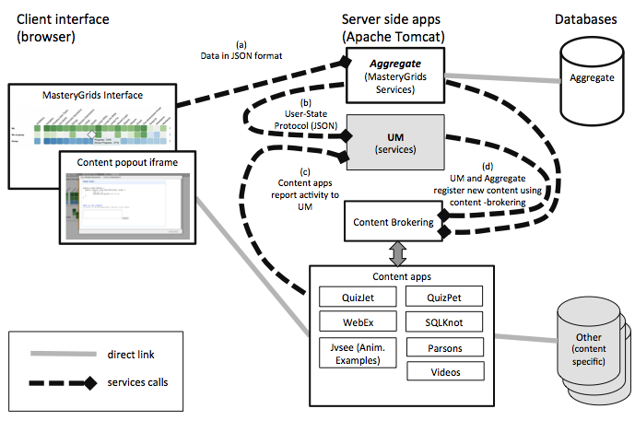
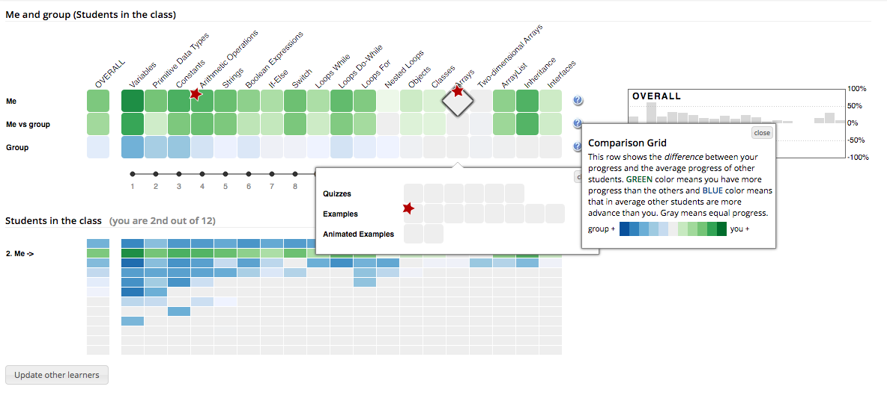
Models
ADL, 2016
Seek Sense Share framework - (Jarche, 2014)
ADL Open Social Learner Model (OSLM) - (ADL, 2015)
IEEE Resource Aggregation Model for Learning, Education and Training (RAMLET) - (Verber, et.al., 2016)
ARRFF - Aggregate, Remix, Repurpose, Feed Forward (Downes, 2016)

Slide 41
Environments
Various contribution-based open course libraries (via MOOCLab) Coursmos -micro-learning platform Eliademy - free & paid online courses with real-time discussions and task management iTunes U - free educational app with audio and video resources from top universities Open Education powered by Blackboard - Free online courses from Blackboard's global community of clients OpenLearning create, run and enrol in a course. Udemy create and run online courses. YouTube Edu - video-based courses
Open learning, eg., Apereo Open Academic Environment
Cloud Technologies, eg. IBM Kenexa, Oracle Taleo
Virtual Classrooms, eg. Connect, Collaborate, Cisco (Spark, WebX)
Social networks for learning, eg. Elgg
MOOCs, eg. gRSShopper, Udemy

Slide 42
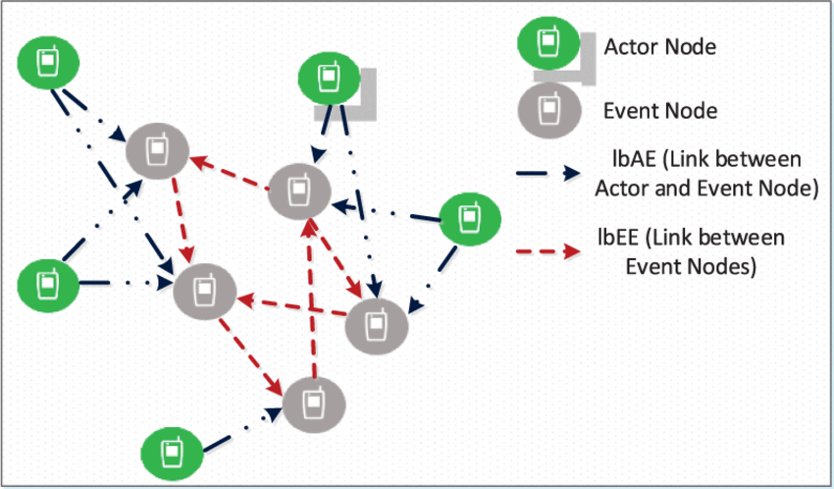
Social Network Formation and Management
A significant area of research exists in the area of automated social network creation and management. There are two major approaches to automated social network formation: collaborative filtering, and privacy preserving.

Slide 43
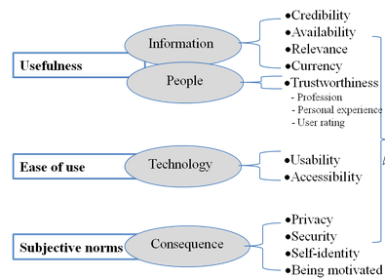
Applications of Crowd-Sourcing
Crowdsourcing for publicengagement
Social bookmarking and search
Social learning, properly so-called
Project teaming and collaborative learning
Social media for research dissemination
Supporting shared spaces
Scientific research
Zhang, 2013

Slide 44
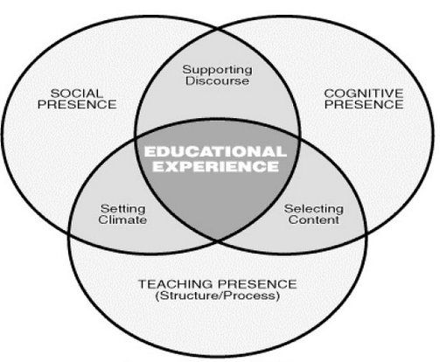
Social Presence

Slide 45
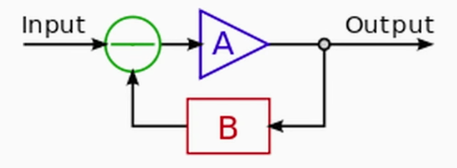
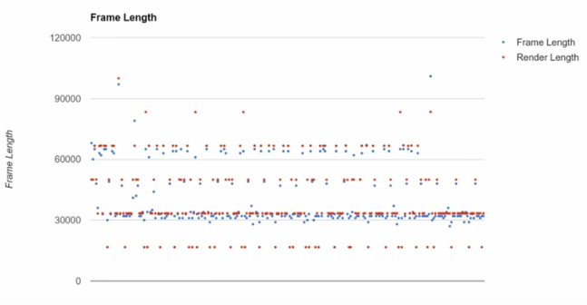
Technology standards for collaboration in learning
Things like….
Open CODECs
Signal envryption
Echo cancellation
Screen sharing
Video smoothness
WebRTC, 2016

Slide 46
Privacy and Security Issues

Slide 47
Research Questions
What principles underlie the CSPS understanding of crowd-sourcing? Open, shared, social and crowdsourced?
If there familiarity with crowd-sourcing models (eg. Open Social Learner Model), or endorsements of any?
What open, shared, social and crowdsourced learning environments are currently supported?
Are there tools and/or support for automated social network formation and management?
What applications of crowd-sourcing are envisioned? (eg. public engagement, problem solving, knowledge bank)
Does CSPS employ teaming environments (Jira, Slack, Git, Trello) and/or offer support for these?
What provisions are there for authorship, sharing, annotation and ratings within the CSPS social environment?
What role does social presence and/or social presence theory play in CSPS pedagogical approaches?
Does CSPS support common messaging, communications, or other networking protocols?
What security and privacy constraints apply to CSPS and other GoC environments? Bilingualism?

Slide 48
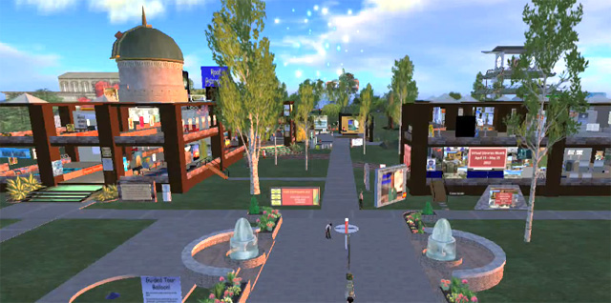
Virtual Library
Second Life

Slide 49
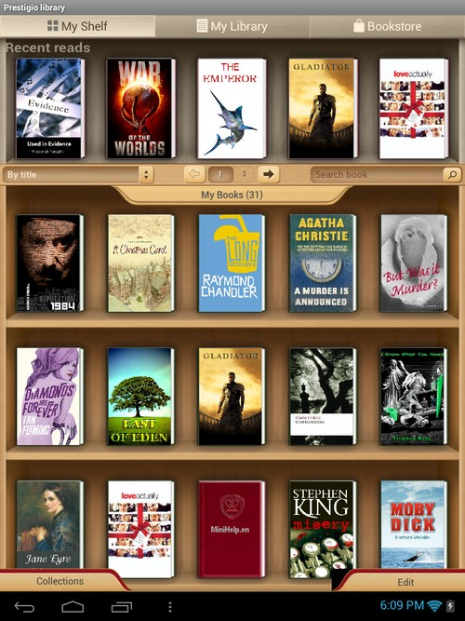
What is a Virtual Library?
Acquisitions & Deposits - eg. GoC Depository Services
Recommendations and surveys - eg. Hill Noters
Browse categories - eg. McGill’s Ecological Agricultural
Search - eg., IEEE Xplore at Athabasca University
Classifications - eg. WWW Virtual Library - http://vlib.org/
Inquiry - eg. Library of Congress Ask a Librarian
Tools - eg., Public Health Ontario MediQAT critical appraisal tool
Read / View - eg. the British Library’s Turning The Pages

Slide 50
Some Canadian Examples
Canada Revenue Agency - virtual reading room Open Government VL component - 2012 Canadian Armed Forces virtual library - Department of fisheries and Oceans Virtual Library and WAVES access point Judicial Affairs - virtual library National Research Council nPARC - staff publications CODES / GUIDES Virtual store Library and Archives Canada (LAC) Library and Archives Canada Action plan on open government - Virtual Gramophone - Canadian Historical Sound Recordings
Federal Science Library (FSL) portal Agriculture and Agri-Food Canada (AAFC) Environment and Climate Change Canada (ECCC) Fisheries and Oceans Canada (DFO) Health Canada (HC) / Public Health Agency of Canada (PHAC) National Research Council Canada (NRC) Natural Resources Canada (NRCan) Health Canada (HC) / Public Health Agency of Canada (PHAC) Vital Statistics - births, marriages and deaths

Slide 51
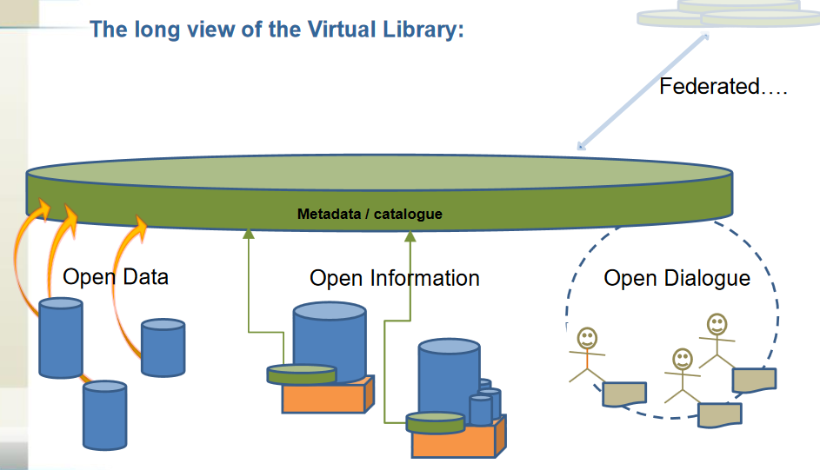
Open Government
Open data and open information
Use of open data on GoC websites
Inventories of data and information
Removal of access restrictions
TBS, 2009

Slide 52
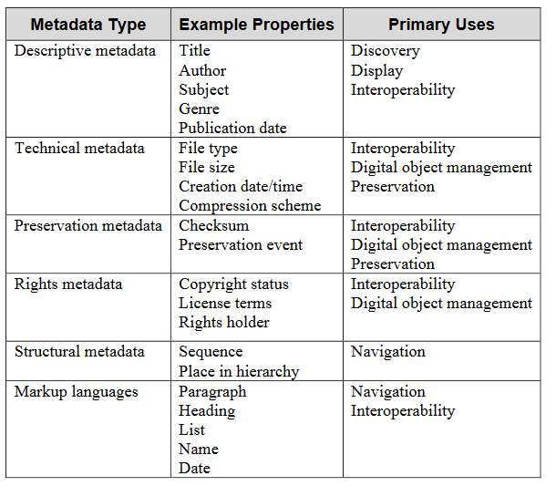
Standards and Metadata
Government of Canada Core Subject Thesaurus
Library and Archives Canada Controlled Vocabularies
The Depository Services Program (DSP)
About ISBNs
About Government of Canada Catalogue Numbers
ISSNs
Cataloguing in Publication (CIP)

Slide 53
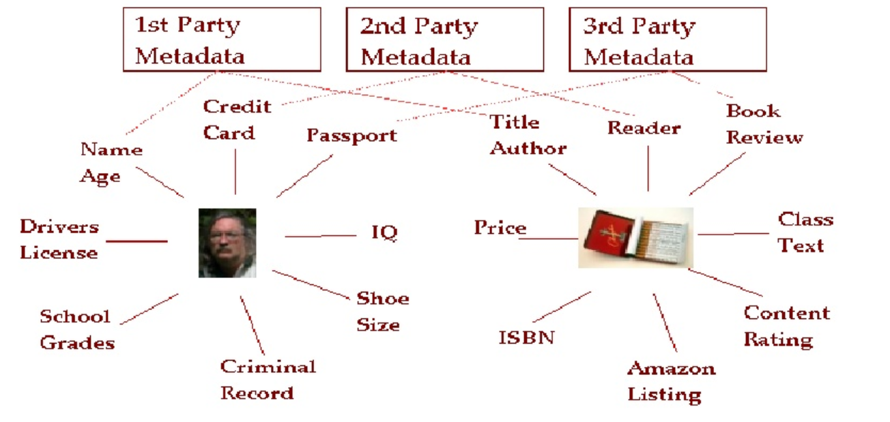
Resource Profiles
Downes, 2006

Slide 54
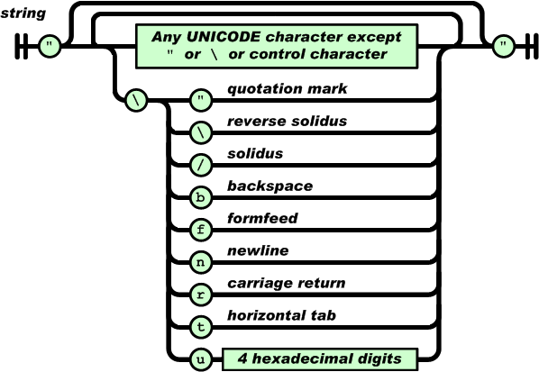
Metadata Representation / Serialization
Plain text (eg., VCard)
Databases (relational databases (MSSQL, MySQL, PostGre), non-relational database (Mongo), graph databases (Neo4J)
XML
Linked Data and Resource Description Format (RDF)
Javascript Object Notation (JSON)
JSON

Slide 55
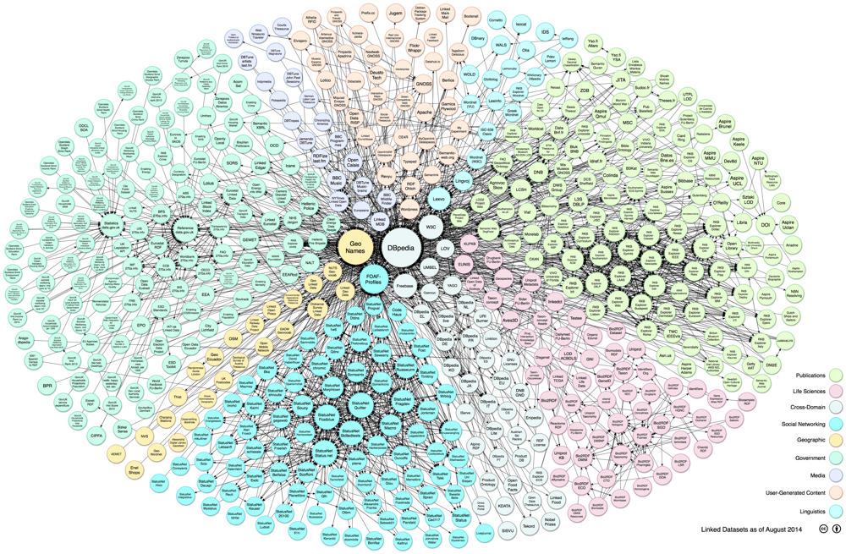
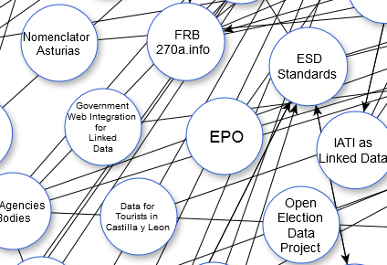
Web of Linked Data
LOD Cloud, 2014

Slide 56
Metadata and Resource Aggregation
Spiders and crawlers / scrapers
RSS / AtomPub
Open Archives Initiative / DSpace
Application Programming Interfaces (APIs)
Integration Systems (eg., IFTTT, Zapier)
IFTTT Channels, 2017

Slide 57
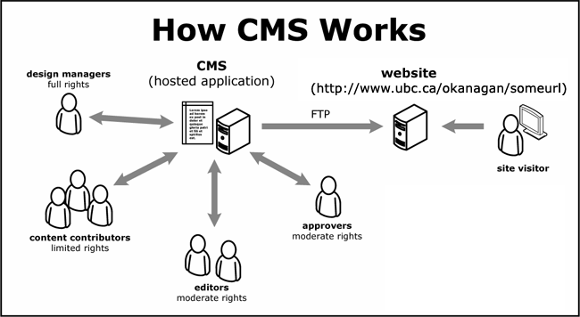
Content and Information Management
CMSs, such as OpenText, Lexmark
eBooks and Textbooks / Open eBooks
Databases – Proquest, JSTOR, etc etc
Course Libraries
GCcampus tools (Moodle, Drupal, Saba)
EPSS – Electronic Performance Support
Media servers, such as Plex, Kaltura, Kodi
App Marketplaces and Servers
Brainsins, 2017

Slide 58
Virtual Library Platforms
ACM - Association for Computing Machinery - proprietary system that is wholly developed, hosted, and maintained by ACM - open source (?)
EPrints - open source software used to manage the EPrints publication library
Fedora - modular open source repository platform
Library for All - cloud-based low-bandwidth virtual library system
Greenstone - can publish on DVD or USB stick
MyCoRe - open source framework for management of digital content
Public Knowledge Project - Open Journal Systems
Omeka - designed for scholars, museums and libraries

Slide 59
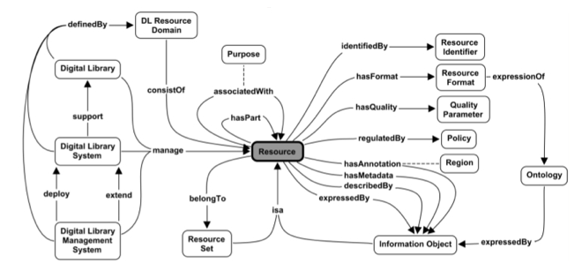
Assessments and Quality Control
Gazan, 2008
Social annotations in a virtual library

Slide 60
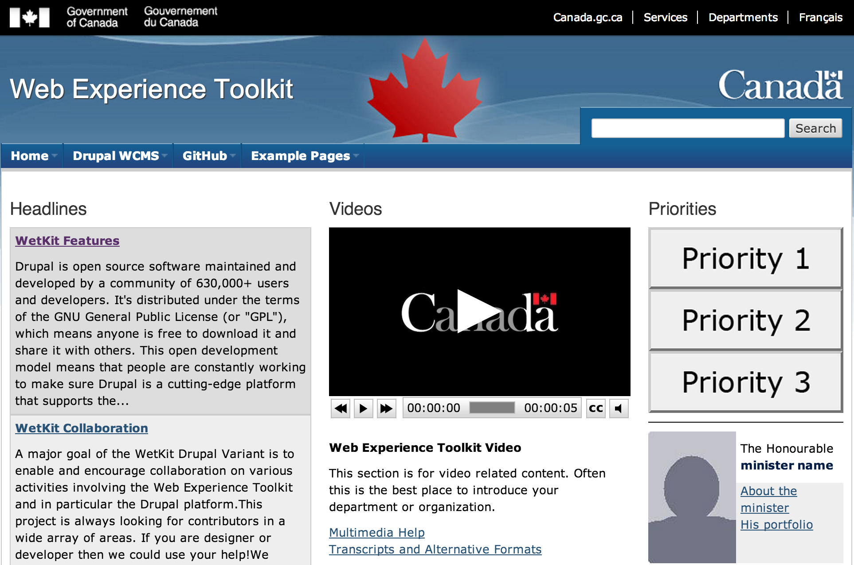
Rights / Language / Accessibility

Slide 61
Research Questions
How does CSPS define a virtual library, and what major functions does it envision a VL supporting?
To what degree does CSPS leverage and/or is integrated with existing VLs in the GoC
Would CSPS consider a VL to be part of Canada's wider Open Government initiative?
What linkages does CSPS have to the GoC and wider library community?
Has CSPS adopted internal resource metadata standards and/or tools for implementing those?
Can other CSPS tools read, recognize and employ VL metadata records?
What is CSPS's information and/or content management environment?
Does CSPS employ or provide access to publication databases? If so, which?
Does CSPS employ and/or provide access to internal and external course libraries?
To what degree does CSPS employ open educational resources, and is there a policy regarding them?
Does CSPS currently participate in shared library services?
What mechanism, tools and/or standards does CSPS provide for material assessment and quality control?
How does CSPS manage Rights / Language / Accessibility

Slide 62
Integration with Social and Collaboration Platforms

Slide 63
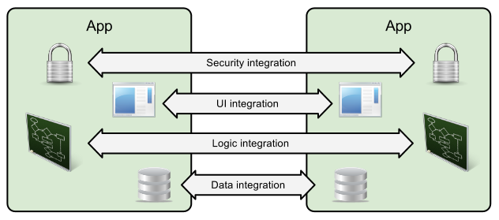
What Does Integration Mean?
Full integration into a single management system
Platform-based integration, with external services
Custom integration with specialized bus
Cloud-based integration with services and APIs
Loose integration with services, APIs and middleware
Salesforce

Slide 64
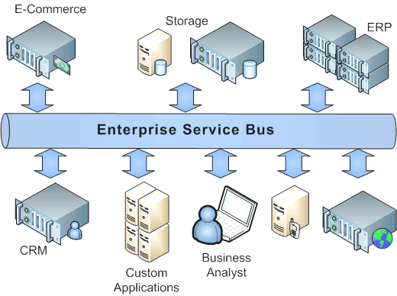
Inbound and outbound messaging
SOAP APIs and toolkits, such as the Mobile SDK, AJAX Toolkit, Java, .NET, PHP and Adobe Flex integrations
HTTP and REST integration using Application Programming Interfaces (APIs)
Data aggregation and syndication using RSS, JSON, Open Archives Initiative (OAI)
Authentication and identity federation
Centeractive

Slide 65
GoC Platforms – what’s out there
BuyAndSell - single source for government contracting, sales and services - https://buyandsell.gc.ca/
GCCampus - the Canada School of Public Service online learning platform, front-ended with Drupal and incorporating Saba, Kaltura, and other back-end services - https://learn-apprendre.csps-efpc.gc.ca/
GCPedia - Wikipedia-like repository of information and resources, accessible to members of the public service - http://www.gcpedia.gc.ca
GCConnex - Elgg-based social networking service for members of the public service - https://gcconnex.gc.ca/splash/

Slide 66
GCCollab - Newly launched Elgg-based social networkings service for members of the federal public service, provincial public service, and college and university members - https://gccollab.ca/newsfeed/
GCTools also include GCintranet and GCdirectory
National Science Library - as described in the ‘Virtual Libraries’ section above, a single interface to virtual libraries hosted by six of Canada’s science-based departments - http://fsl-bsf.scitech.gc.ca/eng/intranet/home/
GoC webex - common conferencing system used by many government of Canada staff and departments - https://pwgsc-nh.webex.com
Open government portal - access to data sets, dialogue on open government, and information requests - http://open.canada.ca/en
Job Bank - www.jobbank.gc.ca

Slide 67
Integration Drivers
Engages staff and partners
Enhances service delivery
Makes smart use of new technologies
Creates a high-performing workforce
Blueprint 2020
Canada’s Draft Plan on Open Government (2016-2018) (GoC, 2016) initiative also envisions linking services and opening access to the public, as evidenced by the 2016-2018 roadmap

Slide 68
Employment and Occupations
TBS, 2017

Slide 69
Authentication and Single-Signon
Group Managed Service Accounts (gMSAs) - eg., University of Washington
EduRoam - worldwide academic login developed by the GÉANT network in Europe
Open Researcher and Contributor ID (ORCID)
Shibboleth - open source identity federation system
Trulioo - for APIs and applications
OpenID-like authentication
Security Assertion Markup Language (SAML)

Slide 70
Distributed Platforms and Cloud Computing
ISO/IEC JTC 001/SC 38 "Cloud Computing and Distributed Platforms" manages standards related to:
Service Oriented Architecture (SOA)
Service Level Agreement
Interoperability and Portability
Data and their Flow Across Devices and Cloud Services

Slide 71
Wolfram Alpha

Slide 72
Environments: VMWare Fusion, VirtualBox
Provisioners: Docker, Vagrant
Providers: AWS, MS Server
Services: MS Cognitive, Wolfram Alpha, Segment

Slide 73
Some Applications
Distributed social networking
Expert search
Second screen
Cloud-based Simulation
Corona Aerospace

Slide 74
Research Questions
What constitutes 'other platforms' for the purposes of this project?
What does 'integration' mean?
What knowledge of other platforms within GoC does CSPS have?
Does CSPS environ and/or support linkages with employment and occupational platforms?
How does CSPS support identification and single sign-on, and are these compatible with external systems?
Could CSPS support changing the SSO mechanism with existing technology?
Does CSPS have expertise and/or support for distributed environments, virtualized environments, and on- and off-campus provisioning?
How would CSPS work with GCCollab? With public interactions?

Slide 75
Project Team
Stephen Downes – principle investigator
Bruno Emond – project lead
Hélène Fournier – research officer
Irina Kondratova – research officer
Shirley MacLeod – knowledge management
 | National Research Council Canada | Conseil national de recherches Canada

