Slide 1
CSPS Technology Integration Projects Business Case
National Research Council Canada
Stephen Dwnes
March 24, 2017
Conseil national
de recherches Canada

Slide 2
Overview
Integrated set of proposed activities:
performance support and resource recommendation services
an expansion of events and subscription-based learning
pilot collaborative rapid resource authoring and curation
integration of programs and services with other government platforms
Duration of 3 years (outcomes for an additional 3 years)
staffing is between 12.5 and 15.5 FTE
$4.41 million over three years
IT staff, instructional designers, program development staff, needs analysis and assessment.

Slide 3
The Challenge
Evolving model of online learning support
from classes to mobile support, personalization and crowd-sourcing
example: Accenture Connected Learning
Expansion of GoC intranet support
Gctools (GCconnect, GCcollab, GCpedia, etc.)
Requirement to follow-up development of GCcampus
CSPS identified five areas for program
mobile, personalization, integration with GCtools, crowdsourcing and virtual library.

Slide 4
Analysis
CSPS has made significant progress extending its platform beyond the LMS (to include Drupal, Moodle, Kaltura)
The school’s structural and service orientation has not aligned to new technologies and pedagogies.
Analyst Recommendations:
define and align to a contemporary model of online learning support
conduct an incremental, rather than a rapid expansion of any individual service

Slide 5
Contemporary model of learning support
Need for staff and learners to work with and understand new learning pedagogies as part of the process of developing a consensus
Need to reassess its development cycle and model in order to support rapidly changing needs
Needs to integrate a process of continuous needs generation and performance assessment into learning program development and delivery.

Slide 6
Incremental rather than a rapid expansion
The school has not yet had time to implement the new functionality that has already been installed
Changes in the wider learning technology infrastructure environment will impact GCcampus
Need to develop experience and skills in performance support as well as course-based learning
No single one of the services (mobile, personalization, crowdsourcing, library, integration) can be expanded without impacting the remaining four.

Slide 7
Strategy
Speak to the role of the School not merely as a provider of learning and learning resources, but also to its role in developing a learning culture in the public service
Define and align to a contemporary model of online learning support
Develop solutions incrementally rather than a rapid expansion of any individual service
Individual projects follow, in order of priority

Slide 8
Mandate
Provide a broad range of learning opportunities and establish a culture of learning within the public service
Key learning needs identified
Augmented online social presence
Integrate services in GoC functions
Increased effectiveness of support
Continuous improvement
Benefits
Content recommendations
Social & community pedagogies
CSPS resources in GCTools
Mobile end-user applications
Rapid resource creation
Outcomes
Personal user learning dashboard
Pilot user blog, ratings, recommends
Single signon
Events and podcasts
Performance support function
Personalized subscription services
Risk assessments
Content brokering
Personal-ization
Crowd-sourcing
GC Campus Integration
Mobile Platform
Virtual Library
Projects
1
2
3
4
5
Priority

Slide 9
Personalization
Texisting resource base does not support personalization based on adaptive systems
The future LMS environment (if any) must be defined
Concrete steps can be taken to prepare staff and students
Content recommendations from GoC libraries
Personalized subscription-based services
User learning dashboard with metrics

Slide 10
Crowdsourcing
Depends on the ability and willingness to integrate learner and third party feedback and contributions
Necessary to develop the school’s capacity and comfort level with crowdsourcing
Learning and development pedagogy review and pilot process
Pilot user blog, ratings or recommendations
Risk assessment for accessibility, privacy, security

Slide 11
Integration with other government services
Primary target for integration is GCTools
Desirable to integrate with human resources, competency and performance management systems
All integration requires c oordination with external services, some of which are not yet fully developed
Integration with single signon services – this was single most-requested feature was single-signon
CSPS resources launched from GCTools, GoC dashboards

Slide 12
Mobile
Mobile devices are not suited to the delivery of online courses
Not practical to develop platform-specific apps (eg. iPhone app).
Mobile support in this context should focus on responsive and cross-platform design (for example, HTML5-based design)
‘Mobile learning’ entails support for learner mobility,
Support for specific end-user applications
Includes elements of GCcampus website
Includes learning resources
Support for crowdsourcing
Events and podcasts in audio/video viewers

Slide 13
Virtual Library
Desirable to provide access to eBooks to support online courses
Not desirable to duplicate library services are being offered in various departments
Purpose of a CSPS virtual library is to support performance support
More than just eBooks; learners require access to videos, podcasts, learning objects
Standardized performance support function
Collaborative rapid resource authoring
Content brokering from GoC and partner libraries

Slide 14
Benefits
Identify and deliver key learning and performance support needs
1
Augmented online social presence
2
Integrated CSPS services with those of other departments and functions
3
Increased effectiveness of learning and performance support
4
Continuous improvement in learning technology
5

Slide 15
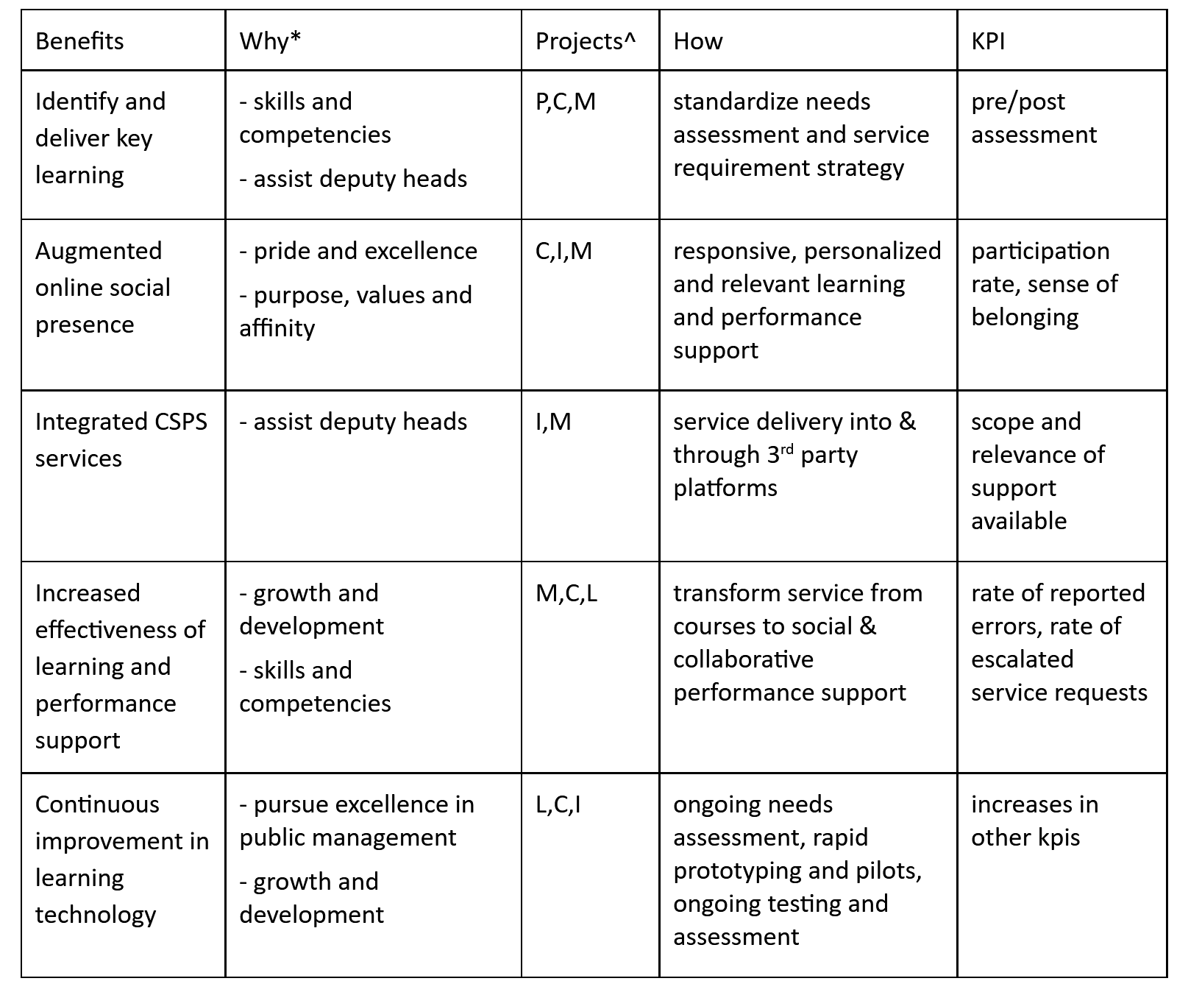

Slide 16
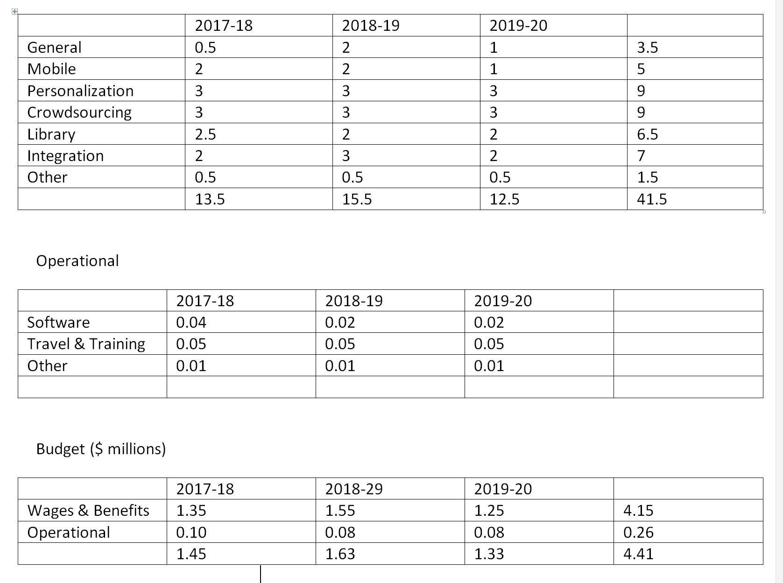
Resources

Slide 17
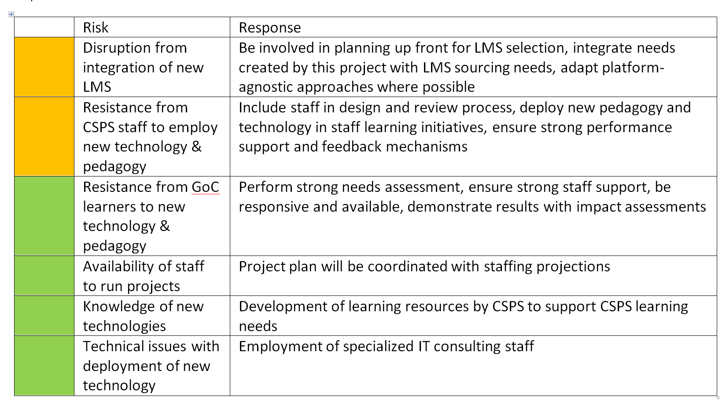
Risks

Slide 18
Project Team
Stephen Downes – principle investigator
Bruno Emond – project lead
Hélène Fournier – research officer
Irina Kondratova – research officer
Shirley MacLeod – knowledge management
 | National Research Council Canada | Conseil national de recherches Canada

