Slide 1
CSPS Technology Integration Projects Overview
National Research Council Canada
Stephen Downes
May 9, 2017
Conseil national
de recherches Canada

Slide 2
Context
3 year GCcampus expansion project was initiated in 2014
Planning for next phase of the project is underway
CSPS required an evaluation of existing to work and roadmap for the next phase
NRC was contracted to perform this work

Slide 3
SOW: Goals, objectives and outcomes
No. | Goals | Objectives | Outcomes
1 | The main goal of the CSPS with the current statement of work is to define a business plan to support the strategic deployment of a set of medium to long-term projects. | Provide a business plan outlining the state of the art, current states and gaps related to: a) learning through mobile, b) personalize learning, c) shared learning space (crowd sourcing), d) virtual library, and e) integration with the Government of Canada social and collaboration platforms. Measurement criteria: The business plan conforms to the CSPS acceptance criteria defined through a series of project workshops. | The CSPS successfully launches a set of projects in FY18. Measurement criteria: The FY18 projects can be directly attributed to the business plan proposal as delivered through the execution of the current statement of work.

Slide 4
SOW: Milestones
Milestone | Description | Date
Project starts | The start of the project | 2017-01-09
“State of the art” workshop | Four hours working session with NRC and CSPS on the first phase of the project “State of the art” | 2017-01-27
“Current state and gaps” workshop | Four hours working session with NRC and CSPS on the second phase of the project “Current state and gaps” | 2017-02-24
“Business plan” workshop | Four hours working session with NRC and CSPS on the third phase of the project “Business plan” | 2017-03-24
Business plan | Delivery of the business plan document. | 2017-03-31
Project ends | The end of the project | 2017-03-31

Slide 5
SOW: Schedule

Slide 6
SOW: Deliverables
Deliverable 1 | Description
Description | Business plan Description of the state of the art, current states and gaps related to: a) learning through mobile, b) personalize learning, c) shared learning space (crowd sourcing), d) virtual library, and e) integration with the Government of Canada social and collaboration platforms. Description of project options related to CSPS strategic interests.
Acceptance criteria | The specific acceptance criteria will be determined and agreed upon between CSPS and NRC through a series of workshops.
Date | 2017-03-31

Slide 7
The Challenge
Evolving model of online learning support
from classes to mobile support, personalization and crowd-sourcing
example: Accenture Connected Learning
Expansion of GoC intranet support
Gctools (GCconnect, GCcollab, GCpedia, etc.)
Requirement to follow-up development of GCcampus
CSPS identified five areas for program
mobile, personalization, integration with GCtools, crowdsourcing and virtual library.

Slide 8
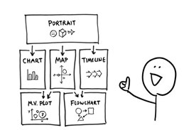
Outline
Mobile Learning
Personalized Learning
Shared Learning Space / Crowd-Sourcing
Virtual Library
Integration with Social and Collaboration Platforms

Slide 9
Methodology – Phase 1
Academic literature search in relevant areas
Trade literature and product identification
Hands-on experience with many of the technologies
LPSS projects with deep dive in some subject areas

Slide 10
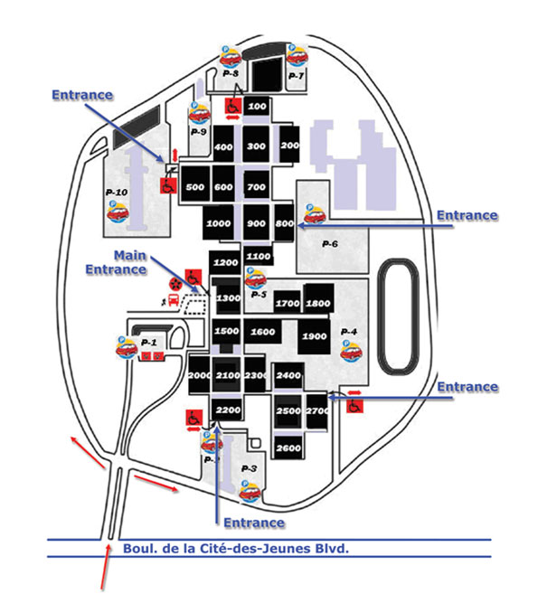
Methodology – Phase 2
Review of background Documents
Usability studies
GCCampus Business Plan
CSPS Annual Reports
Interviews with CSPS staff
12 interviews, 1 hour avg, 16 people
Wide representation of functions
Assessment of CSPS website
Review of videos, learning aids
Enrollment and completion of several courses

Slide 11
Methodology – Phase 3
Development of ‘moot’ business case and roadmap based on research
Collaborative editing of business case and roadmap
Workshop presenting and discussing new business plan document
Finalization and submission of the document

Slide 12
In-Class Learning
Traditional focus on in-class learning
something the school understands and has developed expertise
Through online learning has increased dramatically, classroom-based learning has declined by only a bit more than 25 percent.

Slide 13
Business Model and Transformation
Learning is offered to departments as a centralized service.
This changes the way the school designs and offers courses.
Data collection and storage is necessary to track usage.

Slide 14
GC Campus Suite
Saba learning management system (LMS)
Drupal 7 content management system (CMS)
Moodle LMS
Kaltura OVP
CSPS service bus
Events using WebEx

Slide 15
Analysis
CSPS has made significant progress extending its platform beyond the LMS (to include Drupal, Moodle, Kaltura)
The school’s structural and service orientation has not aligned to new technologies and pedagogies.
Analyst Recommendations:
define and align to a contemporary model of online learning support
conduct an incremental, rather than a rapid expansion of any individual service

Slide 16
Personalization
Existing resource base does not support personalization based on adaptive systems
The future LMS environment (if any) must be defined
Concrete steps can be taken to prepare staff and students
Content recommendations from GoC libraries
Personalized subscription-based services
User learning dashboard with metrics

Slide 17
Crowdsourcing
Depends on the ability and willingness to integrate learner and third party feedback and contributions
Necessary to develop the school’s capacity and comfort level with crowdsourcing
Learning and development pedagogy review and pilot process
Pilot user blog, ratings or recommendations
Risk assessment for accessibility, privacy, security

Slide 18
Integration with other government services
Primary target for integration is GCTools
Desirable to integrate with human resources, competency and performance management systems
All integration requires coordination with external services, some of which are not yet fully developed
Integration with single signon services – this was single most-requested feature was single-signon
CSPS resources launched from GCTools, GoC dashboards

Slide 19
Mobile
Mobile devices are not suited to the delivery of online courses
Not practical to develop platform-specific apps (eg. iPhone app).
Mobile support in this context should focus on responsive and cross-platform design (for example, HTML5-based design)
‘Mobile learning’ entails support for learner mobility,
Support for specific end-user applications
Includes elements of GCcampus website
Includes learning resources
Support for crowdsourcing
Events and podcasts in audio/video viewers

Slide 20
Virtual Library
Desirable to provide access to eBooks to support online courses
Not desirable to duplicate library services are being offered in various departments
Purpose of a CSPS virtual library is to support performance support
More than just eBooks; learners require access to videos, podcasts, learning objects
Standardized performance support function
Collaborative rapid resource authoring
Content brokering from GoC and partner libraries

Slide 21
Mandate
Provide a broad range of learning opportunities and establish a culture of learning within the public service
Key learning needs identified
Augmented online social presence
Integrate services in GoC functions
Increased effectiveness of support
Continuous improvement
Benefits
Content recommendations
Social & community pedagogies
CSPS resources in GCTools
Mobile end-user applications
Rapid resource creation
Outcomes
Personal user learning dashboard
Pilot user blog, ratings, recommends
Single signon
Events and podcasts
Performance support function
Personalized subscription services
Risk assessments
Content brokering
Personal-ization
Crowd-sourcing
GC Campus Integration
Mobile Platform
Virtual Library
Projects
1
2
3
4
5
Priority

Slide 22
Benefits
Identify and deliver key learning and performance support needs
1
Augmented online social presence
2
Integrated CSPS services with those of other departments and functions
3
Increased effectiveness of learning and performance support
4
Continuous improvement in learning technology
5

Slide 23
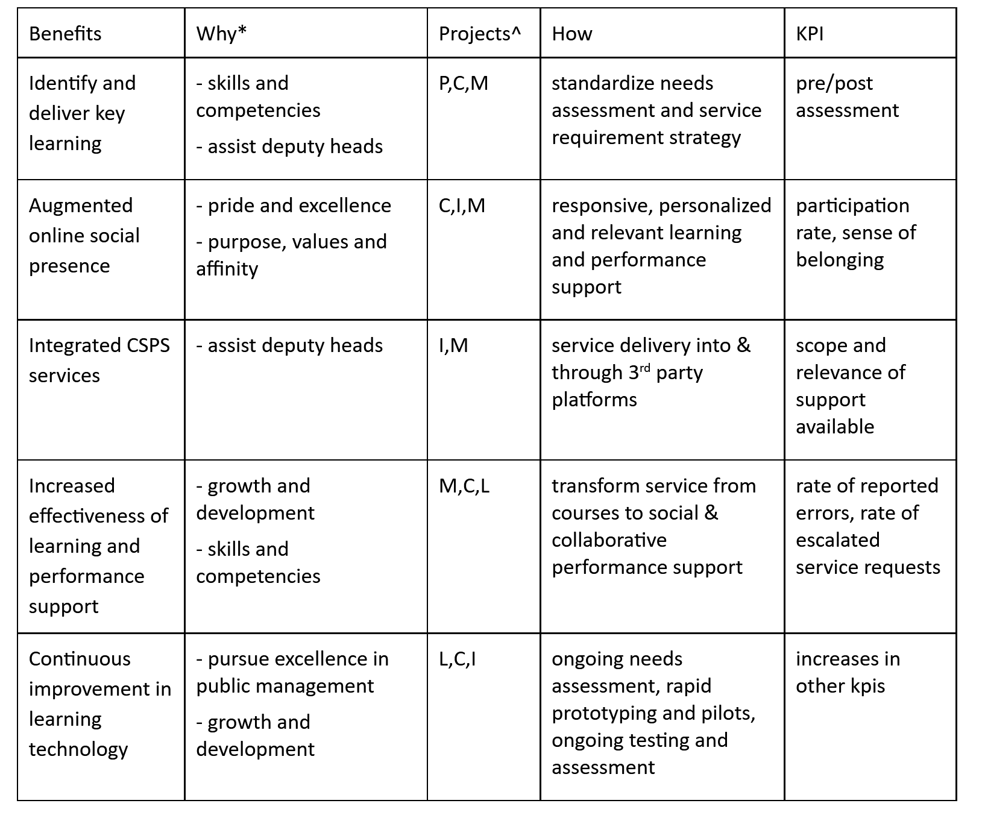

Slide 24
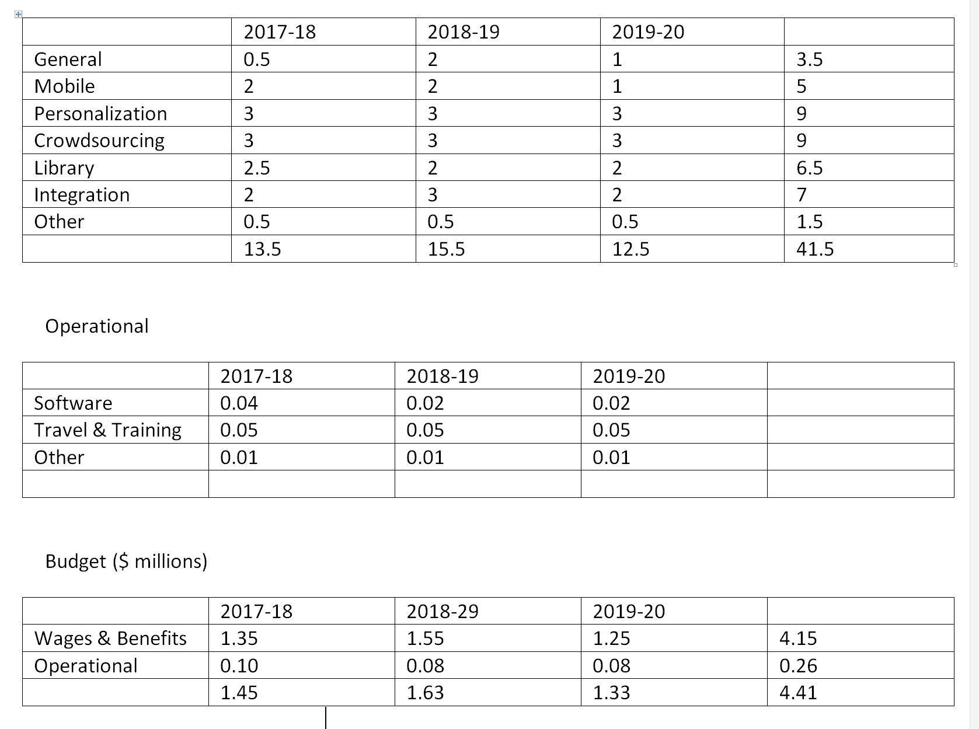
Resources

Slide 25
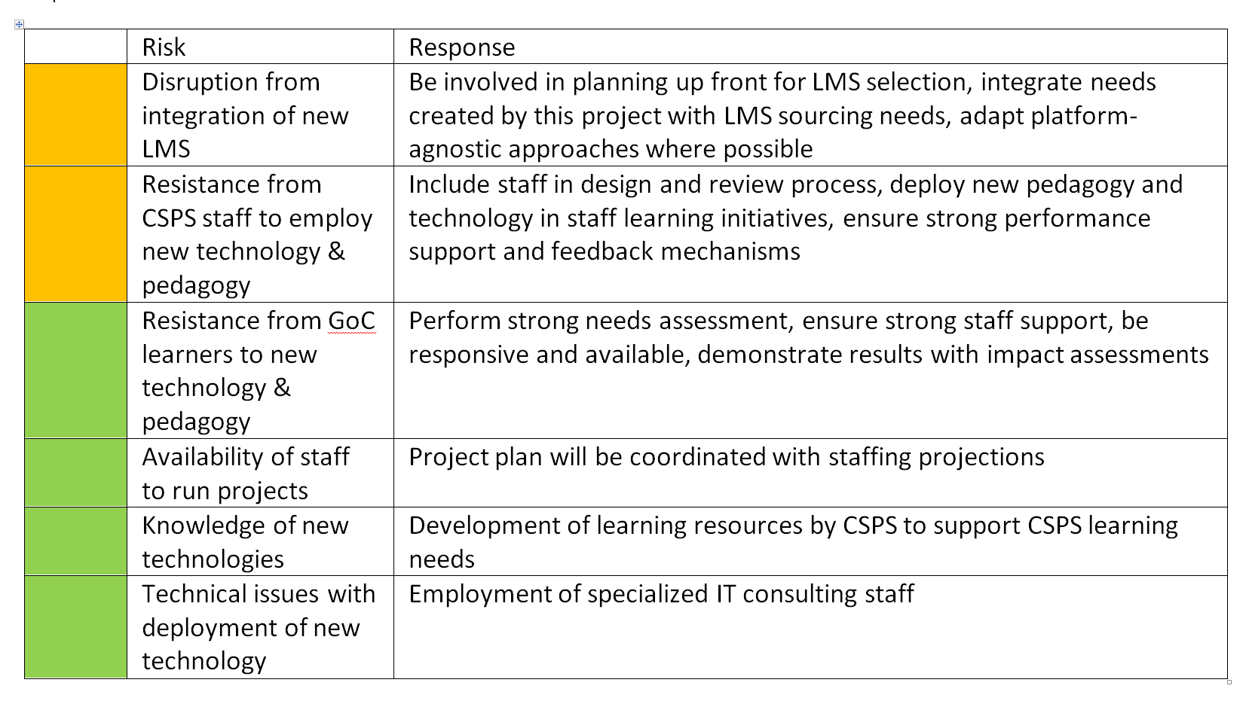
Risks

Slide 26
Project Team
Stephen Downes – principle investigator
Bruno Emond – project lead
Hélène Fournier – research officer
Irina Kondratova – research officer
Shirley MacLeod – knowledge management
 | National Research Council Canada | Conseil national de recherches Canada

