Slide 1
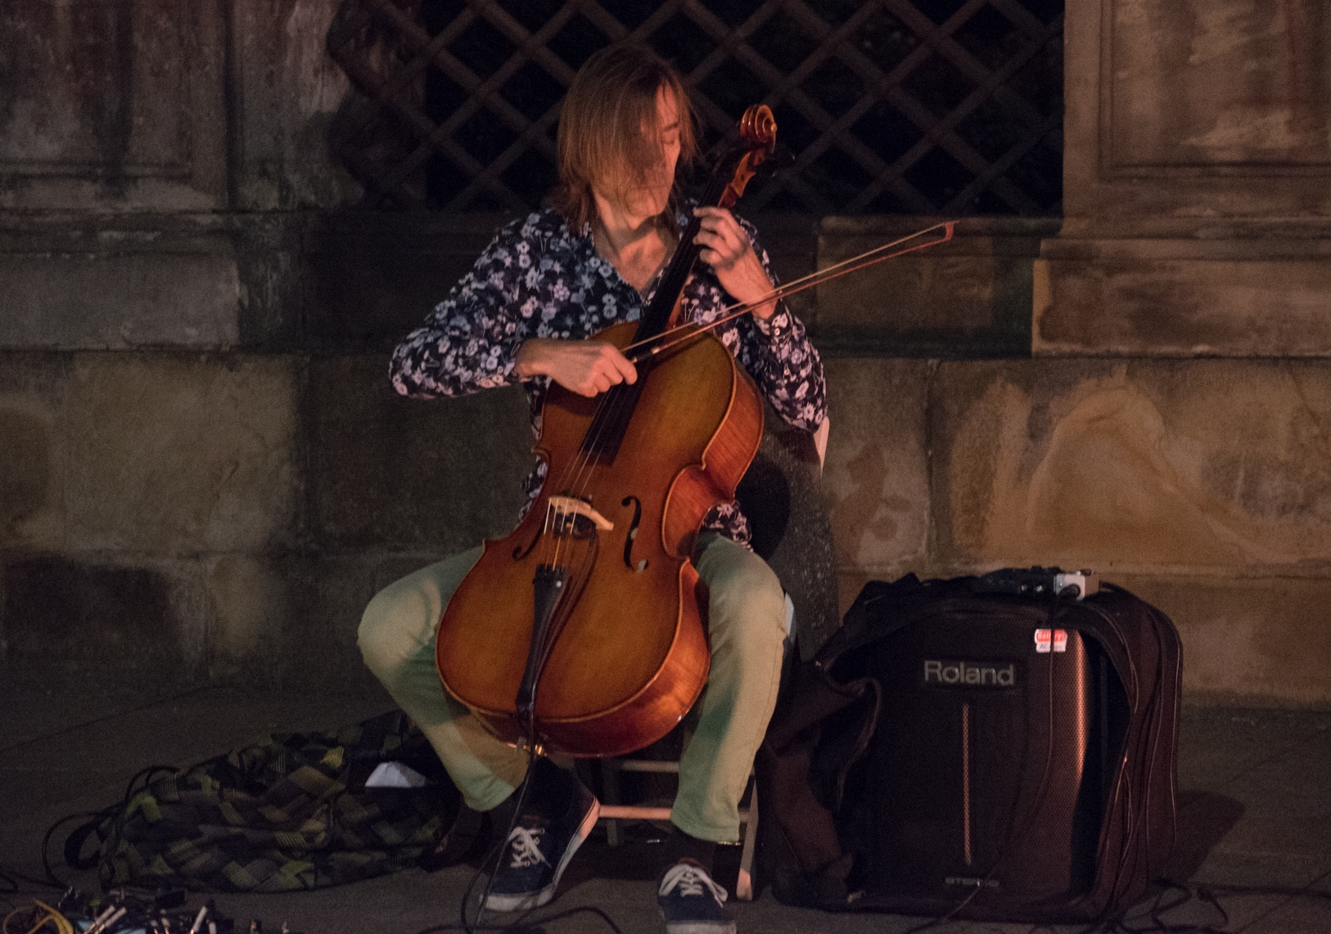
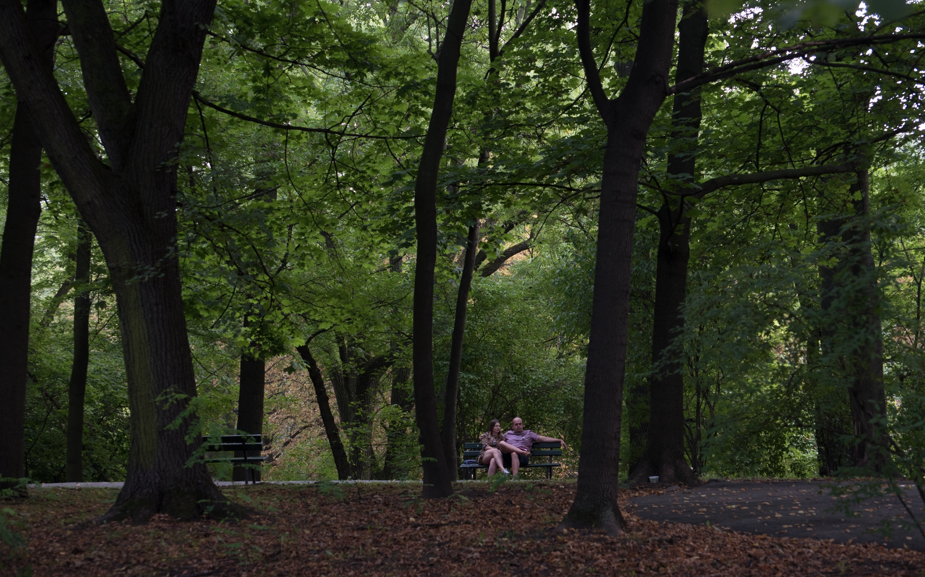
Topics in Connectivism
Stephen Downes
Warsaw, Poland
August 28, 2017

Slide 2
Open Networks

Slide 3
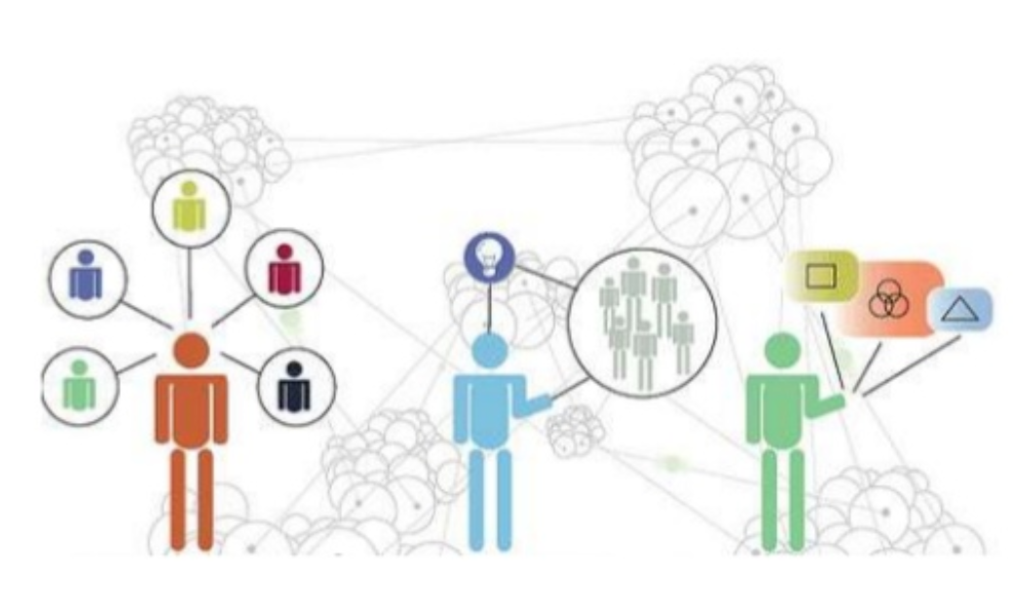
Current Work
Elearning Landscape – TBA
Future of eLearning – TBA
Canada School of Public Service - http://www.csps-efpc.gc.ca/index-eng.aspx
CASS - https://www.adlnet.gov/introducing-the-next-big-thing-cass/
MOOCs – yes, still – http://www.federica.eu/c/connectivism_and_learning http://candl.mooc.ca
MOOC Aggregation Engine – http://www.mooc.ca
Personal Learning Environments – gRSShopper in a Box – http://grasshopper.downes.ca
Connectivism - https://www.slideshare.net/CatherineFarrant/connectivist-learning-theory

Slide 4
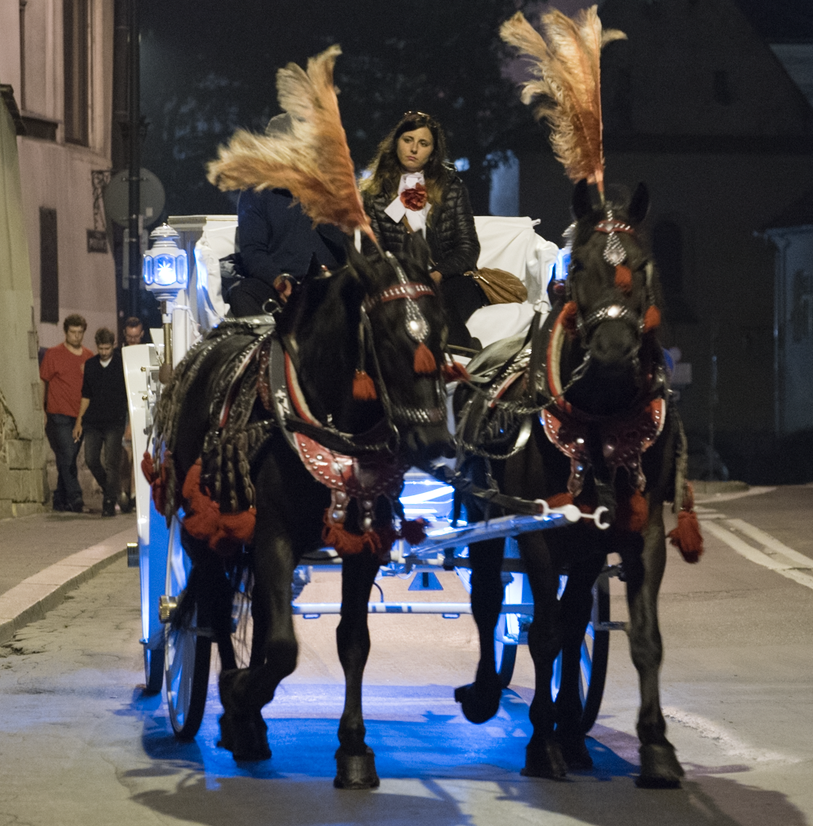
MOOCs
True History of the MOOC - https://sites.google.com/site/themoocguide/home
cMOOC and xMOOC - http://www.tonybates.ca/2014/10/13/comparing-xmoocs-and-cmoocs-philosophy-and-practice/
FutureLearn - https://www.futurelearn.com/
Personal Learning- http://www.downes.ca/presentation/380

Slide 5
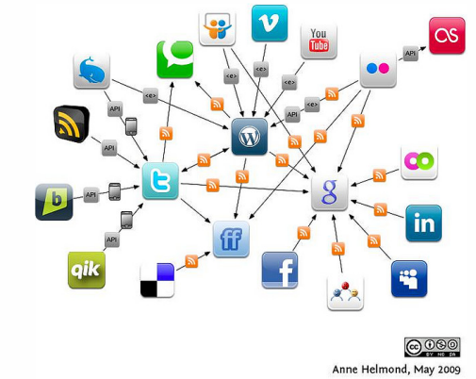
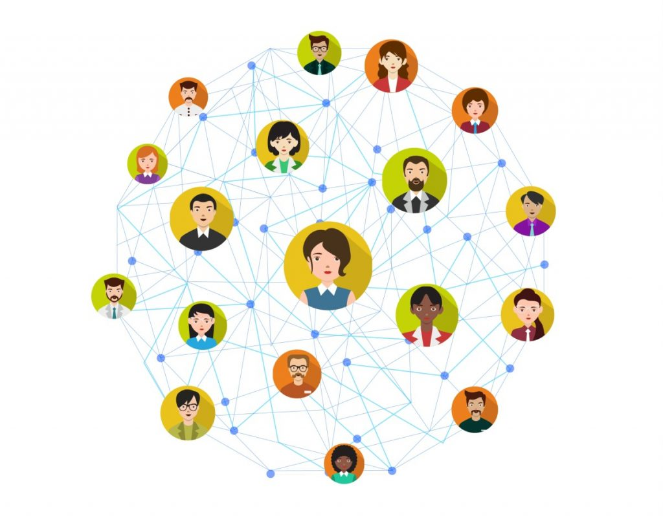
Distributed Social Networks
Opera Unite - http://mashable.com/2009/06/15/opera-unite/
Mozilla OS - https://www.npmjs.com/package/fxos-web-server
Diaspora - https://www.joindiaspora.com/
Solid - "social linked data“ - https://solid.mit.edu/
Keybase - https://keybase.io/
InterPlanetary File System (IPFS) - https://ipfs.io/

Slide 6
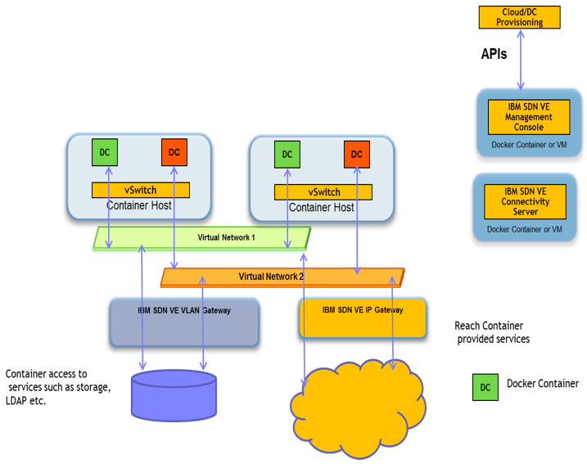
Cloud Infrastructures
Environments: VMWare Fusion, VirtualBox
Provisioners: Docker, Vagrant
Configuration: Chef, Puppet
Providers: AWS, MS Server
Services: MS Cognitive, Wolfram Alpha, Segment
Serverless CMS - http://www.downes.ca/post/66459

Slide 7
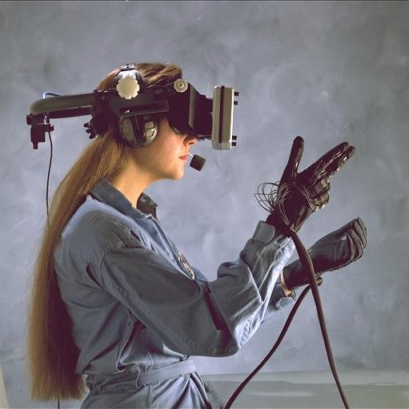
Immersive Reality
What is ‘Immersive’ – a VR helmet?
Key element of immersion: belief
(authentic) applications that matter
social presence (cognitive presence, teaching presence) - https://www.mnsu.edu/its/academic/isalt_social_presence_theory.pdf
multi-modality – cognitive + kinesthetic, etc. - https://www.slideshare.net/jtholden/the-learning-styles-revelation-research-from-cognitive-science
Games and Gamification?

Slide 8
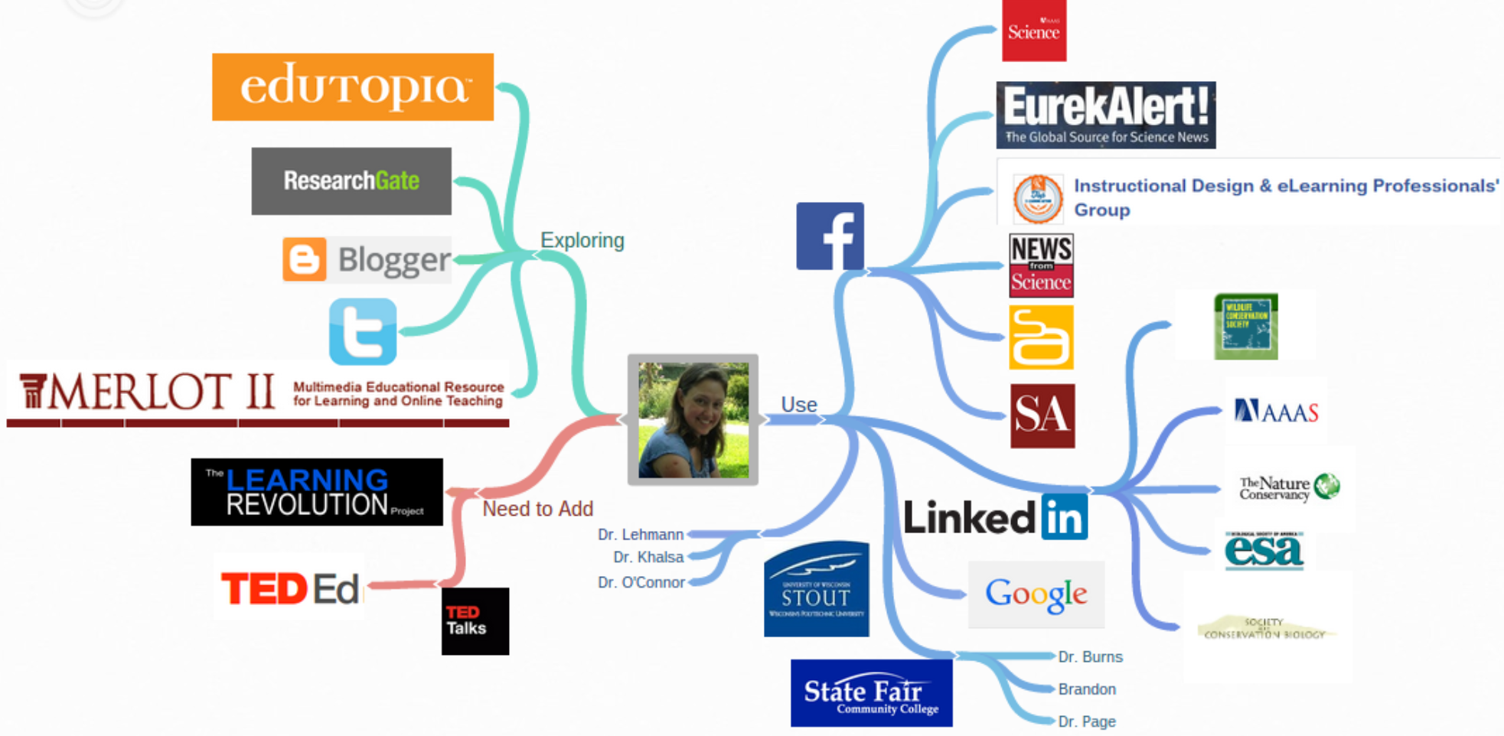
Personal Learning Environments
Resource Repository Network (Aggregation) - http://ec.europa.eu/ipg/standards/markup/web-content-syndication/index_en.htm
Personal Cloud – Dropbox, OwnCloud, etc. https://owncloud.org/
Personal Learning Record – Learning Record Store (xAPI) https://www.adlnet.gov/tla/
Personal Learning Assistant
like Siri? Alexa?
Distributed Intelligence – MLaaS
https://www.slideshare.net/KarlSeiler/mlaas-machine-learning-as-a-service
Heather Taft http://taftportfolio.blogspot.com/p/personal-learning-environment-ple.html

Slide 9
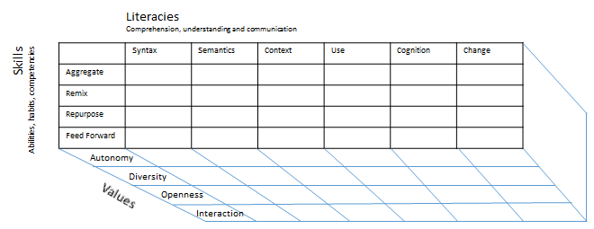
Challenges to Learning Providers
Content Knowledge Vs. Literacies
Not just reading and writing…
http://www.downes.ca/presentation/369
Employment skills Vs. Education
Courses Vs. Performance Support
Authority Vs. the Wisdom of Crowds
Autonomy, Diversity, Openness, Interactivity
Social Proof? https://en.wikipedia.org/wiki/Social_proof
Credentials Vs. Learning Vs. Connections - http://er.educause.edu/articles/2015/3/credentialing-in-higher-education-current-challenges-and-innovative-trends

Slide 10
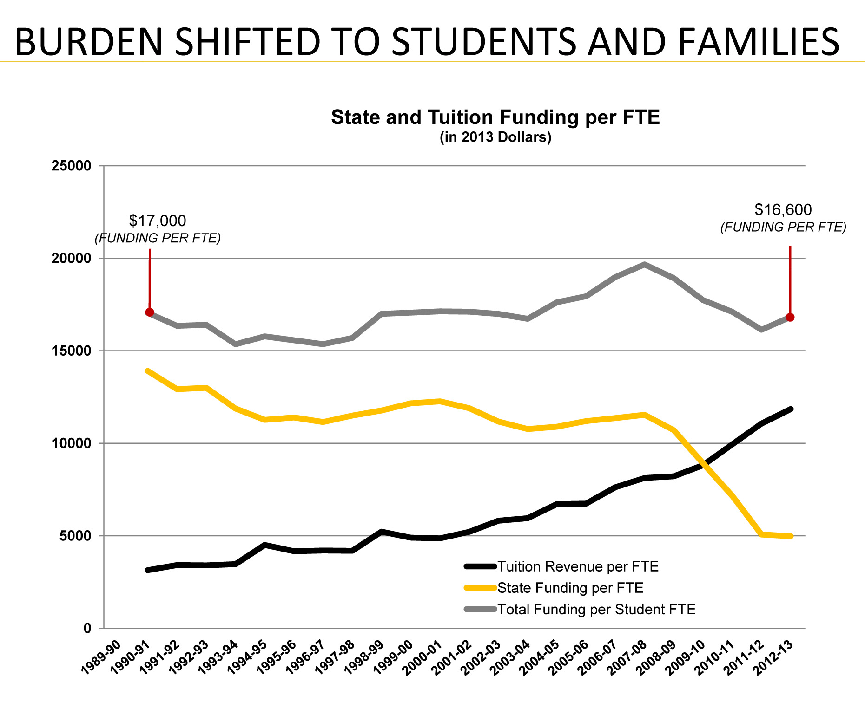
Challenges to Educational Institutions
Public Education Vs. Private Sector
Funding: Tuition, Grants, Reseach….?
Enterprise Vs. Distributed?
Federated Vs. Open? (Social signon Vs. Single Signon Vs. ??)
Transcripts Vs. Blockchain Vs. ?? http://blockgeeks.com/guides/what-is-blockchain-technology/
http://old.seattletimes.com/html/opinion/2018504888_guest25blakecole.html

Slide 11
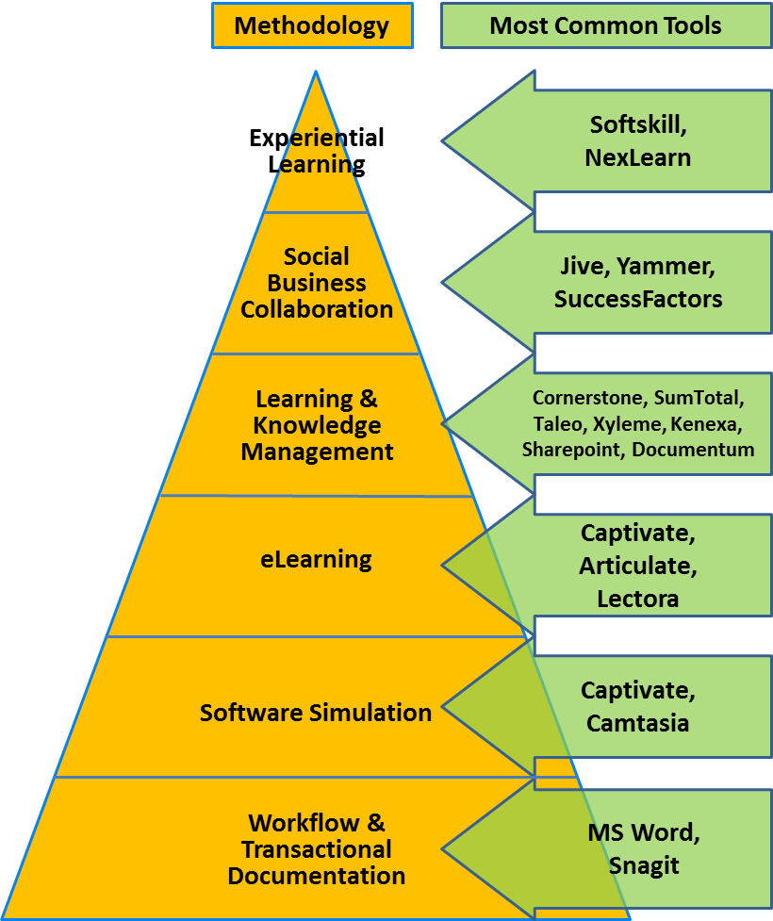
Moving Forward
Competencies? Vs. Capabilities http://www.downes.ca/post/64879
Badges? Vs. Evidence https://openbadges.org/
Classes Vs. Performance Support http://www.nrc-cnrc.gc.ca/eng/solutions/collaborative/lpss.html
Microlearning? Vs. Spaced Learning - https://www.td.org/Publications/Blogs/Science-of-Learning-Blog/2015/01/Spaced-Learning-an-Approach-to-Minimize-the-Forgetting-Curve
Course Libraries? Vs. Subscription-based Learning - http://www.downes.ca/news/OLDaily.htm
http://epiloguesystems.com/about/

Slide 12
Personal Learning

Slide 13
New learning Paradigms
Path | Field
Course | Curriculum (as in ‘mapping’)
Sequence / Prequisite | Core / periphery / foundation
Movement / covered | Inquiry / Discovery / Gaps
Threshold / Levels | Coverage / Construction
Positioning – first / last | Grouping / Clustering
Objective / target | Serendipity / emergence
Leading / Led | Centred
Carrie Paechter, Metaphors of Space in Educational Theory and Practice http://www.tandfonline.com/doi/pdf/10.1080/14681360400200202

Slide 14
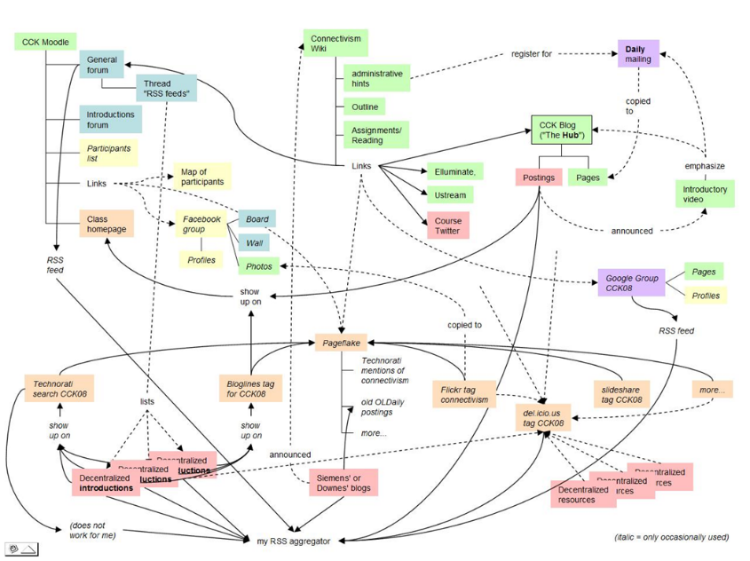
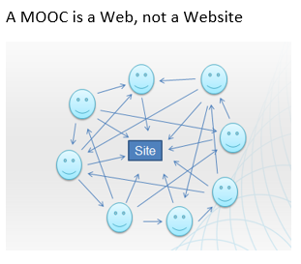
The Connectivist MOOC (cMOOC) Design
Instead of seeing a course as a series of contents to be presented, a course is a network of participants who find and exchange resources with each other
An initial structure is developed and ‘seeded’ with existing OERs
Participants encouraged to use their own sites to create or share resources
A mechanism (gRSShopper) is employed to connect them

Slide 15
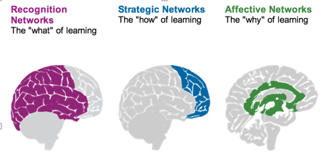
Personalization
What we learn
How we Learn
Why we learn
Rules-Based Events (like notifications)
User Models
Adaptive Learning

Slide 16
Two Approaches…
Content
Practice
Practice
Content

Slide 17
Two Approaches…
Defines an ideal state
Defines a desired state
Content
Practice
Practice
Content
TEST
TRY
Person tests you
Person helps you

Slide 18
Two Approaches…
Defines an ideal state
Defines a desired state
Content
Practice
Correction
Iteration
GAP
Practice
Content
Opport-unity
TEST
TRY
Person tests you
Person helps you

Slide 19
Library Environment
Defines an ideal state
Defines a desired state
Content
Practice
Affordances
Correction
Requirements
Iteration
GAP
Practice
Content
Opport-unity
TEST
TRY
Person tests you
Person helps you

Slide 20
Personalized Personal We do for you You do for yourself
Defines an ideal state
Defines a desired state
Content
Practice
Affordances
Correction
Requirements
Iteration
GAP
Practice
Content
Opport-unity
TEST
TRY
Person tests you
Person helps you

Slide 21
The Personal Learning Environment

Slide 22
Overview of the Concept of PLEs
LMS
Simulation
PLE
Chat Room
MOOC
Blogger
Intranet
Access to many services in one personal environment

Slide 23
Properties of the PLE…
What information should it record?
Who owns the data? How private is it?
What should it do?
What would a person do with it?
Where, exactly, is a PLE located?
PLE

Slide 24
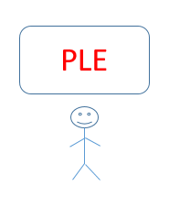
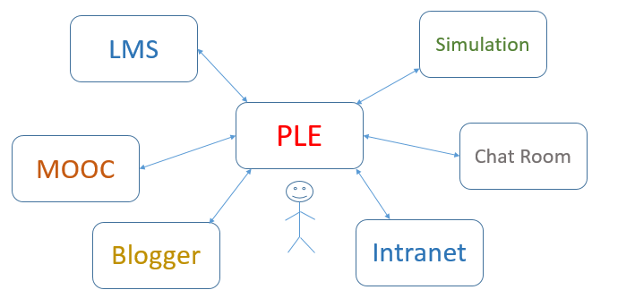
The Network of PLEs

Slide 25
The Social Network of PLEs
twitter
facebook
email

Slide 26
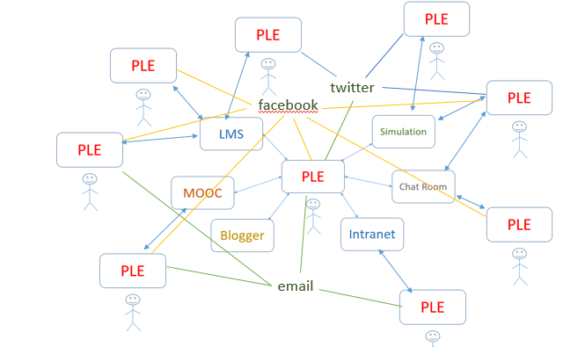
Properties of the Network…
How do people find each other? Services?
How do they communicate? What do they share?
How does a single PLE work with services?
Do we need centralized registries?

Slide 27
Why a personal learning environment?
10:30 – 11:30
What is the value proposition for a PLE?
Note: value isn’t what you can do, it’s how you benefit
This is usually stated in financial terms (earn more, cost less)
Can also be stated in terms of quality: faster, bigger, better
And can be non-financial goods: satisfaction, happiness, memories

Slide 28
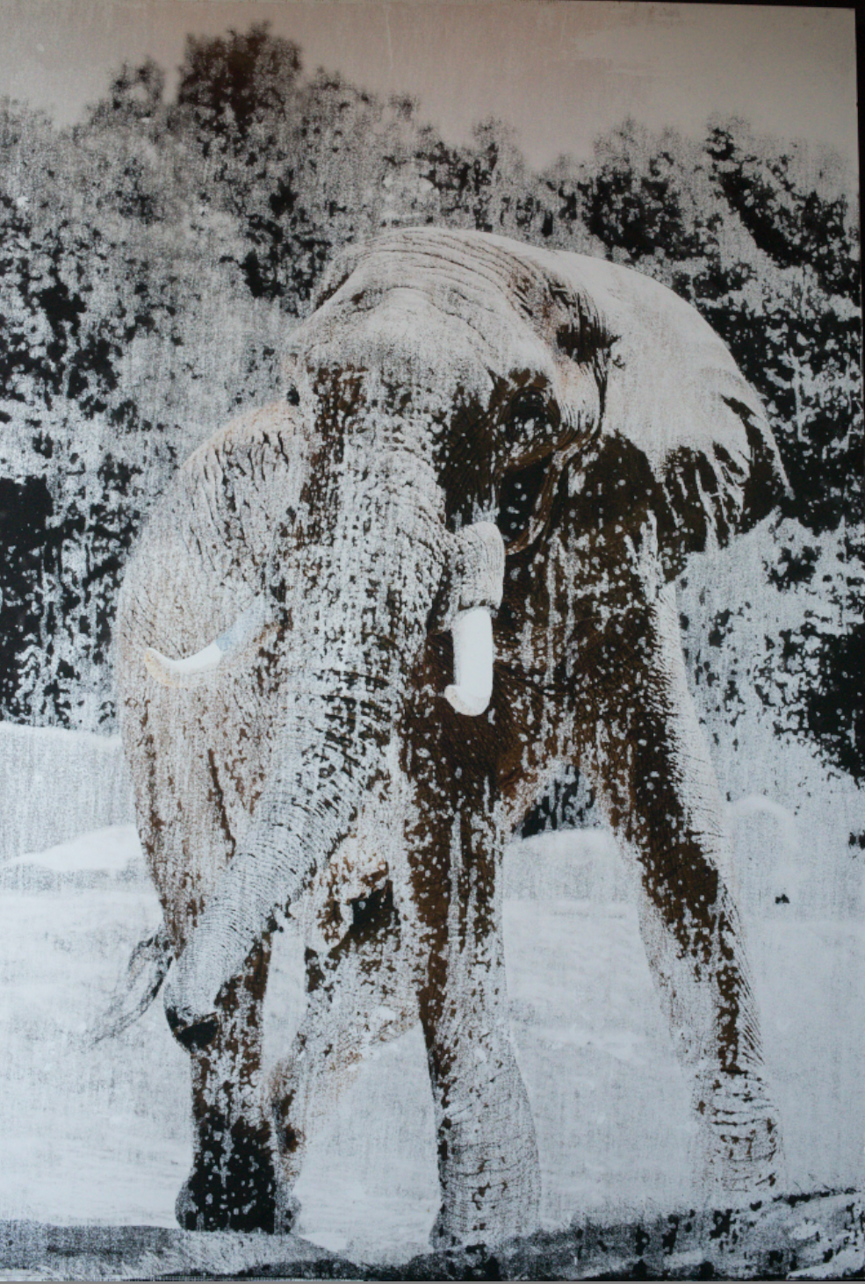
Education is not a search problem

Slide 29
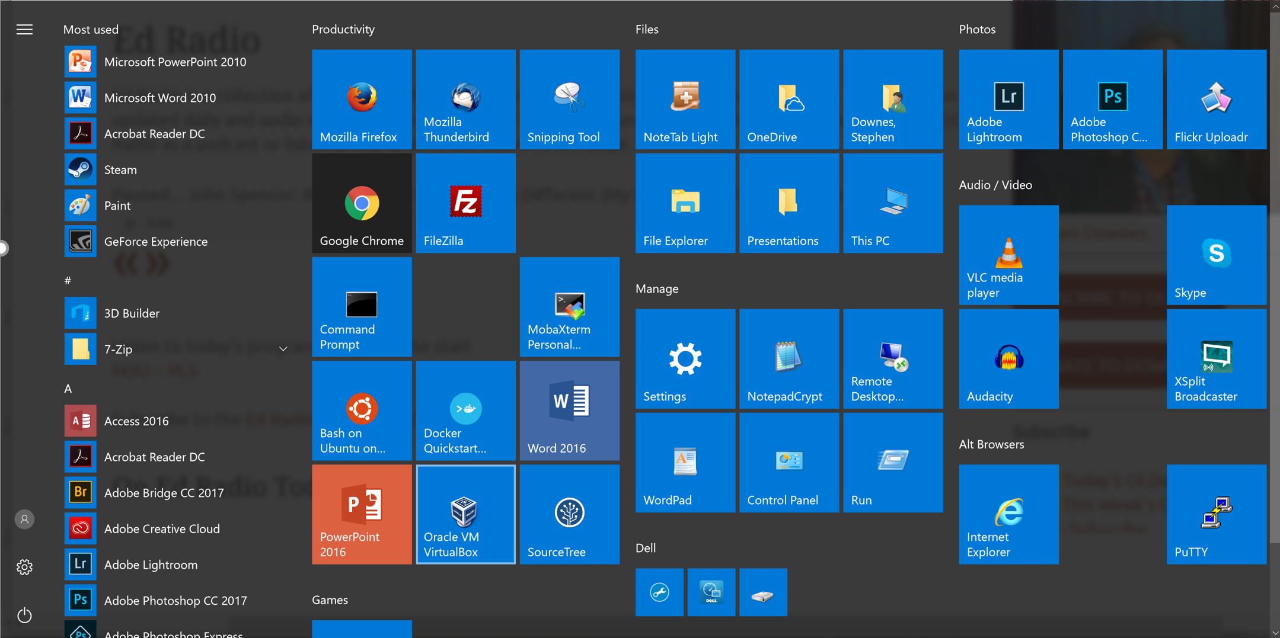
Making

Slide 30
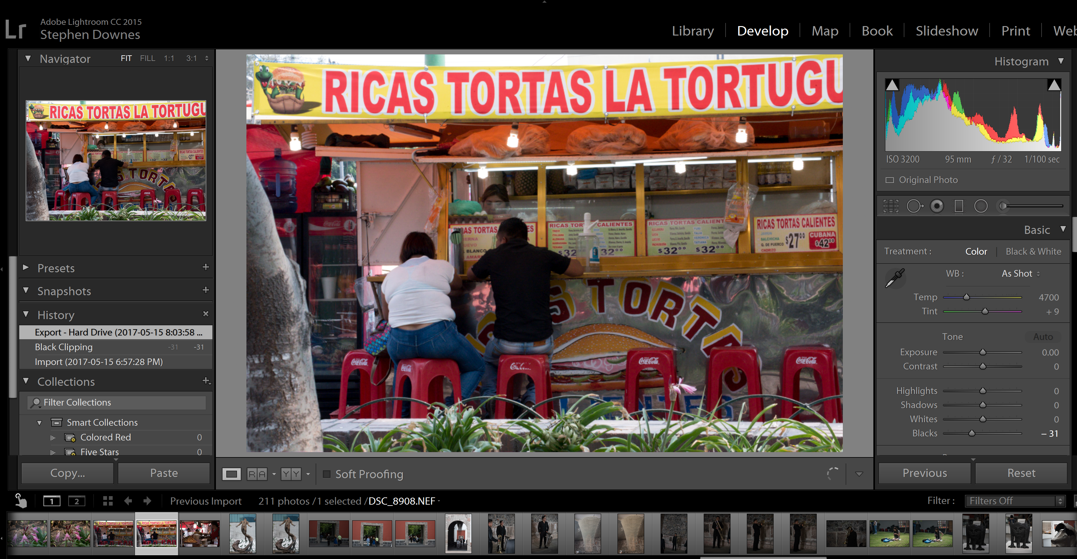
Making
https://lightroom.adobe.com/

Slide 31
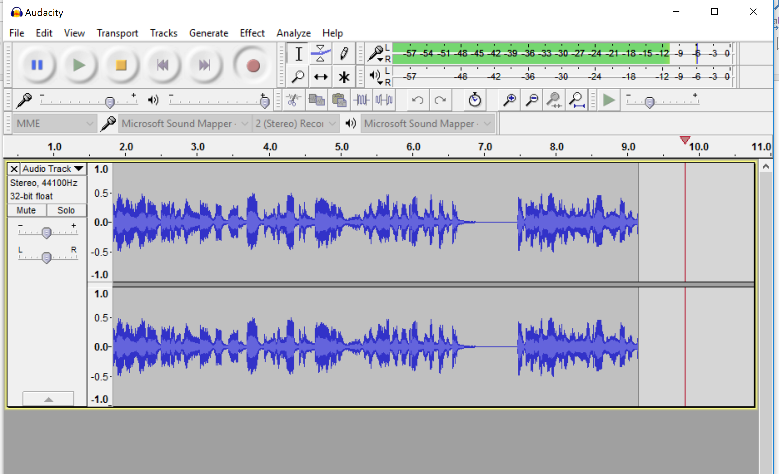
Making
http://www.audacityteam.org/download/

Slide 32
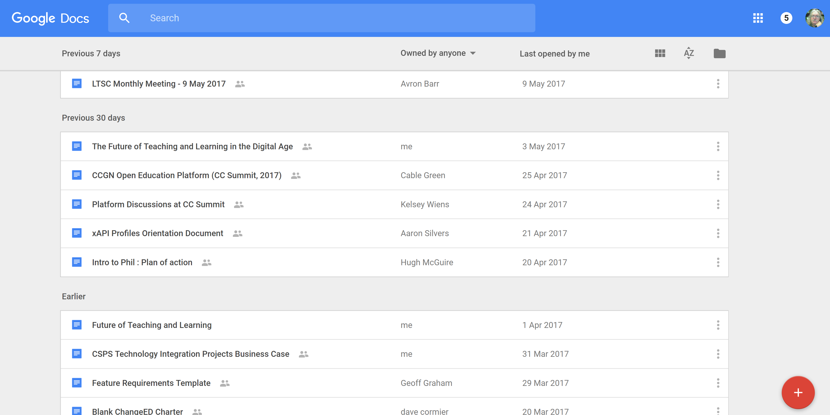
Making
https://docs.google.com/

Slide 33
Making
https://forum.rebus.community/category/17/phil-introduction-to-philosophy-lead-christina-hendricks-ubc

Slide 34
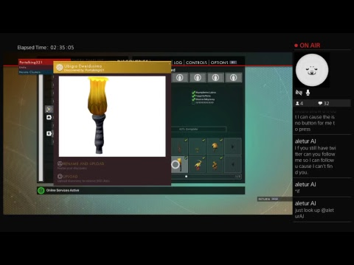
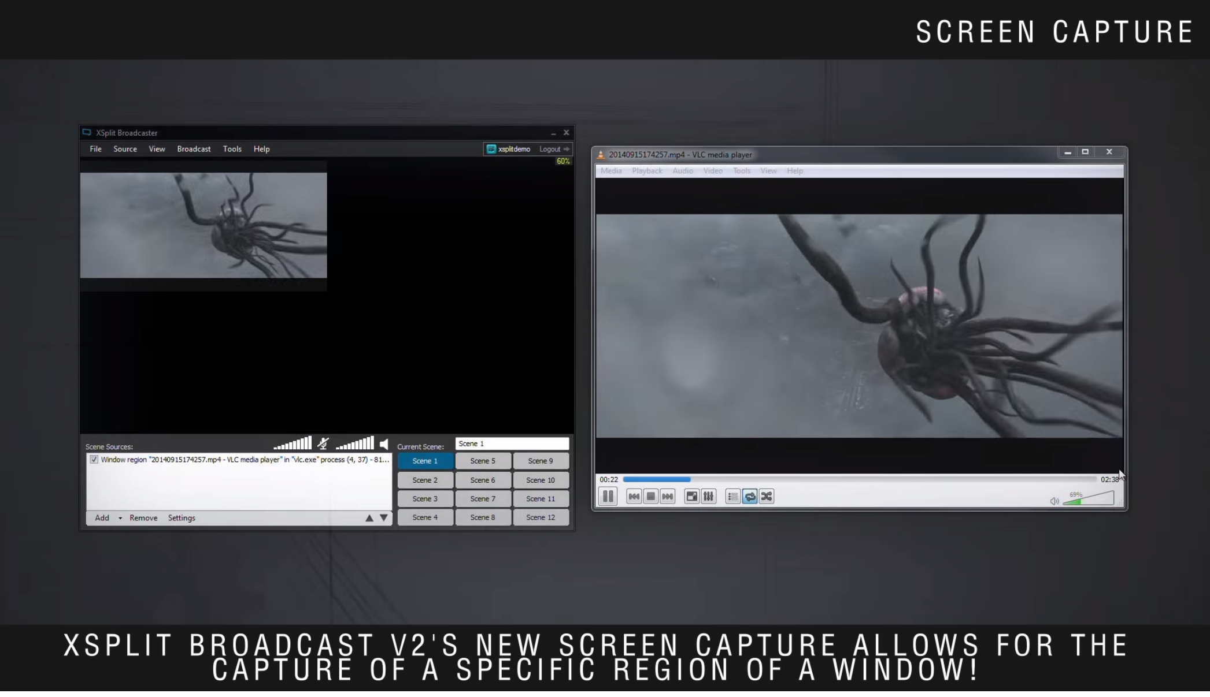
Making
https://www.xsplit.com/

Slide 35
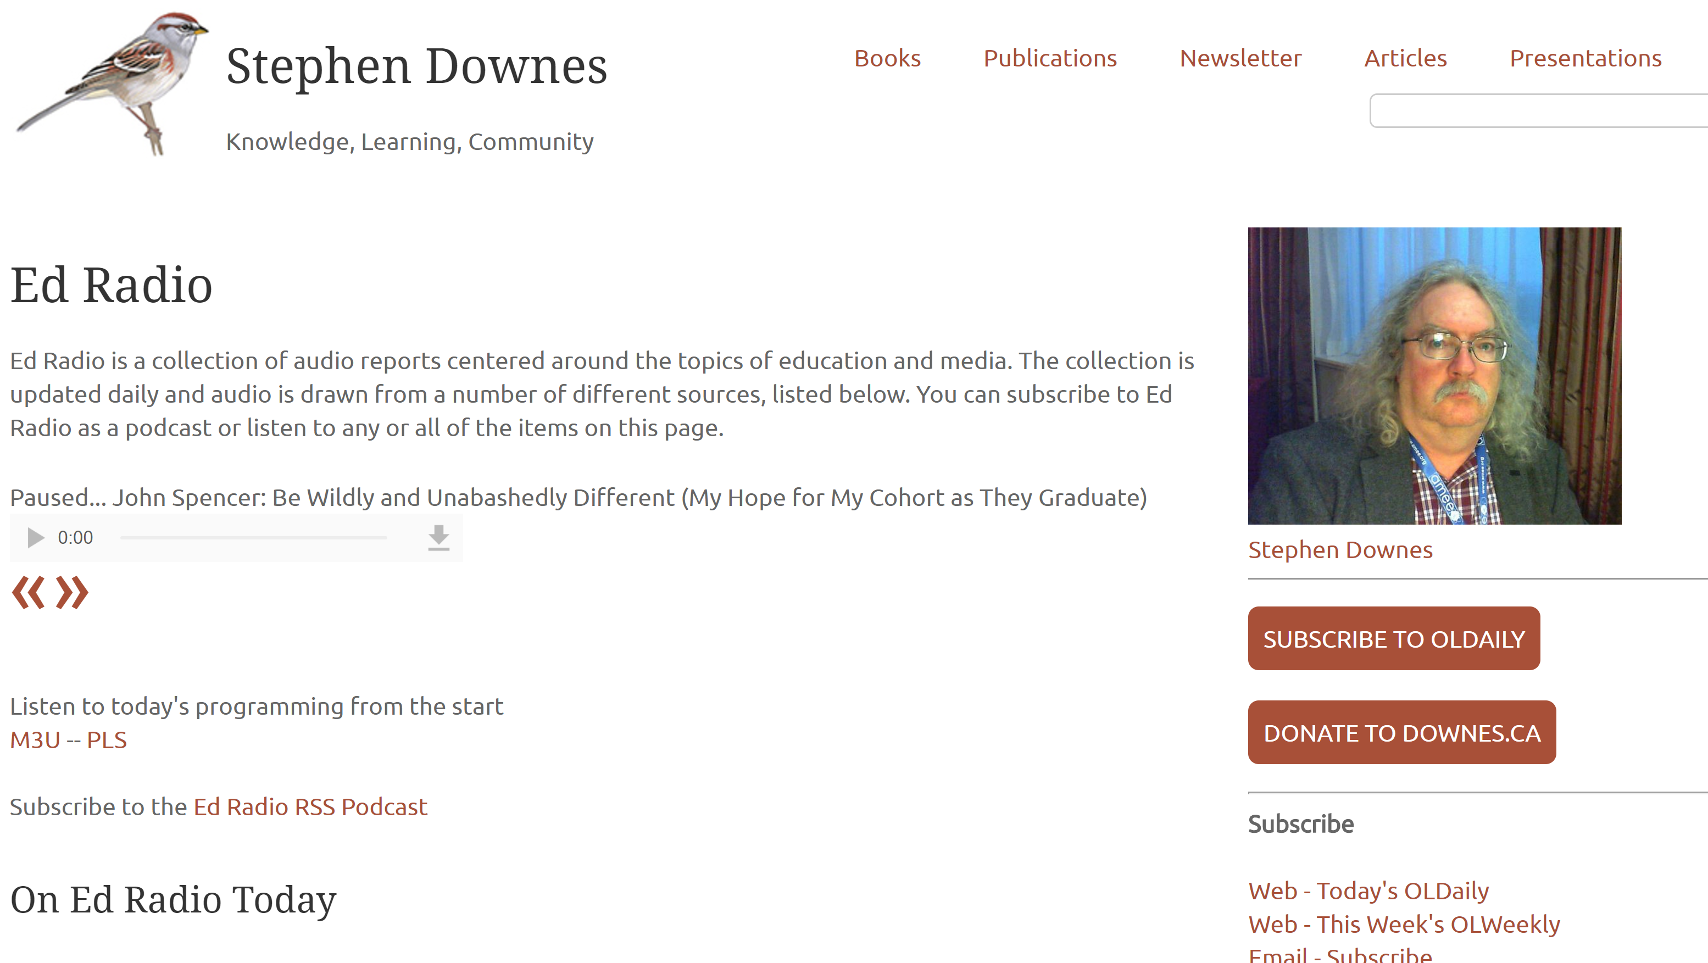
Sharing
http://www.downes.ca/edradio.htm

Slide 36
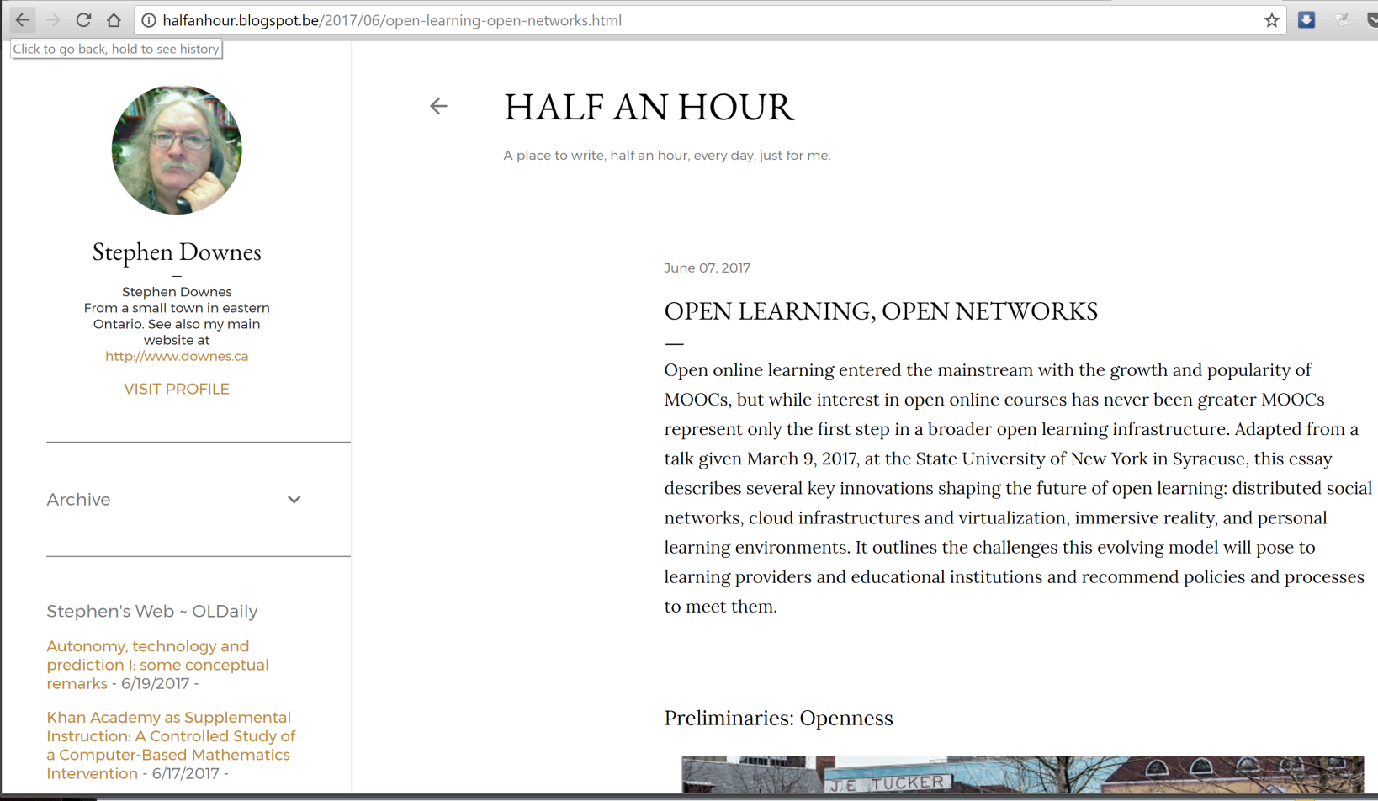
Sharing
http://letsmakesomeartdammit.blogspot.com
http://halfanhour.blogspot.com

Slide 37
Sharing
https://www.slideshare.net/Downes

Slide 38
Sharing
http://www.downes.ca/presentation/468

Slide 39
Critical Literacies

Slide 40
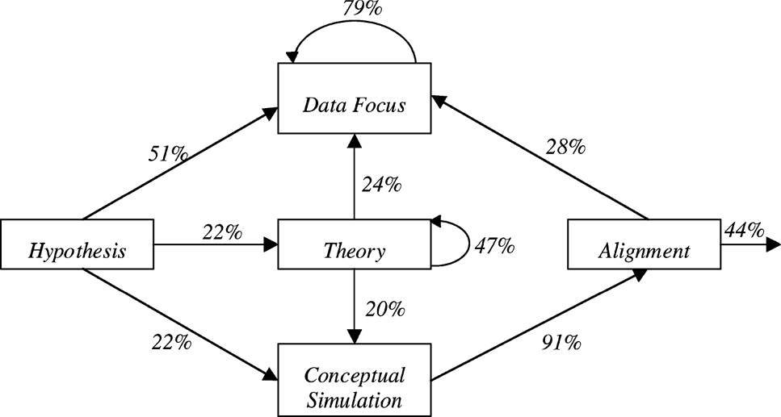
Science as language, learning as conversation, knowledge as inference
“What if…”: The Use of Conceptual Simulations in Scientific Reasoning
http://www.informaworld.com/smpp/1925728116-26233474/ftinterface~db=all~content=a788101161~fulltext=713240928

Slide 41
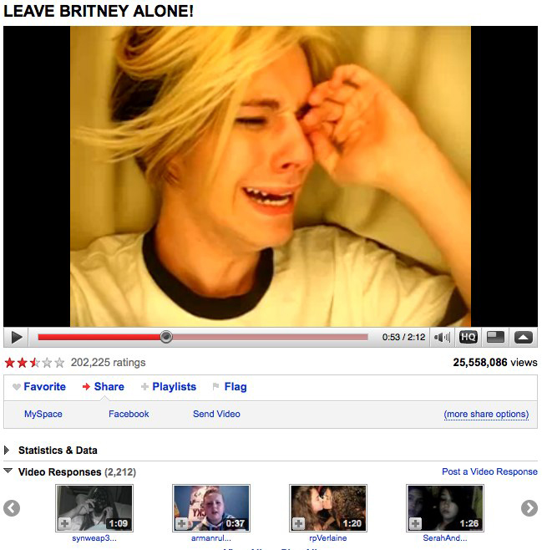
The Second Thesis, Part B
This means getting beyond narrow text-based conceptions we have of media

Slide 42
Conceptions Like:
messages have a sender and a receiver
words get meaning from what they represent
truth is based on the real world
events have a cause, and causes can be known
science is based on forming and testing hypotheses
These, taken together, constitute, a static, linear, coherent picture of the world
The world, as though it were a book, or a library
Not everyone sees it that way

Slide 43
A frame for understanding new media
Morris, Derrida and a little Lao Tzu
Syntax | Cognition
Semantics | Context
Pragmatics | Change
We need this frame because (as Jukes said) if we aren’t looking for these things, we just won’t see them.

Slide 44
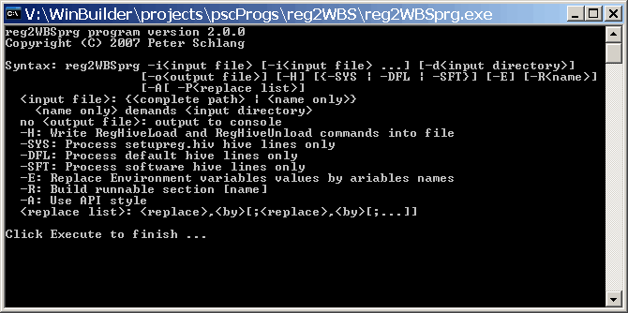
Syntax
Not just rules and grammar
Forms: archetypes? Platonic ideals?
Rules: grammar = logical syntax
Operations: procedures, motor skills
Patterns: regularities, substitutivity (eggcorns, tropes)
Similarities: Tversky - properties, etc

Slide 45
Semantics
theories of truth / meaning / purpose / goal
http://www.cs.cmu.edu/~tom7/csnotes/fall02/semantics.gif
- Sense and reference (connotation and denotation)
- Interpretation (Eg. In probability, Carnap - logical space; Reichenbach - frequency; Ramsey - wagering / strength of belief)
- Forms of association: Hebbian, contiguity, back-prop, Boltzmann
- Decisions and decision theory: voting / consensus / emergence

Slide 46
Pragmatics
use, actions, impact
Speech acts (J.L. Austin, Searle) assertives, directives, commissives, expressives, declarations (but also - harmful acts, harassment, etc)
Interrogation (Heidegger) and presupposition
Meaning (Wittgenstein - meaning is use)

Slide 47
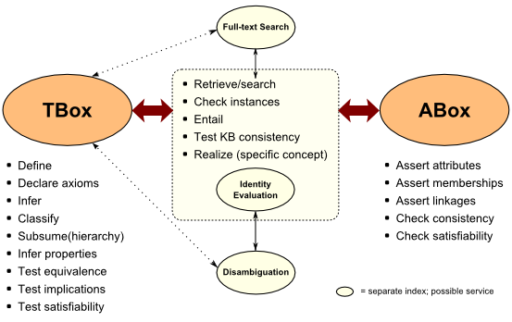
Cognition
reasoning, inference and explanation
http://www.mkbergman.com/category/description-logics/
description - X (definite description, allegory, metaphor)
definition - X is Y (ostensive, lexical, logical (necess. & suff conds), family resemblance - but also, identity, personal identity, etc
argument - X therefore Y - inductive, deductive, abductive (but also: modal, probability (Bayesian), deontic (obligations), doxastic (belief), etc.)
explanation - X because of Y (causal, statistical, chaotic/emergent)

Slide 48
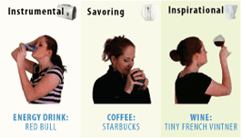
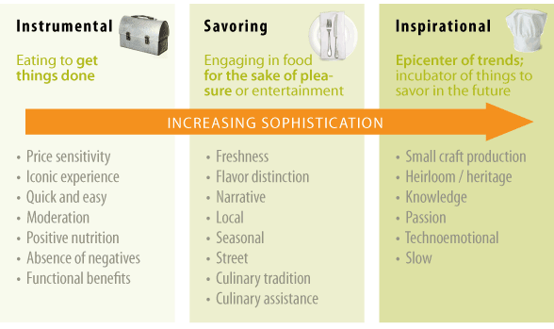
Context
placement, environment
http://www.occasionbasedmarketing.com/what-it-is
- explanation (Hanson, van Fraassen, Heidegger)
- meaning (Quine); tense - range of possibilities
- vocabulary (Derrida); ontologies, logical space
Frames (Lakoff) and worldviews

Slide 49
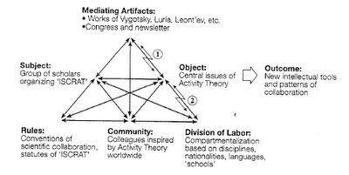
Change
relation and connection: I Ching, logical relation
flow: Hegel - historicity, directionality; McLuhan - 4 things
- progression / logic -- games, for example: quiz&points, branch-and-tree, database
- scheduling - timetabling - events; activity theory / LaaN

Slide 50
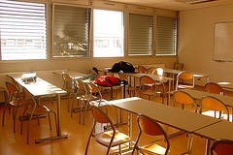
21st Century Skills Languages
http://spotlight.macfound.org/btr/entry/new_media_literacies/
The ‘skills’ described by Jenkins – performance, simulation, appropriation, etc - are actually languages and should be understood in terms of these six dimensions

Slide 51
21st Century Languages
Languages Elements | Performance | Simulation | Appropriation
Syntax
Semantics
Pragmatics
Cognition
Context
Change

Slide 52
Example: Performance - Syntax
Languages Elements | Performance (the ability to adopt alternative identities for the purpose of improvisation and discovery)(subcategories?)
Syntax: - Forms - Rules - Operations - Patterns - Similarities | - Presentation acting, method acting - “Know your lines” etc http://filmtvcareers.about.com/od/gettingthejob/a/GJ_Actor_Tips.htm - Stanislavski’s system (etc…) http://en.wikipedia.org/wiki/Stanislavski%27s_system - Ritual Performance (etc.) http://www.let.rug.nl/koster/papers/JHP.Koster2.Edit.pdf - Comparing Tales (etc.) http://artsedge.kennedy-center.org/content/2343/

