Slide 1
MOOC Aggregator
Objectives: provide single point of access to MOOC opportunities for students.
Presented by: Stephen Downes
Program or portfolio: LPSS

Slide 2
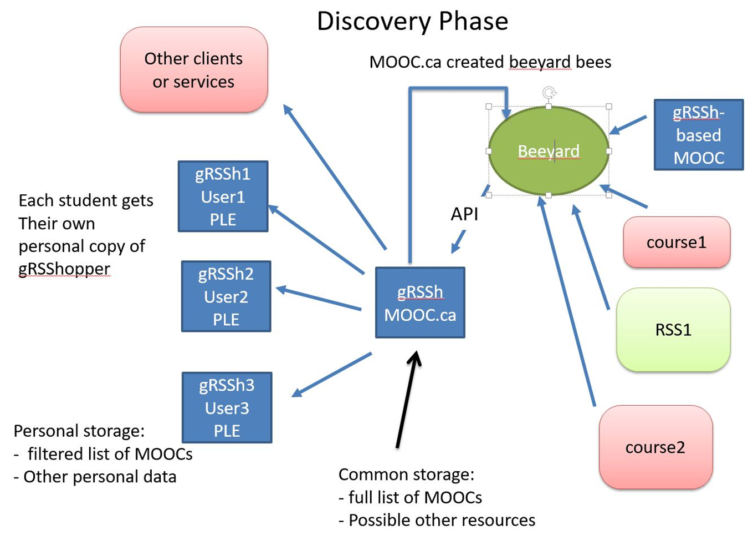
MOOC Aggregator in the Ecosystem (1)
Pppp
http://www.mooc.ca/

Slide 3
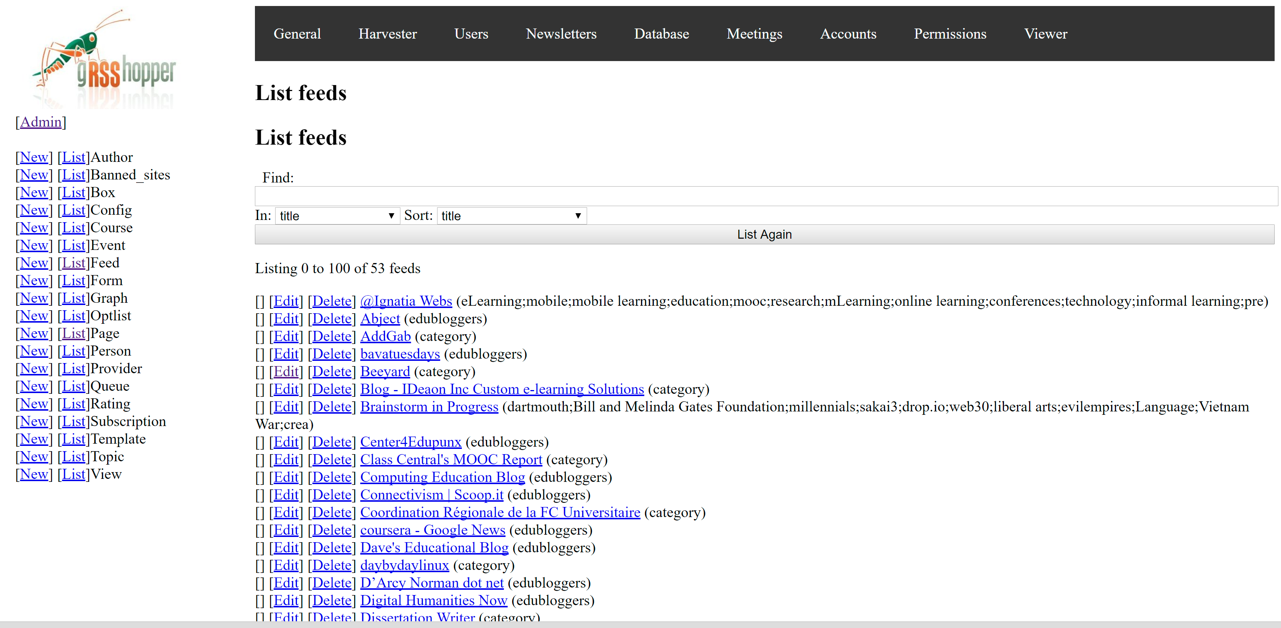
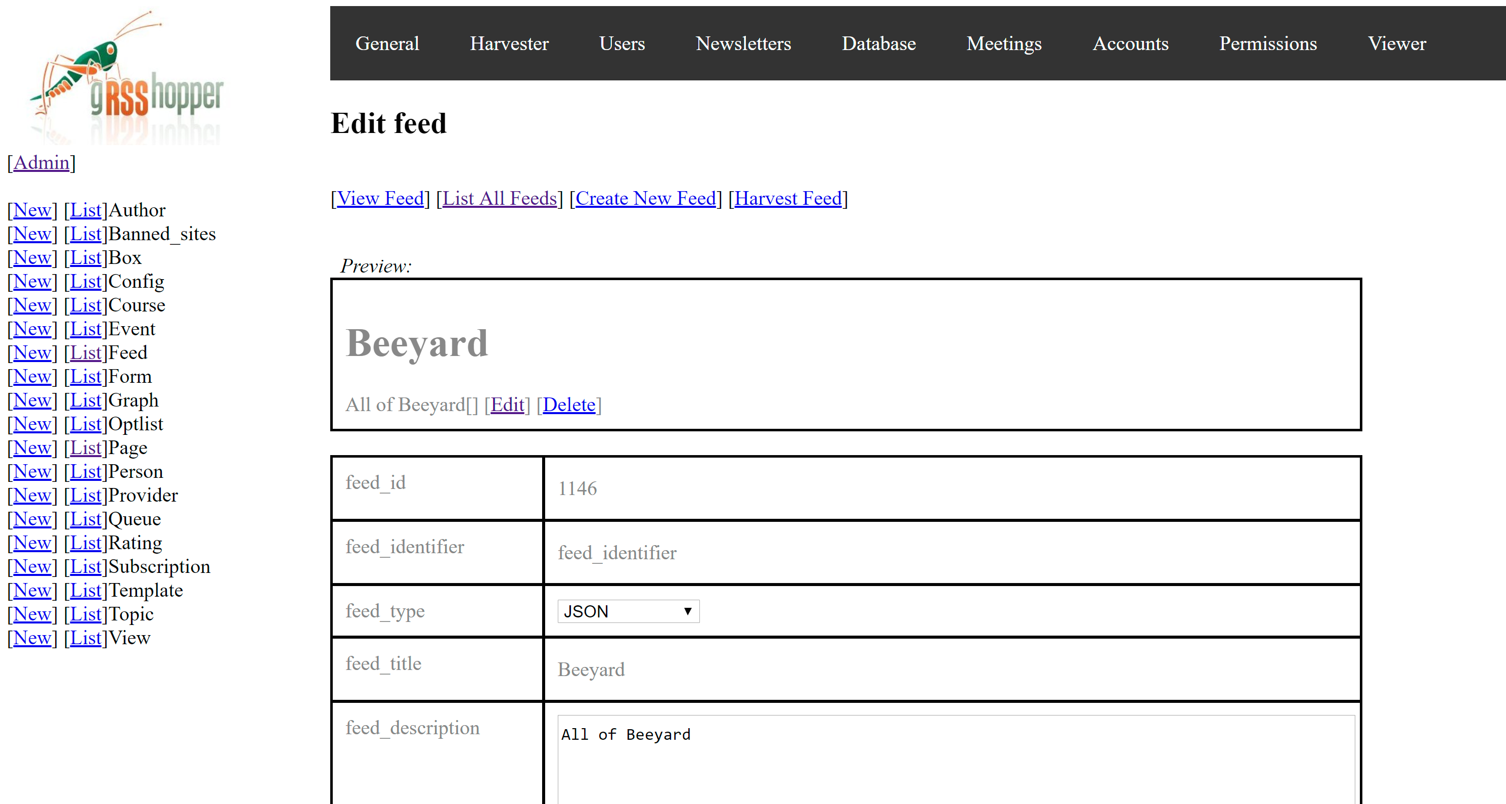
MOOC.ca Admin Functions
Feed List
Feed Management
http://www.mooc.ca/cgi-bin/admin.cgi?db=feed&action=list

Slide 4
MOOC Aggregator in the Ecosystem (2)
Pppp
http://www.mooc.ca/

Slide 5
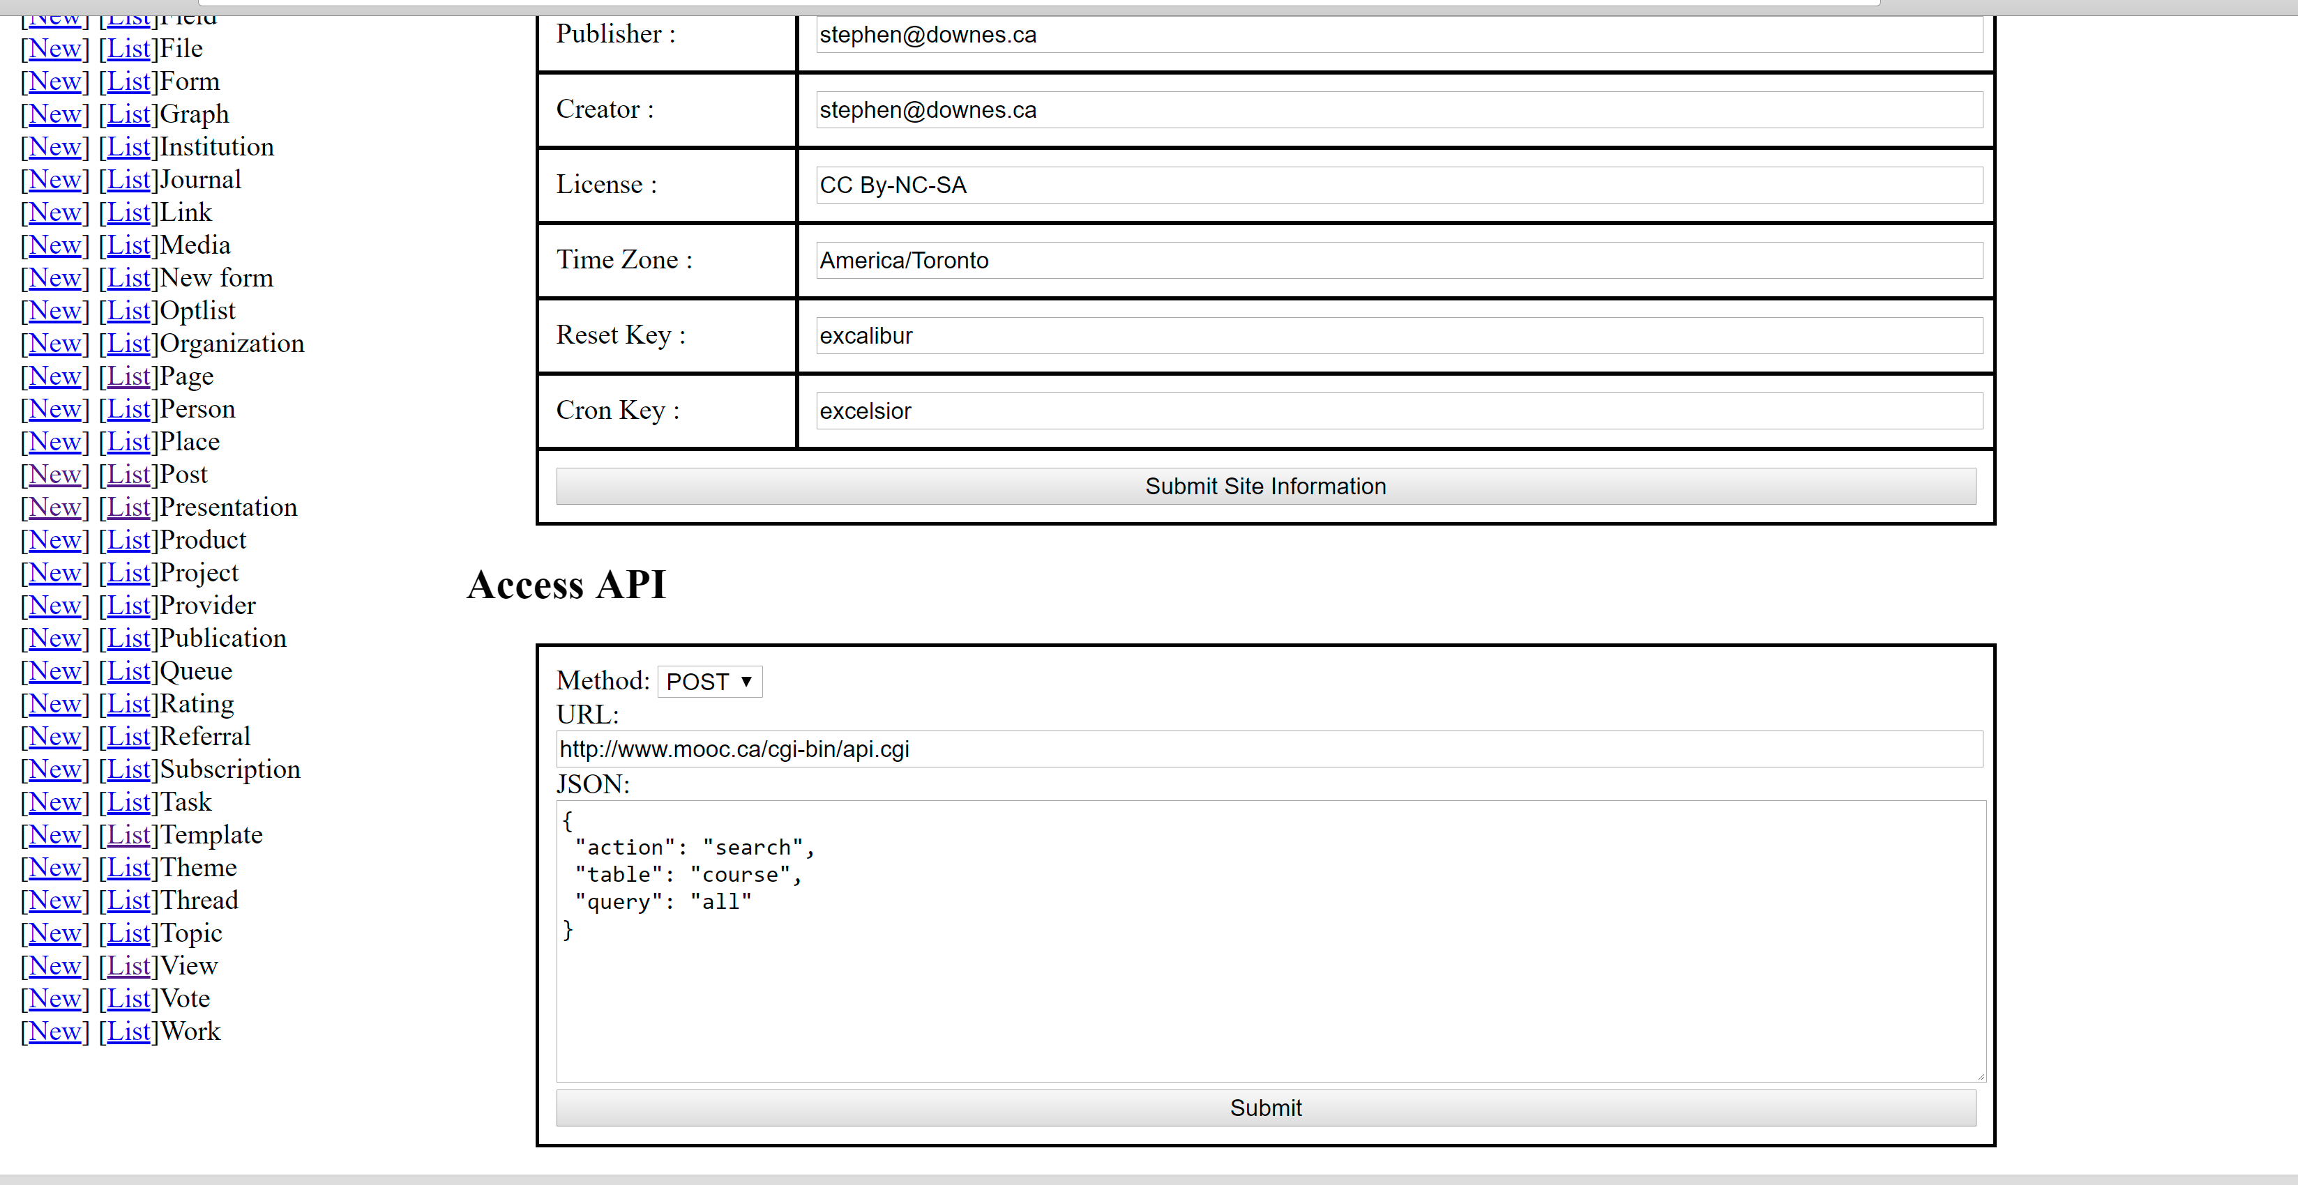
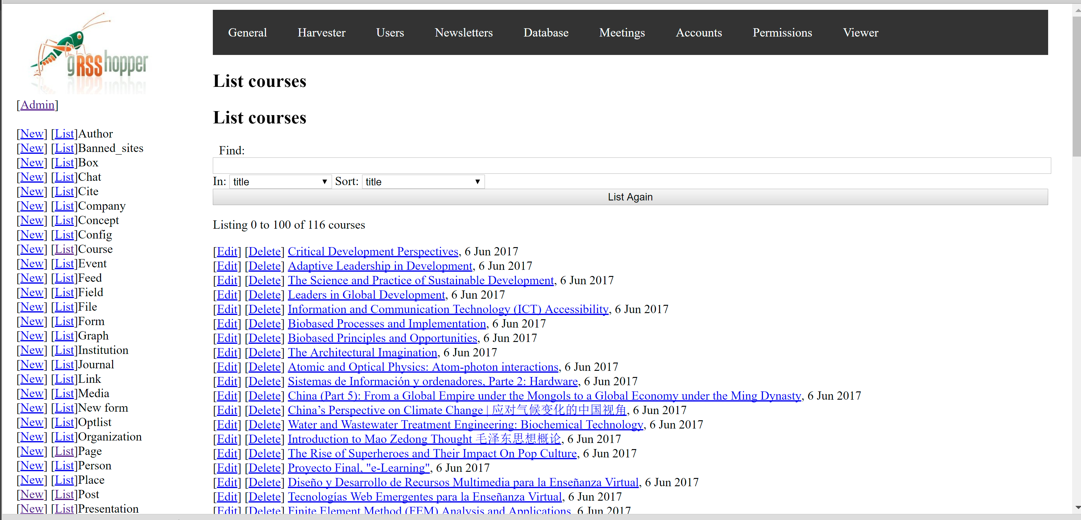
MOOC.ca User Functions
Access API
List Courses
http://www.downes.ca/cgi-bin/admin.cgi

Slide 6
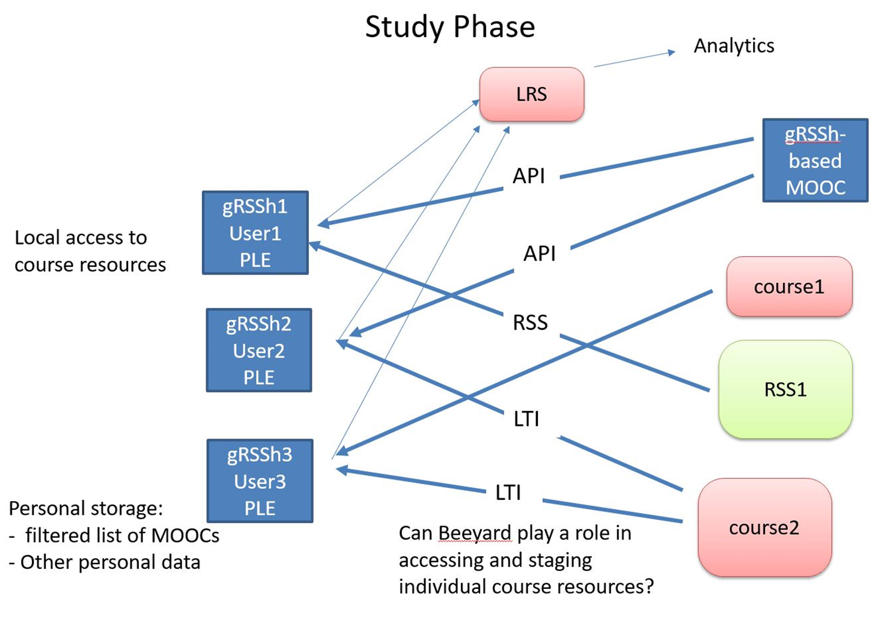
Next Phase: Accessing Courses

