Slide 1
Change, Challenge and Opportunity
Six Trends Defining the Future of Online Learning
Stephen Downes
World Conference in Online Learning, Toronto, Canada, October 18, 2017
http://www.downes.ca/presentation/478

Slide 2
The Backchannel
Use Twitter with the hashtag #icde2017
Or go to
http://bit.ly/icde2017 and use the live comments form
If it looks broken, just reload it. ☺

Slide 3
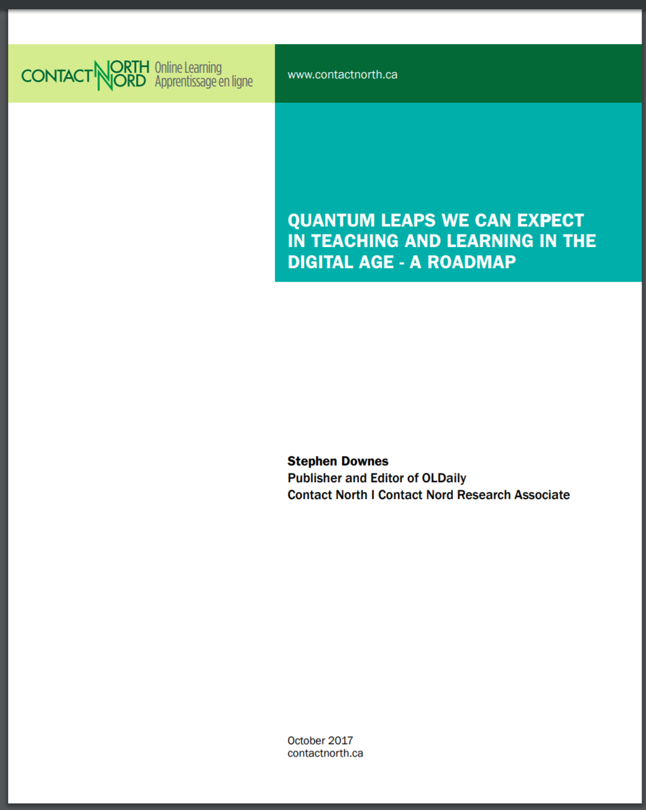
The Report…
You can download this report from: http://bit.ly/quantum-leaps
The report talks a lot about what will change (and some about what will not_ and also about how things change
Add your comments
http://bit.ly/quantum-edit

Slide 4
The Inflexible Law of Learning
It's when we do stuff that we learn, not when stuff does something for us.

Slide 5
Part One. The Future
Machine learning and artificial intelligence
Handheld and Mobile Computing
Badges and Blockchain
Internet of Things
Games, Sims and Virtual Reality
Translation and Collaborative Technology
http://teachonline.ca/tools-trends/exploring-future-education/2016-look-future-online-learning-part-1
http://halfanhour.blogspot.com.tr/2016/03/the-2016-look-at-future-of-online.html

Slide 6
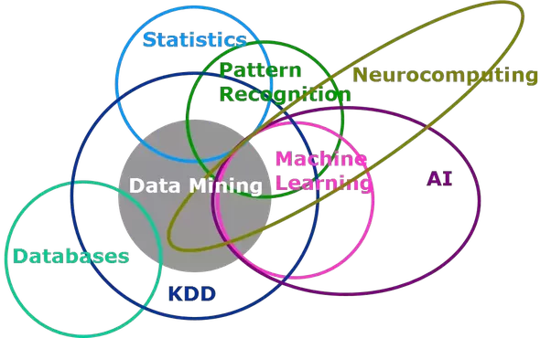
1. Machine Learning and AI
Picture taken from a data mining primer course SAS offered in 1998. https://blogs.sas.com/content/subconsciousmusings/2014/08/22/looking-backwards-looking-forwards-sas-data-mining-and-machine-learning/

Slide 7
Three Types of AI
decision engines - these are expert systems that are based on rule-driven strategies
pattern recognition - perceptual systems that identify patterns from partial or disorganized data
cluster detection - detecting nearest neighbours and categories of things
http://research.microsoft.com/en-us/um/people/cmbishop/prml/
http://www.wtec.org/loyola/kb/c1_s1.htm

Slide 8
Learning Analytics
Siemens and Long
Course-level: learning trails, social network analysis, discourse analysis
Educational data-mining: predictive modeling, clustering, pattern mining
Intelligent curriculum: semantically defined curricular resources
Adaptive content: content sequence based on behavior, recommendation
Adaptive learning: social interactions, learning activity, learner support
https://er.educause.edu/articles/2011/9/penetrating-the-fog-analytics-in-learning-and-education
We talk about predictive analytics as though finishing a course is the problem. But I think the real future is in the quantified self
http://quantifiedself.com/

Slide 9
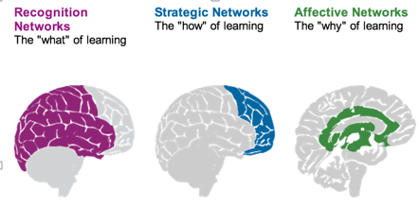
Personalized Learning
Rules-Based Events (like notifications)
User Models
Adaptive Learning
Notes:
- rules-based interactions – eg. Personalized Learning Designer (Blackboard / Moodlerooms) http://www.moodlerooms.com/3-rules-you-cant-live-without-the-personalized-learning-designer/

Slide 10
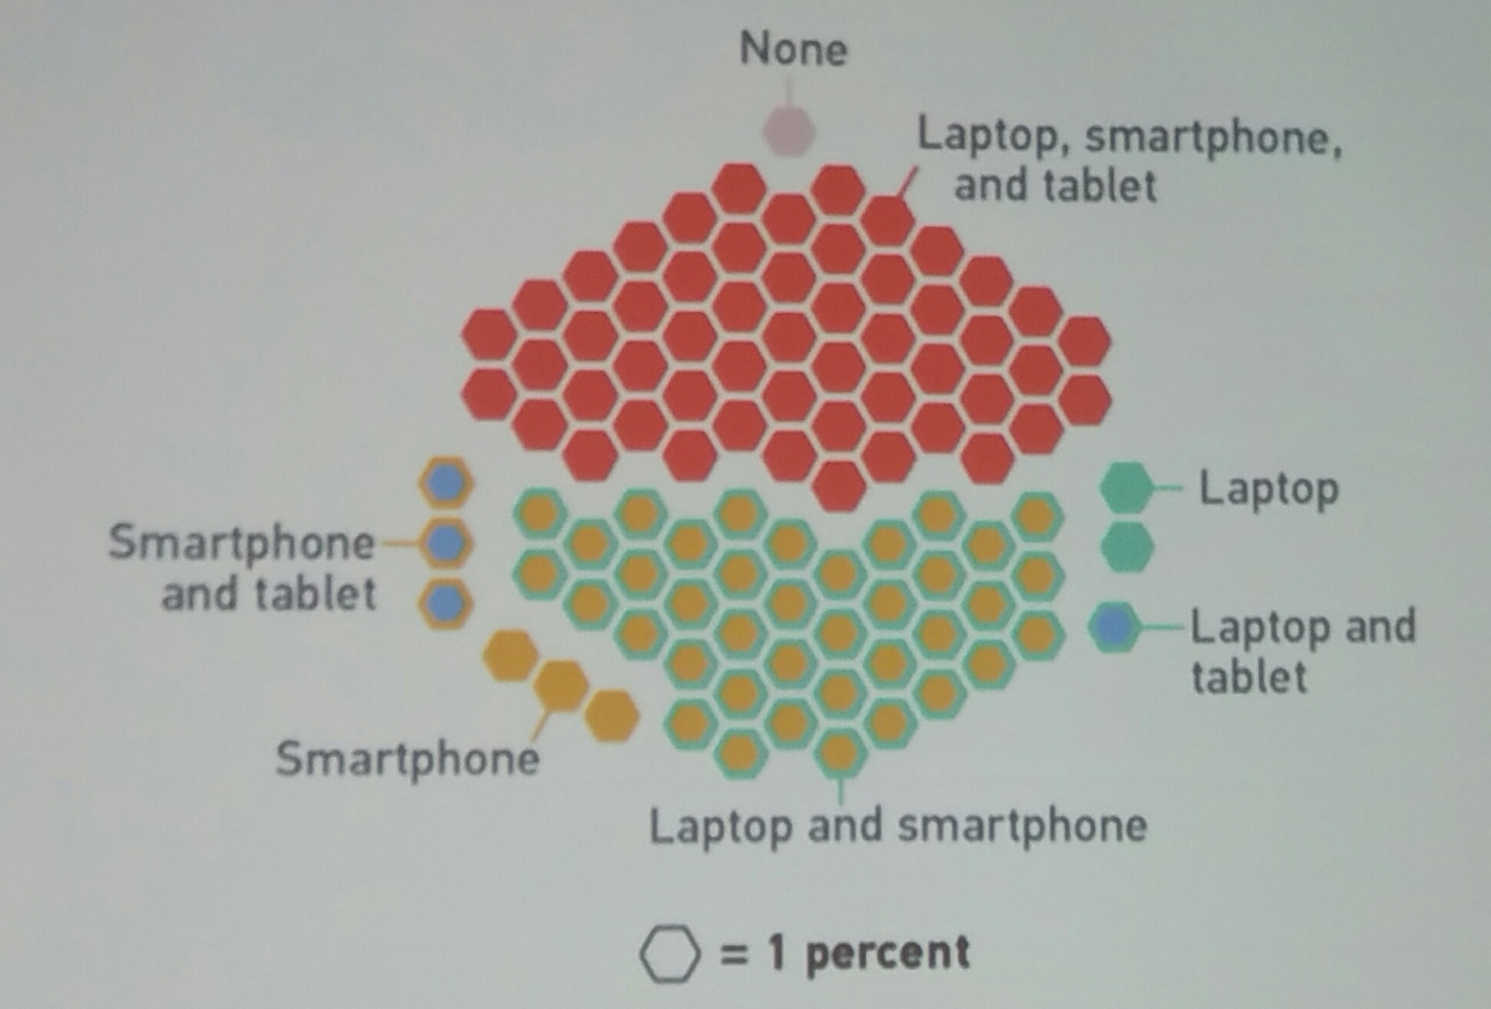
2. Handheld and Mobile Computing
Student laptop, tablet and smartphone ownership; EDUCAUSE survey, 2016
https://www.slideshare.net/PhilHill3/hill-slides-world-congress-session-20171018/1

Slide 11
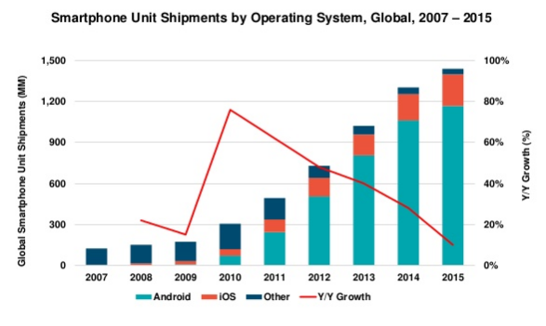
Smartphone Unit Shipments
Mary Meeker http://www.slideshare.net/kleinerperkins/2016-internet-trends-report?ref=http://www.kpcb.com/internet-trends

Slide 12
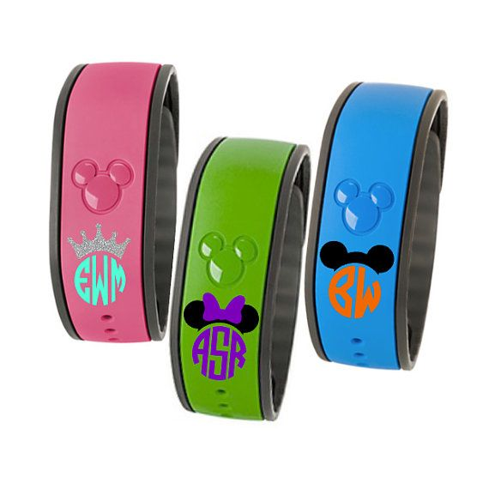
Microcomputing in Unexpected Places
Forbes writes about AI on a chip
A man built a face-recognizing doorbell for about $100 (from O’Reilly).
MagicBand. It’s a bracelet Disney hands out (story on Gizmodo)
https://www.pinterest.ca/explore/magic-bands/?lp=true

Slide 13
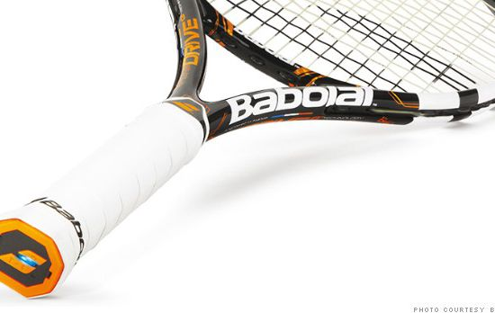
Performance Support
The future of learning isn’t the mobile phone
It’s in the integrated performance support system
http://fortune.com/2014/05/27/a-tennis-racquet-that-isnt-just-strung-but-wired/

Slide 14
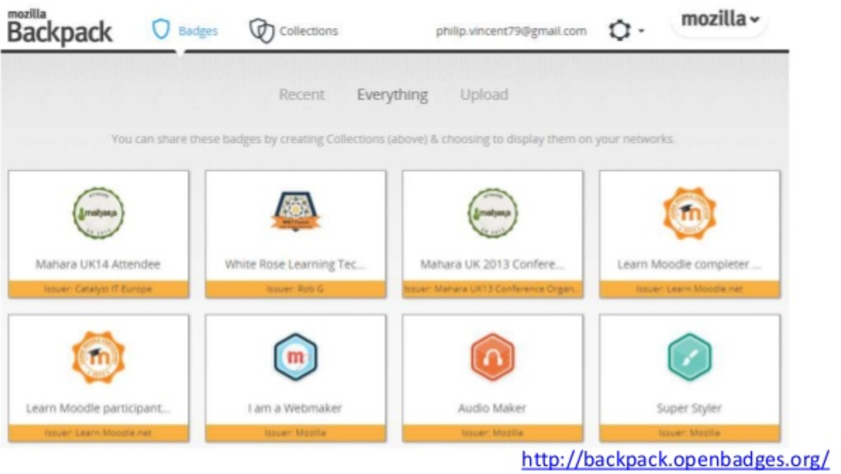
3. Badges and Blockchain

Slide 15
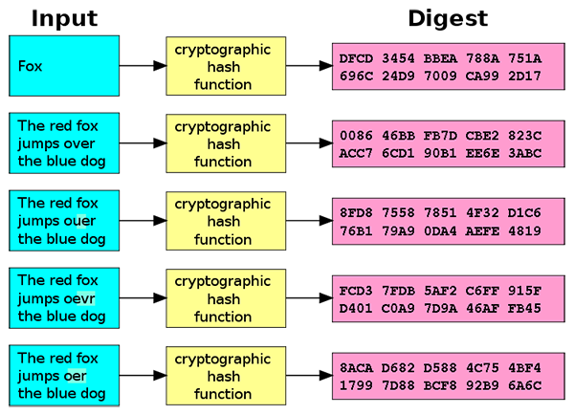
3. Badges and Blockchain
Doug Belshaw:
"If we used the blockchain for Open Badges," he writes, "then we could prove beyond reasonable doubt that the person receiving badge Y is the same person who created evidence X.
http://dmlcentral.net/blog/doug-belshaw/peering-deep-future-educational-credentialing
http://www.downes.ca/search/blockchain

Slide 16
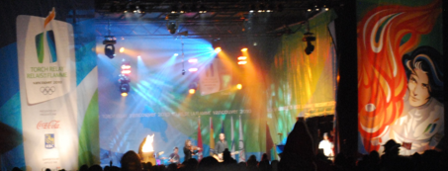
The Dao
Ethereum is a decentralized platform that runs smart contracts https://www.ethereum.org/
The Dao is a 'distributed corporation' that receives investments, chooses projects, and pays for their development; some of these projects return revenue to Dao and others don't. https://magazine.backfeed.cc/dao-alive-now-let-evolution-begin/

Slide 17
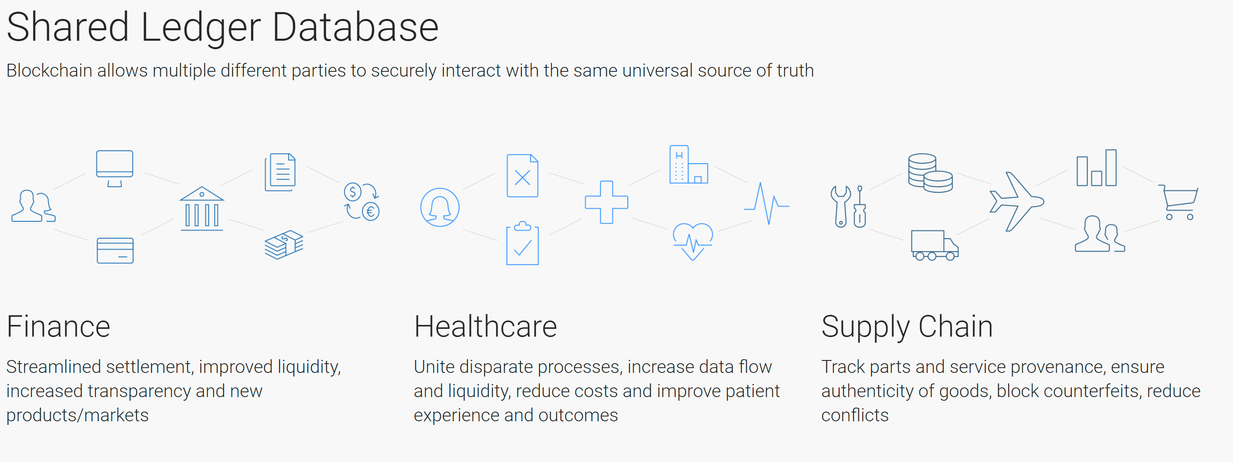
Hyperledger
Hyperledger - https://www.hyperledger.org/
MOOC on EdX - http://www.prnewswire.com/news-releases/hyperledger-launches-first-free-massive-open-online-course-mooc-on-edxorg-300532968.html

Slide 18
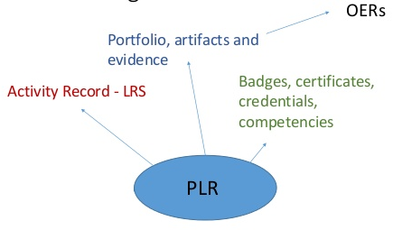
Personal Learning Records

Slide 19
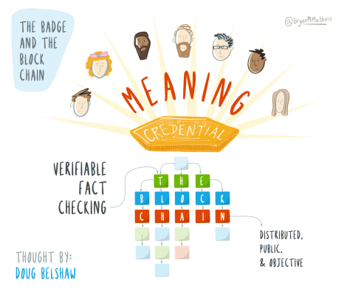
Credentials
Sony plans to launch a testing platform powered by blockchain and that IBM plans to offer 'blockchain-as-a-service,'"
Audrey Watters
http://hackeducation.com/2016/02/25/blockchain-edu1

Slide 20
Microcredentials
Disaggregation of the traditional degree, breaking it into component parts (Horizon Report).
“To be profitable privatisation depends on standardisation to scale.” (We The Educators)
Credentials earn careers, but competencies earn gigs.
http://digitalpromise.org/initiative/educator-micro-credentials/

Slide 21
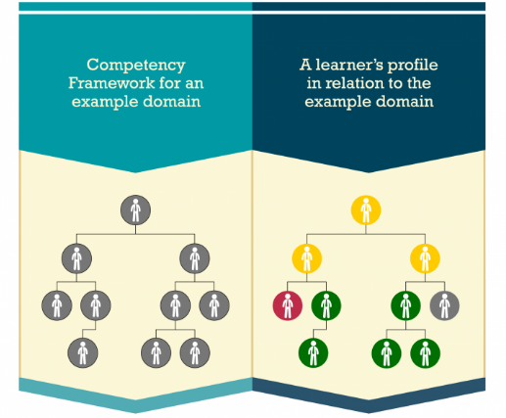
CASS
Competency and Skills System
https://www.adlnet.gov/introducing-the-next-big-thing-cass/

Slide 22
The Assessment Dilemma
How can we design assessment systems that accurately and honestly measure a student’s achievement?
Even more to the point, how can create incentives for honest academic behaviour?
http://pagecentertraining.psu.edu/public-relations-ethics/core-ethical-principles/lesson-2-sample-title/the-pillars-of-public-relations-ethics/

Slide 23
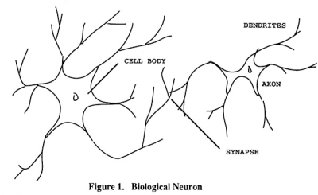
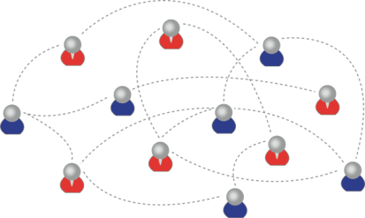
Learning Outcomes
We recognize this
By perfomance in this
There are not specific bits of knowledge or competencies, but rather, personal capacities

Slide 24
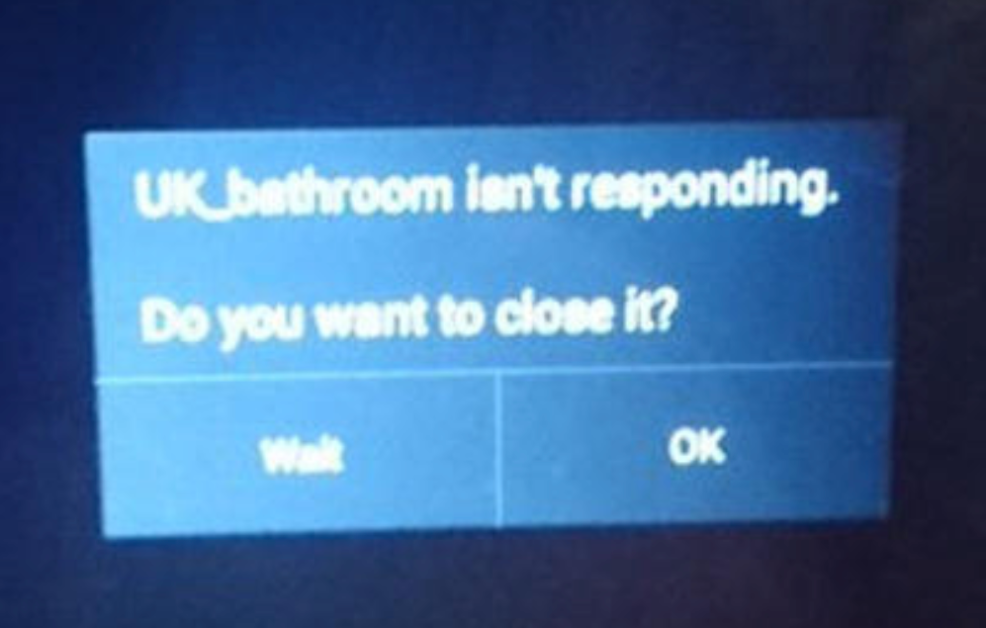
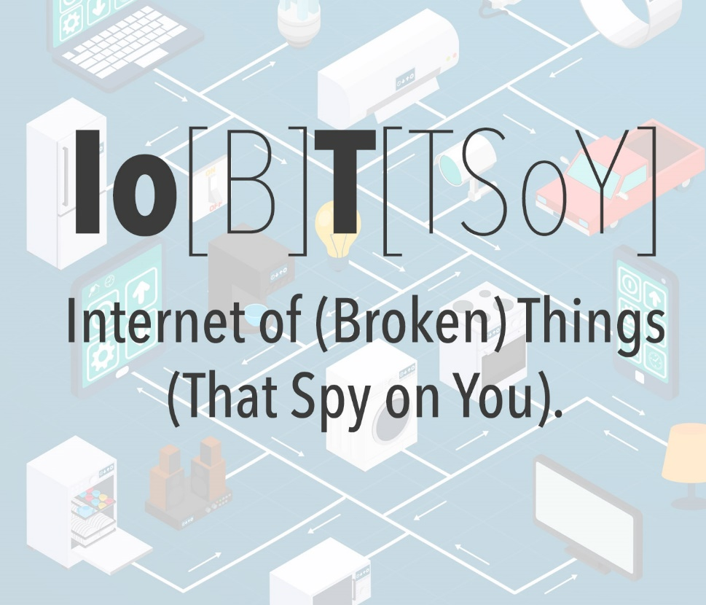
4. Internet of (Broken) Things

Slide 25
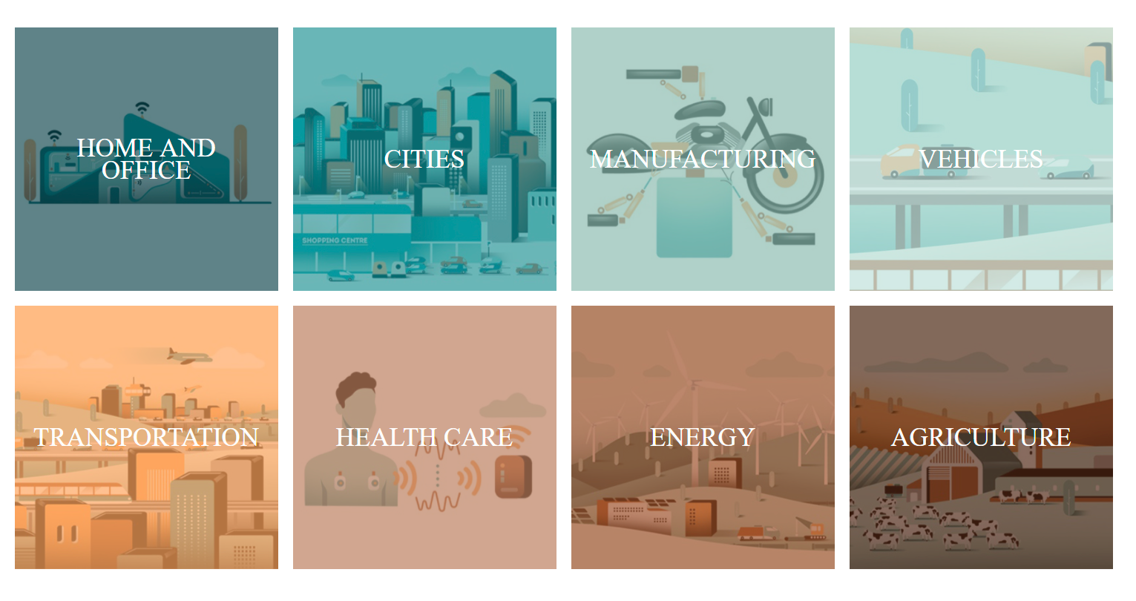
The Internet of Things is Already Everywhere
https://beta.theglobeandmail.com/report-on-business/rob-magazine/the-future-is-smart/article24586994/?ref=http://www.theglobeandmail.com&

Slide 26
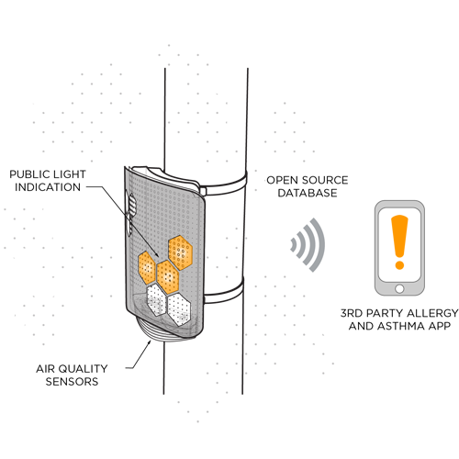
The Main Enablers
Microcomputing & cloud computing
Wireless communication (and communication standards)
Sensors (and AI-augmented sensors)
Remote control / interfaces
https://arrayofthings.github.io/

Slide 27
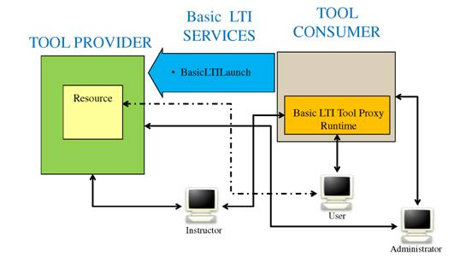
Learning Tools
LTI Producer – provides features
LTI Consumer – connects to features
https://www.imsglobal.org/specs/ltiv1p0/implementation-guide
Notes:
LTI Proivider plugin - https://moodle.org/plugins/local_ltiprovider
The LTI Provider is an application which provides features that other people want to and can connect to from their own LMS.
Provide access to full courses or single activities.
Single sign on
Change the navigation block of a course or activity for displaying information and links only regarding to your current course.
Send backs course or activity final grades to the LTI consumer tool
Modify the course or activity page for hiding the header, footer and left or right blocks
The LTI Consumer is an application which can connect to the 3rd party Provider system to avail of the features it has.
Eg. http://support.mediacore.com/customer/portal/articles/869178-configuring-a-lti-consumer

Slide 28
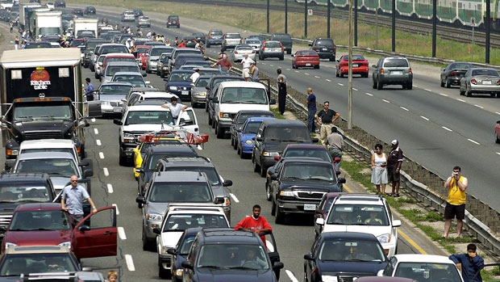
https://gizmodo.com/roombas-next-big-step-is-selling-maps-of-your-home-to-t-1797187829
What happens when companies know the state of all your devices?
http://www.cbc.ca/news/canada/car-tracking-devices-spark-privacy-concerns-1.1366687

Slide 29
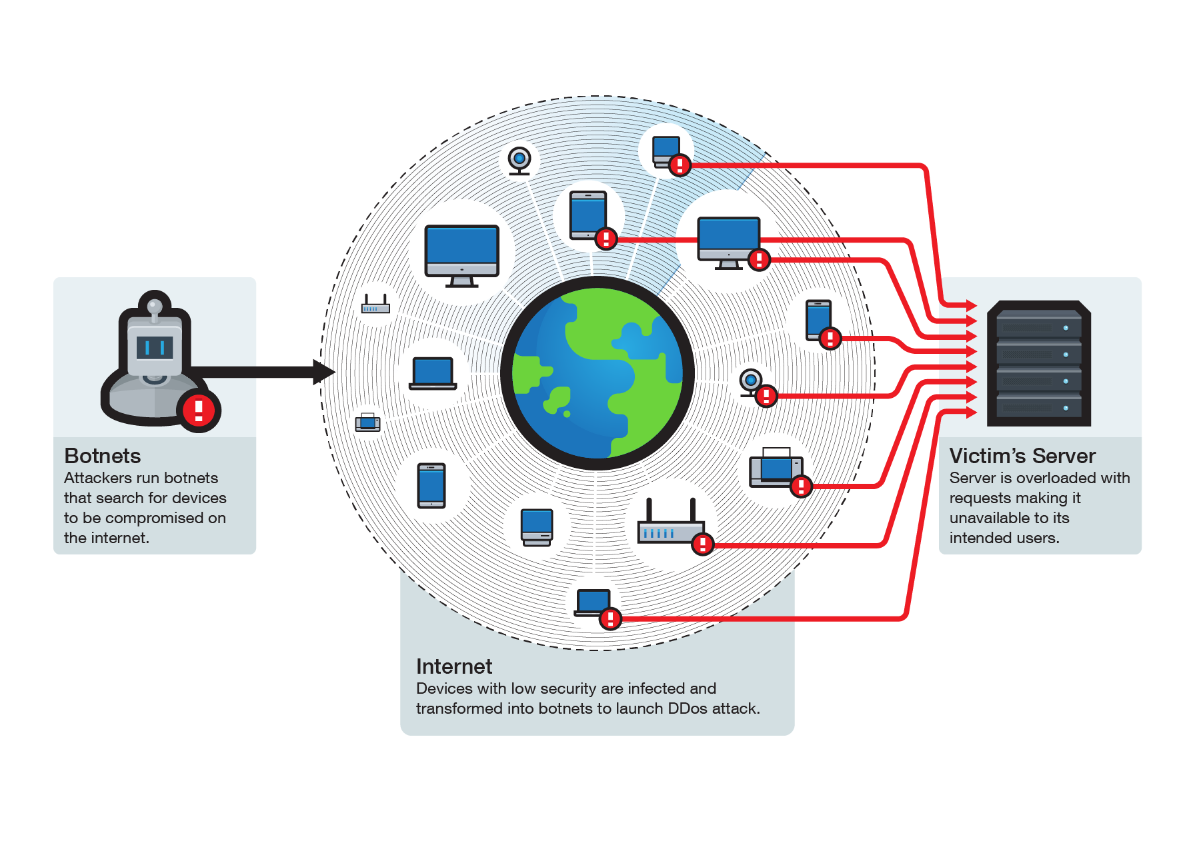
What Happens when they Break?
Botnets and worse
http://blog.trendmicro.com/trendlabs-security-intelligence/internet-things-ecosystem-broken-fix/

Slide 30
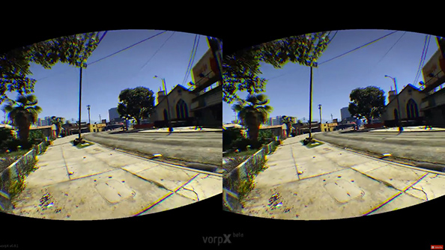
5. Games, Sims and Virtual Reality
https://www.pcgamesn.com/grand-theft-auto-v/the-best-grand-theft-auto-v-mods

Slide 31
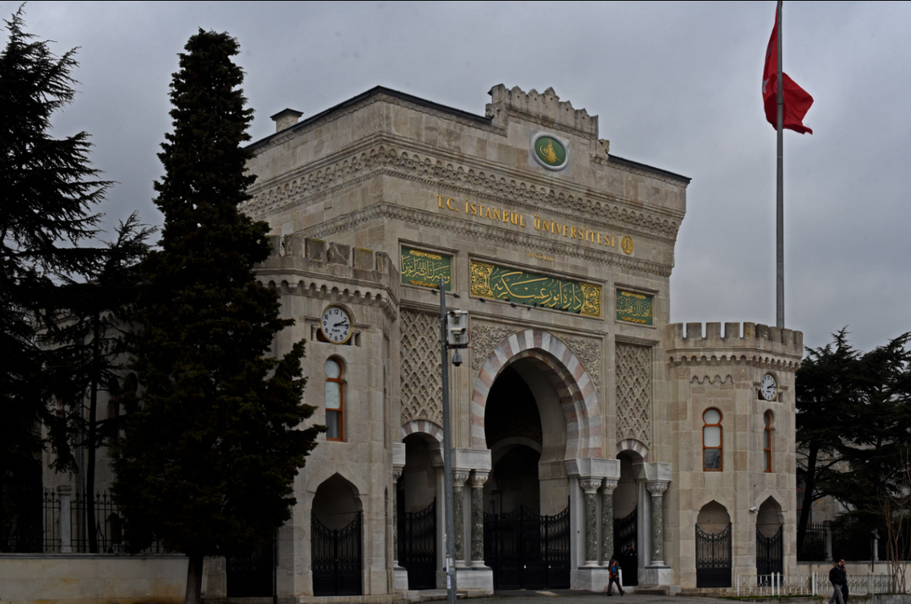
‘Gamification’ – adds game elements to learning
‘Serious Games’ – employs a game to facilitate learning
https://badgeville.com/wiki/Gamification

Slide 32
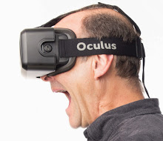
Oculus Rift
1. Freezers
2. Smilers
3. Grippers
4. Swayers
5. Screamers
6. Freak-outs
http://donaldclarkplanb.blogspot.ca/2014/11/oculus-rift-freezers-smilers-grippers.html
http://www.downes.ca/search/oculus

Slide 33
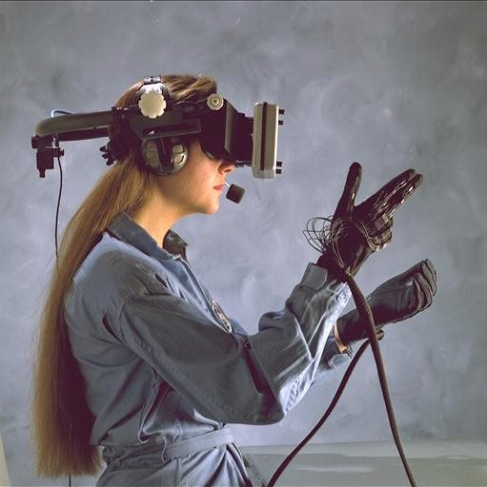
Immersive Reality
What is ‘Immersive’ – a VR helmet?
Key element of immersion: belief
(authentic) applications that matter
social presence (cognitive presence, teaching presence) - https://www.mnsu.edu/its/academic/isalt_social_presence_theory.pdf
multi-modality – cognitive + kinesthetic, etc. - https://www.slideshare.net/jtholden/the-learning-styles-revelation-research-from-cognitive-science
Games and Gamification?

Slide 34
6. Translation and Collaborative Technology
https://en.wikipedia.org/wiki/Videotelephony

Slide 35
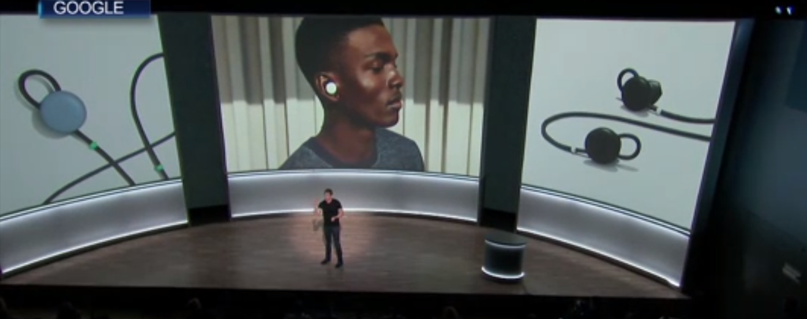
Google shows off wireless headphones that it says can translate languages on the fly
https://www.cnbc.com/2017/10/04/google-translation-earbuds-google-pixel-buds-launched.html

Slide 36
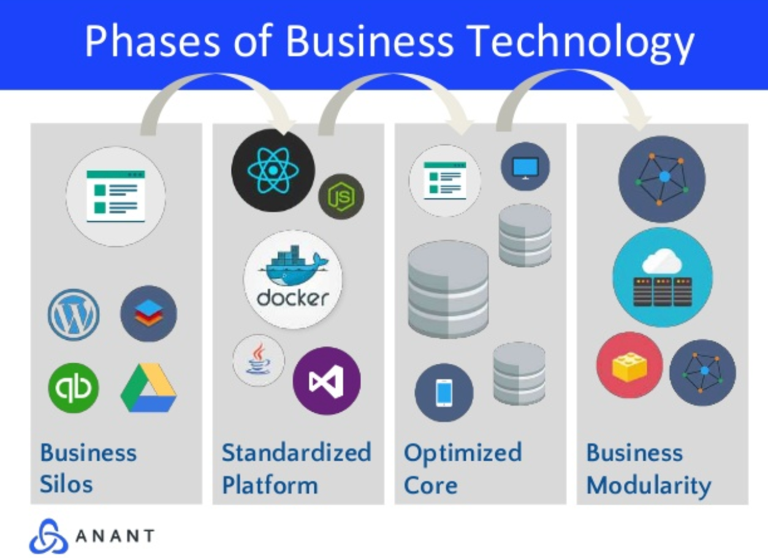
Slack, Airtable, Trello: what makes them good?
https://pt.slideshare.net/AnantCorp/team-collaboration-slack-airtable-trello-what-makes-them-good-76384318

Slide 37
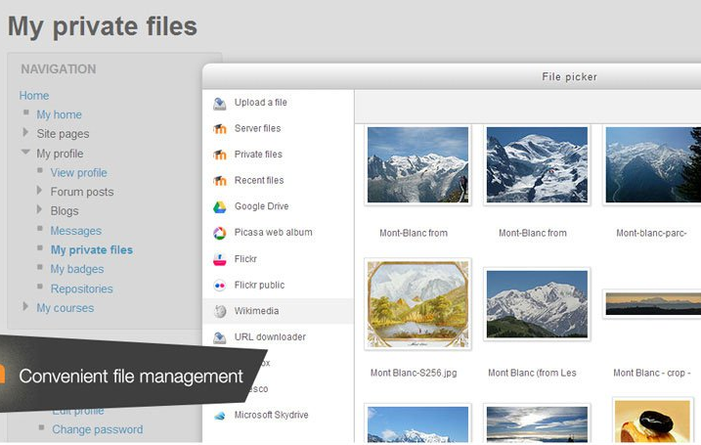
Cloud Storage
Cloud hosting of Moodle
File management
Notes:
MoodleCoud - https://moodle.com/cloud/
(includes BigBlueButton)
Cloud storage - https://docs.moodle.org/30/en/Working_with_files

Slide 38
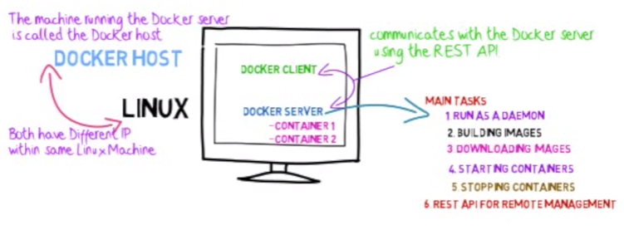
Docker
http://www.tomsitpro.com/articles/docker-enterprise-hub-orchestration,1-2375.html
Notes:
Image: http://www.tomsitpro.com/articles/docker-enterprise-hub-orchestration,1-2375.html
https://www.youtube.com/watch?v=pgiFwriExYg

Slide 39
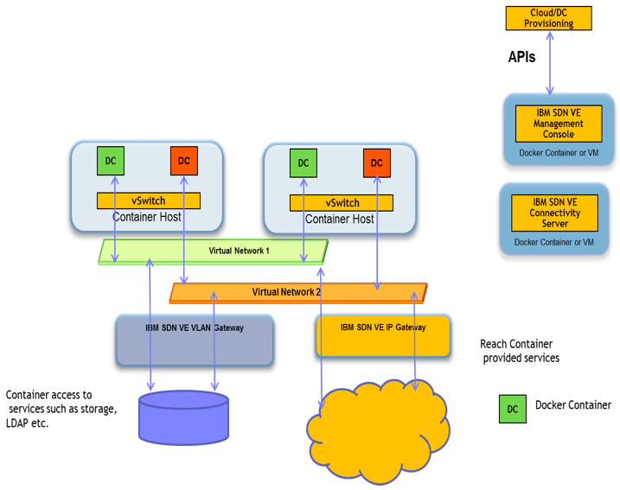
Cloud Infrastructures
Environments: VMWare Fusion, VirtualBox
Provisioners: Docker, Vagrant
Configuration: Chef, Puppet
Providers: AWS, MS Server
Services: MS Cognitive, Wolfram Alpha, Segment
Serverless CMS - http://www.downes.ca/post/66459

Slide 40
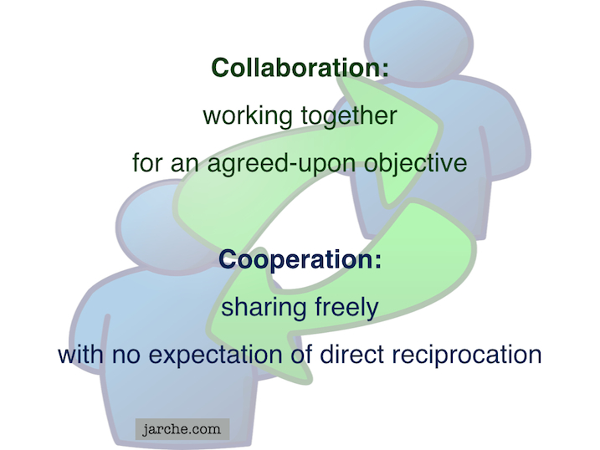
Communication is and will be everywhere
But the future lies in cooperation, not collaboration
https://cyber.law.harvard.edu/research/cooperation
Image: http://Jarche.com

Slide 41
Part Two. What Does Learning Become?
Context-Sensitive
Engaging
Personal

Slide 42
Any Time / Any Place?
It’s all about context
The airplane cockpit is no place for a two week course
Learning will be like water or electricity – or text
http://www.sciencedirect.com/science/article/pii/S1319157813000372

Slide 43
Engaging = Immersive + Wanted
Just because it’s interactive doesn’t make it engaging
We have to want to be there
And we have to believe that we’re there
http://www4.ncsu.edu/unity/lockers/users/f/felder/public/Columns/Active.pdf

Slide 44
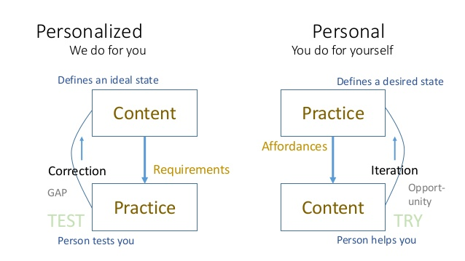
Learning is Personal
Tomorrow: 9:45 a.m. – Birchwood Room – Mezzanine Level

Slide 45
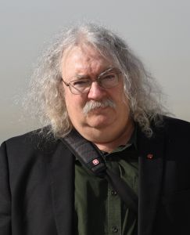
http://www.downes.ca

