Slide 1
A Roadmap of the Future of Teaching and Learning
Stephen Downes
Online Educa Berlin
December 7, 2017
http://www.downes.ca/presentation/483

Slide 2
A Roadmap of the Future of Teaching and Learning
Stephen Downes
Online Educa Berlin
December 7, 2017

Slide 3
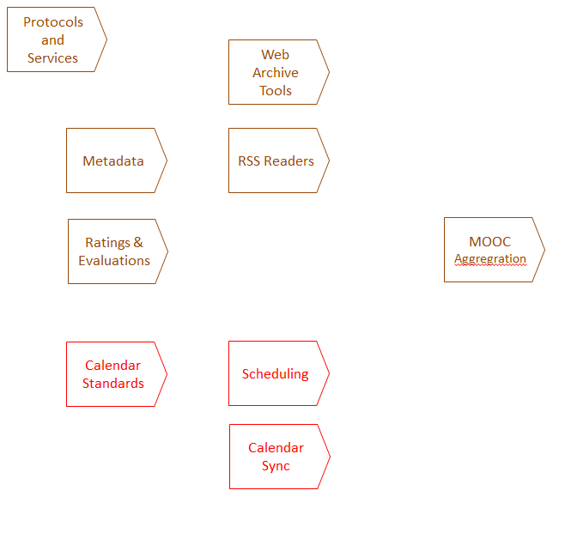
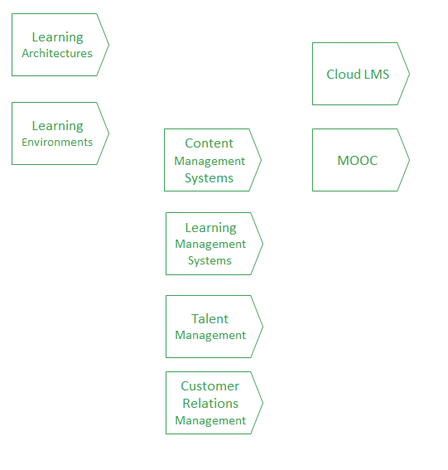
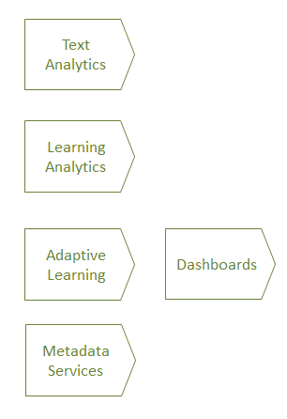
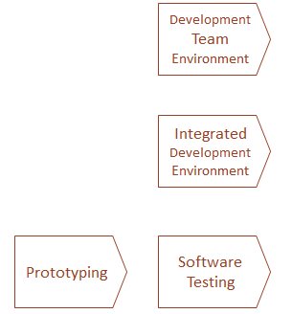
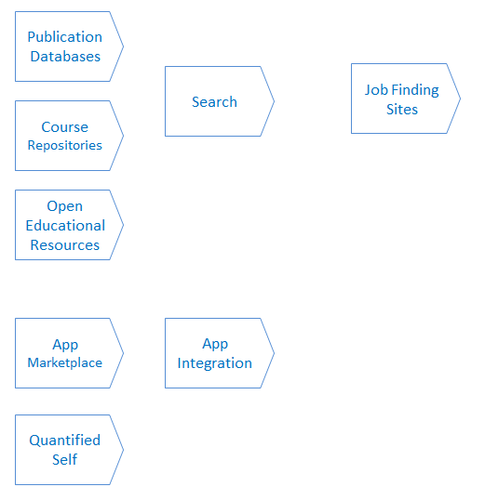
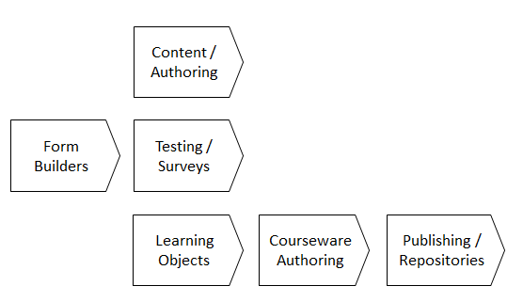
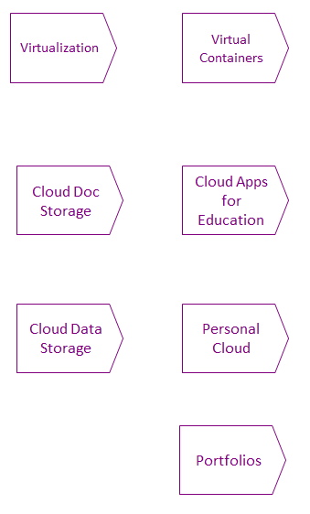
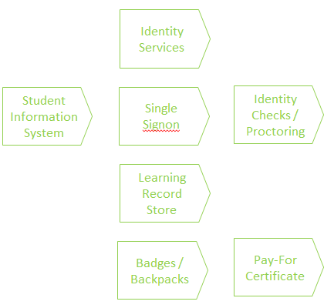
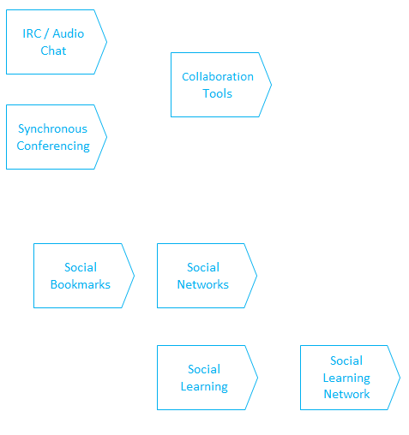
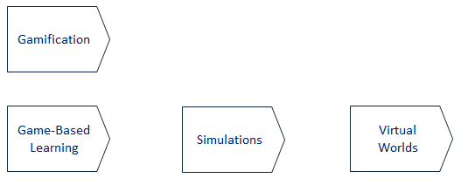
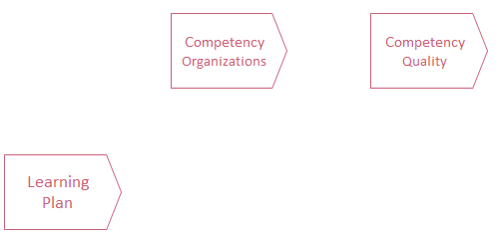
Learning Environments
Aggregation and Metadata
Development
Analytics
Calendaring
Resource Bases and Sources
Authoring and Publishing
Cloud apps and storage
Learning Records
Learning Activities
Competencies and Skills
Collaboration and Social Media

Slide 4
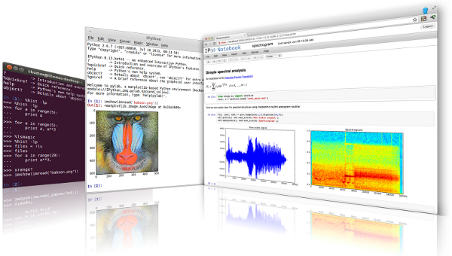
Authoring and Publishing
Content / Authoring
Form Builders
Testing / Surveys
Open Data
Data Books
Learning Objects
Courseware Authoring
Publishing / Repositories
iPython is an interactive programming shell for the Python programming language https://ipython.org/
The Jupyter Notebook is an open-source web application that allows you to create and share documents that contain live code… http://jupyter.org/

Slide 5
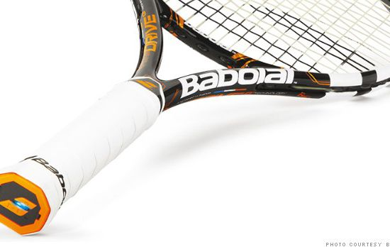
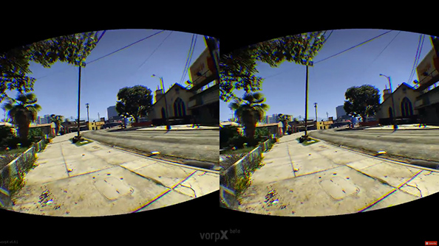
Learning Activities
Gamification
Performance Support
Game-Based Learning
Simulations
Virtual Worlds
http://fortune.com/2014/05/27/a-tennis-racquet-that-isnt-just-strung-but-wired/
Internet of Things
Augmented Reality
MagicBand. It’s a bracelet Disney hands out (story on Gizmodo)
https://www.pcgamesn.com/grand-theft-auto-v/the-best-grand-theft-auto-v-mods

Slide 6
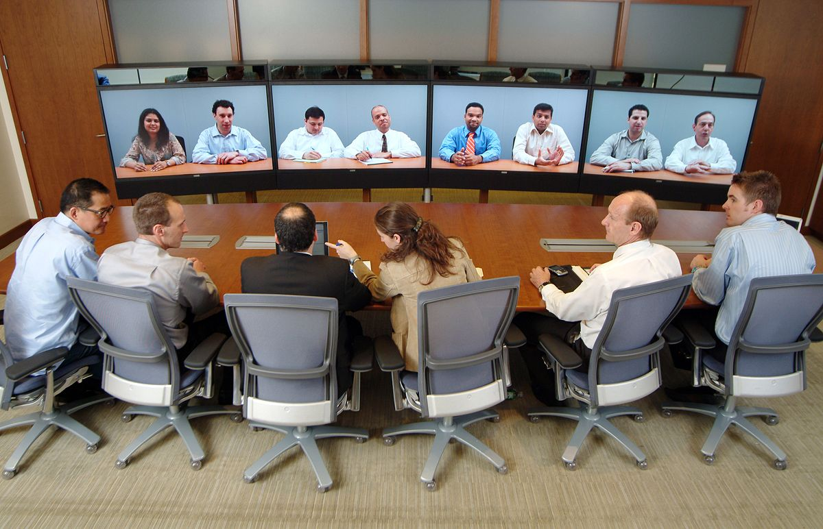
IRC / Audio Chat
Collaboration and Social Media
Collaboration Tools
Synchronous Conferencing
Social Bookmarks
Social Networks
Social Learning
Social Learning Network
AutomatedTranslation
https://www.cnbc.com/2017/10/04/google-translation-earbuds-google-pixel-buds-launched.html

Slide 7
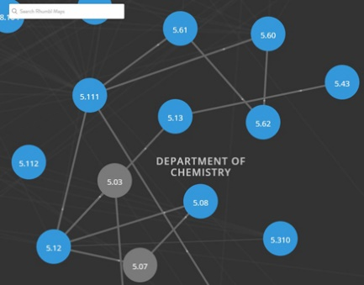
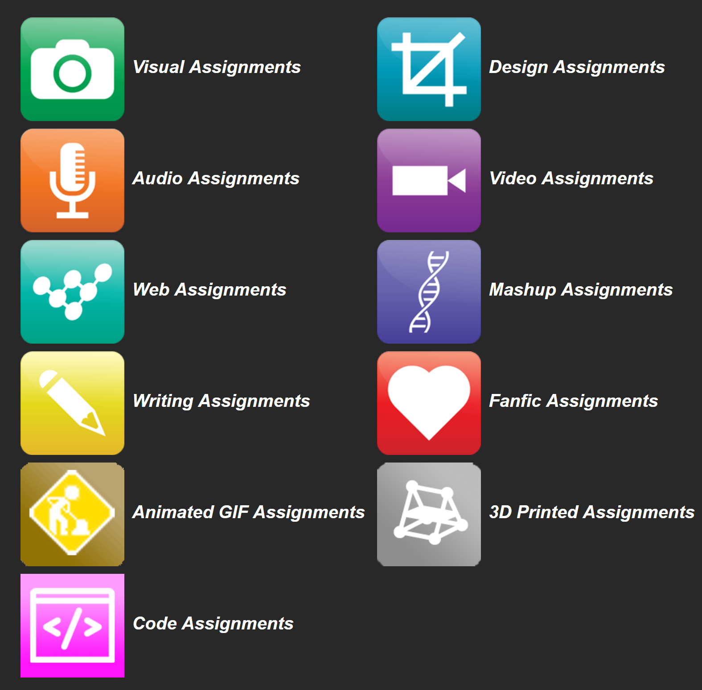
Resource Bases and Sources
Publication Databases
Search
Job Finding Sites
Course Repositories
https://openstax.org/
OERs are now widely available through subject-specific libraries with provisions forauthoring as well
Open Educational Resources
App Marketplace
https://ocw.mit.edu/
Quantified Self
App Integration
DS106 – assignment bank http://assignments.ds106.us/
https://www.oercommons.org/

Slide 8
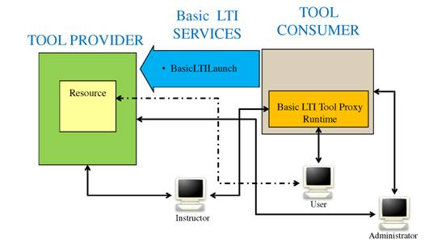
Learning Environments
Learning Architectures
Cloud LMS
Learning Environments
Personal Learning Environments
Content Management Systems
MOOC
Learning Management Systems
LTI Producer – provides features
LTI Consumer – connects to features
Talent Management
Customer Relations Management
Learning Platforms
https://www.imsglobal.org/specs/ltiv1p0/implementation-guide

Slide 9
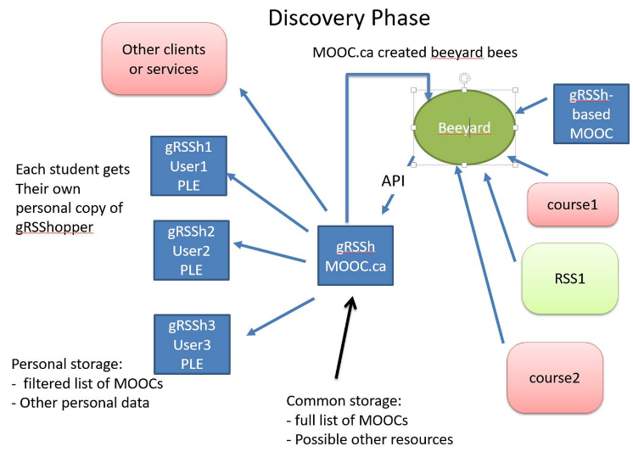
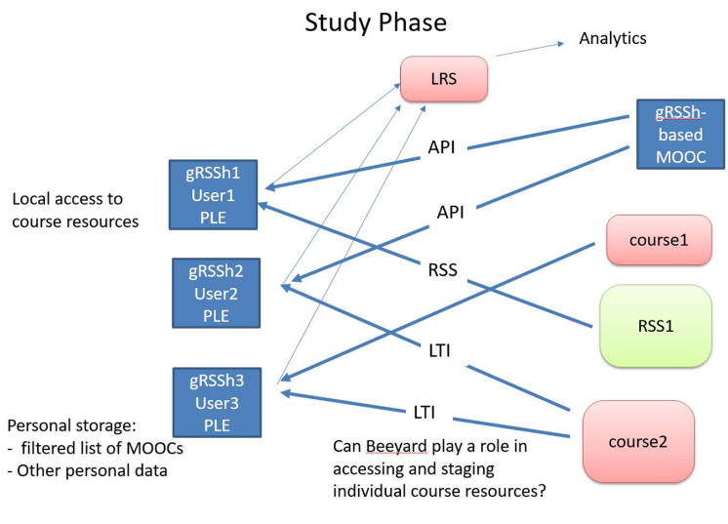
Aggregation and Metadata
Protocols and Services
Web Archive Tools
Metadata
RSS Readers
Ratings & Evaluations
MOOC Aggregration
APIs / JSON
Calendar Standards
Scheduling
Calendaring
Calendar Sync

Slide 10
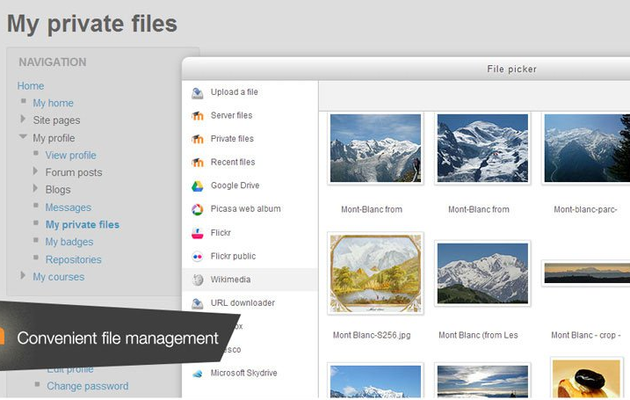
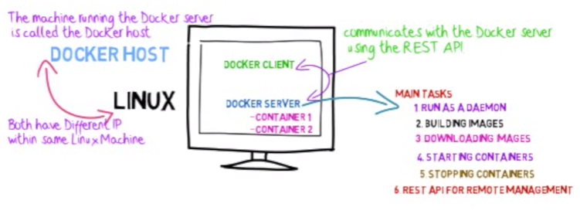
Cloud apps and storage
Virtualization
Virtual Containers
Cloud Doc Storage
Cloud Apps for Education
Personal Cloud
Cloud Data Storage
Portfolios
http://www.tomsitpro.com/articles/docker-enterprise-hub-orchestration,1-2375.html

Slide 11
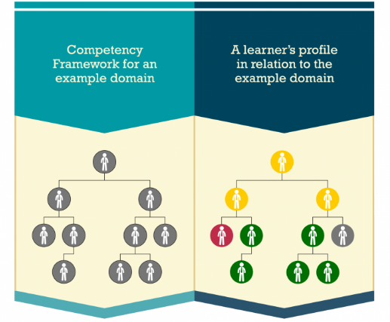
Competencies and Skills
Assessment
Competency Organizations
Competency Quality
Automated Assessment
Learning Plan
accurately and honestly measure a student’s achievement?
incentives for honest academic behaviour?
https://www.adlnet.gov/introducing-the-next-big-thing-cass/
http://pagecentertraining.psu.edu/public-relations-ethics/core-ethical-principles/lesson-2-sample-title/the-pillars-of-public-relations-ethics/

Slide 12
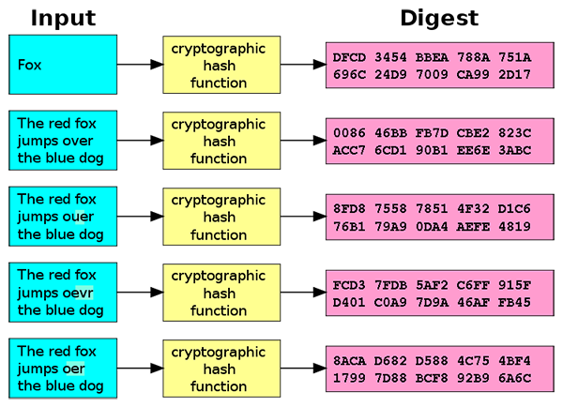
Learning Records
Personal Learning Record
Identity Services
Student Information System
Single Signon
Identity Checks / Proctoring
Doug Belshaw:
"If we used the blockchain for Open Badges," he writes, "then we could prove beyond reasonable doubt that the person receiving badge Y is the same person who created evidence X.
Learning Record Store
Blockchain
Badges / Backpacks
Pay-For Certificate
http://dmlcentral.net/blog/doug-belshaw/peering-deep-future-educational-credentialing
http://www.downes.ca/search/blockchain

Slide 13
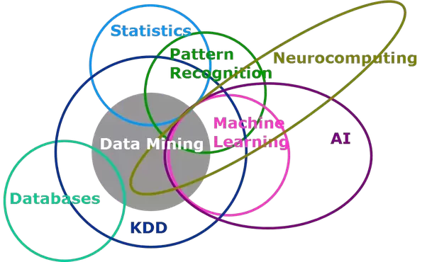
Analytics
Text Analytics
Learning Analytics
Adaptive Learning
Dashboards
Picture taken from a data mining primer course SAS offered in 1998. https://blogs.sas.com/content/subconsciousmusings/2014/08/22/looking-backwards-looking-forwards-sas-data-mining-and-machine-learning/
Metadata Services
Quantified Self
We talk about predictive analytics as though finishing a course is the problem. But I think the real future is in the quantified self
Siemens and Long https://er.educause.edu/articles/2011/9/penetrating-the-fog-analytics-in-learning-and-education
http://quantifiedself.com/

Slide 14
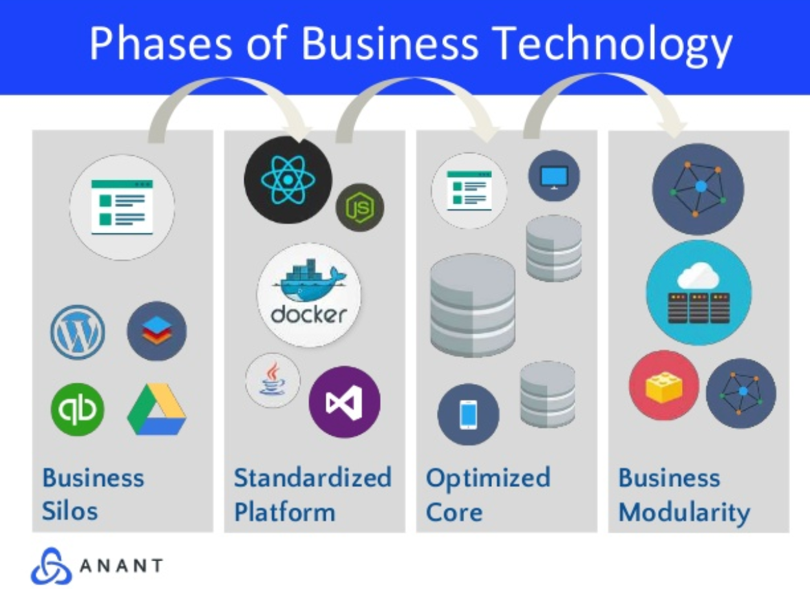
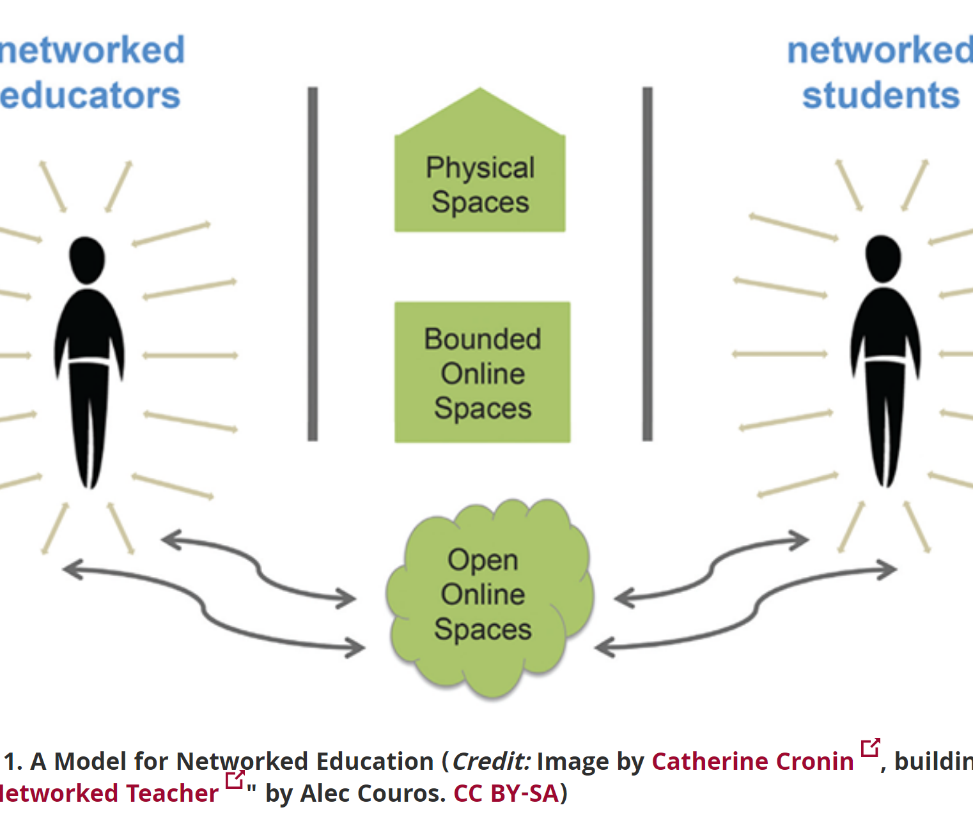
Development
Development Team Environment
Community Resource Development
Integrated Development Environment
Prototyping
Software Testing
Slack, Airtable, Trello: what makes them good?
https://pt.slideshare.net/AnantCorp/team-collaboration-slack-airtable-trello-what-makes-them-good-76384318
Open Pedagogy – Using OER to Chane How We Teach – Heather Ross https://words.usask.ca/gmcte/2016/09/26/open-pedagogy-using-oer-to-change-how-we-teach/

Slide 15
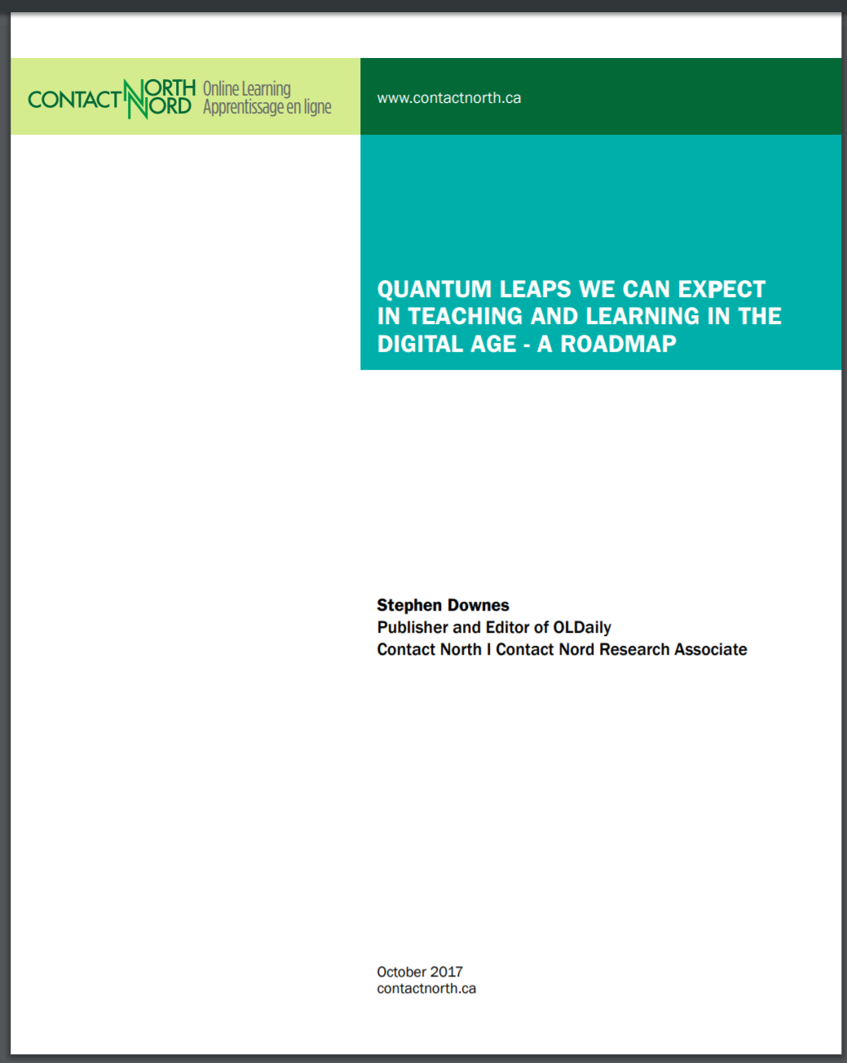
The Report…
You can download this report from: http://bit.ly/quantum-leaps
The report talks a lot about what will change (and some about what will not_ and also about how things change
Add your comments
http://bit.ly/quantum-edit

Slide 16
http://www.downes.ca

