Slide 1
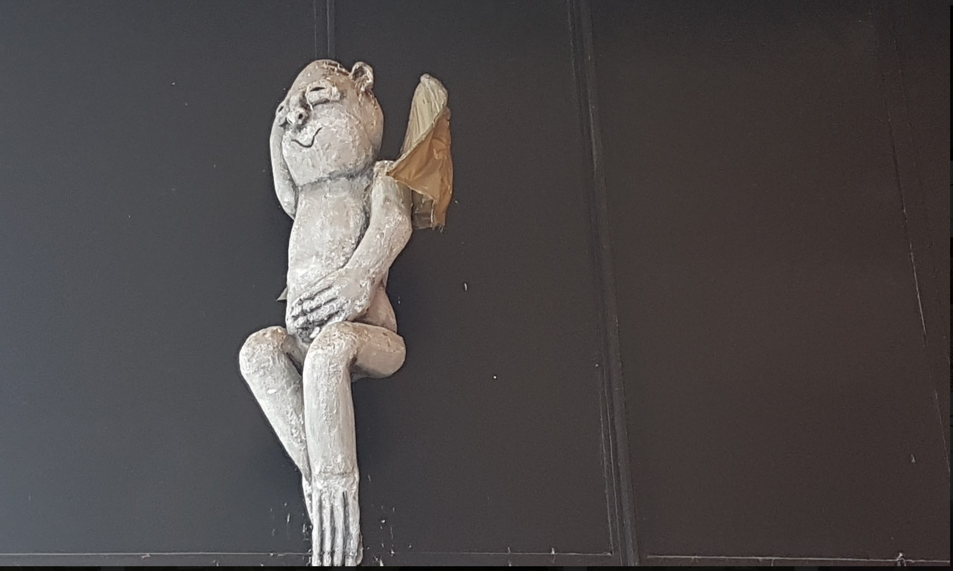
Why Personal Learning?
Stephen Downes
Canada Moodle Moot
York University
February 23, 2018

Slide 2
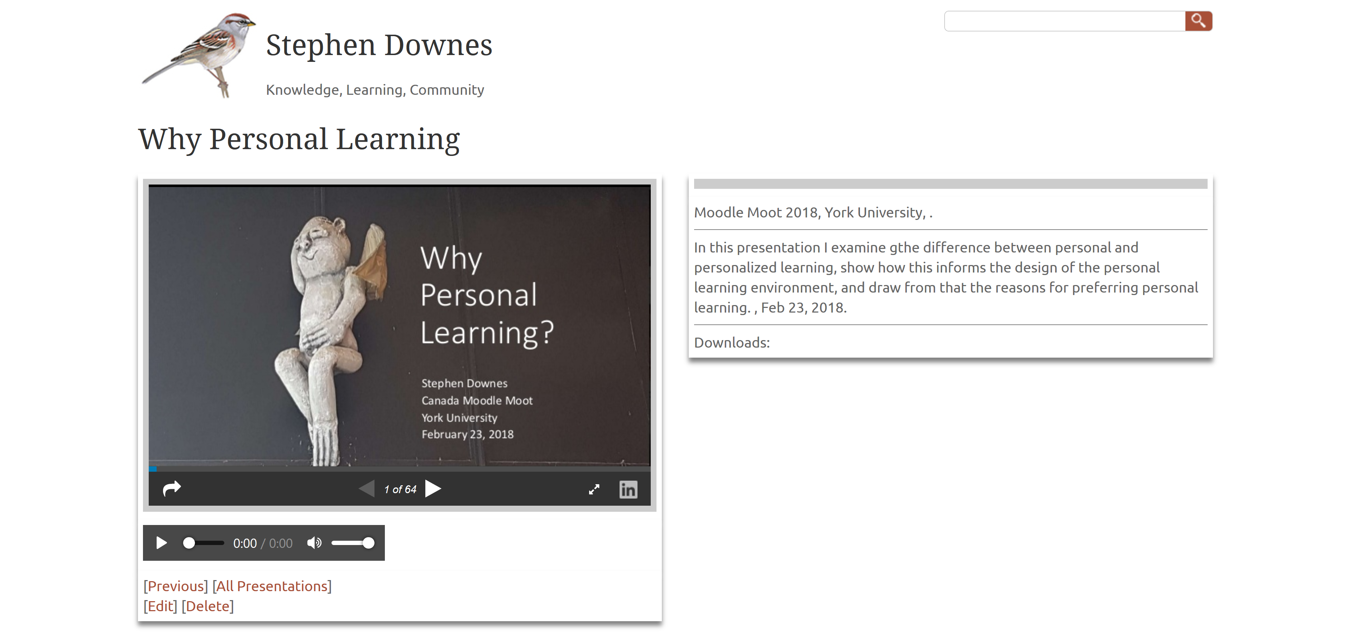
http://www.downes.ca/presentation/487

Slide 3
Two Perspectives….
1

Slide 4

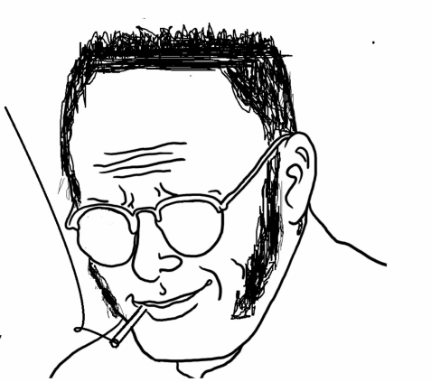
The State The Individual

Slide 5
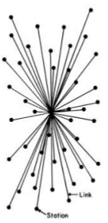

The State The Individual

Slide 6
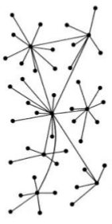
The State The Individual

Slide 7
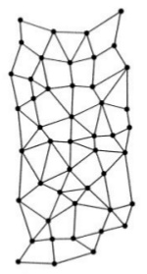
The State The Network The Individual

Slide 8
Groups Networks

Slide 9



Groups Networks
SAMENESS
AFFINITY
Collectives
Communities
ONE WAY
MANY WAYS

Slide 10
Groups Networks
SAMENESS
AFFINITY
Collectives
Communities
ONE WAY
MANY WAYS
Metallic - Elemental
Organic - Biological
UNITY | DIVERSITY
COORDINATION | AUTONOMY
CLOSED | OPENNESS
DISTRIBUTIVE | INTERACTIVE
VISION
STATEMENT
SOMETIMES EVEN PURITY
MELTING POT
MIXTURES
SALAD BOWL

Slide 11
Groups Networks
SAMENESS
AFFINITY
Collectives
Communities
ONE WAY
MANY WAYS
Metallic - Elemental
Organic - Biological
UNITY | DIVERSITY
COORDINATION | AUTONOMY
CLOSED | OPENNESS
DISTRIBUTIVE | INTERACTIVE
VISION
STATEMENT
SOMETIMES EVEN PURITY
MELTING POT
MIXTURES
SALAD BOWL
LEADERS! COLLABORATION
GROUP VALUE
(= LEADER VALUE)
COOPERATION
EXCHANGE
MUTUAL VA:UE

Slide 12
Groups Networks
SAMENESS
AFFINITY
Collectives
Communities
ONE WAY
MANY WAYS
Metallic - Elemental
Organic - Biological
UNITY | DIVERSITY
COORDINATION | AUTONOMY
CLOSED | OPENNESS
DISTRIBUTIVE | INTERACTIVE
VISION
STATEMENT
SOMETIMES EVEN PURITY
MELTING POT
MIXTURES
SALAD BOWL
LEADERS! COLLABORATION
GROUP VALUE
(= LEADER VALUE)
COOPERATION
EXCHANGE
MUTUAL VA:UE
LOCK-IN
MEMBERSHIP / IN CAMERA
STANDARDS - JARGON
WALLS
CONNECTION
PERSPECTIVE / CONTEXT
BRIDGES

Slide 13
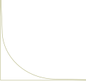
Groups Networks
SAMENESS
AFFINITY
Collectives
Communities
ONE WAY
MANY WAYS
Metallic - Elemental
Organic - Biological
UNITY | DIVERSITY
COORDINATION | AUTONOMY
CLOSED | OPENNESS
DISTRIBUTIVE | INTERACTIVITY
VISION
STATEMENT
SOMETIMES EVEN PURITY
MELTING POT
MIXTURES
SALAD BOWL
LEADERS! COLLABORATION
GROUP VALUE
(= LEADER VALUE)
COOPERATION
EXCHANGE
MUTUAL VA:UE
LOCK-IN
MEMBERSHIP / IN CAMERA
STANDARDS - JARGON
WALLS
CONNECTION
PERSPECTIVE / CONTEXT
BRIDGES
AKA
TRICKLE DOWN
BROADCAST
STARS AND GURUS
CENTRALIZED
POWER – POWER LAWS
CONVERSATION
DISTRIBUTED
DEMOCRACY (OR POST-DEMOCRACY)
KNOWLEDGE
EMERGES
RICH
KNOWLEDGE,
LIKE MONEY,
FLOWS FROM AUTHORITY
POOR

Slide 14


Groups Networks
SAMENESS
AFFINITY
Collectives
Communities
ONE WAY
MANY WAYS
Metallic - Elemental
Organic - Biological
UNITY | DIVERSITY
COORDINATION | AUTONOMY
CLOSED | OPENNESS
DISTRIBUTIVE | INTERACTIVITY
VISION
STATEMENT
SOMETIMES EVEN PURITY
MELTING POT
MIXTURES
SALAD BOWL
LEADERS! COLLABORATION
GROUP VALUE
(= LEADER VALUE)
COOPERATION
EXCHANGE
MUTUAL VA:UE
LOCK-IN
MEMBERSHIP / IN CAMERA
STANDARDS - JARGON
WALLS
CONNECTION
PERSPECTIVE / CONTEXT
BRIDGES
AKA
TRICKLE DOWN
BROADCAST
STARS AND GURUS
CENTRALIZED
POWER – POWER LAWS
CONVERSATION
DISTRIBUTED
DEMOCRACY (OR POST-DEMOCRACY)
KNOWLEDGE
EMERGES
RICH
KNOWLEDGE,
LIKE MONEY,
FLOWS FROM AUTHORITY
POOR

Slide 15
Two Approaches….
2

Slide 16
Two Approaches…
Content
Practice
Practice
Content

Slide 17
Two Approaches…
Defines an ideal state
Defines a desired state
Content
Practice
Practice
Content
TEST
TRY
Person tests you
Person helps you

Slide 18
Two Approaches…
Defines an ideal state
Defines a desired state
Content
Practice
Correction
Iteration
GAP
Practice
Content
Opport-unity
TEST
TRY
Person tests you
Person helps you

Slide 19
Library Environment
Defines an ideal state
Defines a desired state
Content
Practice
Affordances
Correction
Requirements
Iteration
GAP
Content
Opport-unity
Practice
TEST
TRY
Person tests you
Person helps you

Slide 20
Personalized Personal
We do for you You do for yourself
Defines an ideal state
Defines a desired state
Content
Practice
Affordances
Correction
Requirements
Iteration
GAP
Practice
Content
Opport-unity
TEST
TRY
Person tests you
Person helps you

Slide 21
A Personal Learning Environment
3

Slide 22
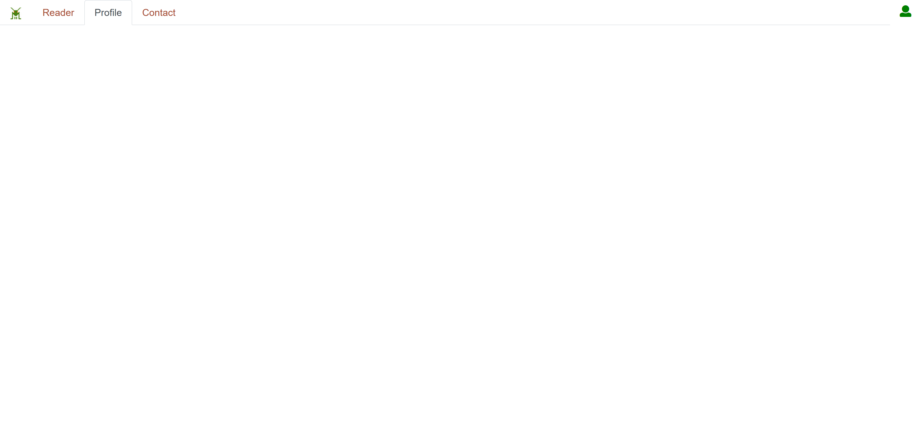
gRSShopper – my PLE

Slide 23
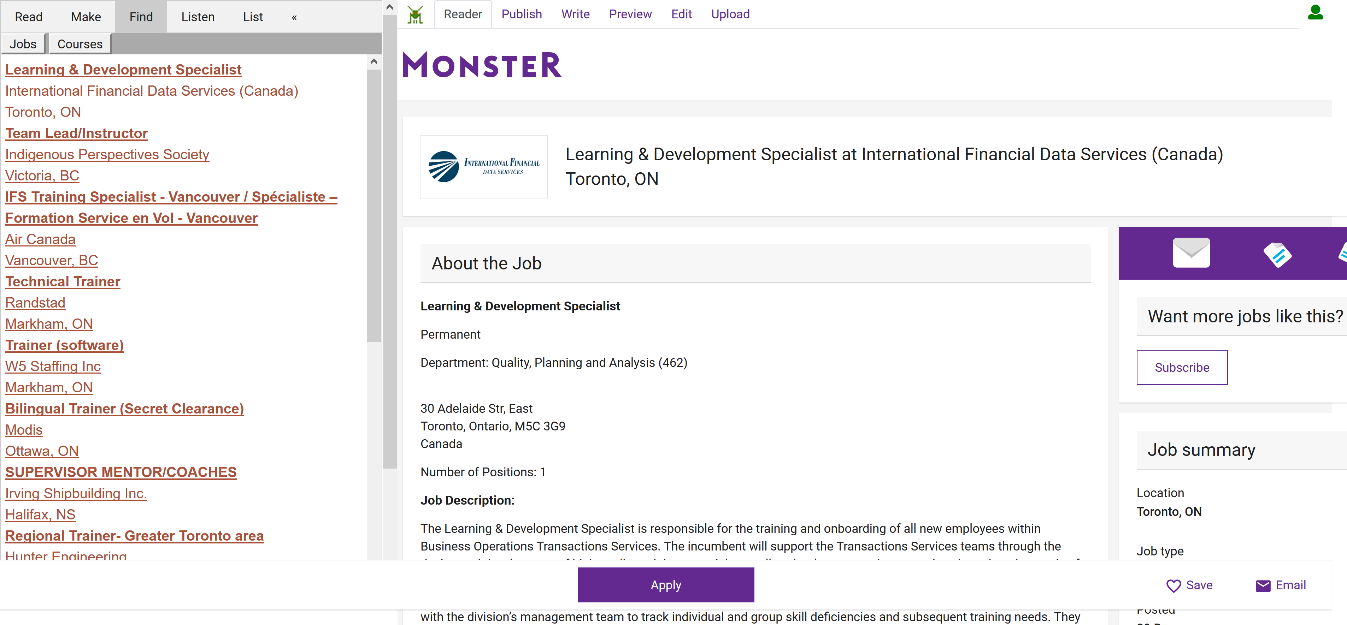
Look for a job, contract, project…

Slide 24
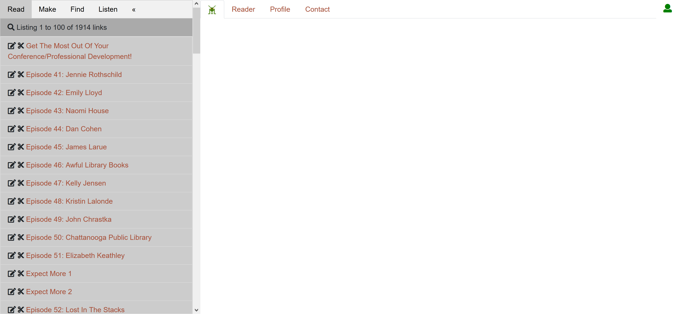
Find related resources

Slide 25
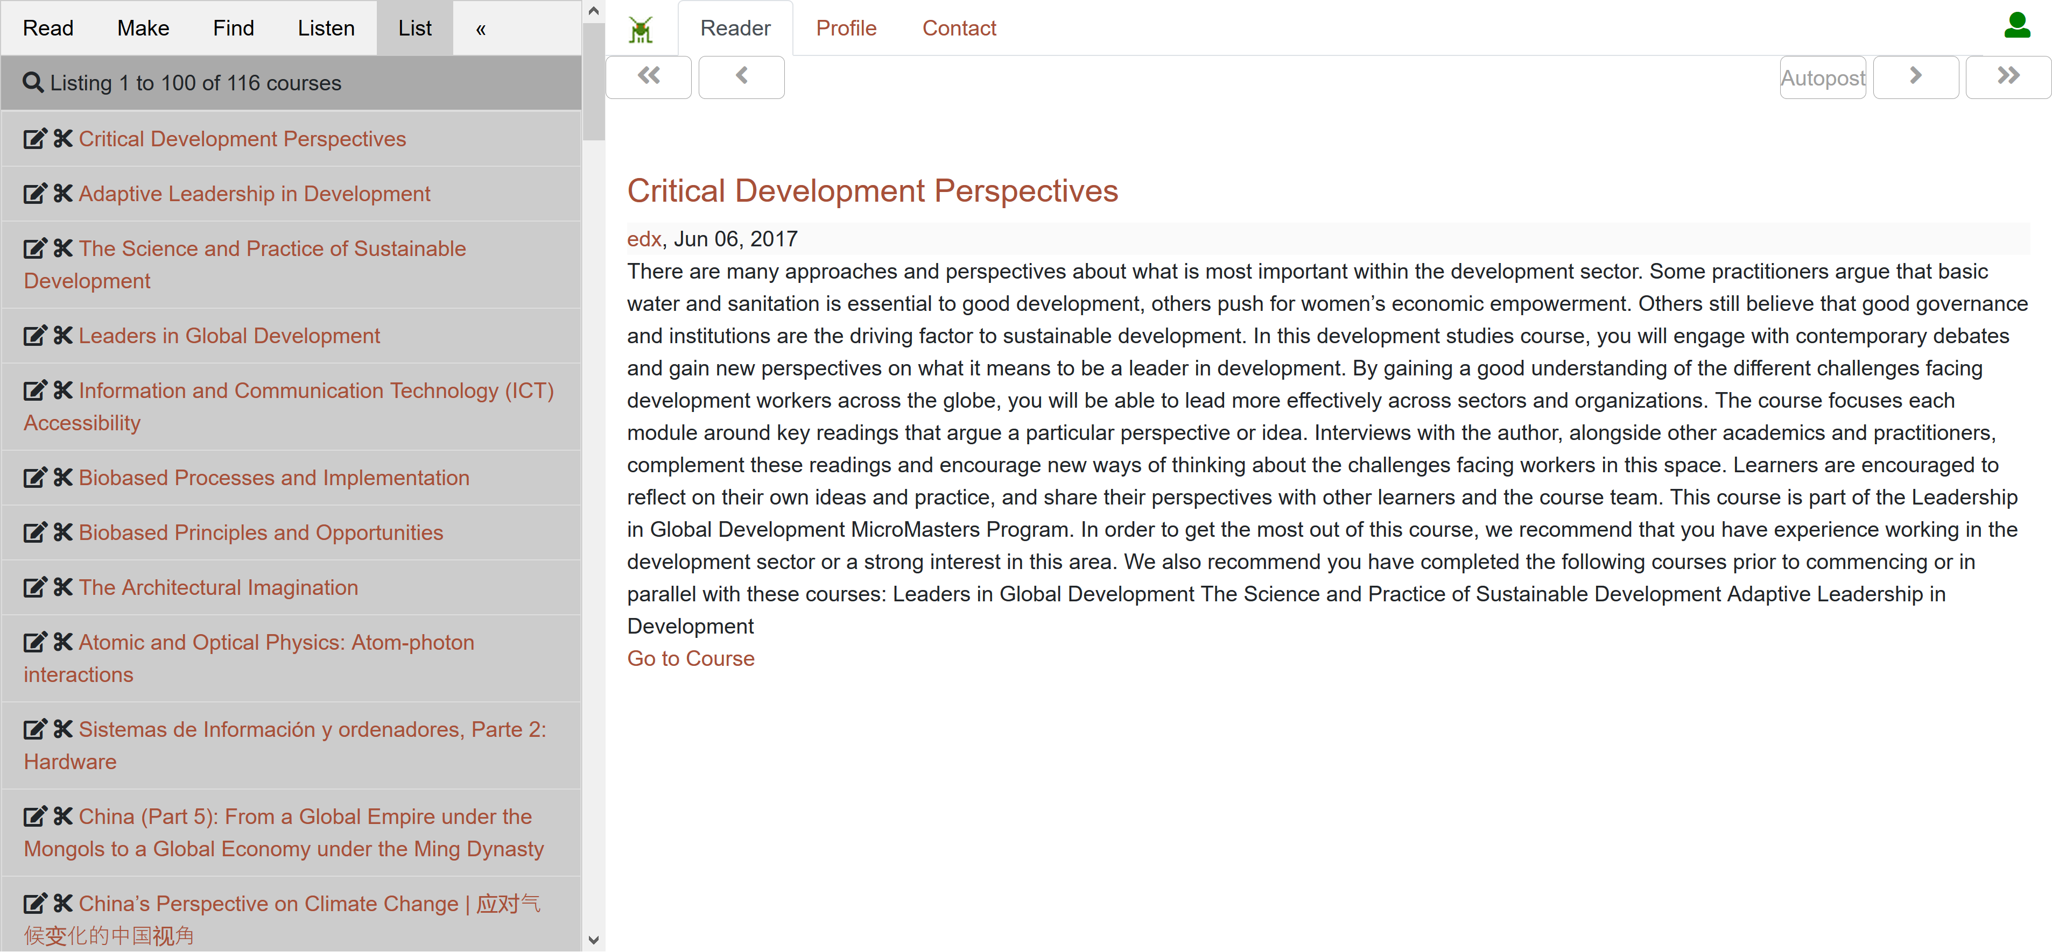
Find a related course

Slide 26
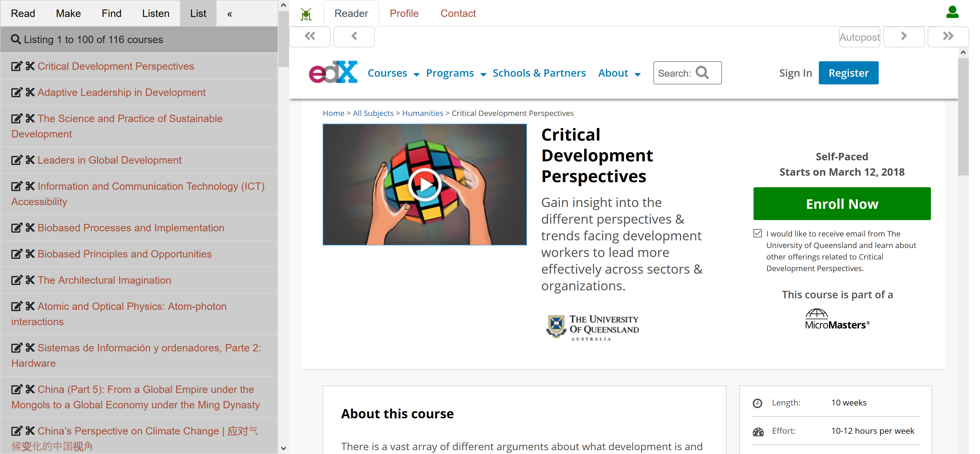
Register for the course

Slide 27
gRSShopper workflow
Personal
Context
Article
Photograph
Video
Person
Author
Publisher
Organization
Job Opportunity
Competency
Cetrificate
Event
Location / Place
Time / Date
Email
RSS
OAI
Sharepoint
Facebook
Twitter
Monster
Government
Repositories
Desire2Learn
Coursera
EdX
etc
Parsing
Scraping
Analytics
etc
Storage
RELATIONS

Slide 28
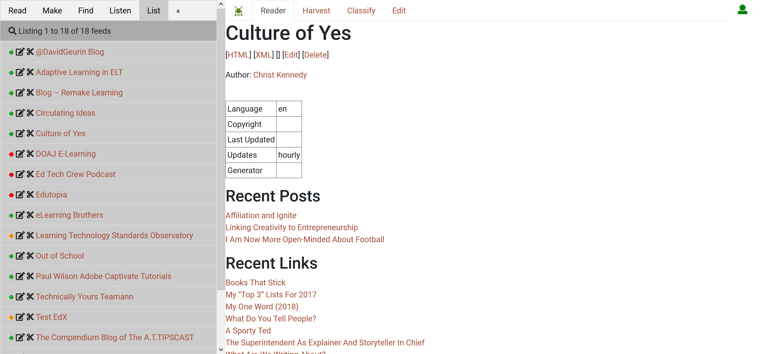
Aggregate resources from feeds

Slide 29
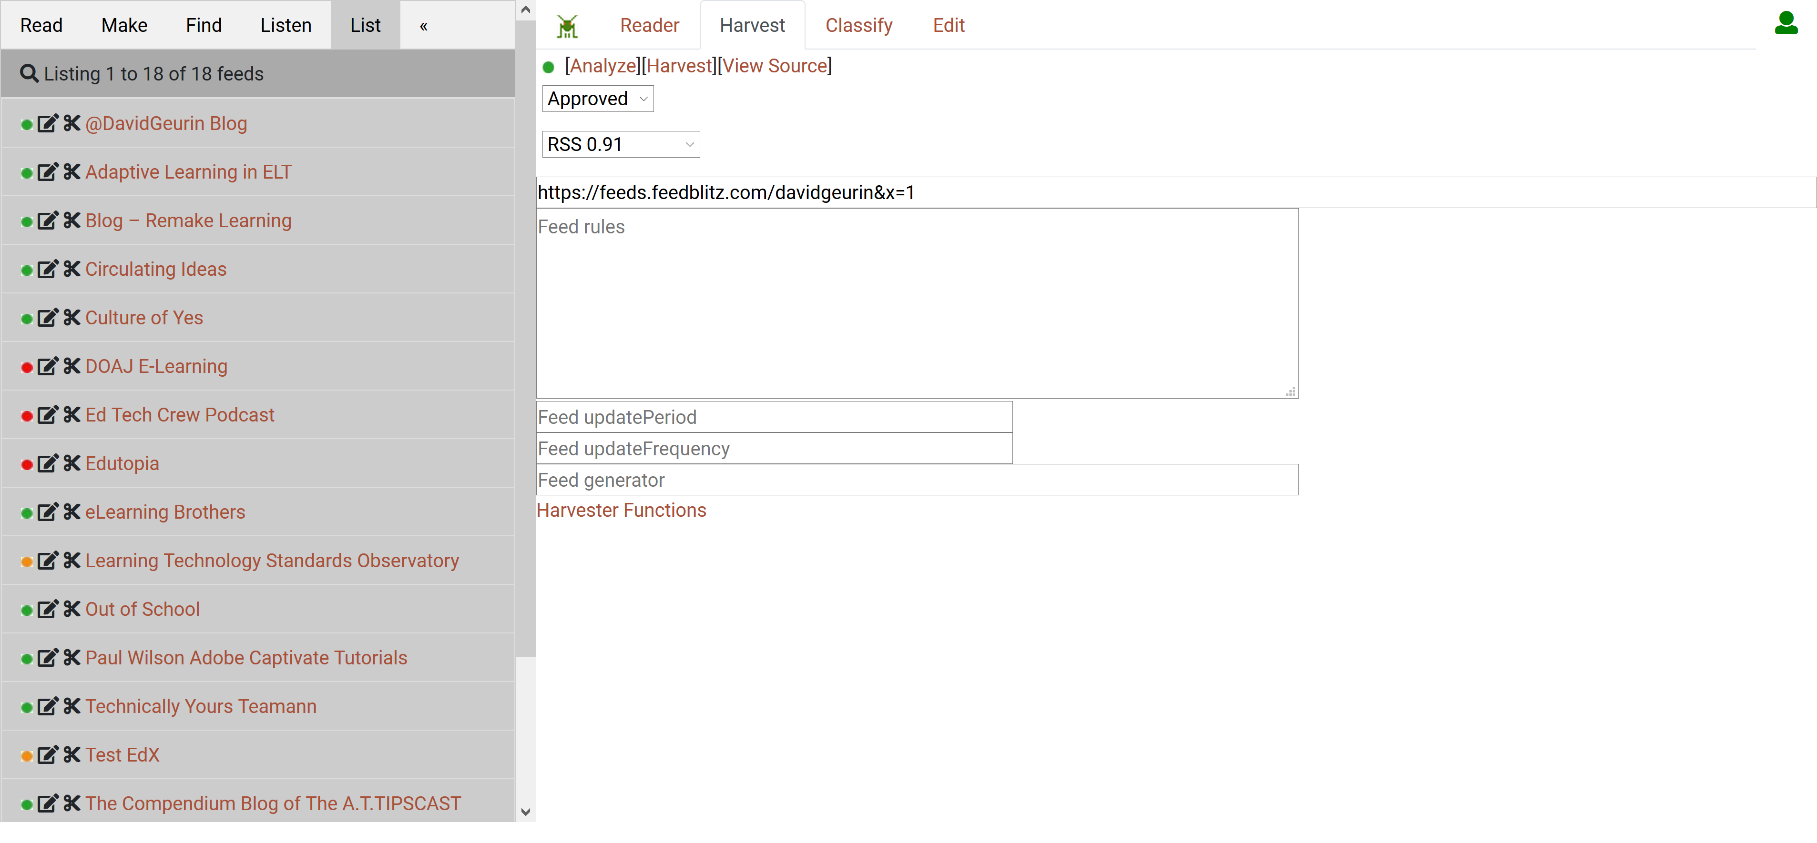
Manage and classify feeds

Slide 30
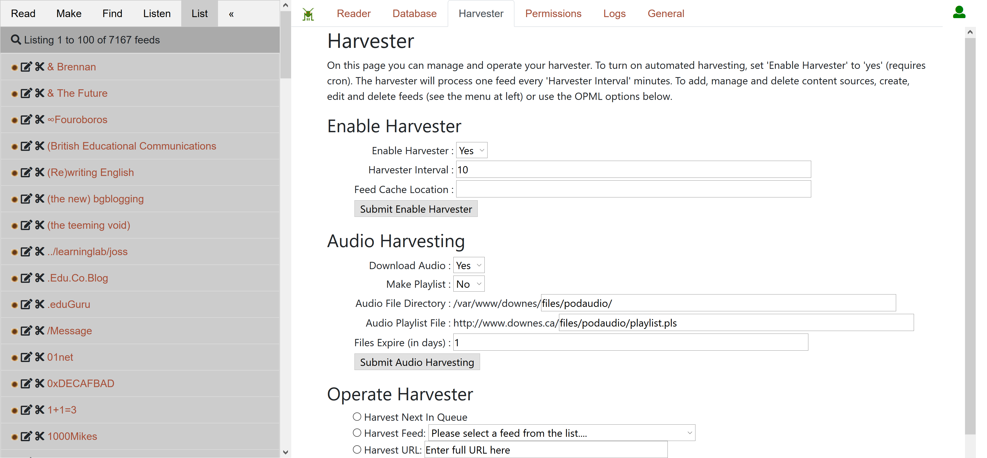
Manage the feed harvester

Slide 31
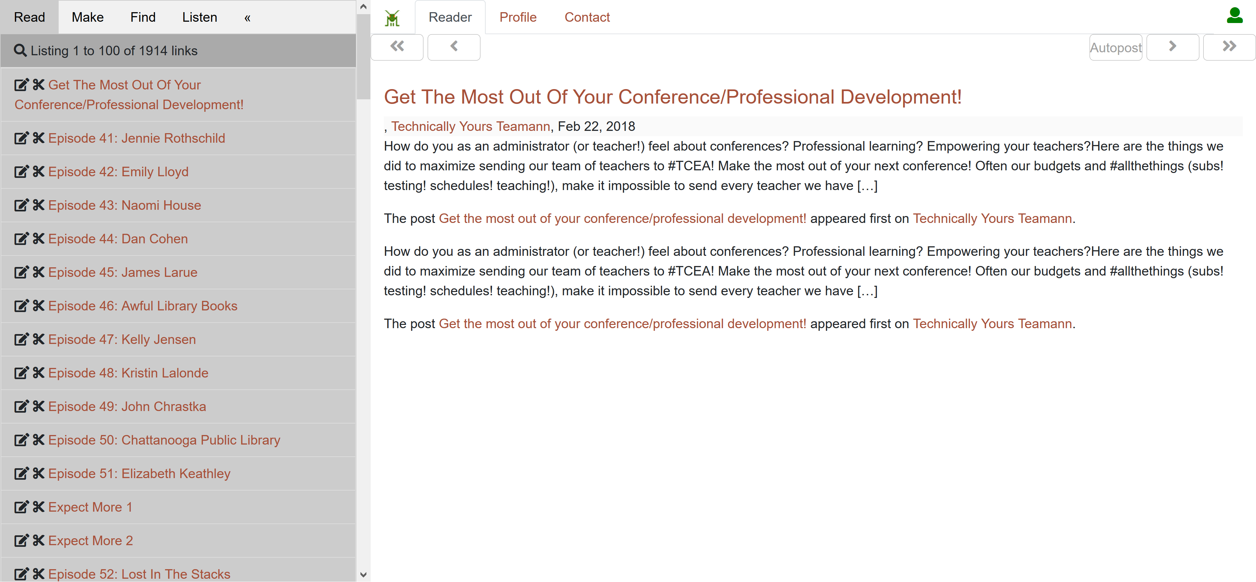
Read harvested resources

Slide 32
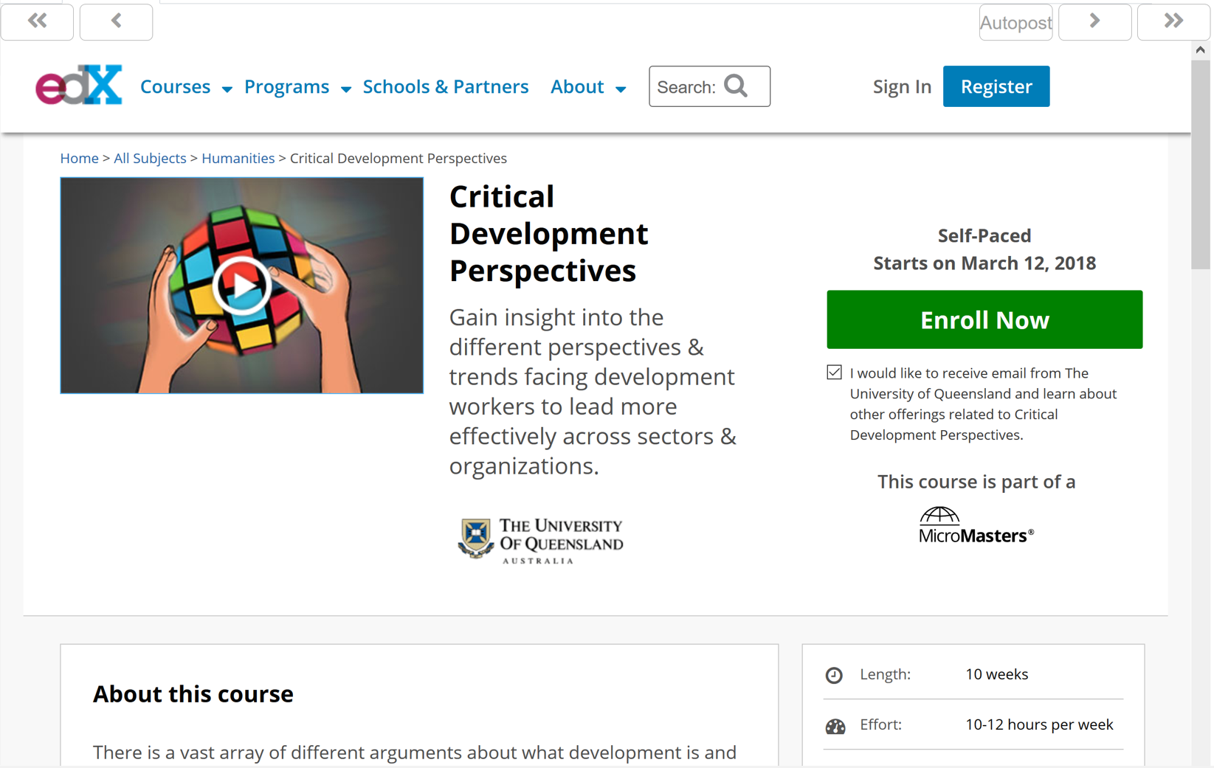
Read resources while in my course

Slide 33
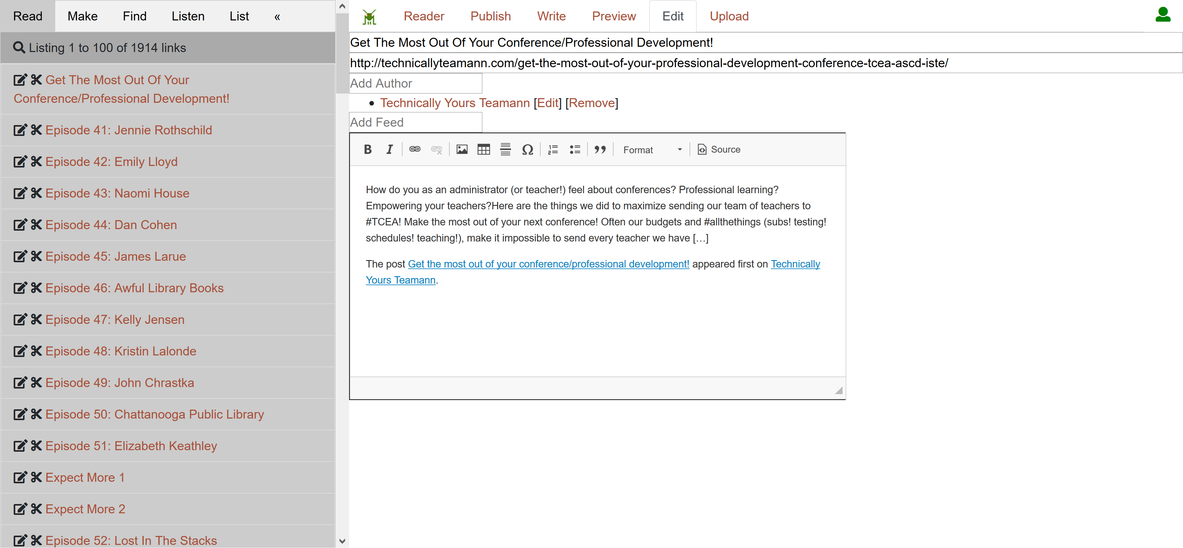
Save resources as post or reference

Slide 34
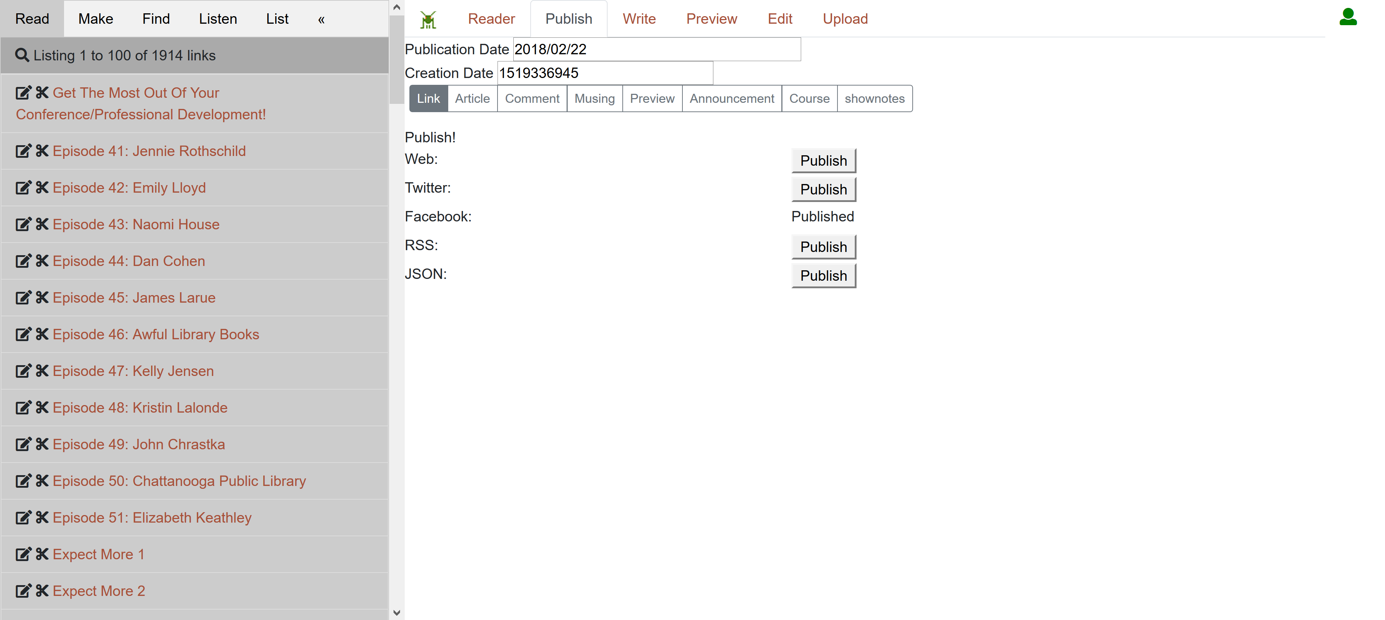
Share my post to Twitter, web, etc.

Slide 35
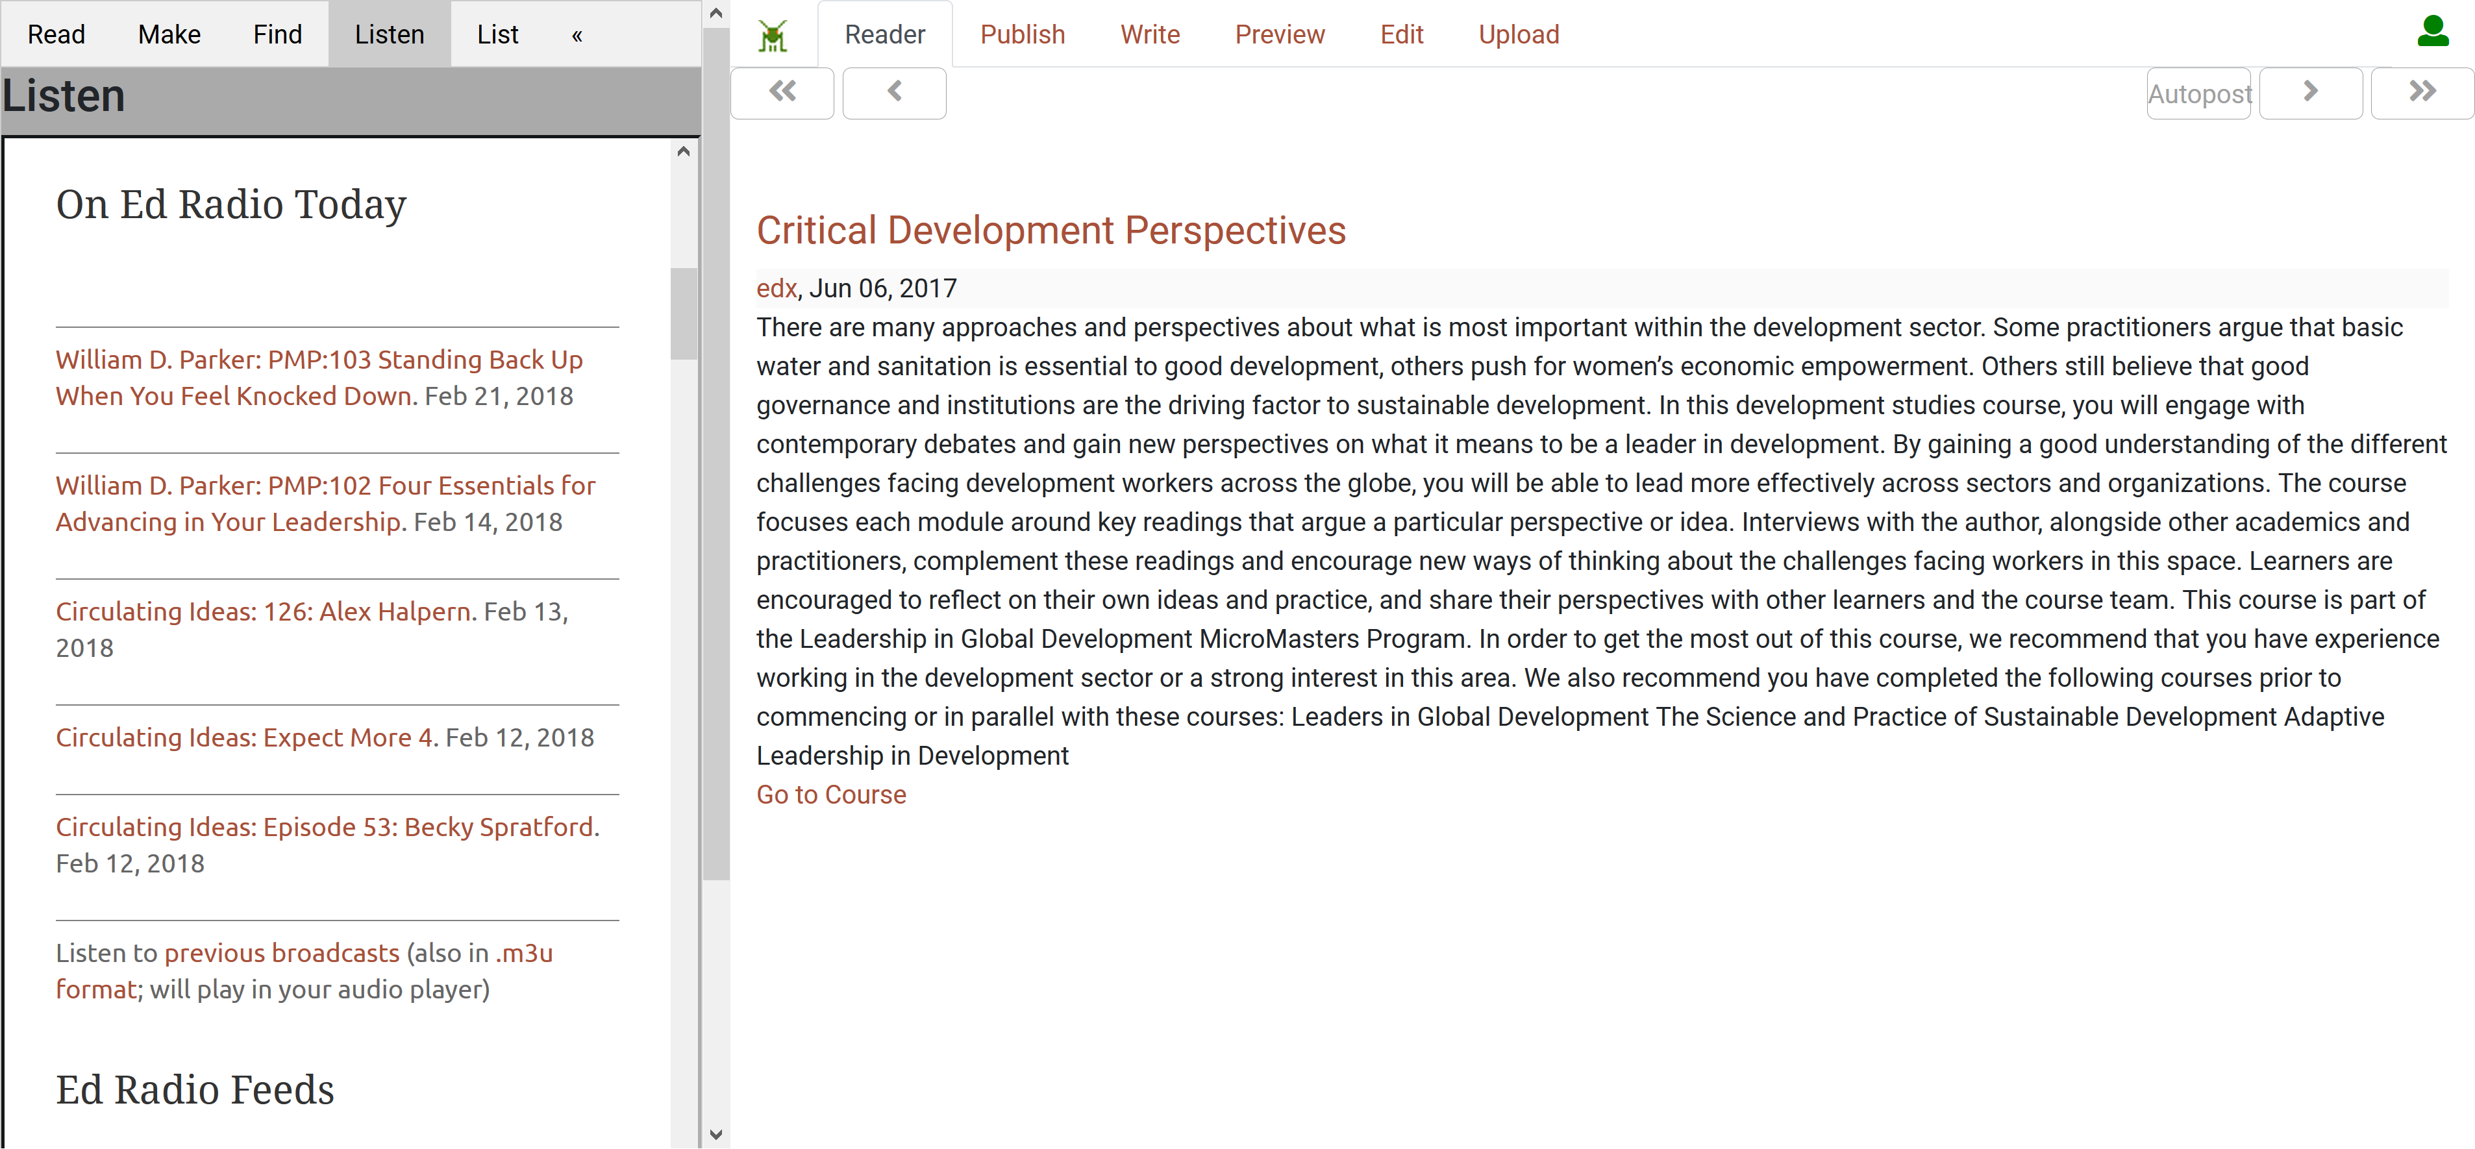
Listen to related audio feeds

Slide 36
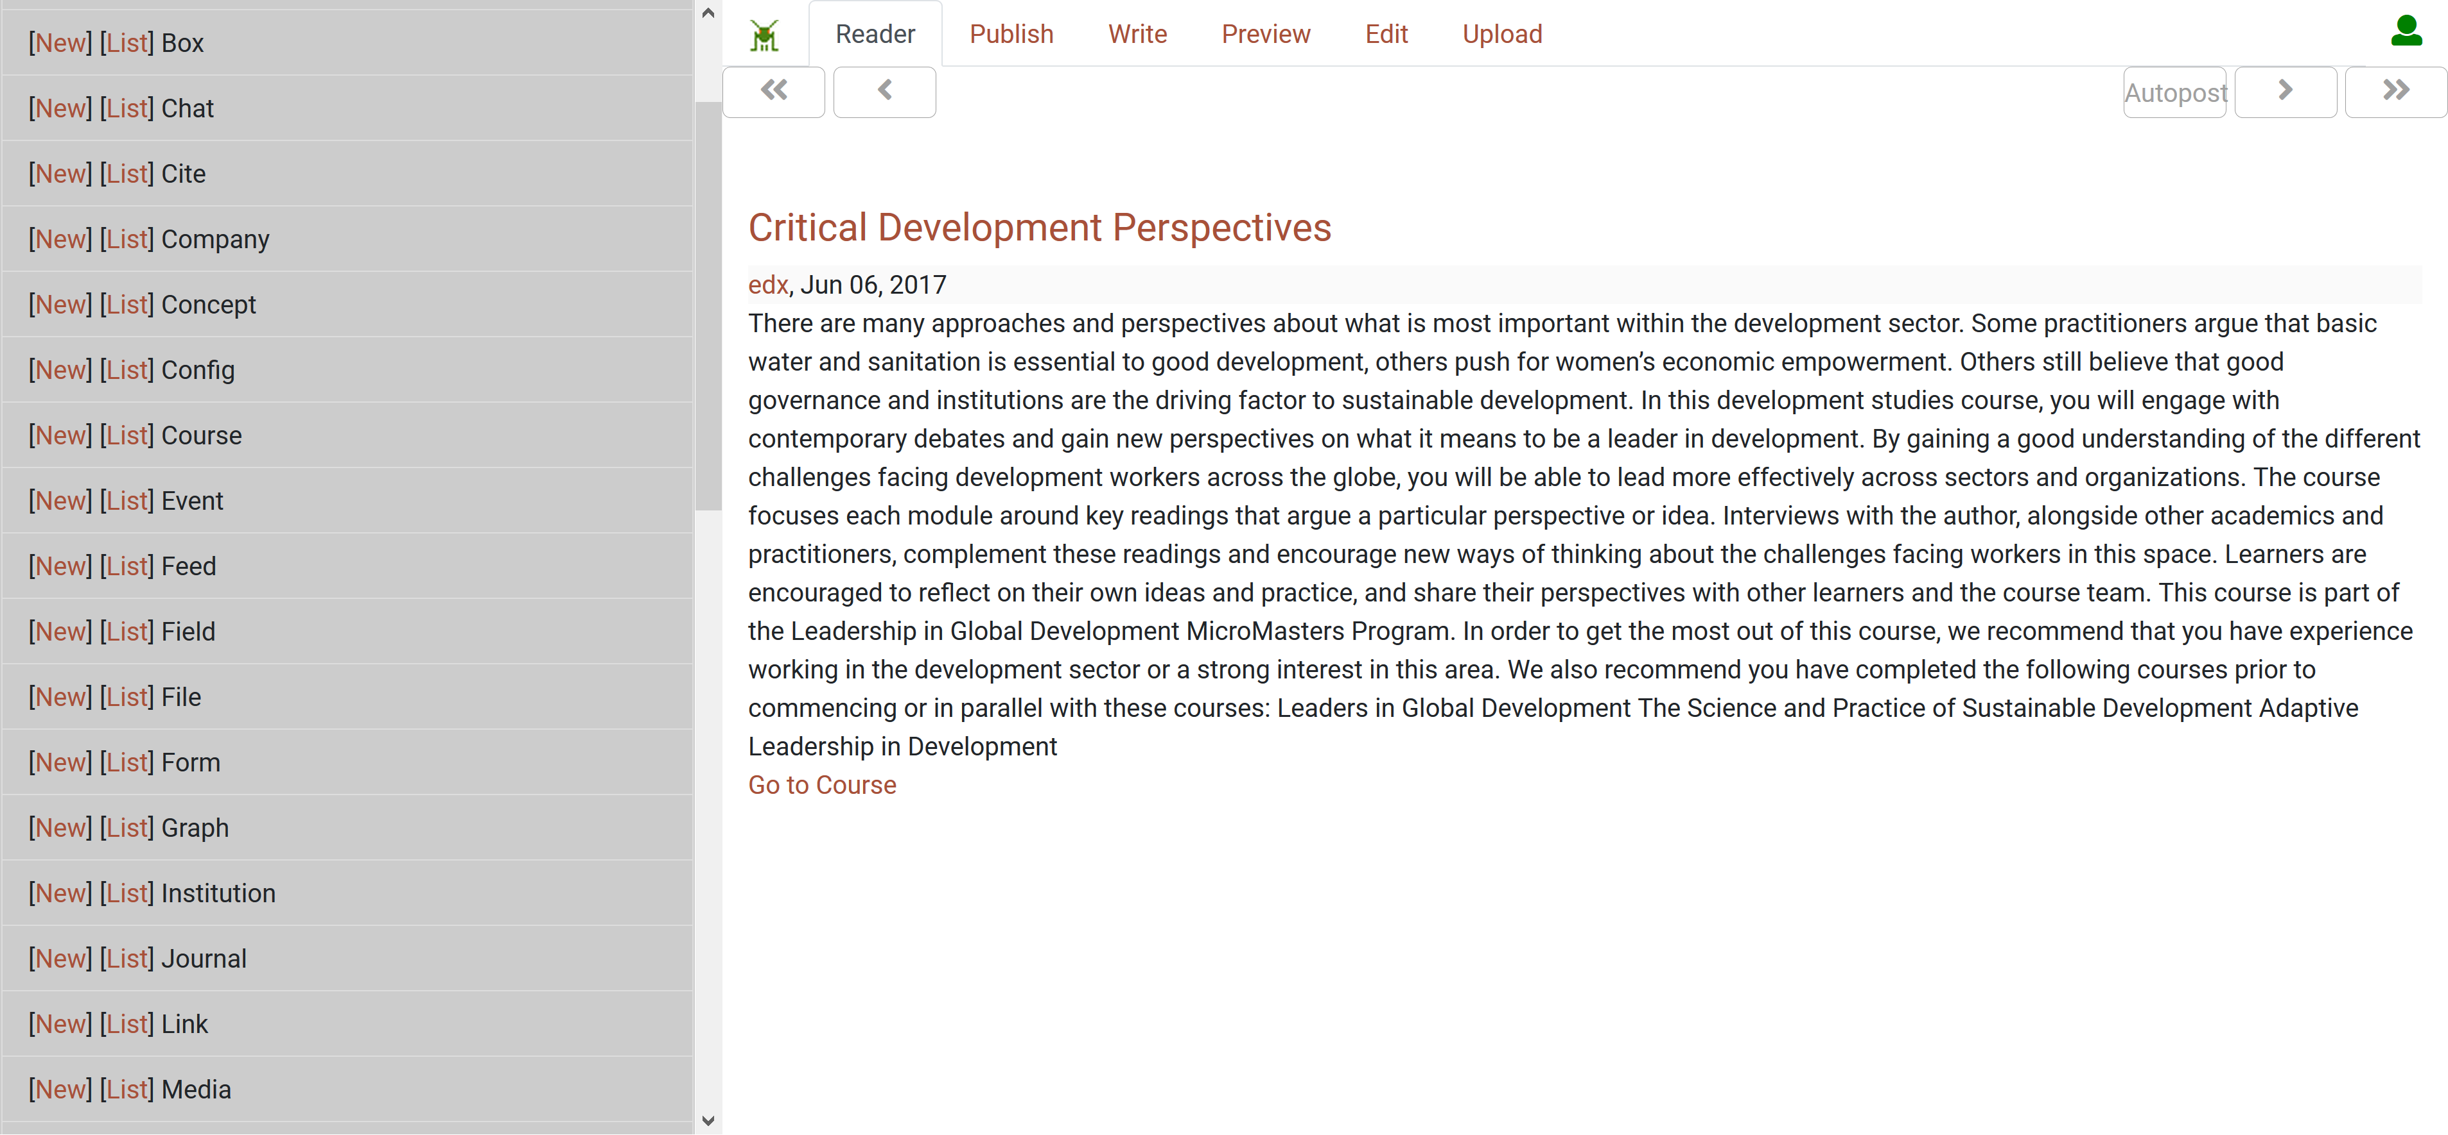
Work with various data types

Slide 37
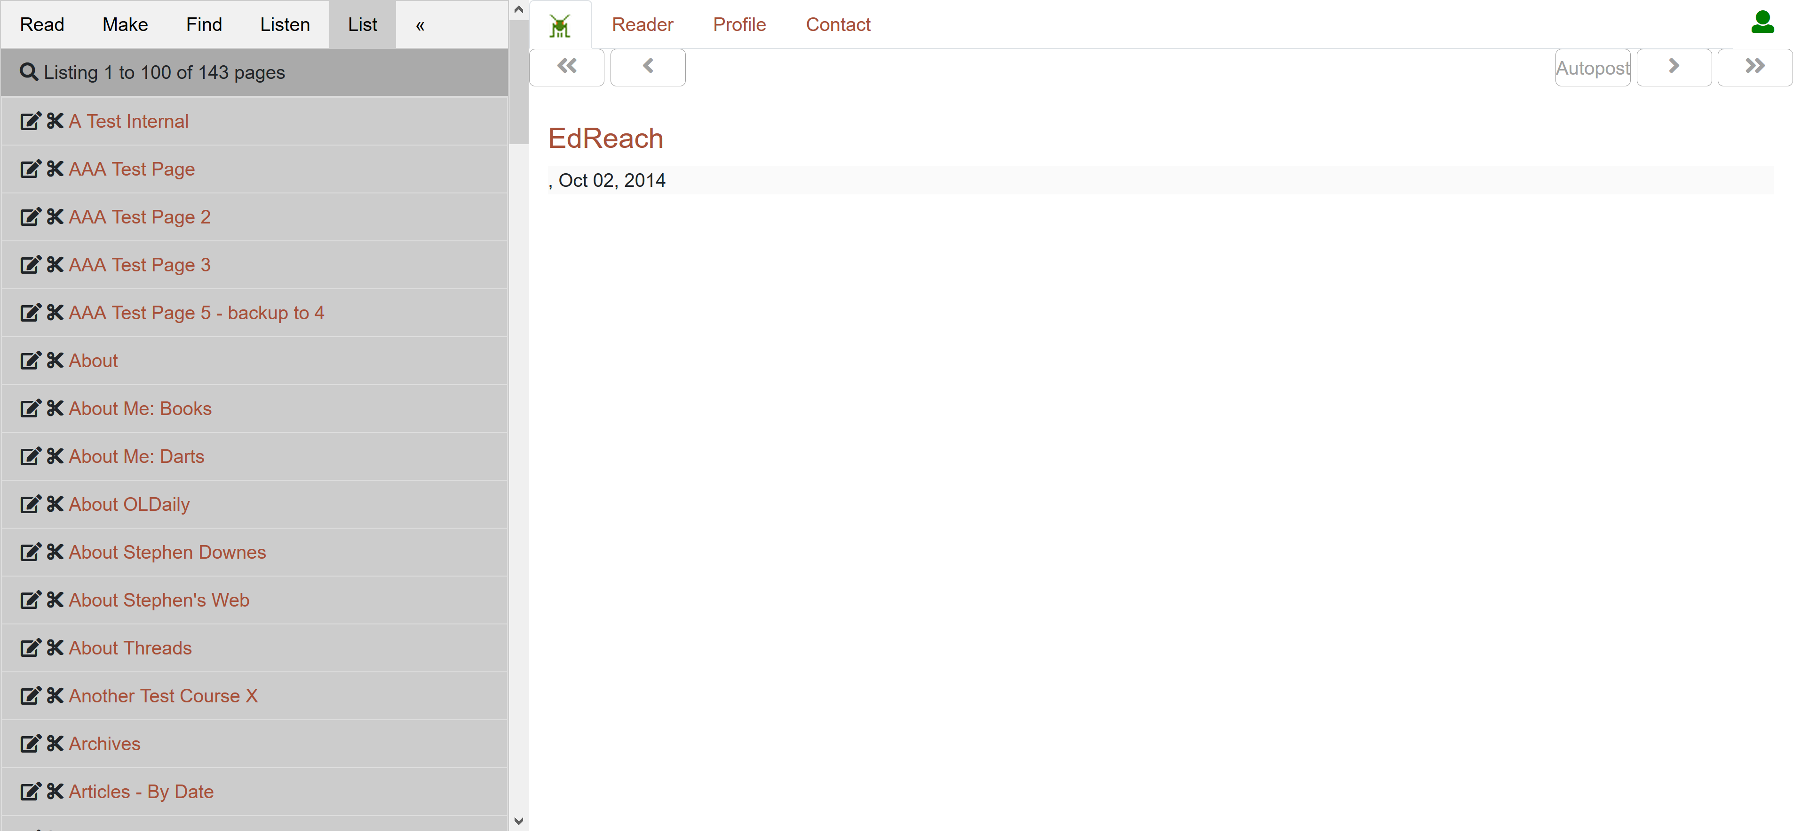
Create pages by combining data

Slide 38
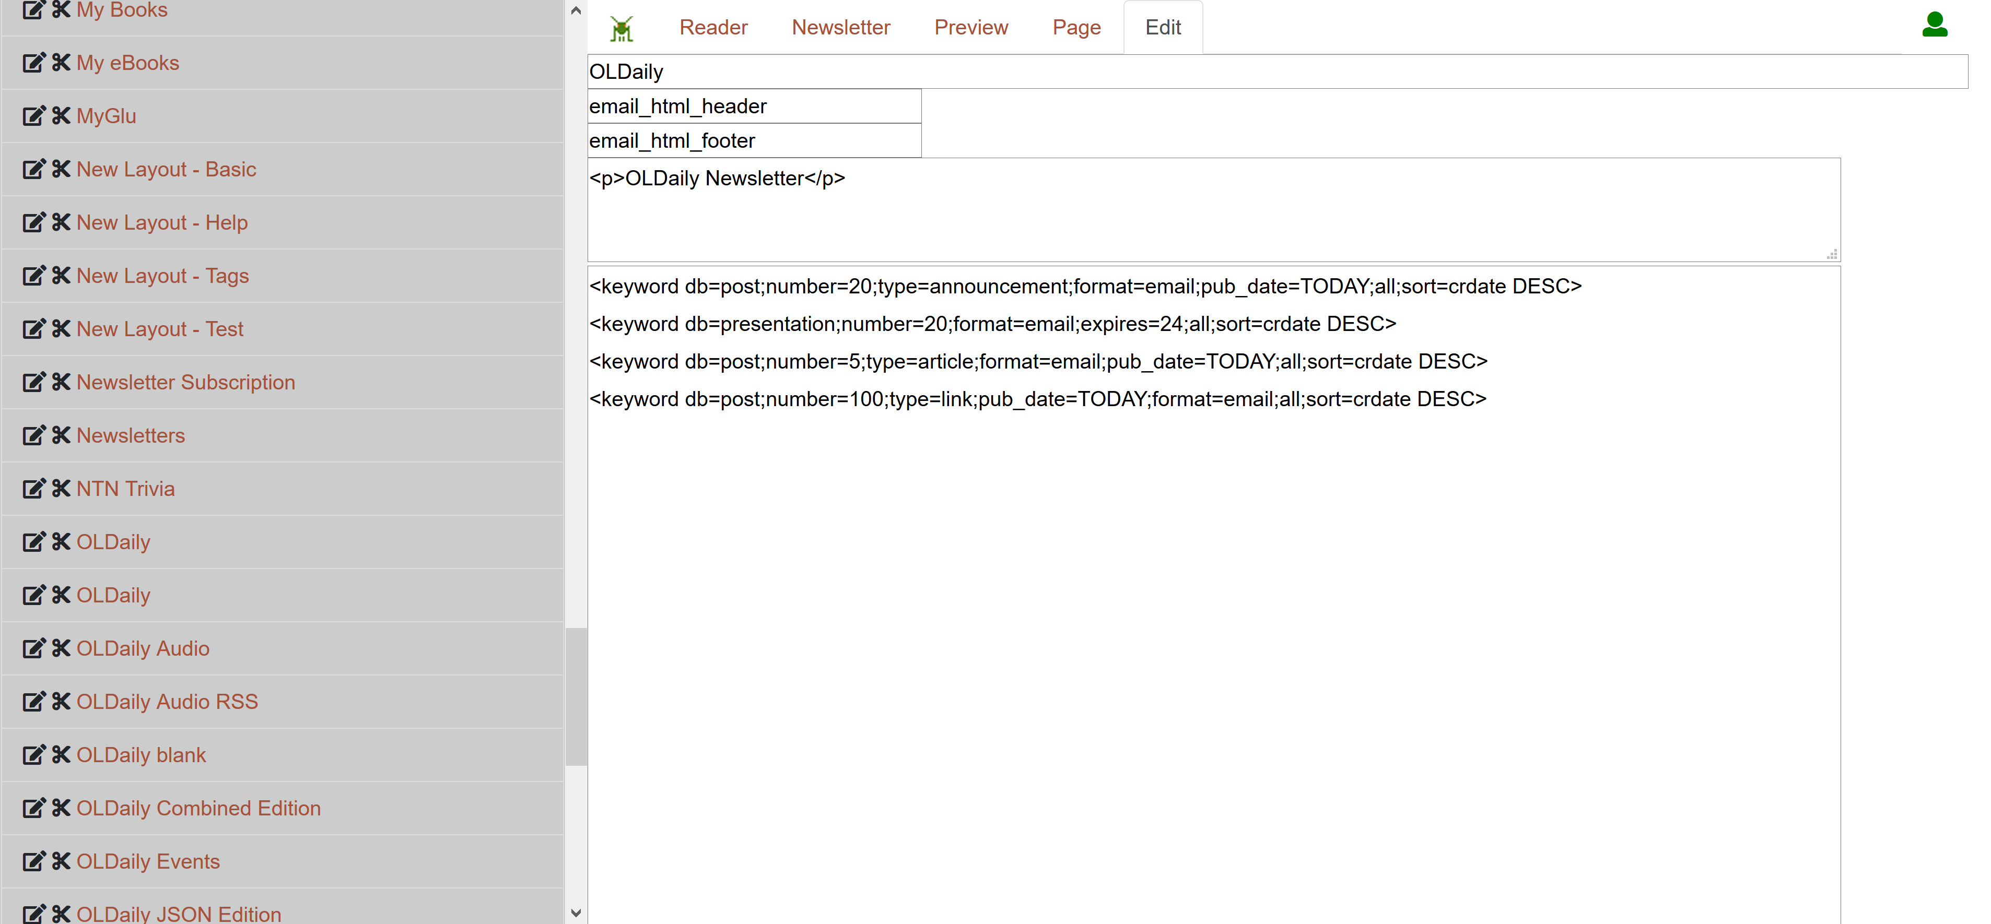
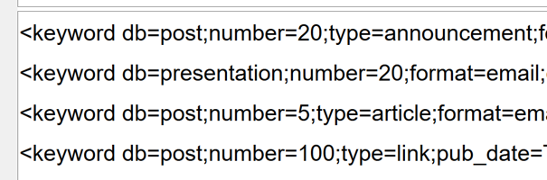
Create pages by combining data

Slide 39
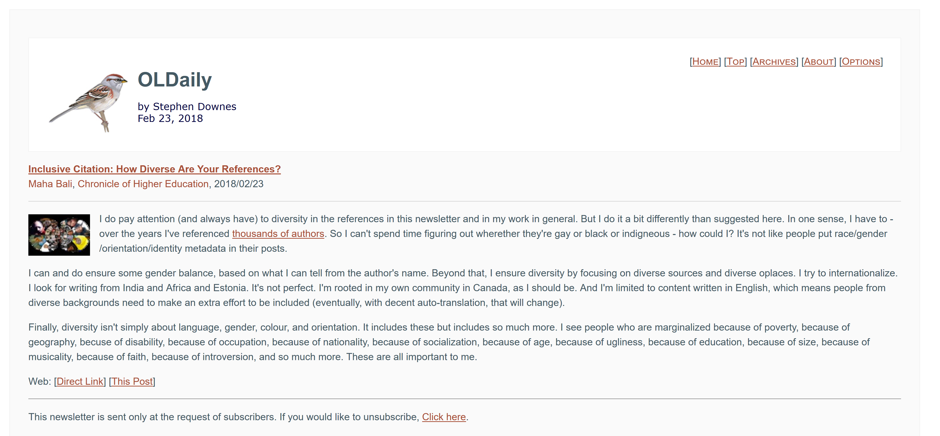
Preview my page

Slide 40
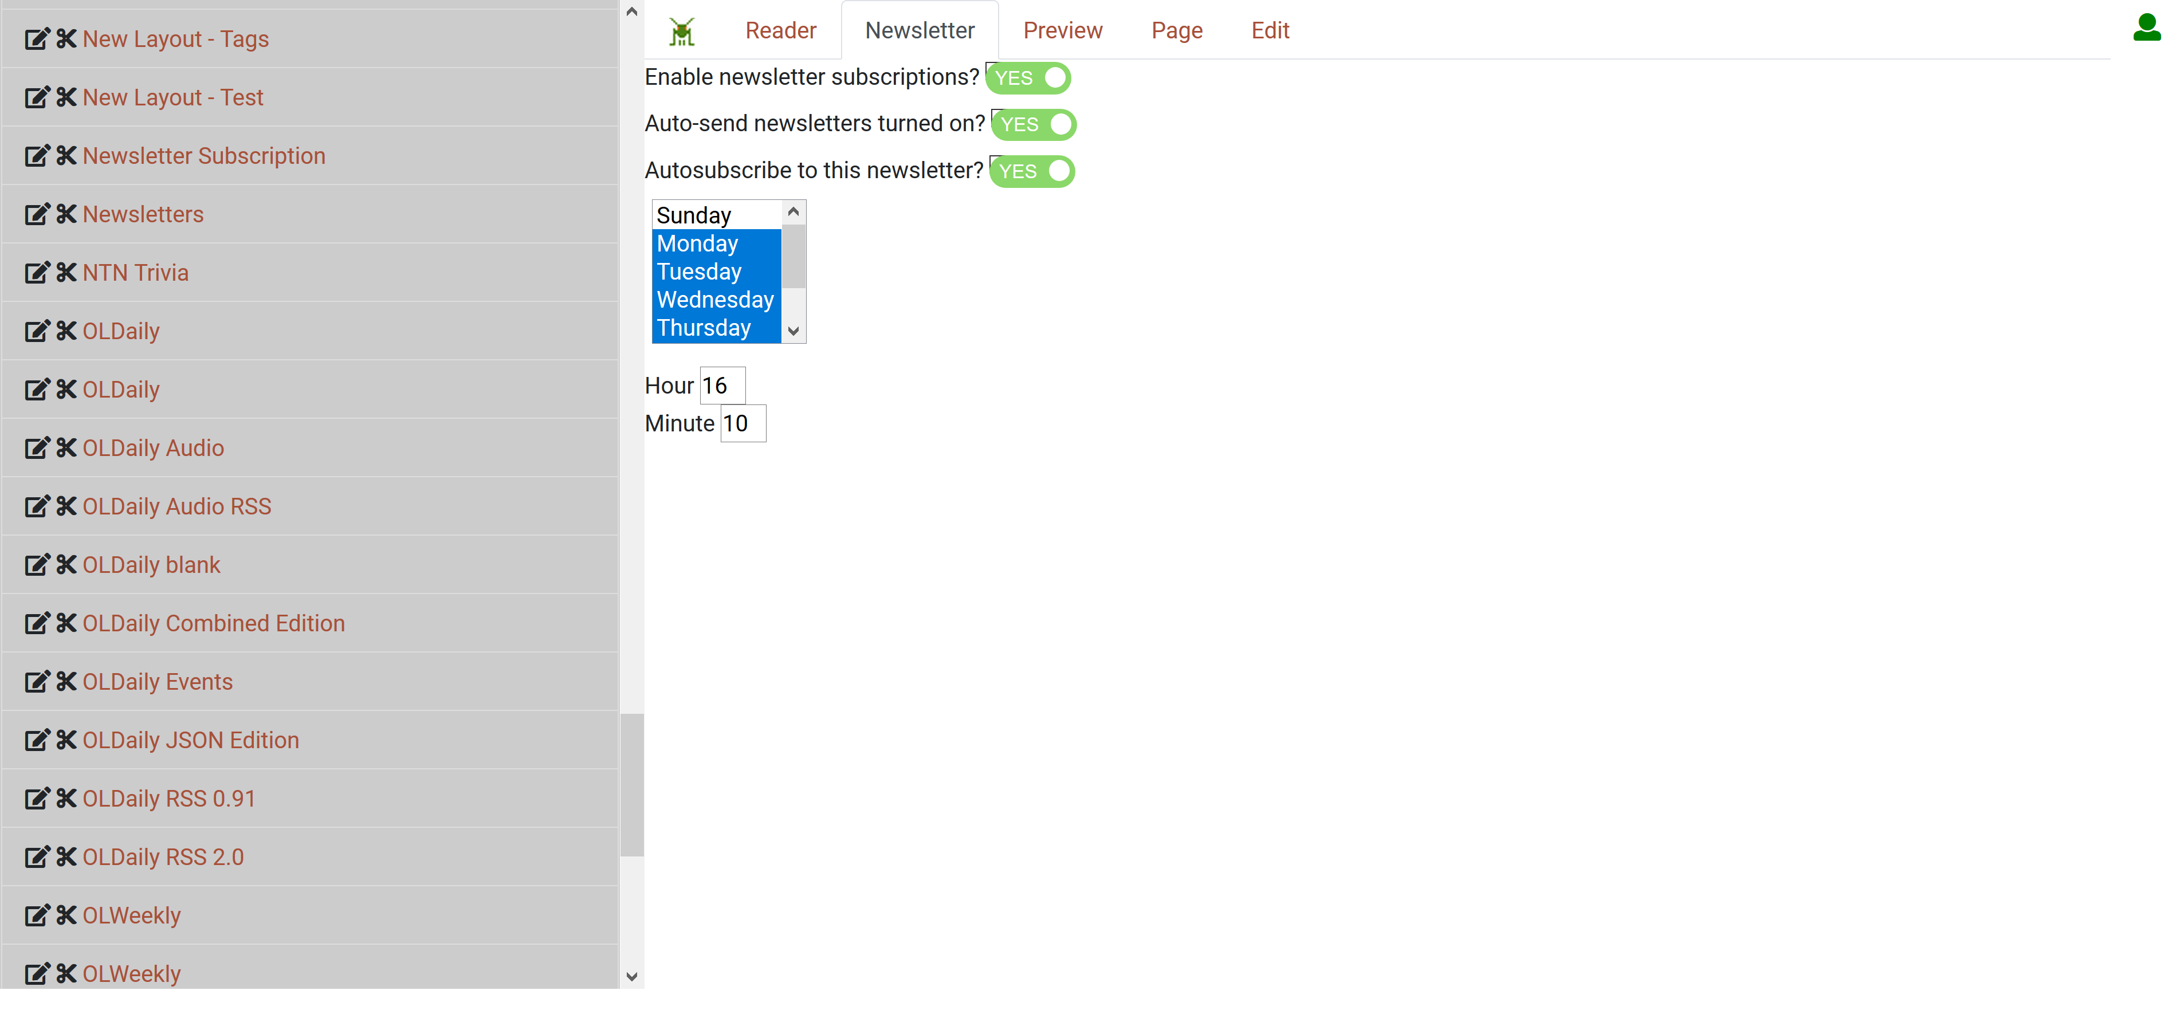
Create newsletters from my pages

Slide 41
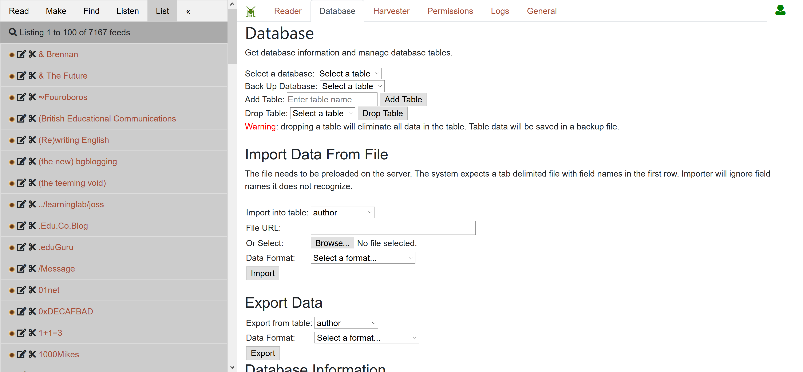
Manage the resource database

Slide 42
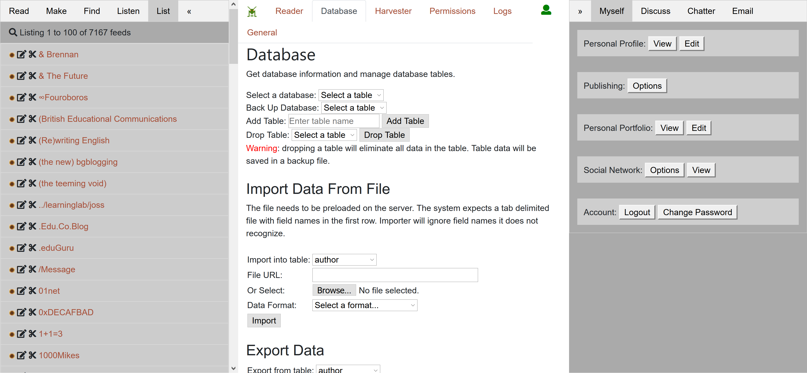
Make my personal learning record

Slide 43
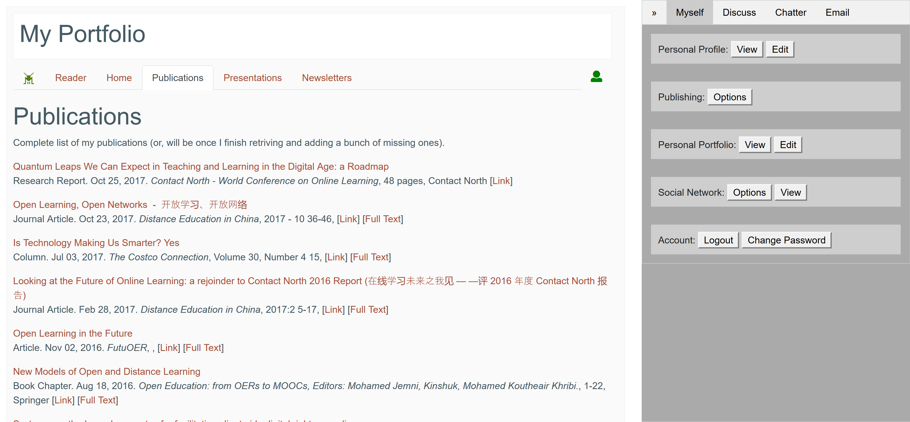
Display my portfolio

Slide 44
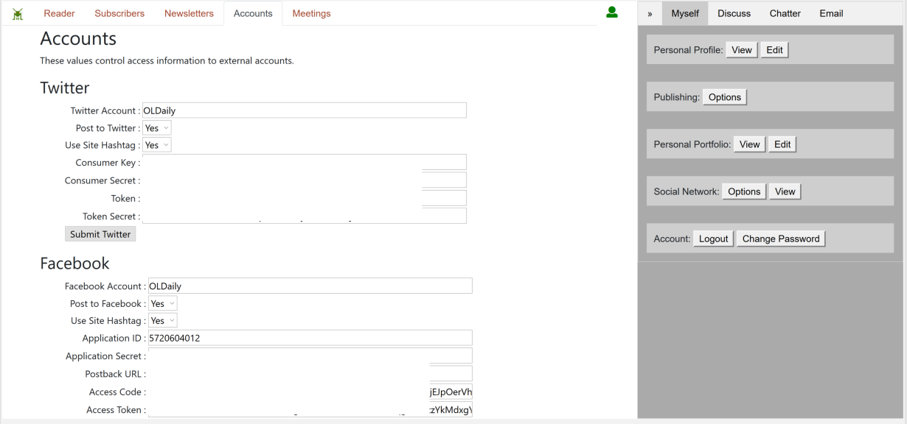
Manage social media accounts

Slide 45
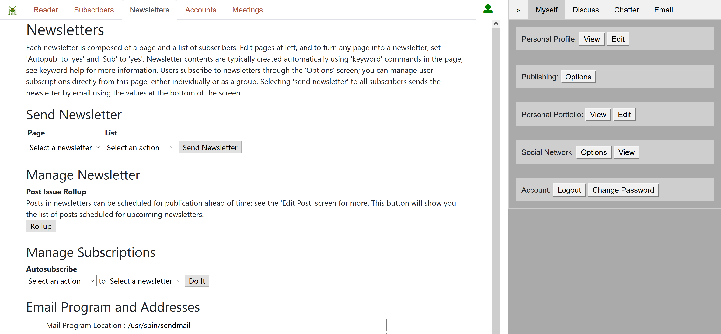
Manage my newsletters

Slide 46
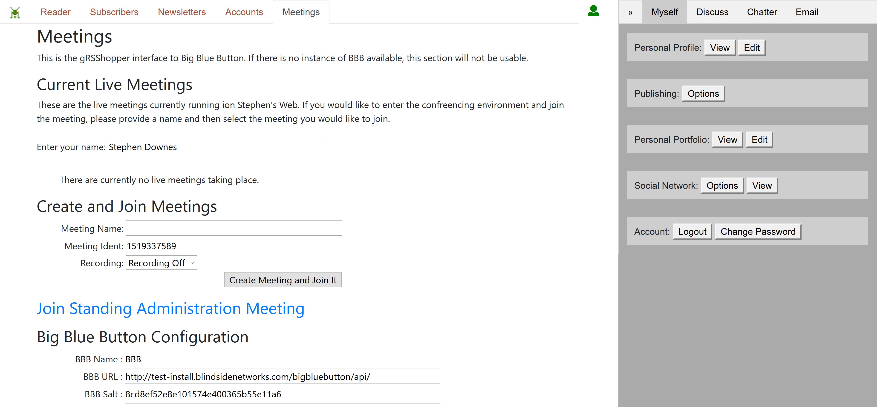
Create and attend live meetings

Slide 47
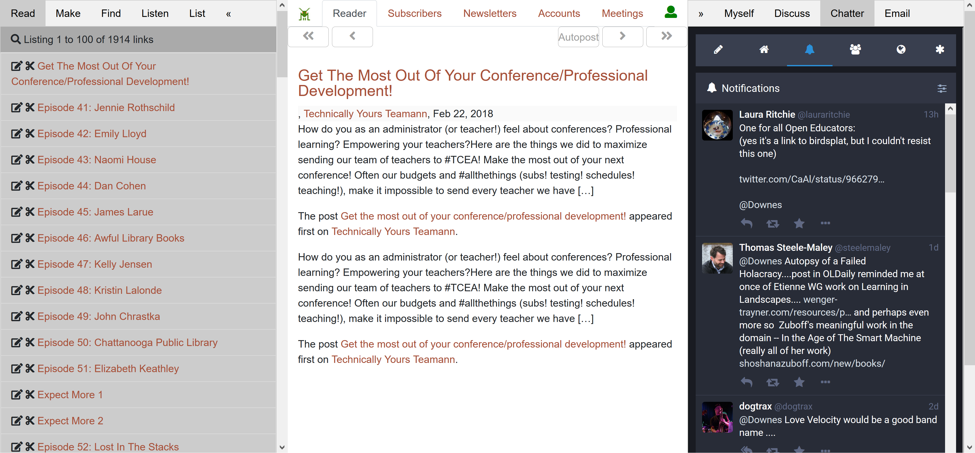
Chat with social media friends

Slide 48
The Personal Graph
4

Slide 49
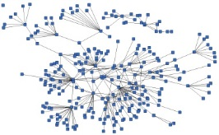
gRSShopper creates my Personal Learning Record
Stuff Goes Out
Stuff Comes In
Learning Activities
I read and watch stuff
I play with toys
I make stuff
Things, Properties, Relations
Things I did
Stuff I make
Big stuff goes here
Me
Questions
Personal Library
Pictures
Books
Movies
Answers
Learning Analytics Services

Slide 50
gRSShopper creates my Personal Learning Record
This is a new type of data – it’s called the personal graph.
Each person has their own private personal graph.
The PLR contains all a person’s learning records, including:
certificates, badges and credentials
activity records, test results, scores
Assignments, papers, drawings, things they create
Me

Slide 51

Analytics and Big Data
Facebook
Twitter
EdX
Coursera
YouTube
Blackboard
Email
etc
Shallow
Tells us about the platform
Deep
Tells us about the person

Slide 52
Why Personal Learning
5

Slide 53
I make my own learning decisions
My learning choices are directly related to my:
- current projects
- career choices
- opportunities
- needs

Slide 54
I make my own learning decisions
I selected my own learning resources to suit my:
- previous experience
- learning preference
- trust in the source
- needs

Slide 55
I make my own learning decisions
I design my own learning environment to add:
- relevant activities
- my own social network
- my design preferences
- A soundtrack

Slide 56
I’m not locked in a box
My courses come from multiple sources:
- different institutions
- various learning platforms
- multiple perspectives
- many communities

Slide 57
I’m not locked in a box
I use multiple learning technologies:
- audio, video, animations
- 3rd party platforms for discussions and interaction
- games and virtual reality
- future tech

Slide 58
I’m not locked in a box
My resources stay mine and I save them where I want:
- on my own computer
- on sites like Flickr and YouTube
- in cloud storage services
- wherever

Slide 59
I can learn openly
I not only use OERs, I create new ones as I learn:
- I access OER repositories
- I exchange them with friends
- my resources are available to anyone I want
- it’s my choice

Slide 60
I can learn openly
My learning achievements are visible to who I choose:
- I share my achievements
- my machine-readable personal learning record is automatically created

Slide 61
I can learn openly
My learning community follows me, not my school:
- I stay connected to friends after the course
- My learning community becomes my professional community

Slide 62
I am connected
I am never alone as I pursue my learning objectives:
- I’m following other people as they do the same thing
- courses & teachers guide me
- help is available when I need it

Slide 63
I am connected
My learning evolves and grows from day to day:
- As the world changes, my learning resources change
- I can see patterns and trends as they develop in the world
- I am part of a community

Slide 64
I am connected
I can track and understand my own progress:
- My AI and analytics are mine
- I can see patterns and trends across different parts of my learning and work
- And from different platforms

Slide 65
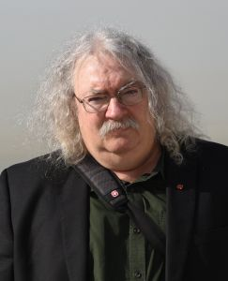
http://www.downes.ca

