Slide 1
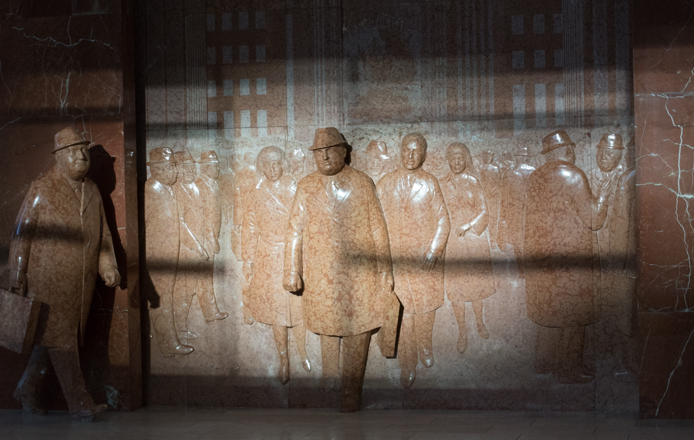
Personal Learning vs Personalized Learning What Needs to Happen
Stephen Downes
Online Learning 2018
Toronto, Ontario
October 17, 2018
http://www.downes.ca/presentation/497

Slide 2
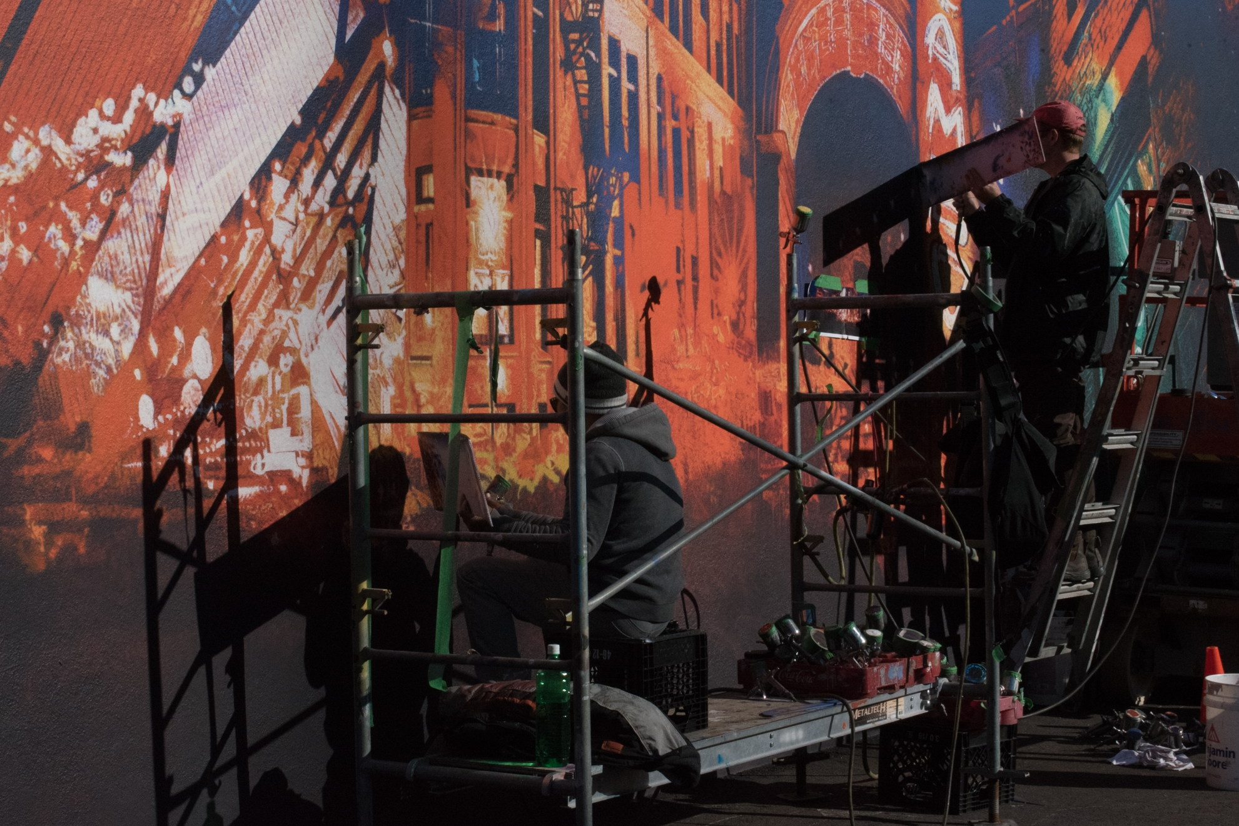
Personal vs Personalized Learning
1

Slide 3
Two Approaches…
Content
Practice
Practice
Content

Slide 4
Two Approaches…
Defines an ideal state
Defines a desired state
Content
Practice
Practice
Content
TEST
TRY
Person tests you
Person helps you

Slide 5
Two Approaches…
Defines an ideal state
Defines a desired state
Content
Practice
Correction
Iteration
GAP
Practice
Content
Opport-unity
TEST
TRY
Person tests you
Person helps you

Slide 6
Library Environment
Defines an ideal state
Defines a desired state
Content
Practice
Affordances
Correction
Requirements
Iteration
GAP
Content
Opport-unity
Practice
TEST
TRY
Person tests you
Person helps you

Slide 7
Personalized Personal We do for you You do for yourself
Defines an ideal state
Defines a desired state
Content
Practice
Affordances
Correction
Requirements
Iteration
GAP
Practice
Content
Opport-unity
TEST
TRY
Person tests you
Person helps you

Slide 8
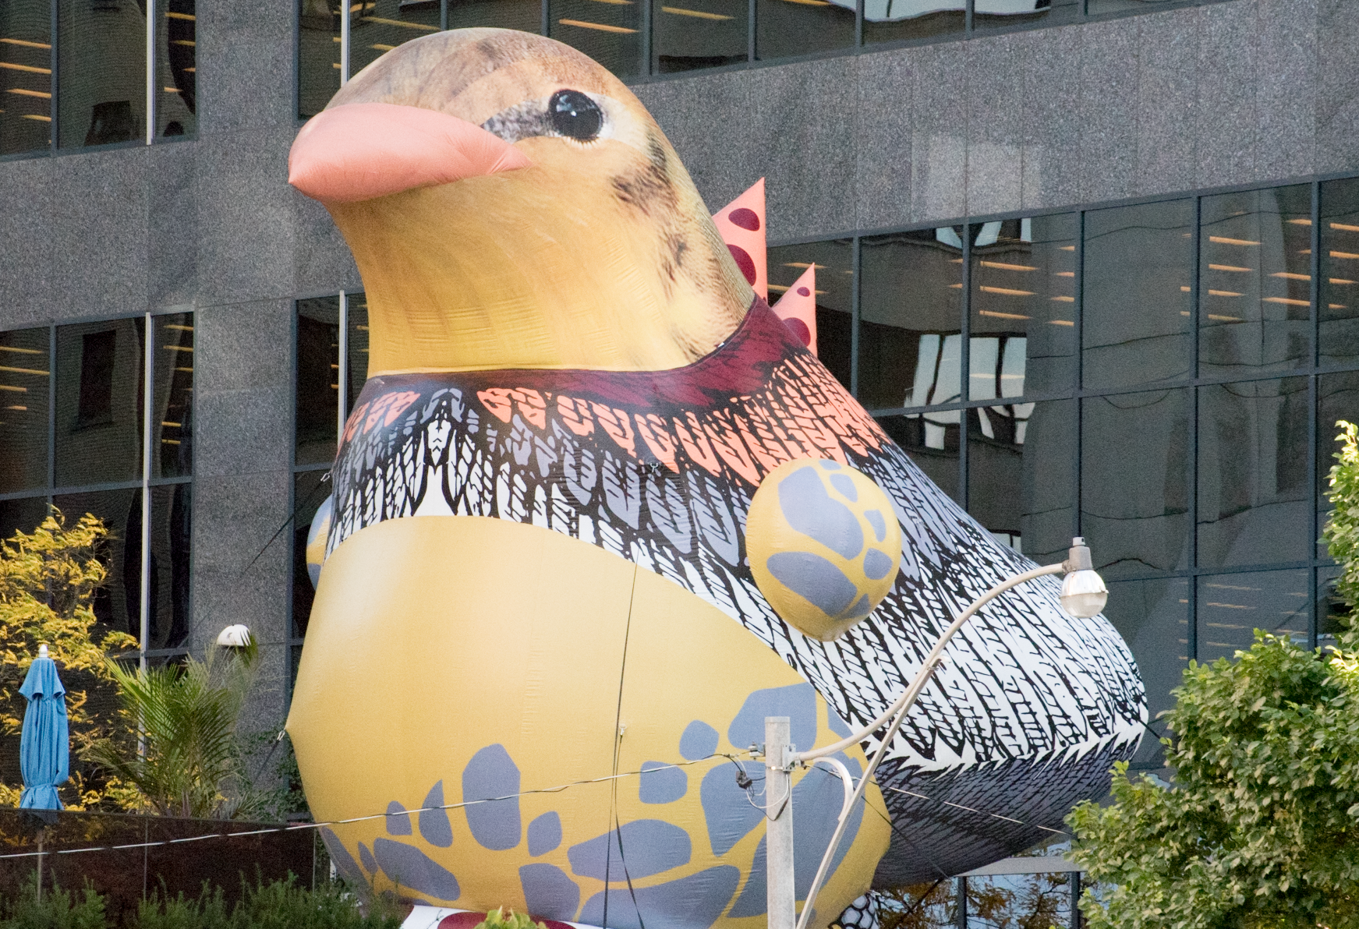
What Personal Learning Means to Me
2

Slide 9
and How We Make it Work for Everyone
2

Slide 10
Choice
a

Slide 11
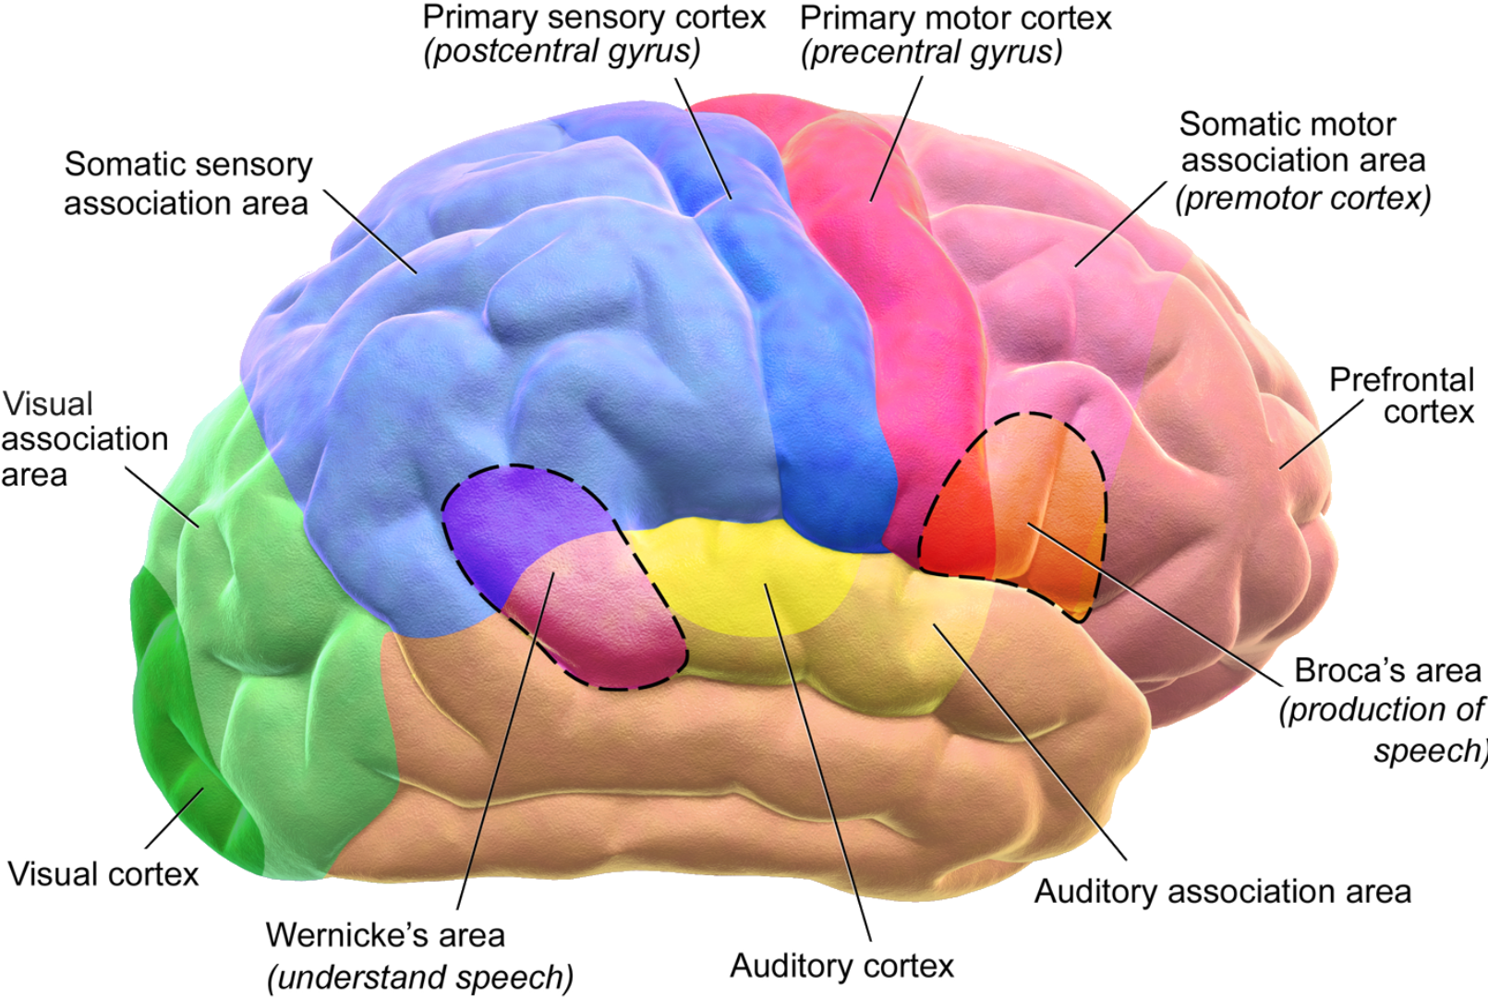
I make my own learning decisions
My learning choices are directly related to my:
- current projects
- career choices
- opportunities
- needs
Image: Wikipedia

Slide 12
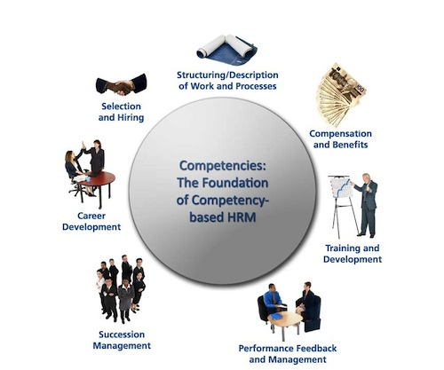
Help me decide
We need systems that show the relation between specific learning goals and our career choices
Image: Wikipedia

Slide 13
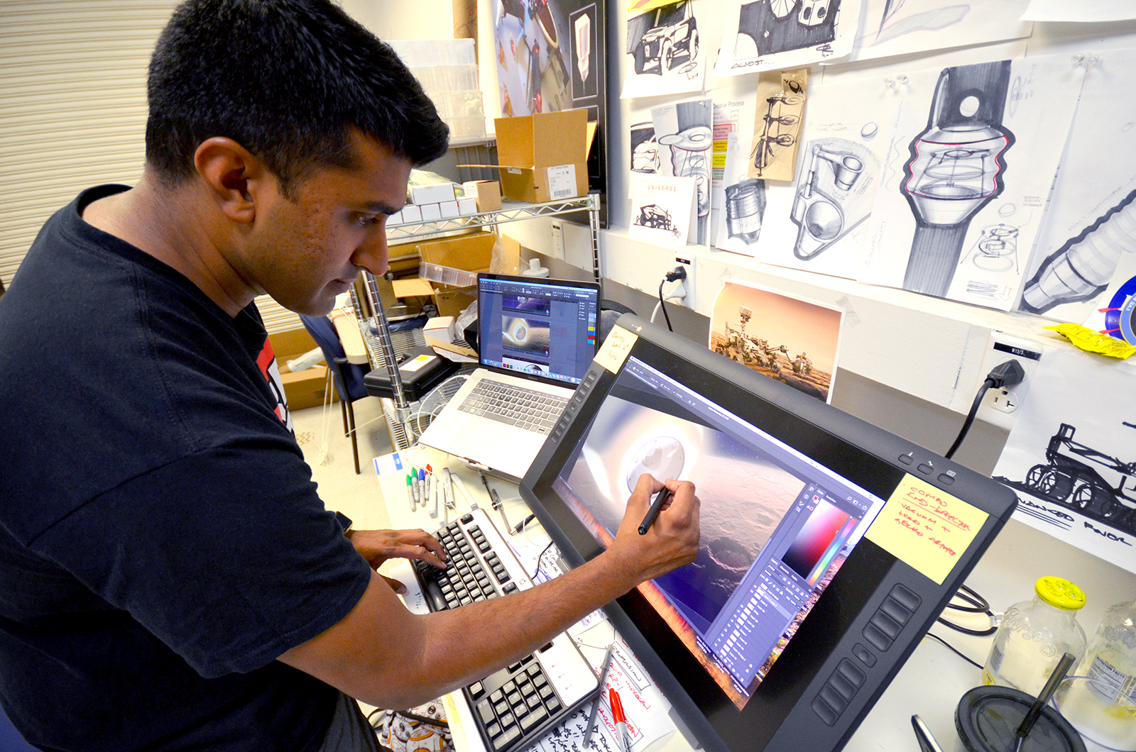
I make my own learning decisions
I selected my own learning resources to suit my:
- previous experience
- learning preference
- trust in the source
- needs
Image: NASA/JPL Internship Program https://www.jpl.nasa.gov/edu/news/column/meet-jpl-interns/

Slide 14
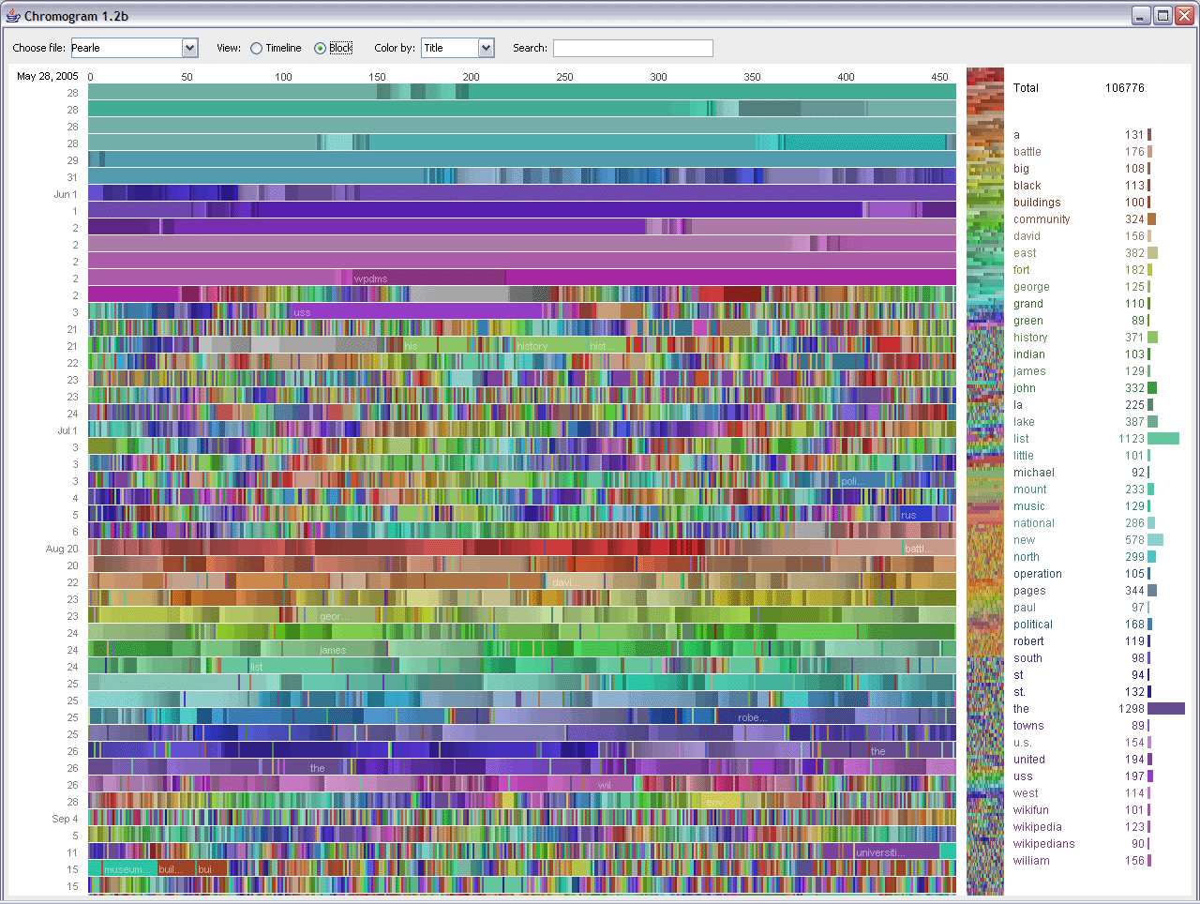
Narrow the choice
Recommend learning resources that suit my:
- previous experience
- learning preference
- trust in the source
- needs
Image: Wikipedia – Big Data

Slide 15
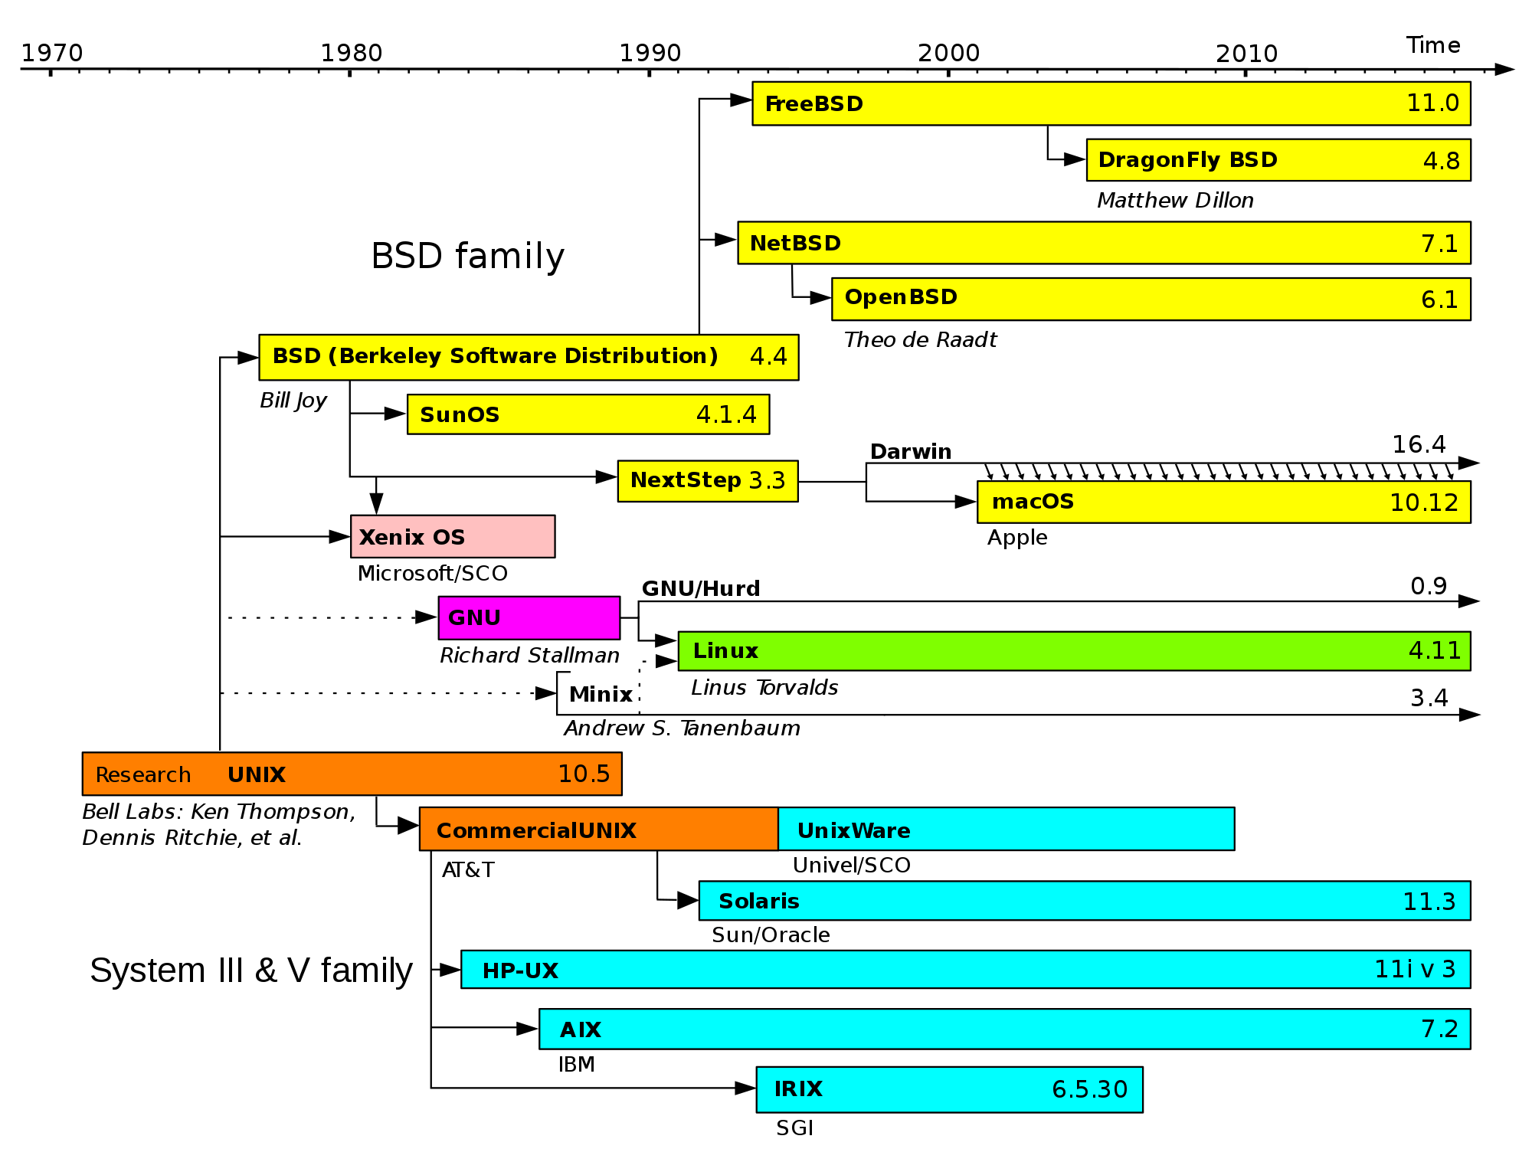
I make my own learning decisions
I design my own learning environment to add:
- relevant activities
- my own social network
- my design preferences
- A soundtrack

Slide 16
Personal Learning Environment
I design my own learning environment to add:
- relevant activities
- my own social network
- my design preferences
- A soundtrack
Image: Wikipedia

Slide 17
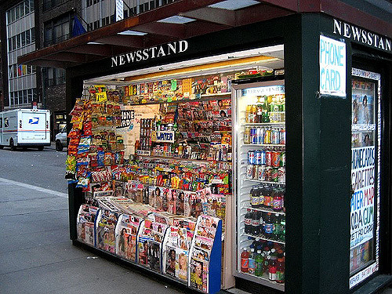
I’m not locked in a box
My courses come from multiple sources:
- different institutions
- various learning platforms
- multiple perspectives
- many communities
Image: Molly https://www.flickr.com/photos/maulleigh/407259826

Slide 18
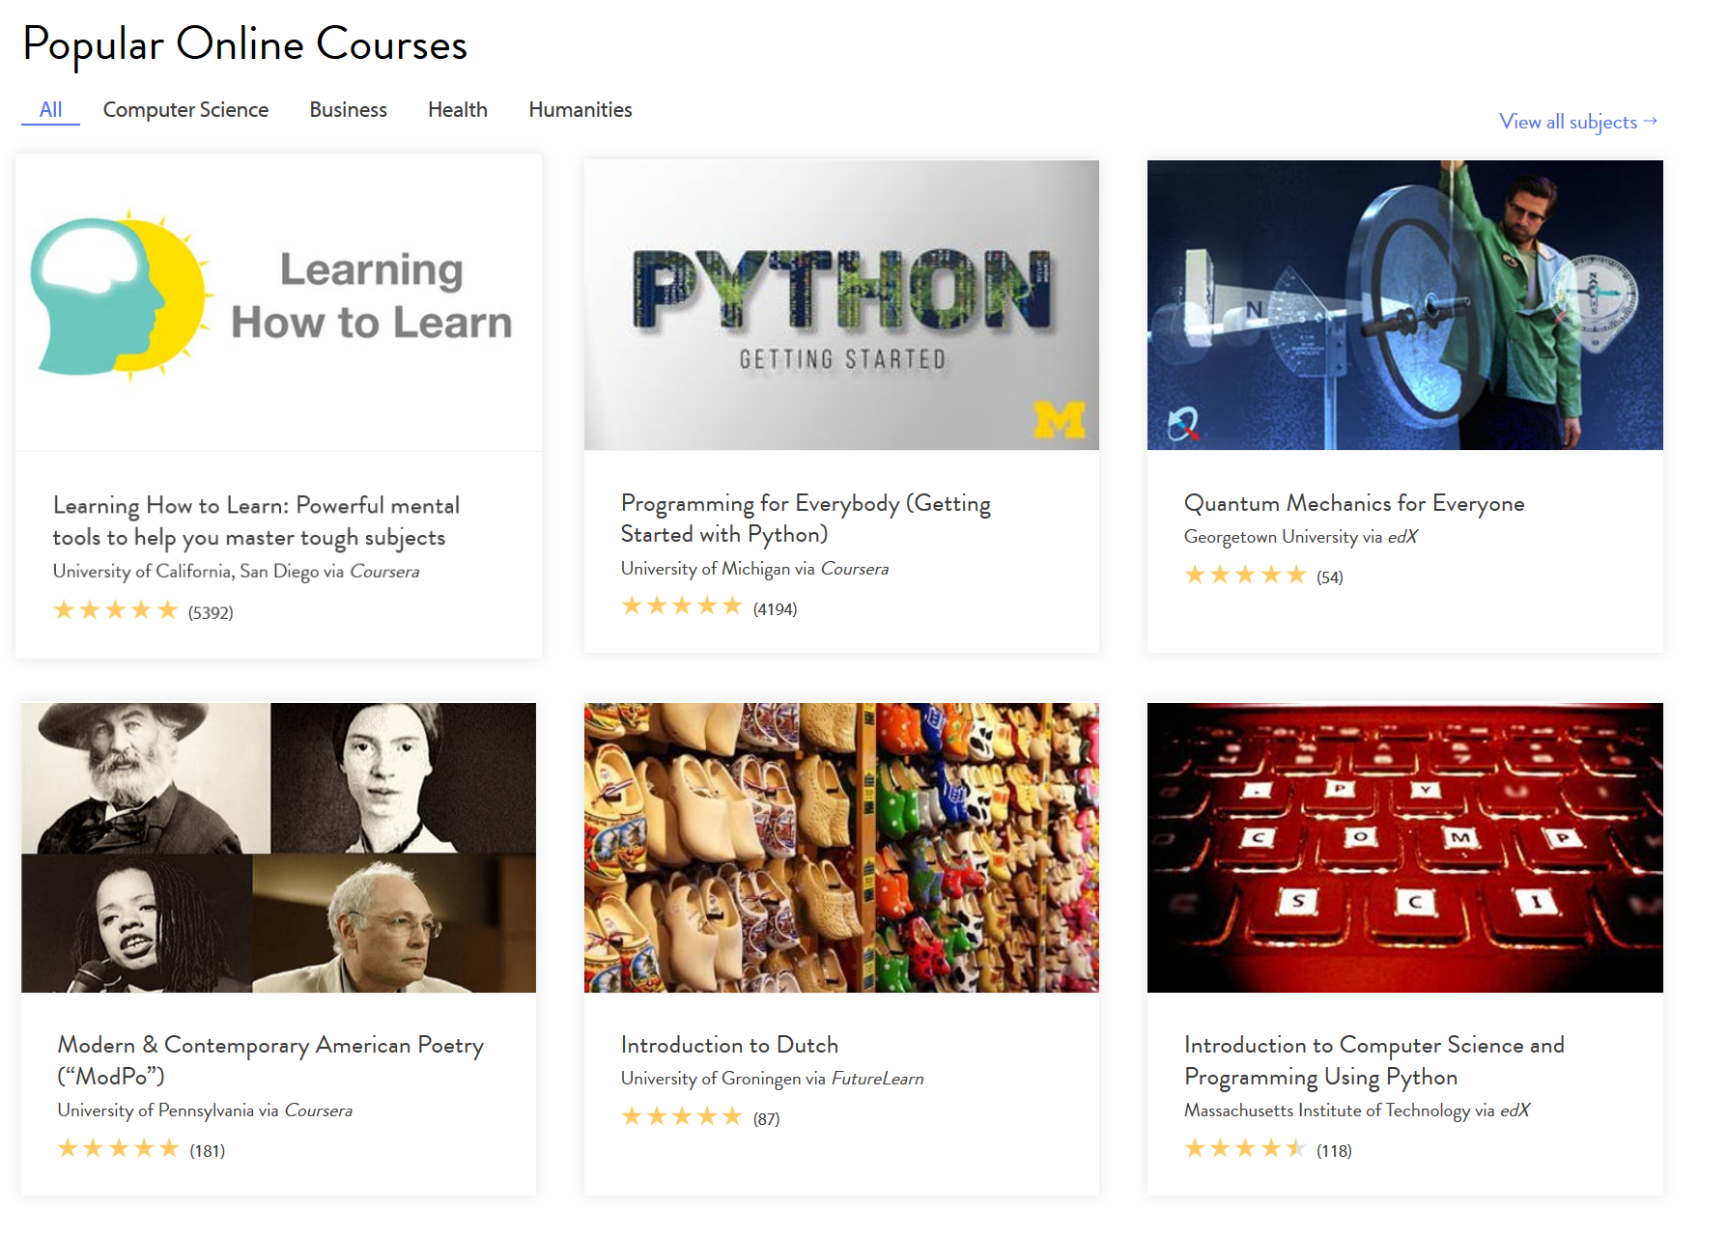
Give me Choice
Online access to courses from different institutions on various learning platforms
Screenshot: Class Central https://www.class-central.com/

Slide 19
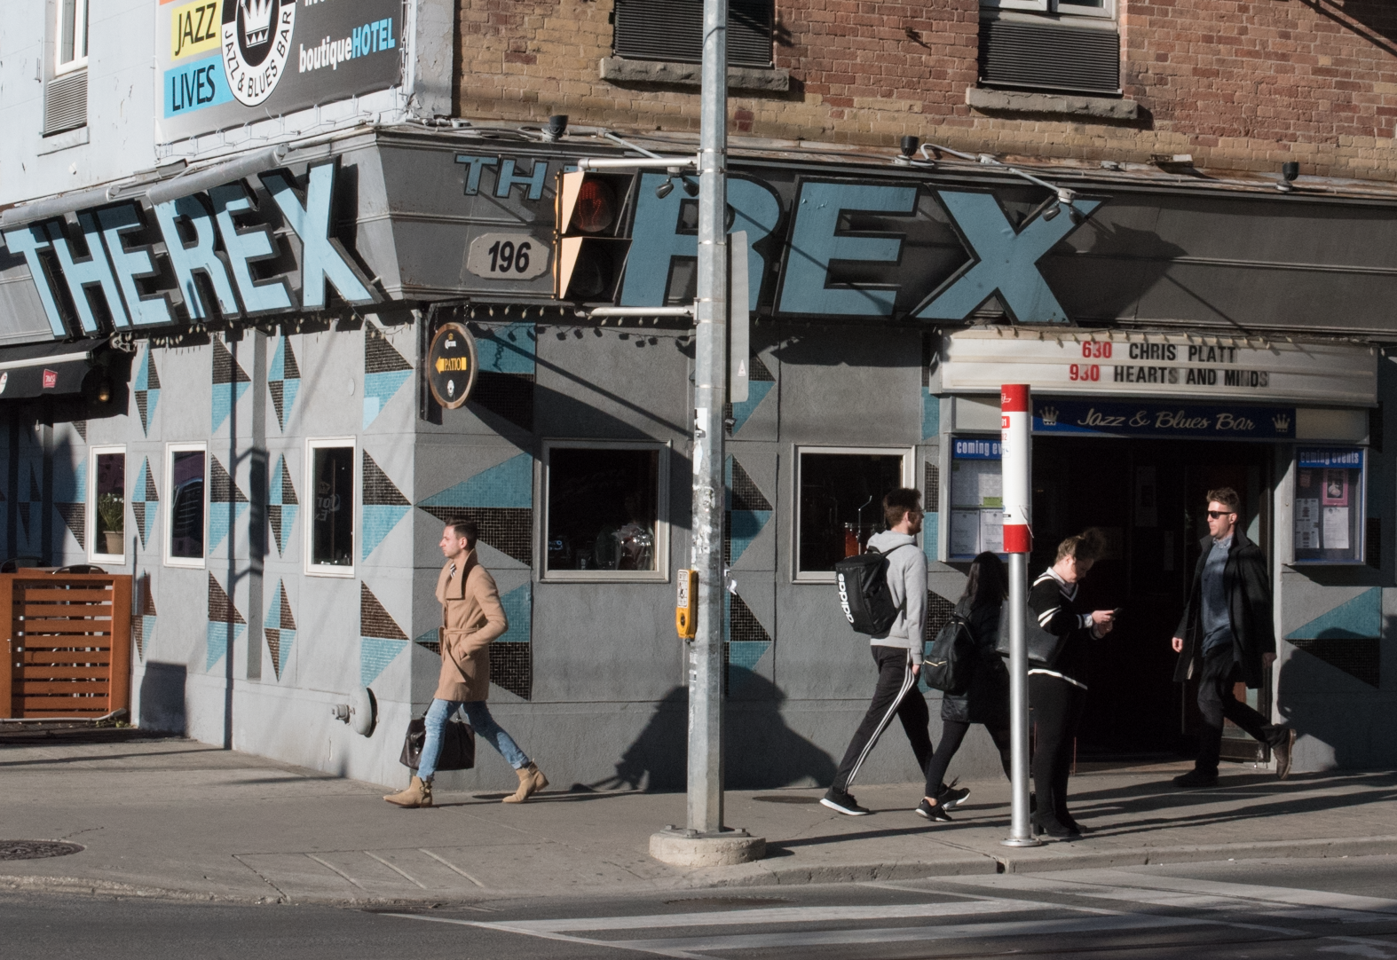
Ownership
b

Slide 20
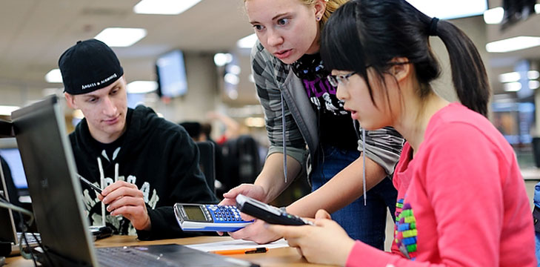
I’m not locked in a box
I use multiple learning technologies:
- audio, video, animations
- 3rd party platforms for discussions and interaction
- games and virtual reality
- future tech
Image: Jisc

Slide 21
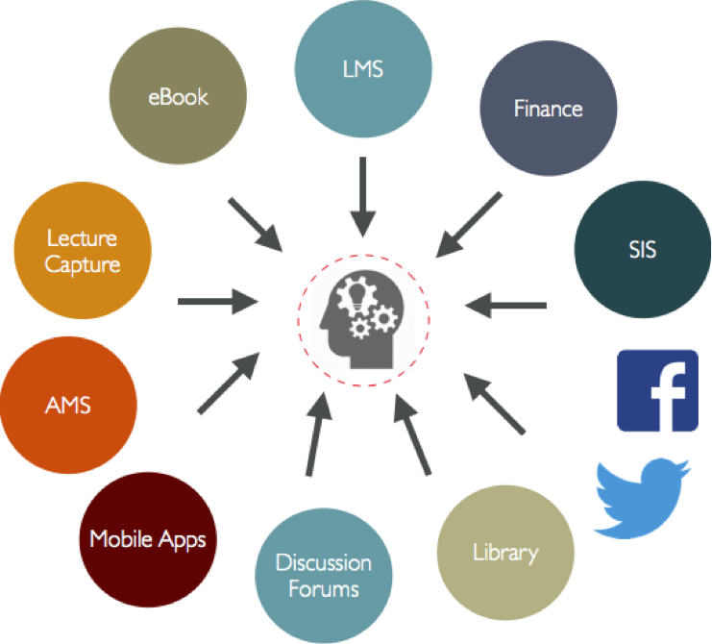
Support Multiple Media
- Provide access to resources in audio, video, animations, etc
- Support 3rd party platforms for discussions and interaction
Image: Wikipedia

Slide 22
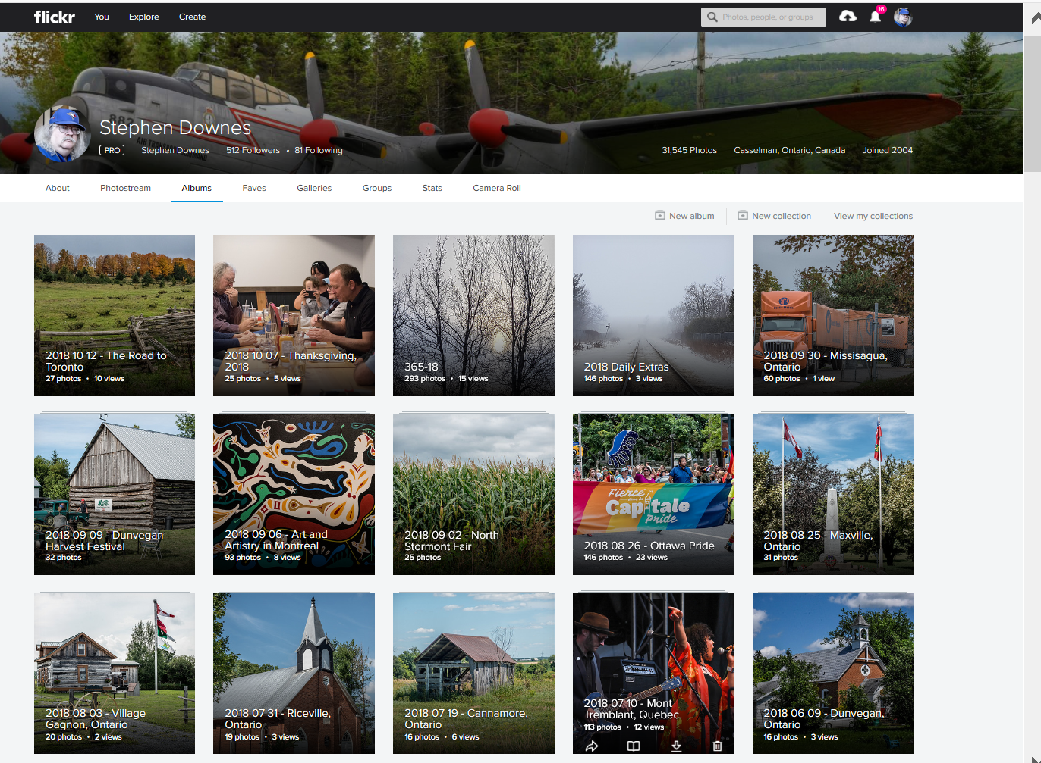
I’m not locked in a box
My resources stay mine and I save them where I want:
- on my own computer
- Flickr and YouTube
- in cloud storage services
- wherever
Screenshot: Flickr

Slide 23
Recognize and Enable Ownership
Use and support open content formats
Support downloading, uploading and cloud storage
Content portability
Image: Alastair Creelman http://acreelman.blogspot.com/

Slide 24
I can learn openly
I not only use OERs, I create new ones as I learn:
- I access OER repositories
- I exchange them with friends
- my resources are available to anyone I want
- it’s my choice
Image: Photoshop brushes, Garcya, Deviant Art https://www.deviantart.com/garcya/art/5-Flowers-Photoshop-Brushes-343330158

Slide 25
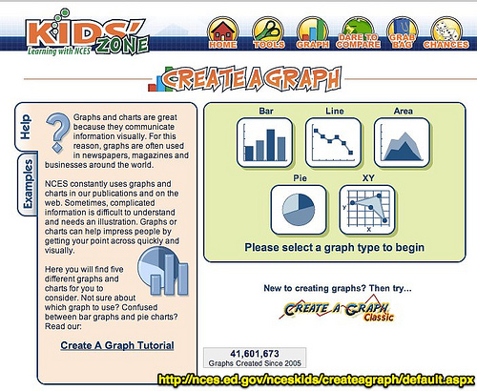
Support Sharing
Methods to create resources as we learn:
- Support blogs and wikis
Sharing networks (e.g., RSS, Webmentions)
Social Media
Image: Wesley Fryer

Slide 26
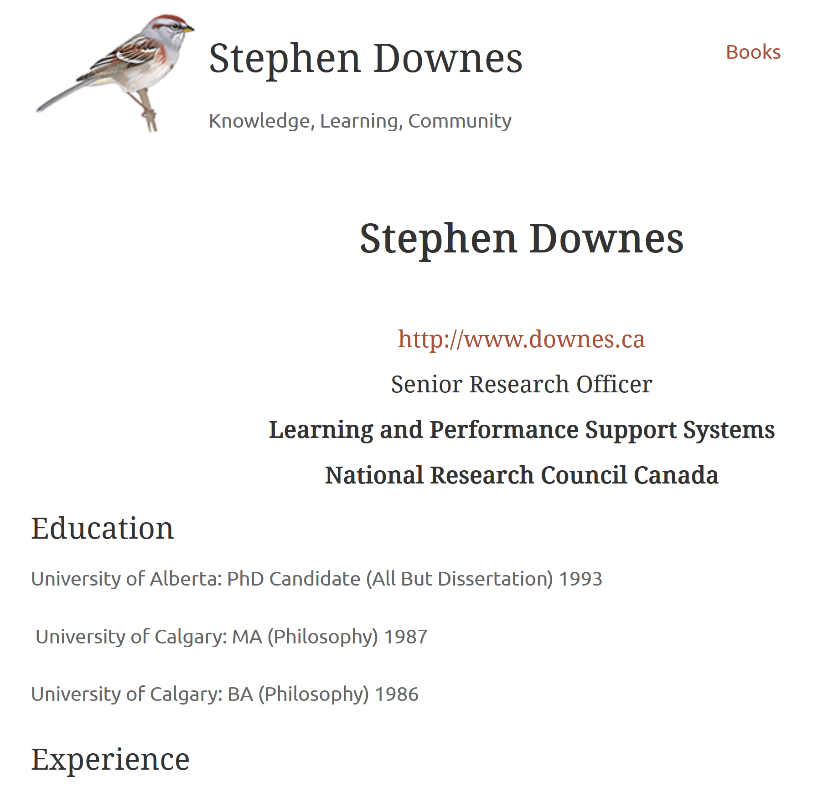
I can learn openly
My learning achievements are visible to who I choose:
- I share my achievements
- my machine-readable personal learning record is automatically created

Slide 27
Give me Credit
- Badging or credentials service
- Machine-readable personal learning record is automatically created
Image: Public Domain Clip Art

Slide 28
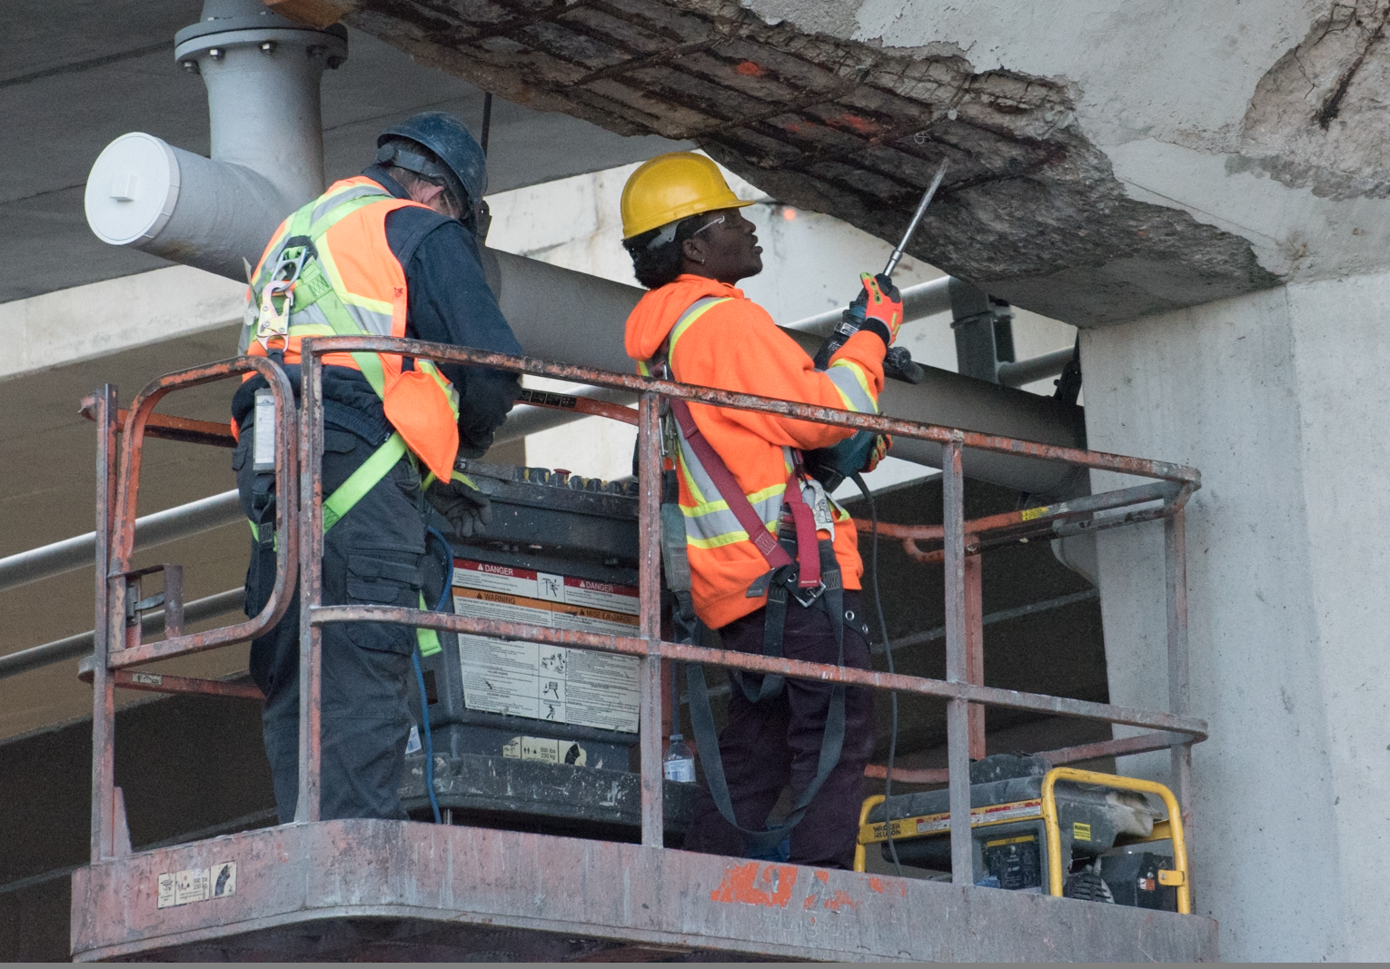
Community
c

Slide 29
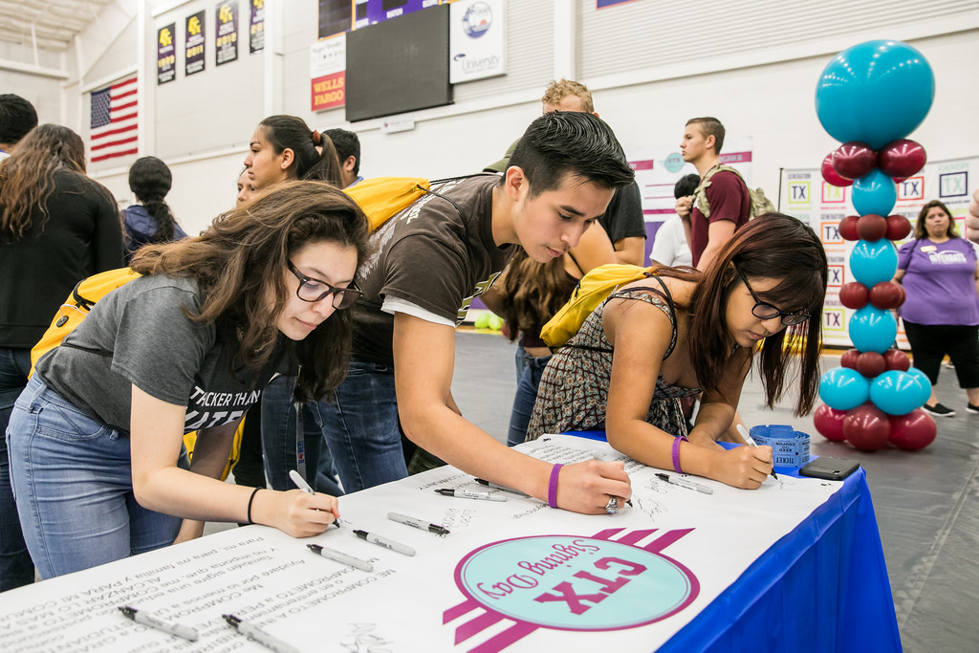
I can learn openly
My learning community follows me, not my school:
- I stay connected to friends after the course
- My learning community becomes my professional community
Image: Austin Community College https://www.flickr.com/photos/accdistrict/41255840484/in/photostream/

Slide 30
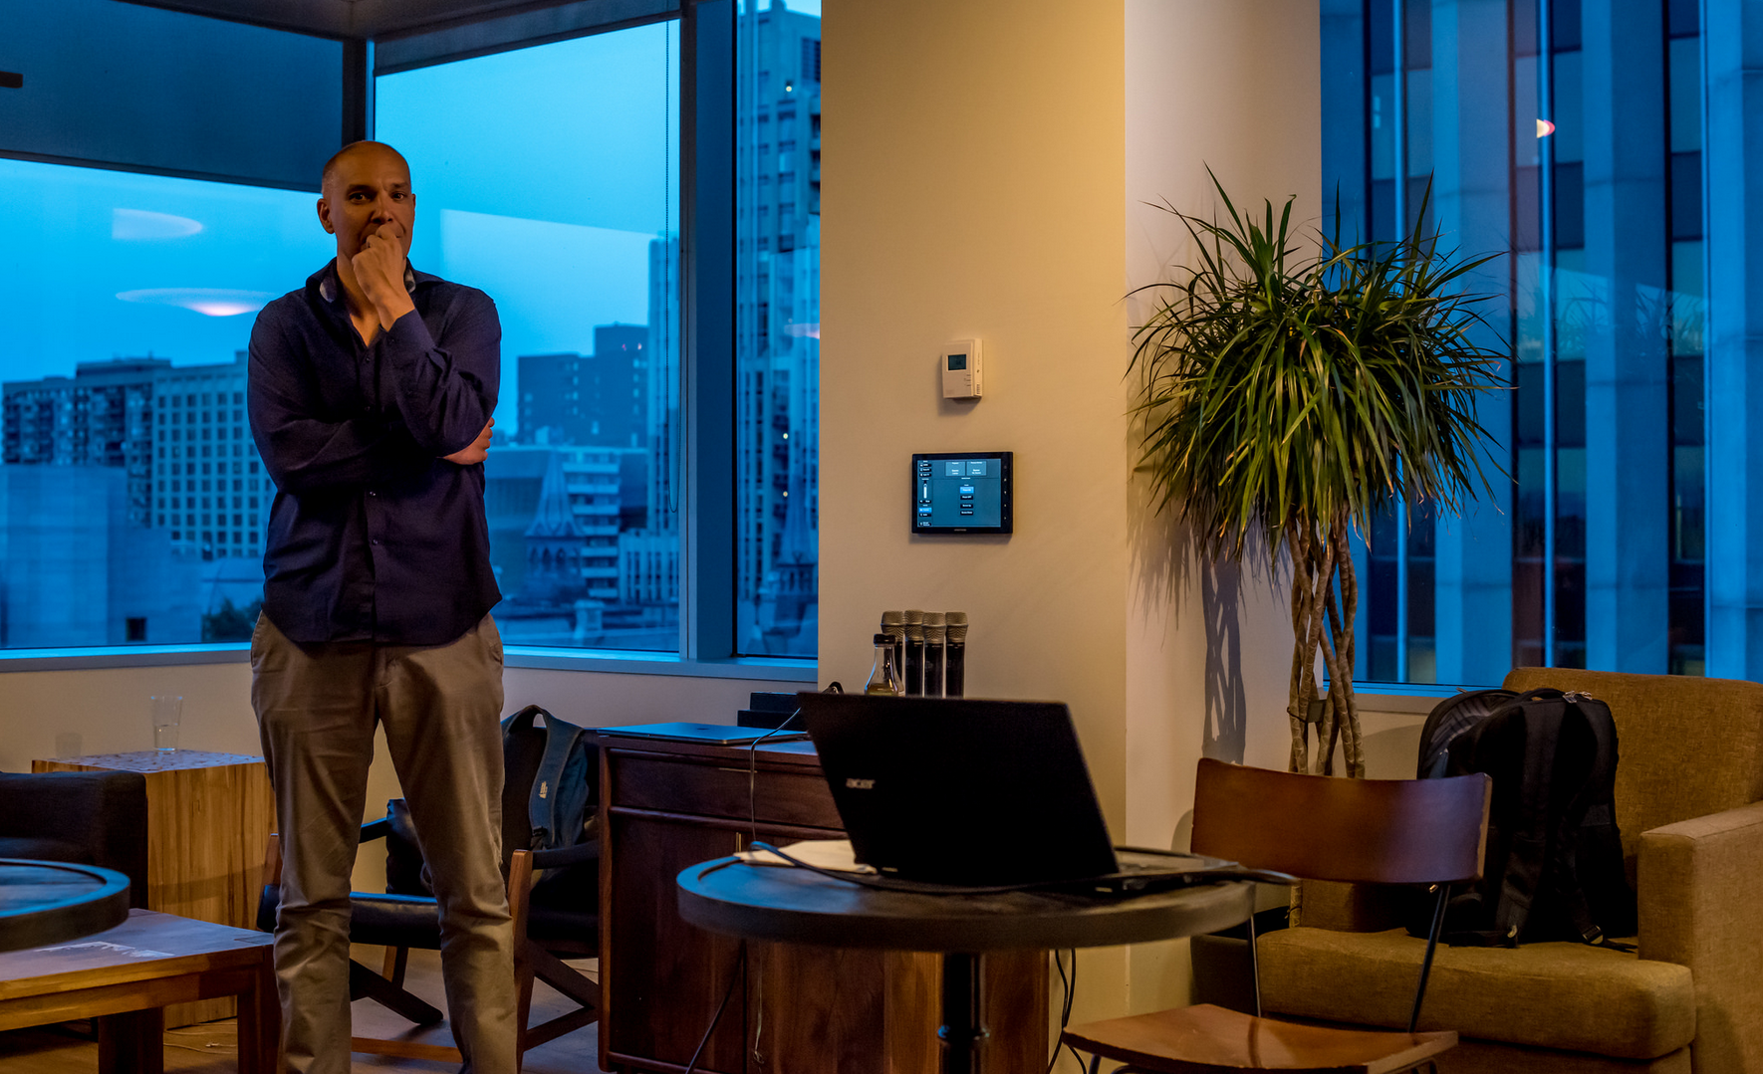
Community
Support community that extends beyond the school or the company
Eg. Shopify Meetups

Slide 31
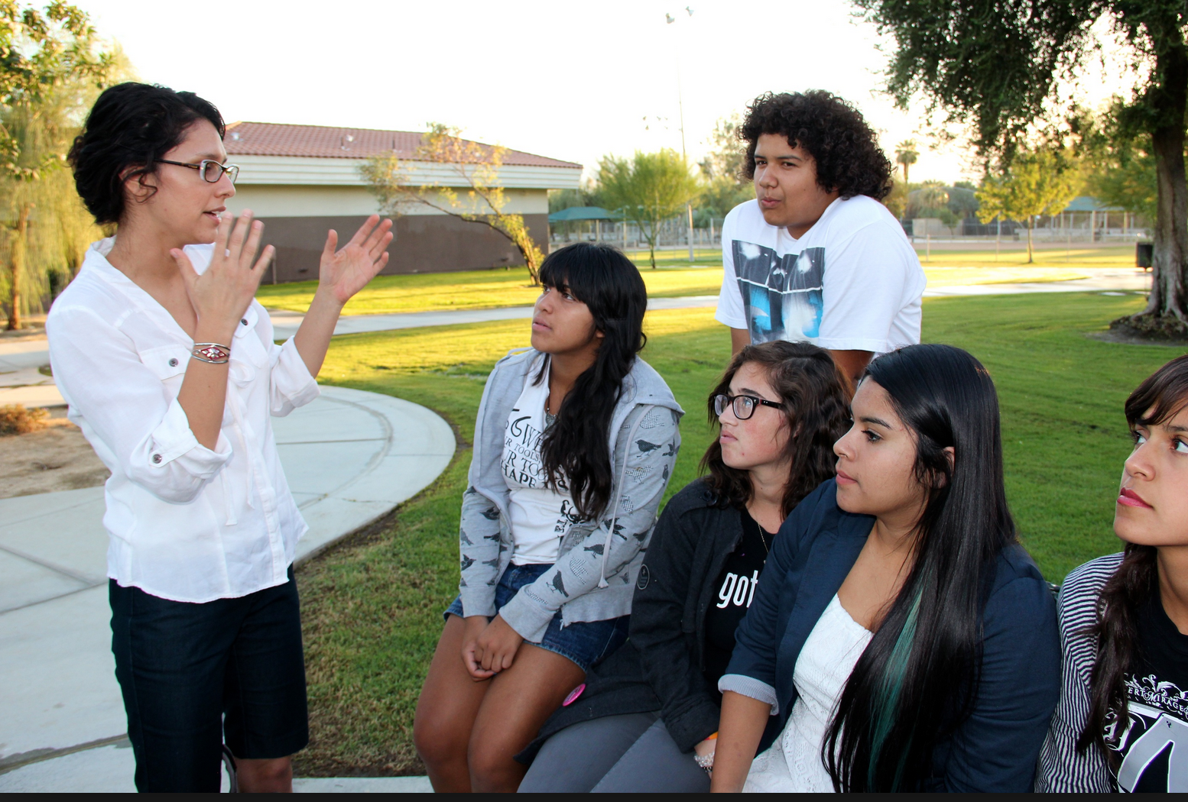
I am connected
I am never alone as I pursue my learning objectives:
- I’m following other people as they do the same thing
- courses & teachers guide me
- help is available when I need it
Image: Coachella http://coachellaunincorporated.org/2012/11/01/community-group-poised-to-take-action-following-youth-research-finding/

Slide 32
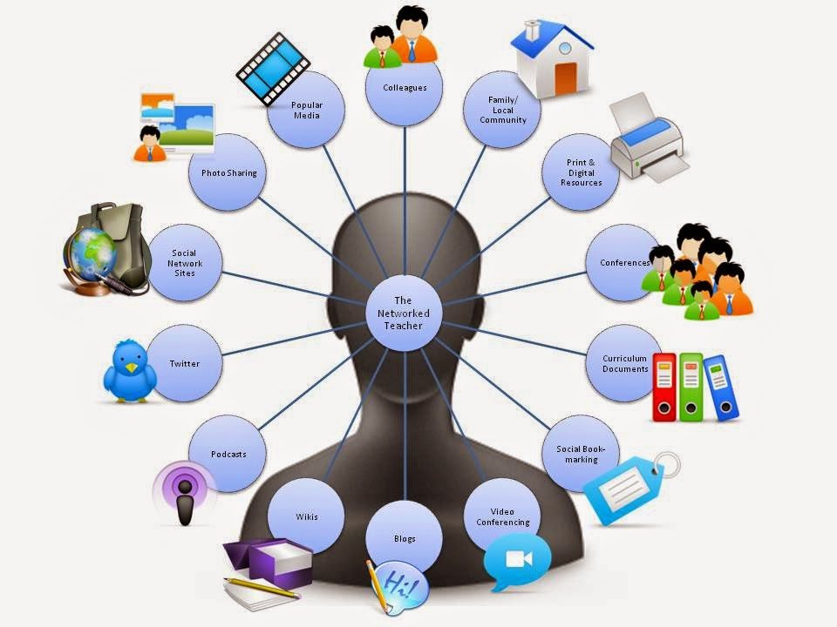
Support Community
Encourage people to work openly and share insghts
Recognize and reward mentoring and training activities
Image: Sahana Chattopadhyay
http://idreflections.blogspot.com/2015/02/moocs-in-workplace-learning-part-3.html

Slide 33
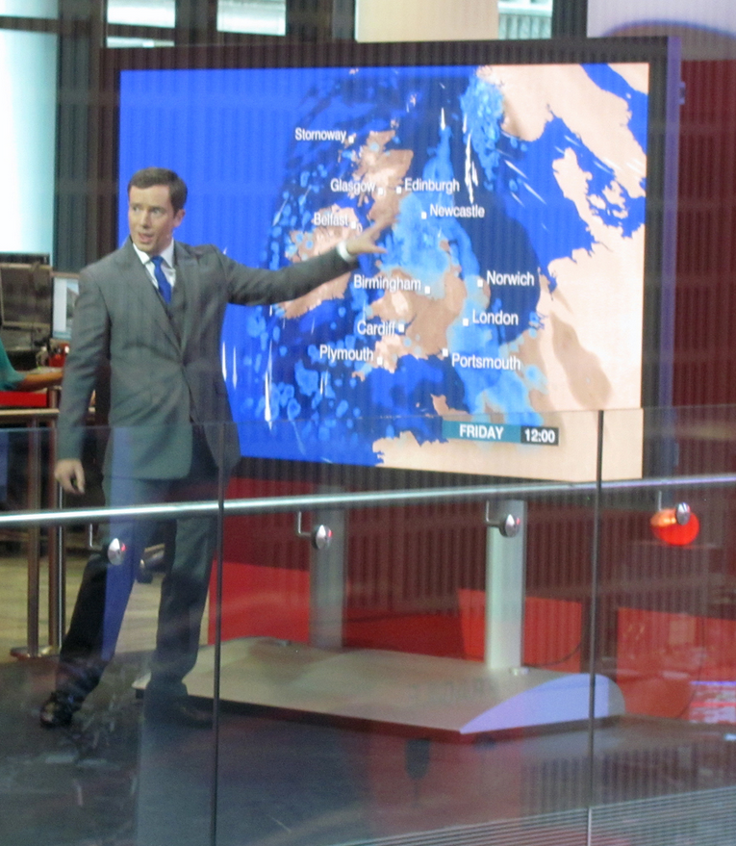
I am connected
My learning evolves and grows from day to day:
- As the world changes, my learning resources change
- I can see patterns and trends as they develop in the world
- I am part of a community
Image: BBC

Slide 34
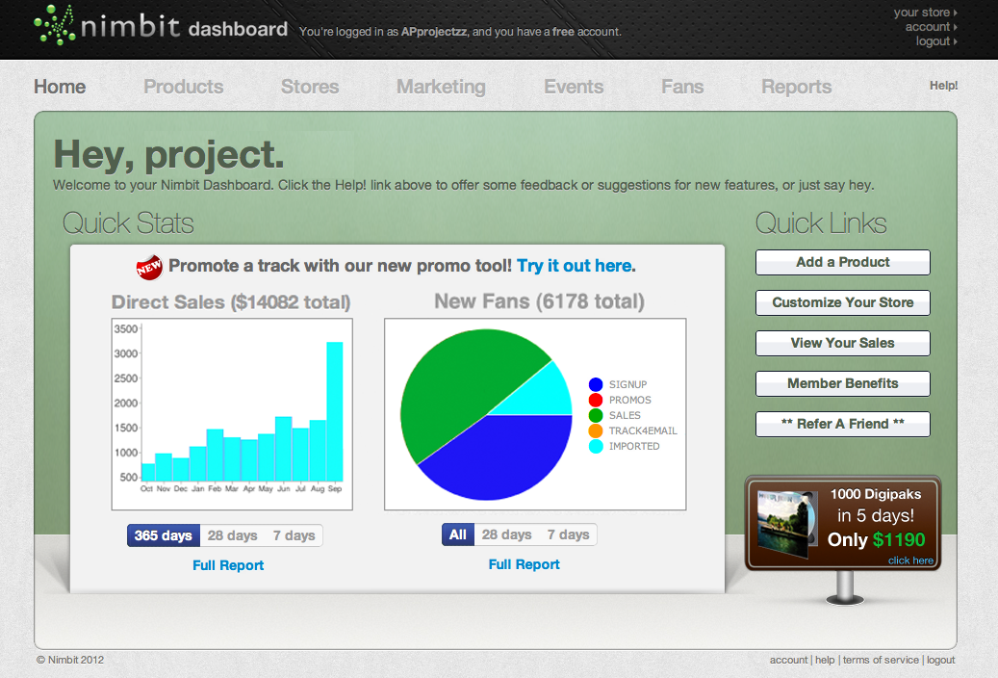
I am connected
Dashboards
Visualization Tools
Access to AI-as-a-service
Image: WikiMedia

Slide 35
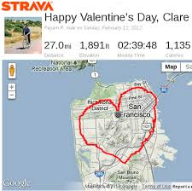
I am connected
I can track and understand my own progress:
- My AI and analytics are mine
- I can see patterns and trends across different parts of my learning and work
- And from different platforms
Image: Richard Masoner https://www.flickr.com/photos/bike/8428279662

Slide 36
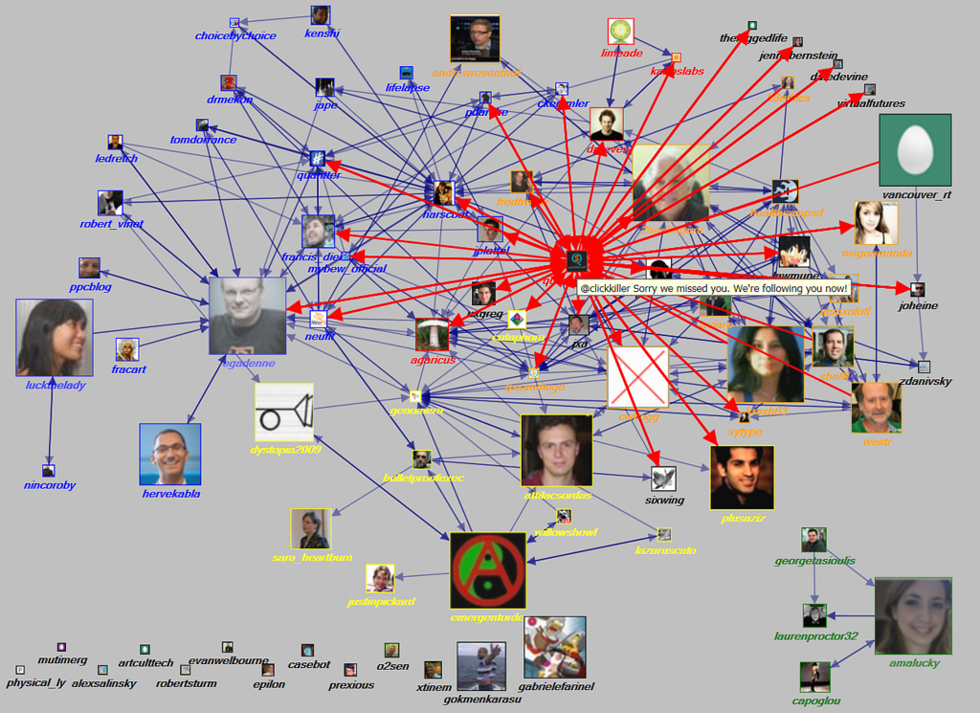
I am connected
- Quantified self
- Personal ownership of data
- Track impact – provide data from across different parts of my learning and work
- And from different platforms
Image: Marc Smith https://www.flickr.com/photos/marc_smith/5373492204

Slide 37
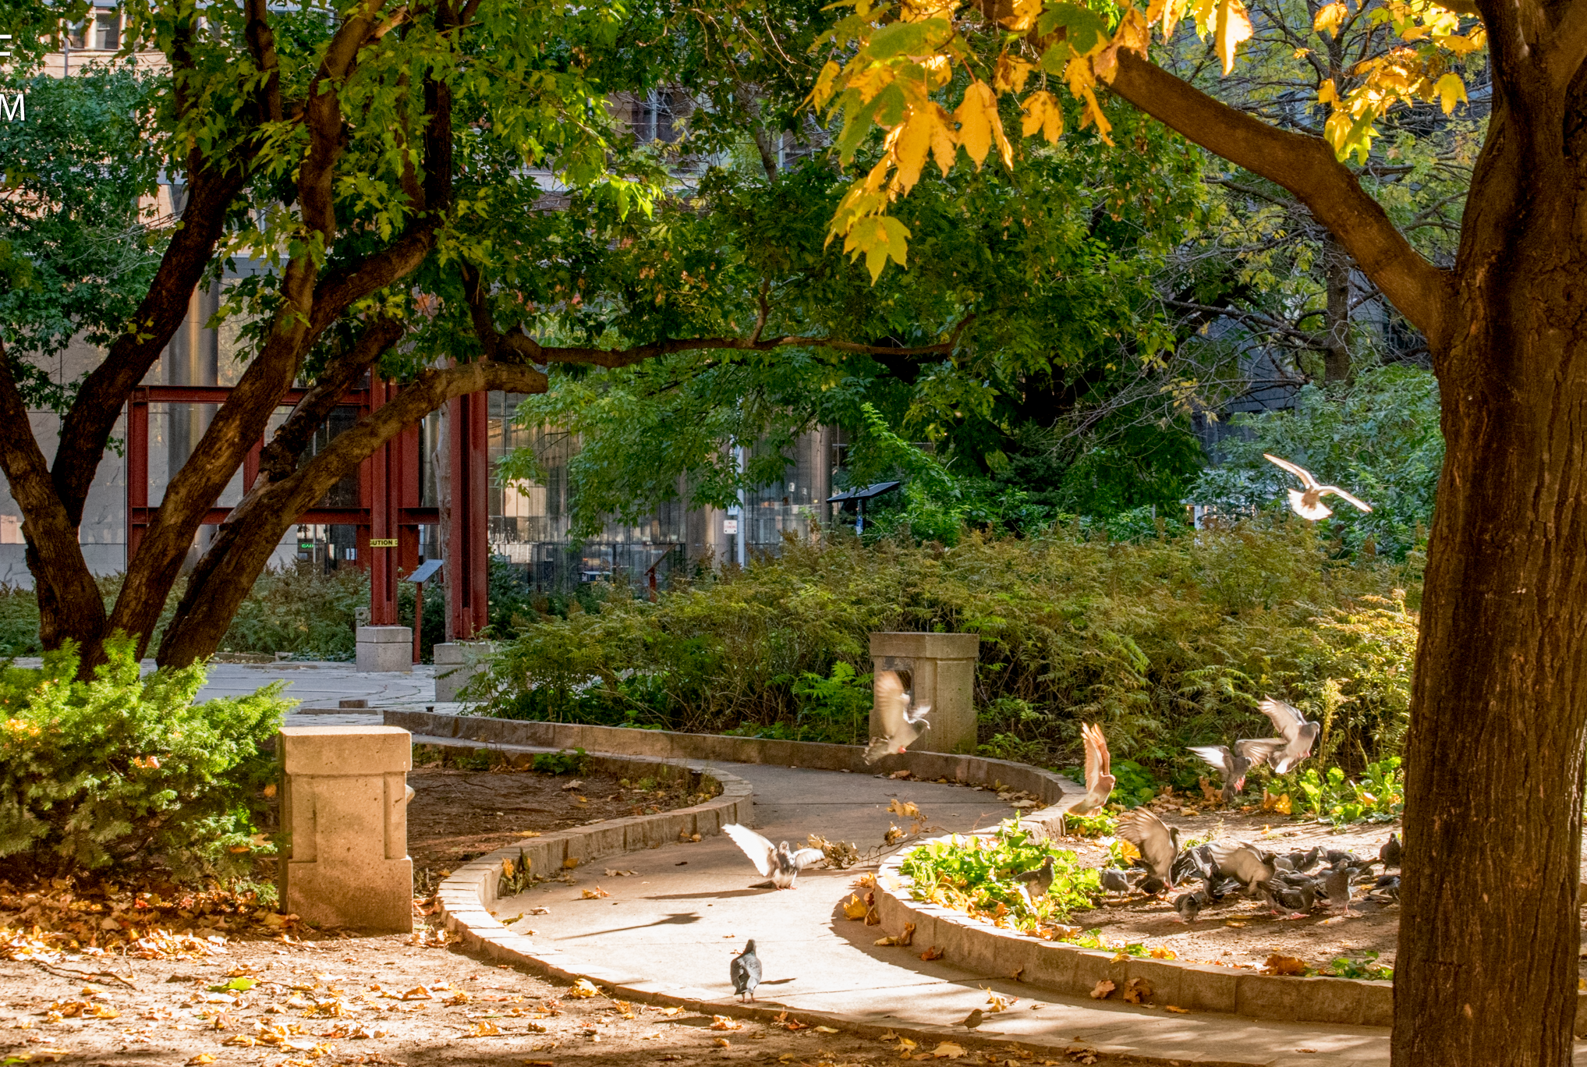
How We Make That Happen
3

Slide 38
Look for a job, contract, project…

Slide 39
Register for the course

Slide 40
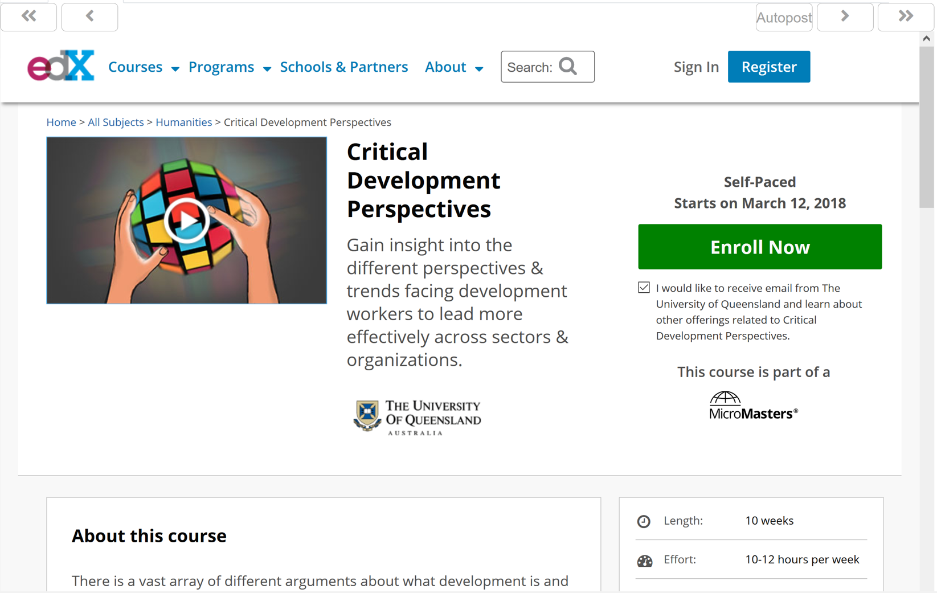
Read resources while in my course

Slide 41
Make my personal learning record

Slide 42
Create and attend live meetings

Slide 43
Chat with social media friends

Slide 44
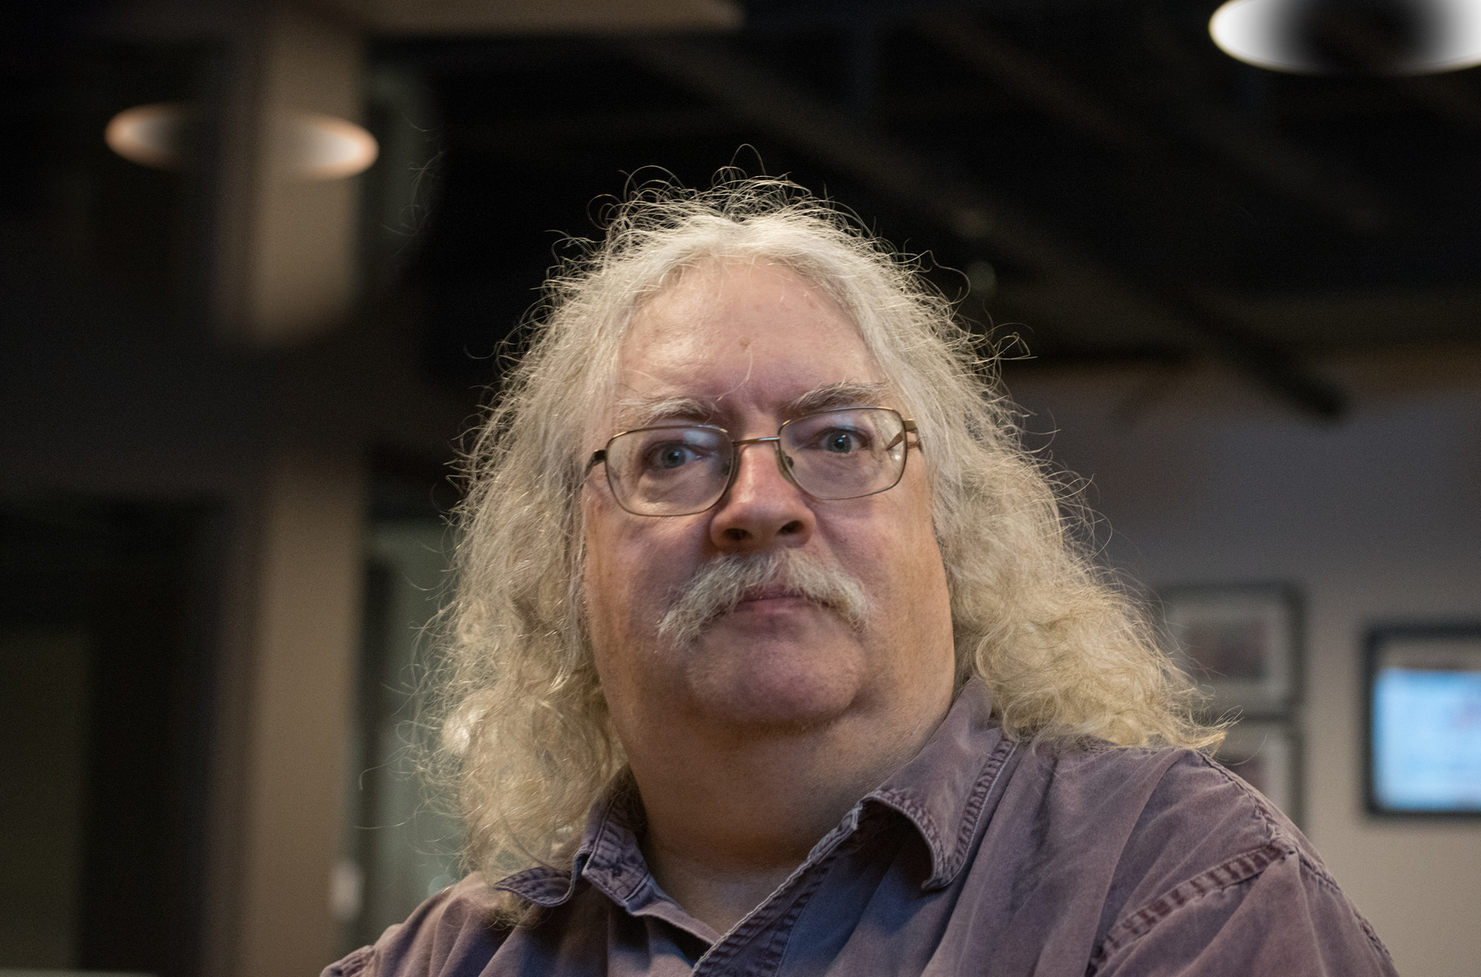
http://www.downes.ca
Photo by Lorelei

