Slide 1
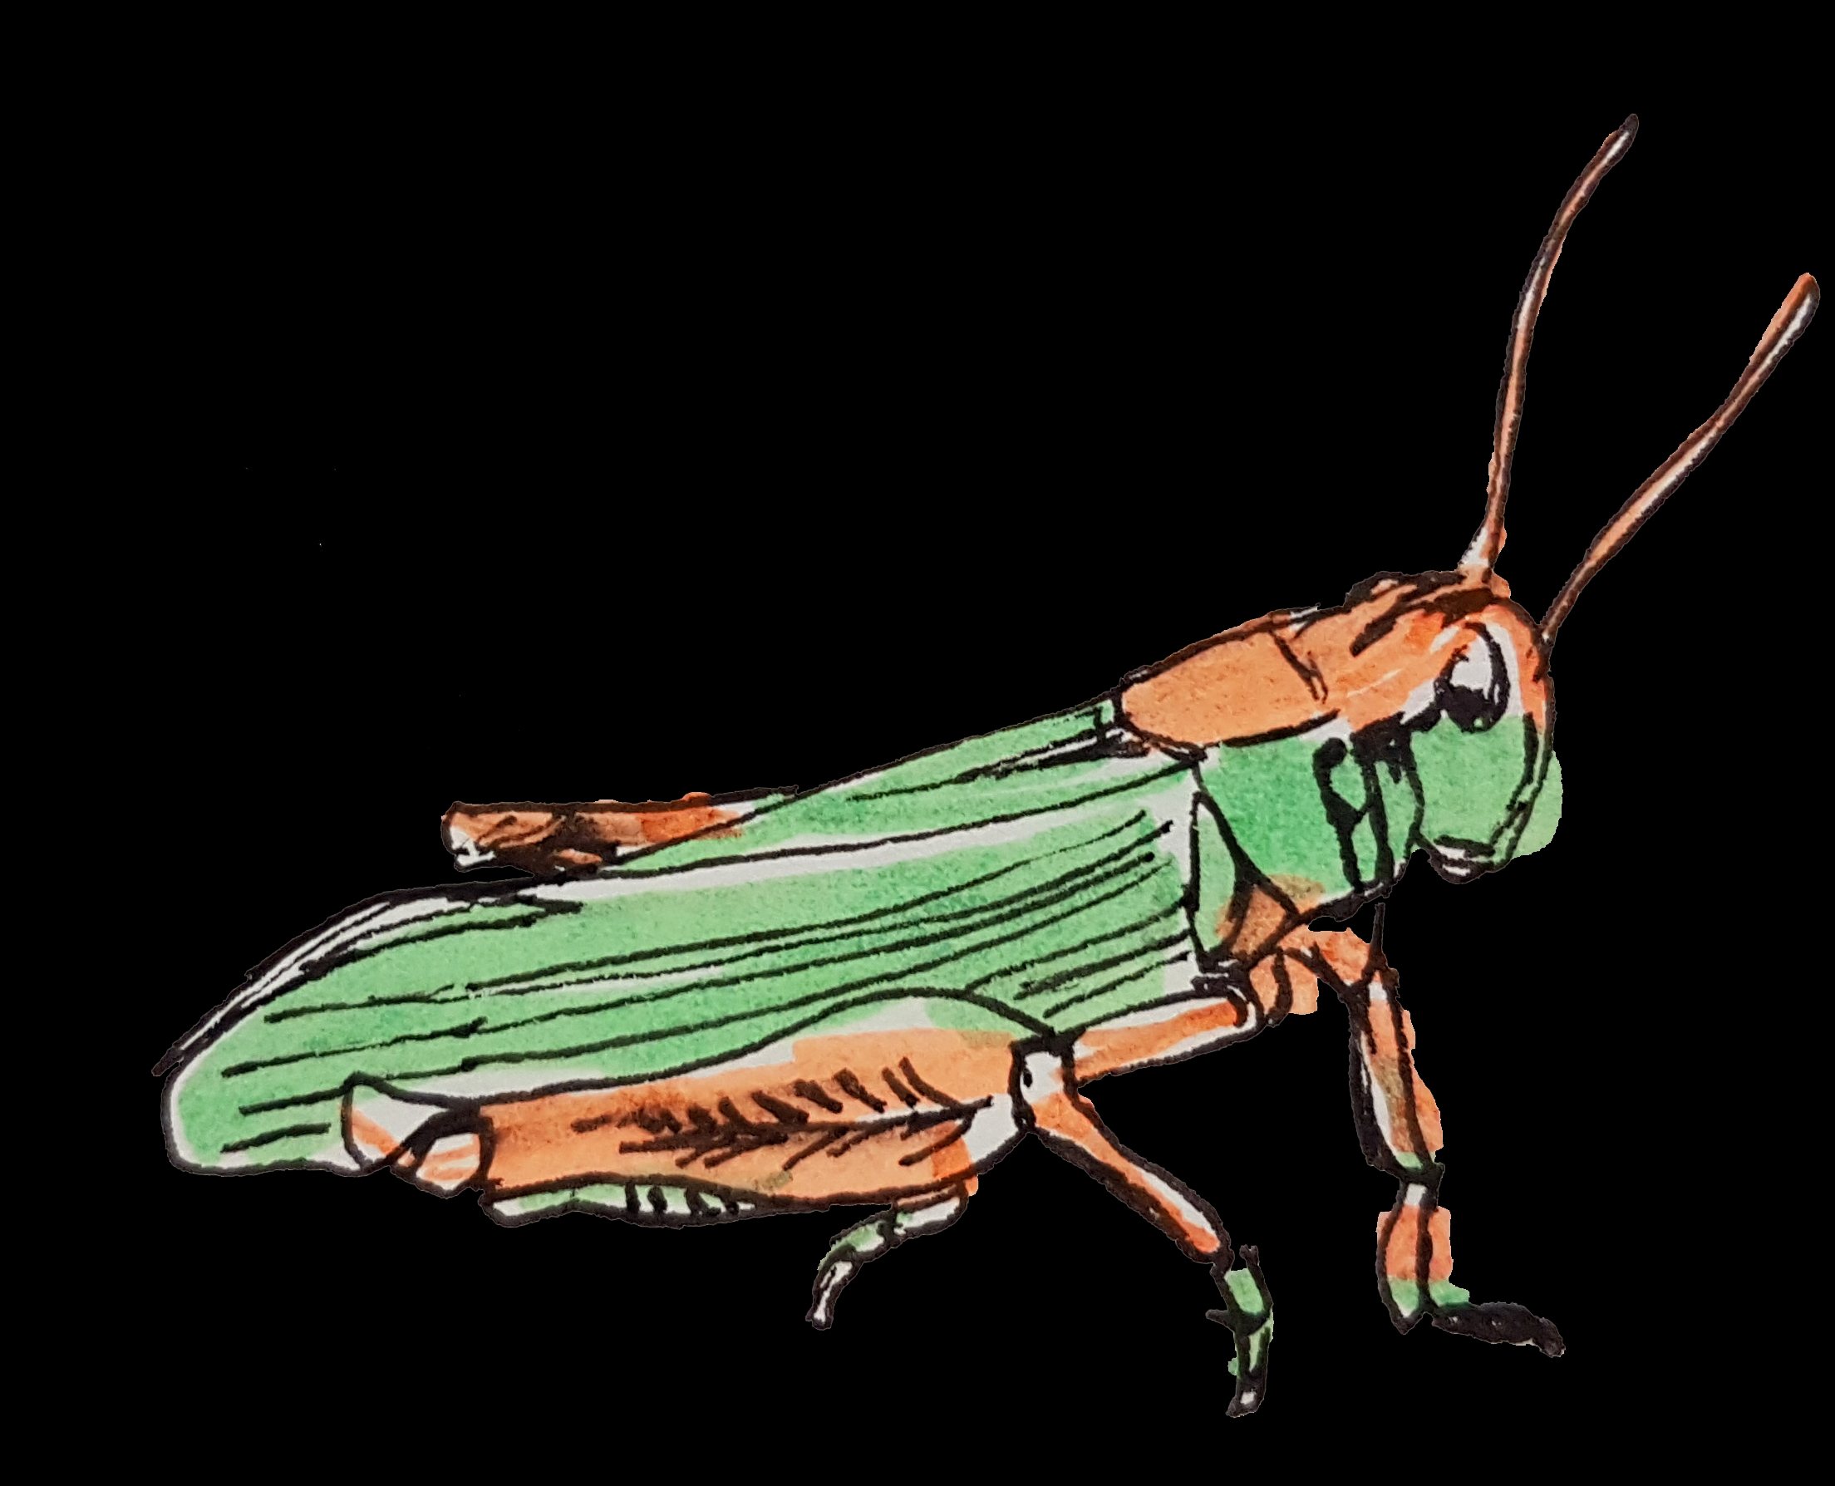
E-Learning 3.0
Stephen Downes
Online Learning 2018,
Toronto, Ontario 18 October 2018
http://www.downes.ca/presentation/498

Slide 2
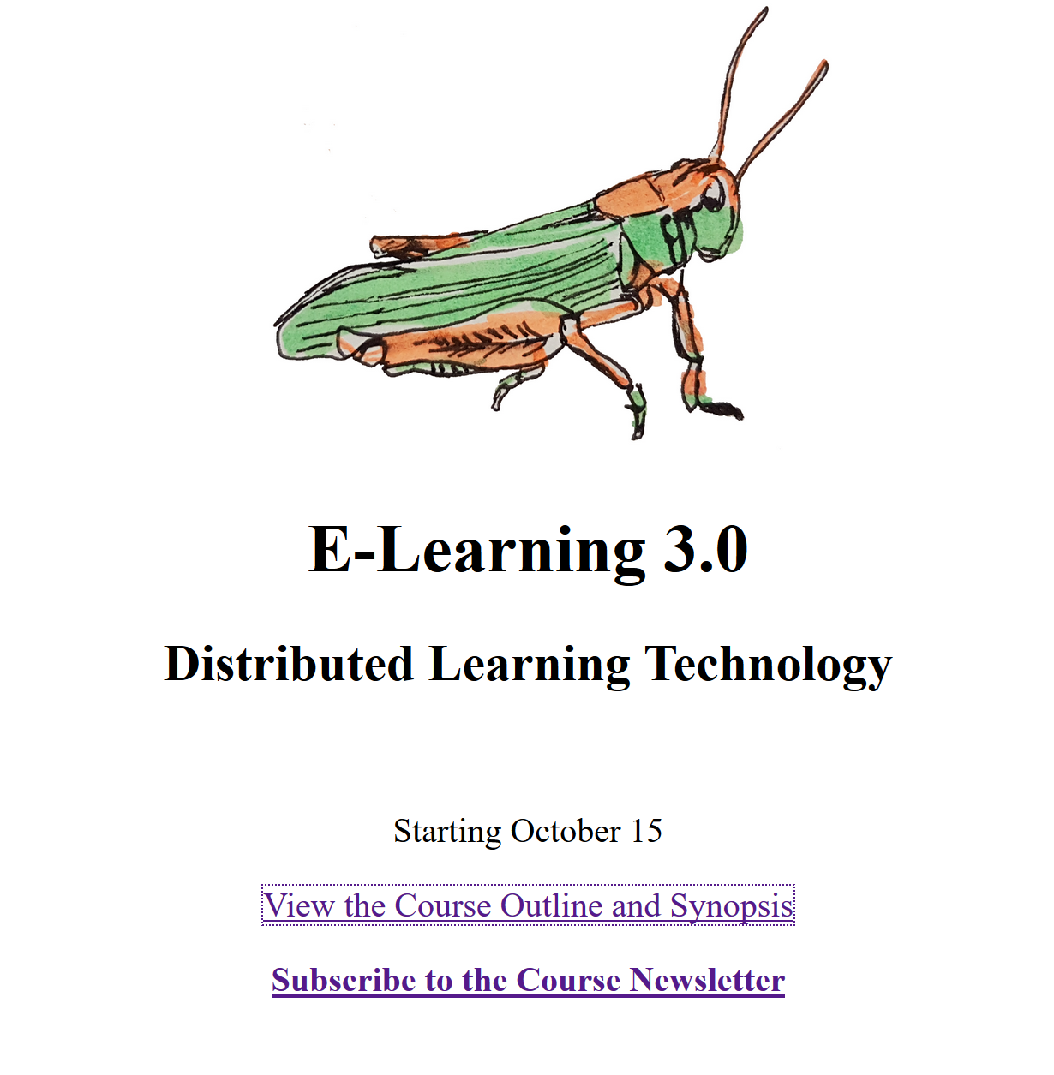
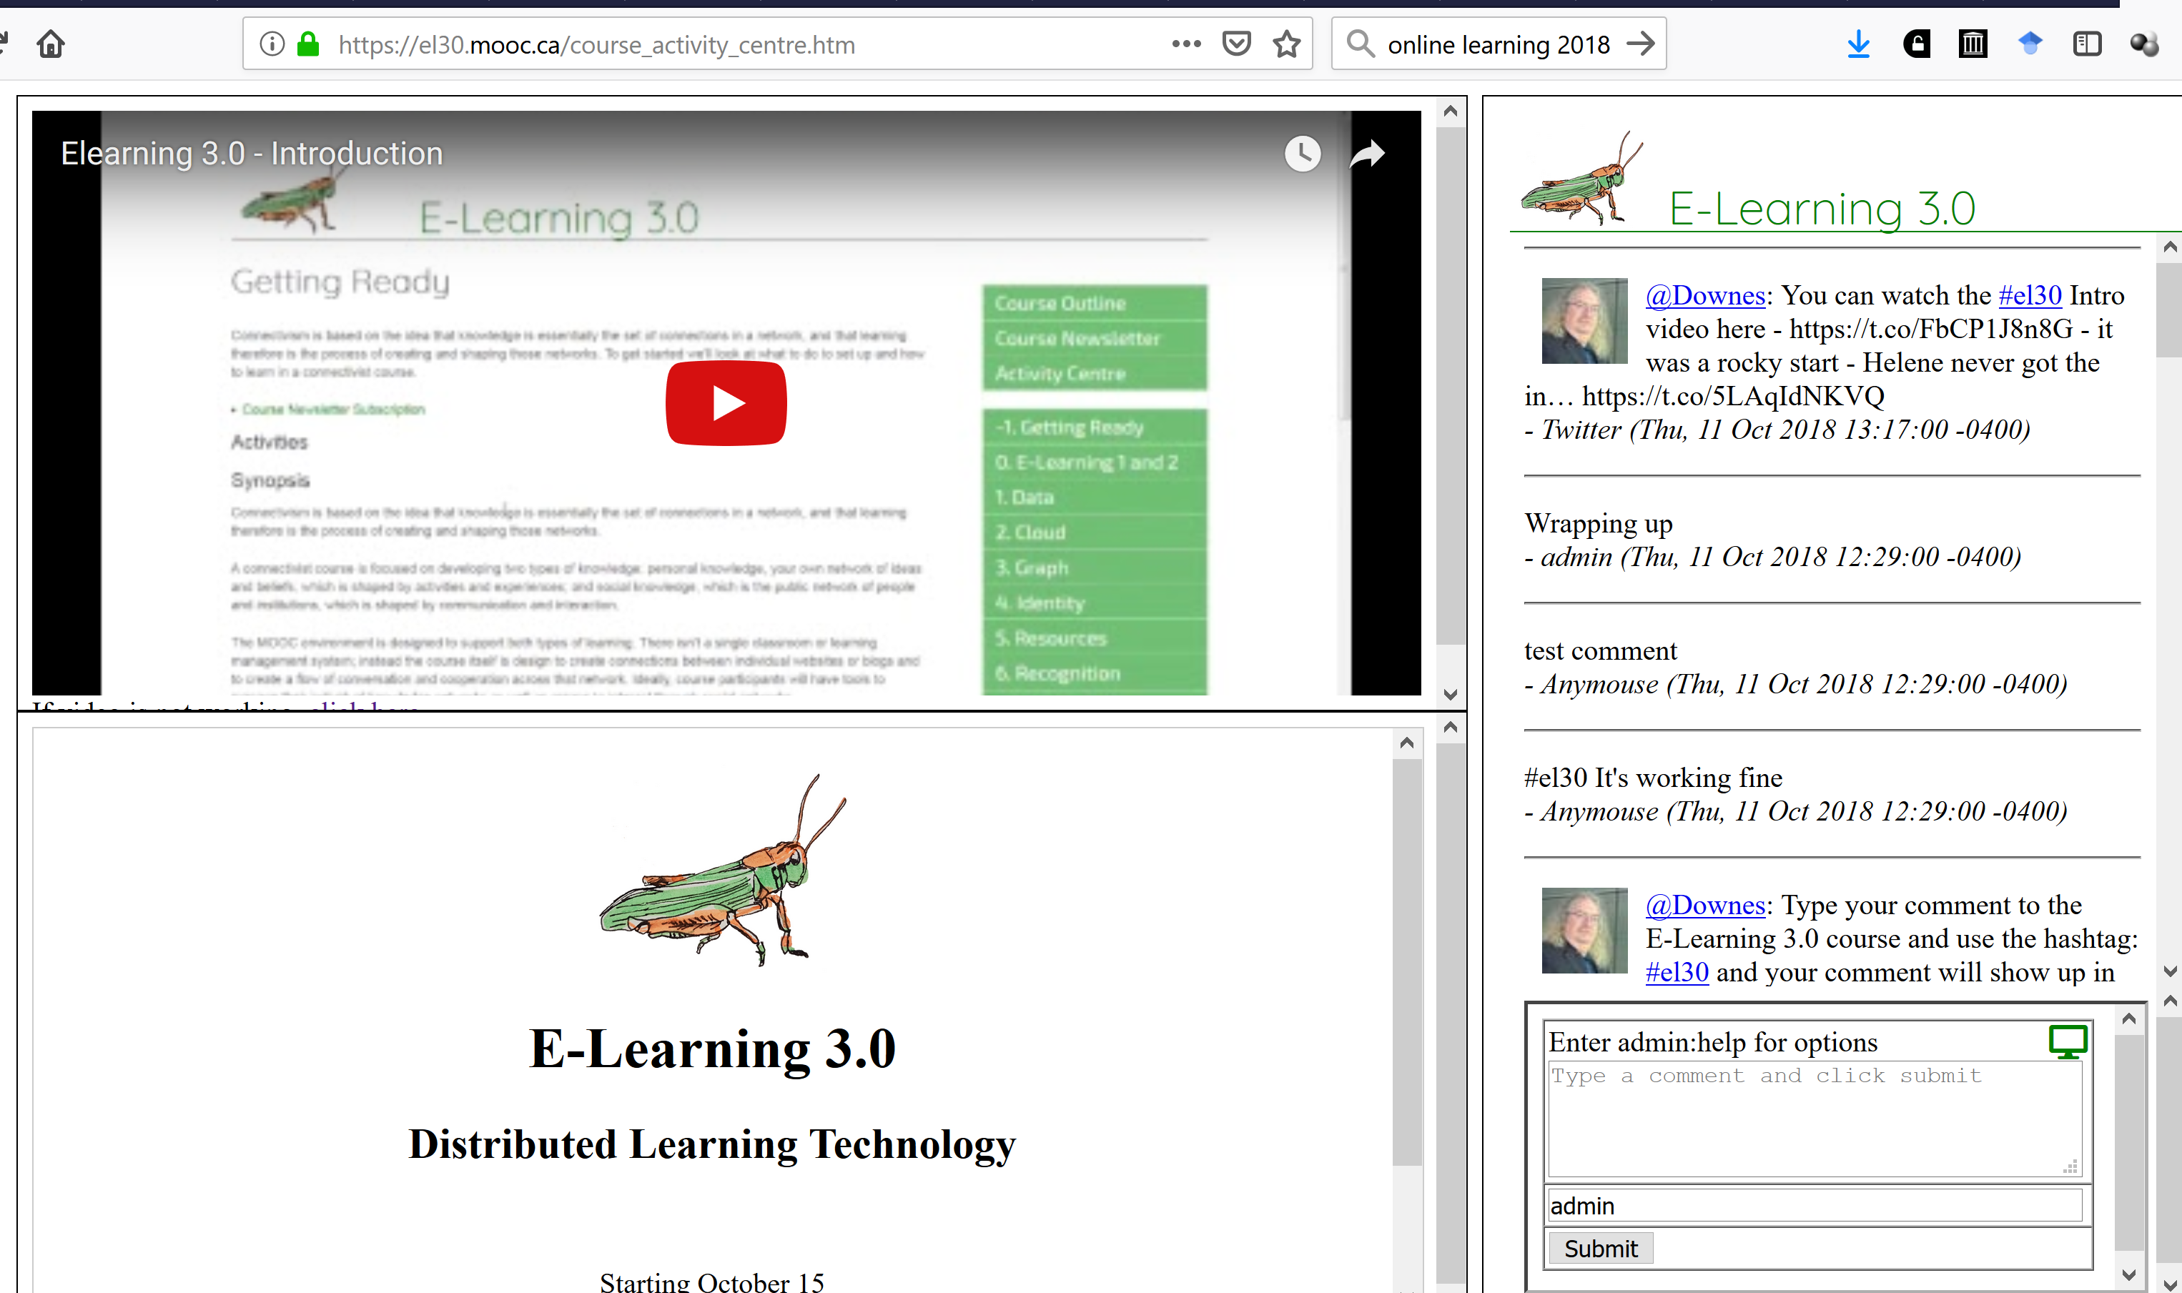
E-Learning 3.0 MOOC Official Launch
https://el30.mooc.ca

Slide 3
What is E-Learning 3.0?
The Client-Server Model
Websites, content management

Slide 4
What is E-Learning 3.0?
The Platform Model
Social Networks, APIs

Slide 5
What is E-Learning 3.0?
Distributed Ledger Technology
Content networks

Slide 6
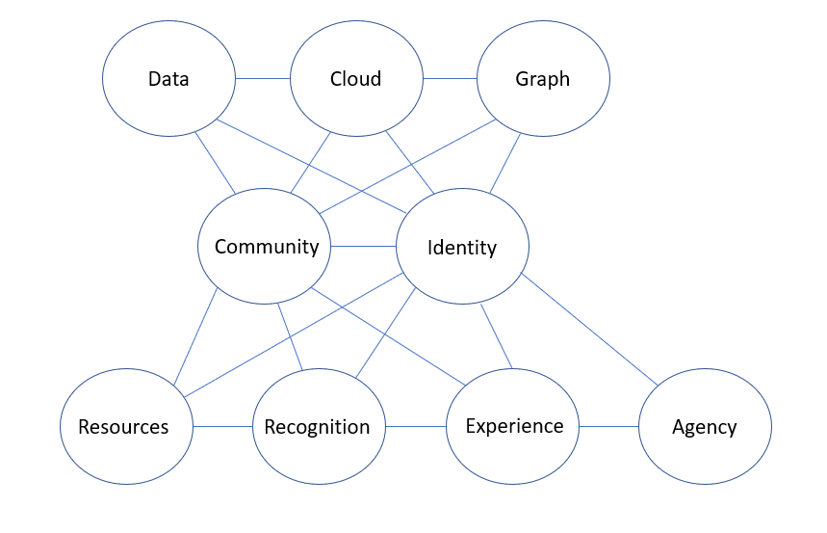
What is E-Learning 3.0?
Core Concepts of web3 and
E-Learning 3.0

Slide 7
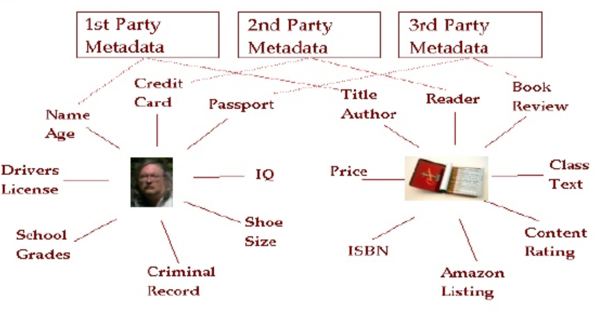
Data
Data as distributed and dynamic

Slide 8
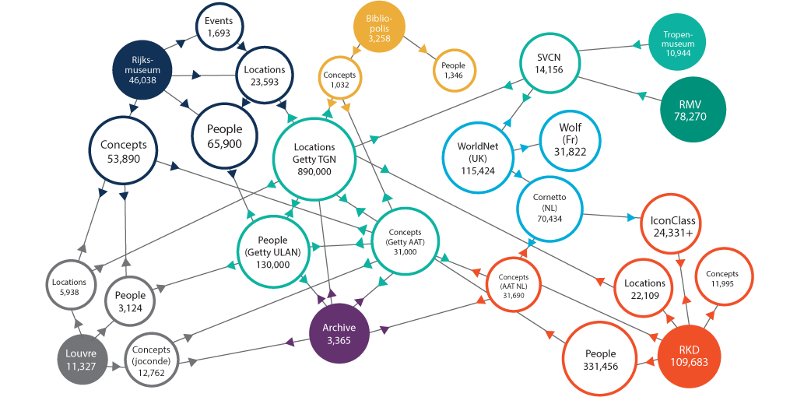
Data
The linked open data cloud
https://www.w3.org/wiki/LinkedData
https://ontotext.com/linked-open-data-cultural-heritage/

Slide 9
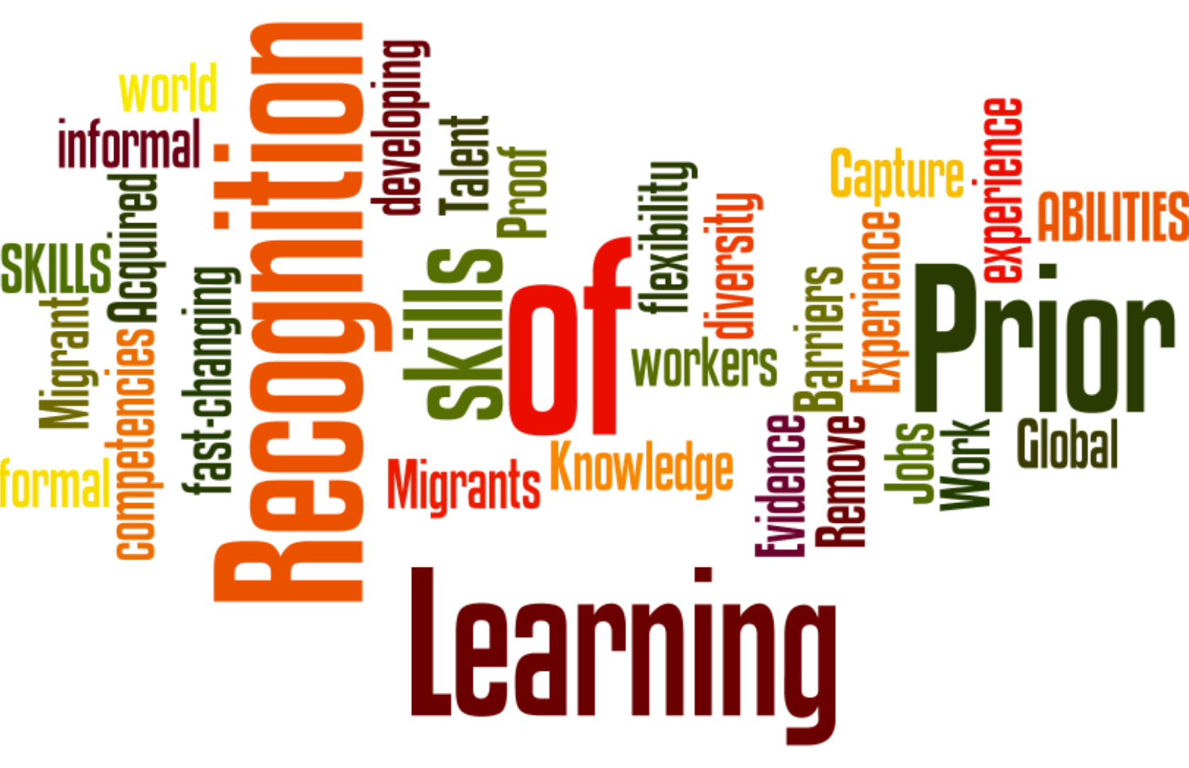
Data
Learning with data: knowledge as pattern recognition rather than remembering

Slide 10
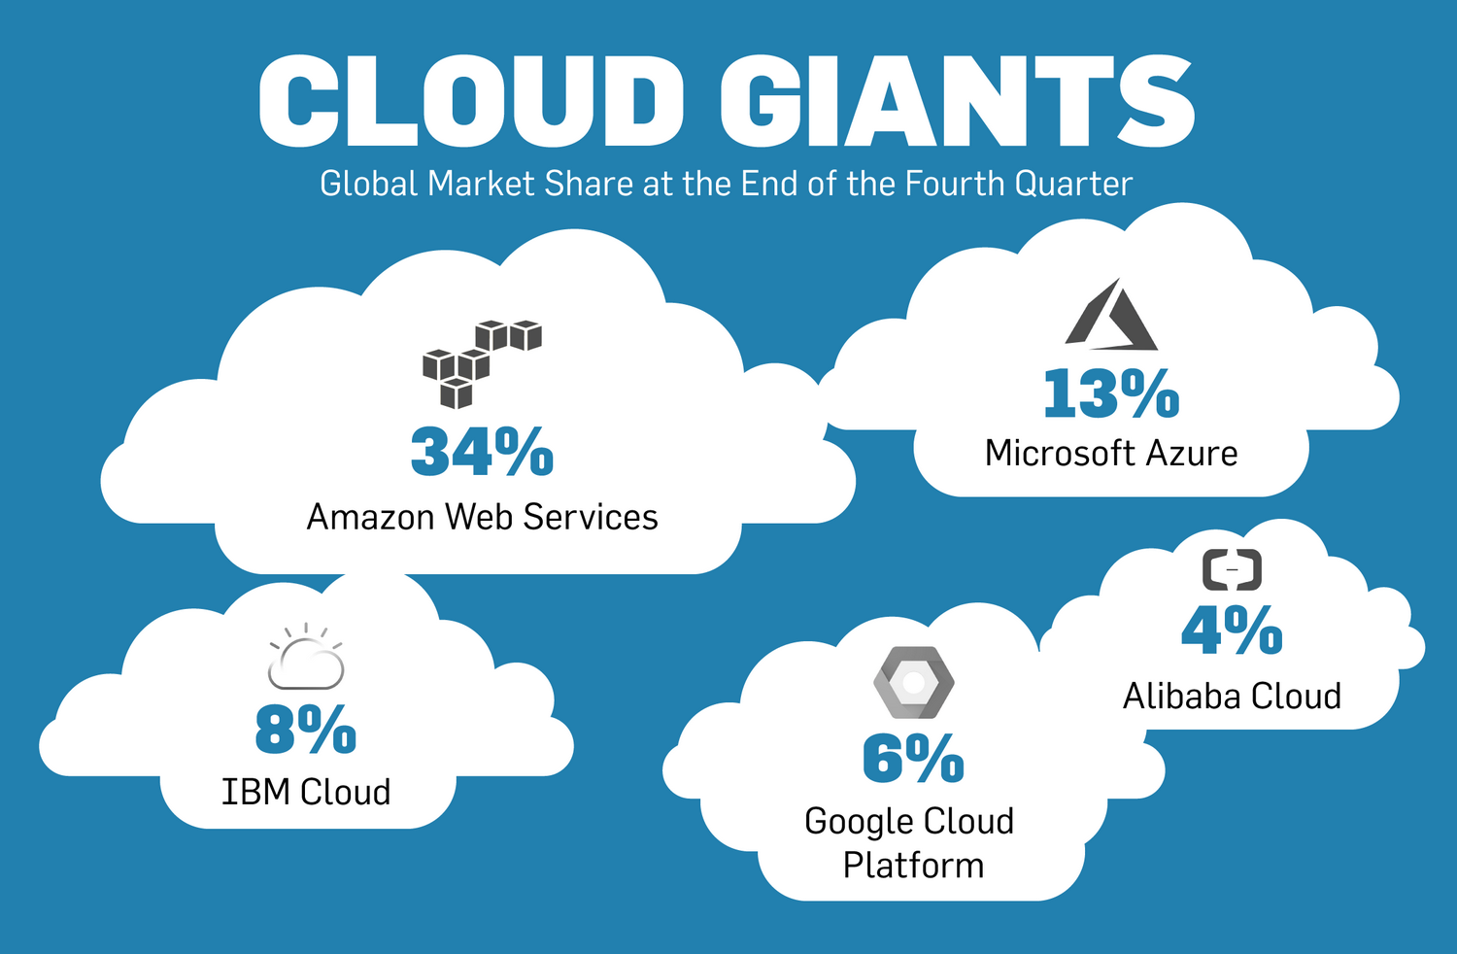
Cloud
Always-available data and services
Affordably priced

Slide 11
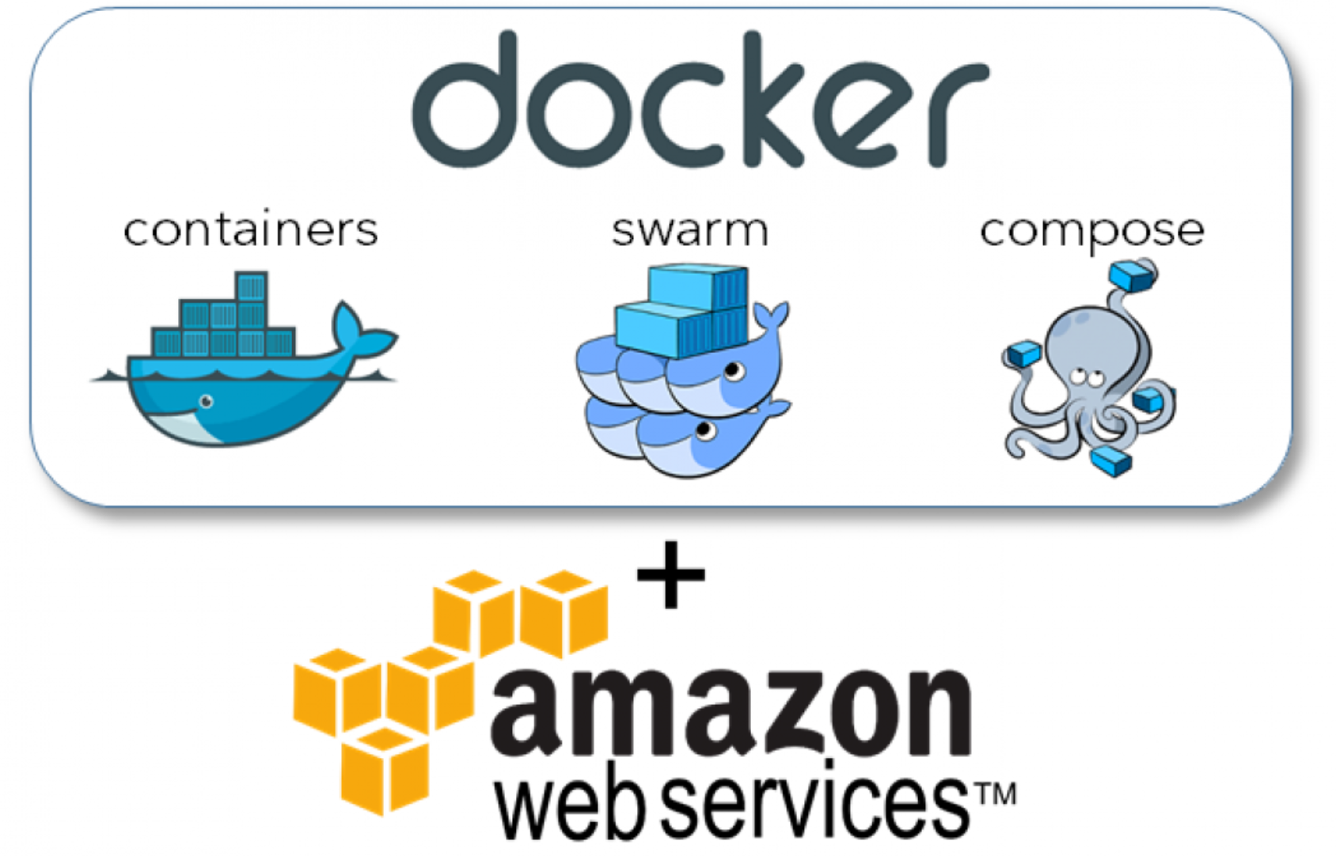
Cloud
Tools that enable cloud-on-demand applications and services
https://www.whatmatrix.com/portal/developing-for-the-cloud-in-the-cloud-bigdata-development-with-docker-in-aws/

Slide 12
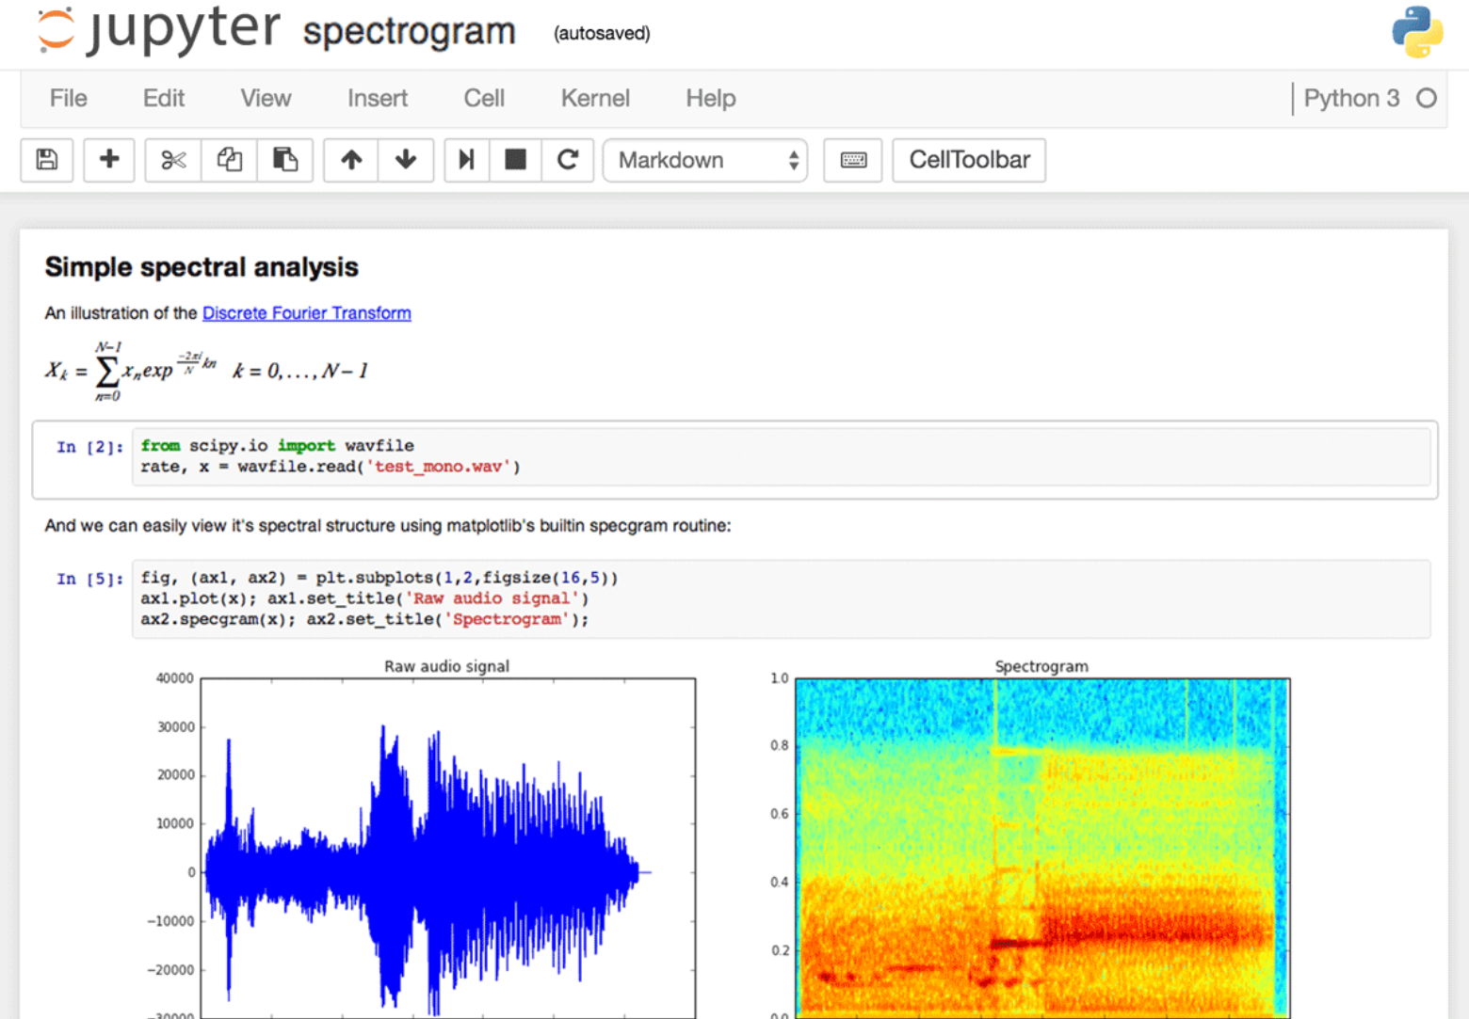
Cloud
New types of learning resources
Eg. Jupyter Notebook
https://www.dataquest.io/blog/jupyter-notebook-tips-tricks-shortcuts/

Slide 13
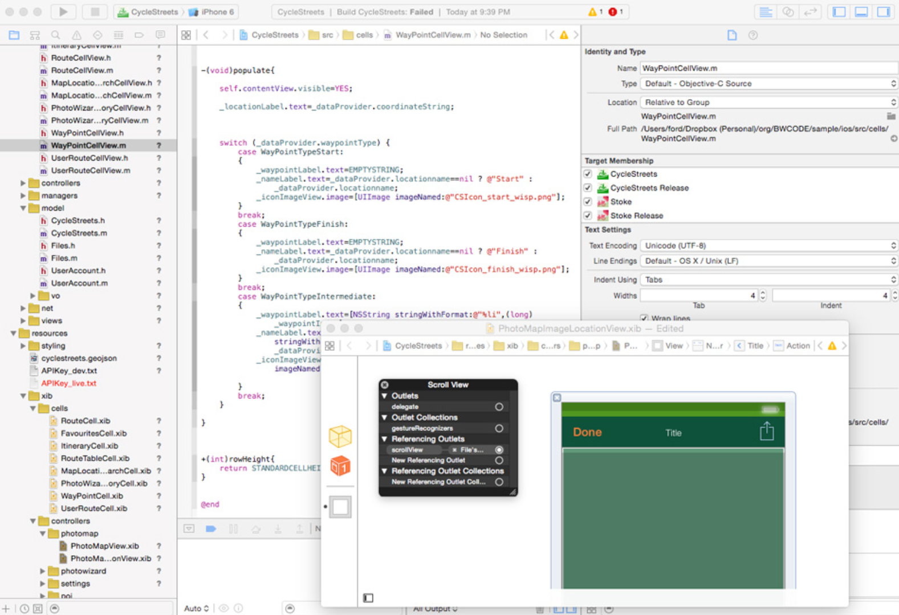
Cloud
Creating and learning – code and outcome - combine in a single environment
https://www.bloomberg.com/graphics/2015-paul-ford-what-is-code/

Slide 14
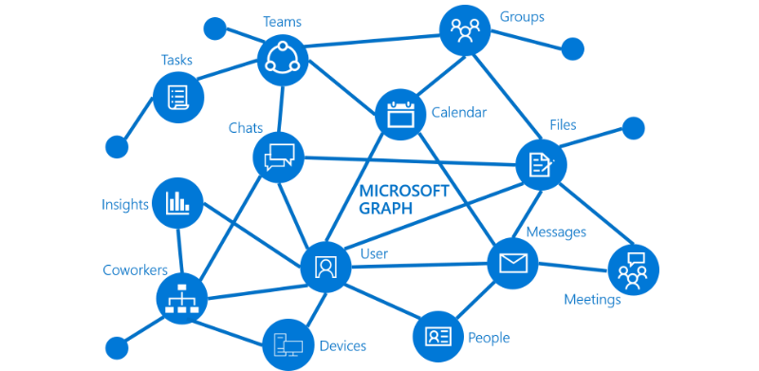
Graph
Graph as the conceptual basis for web3 networks
https://developer.microsoft.com/en-us/graph/docs/concepts/overview

Slide 15
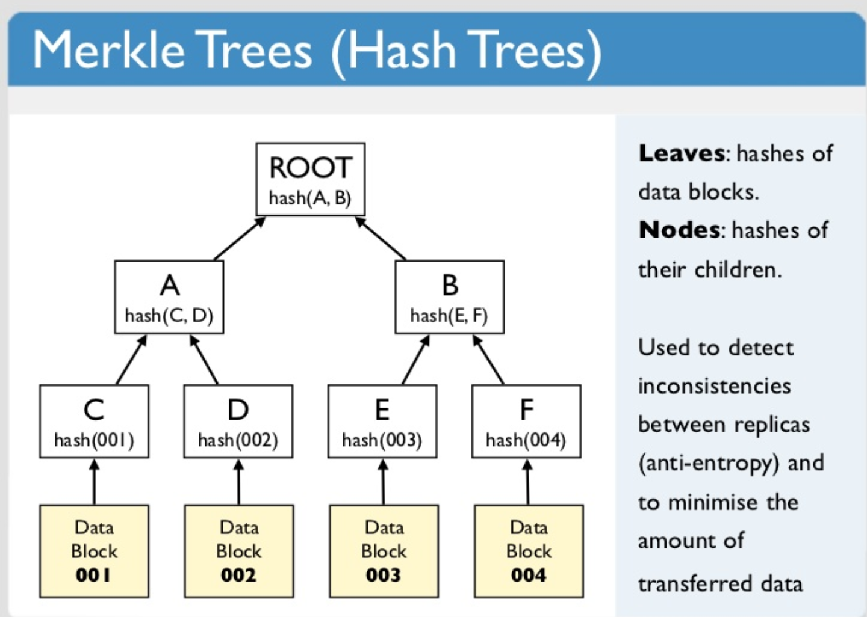
Graph
The transition from semantics to cryptography: the Merkle graph
https://www.slideshare.net/quipo/nosql-databases-why-what-and-when/91-Merkle_Trees_Hash_Trees_Leaves

Slide 16
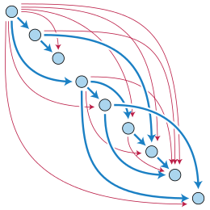
Graph
Directed Acyclic Graph (DAG)
Used to create collections of related data elements
https://en.wikipedia.org/wiki/Directed_acyclic_graph

Slide 17
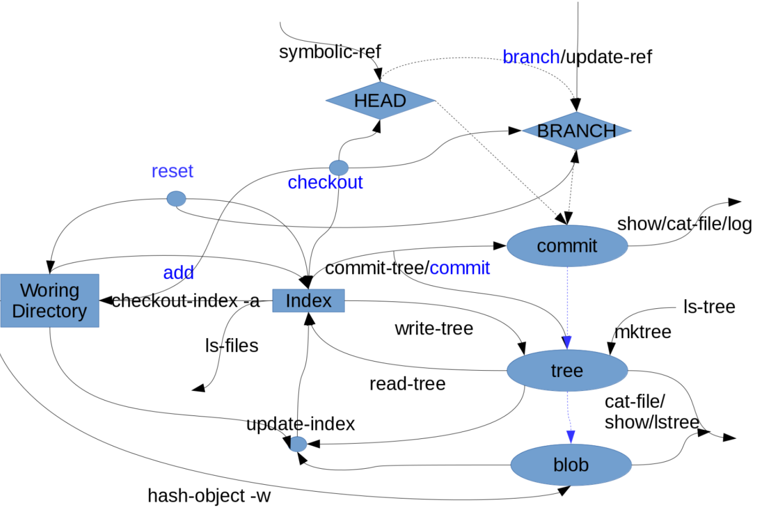
Graph
GitHub
Version control in a DAG
https://lukeluo.blogspot.com/2014/06/git-as-i-understand-4-working.html

Slide 18
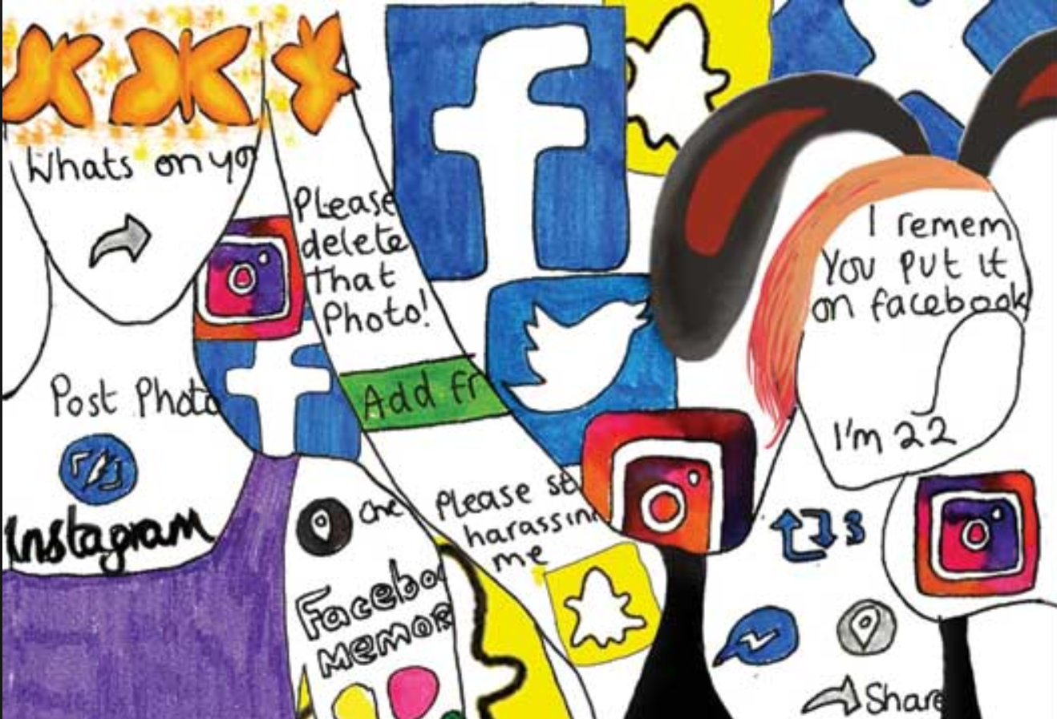
Identity
In social networks, we were the product – what about now?
https://thepsychologist.bps.org.uk/volume-30/may-2017/caution-identity-under-construction

Slide 19
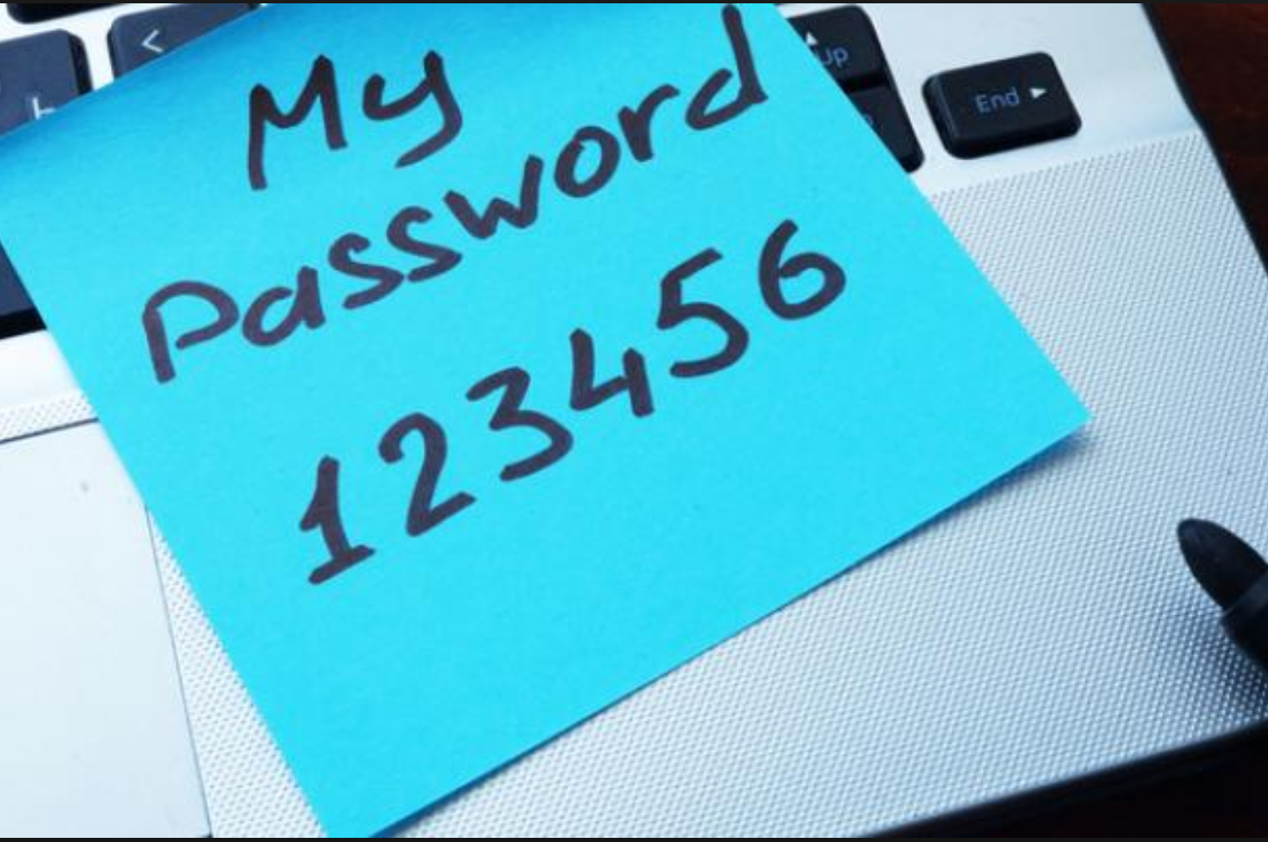
Identity
An end to passwords (and even to two-factor authentication)
https://www.channelfutures.com/business-models/new-guidelines-end-frequent-password-changes

Slide 20
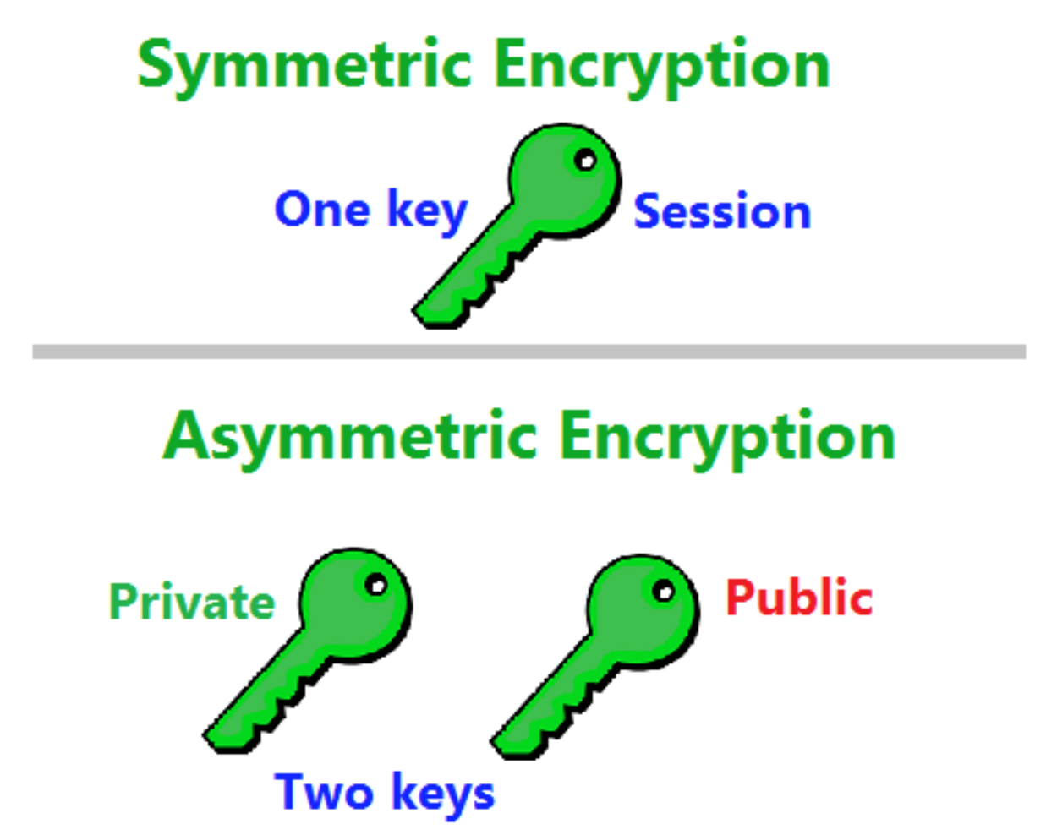
Identity
Symmetric vs Asymmetric Keys
https://www.thesslstore.com/blog/difference-asymmetric-encryption-algorithms-vs-symmetric-encryption-algorithms/

Slide 21
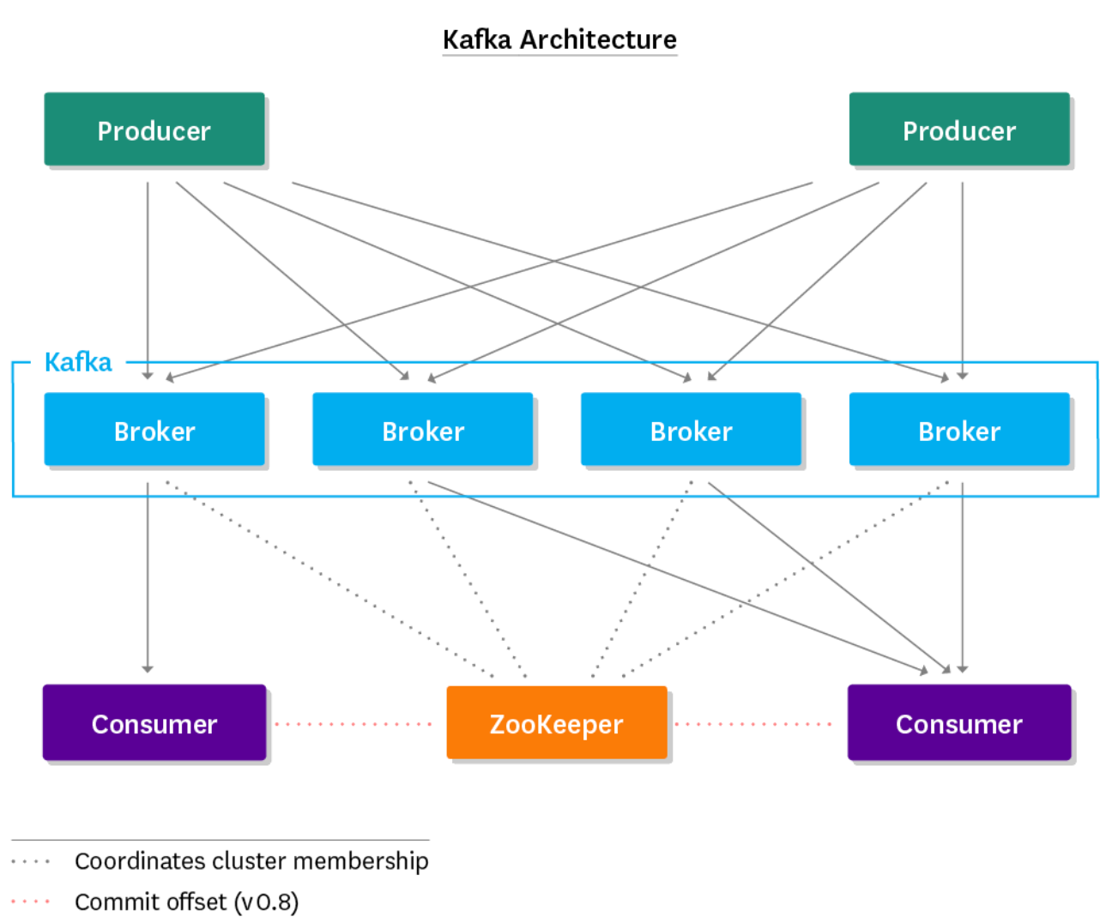
Identity
We are the thread that runs through an otherwise disconnected set of data
https://www.datadoghq.com/blog/monitoring-kafka-performance-metrics/

Slide 22
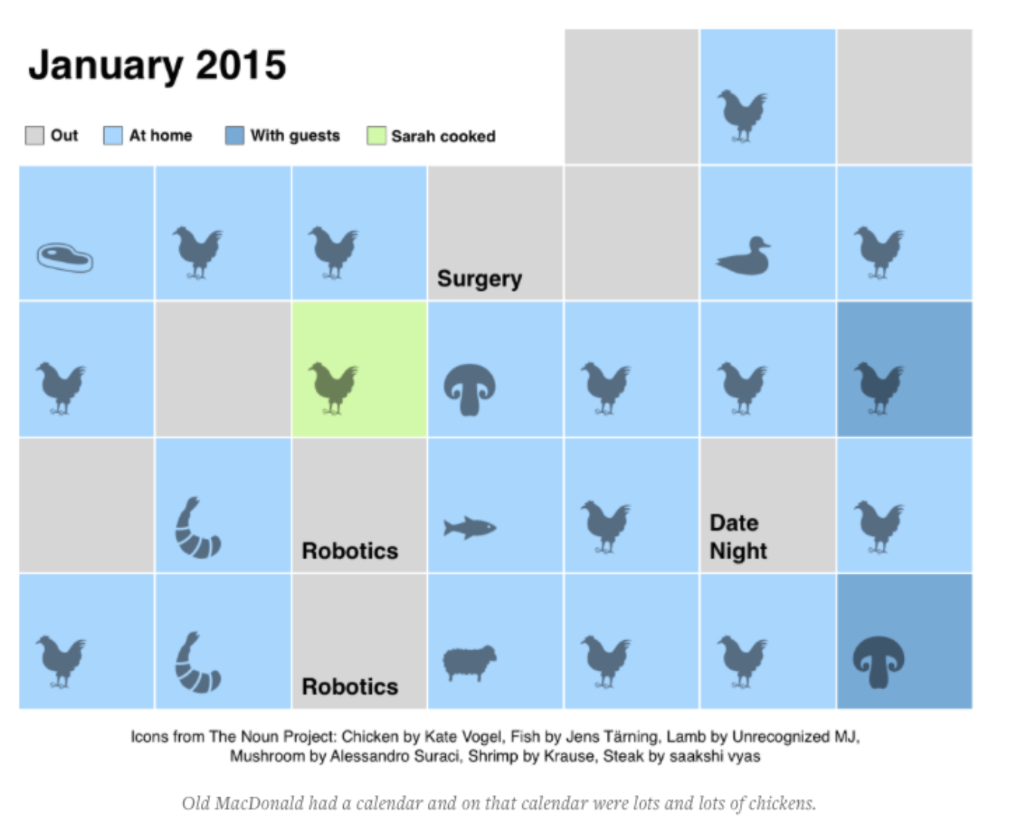
Identity
The quantified self will give way to the qualified self
http://quantifiedself.com/reporter-app/

Slide 23
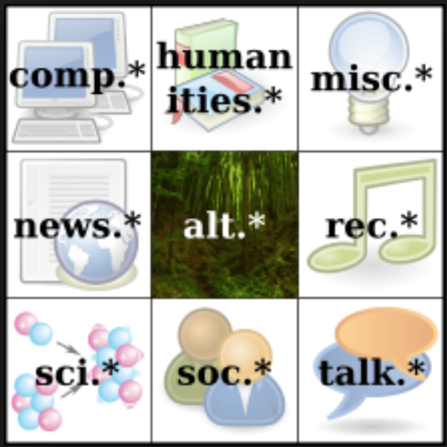
Resources
The once-open web has been increasingly locked down by the platforms
https://en.wikipedia.org/wiki/Usenet

Slide 24
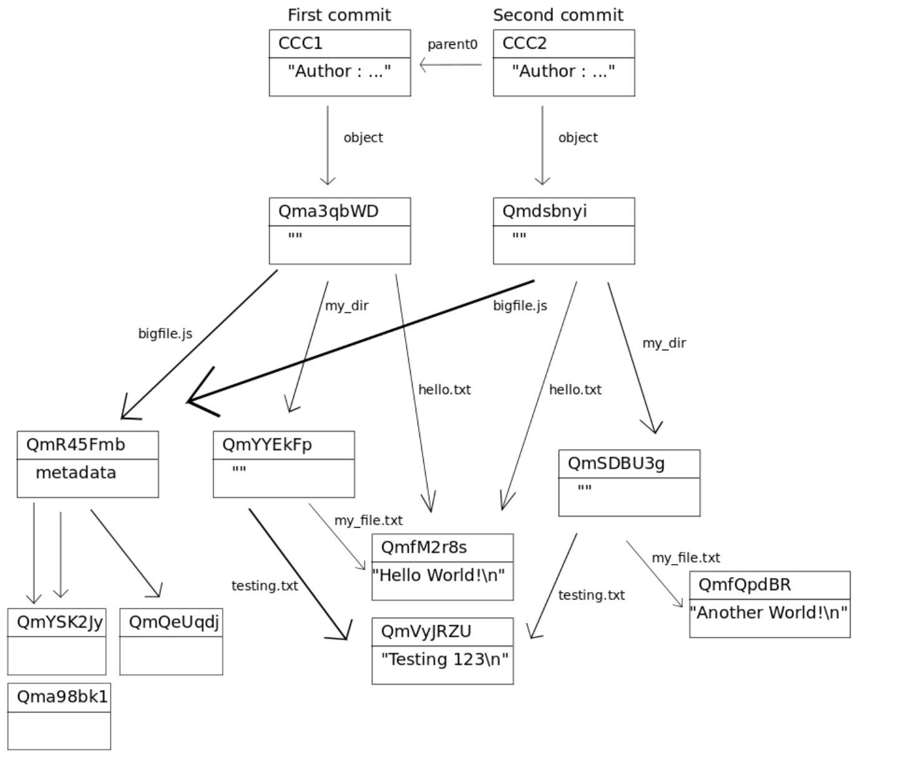
Resources
Web3 is to a large degree a reaction against this
Eg. IPFS, IPLD
http://whatdoesthequantsay.com/2015/09/13/ipfs-introduction-by-example

Slide 25
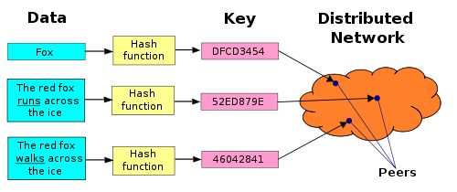
Resources
Content Addressable Networking
https://ipfs.io/ipfs/QmXoypizjW3WknFiJnKLwHCnL72vedxjQkDDP1mXWo6uco/wiki/Distributed_hash_table.html
Distributed Hash Table

Slide 26
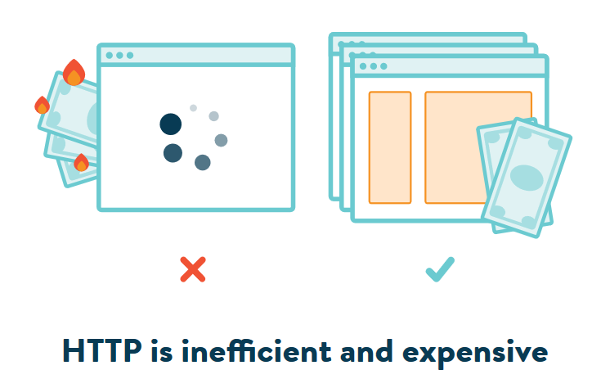
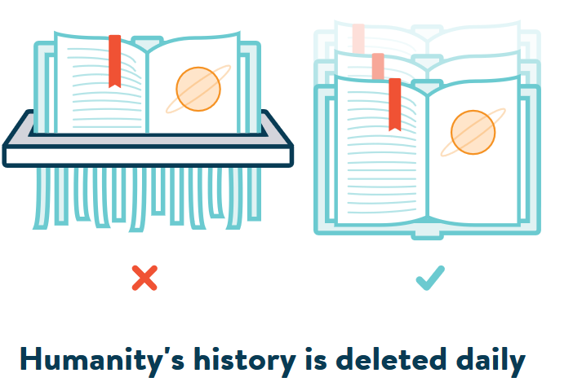
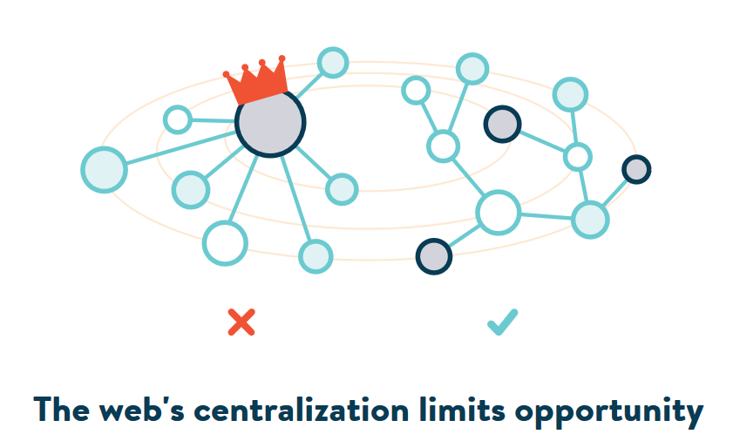
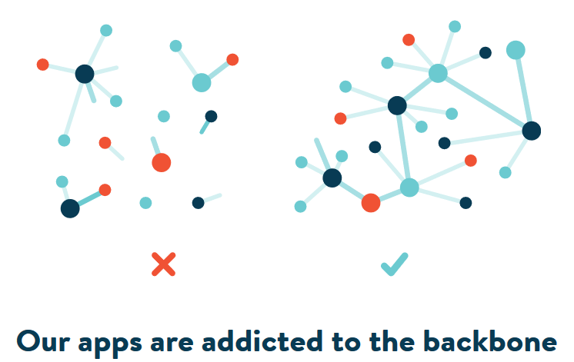
Resources
Content Addressable Resources for
Education
The new OER
https://ipfs.io/

Slide 27
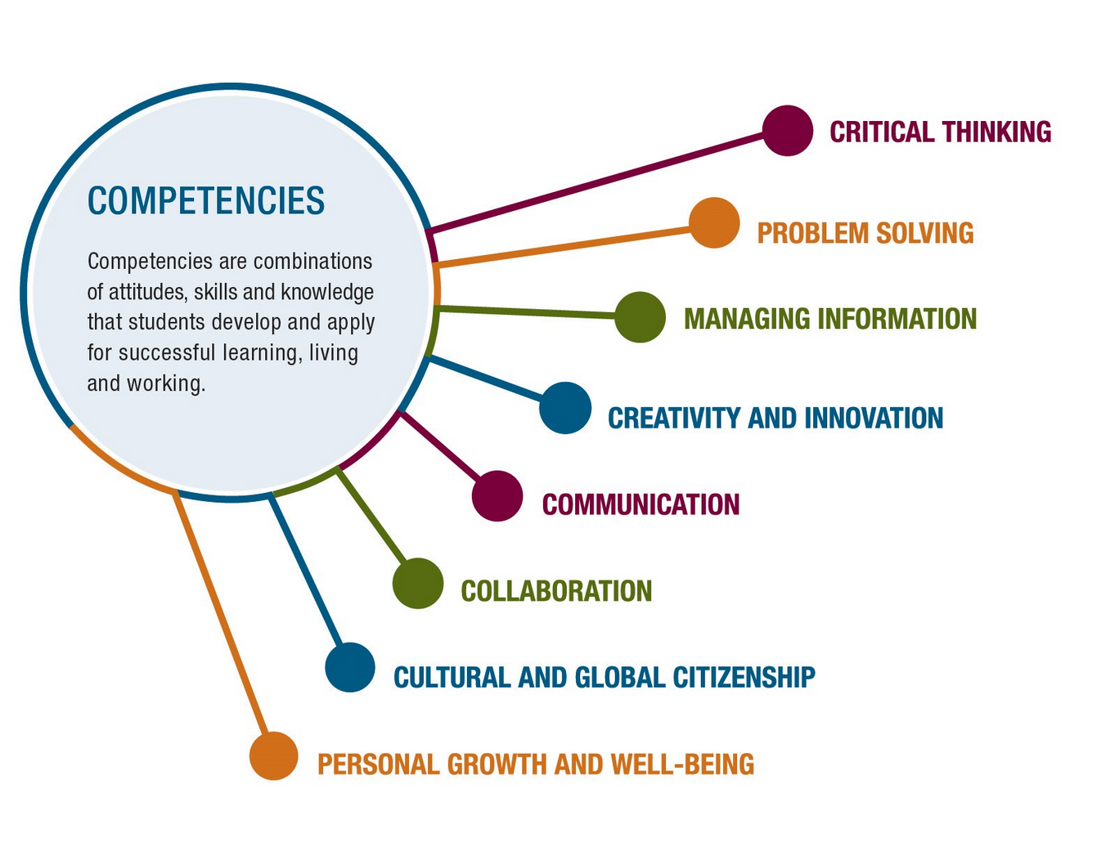
Recognition
What counts as success?
Competencies?
https://www.pearson.com/us/higher-education/products-services-institutions/career-success-program.html

Slide 28
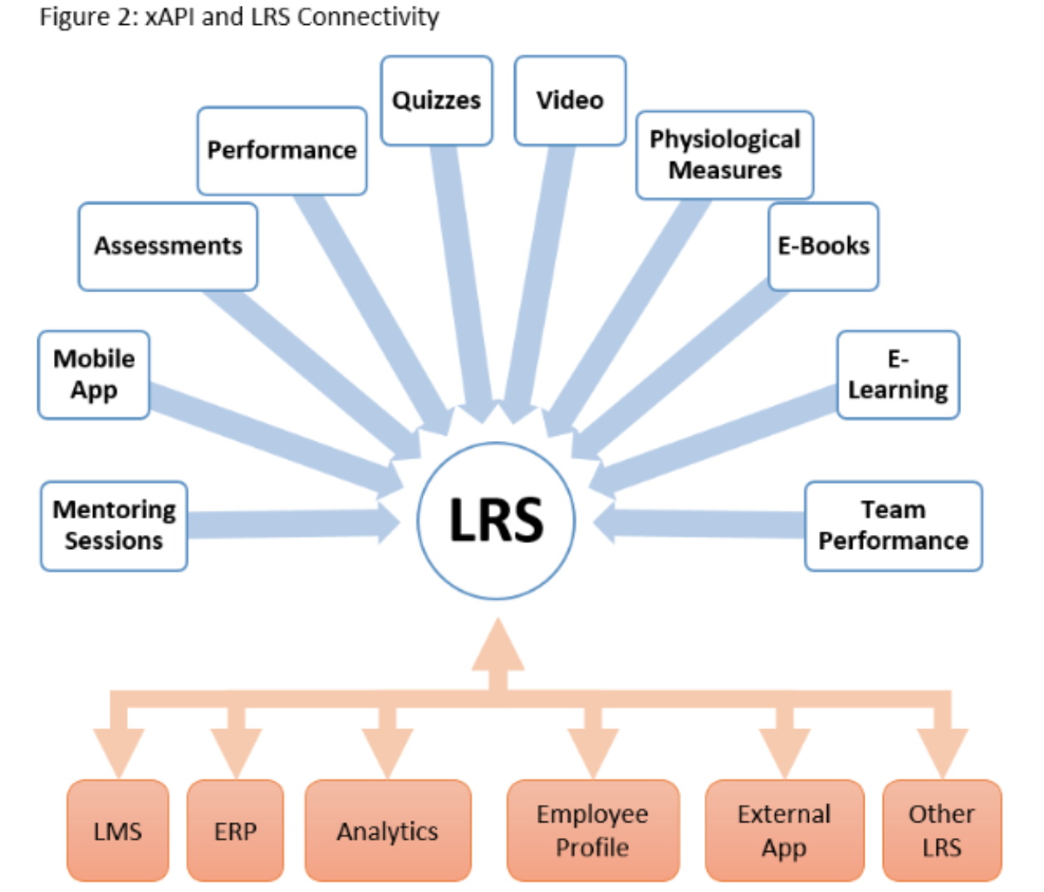
Recognition
Measuring activities: xAPI and the Learning Record Store
https://xapi.com/overview/

Slide 29
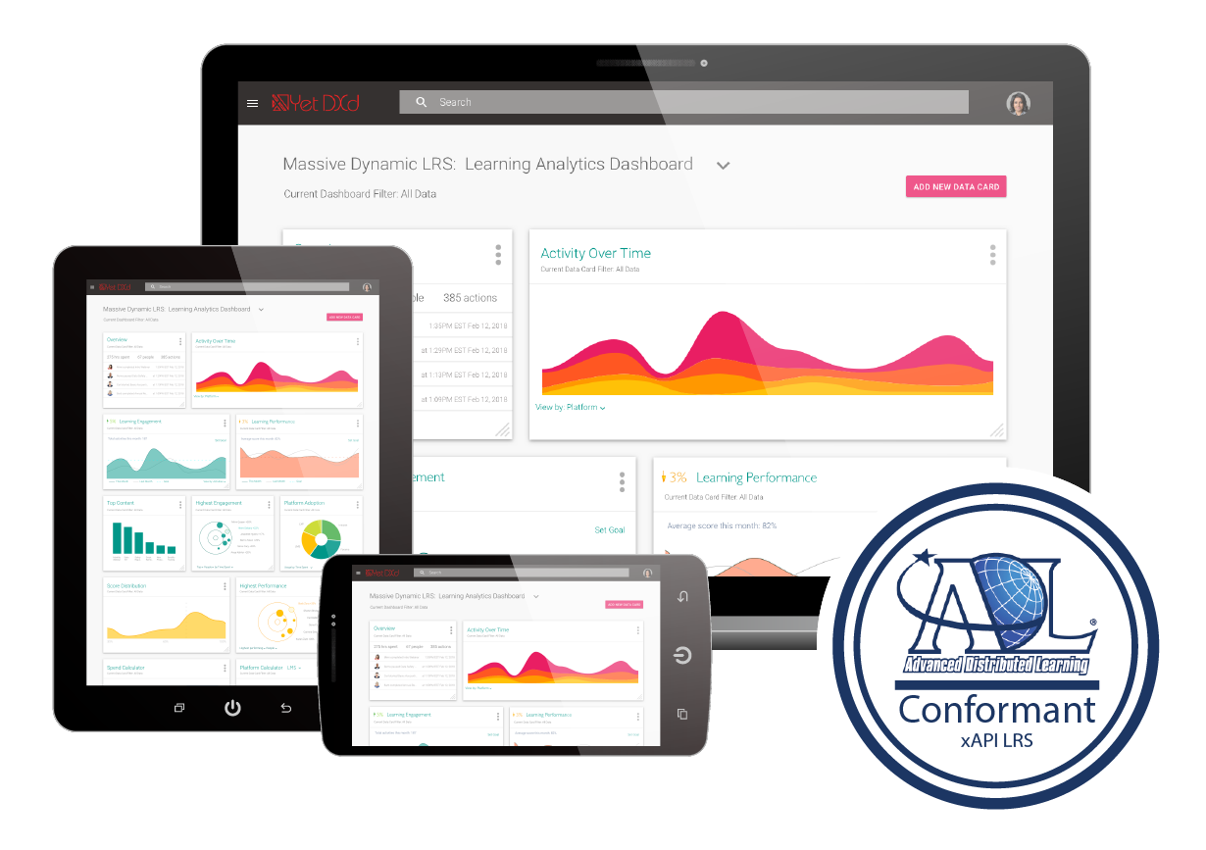
Recognition
Unifies and visualizes data from across your learning ecosystem
https://www.yetanalytics.com/xapi-lrs

Slide 30
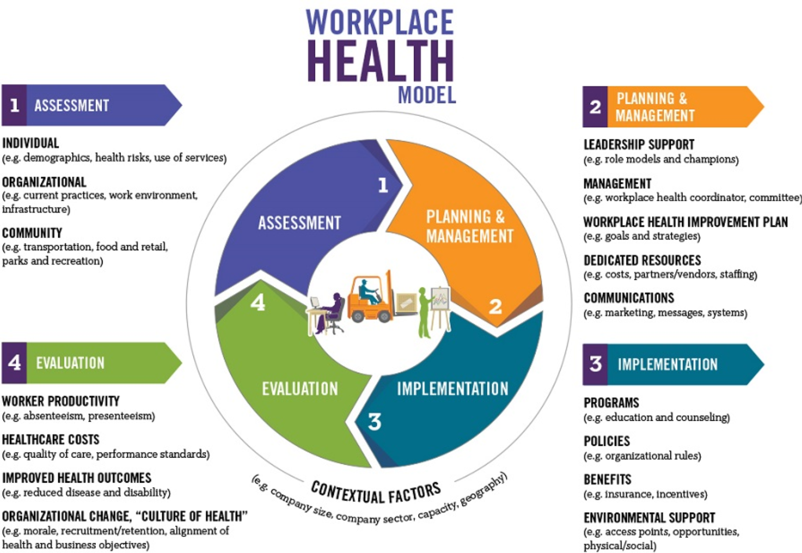
Recognition
We can also gather data outside the school or program, looking at actual results and feedback from the workplace.
https://www.cdc.gov/chronicdisease/resources/publications/aag/workplace-health.htm

Slide 31
Community
No longer based on sameness…
Now based on making decisions together…
On consensus
https://www.onecommunityglobal.org/consensus-and-decision-making-lesson-plan/

Slide 32
Community
Truth begins with personal knowledge…
We can describe how it works in a specific domain
https://partiallyexaminedlife.com/2018/08/06/ep196-1-simon-blackburn/

Slide 33
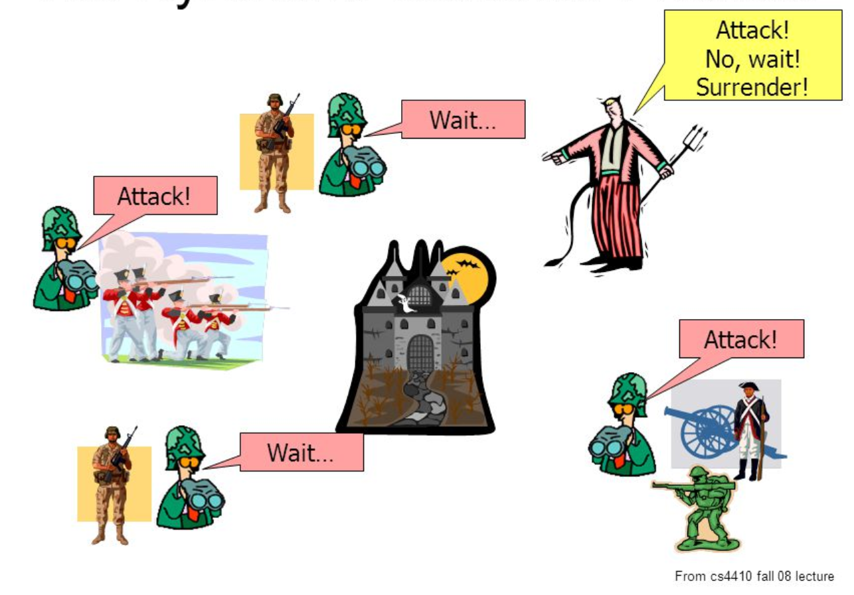
Community
The Byzantine Generals Problem
https://slideplayer.com/slide/5163640/

Slide 34
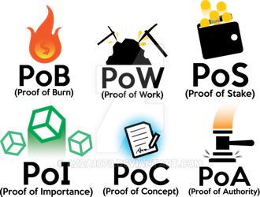
Community
The mechanisms we use to interact and reach consensus
https://www.deviantart.com/azza1070/art/Blockchain-Protocols-PoB-PoW-PoS-PoI-PoC-PoA-734159319

Slide 35
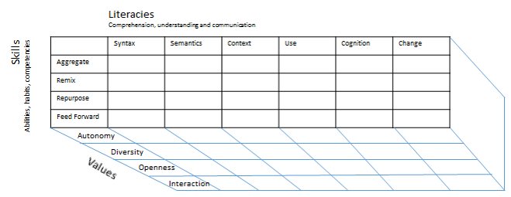
Community
The critical literacies
https://www.downes.ca/post/66802

Slide 36
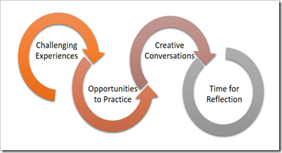
Experience
We learn from experience…
And reflecting on experience
https://charles-jennings.blogspot.com/2016/07/the-power-of-reflection-in-ever.html

Slide 37
Experience
We are bginning to combine the experience and reflection
https://www.epicgames.com/fortnite/en-US/home

Slide 38
Experience
Creation of the content becomes a part of the content itself.
https://intrsection.com/2017/04/8396/

Slide 39
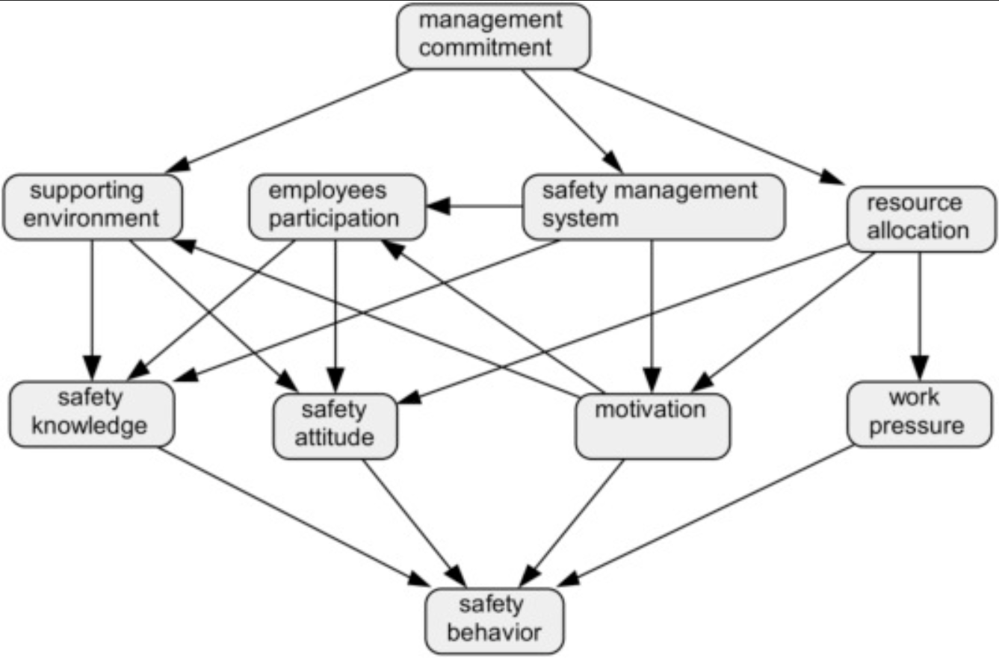
Experience
Workplaces, are beginning to create self-organizing consensus-based co-production networks.
https://www.sciencedirect.com/science/article/pii/S000368701630093X

Slide 40
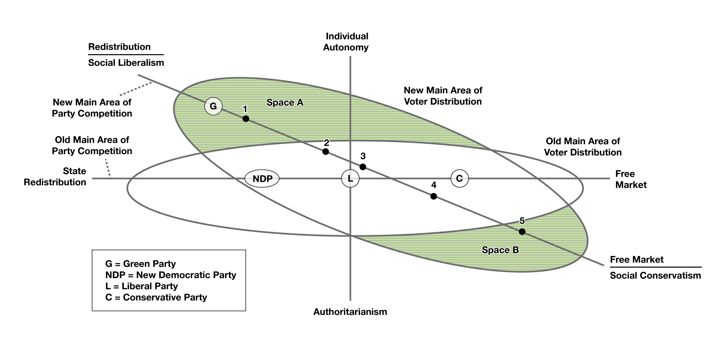
Agency
The relative standing of the individual with respect to community, institutions, and governments
https://opentextbc.ca/introductiontosociology/chapter/chapter17-government-and-politics/

Slide 41
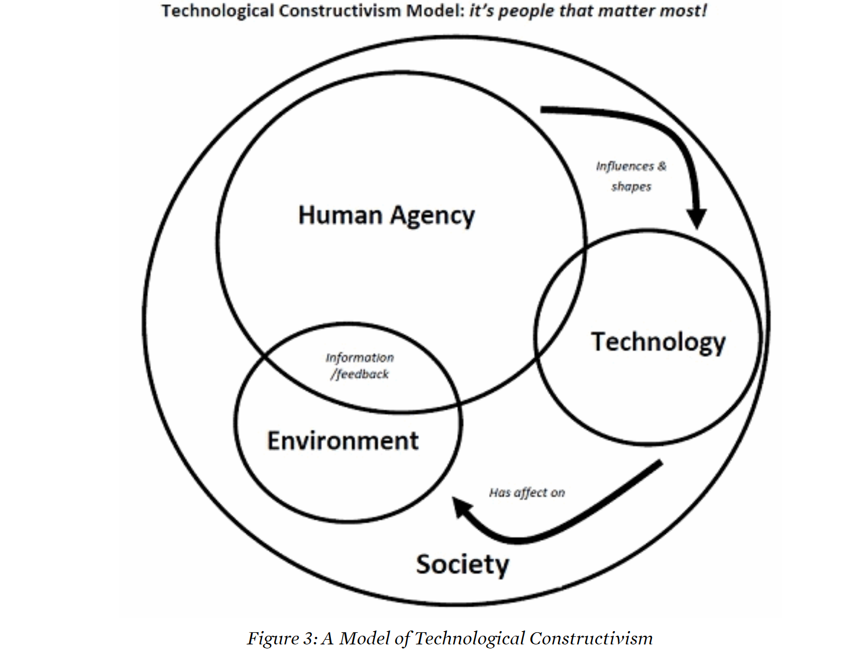
Agency
Agency changes as technology changes
https://www.tcd.ie/Geography/assets/pdf/env_gov/Hynes_2013_practices_of_technology.pdf

Slide 42
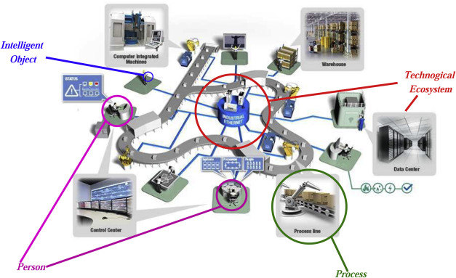
Agency
Four key elements of the new technological framework: security, identity, voice and opportunity.
https://www.sciencedirect.com/science/article/pii/S2352864817300214
https://www.downes.ca/post/68088

Slide 43
Agency
Education must focus on the tools and capacities for agency
https://www.globalpartnership.org/blog/building-peace-through-education

Slide 44
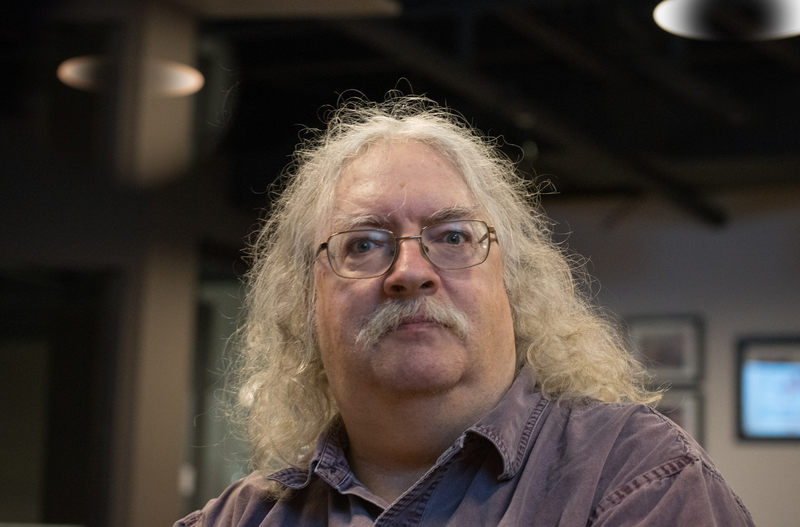
Stephen Downes
Photo by Lorelei
https://www.downes.ca

