Slide 1
Future Learning in an Advanced Decentralized Learning Ecosystem

Slide 2
Future Learning in an Advanced Decentralized Learning Ecosystem
Learning management technology has tended toward centralization over the last two decades as resources and services consolidated in learning management systems. This creates a challenge for learning that needs to be conducted in the field or that requires specialized equipment. It is also a challenge for any approach to learning based in individual capacities and contexts. This is why the U.S. Advanced Distributed Learning Initiative (ADL) has historically emphasized interoperability in decentralized learning ecosystems, supporting such things as the Personal Assistant for Learning (PAL) and Open Social Learning Models (OSLM). Similar challenges are being faced in the wider internet community. Developers have responded with new approaches supporting decentralized networks, such as open social applications (for example, micropub), distributed ledger technology (for example, blockchain), and cloud container networks. These will support new learning application such as virtual reality, artificial intelligence, and personal assistants. This presentation will provide an overview of this emerging infrastructure, describe key points of contact with training and development services, and outline the impact on future learning programs and systems.

Slide 4
DATA - CLOUD - AI
https://giphy.com/gifs/cat-just-sleepy-DAmosupuFkPjG

Slide 5
High School Math ML Problem
Here we have a case where a high school student has been given the problem of optimizing traffic flow in his school parking lot.
https://www.reddit.com/r/MachineLearning/comments/bhp6bw/p_can_you_solve_this_high_school_ml_problem/
Notes:
Can you solve this High School ML problem?
LittleLouis, Reddit, Apr 27, 2019
https://www.reddit.com/r/MachineLearning/comments/bhp6bw/p_can_you_solve_this_high_school_ml_problem/

Slide 6
Re-Decentralize the Web
current Web apps combine data and service. Because of this coupling, our LinkedIn contacts cannot comment on our Facebook pictures, and an RSVP on a Facebook event will not be reflected in our Doodle calendar’s availability. Decentralized applications, on the other hand, act as views on top of our data pod and those of others.
Notes:
Re-decentralizing the Web, for good this time
Ruben Verborgh, Ghent University – imec – IDLab
11 January 2019
https://ruben.verborgh.org/articles/redecentralizing-the-web/
Challenges and Opportunities for use of Social Media in Higher Education
Terry Anderson, Journal of Learning for Development, 2019/04/23
https://jl4d.org/index.php/ejl4d/article/view/327/361

Slide 7
Decentralized Data and Service Providers
Centralized applications compete in a single market, based on data ownership. On a decentralized Web, data and service providers compete in different markets.
Notes:
Re-decentralizing the Web, for good this time
Ruben Verborgh, Ghent University – imec – IDLab
11 January 2019
https://ruben.verborgh.org/articles/redecentralizing-the-web/

Slide 8
Solid – IndieWeb - Etc
Notes:
“Solid”. (n.d.). , available at: https://solid.mit.edu/.
Berners-Lee, T. (2006), “Linked Data”, 27 July, available at: https://www.w3.org/DesignIssues/LinkedData.html.
Berners-Lee, T. and O’Hara, K. (2013), “The read–write Linked Data Web”, Philosophical Transactions of the Royal Society A, Vol. 371 No. 1987.

Slide 9
AI-Generated Music
MuseNet, " a deep neural network that can generate 4-minute musical compositions with 10 different instruments, and can combine styles from country to Mozart to the Beatles.“
Relentless Doppelganger, the Bot Prownies, who produce an almost-acceptable brand of punk. If you prefer guitar metal, Coditany of Timeness might be more to your taste. Not quite as successful is Evolution 22 by Deep the Beatles. For something a little softer (and quite good) try On the Edge, by AIVA. AIVA also does a nice classical tune or movie score. Need royalty-free music for your videos? Try JukeDeck (a little too house for my tastes). Taryn Southern, meanwhile, uses an AI to compose the music, then adds her own lyrics and vocals - her song Break Free is quite nice.
Notes:
MuseNet
Christine Payne, OpenAI, 2019/04/26
Icon
https://openai.com/blog/musenet/

Slide 10
Cognii – SquirrelAI – Magpie – X5GON
Cognii Virtual Learning Assistant engages a student in a chatbot-style learning conversation by prompting them to construct an answer, giving them instant formative assessment - http://cognii.com/
Squirrel AI - pure-play AI-powered adaptive education provider in China… provides personalized and high-quality K-12 after-school tutoring - http://squirrelai.com/
magpie recommends high-quality content and integrates with your learning systems - starts with a configurable chatbot conversation - prioritises most relevant content for each user. https://learn.filtered.com/magpie
X5GON.org – fully automated creation of OER courses - https://www.x5gon.org/follow/oer/

Slide 12
GRAPH – COMMUNITY – AGENCY
https://giphy.com/gifs/weekend-days-129NVCr1UfsGTS

Slide 13
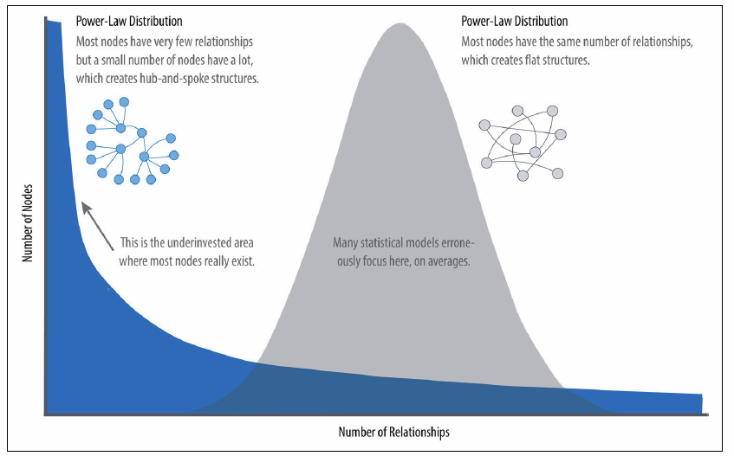
Graph Algorithms
Real-world networks have uneven distributions of nodes and relationships represented in the extreme by a power-law distribution. An average distribution assumes most nodes have the same number of relationships and results in a random network.
Notes:
Graph Algorithms: Practical Examples in Apache Spark and Neo4j
Mark Needham, Amy E. Hodler, O'Reilly, 2019/04/23
https://neo4j.com/graph-algorithms-book/

Slide 14
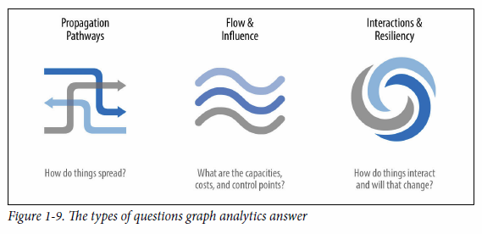
The types of questions graph analytics answer
Investigate the route of a disease or a cascading transport failure.
Uncover the most vulnerable, or damaging, components in a network attack.
Identify the least costly or fastest way to route information or resources.
https://neo4j.com/graph-algorithms-book/
Notes:
Graph Algorithms: Practical Examples in Apache Spark and Neo4j
Mark Needham, Amy E. Hodler, O'Reilly, 2019/04/23
https://neo4j.com/graph-algorithms-book/
• Investigate the route of a disease or a cascading transport failure.
• Uncover the most vulnerable, or damaging, components in a network attack.
• Identify the least costly or fastest way to route information or resources.
• Predict missing links in your data.
• Locate direct and indirect influence in a complex system.
• Discover unseen hierarchies and dependencies.
• Forecast whether groups will merge or break apart.
• Find bottlenecks or who has the power to deny/provide more resources.
• Reveal communities based on behavior for personalized recommendations.
• Reduce false positives in fraud and anomaly detection.
• Extract more predictive features for machine learning.

Slide 15
You’re Not Stuck In Traffic, You Are Traffic
“a new generation of designers has emerged, concerned with designing strategies to subvert this “natural default-setting” in which each person understands themselves at the center of the world.”
https://jods.mitpress.mit.edu/pub/design-as-participation
Notes:
Design as Participation
Kevin Slavin, Journal of Design and Science, 2019/04/29
https://jods.mitpress.mit.edu/pub/design-as-participation

Slide 16
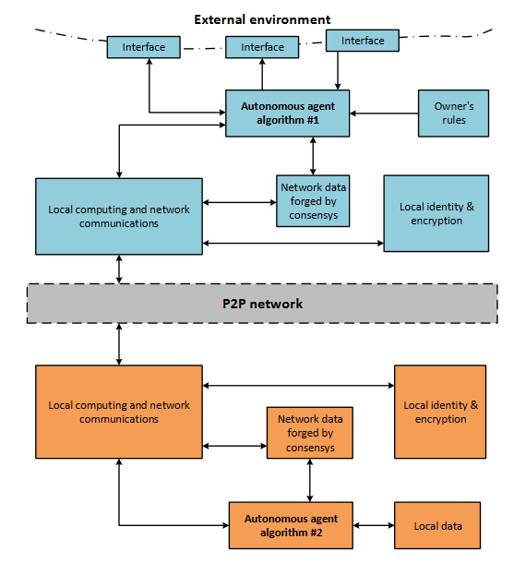
Autonomous Agents Communication Scheme
autonomous agents communication scheme. The arrows indicate transfer of any data. The dashed line shows the P2P network between agents.
The dotted line shows external environment of the agent.
(2) (PDF) Blockchain-based protocol of autonomous business activity for multi-agent systems consisting of UAVs. Available from: https://www.researchgate.net/publication/325451400_Blockchain-based_protocol_of_autonomous_business_activity_for_multi-agent_systems_consisting_of_UAVs [accessed Apr 28 2019].
Notes:
(PDF) Blockchain-based protocol of autonomous business activity for multi-agent systems consisting of UAVs. Available from: https://www.researchgate.net/publication/325451400_Blockchain-based_protocol_of_autonomous_business_activity_for_multi-agent_systems_consisting_of_UAVs [accessed Apr 28 2019].

Slide 17
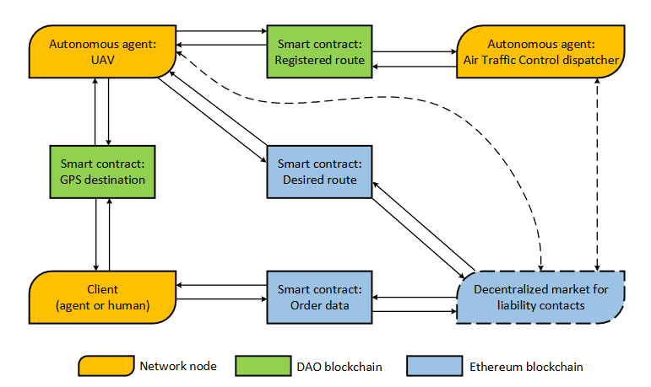
Blockchain-based protocol for autonomous business activity
Typical work scenario of Drone Employee. Dashed arrows indicate waiting of contract appearance. A set of all contracts in the network are integrated into decentralized market block.
(2) (PDF) Blockchain-based protocol of autonomous business activity for multi-agent systems consisting of UAVs. Available from: https://www.researchgate.net/publication/325451400_Blockchain-based_protocol_of_autonomous_business_activity_for_multi-agent_systems_consisting_of_UAVs [accessed Apr 28 2019].
Forget about artificial intelligence, extended intelligence is the future…
Instead of thinking about machine intelligence in terms of humans vs machines, we should consider the system that integrates humans and machines – not artificial intelligence but extended intelligence.
Notes:
(PDF) Blockchain-based protocol of autonomous business activity for multi-agent systems consisting of UAVs. Available from: https://www.researchgate.net/publication/325451400_Blockchain-based_protocol_of_autonomous_business_activity_for_multi-agent_systems_consisting_of_UAVs [accessed Apr 28 2019].

Slide 20
RESOURCES – EXPERIENCE - AGENCY
https://giphy.com/gifs/cat-lazy-sleepy-papAALBn286ty

Slide 21
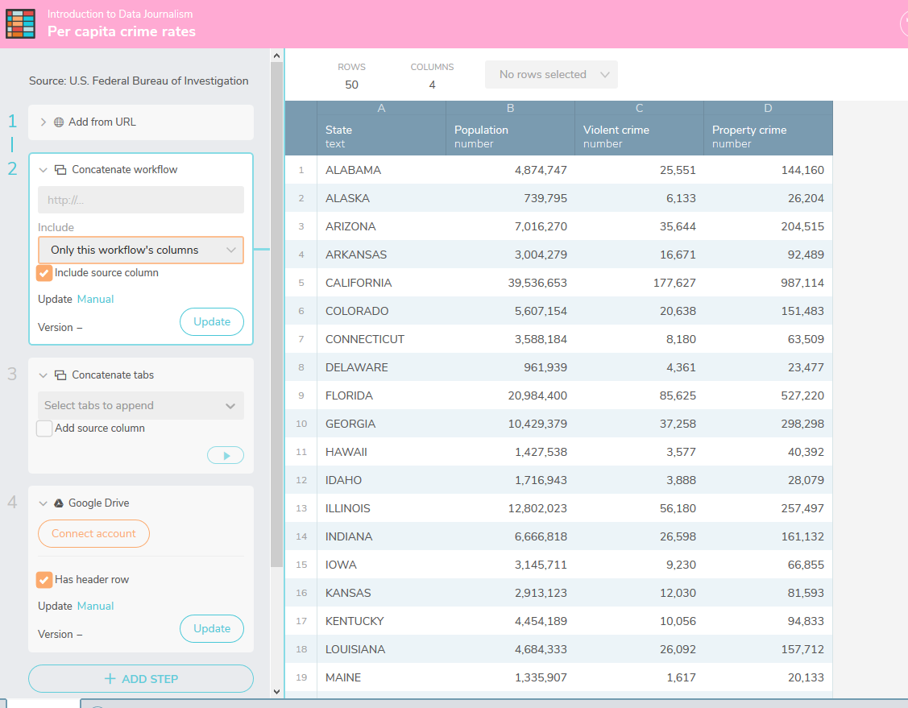
Workbench
Workbench is a free and open source data journalism platform "that enables all stages of data journalism: getting data (including scraping), then cleaning, analyzing, visualizing, and sharing it.
Notes:
Introducing Workbench, an Open Source Platform
Pierre Conti, Adam Hooper, Jonathan Stray
https://source.opennews.org/articles/workbench-data-journalism-open-source-platform/
Course - https://app.workbenchdata.com/courses/intro-to-data-journalism, Source, 2019/04/25

Slide 22
Extended intelligence is the future
Notes:
Forget about artificial intelligence, extended intelligence is the future
Joi Ito, Wired, 2019/04/29
https://www.wired.co.uk/article/artificial-intelligence-extended-intelligence?utm_source=pocket&utm_medium=email&utm_campaign=pockethits

Slide 23
Brain Implant Can Say What You’re Thinking
"it translates brain signals into movements of the vocal tract, including the jaw, larynx, lips, and tongue." These movements are then translated into speech.
https://spectrum.ieee.org/the-human-os/biomedical/devices/implant-translates-brain-activity-into-spoken-sentences
Notes:
Published: 24 April 2019
Speech synthesis from neural decoding of spoken sentences
Gopala K. Anumanchipalli,
Josh Chartier &
Edward F. Chang
Naturevolume 568, pages493–498 (2019)
https://www.nature.com/articles/s41586-019-1119-1
24 Apr 2019 | 17:45 GMT
Brain Implant Can Say What You’re Thinking
A brain-computer interface that records signals in the motor cortex can synthesize speech from activity in a user’s brain
By Megan Scudellari
IEEE Spectrum
https://spectrum.ieee.org/the-human-os/biomedical/devices/implant-translates-brain-activity-into-spoken-sentences

Slide 25
FINAL WORD
Remember….
It’s all just cat videos
https://giphy.com/gifs/air-zzz-biscuits-9ociuoxbsNeE0

