Slide 1
Toward a Distributed OER Network
Stephen Downes
June 12, 2019

Slide 2
Open Educational Resources (OER)
2019 UNESCO OER Recommendation https://www.oercongress.org/wp-content/uploads/2018/04/Draft-OER-Recommendation-Version-Draft-18-April-2018-text-for-online-consultation-ENG.pdf
“Open Educational Resources (OERs) are teaching, learning and research materials in any medium –digital or otherwise –that reside in the public domain or have been released under an open license that permits no-cost access, use, adaptation and redistribution by others with no or limited restrictions.”

Slide 3
Properties of OER
Open copyright licenses provide the public with free and perpetual permissions to:
Retain - the right to create, own, and control copies of the content;
Reuse - the right to use the content in a wide range of ways;
Revise - the right to adapt, adjust, modify, or alter the content itself;
Remix - the right to combine the original or revised content with other material to create something new;
Redistribute - the right to share copies of the original content, the revisions, or the remixes with others.

Slide 4
Issues related to OER
Permanence - OERs can disappear if not archived and backed up in a trusted repository;
Corporatization - companies may monopolize or otherwise limit the openness of the OER;
Complex IP issues - open licensing can be a challenge to navigate;
Ancillary resources - often missing instructor copies, outlines, quizzes/tests, clicker exercises, and materials that can make publisher offerings attractive.
Quality issues - editing, updating, public review
https://libguides.libraries.wsu.edu/affordablelearning/oerprocon

Slide 5
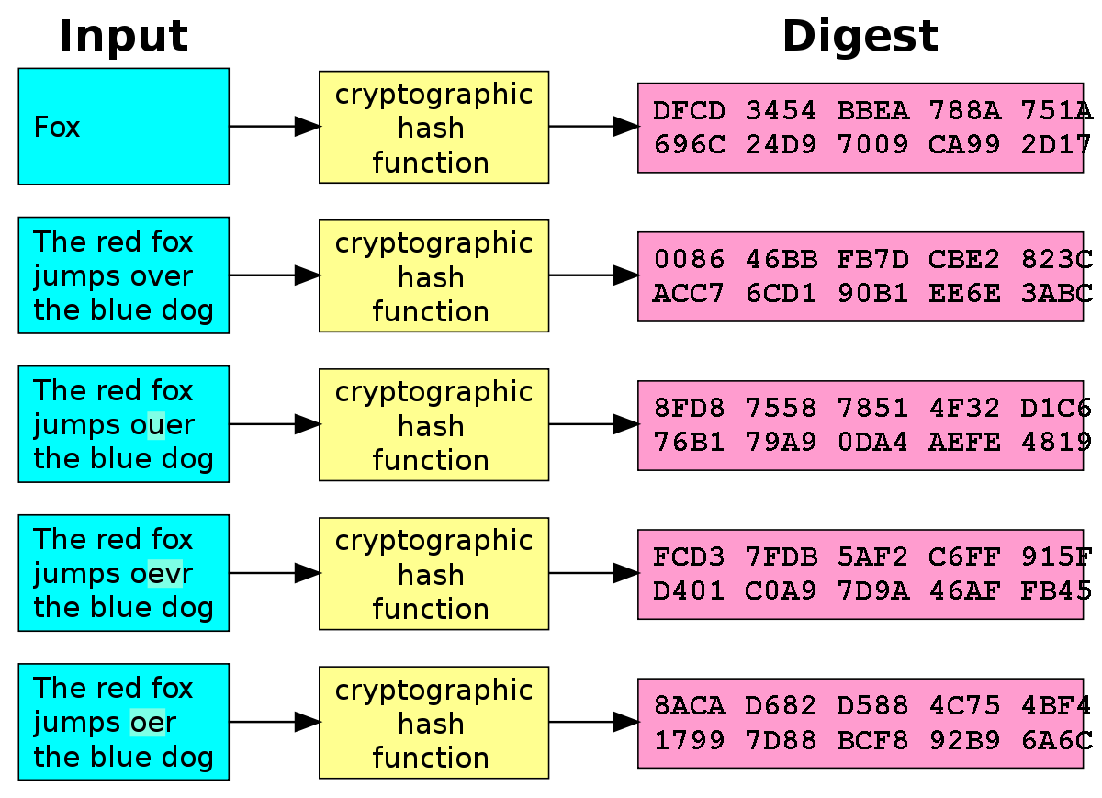
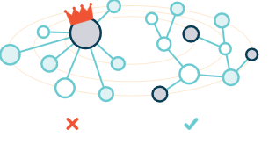
Content Addressing
Create a hash of a piece of content (for example, an OER). Use that hash as the address of that content.
Distribute copies across a network instead of one single location.
https://en.wikipedia.org/wiki/Cryptographic_hash_function

Slide 6
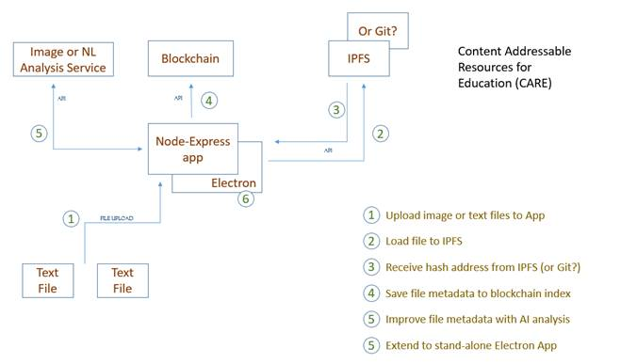
Creating CARE Net
This is in development only and does not yet exist.
But this does: https://ipfs.io/
And this: https://www.ethereum.org/

Slide 7
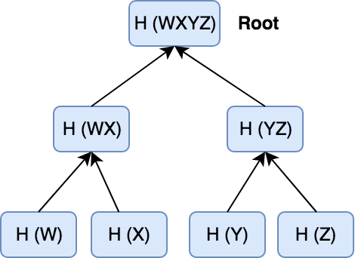
Building CARE Packages
These are called Merkle Trees – they are built by creating hashes of two (or more) hash addresses.
Git is a specialized Merkle Tree
(Really detailed explanation here: https://git-scm.com/book/en/v2/Git-Internals-Git-Objects )
https://en.wikipedia.org/wiki/Merkle_tree

Slide 8
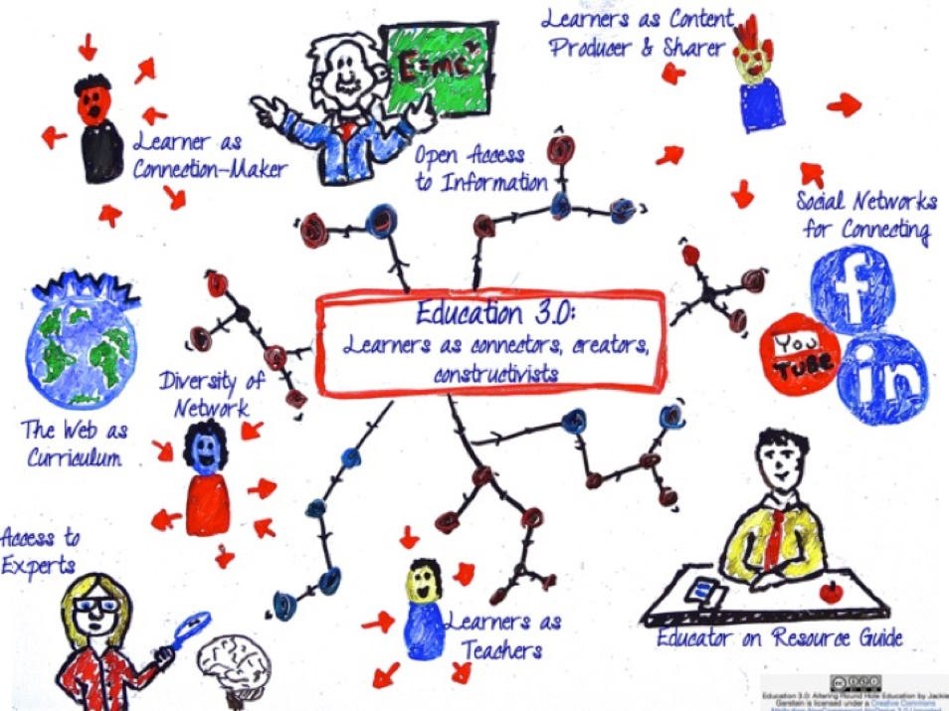
The OER Sharing Community
Because the network is distributed content is accessible to all members of the community.
Digital signatures ensure provenance and authenticity of author credentials.
The entire community can both use and create OER contents with a CARE Net.
Accuracy of the content is ensured by testing the content with the hash algorithm.
Connected webs of content can be used to create graph-based or semantic resources.

Slide 9
THANK YOU
Stephen Downes • Researcher • Stephen.Downes@nrc-cnrc.gc.ca
https://www.downes.ca

