Slide 1
Distributed Learning Technologies and Next Generation E-Learning
Stephen Downes
National Research Council Canada
October 23, 2019

Slide 2
Agenda
→ EVENT LEADER: Stephen Downes, National Research Council Canada, Canada
→ DESCRIPTION: This workshop will give participants a map of the next-generation learning technology landscape. It will show how the major developments in new technologies relate to each other and how they will change the learning landscape over the next decade or more. It will offer an accessible and down-to-earth presentation of the concept of ‘web3’ as it has emerged from the decentralized digital currently community (ie., blockchain) and trace the relation between new and unfamiliar concepts such as hash-graphs, consensus, cloud architecture and machine learning and previous work in online and personal learning environments. And it will explore several new technologies piloted over the last year, including blockchain-based badges, identity graphs, and new types of open educational resources.
→ AGENDA:
09:00 – 10:30 Data and Cloud
Content: developing an understanding of dynamic and fluid data networks, how to access open data, and how to work with data in cloud-based resources. Hands-on activities: creation and consumption of RSS feeds, and access to and use of open data; exploration of a cloud environment.
10:30 – 11:00 Tea/Coffee Break
11:00 – 13:00 Graph and Resources
Content: new types of graph-based resources, including distributed knowledge networks. Hands-on activities: experience developing graphs, use of distributed resources such as Jupyter Notebooks, and exploration of graph-based content repositories.
13:00 – 14:00 Lunch
14:00 – 15:30 Identity and Recognition
Content: how we know who someone is, how we project ourselves on the internet, and how we can be safe and secure; how we know what someone has learned. Hands-on activities: in this section include the creation of ‘identity graphs’, creation of public and private keys, and creation of digital credentials, including securing them with blockchain.
15:30 – 16:00 Tea/Coffee Break
16:00 – 17:30 Experience, Community and Agency
Content: how to enable learning experiences based on hands-on practice and knowledge creation sufficient to support a rapidly evolving sense of community based on information exchange and consensus. Hands-on activities: an exploration of immersive learning and a consensus-based decision-making activity.

Slide 3
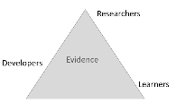
The Learning Context
These are my perspectives. They represent the areas of expertise I have developed over the years. As I study new pedagogies and technologies, I ask questions from the following points of view:
ψ
 | Philosophy My degrees are in philosophy and I specialized in philosophies of mind, science, knowledge and logic. I ask questions about the bases for arguments and claims, look for presumptions about meaning and value, and consider ways of sensing, comprehending and knowing. |  | Education I am interested in the processes of learning, inference and discovery on a practical level. I ask what it is to learn – why and how people learn - and what are the conditions for best learning outcomes. I am focused on learning experience and personal agency.
 | Computing I took a few courses but have mostly taught myself computer programming over the years, learning a number of languages, and building websites, content management systems, and learning technology. I think of programming as a means of expression. |  | Media Since my days as a newspaper carrier to my involvement in student journalism to my work today in online media I have worked on new and better means of conveying information, illustration and photography, community-building and interactivity.
%
:
Ξ
From a connectivist perspective, knowledge is the organization of connections between a set of entities, where the result of that organization is the capacity to ​recognize​ objects or states of affairs in the world. For all practical purposes, we can recognize anything: friends, pets, past events, future events, types, consequences, whatever. Moreover, there are different ways of recognizing: we can have a memory, imagine an object, exercise a certain skill, have some emotion or another.
Designing Learning Experiences
1. Learning from Experts 2. Learning with Others 3. Learning through Making 4. Learning through Exploring 5. Learning through Inquiry 6. Learning through Practising 7. Learning from Assessment
8. Learning in and across Settings
http://discovery.ucl.ac.uk/1475754/4/Luckin_SoTL_Luckin_Final.pdf

Slide 4
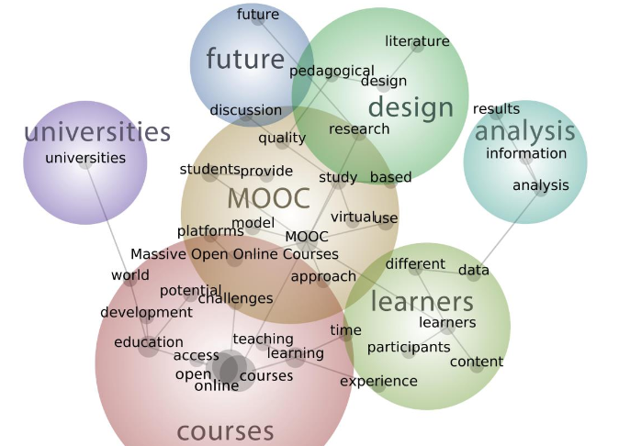
Open Online Learning
The Massive Open Online Course (MOOC)
was originally developed with the objective of
creating an open and distributed learning
environment. The objective was not to pass on
a certain both of content, but rather, to create
a network in which new connections could
develop and grow and new knowledge could
be created. The ​experience​ of participating in
this network would lead to individual learning
with each person defining success in their own
way.
Zawacki-Richter, Bozkurt, Alturki,and Aldraiweesh. 2018. What Research Says About MOOCs –An Explorative Content Analysis. InternationalReview of Research in Open andDistributed LearningVolume 19, Number 1. ​https://files.eric.ed.gov/fulltext/EJ1174059.pdf
Open Pedagogy
Participatory | Interacting via social networks and mobile apps
People and trust | Develop trust, confidence and openness working with others
Innovation & creativity | Encourage spontaneous innovation and creativity
Sharing ideas and resources | Share freely to disseminate ideas and thoughts
Connected community | Participate in a community of practice
Learner-generated | Facilitate learner contributions to OER
Reflective practice | Create opportunities for dialogue and reflection
Peer review | Contribute to an open critique of scholarship
Gráinne Conole. 2015. MOOCs as disruptive technologies: strategies for enhancing the learner experience and quality of MOOCs. Revista de Educación a Distancia. Número 39.
http://www.um.es/ead/red/39
Bronwyn Hegarty. 2015. Attributes of Open Pedagogy: A Model for Using Open Educational Resources. Educational Technology, July/August, 2015. https://upload.wikimedia.org/wikipedia/commons/c/ca/Ed_Tech_Hegarty_2015_article_attributes_of_open _pedagogy.pdf

Slide 5
Data
This part of the workshop addresses two conceptual challenges: first, the shift in our understanding of content from documents to data; and second, the shift in our understanding of data from centralized to decentralized.
ψ
 | From Document to Data Storing our content as data makes it more flexible and more useful. One piece of data could be inserted into another piece of data, such as a template. Our perspective shifts from a linear organization to something more complex. |  | Learning with Data Learning with data isn’t the same as learning with books. It’s interactive, immersive and engaging, a process of learning how to perceive and comprehend rather than to decode and store.
 | Application Interfaces The central role played by platforms is diminished in favour of direct interactions between peers, that is, a distributed web, which communicate with each other by means of application programming interfaces (API). |  | Linked Data Today we are seeing a trend toward decentralized linked data. This is the idea that each person can manage his or her own data, storing it wherever they want, and using it whenever they like.
%
:
Ξ
Resources
Introduction to Linked Data. This slide show introduces linked data principles. https://www.europeandataportal.eu/sites/default/files/d2.1.2_training_module_1.2_introduction_to_linked_data_en_edp.pdf
The Linked Open Data Cloud. John P. McCrae. This web page is the home of the LOD cloud diagram. https://lod-cloud.net/
Open Government Portal: Enables access to open data on the government of Canada website. https://open.canada.ca/data/en/dataset?res_format=JSON
Solid. Tim Berners-Lee. Solid (derived from "social linked data") is a proposed set of conventions and tools for building decentralized social applications. https://solid.mit.edu/
IndieWeb. The IndieWeb is a people-focused alternative to the "corporate web". https://indieweb.org/
An Increasingly Less-Brief Guide to Mastodon. Noëlle Anthony. GitHub. https://github.com/joyeusenoelle/GuideToMastodon/
Feature Article: Data. https://el30.mooc.ca/post/68416
Featured Video: Conversation with Shelly Blake-Plock https://el30.mooc.ca/event/80

Slide 6
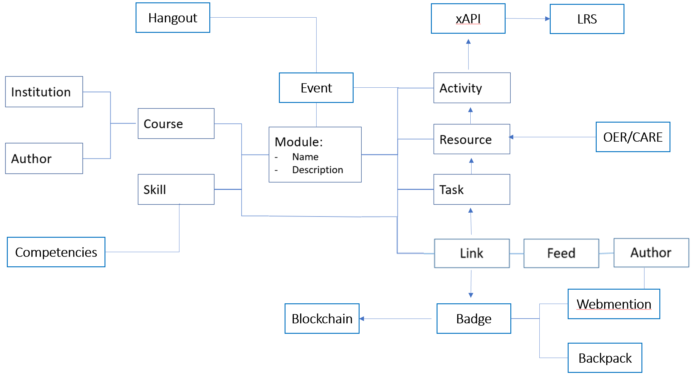
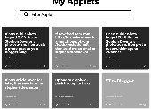
The BIG Idea - Course(?) as Open Data
“Open Data is the idea that some data should be publicly available and usable, and this idea has engendered a growing movement that attempts to remove technical and legal barriers to the use of public data.” https://www.worldbank.org/en/news/feature/2018/10/04/open-data-online-learning-for-producers-users-and-policymakers
The course as decentralised: "Decentralized means that there is no single point where the decision is made. Every node makes a decision for its own behaviour and the resulting system behaviour is the aggregate response." https://medium.com/distributed-economy/what-is-the-difference-between-decentralized-and-distributed-systems-f4190a5c6462
The course as distributed: There is no one place where the course is. Resources and activities related to the course are on multiple servers, hosted by multiple individuals or institutions, and use multiple applications or systems.
Working With Open Data: IFFFT
‘If This Then That (IFTTT) is a service that allows you to link data from different information sources. Thus, for example, you could have IFTTT send you an email each time the fridge is opened. Or compile a spreadsheet of all your Twitter posts.
http://www.ifttt.com

Slide 7
Activity - My Open Data Feed
Use this space to design a data flow for your course, thinking of different sources of data and how they might be applied.

Slide 8
Cloud
Cloud computing involves using servers and infrastructure hosted by internet-based providers. You can then access these from any computer, and also link them together for advanced applications.
ψ
 | Computing as Commodity The conceptual challenge is that it doesn’t matter whose computer it is, that it could change any time, and that we should begin to think of “computing” and “storage” as commodities, more like “water” or “electricity”. |  | Direct Experience Students are now able to edit and create new tools to create text, music and art. They will be able to directly experience the relation between algorithm and outcome, or between mathematics and music, as the case may be.
 | Virtualization Server virtualization begins with applications such as VMWare or Parallels, and progresses through a range of increasingly sophisticated computing containers created using programs like Docker and run using services like Amazon Web Services. |  | New Possibilities These new resources allow us to redefine what we mean by ‘textbooks’ and even ‘learning objects’. By putting powerful applications into the hands of students we create new possibilities for manipulation, visualization and creativity.
%
:
Ξ
Resources
What is Cloud Computing in Simple Terms? Definition & Examples. Bojana Dobran. https://phoenixnap.com/blog/what-is-cloud-computing
Cloud Adoption Strategy: 2018 update. Government of Canada. https://www.canada.ca/en/treasury-board-secretariat/services/information-technology/cloud-computing/government-canada-cloud-adoption-strategy.html
Forget the File System: The Future of Scalable Cloud Storage Will Be Objects. Joab Jackson. https://thenewstack.io/forget-file-system-future-scalable-cloud-storage-will-objects/
What is Docker? Docker containers explained. Serdar Yegulalp, InfoWorld. https://www.infoworld.com/article/3204171/docker/what-is-docker-docker-containers-explained.html
Feature Article: Cloud: https://el30.mooc.ca/post/68440
Featured Video: Conversation with Tony Hirst https://el30.mooc.ca/event/81

Slide 9
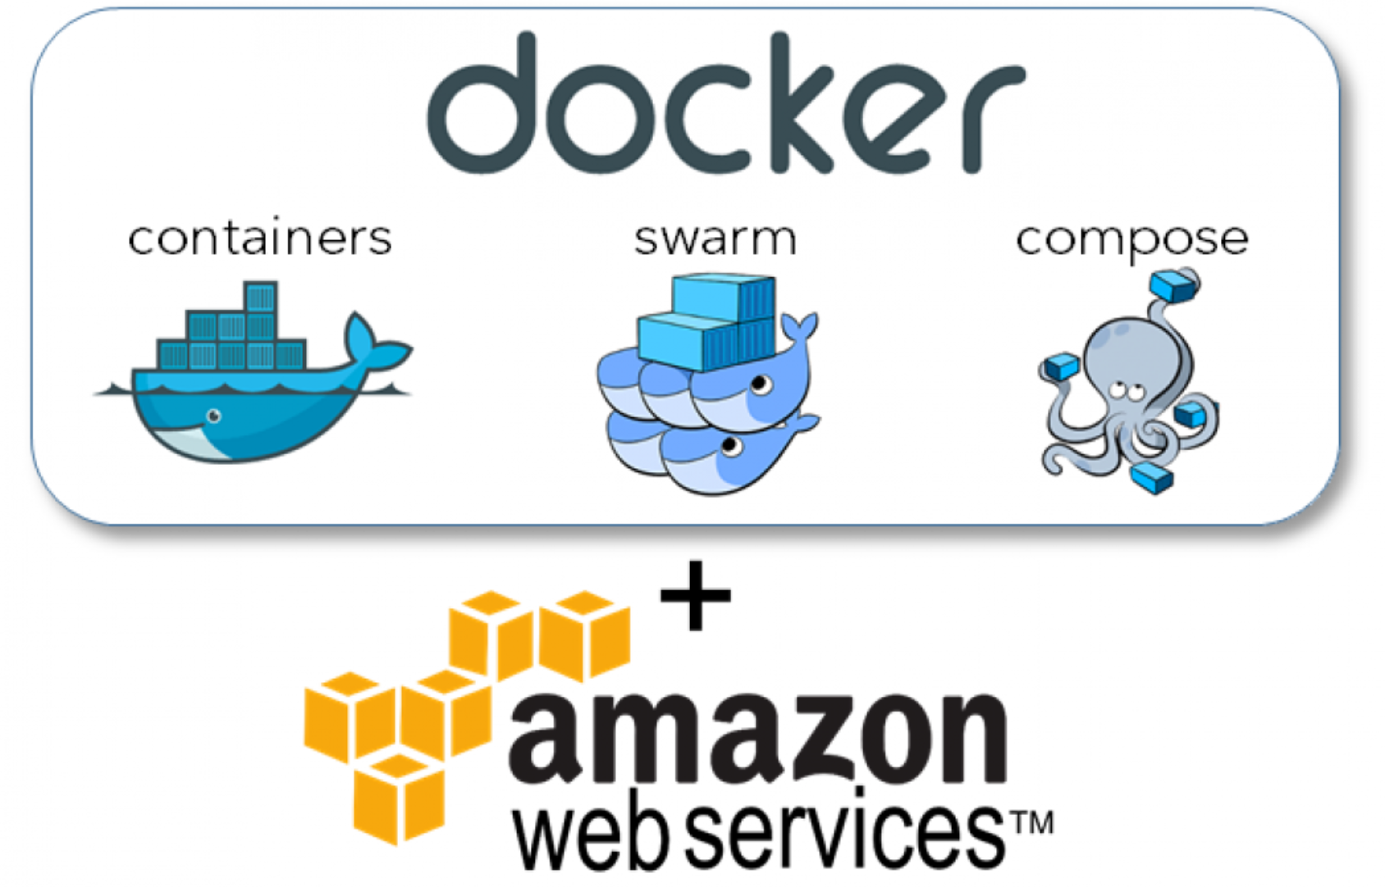
The BIG Idea - ​Courses in Containers
How did the early MOOCs host hundreds of thousands of students? They used cloud
technologies. As the demand for their course grew, they were able to scale up their databases and web servers in order to meet the demand.
Google Cloud - https://cloud.google.com/
IBM Cloud https://cloud.ibm.com
Microsoft Azure - https://azure.microsoft.com/en-us/solutions/
Amazon S3 - https://aws.amazon.com/s3/
Digital Ocean Spaces - https://www.digitalocean.com/products/spaces/
Dropbox - https://www.dropbox.com/
Alibaba Cloud - https://www.alibabacloud.com/product/oss
Oracle - https://www.oracle.com/cloud/storage/object-storage.html
Fuga - https://fuga.cloud/academy/ (Open Stack)
Rackspace - https://www.rackspace.com/cloud (Open Stack) OwnCloud - https://owncloud.com/overview/
Heroku - https://www.heroku.com/ - cloud application platform Min.io - https://min.io/ (for S3)
Today, we can automate the creation and deployment of cloud containers. This means that a course can be created ‘in a box’ and then deployed when and were needed.

Slide 10
Activity - Create a Cloud-Based Service
Use this space to design the architecture of a cloud-based online course. What services would you need? How would you provide them?

Slide 11
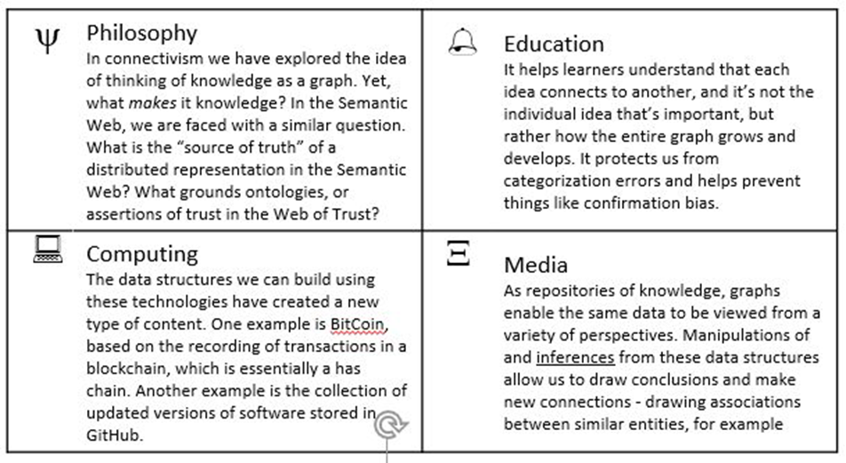
Graph
When we connect things together we have created a graph. A graph has two types of component: the entities
being connected (sometimes called nodes), and the connections between those entities (sometimes called edges).
Resources
A Gentle Introduction To Graph Theory. Vaidehi Joshi. https://medium.com/basecs/a-gentle-introduction-to-graph-theory-77969829ead8
The Neural Network Zoo. Fjodor van Veen. Neural Networks are types of graphs. http://www.asimovinstitute.org/neural-network-zoo/
Graph Data Structure And Algorithms. This page has a very brief description of a graph data structure and then a long list of things that can be done with graphs - cycling, sorting, spanning, searching. https://www.geeksforgeeks.org/graph-data-structure-and-algorithms/
GQL Is Now a Global Standards Project alongside SQL. https://gql.today/
Social Network Analysis. Philip Leifeld. http://www.bearnetwork.ca/wp-content/uploads/2018/10/slides-leifeld-bear.pdf
Feature Article: Graph. https://el30.mooc.ca/post/68472
Featured Video: Conversation with Ben Werdmuller https://el30.mooc.ca/event/82

Slide 12
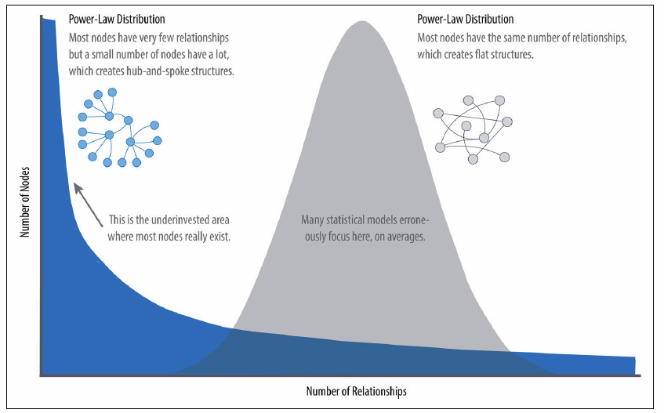
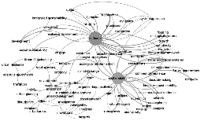
The BIG Idea - Graph, Not Story
All events are complex events and all disciplines are complex disciplines. Yet we have the urge to represent events and disciplines from the perspective of a narrative, or a story. The narrative focuses us toward one thing - a key figure in history, a single rule, a specific case.
We are seeing the flaws of the narrative approach in contemporary journalism. “The ultimate bias in journalism is not political. It’s toward controversy, gaffes, and scandal—shiny new things that get ratings and shares and downloads.” It trends toward a power-law understanding of the world, with a focus on a small and narrow set of interests and priorities.
https://www.vanityfair.com/news/2019/01/how-the-media-can-prevent-2020-from-becoming-2016
 | Urban Resilience Discourse Analysis By mapping the graph of topics discussed by authors in a set of journal articles researchers can obtain a ‘map’ of the field, helping them instantly perceive trends and relations of ideas. This gives students multiple entry points into the study. https://www.mdpi.com/2071-1050/10/ 12/4431

Slide 13
Activity - My Model Graph
Instructions
Create a model graph of some aspect of this workshop (it doesn't have to be an actual graph, only a representation of what an actual graph might look like. We've already seen, eg., graphs on the relations between people in the workshop. Could there be other types of graphs?
In your model, consider how the states of the entities in that graph might vary. Consider not only how nodes might vary (eg., a person might have a different height over time) but also how the edges might vary (eg., a person might have a different strength of relation (calculated how?) with another person over time).
In your model, consider how knowledge about the changes in states in the graph might be used.
Optional: Create your graph using an online service like https://www.draw.io/

Slide 14
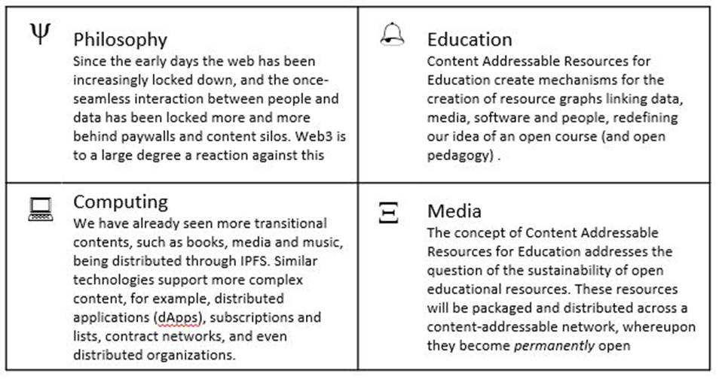
Resources
Learning resources have traditionally been things like textbooks and media, but now learning resources can be anything from video to virtual reality to application. How we describe these, and access them, is changing.
Resources
OER World Map. A couple years or so ago UNESCO launched an OER mapping project. https://oerworldmap.org/
Introducing the Dweb. Dietrich Ayala. The “d” in “dweb” usually stands for either decentralized or distributed. https://hacks.mozilla.org/2018/07/introducing-the-d-web/
Distributed Hash Table. Type of decentralized distributed system. https://ipfs.io/ipfs/QmXoypizjW3WknFiJnKLwHCnL72vedxjQkDDP1mXWo6uco/wiki/Distributed_hash_table.html
Beaker. Beaker brings peer-to-peer publishing to the Web. https://beakerbrowser.com/ Inter Planetary File System. IPFS is the Distributed Web, a peer-to-peer hypermedia protocol. https://ipfs.io/
A Look at the Future of Open Educational Resources. https://www.ijoer.org/a-look-at-the-future-of-open-educational-resources/
Feature Article: Resources. https://el30.mooc.ca/post/68554
Featured Video: Conversation with Sukaina Walji and Cheryl Hodgkinson-Williams https://el30.mooc.ca/event/84

Slide 15
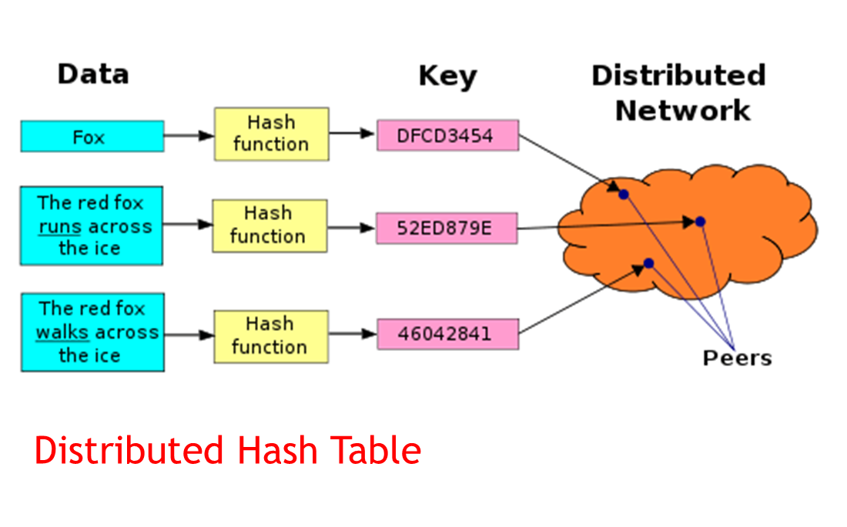
The BIG Idea - ​Content Addressable Resources for Education
Each piece of content has a unique address, which is a hash of its content
Open educational resources in the future:
New models of open educational resources will be more like tools that students use in order to create their own learning content, which they will then consume or use for some other purpose.
The learning happens not through the consumption of the content but through the use of the content.
Licensing fades to the background is that most resources are created and used only once. The resource taps into current data and may be localized or adapted to the content consumer.
Technologies such as encryption, hashing and blockchain create a record of ownership and provenance of any resource.
Our understanding of the concept of the ‘open educational resource’ changes from a definition based on the concepts and metaphors of textbooks and libraries, and toward one based on the concepts of data-processing networks, cloud services and applications, decentralized encryption-based ledgers, and AI-assisted design and information processing.

Slide 16
Activity - My OER
Instructions:
Design a scenario where students could obtain content or data, revise or remix that content or data, and create a new learning resource for their own use.
Bonus: try downloading and using the Beaker browser

Slide 17
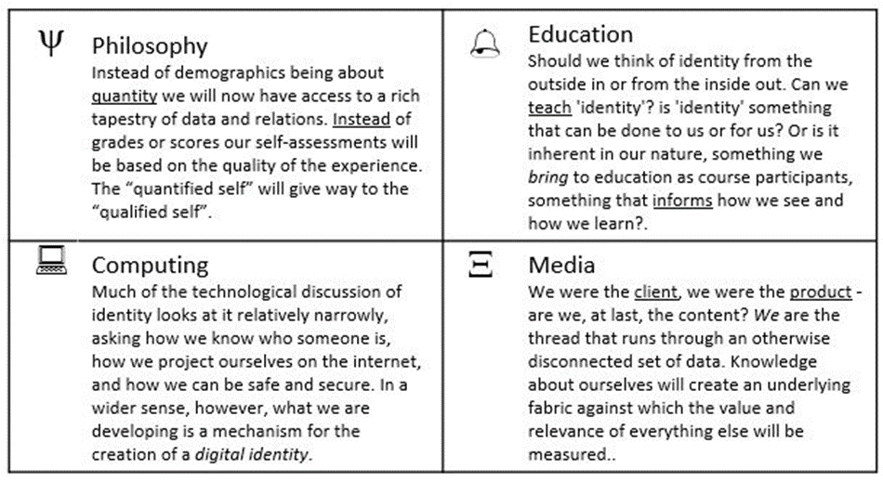
Identity
In this workshop we look at identity relatively narrowly, asking how we know who someone is, how we project ourselves on the internet, and how we can be safe and secure.
Resources
Identity Graphs: how online trackers follow you across devices. Robert Heaton. https://robertheaton.com/2017/11/24/identity-graphs-how-online-trackers-follow-you-across-devices/
What Is Identity? OpenLearn. Read through the first part of this short course. https://www.open.edu/openlearn/people-politics-law/politics-policy-people/sociology/identity-question/content-section-1.1
Identity as Evolving, Dynamic, Contextual. Maha Bali. https://blog.mahabali.me/writing/identity-as-evolving-dynamic-contextual-el30/
Keybase.io - Downes. This is my Keybase page. https://keybase.io/downes
The Basics of Decentralized Identity. Kames. https://medium.com/uport/the-basics-of-decentralized-identity-d1ff01f15df1
Decentralized Identifiers. A new World Wide Web Confortium (W3C) specification. https://w3c-ccg.github.io/did-spec/
Feature Article: Identity. https://el30.mooc.ca/post/68516
Featured Video: Conversation with Maha Bali https://el30.mooc.ca/event/83

Slide 18
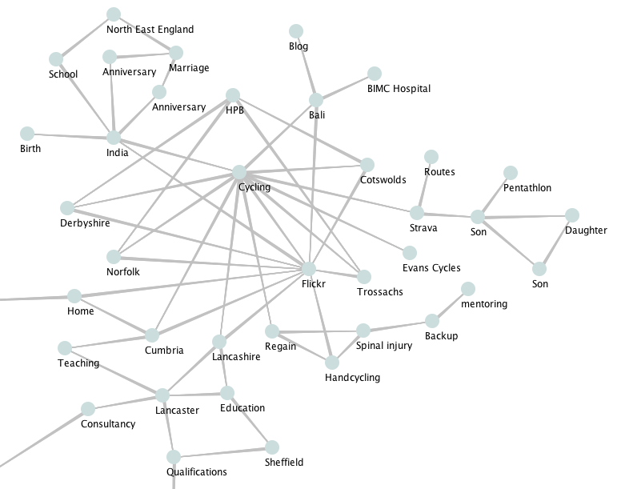
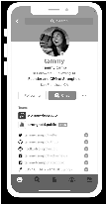
The BIG Idea - We Are the Content
Will the ‘connected self’ be more reflective? Will ‘the connective self’ more honestly reflect our hopes, aspirations and dreams?
https://www.youtube.com/watch?v=QNKpK_InQHQ
https://jennymackness.wordpress.com/tag/digital-identity/
https://mitpress.mit.edu/books/qualified-self
https://markcarrigan.net/2014/07/23/qualitative-self-tracking-and-the-qualified-self/
Cryptographic keys - either digital or physical - will become the norm, but this gives us a permanent identity that not only secures our data, it is our data.
Our new identities have the potential to be an enormous source of strength or a debilitating weakness. Will we be lost in the sea of possibilities, unable to navigate through the complexities of defining for ourselves who we are, or will we be able to forge new connections, creating a community of interwoven communities online and in our homes?

Slide 19
Activity - My Identity Graph
Instructions
Create an Identity Graph: We are expanding on the marketing definition of an identity graph. It can be anything you like, but with one stipulation: your graph should not contain a self-referential node titled ‘me’ or ‘self’ or anything similar
Think of this graph as you defining your identity, not what some advertiser, recruiter or other third party might want you to define.
Don't worry about creating the whole identity graph - focusing on a single facet will be sufficient. And don't post anything you're not comfortable with sharing. It doesn't have to be a real identity graph, just an identity graph, however you conceive it.
Optional: consider some of these questions about your identity graph:
What is the basis for the links in your graph: are they conceptual, physical, causal, historical, aspirational?
Is your graph unique to you? What would make it unique? What would guarantee uniqueness?
How (if at all) could your graph be physically instantiated? Is there a way for you to share your graph? To link and/or intermingle your graph with other graphs?
What’s the ‘source of truth’ for your graph?

Slide 20
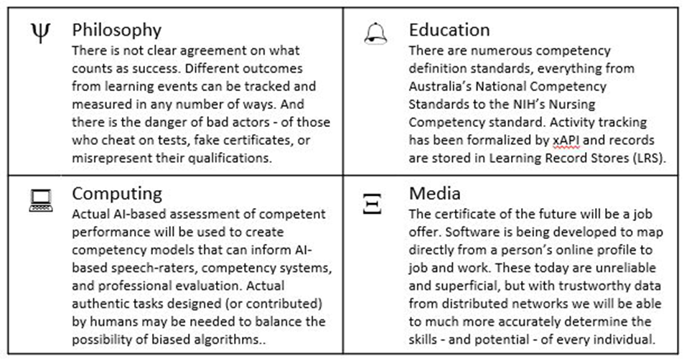
Recognition
How do we know a course has been successful? How do we know what someone has learned? How can we know whether to trust in the education of our mechanics, doctors, engineers and pilots.
Resources
China’s Social Credit System: A Mark of Progress or a Threat to Privacy? https://piie.com/publications/policy-briefs/chinas-social-credit-system-mark-progress-or-threat-privacy
Open Badges. General information page about badges. https://openbadges.org/
Competency & Skills System (CaSS). Advanced Distributed Learning. https://adlnet.gov/projects/cass
An Experience API for learning everywhere (also in virtual worlds). Roland Legrand. https://www.mixedrealities.com/2018/10/25/an-experience-api-for-learning-everywhere-also-in -virtual-worlds/
2018 Technical Report on xAPI. IEEE LTSC TAGxAPI. https://www.tagxapi.org/ieee-technical-report/
Feature Article: Recognition. https://el30.mooc.ca/post/68595
Featured Video: Conversation with Viplav Baxi https://el30.mooc.ca/event/85

Slide 21
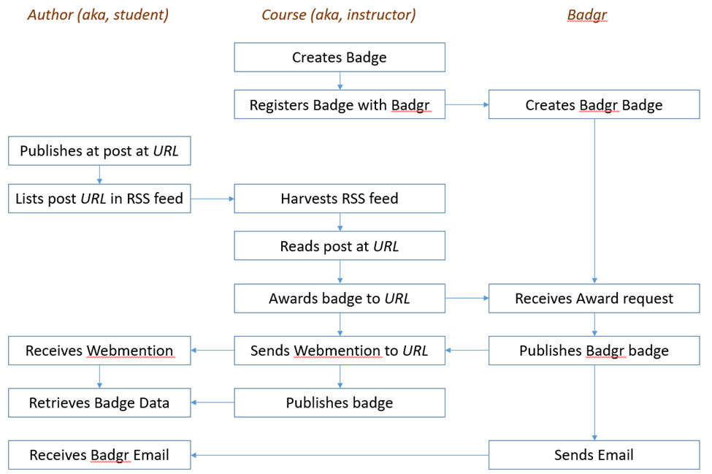
The BIG Idea - AI-Based Learning Recognition
xAPI lets you capture (big) data on human performance, along with associated instructional content or performance context information…
We can also gather data outside the school or program, looking at actual results and feedback from the workplace.
What will be assessed? There are ways to assess coursework directly and recognize achievements with badges, creating ‘stackable credentials’. Alternatively, we may opt to assess for competencies as defined (?) by some standards-based organization. Ultimately, we may be assessed broadly, as a whole person, via our own online presence.
How will we be assessed? Today we use rules and rubrics. But we already know that in high-stakes assessment, we depend on recognition by an expert. We know AI systems can already recognize simple forms of expertise, for example, by marking papers.

Slide 22
Activity - My Identity Graph
Instructions
Use this space to design your badge, clearly identifying different data elements:
create a badge and give it a name, criteria, design
award it to yourself or describe how it would be awarded.
use a blog post on your blog as the 'evidence' for awarding yourself the badge
place the badge on the blog post.
Optional
Define how your digital badge connect to or ties in to your identity graph
If you have internet access, create a free account on a Badge service (https://badgr.com/ , https://www.openbadges.me/ , https://openbadgefactory.com/ ).

Slide 23
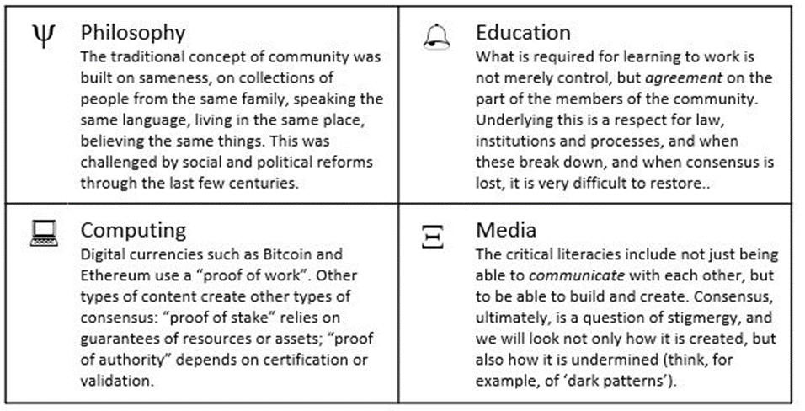
Community
The fundamental challenge to community is to make decisions on matters affecting everybody while leaving to individuals, companies and institutions those matters not effectively managed by consensus.
Resources
The Byzantine Generals Problem - https://lamport.azurewebsites.net/pubs/byz.pdf
Trust, Truth, Consensus and Community on the distributed web - Jenny Mackness https://jennymackness.wordpress.com/2018/12/09/trust-truth-consensus-and-community-on-the-distributed-web/
How Does Distributed Consensus Work? Preethi Kasireddy. Distributed systems and consensus. https://medium.com/s/story/lets-take-a-crack-at-understanding-distributed-consensus-dad23d0dc95
What is Blockchain? Lucas Mostazo, YouTube. Blockchain explained in plain English. https://www.youtube.com/watch?v=3xGLc-zz9cA
Education Blockchain Market Map. HolonIQ. https://www.holoniq.com/blockchain
ConsensusPedia: An Encyclopedia of 30 Consensus Algorithms. Consensus algorithms are the basis of all the blockchains/DAGs. https://hackernoon.com/consensuspedia-an-encyclopedia-of-29-consensus-algorithms-e9c4b4b7d08f
Feature Article: Community. https://el30.mooc.ca/post/68638
Featured Video: Conversation with Pete Forsyth https://www.youtube.com/watch?v=1Urc4EW9hiE

Slide 24
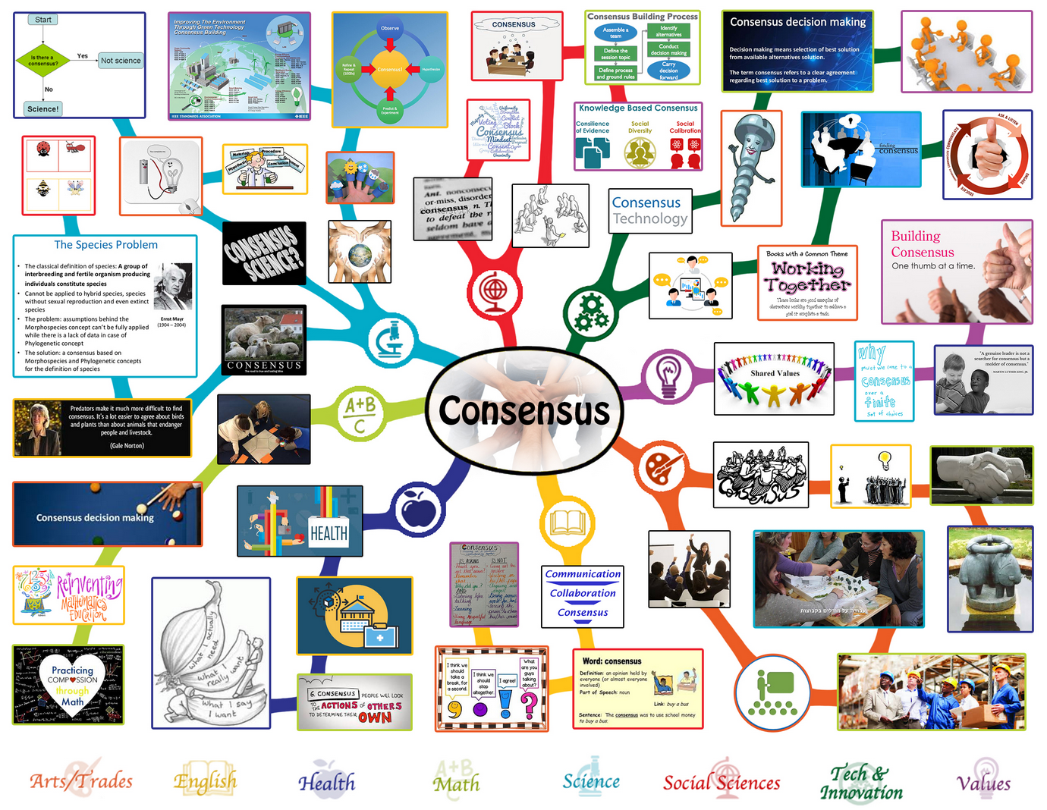
The BIG Idea - AI-Based Learning Recognition
The mechanisms we use to interact and reach consensus are what define us as a community… but what are the conditions for consensus?
The capacity to withstand the influence of such bad actors is known technically as Byzantine Fault Tolerance, and there are different approaches to achieving consensus even when there is no certainty, based on the general common sense of the rest. While not defining truth as consensus, the problem of truth, at least from a community perspective, is a consensus problem.
This makes the mechanisms we use to interact and reach consensus particularly important. For example, even if we have a chain of verified and trustworthy facts, validated by previous consensus and guaranteed by encryption technology, how do we choose between competing chains? Digital currencies such as Bitcoin and Ethereum use a “proof of work”. This makes it too expensive to create a fake chain from scratch, but at the cost of inefficiency and enormous energy consumption.
Other types of content create other types of consensus: “proof of stake” relies on guarantees of resources or assets; “proof of authority” depends on certification or validation, and “oracles” depend on widely observable and incorruptible sources of data.
What this teaches is that community and consensus are about more than voting and about more than having power. What is required for a community to work is not merely control, but agreement on the part of the members of the community. Underlying this is a respect for law, institutions and processes, and when these break down, and when consensus is lost, it is very difficult to restore.

Slide 25
Activity - My Community
Instructions
As a community, create an assignment the completion of which denotes being a member of the community. For the purposes of this task, there can only be one community for the entire workshop.
Use the space above to contain your contribution to the community.
For each participant, your being a member of the community completes the task.
Note: in the workshop, you may be presented with the ‘Byzantine Generals Problem’ and left to consider how you, as a community of communities, might solve it.

Slide 26
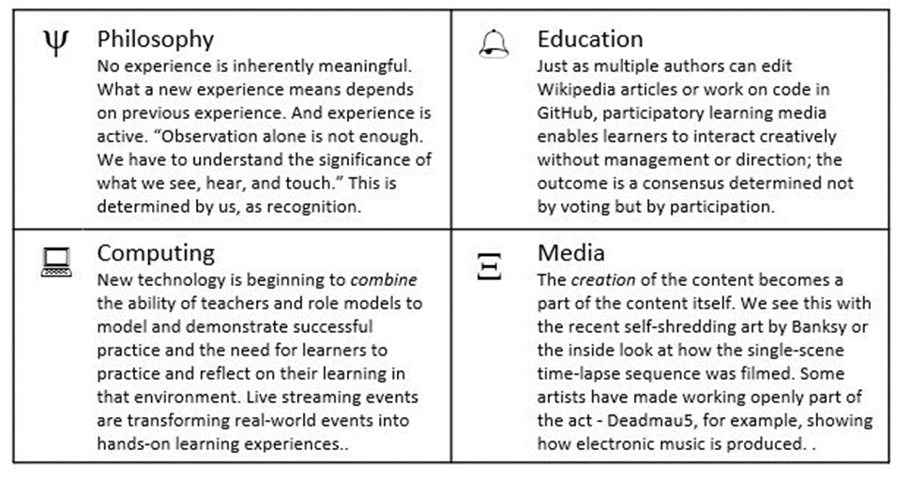
Experience
It is a truism that we learn from experience, and yet creating a role for experience in learning has been one of the most difficult problems in education. And so much of education continues to rely on indirect methods depending on knowledge transfer - reading, lectures, videos - rather than hands-on practice and knowledge creation.
Resources
How to Be an Artist. Jerry Saltz. Good advice that could be applied not only to art but to anything. https://www.vulture.com/2018/11/jerry-saltz-how-to-be-an-artist.html
Openness to Experience and Creative Achievement. Scott Barry Kaufman, Scientific American. https://blogs.scientificamerican.com/beautiful-minds/openness-to-experience-and-creative-achievement/
Twitch. A global community of millions who come together each day to create their own entertainment. https://www.twitch.tv/
Jupyter Notebooks. https://jupyter.org/
Binder. https://mybinder.org/
Feature Article: Experience. https://el30.mooc.ca/post/68683
Featured Video: Conversation with Amy Burvall https://el30.mooc.ca/event/87

Slide 27
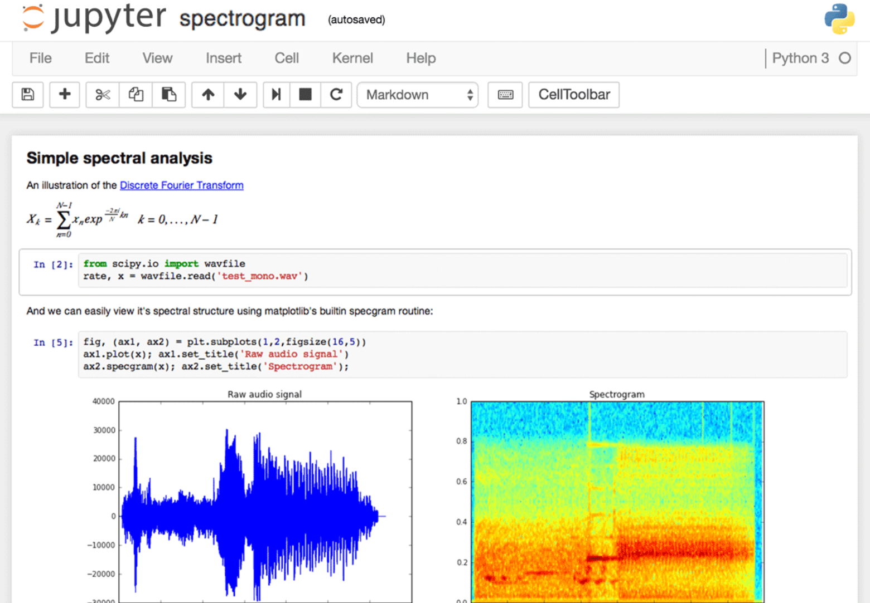
The BIG Idea - Content and Creation Combined
New technology is beginning to combine the ability of teachers and role models to model and demonstrate successful practice and the need for learners to practice and reflect on their learning in that environment. Content distribution networks and live streaming are transforming real-world events into hands-on learning experiences.
A good example of this is the live-streaming platform Twitch and especially games like Fortnite, in which players become spectators, and back again, ver and over. And using applications like xSplit or Open Broadcaster Software individuals can make their experiences part of the learning experience shared by others.
Tools for Creating
➢Twitch https://www.twitch.tv/
live-streaming site for game
playing, game-watching, and
chat
➢Filmora and Filmore Go
https://filmora.wondershare.com video creation, editing, upload
➢Tiktok http://www.tiktok.com
social video meme and sharing
➢Turtle http://turtle.audio/
make music - see also
https://www.youtube.com/watch?v=lg_LKkMx2FE
➢Glitch https://glitch.com/
make apps, remix others
➢Livecaster https://intrsection.com/2017/04/8396/ make webcasts
➢Open Broadcaster https://obsproject.com/ stream desktop
➢Workbench https://www.dataquest.io/blog/jupyter-notebook-tips-tricks-shortcuts/ free and open source data journalism
For example, Jupyter Notebook combines data and code in a document. In the JupyterLab Environment - work with code, data, and the Jupyter notebook format.
A Gallery of interesting Jupyter Notebooks:
https://github.com/jupyter/jupyter/wiki/A-gallery-of-interesting-Jupyter-Notebooks
Binder - https://mybinder.org - runs Jupyter Notebooks in a web browser, eg. Jupyter for kids -
https://mybinder.org/v2/gh/mikkokotila/jupyter4kids/master

Slide 28
Activity - My Community
Instructions
Be creative! Using the medium of your choice, create a representation of your experience of this workshop. Optional: post your creation (or post a link to your creation) on your blog.
Here's a good example of the sort of thing you could create, by Kevin Hodgeson: http://dogtrax.edublogs.org/2018/12/12/el30-a-visual-sense-of-community-connected/
If you need inspiration, visit the DS106 Assignment Bank and select one of the assignments, and then interpret it in the light this workshop. http://assignments.ds106.us/

Slide 29
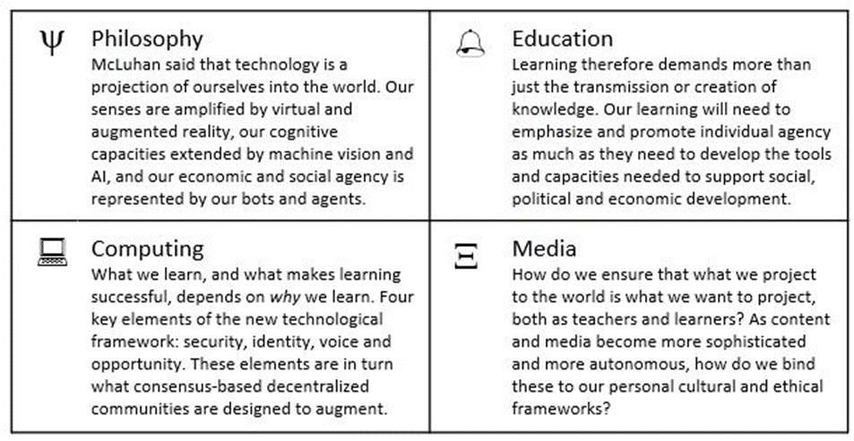
Agency
This part of the workshop addresses two conceptual challenges: first, the shift in our understanding of content from documents to data; and second, the shift in our understanding of data from centralized to decentralized.
Resources
The Three Dimensions of Inclusive Design. GitHub. https://handbook.floeproject.org/TheThreeDimensionsPartOne.html
Social Justice Repair Kit. Inclusive Design Research Centre. https://sojustrepairit.org/
Self-efficacy beliefs of medical students: a critical review - Klassen & Klassen - https://link.springer.com/article/10.1007/s40037-018-0411-3
Agency and responsibility in adolescent students: A challenge for the societies of tomorrow - https://onlinelibrary.wiley.com/doi/full/10.1111/bjep.12215
APA Good Practices Guide - http://dailynous.com/2019/09/19/apa-publishes-good-practices-guide/
Digital Wellbeing, BBC - https://www.bbc.co.uk/rd/projects/digital-wellbeing
Featured Video: Conversation with Silvia Baldiris and Jutta Treviranus https://el30.mooc.ca/event/88

Slide 30
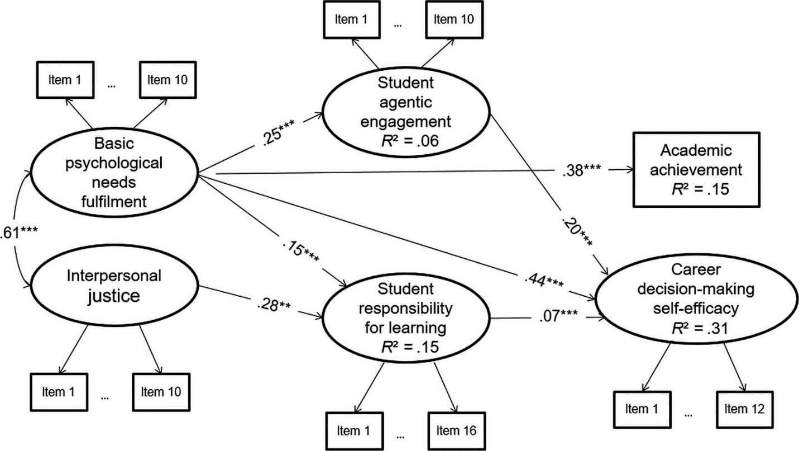
The BIG Idea - Redefining Success
Each of the major developments in the internet - from the client-server model to platform-based interoperability to web3-based consensus networks - has been accompanied by a shift in agency. The relative standing of the individual with respect to community, institutions, and governments was shifted, for better or worse.
Each stage in technological development is inspired by social, political and economic aspirations, and understanding the next generation of learning and technology requires understanding the forces that shaped them. So we close our enquiry with a consideration of issues related to power and control, to peace and prosperity, to hopes and dreams.
McLuhan said that technology is a projection of ourselves into the community, so we need to consider how human capacities are advanced and amplified in a distributed and interconnected learning environment. Our senses are amplified by virtual and augmented reality, our cognitive capacities extended by machine vision and artificial intelligence, and our economic and social agency is represented by our bots and agents.
‘Success’ in the future will not be defined by employment opportunities, by competencies, by skills and expertise, but by agency - can the learner learn, think and do for themselves in a rapidly changing and complex environment?

Slide 31
Activity - My Definition of Success
Instructions
Using the space below or one of the many online tools at your disposal, consider what success - in this workshop, in your career, in life - looks like to you.

Slide 32
Articles / Presentations by Stephen Downes
A Look at the Future of Open Educational Resources. 2019. International Journal of Open Educational Resources, Volume 1, Issue 2, Spring/Summer, American Public University
System. https://www.ijoer.org/a-look-at-the-future-of-open-educational-resources/
The Third Wave: the Next Generation of Distributed Learning Technology. 2019. Canadan Network for Innovation in Education, Vancouver. http://www.downes.ca/presentation/505
Future Learning in an Advanced Decentralized Learning Ecosystem. 2019. Individual Training and Education (IT&E) Symposium, Canadian Forces Base Borden.
https://www.downes.ca/cgi-bin/presentation/504
Vision 2030: Redesigning Education for the Future. 2018. The 3rd Asbar World Forum 2018, Riyadh. https://www.downes.ca/files/2018%2010%2028%20-%20Vision%202030.pdf
Online Learning and MOOCs: Visions and Pathways. 2018. China International Distance
Education Conference, Beijing. https://www.downes.ca/files/Visions%20and%20Pathways.pdf
Modernised learning delivery strategies: The Canada School of Public Service
technology integration project. 2018. Journal of Applied Learning & Teaching, Vol.1 No.2 15-25, Kaplan Singapore. http://journals.sfu.ca/jalt/index.php/jalt/article/view/17/17
Quantum Leaps We Can Expect in Teaching and Learning in the Digital Age: a Roadmap Research Report. 2017. Contact North, World Conference on Online Learning, Toronto.
http://onlinelearning2017.ca/en/special-series-of-contact-north-i-contact-nord-insight-reports/
Open Learning, Open Networks - 开放学习、开放网络. 2017. Distance Education in China, 2017 - 10 36-4. http://kns.cnki.net/kcms/detail/11.4089.G4.20171019.1052.008.html
New Models of Open and Distance Learning. 2016. Open Education: from OERs to MOOCs, Editors: Mohamed Jemni, Kinshuk, Mohamed Koutheair Khribi., 1-22, Springer.
http://link.springer.com/book/10.1007/978-3-662-52925-6
Applications, Algorithms and Data: Open Educational Resources and the Next
Generation of Virtual Learning. Education Ouverte: Ressources Educatives Libres et Ingenierie de Formation, Hammamet. http://www.downes.ca/presentation/481
All: https://www.downes.ca/publications.htm
https://www.downes.ca/presentations.htm

