Slide 1
A Distributed Content Addressable Network for Open Educational Resources
Stephen Downes
National Research Council Canada
CELDA 2019, Cagliari, Sardinia, Italy

Slide 2
OER: A Problem

Slide 3
The Open Web
Began as email lists and Usenet groups.
Grew through blogs and personal websites
Thrived in the age of social networks, online classrooms, and massive open online courses.

Slide 4
Open Education
The philosophy of ‘open’ that characterized the early internet was also reflected in the concept of open education.
“Open education is a philosophy about the way people should produce, share, and build on knowledge.” (opensource.com; Colpaert, 2018)

Slide 5
Open Educational Resources
Teaching, learning and research materials that reside in the public domain or have been released under an open license that permits no-cost access, use, adaptation and redistribution by others with no or limited restrictions. (UNESCO, 2002)

Slide 6
MOOCs and Open Courses
First MOOC created in 2008 (CCK08)
Based on the idea of open eduction
Created using open educational resources, an are themselves open educational resources

Slide 7
Courses as Linked Open Data

Slide 8
A Pedagogy of Engagement
OER enables students to select resources
Use inherently involves discussion and interaction
Content creation as important as consumption

Slide 9
Open Pedagogy
Participatory | Interacting via social networks and mobile apps
People and trust | Develop trust, confidence and openness working with others
Innovation & creativity | Encourage spontaneous innovation and creativity
Sharing ideas and resources | Share freely to disseminate ideas and thoughts
Connected community | Participate in a community of practice
Learner-generated | Facilitate learner contributions to OER
Reflective practice | Create opportunities for dialogue and reflection
Peer review | Contribute to an open critique of scholarship
Gráinne Conole. 2015. MOOCs as disruptive technologies: strategies for enhancing the learner experience and quality of MOOCs. Revista de Educación a Distancia. Número 39. http://www.um.es/ead/red/39
Bronwyn Hegarty. 2015. Attributes of Open Pedagogy: A Model for Using Open Educational Resources. Educational Technology, July/August, 2015. https://upload.wikimedia.org/wikipedia/commons/c/ca/Ed_Tech_Hegarty_2015_article_attributes_of_open_pedagogy.pdf

Slide 10
The Pushback Against Open
Vendors require payment for access to resources. (Aversa, Hervas-Drane & Evenou, 2019)
Vendors began making money through advertising.
Both subscription-based and advertising-based models encouraged the growth of technology that herded users into content silos and that tracked and analyzed their behaviour. (Papadopoulos, Snyder & Livshits, 2019)

Slide 11
Challenges to OER
MOOCs create barriers, charging first for certification and then for access to content itself. (Shah, 2017)
Same thing for access to OER, e.g. Flat World Knowledge
Ongoing issues of sustainability that need to be addressed for centralized services (Downes, 2005)

Slide 12
The Enclosure of OER
As David Bollier says, the enclosure of open content is one of the greatest threats to the internet. “Enclosure is about dispossession. It privatizes and commodifies resources that belong to a community or to everyone, and dismantles a commons-based culture.” (Bollier, 2011).

Slide 13
The Enclosure of OER
As David Bollier says, the enclosure of open content is one of the greatest threats to the internet. “Enclosure is about dispossession. It privatizes and commodifies resources that belong to a community or to everyone, and dismantles a commons-based culture.” (Bollier, 2011).

Slide 14
Application Issues for OER
Limited re-use, and almost no adaptation
Licensing remains a mystery to many people
Not easy to create and upload OER to repositories
Walju & Hodgkinson-Williams, 2018)

Slide 15
Application Issues for OER
Limited re-use, and almost no adaptation
Licensing remains a mystery to many people
Not easy to create and upload OER to repositories
Walju & Hodgkinson-Williams, 2018)

Slide 16
Additional Issues
OER remain hard to discover
Individual OER often lacked educational
No mechanism for ensuring the quality of OER

Slide 17
CARE: A Solution

Slide 18
Content Distribution Neworks
Content is stored on multiple servers. And when a web user requests that content, it is served from the nearest server.
E.g. Content Distribution Networks
Companies such as Cloudflare and Akamai now serve as much as half the content traffic on the internet

Slide 19
The Distributed Web
Rather than belonging to a company such as Akamai, servers are individual users’ computers.
Continuous development including services such as Napster, Gnutella, Tor and BitTorrent. (Troncoso, Isaakidis, Danezis & Halpin, Harry, 2017)
These are called ‘peers’ and the system as a whole is called a ‘peer-to-peer’ (P2P) network.

Slide 20
Decentralization
The distributed web potentially solves issues proponents have long sought to address.
traffic, which overloads a single server.
latency, or the lag created by accessing resources half a world away.
national policies creating the need to differentiate access.
Reliance on a centralized source

Slide 21
Web3
“Web3” (corresponding to a JavaScript library called Web3.js) (Stark, 2018)
Chains encrypted data structures to create what may be characterized as a “stateful” distributed web.
Beyond obvious applications such as distributed token networks such as Bitcoin or Ethereum, Web3 may offer a response to the issues of centralization and commercialization afflicting OER.

Slide 22
Content Addressing
Content of a resource is used as input to a hash algorithm that produces a scrambled string of characters - the hash - of the resource.
Each hash is an essentially unique identifier for that resource. (Sicilia, Sánchez-Alonso & Barriocanal, 2016).
A peer sends a request to the closest peer, which either sends us the resource, or passes the request along to more peers.

Slide 23
Content Addressing

Slide 24
Content Addressing
Content of a resource is used as input to a hash algorithm that produces a scrambled string of characters - the hash - of the resource.
Each hash is an essentially unique identifier for that resource. (Sicilia, Sánchez-Alonso & Barriocanal, 2016).
A peer sends a request to the closest peer, which either sends us the resource, or passes the request along to more peers.

Slide 25
Dweb
One significant current project implementing such a protocol is called Dweb (for ‘distributed web’ or ‘decentralized web’). (Ayala, 2018)
Based on the dat protocol, (https://www.datprotocol.com/) a mechanism for finding and distributing content
dat://502bdf152d00a35f9785f78d107b9037b5eca9354bcf593e7b4995f9be97a614/
This address is in fact the dat:// address for the first Content Addressable Resource for Education (CARE).

Slide 26
Peer Applications
An application that runs on your computer and communicates with other nodes in a P2P network to share resources.
Beaker Browser
allows users to explore Dweb resources, ‘clone’ those resources and create or edit new resources.
manages Dweb functionality like creating hashes and chaining resources together. (Robinson, Hand, Madsen, Buus & McKelvey, 2018).
Addesses ‘dat name service’

Slide 27
Other Applications
Blockchain - the resources in question are entries in financial ledgers.
Git (with services based on the protocol like GitHub and GitLab), chains resources in different versions or branches of a software development project.
Interplanetary File System (IPFS) along with the associated project, Inter Planetary Linked Data (IPLD).

Slide 28
Content Addressable Resources for Education
CARE are content-addressable, they are stored and access in the web as a whole
CARE are also associated with each other in an Open Resource Graph (ORG)
CARE can be cloned and edited by any user

Slide 29
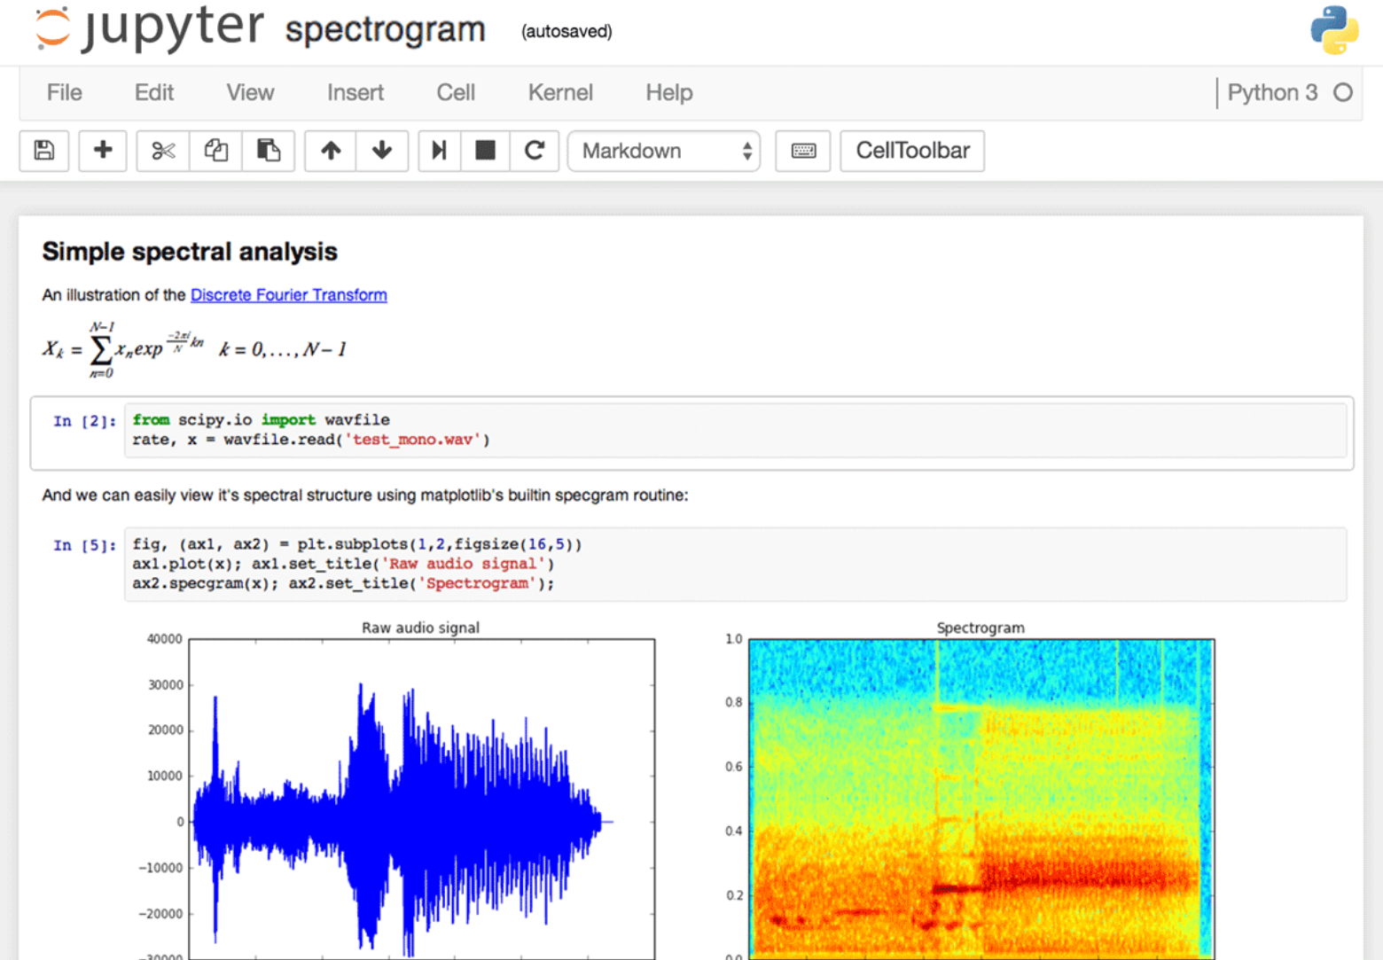
Example: Notebooks
https://github.com/jupyter/jupyter/wiki/A-gallery-of-interesting-Jupyter-Notebooks#machine-learning-statistics-and-probability
OpenLearn Jupyter Books Remix, TM351 Notebooks in VM and Electron.
https://www.dataquest.io/blog/jupyter-notebook-tips-tricks-shortcuts/

Slide 30
Implementation of CARE
distributed through IPFS and Dweb - resources are uploaded into IPFS, where they receive a content-based address. This address is stored on an Ethereum blockchain
not only of educational content, but interactive applications and service interfaces as well.
CARE can be cloned and edited by any user

Slide 32
Software
Authored by Rashi Nagpal as part of NRC summer co-op program - https://github.com/Downes/CARE-project

Slide 33
Results
Authored by Rashi Nagpal as part of NRC summer co-op program - https://github.com/Downes/CARE-project

Slide 34
Current Issues for CARE
Speed - can be very fast, in practice, it often isn’t
Ease of Use - while it may seem that creating and sharing a web resource should be easy, in practice it often isn’t
There isn’t yet a good Dweb search engine. Additionally, resources can disappear when a host goes offline.
development of semi-centralized intermediaries such as Hashbase (https://hashbase.io/)
Acceptance - many institutions officially disapprove of P2P

Slide 35
Future Work
Addressing speed issues with a set of known CARE repositories functioning as IPFS nodes (known as CARE Net)
Development of multi-part CARE resources (known as CARE Packages).
Develop mechanisms for content creation through remixing and reusing existing resources.

Slide 36
Stephen Downes
Photo by Lorelei
https://www.downes.ca

