Slide 1
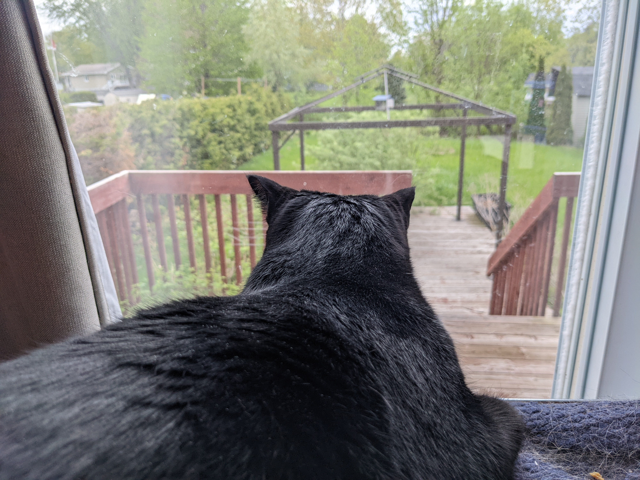
The Next Generation
of MOOCs
Stephen Downes
National Research Council Canada
for
Iranian Conference of Health Professions Education (ICHPE)
May 18-20, 2022

Slide 2
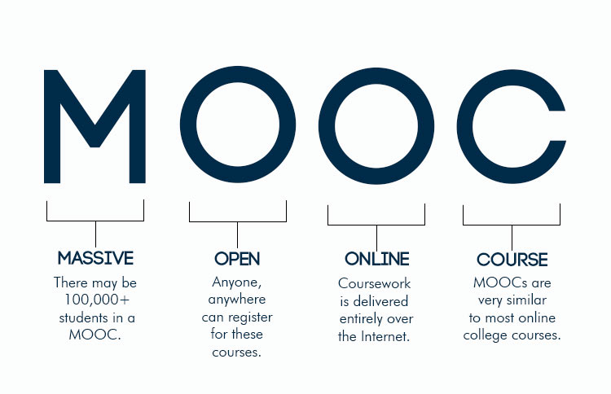
Although only 15 years old, Massive Open Online Courses (MOOCs) have captured the imagination of online learners.
Image: https://www.codlearningtech.org/2015/11/23/5-questions-what-you-need-to-know-about-moocs/

Slide 3
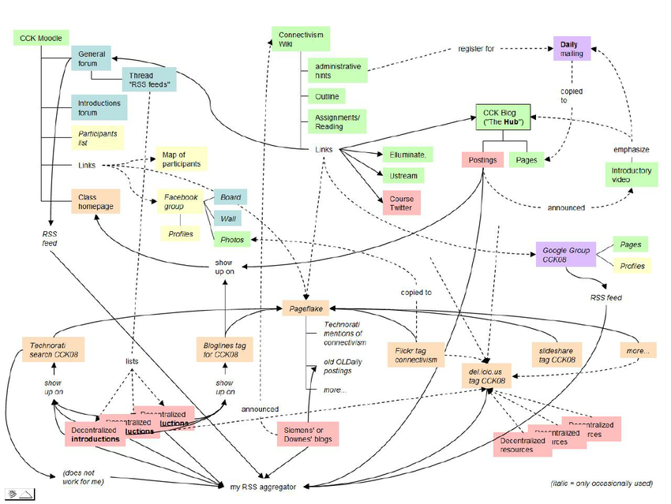
Original cMOOC
Based on the idea of free access and open educational resources (OER), MOOCs enabled teachers and instructors to reach thousands of students in a single class.
Tharindu R. Liyanagunawardena Shirley Ann Williams Massive Open Online Courses on Health and Medicine: Review https://www.researchgate.net/figure/CCK08-A-connectivist-course-structure_fig1_264833750

Slide 4
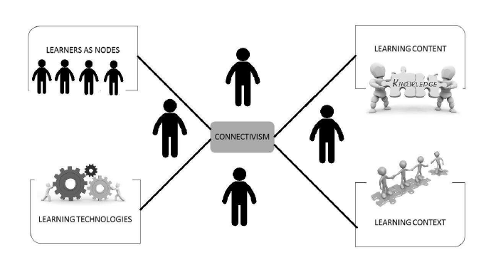
The c in cMOOC stands for connectivist.
Connectivism is the thesis that knowledge is distributed across a network of connections, and therefore that learning consists of the ability to construct and traverse those networks
Stephen Downes, 2022, Connectivism. http://www.asianjde.com/ojs/index.php/AsianJDE/article/view/623
Image: Denzil Chetty, 2013, Connectivism: Probing Prospects for a Technology-Centered Pedagogical Transition in Religious Studies https://www.researchgate.net/publication/269071838_Connectivism_Probing_Prospects_for_a_Technology-Centered_Pedagogical_Transition_in_Religious_Studies_1

Slide 5
Elements of a cMOOC
Network Empowerment
Reproduction/ Recombination
Analysis and Accreditation
Network and Ecosystem Design
Targeting / Creating a Common Interest
Re-Targeting
Knowledge Facilitation
Feedback and Evaluation
From a presentation by Eisa rezaei

Slide 6
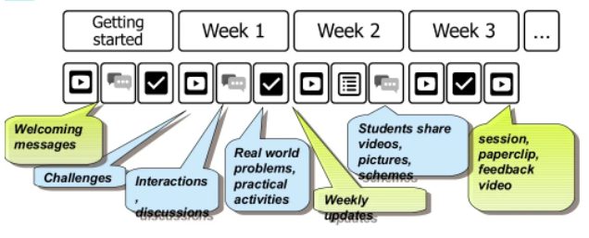
xMOOC
The x in xMOOC stands for eXtended
Image: Eisa rezaei, 2018, Teaching And Learning Models in MOOCs. https://www.slideshare.net/rezaeieisa/teaching-and-learning-models-in-moocs

Slide 7
The xMOOC adapted video, cloud technologies and artificial intelligence to automate course delivery to massive audiences
Cloud content and video storage
Load balancer
Could expand when needed
Automated grading
The xMOOC

Slide 8
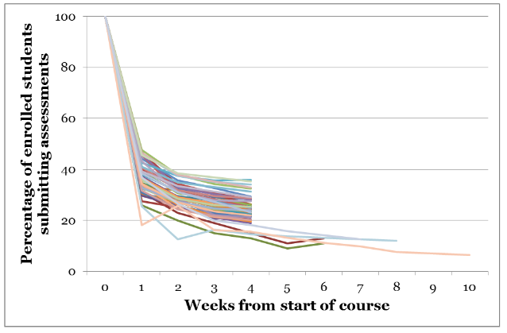
Early MOOCs faced pedagogical challenges, however. Students needed to be able to manage their own learning, and the lack of personal contact and community resulted in low completion rates.
Katy Jordan, 2015, Massive open online course completion rates revisited: Assessment, length and attrition http://www.irrodl.org/index.php/irrodl/article/view/2112

Slide 9
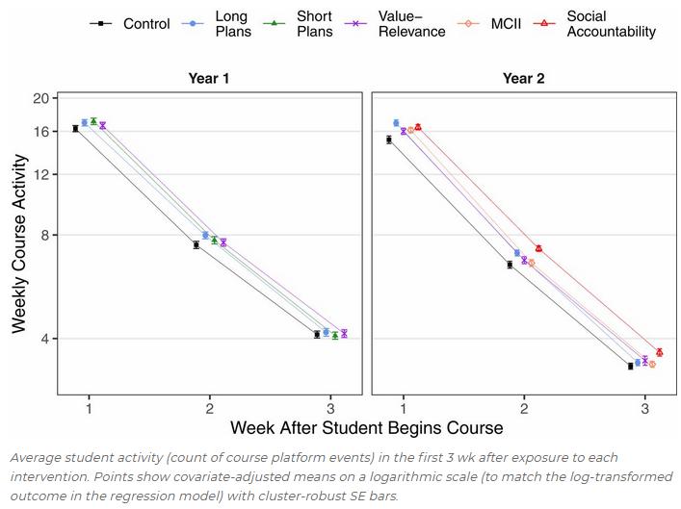
A study “found that efforts to put ‘interventions’ at the front of MOOC classes did not boost completion rates, even though the authors had good reason to think they would.”
Derek Newton, 2020, https://www.forbes.com/sites/dereknewton/2020/06/21/the-depressing-and-disheartening-news-about-moocs/?sh=28f4fcf176ed
René F. Kizilcec, Justin Reich, Michael Yeomans et.al., 2020, Scaling up behavioral science interventions in online education https://doi.org/10.1073/pnas.1921417117

Slide 10
Other MOOCs
https://sites.google.com/site/themoocguide/home

Slide 11
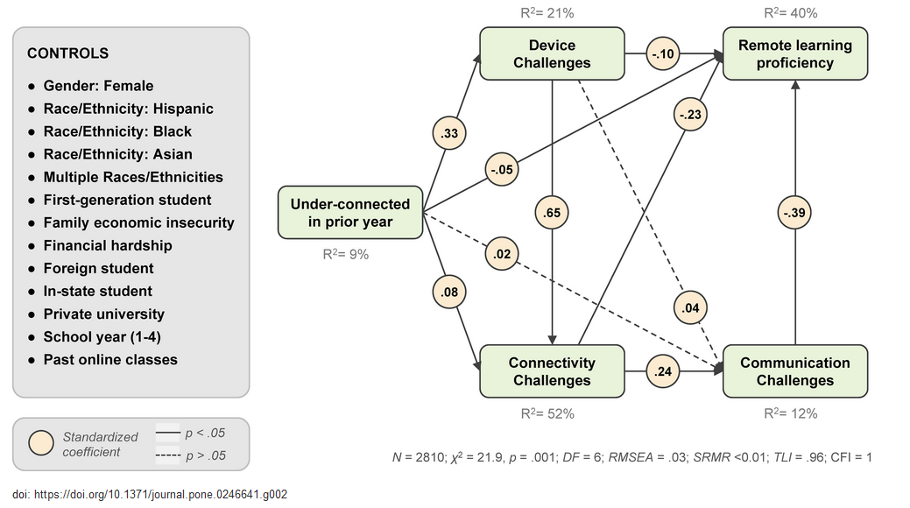
With the recent pandemic forcing much learning to move online, educators have been catching up with MOOCs. They are bringing with them the sense of interaction and community they develop in the classroom and moving it online.
https://journals.plos.org/plosone/article/figure?id=10.1371/journal.pone.0246641.g002

Slide 12
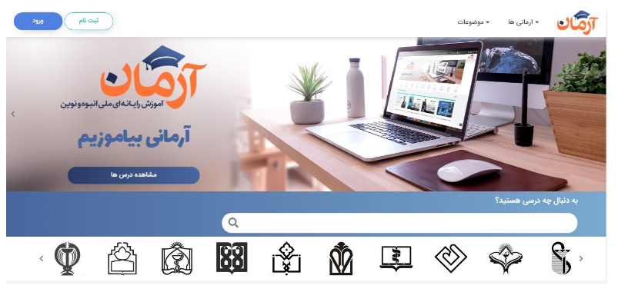
Teaching in a Digital Age
MOOC providers are learning from the experience of distance learning, as for example from the SECTIONS model
Image: ARMAN MOOC Website, Mohsen Keshavarz and Andrea Ghoneim, 2021, Preparing Educators to Teach in a Digital Age http://www.irrodl.org/index.php/irrodl/article/view/4910
See also https://www.irrodl.org/index.php/irrodl/article/view/4910/5460

Slide 13
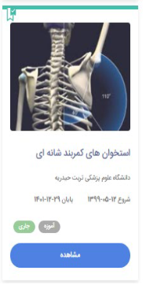
Students
Ease of use
Cost
Teaching functions, including pedagogical affordances of media
Interaction
Organizational issues
Networking
Security and privacy
Tony Bates, 2019, Introduction to From Blackboard to MOOC https://www.youtube.com/watch?v=llTfFy6nKSQ

Slide 14
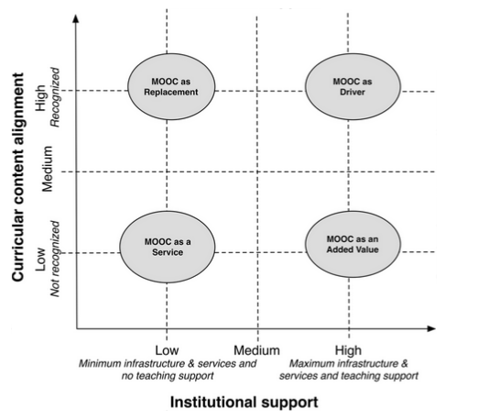
New models of technology and teaching enable a next generation of MOOCs.
Pérez-Sanagustín, et.al, 2017, H-MOOC Framework: Reusing MOOCs for Hybrid Education. http://rdcu.be/oMnE
Pérez-Sanagustín, 2021, MOOCs and University Courses during COVID-19 Pandemic https://mperezsanagustin.wordpress.com/2021/01/18/moocs-and-university-courses-during-covid-19-pandemic/

Slide 15
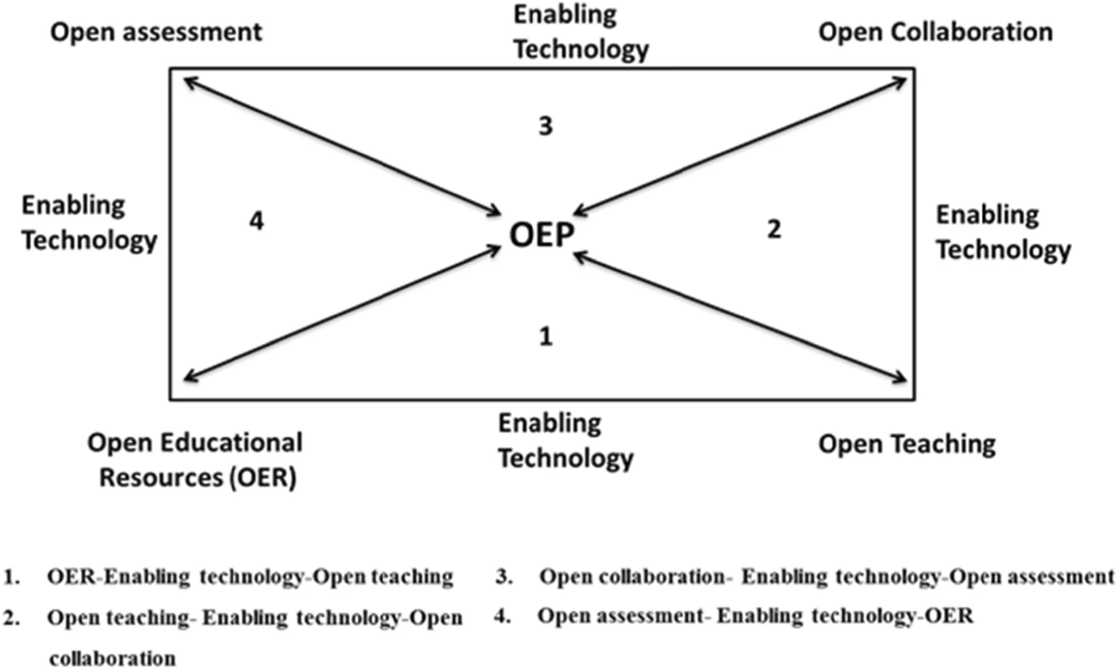
Open Educational Practices
OEP “draw upon open technologies that facilitate collaborative, flexible learning and the open sharing of teaching practices”
Ronghuai Huang et.al., 2020, Disrupted classes, undisrupted learning during COVID-19 outbreak in China: application of open educational practices and resources. https://slejournal.springeropen.com/articles/10.1186/s40561-020-00125-8
Beetham, H., Falconer, I., McGill, L. and Littlejohn, A. Open practices: briefing paper. JISC, 2012
https://oersynth.pbworks.com/w/page/51668352/OpenPracticesBriefing

Slide 16
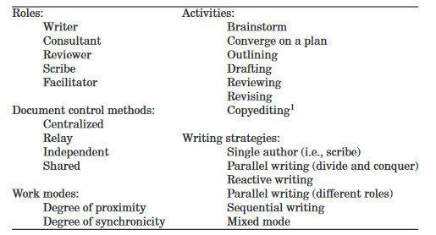
Collaborative Online Document Authoring
Many examples of collaborative writing as note-taking, assignment, writing project, etc
Olson, et.al. How people write together now: Beginning the investigation with advanced undergraduates in a project course. https://dl.acm.org/doi/pdf/10.1145/3038919
Goei, et.al., 2021, Online lesson study: virtual teaming in a new normal. https://www.emerald.com/insight/content/doi/10.1108/IJLLS-09-2020-0078/full/html
Vandendorpe, 2021, Book sprint for FAIR Adoption Handbook for Universities. https://blog.zbmed.de/booksprint-for-fair-adoption-handbook-by-fairsfair/

Slide 17
Decentralized Course Design
Decentralized course design originally
Math for Engineers
Math for Physicians
Math Faculty
Medical Faculty
Math for Artists
Math for Business
Arts Faculty
Business Faculty

Slide 18
Centralized Course Design
Decentralized course design originally
Math Faculty
Medical Faculty
Math
Arts Faculty
Business Faculty

Slide 19
Decentralized Course Design
Decentralized course design originally
Math for Engineers
Math for Physicians
Math Faculty
Medical Faculty
Math
Math for Artists
Math for Business
Arts Faculty
Business Faculty

Slide 20
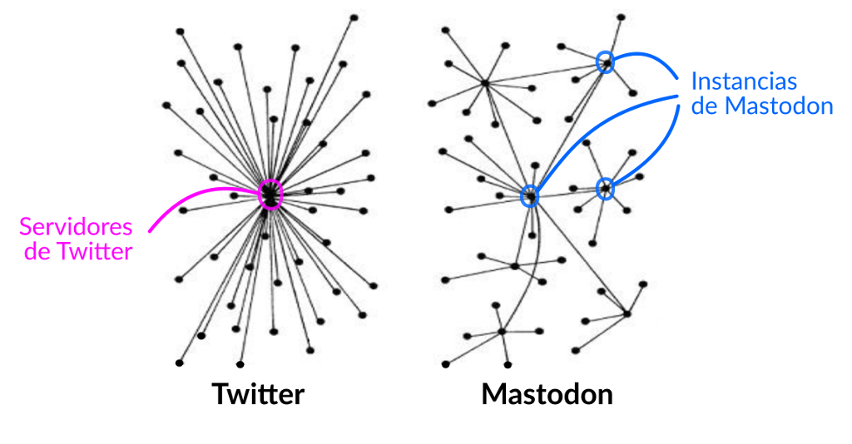
Federation
Mastodon Instances
Twitter server
Federation is a principle in social networks describing the transition to decentralized networks
Image: Inés Binder , 2019, Mastodon: mejor tootear que tuitear https://radioslibres.net/mastodon-mejor-tootear-que-tuitear/

Slide 21
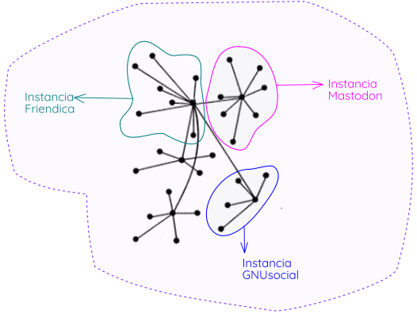
The Fediverse
Common protocols allow different federated technologies to communicate with each other
Image: https://radioslibres.net/fediverso/

Slide 22
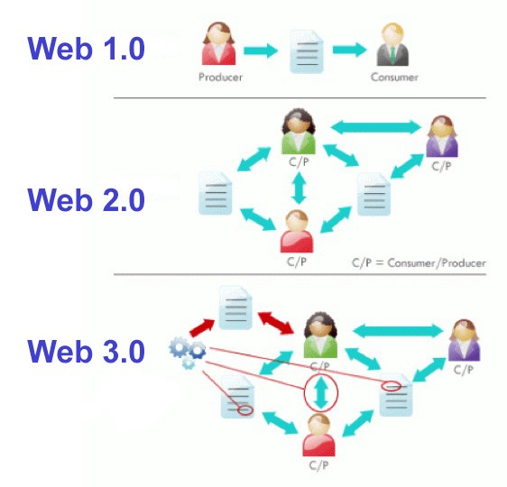
Web3
Data
Artificial Intelligence
Blockchain

Slide 23
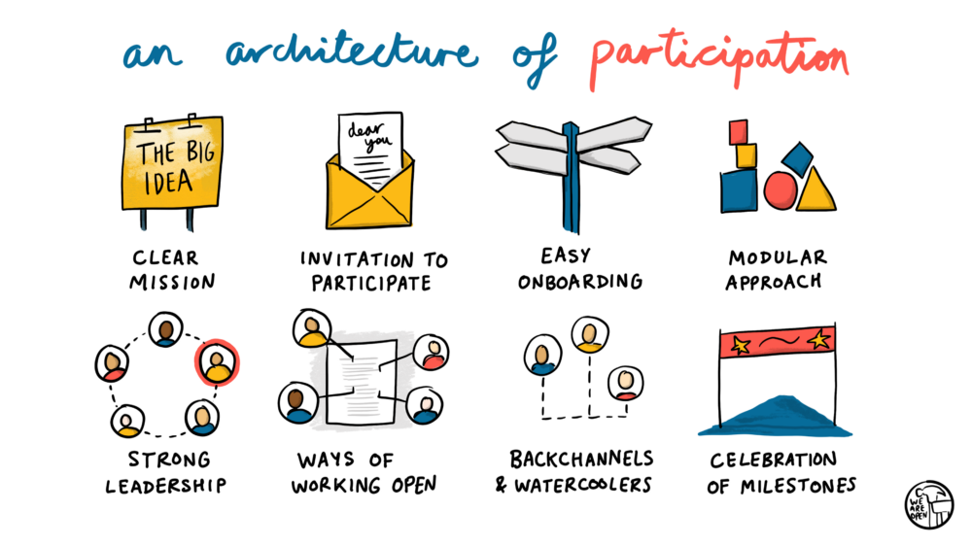
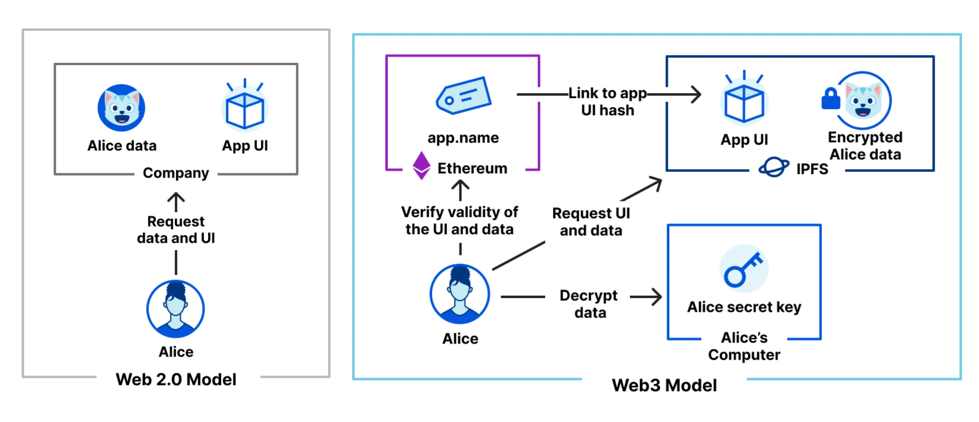
New distributed platforms enable an architecture of participation based on co-creating and sharing resources
Doug Belshaw - https://blog.weareopen.coop/howto-create-an-architecture-of-participation-for-your-open-source-project-a38386c69fa5
Web3 Explained - https://techjourneyman.com/blog/web3-explained/

Slide 24
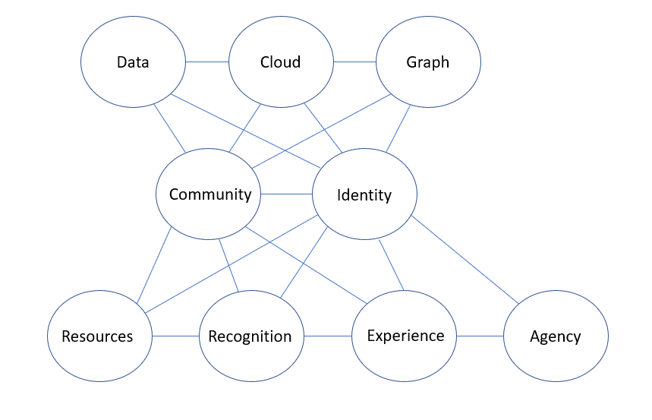
Ed3
Distributed Learning Technology
https://el30.mooc.ca/

Slide 25
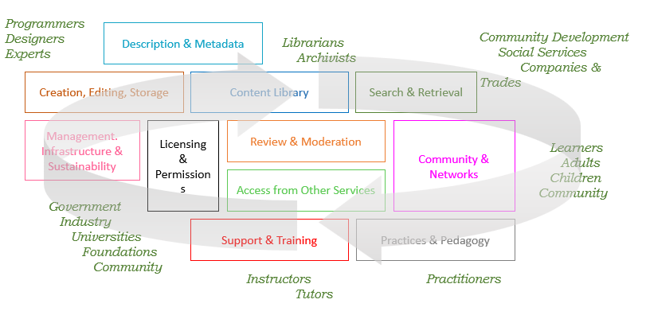
Supporting Open Learning Resources
https://www.downes.ca/presentation/559

Slide 26
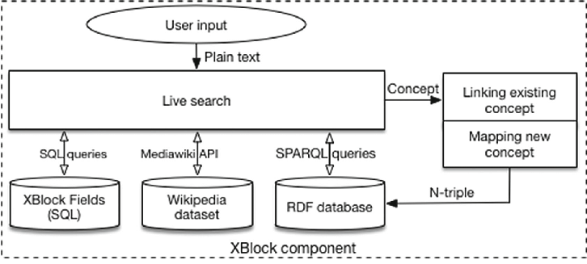
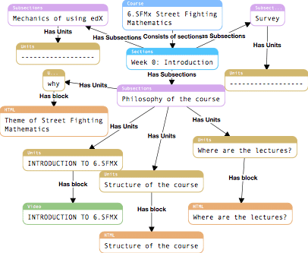
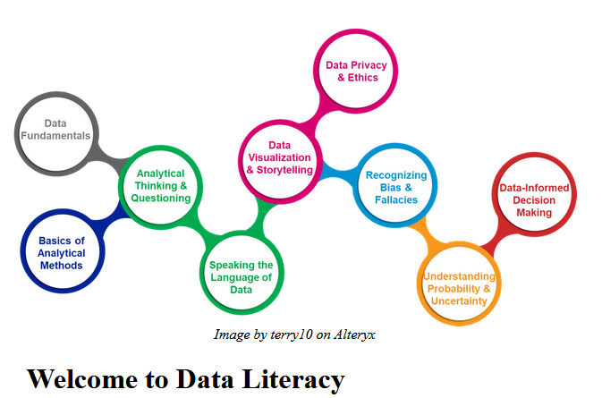
Data Based MOOC (dbMOOC)
Built around a cooperative database
Dmitry Mouromtsev, wt.al., 2016 https://www.researchgate.net/publication/312635085_Metadata_Extraction_from_Open_edX_Online_Courses_Using_Dynamic_Mapping_of_NoSQL_Queries
Downes, 2022, Data Literacy MOOC https://data.mooc.ca
https://www.youtube.com/playlist?list=PLeBQHgzQN9x3Ro289GA7IPaJLdXwxXtLp

Slide 27
Live-Linked Data MOOC (ldMOOC)
Live linked data world-wide from federated scientific network becomes content for lbMOOC
FUN MOOC – Medical Entomology https://www.dailymotion.com/video/x6yh8mo

Slide 28
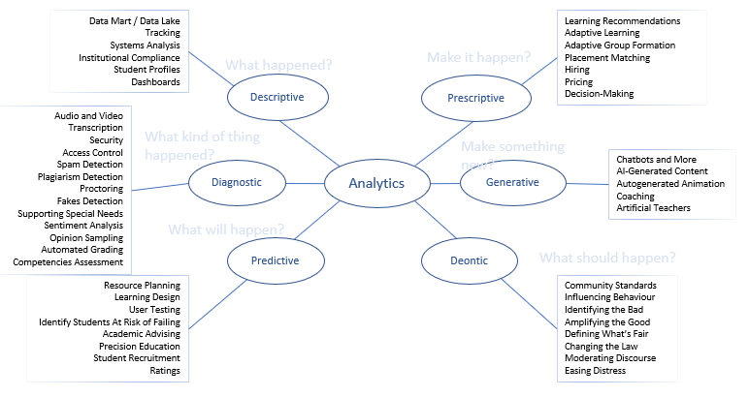
AI-Supported MOOC (aiMOOC)
Artificial Intelligence in e-learning,
https://ethics.mooc.ca/

Slide 29
Example
Artificial Intelligence (AI) for Earth Monitoring
“massive amounts of Earth observation data that are collected every day from space”
https://www.futurelearn.com/courses/artificial-intelligence-for-earth-monitoring

Slide 30
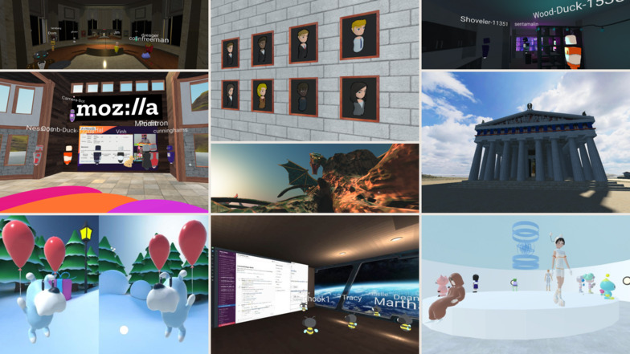
Massive Open Online Simulation (MOOS)
Creating a MOOC in the multiverse…
Astra, et.al., 2022 Massive Open Online Simulation (MOOS) of physics concepts microscopic for improving creative thinking https://www.researchgate.net/publication/350911228_Massive_Open_Online_Simulation_MOOS_of_physics_concepts_microscopic_for_improving_creative_thinking

Slide 31
Defining the Multiverse
VR (Virtual Reality) uses a headset or viewing device l
AR (Augmented Reality) uses a see-through viewing device
MR (Mixed Reality) is a merging of virtual and real environments
XR (eXtended Reality) is a term that refers to VR, AR and MR technologies in general.
The Metaverse includes all XR technologies and combines it with persistent digital objects

Slide 32
Thank You
https://www.downes.ca
Notes:
https://www.downes.ca

