Slide 1
Ethical Codes and Learning Analytics
ETHICAL CODES A
Stephen Downes
National Research Council Canada
June 22, 2020

Slide 2
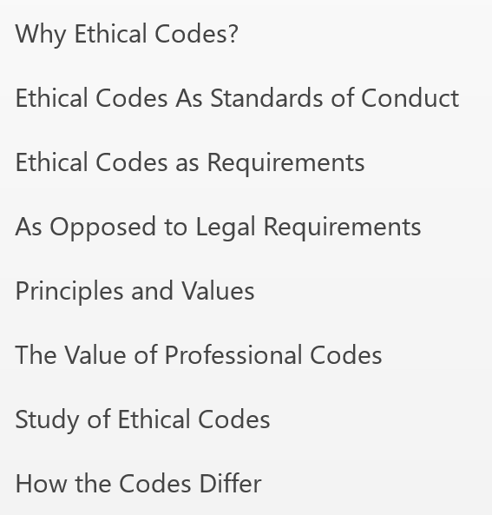
Standards of Conduct
Stand
OF c

Slide 3
The Codes
Professional ethics – broad-based ethical codes (4)
Academic ethics – codes of conduct for professors and staff in traditional academic institutions (3)
Teacher ethics – codes governing teachers and the teaching profession (7)
Ethics for librarians and information workers – ethics of information management (2)
Public service ethics – codes of conduct for government employees (2)
Research ethics – includes international declarations and government policy (6)
Health care ethics – including codes for doctors and nurses (6)
Ethics in social science research – research ethics (1)
Data ethics – government and industry declarations on the use of study and survey data (7)
Market research ethics – codes describing the ethical use of data in advertising and market studies (2)
Journalism ethics – codes of conduct governing the use of public information by journalists (3)
Ethics for IT professionals – system administration and software development ethics (3)
Data research ethics – related specifically to the use of data in research (1)
Ethics for artificial intelligence – government, industry and academic codes (15)
Information and privacy – principles specifically addressing individual rights (1)
Ethics in educational research – policies governing educational researchers specifically (3)
Ethics in learning analytics – government, academic and industry guidelines and codes (7)
The Codes Codes

Slide 4
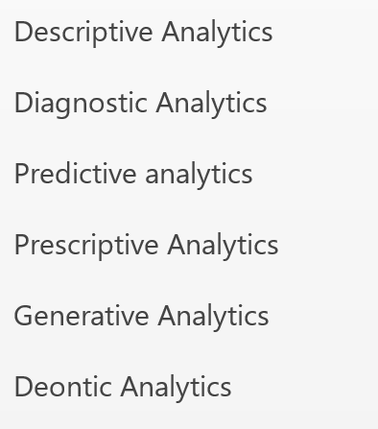
Applications of Learning Analytics
ApplicAT
Of Learn
Analytic

Slide 5
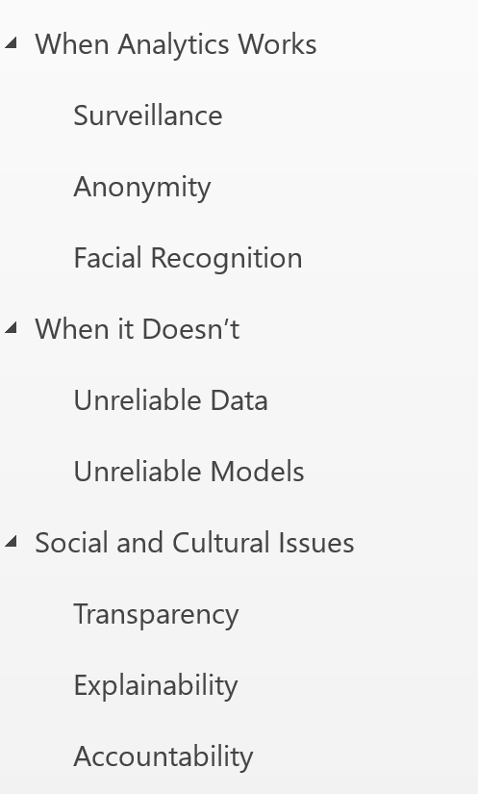
Ethical Issues in Learning Analytics
Ethical I
In Learn
Analytic

Slide 6
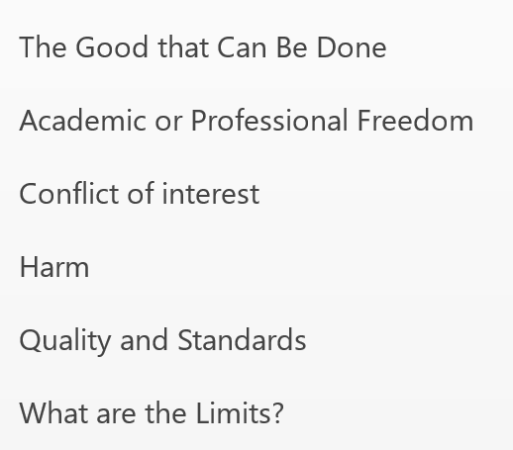
Focus on Ethical Issues
Focus on
Ethical i

Slide 7
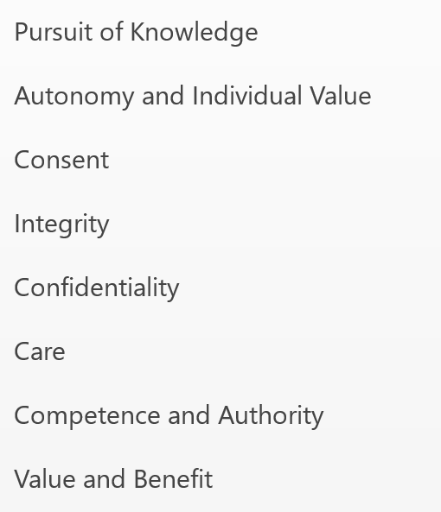
Core Values and Priorities (1)
Core
And

Slide 8
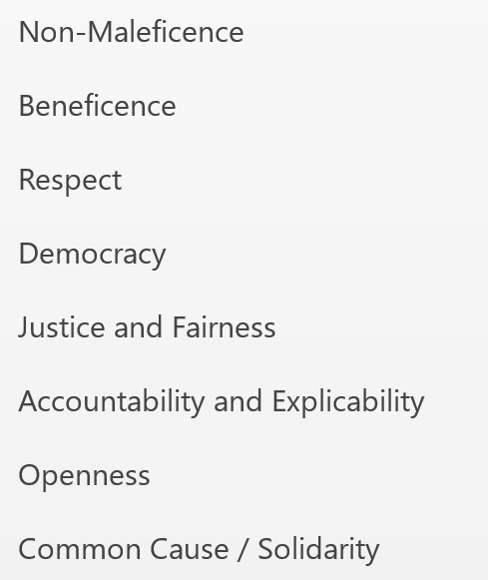
Core Values and Priorities (2)
Core vaL
And priO

Slide 9
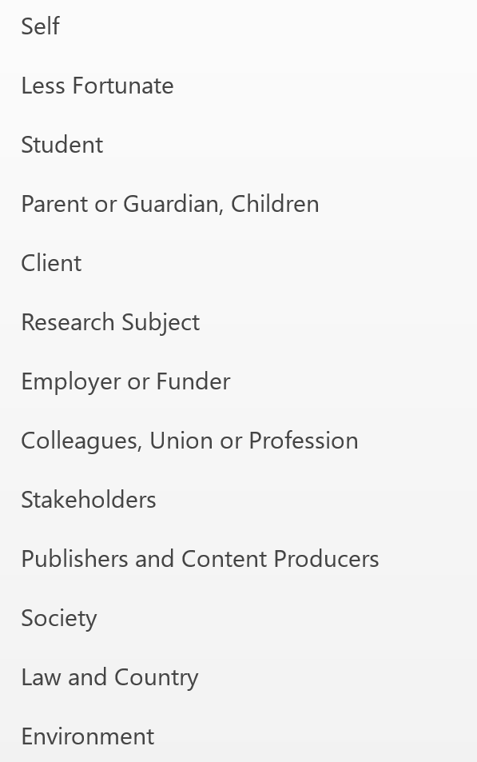
Obligations and Duties
Obligatio
And duti

Slide 10
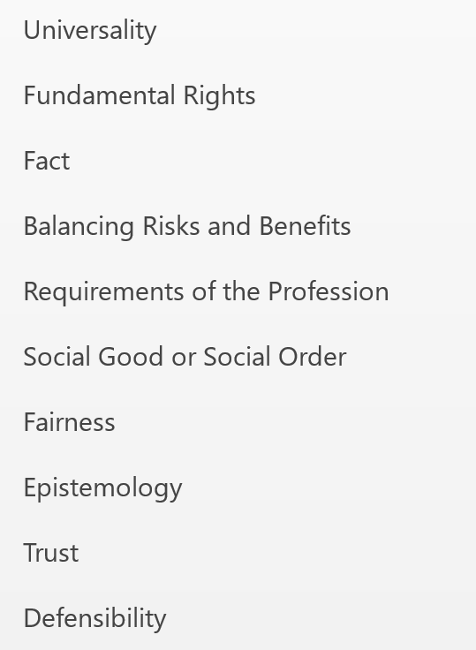
Bases for Values and Principles
Bases
Values
Princi

Slide 11
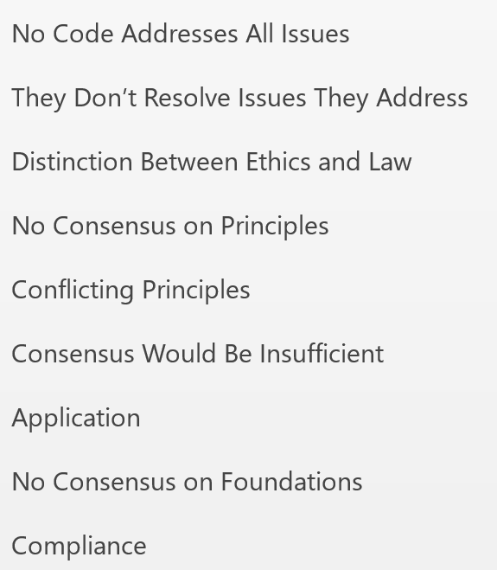
Conclusions of the Study
Conclusi
Of the st

Slide 12
Stephen Downes
Stephen Downes
https://www.downes.ca

