Slide 1
Personal Learning: Taking Ownership of Learning Online – Part 4
Stephen Downes
October 10, 2020
https://www.downes.ca/presentation/531

Slide 2
Takeaways for this Webinar
In this webinar, you learn:
The difference between ‘personalized learning’ and ‘personal learning’.
Why personal learning is the preferred concept for student success.
Key starting points for personal learning, objectives, learning processes and forms of evaluation that best suit personal learning.
Strategies to implement personal learning in the form of support for remote teaching, online learning, and lifelong learning.
Silhouette Images via Gordon Johnson https://pixabay.com/users/gdj-1086657

Slide 3
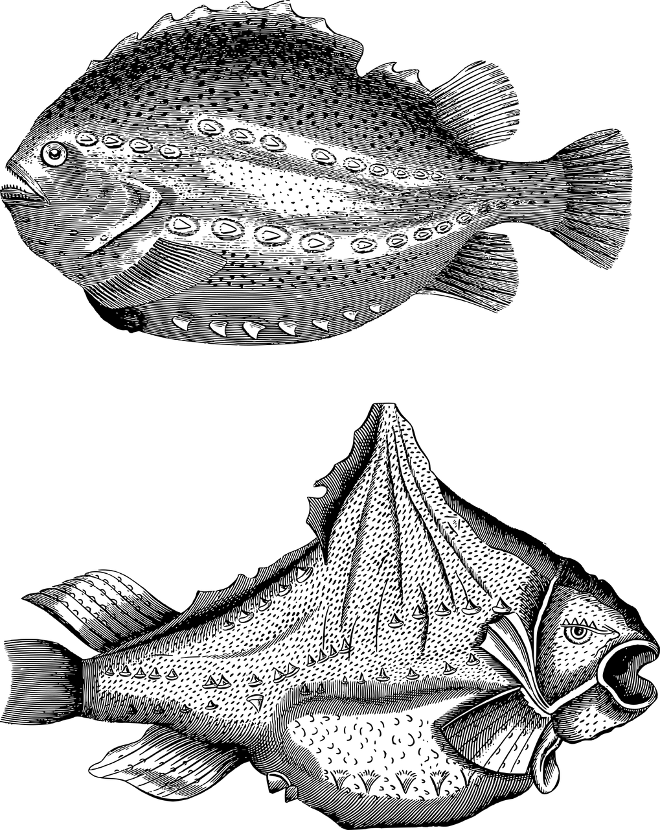
Topics for Discussion - Practical
Part One: Relevance and Usability
Starting points
Supporting them when they’re not supported
https://www.downes.ca/presentation/525
Part Two: Interactivity
Starting points
Supporting them when they’re not supported
https://www.downes.ca/presentation/528

Slide 4
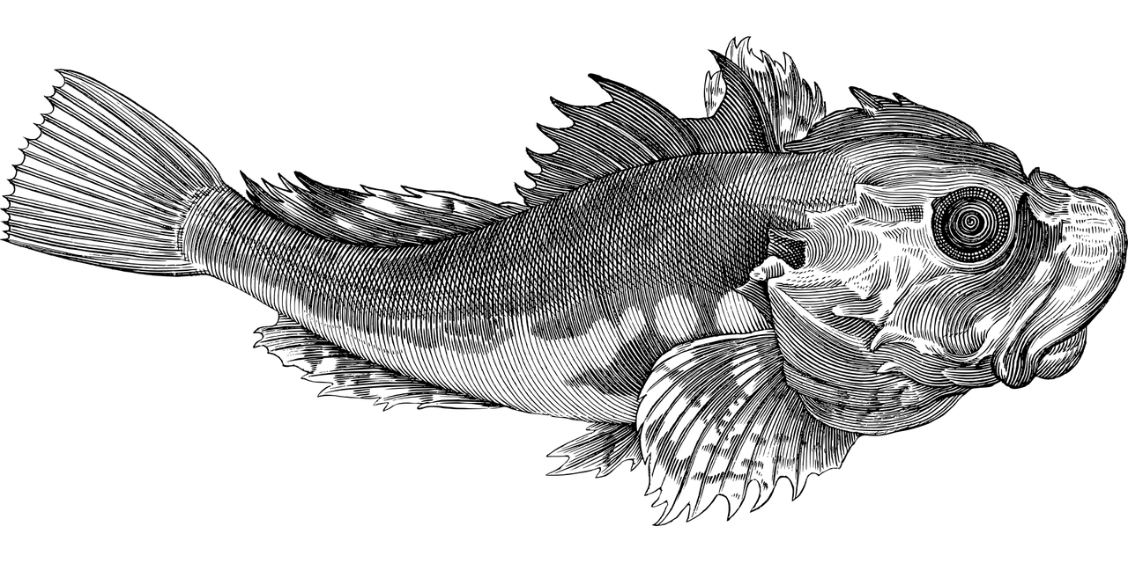
Topics for Discussion - Theory
Part Three: Personal Learning
What is personal learning?
Elements of personal learning
https://www.downes.ca/presentation/530
Part Four: Supporting Personal Learning
Personal learning starting points
Supporting personal learning online
https://www.downes.ca/presentation/531

Slide 5
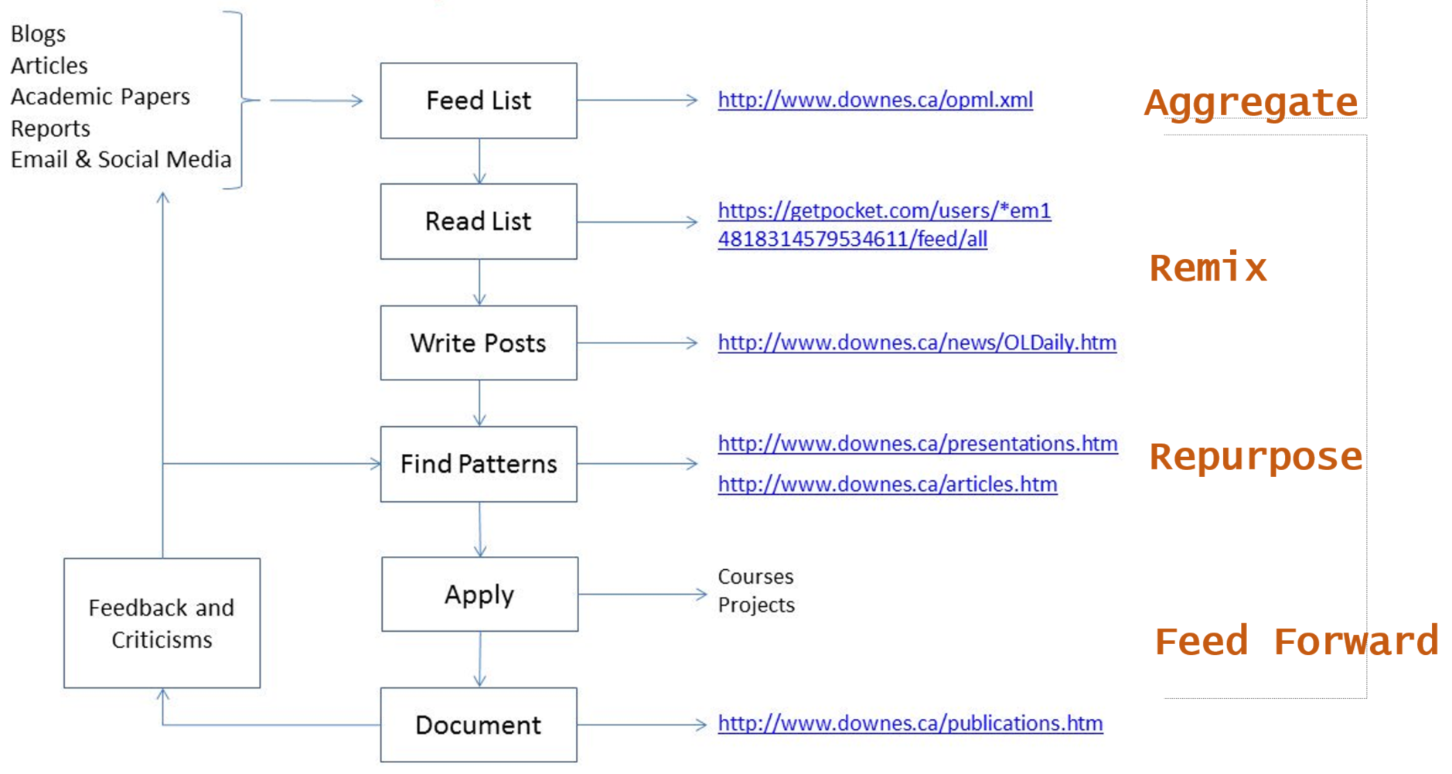
My Research Workflow

Slide 6
Personal Learning Starting Points

Slide 7
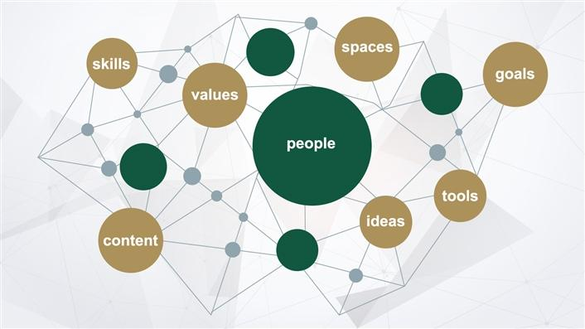
Self-Directed Learning
Students "will need to be self-directed in their learning. This includes making sound judgements about how much they know compared to how much they need to know, how they are progressing towards completing quality work and whether or not they need to shift strategies."
Digital learning environments, the science of learning and the relationship between the teacher and the learner. Jason M Lodge, Gregor Kennedy, L. Lockyer. https://www.downes.ca/files/TandS_Relationship_SoL_Preprint.pdf

Slide 8
Items to Consider
Learning objectives
Learning processes
Forms of evaluation that best suit personal learning
Image by Gordon Johnson

Slide 9
Learning Objectives
"The oft-repeated assumption that children would have to face an uncertain job market and a fast-changing world a few years from now is already amidst us," write the authors. "Today we are rightly being forced to prioritize well-being over economic growth, for ourselves and the planet."
What if Kindness Is the New Normal? A Call to Re-Imagine the Purpose of Education in the Post-COVID World. Vishal Talreja, Sucheta Bhat, Qatar Foundation. https://www.wise-qatar.org/what-if-kindness-is-the-new-normal-a-call-to-re-imagine-the-purpose-of-education-in-the-post-covid-world/

Slide 10
Objectives for Learners
How to BUILD AWARENESS (e.g. of contexts and environments, cultures, needs, change, circumstance)
How to BUILD KNOWLEDGE (e.g. of sciences and technologies, formalization, models, algorithms, etc)
How to BUILD CHARACTER (e.g. purpose and value, ethics and emotional intelligence)
How to BUILD JUDGMENT (e.g. recognizing and countering deception, inference and explanation)
How to BUILD RESILIENCE (e.g. global challenges and their impacts, sustainable development, stewardship)
How to BUILD SOCIETY (e.g. develop consensus, collaborate and cooperate, responsible citizenship)
Notes:
International Science Council - https://council.science/call-for-nominations-covidea/

Slide 11
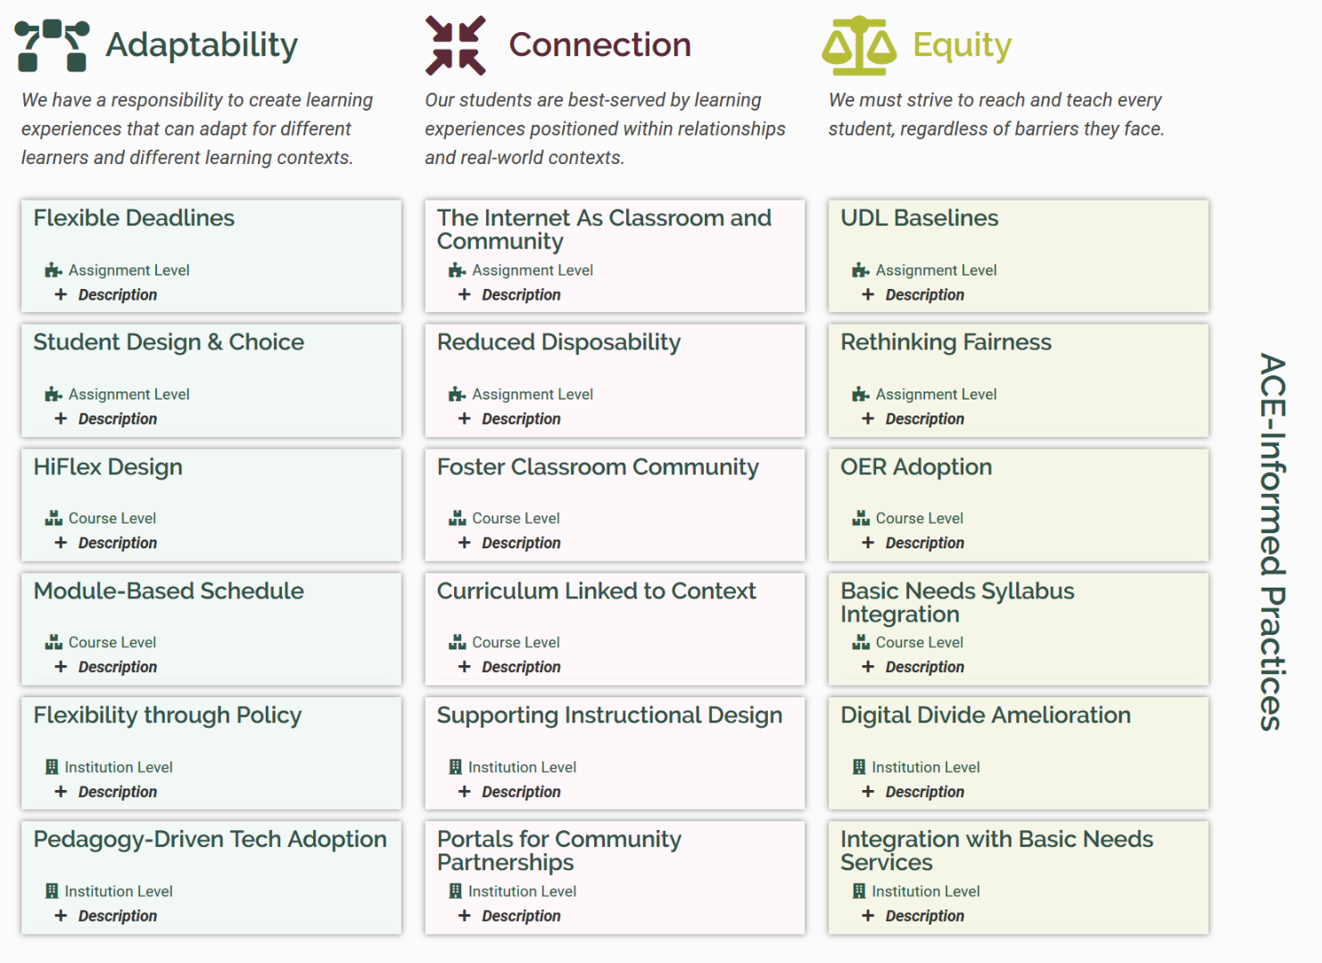
Objectives for Institutions
ACE
ACE Framework. Robin DeRosa, Plymouth State University. https://colab.plymouthcreate.net/ace/

Slide 12
Learning Processes
Learning when the learner is ready
Requires the learner to move beyond knowledge and
Learner does not depend solely on the teacher
Learning is focused on the student not on a syllabus
The principles of heutagogy as outlined in Hase and Kenyon (2013)
Image: Eachempati , et.al. Heutagogy through Facebook for the Millennial learners
https://www.mededpublish.org/manuscripts/1268

Slide 13
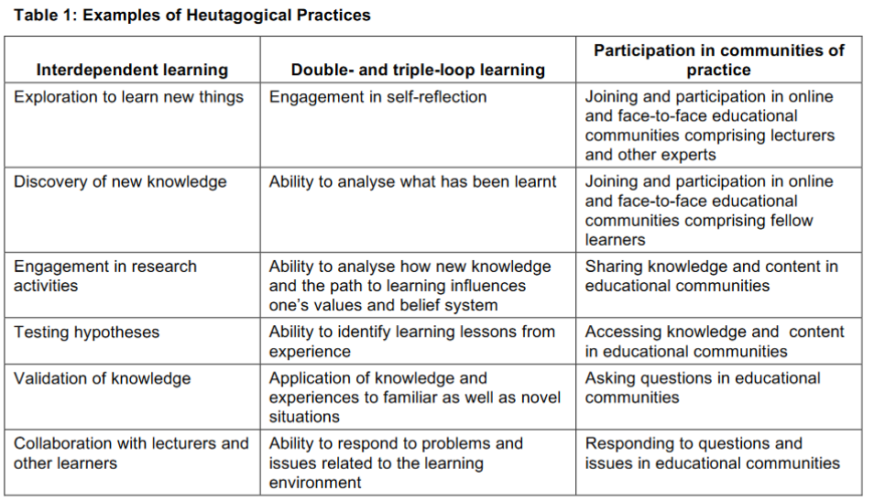
Learning Processes
Of these, only the third is employed to any significant degree. Andrew Chimpololo concludes, "training institutions need to create a conducive environment where learners are provided the freedom to define their own learning paths and determine individual learning styles."
An Analysis of Heutagogical Practices through Mobile Device Usage in a Teacher Training Programme in Malawi
Andrew Chimpololo, Journal of Learning for Development, https://jl4d.org/index.php/ejl4d/article/view/391/485

Slide 14
Learning in Context
Active learning
Problem-based learning
Case studies
Work-integrated learning
Design and creation
Learning Supports
Coaching and encouragement
Methods, tools and models
Access to learning resources
Connection to community
The effect of authentic project‐based learning on attitudes and career aspirations in STEM. Margaret E. Beier, et.al. https://doi.org/10.1002/tea.21465

Slide 15
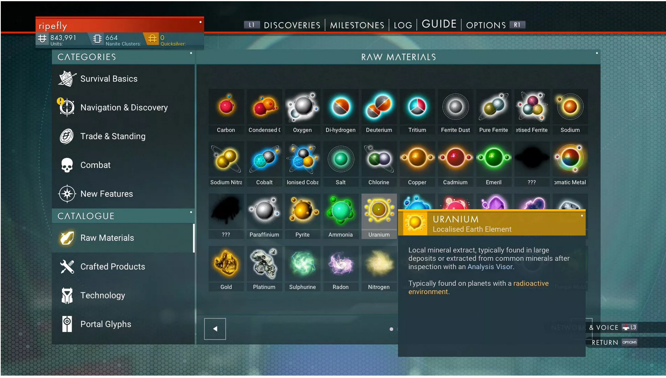
Learning in Context
https://www.nomanssky.com/

Slide 16
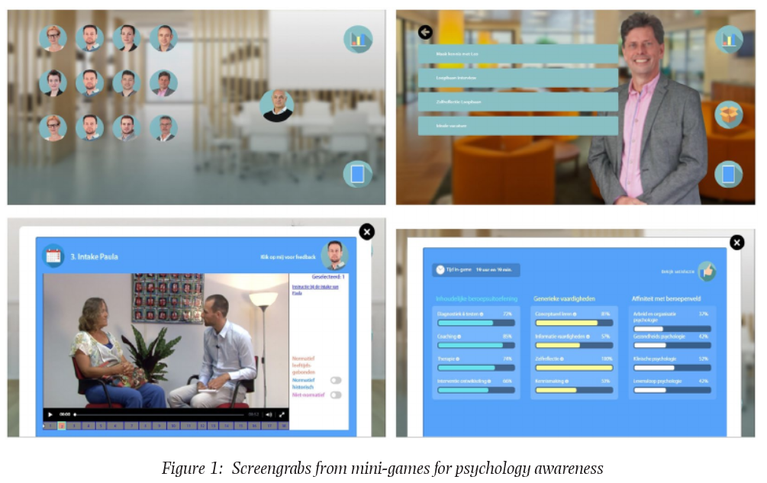
Gaming and Simulations
Serious game in introductory psychology for professional awareness: Optimal learner control and authenticity. Hans Hummel, BERA Blog. https://www.bera.ac.uk/blog/the-thin-line-between-gaming-and-learning

Slide 17
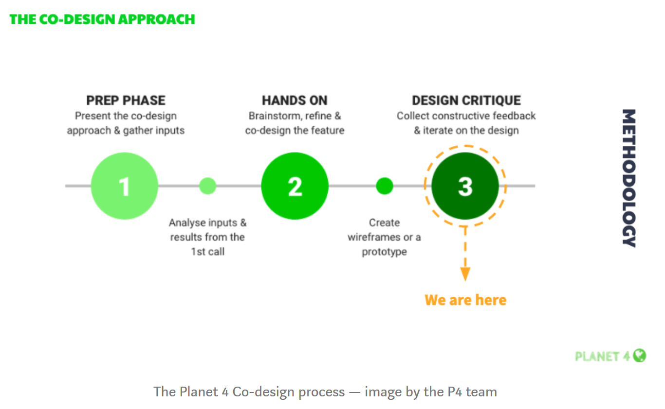
Supporting Agency
CMSI executive director, Caty Borum Chattoo joins host Rev. Lennox Yearwood Jr., President & Founder of Hip Hop Caucus,. https://mailchi.mp/american/july-2020?e=6eb0d07479
Co-design of the “Challenges”: the design critique. Magali Fatome. https://medium.com/planet4/co-design-of-the-challenges-the-design-critique-a096b46b3e13

Slide 18
Networks in Learning
The major value proposition offered by top tier universities isn't knowledge. This is available anywhere.
Nor is it even top-flight professors. Great teachers and researchers can be found in institutions large and small around the world.
No, the value proposition is access to the network of contacts, influencers, and collaborators. Access to networks matters, and it's this gap that isn't addressed in education reform programs ignore, to the detriment of participants.

Slide 19
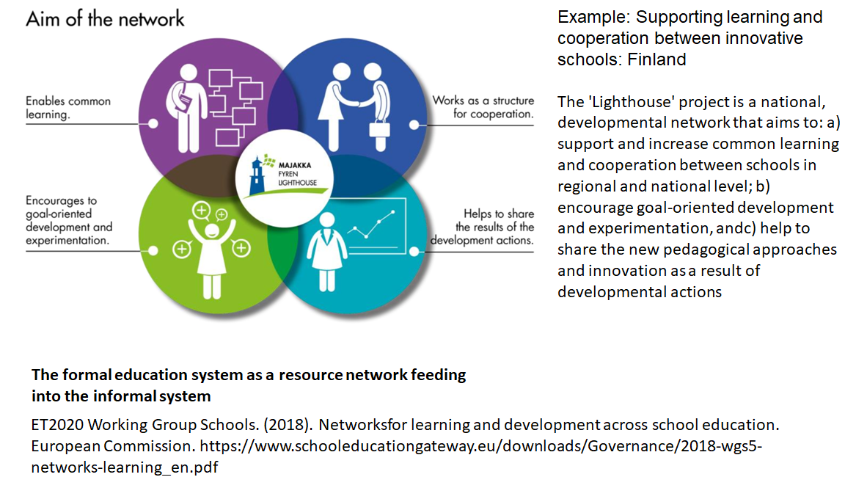
Networks in Learning

Slide 20
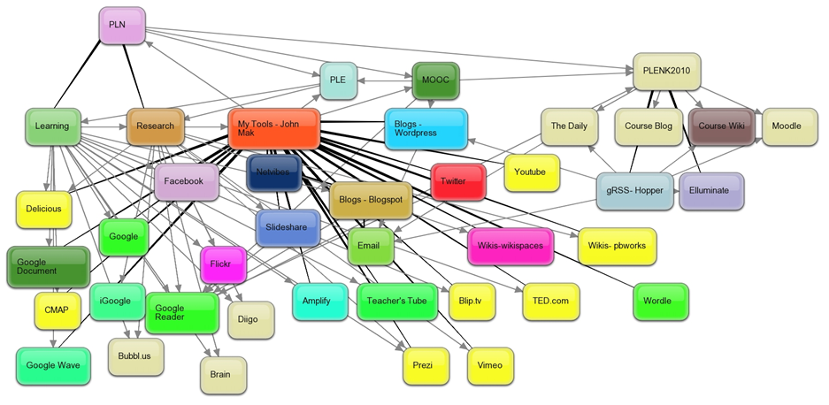
Personal Learning Environments
Martin Weller: "Open universities across the world have been operating large scale, open, equitable learning for decades." My response. I write, "the cost of educational labour is what makes it so expensive... (but) The connectivist approach is to do whatever can be done to help students perform this labour themselves." https://www.downes.ca/post/69410

Slide 21
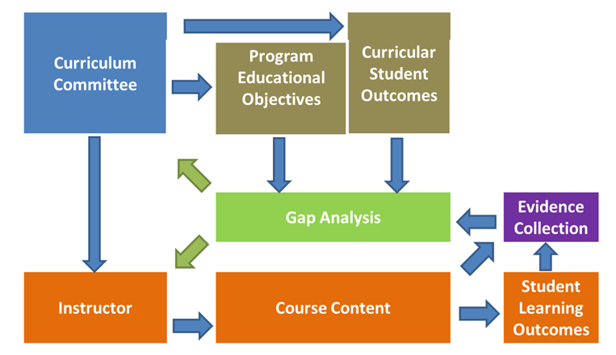
Evaluation and Assessment
Gap-Based Assessment - What You Know
Curtis, et.al. (2012). Development of evidence management and gap analysis tools for continuous improvement of engineering programs . American Society for Engineering Education. https://images.app.goo.gl/3XXtbRZ8KPxSHuRD8

Slide 22
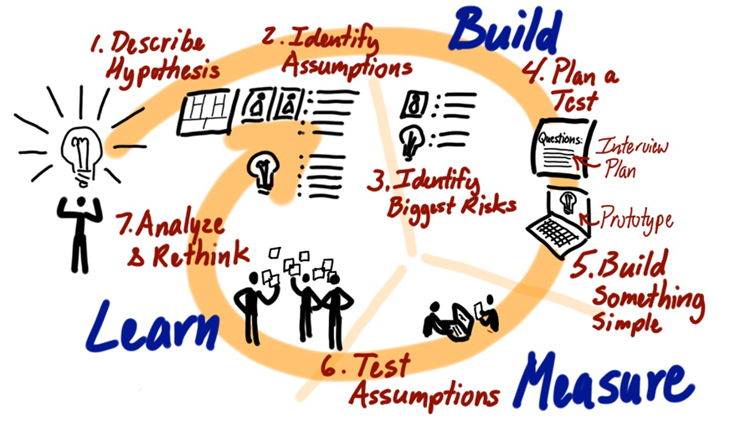
Evaluation and Assessment
Iterative Assessment - What You Can Do
Image: Jeff Patton. (2015). Common Agile Practice Isn’t for Startups. https://www.jpattonassociates.com/common-agile-isnt-for-startups/

Slide 23
Evaluation and Assessment
Assessing a physicist:
Do they know a certain body of information
vs
Do they see the world the way a physicists does?
Do they ask the same sorts of questions? Use words the same way?
Do they accept the same sort of evidence to change their beliefs?
Can they do thing physicists can do?
Have they actually done physics and shared the results?
Would other physicists recognize them as a physicist?

Slide 24
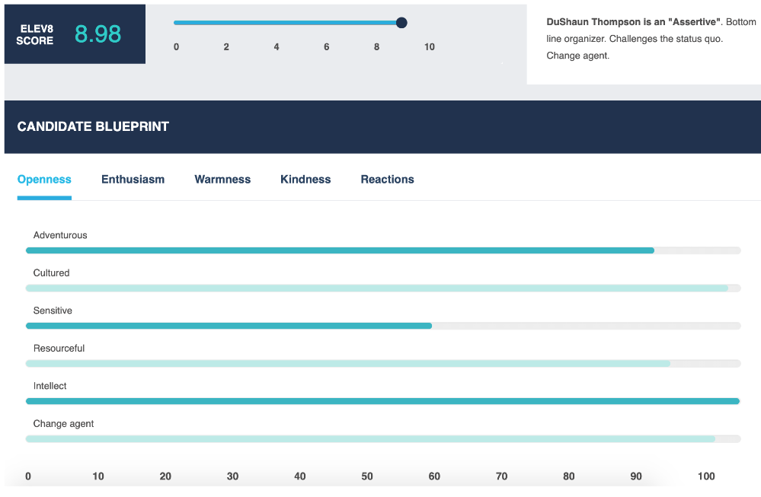
Algorithmic Assessment
Mitigating Bias in Algorithmic Hiring: Evaluating Claims and Practices
Manish Raghavan, Solon Barocas, Jon Kleinberg, Karen Levy, arXiv, Nov 23, 2019 https://arxiv.org/pdf/1906.09208.pdf

Slide 25
Supporting Personal Learning Online

Slide 26
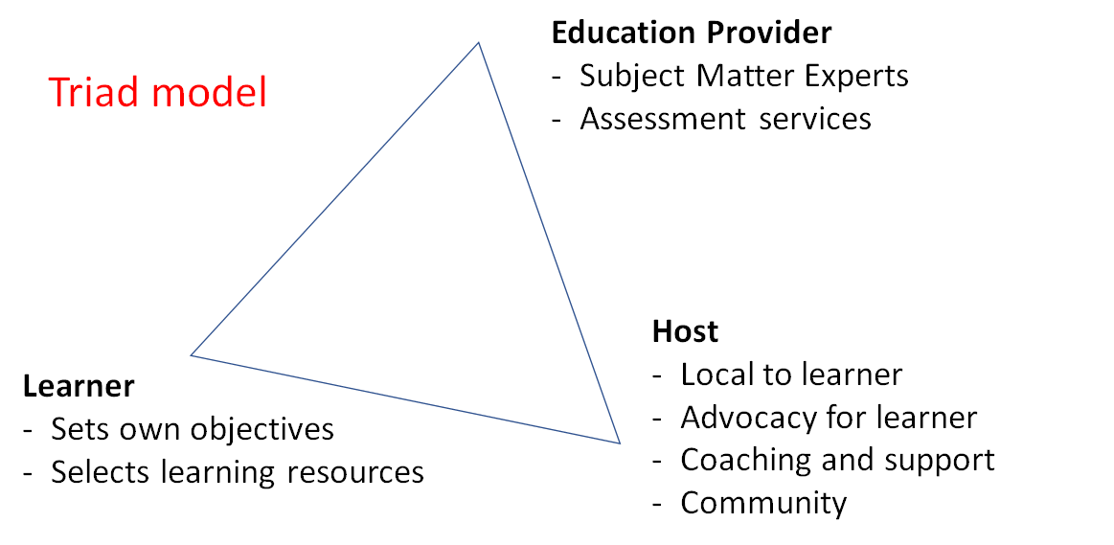
Online Host-Provider Framework

Slide 27
Online Host-Provider Framework

Slide 28
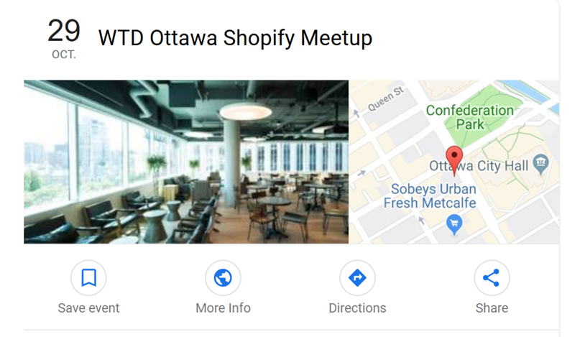
Online Host-Provider Framework
Community Learning Centres
Image: Google Events
https://www.google.com/search?client=firefox-b-d&q=shopify+ottawa+meetups&ibp=htl;events

Slide 29
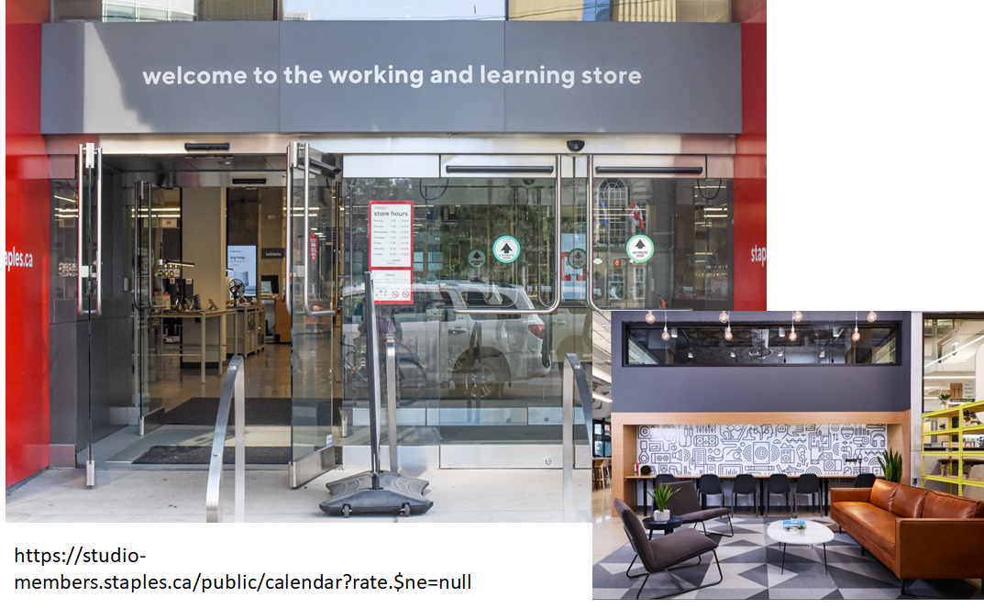
Online Host-Provider Framework

Slide 30
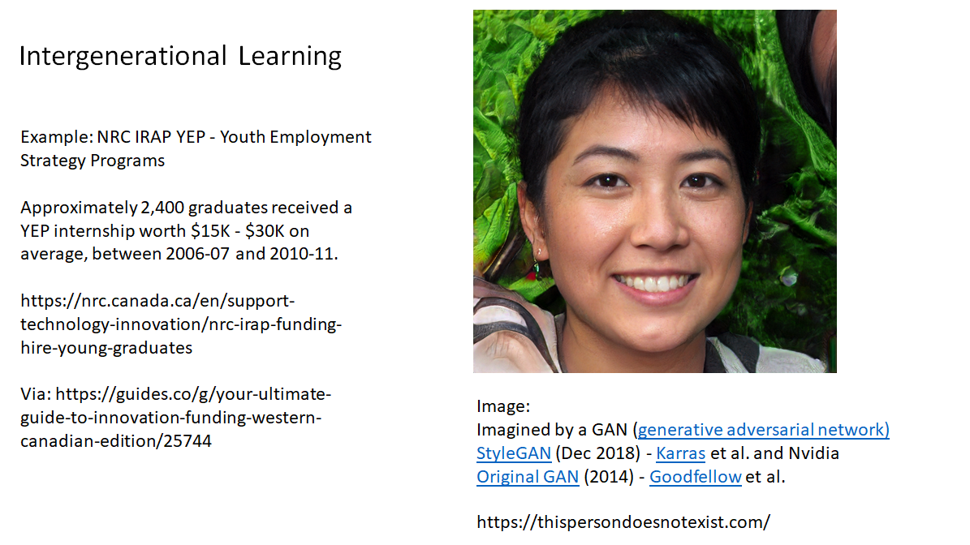
Education Providers...

Slide 31
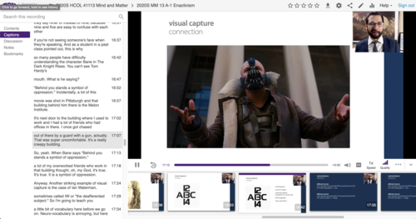
Education Providers...
Teaching from Home
Creating an Online Community, Class or Conference - Quick Tech Guide - http://bit.ly/quicktechguide

Slide 32
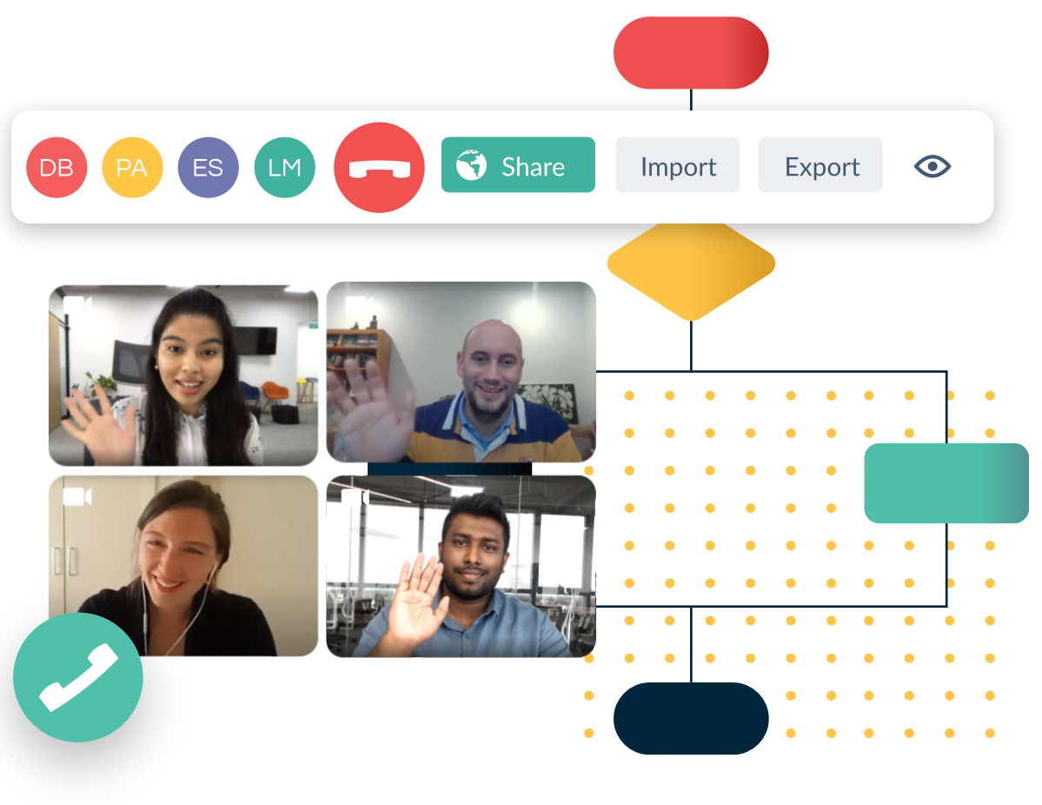
Education Providers...
Collaborative Tools
For example, Creately, a web-based tool that allows users to collaboratively create designs using a common interface.
https://creately.com/

Slide 33
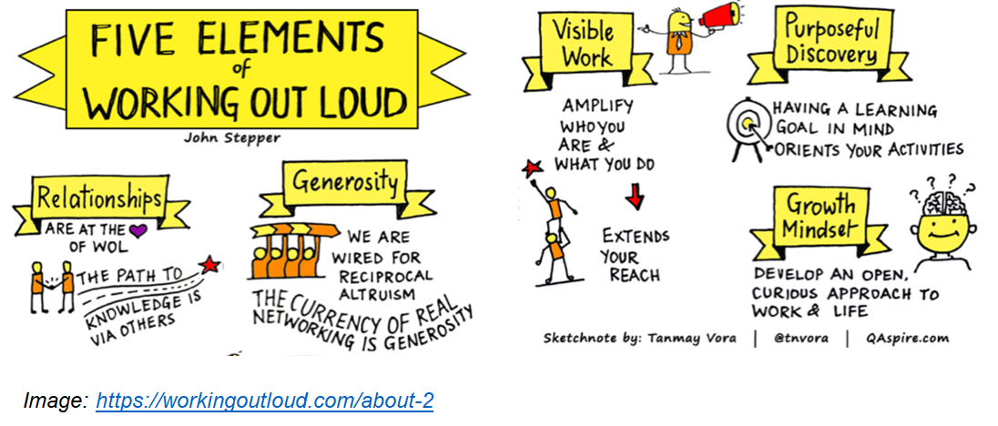
Education Providers...

Slide 34
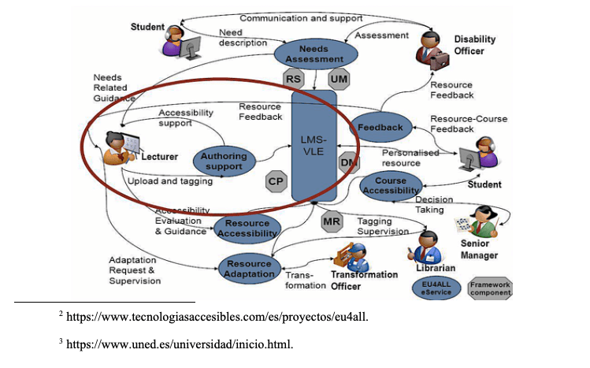
Education Providers...
OERs
Support for community in the development, discovery, use and sharing of open educational resources
Accessible Open Educational Resources and Librarian Involvement
Silvana Temesio, International Journal of Open Educational Resources. https://www.ijoer.org/accessible-open-educational-resources-and-librarian-involvement/

Slide 35
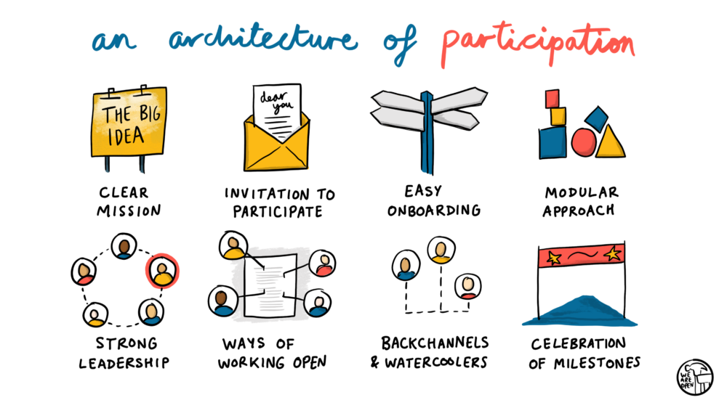
Education Providers...
Doug Belshaw - https://blog.weareopen.coop/howto-create-an-architecture-of-participation-for-your-open-source-project-a38386c69fa5

Slide 36
Stephen Downes
https://www.downes.ca

