Slide 1
Personal Learning: Taking Ownership of Learning Online – Part 3
Stephen Downes
September 28, 2020
Previously: https://www.downes.ca/presentation/525
This one: https://www.downes.ca/presentation/530

Slide 2
Takeaways for this Webinar
In this webinar, you learn:
The difference between ‘personalized learning’ and ‘personal learning’.
Why personal learning is the preferred concept for student success.
Key starting points for personal learning, objectives, learning processes and forms of evaluation that best suit personal learning.
Strategies to implement personal learning in the form of support for remote teaching, online learning, and lifelong learning.

Slide 3
Topics for Discussion - Practical
What are relevance, usability, interactivity?
Starting points
Supporting them when they’re not supported (a.k.a. Geurilla Tactics)
These slides will be available at: https://www.downes.ca/presentation/530
Silhouette Images via Gordon Johnson https://pixabay.com/users/gdj-1086657/

Slide 4
Topics for Discussion - Theory
What is personal learning?
Personal learning starting points
Supporting personal learning online
These slides will be available at: https://www.downes.ca/presentation/530
Silhouette Images via Gordon Johnson https://pixabay.com/users/gdj-1086657/

Slide 5
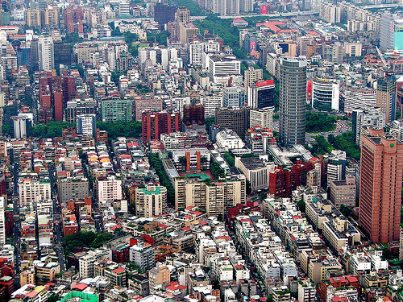
What I’m Really Saying Here…
You are at the centre of your own personal learning network

Slide 6
What I’m Really Saying Here…
To gain from self-directed learning you must be self-directed

Slide 7
What I’m Really Saying Here…
These principles should guide how we teach as well as how we learn

Slide 8
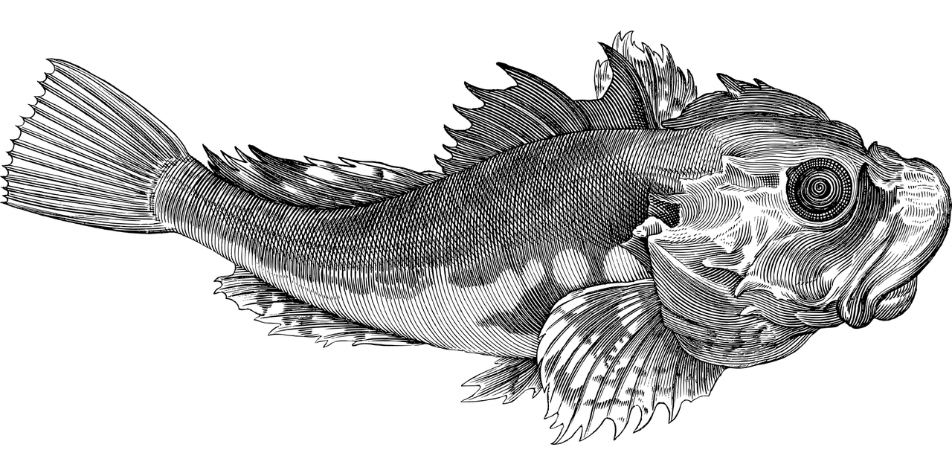
What Is Personal Learning?

Slide 9
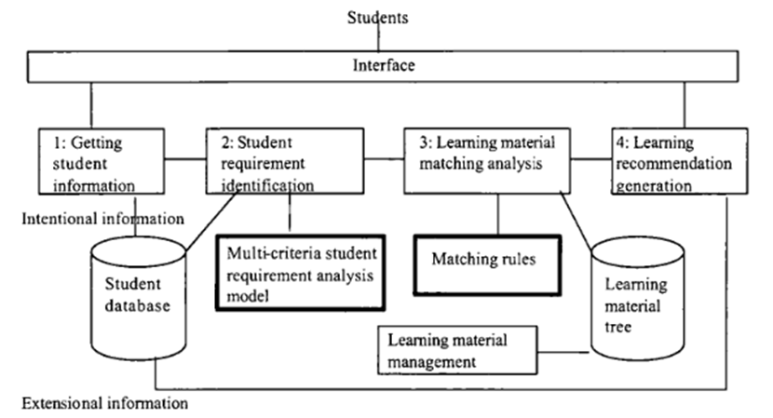
Personalized Learning
Image: Jie Lu, 2004. Framework for personalized learning recommender system. P. 376

Slide 10
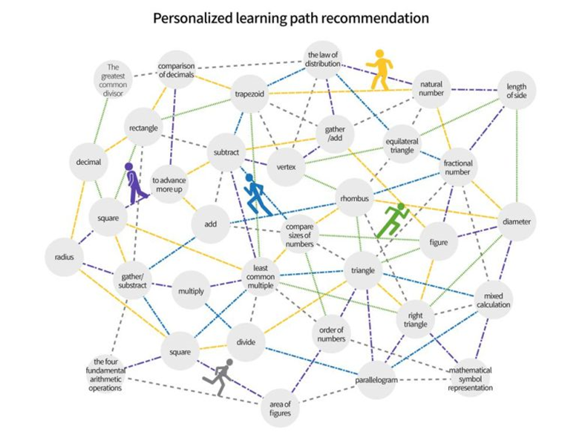
Learning Path Recommendation
Image: Bitnine Global, Inc. (2019). Personalized learning path recommendation.

Slide 11
Criticisms of Personalized Learning
Personalized learning is ineffective
Recommendations just aren’t very good
It’s isolating and depersonalizing
Personalized learning systems depend on surveillance and violates personal privacy

Slide 12
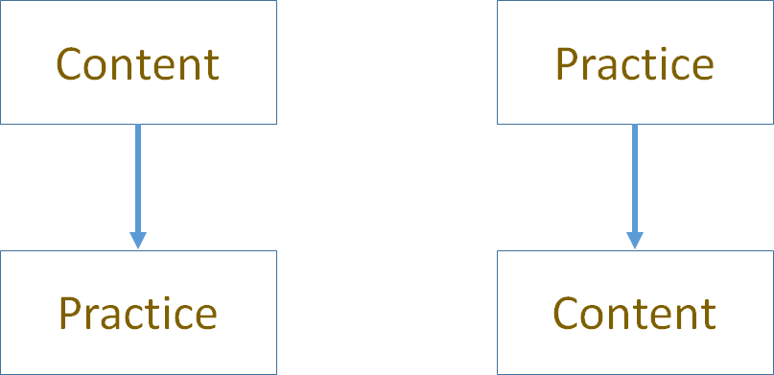
Two Approaches

Slide 13
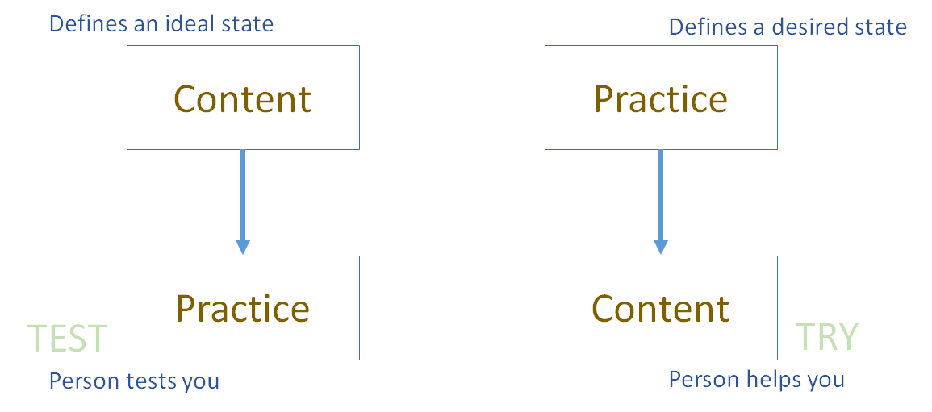
Two Approaches

Slide 14
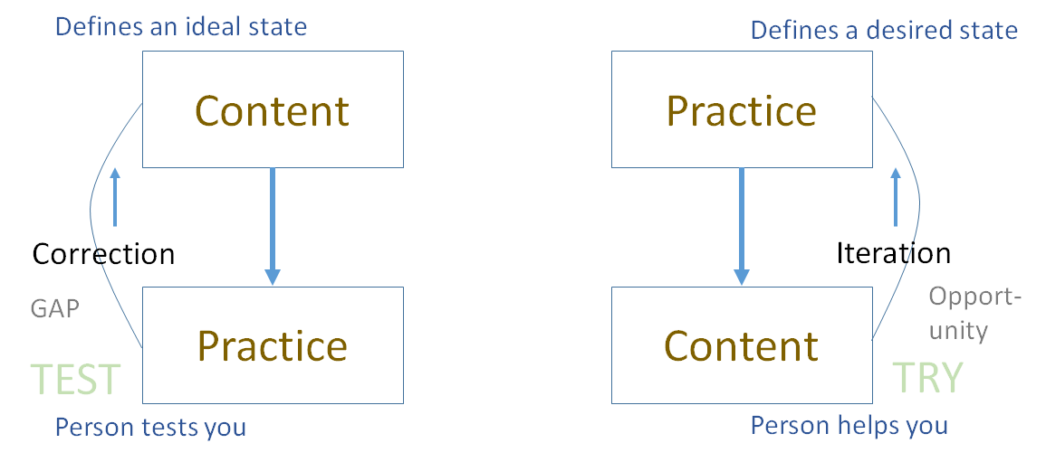
Two Approaches

Slide 15
Library Environment

Slide 16
Personalized Personal
We do for you (you consume) You do for yourself (we help)

Slide 17
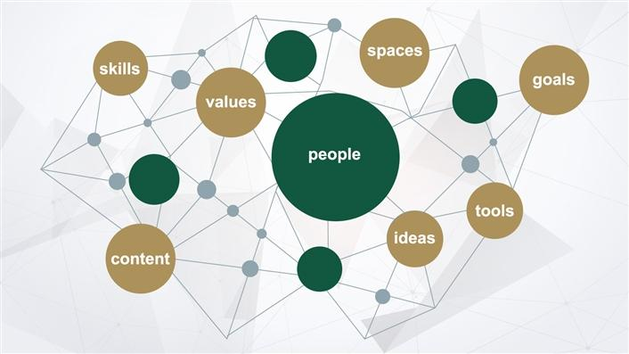
Self-Directed Learning
Students "will need to be self-directed in their learning. This includes making sound judgements about how much they know compared to how much they need to know, how they are progressing towards completing quality work and whether or not they need to shift strategies."
Digital learning environments, the science of learning and the relationship between the teacher and the learner. Jason M Lodge, Gregor Kennedy, L. Lockyer. https://www.downes.ca/files/TandS_Relationship_SoL_Preprint.pdf

Slide 18
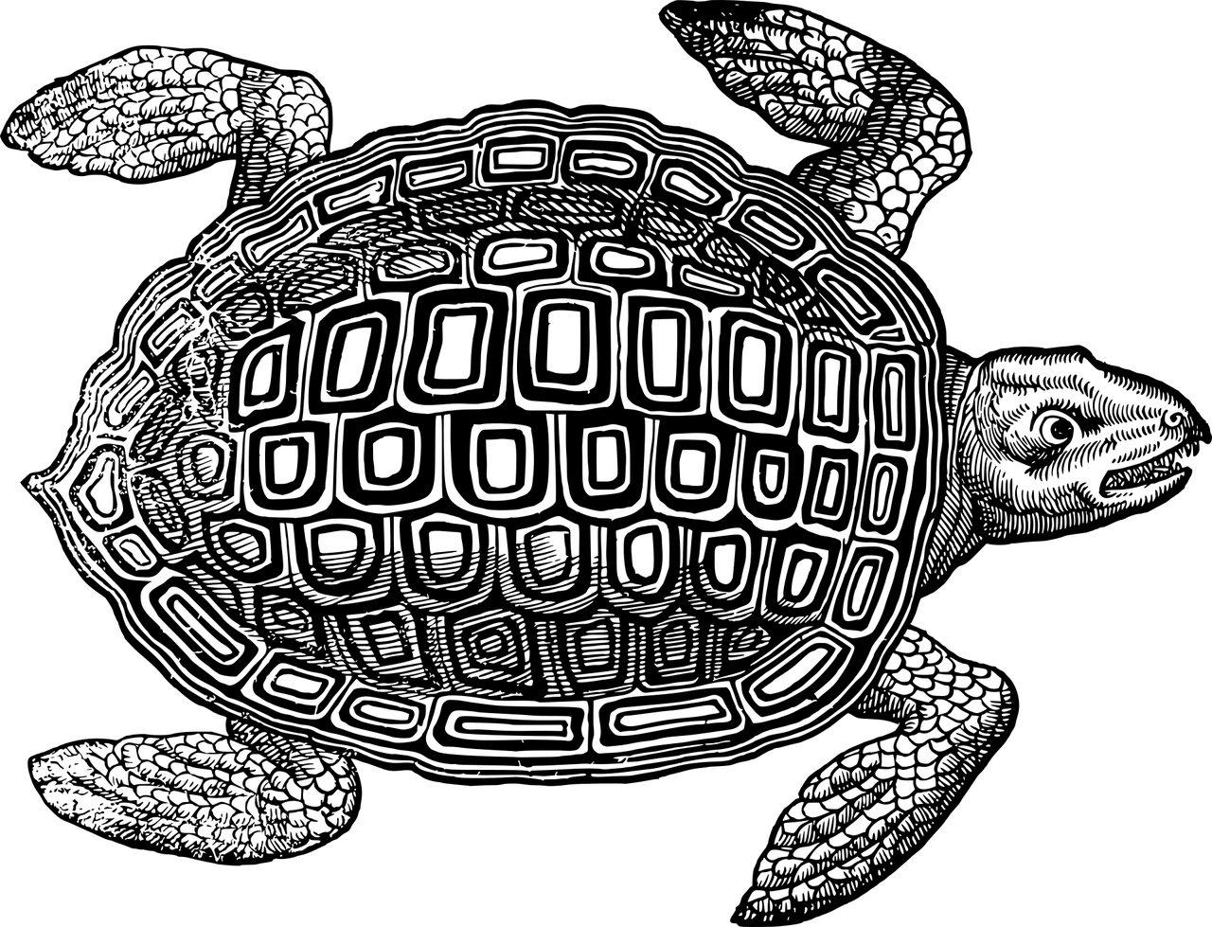
Personal Learning Starting Points

Slide 19
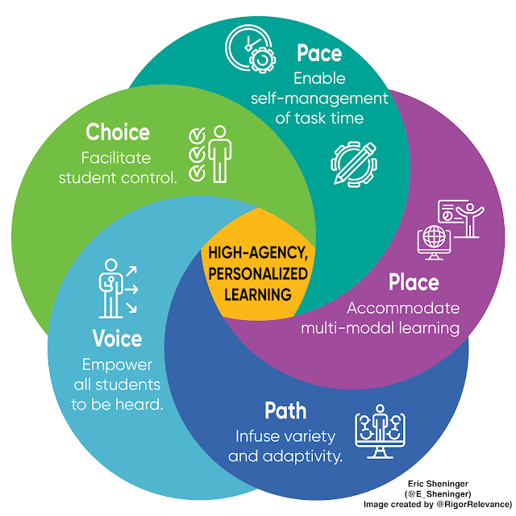
Elements of Personal Learning
High-Agency in the Remote and Hybrid Classroom
Eric Sheninger, A Principal's Reflections
https://esheninger.blogspot.com/2020/09/high-agency-in-remote-and-hybrid.html

Slide 20
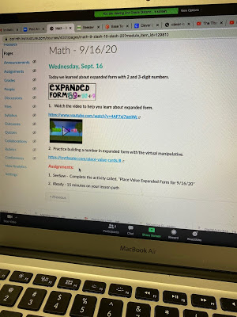
Voice
Anonymity
breakout rooms
digital tools
reviews of prior learning
checks for understanding
closure activities

Slide 21
Choice

Slide 22
Path

Slide 23
Pace

Slide 24
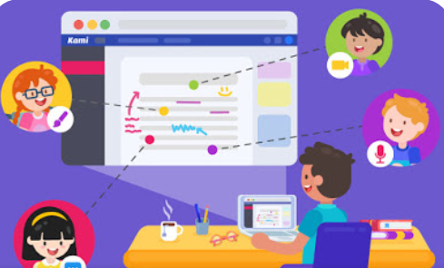
Place

Slide 25
Stephen Downes
https://www.downes.ca

