Slide 1
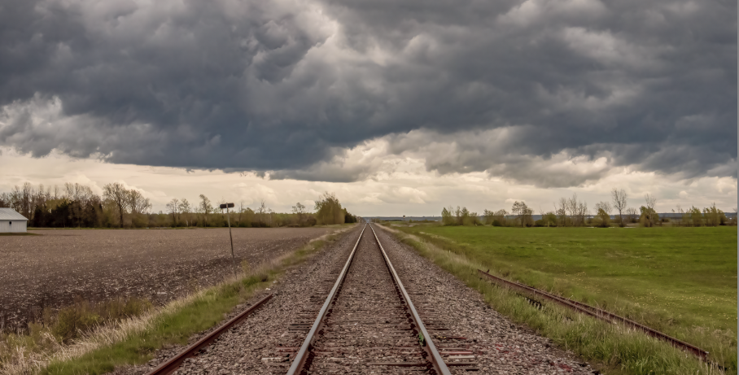
Sharing and collaborating our way out of the storm
Stephen Downes
National Research Council Canada
May 10, 2021

Slide 2
Any change will be hard at first.
It’s hard to jump right into remote learning. It takes time to get comfortable with new technology and new ways of doing things. And it will be hard to jump back into the new classroom environment. So we can’t directly compare the new thing with the old thing. We need to give ourselves some time to get used to it and for people to get good at it.

Slide 3
Sharing

Slide 4
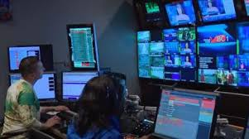
Open media plays a key role
It’s not simply about saving money. We can’t learn – we can’t even communicate – without open media. We need an alphabet, we need words, we need data – and these need to be available for any of us to use without worrying about who owns it or how much it costs. That’s why we needed Zoom, and that’s why open textbooks became so essential.

Slide 5
Learning is Social
Of course, we knew that already, but being apart underlined the idea that some of the important outcomes of learning are social. Like wearing masks and social distancing and beating the pandemic. We don’t just learn as individuals, we learn as a community. Learning isn’t just about remembering stuff, it’s about how we exchange ideas, conduct trade, and develop community networks with each other.

Slide 6
Collaboration

Slide 7
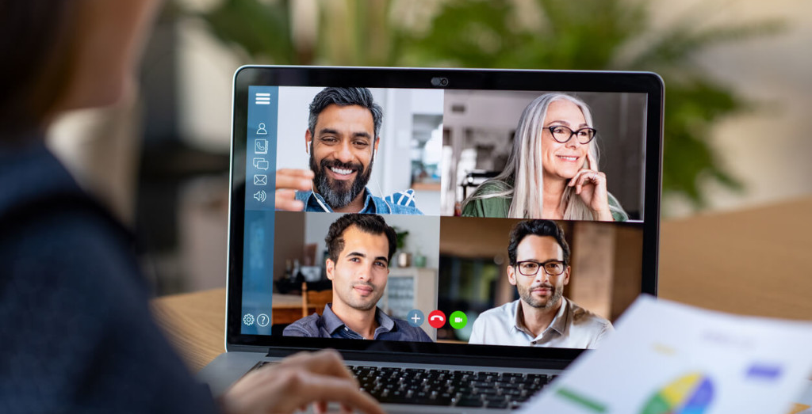
We Like Live Events
Sure, not everything needs to be live – there’s a lot we can get from videos and simulations and other content. But live events draw us in and challenge us. When we don’t know what’s going to happen, we are engaged in planning and anticipation. And live events have us interacting, even if indirectly with the people in the scene. It’s what we call ‘presence’.

Slide 8
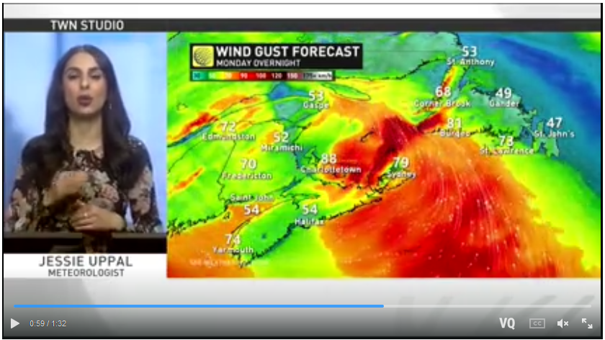
It Takes a Community
We already know teachers need buildings and facilities and support staff and computer networks and the rest. But now that they are working with advanced technology in both digital and in-person environments, they need to be constantly developing their skills, and they need a team supporting them. It’s like when we watch the news on television: we may see only the presenters on the screen, but we know there’s a team of people supporting them.

Slide 9
Sharing + Collaboration = Open Community

Slide 10
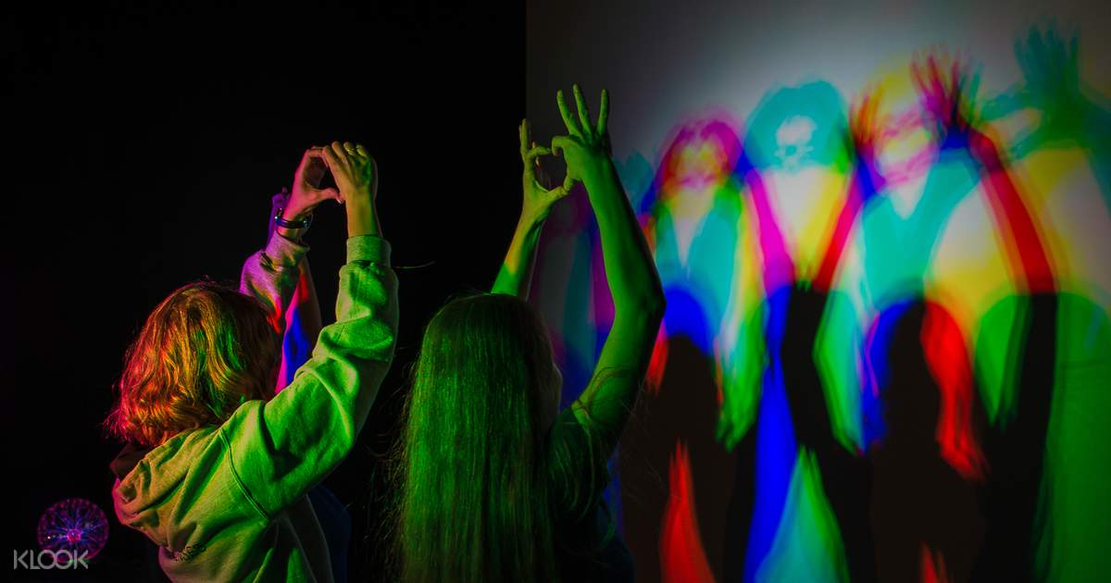
People have diverse needs.
They come from different cultures, speak different languages, and have different abilities. Before the pandemic we designed for the mainstream and hoped that the rest could adapt. But a lot of difficult issues surfaced as we tried to adapt, and we had to address built-in or systemic discrimination. We have to get past the idea that some people are ‘special needs’ and to adopt the attitude that everyone has special needs.

Slide 11
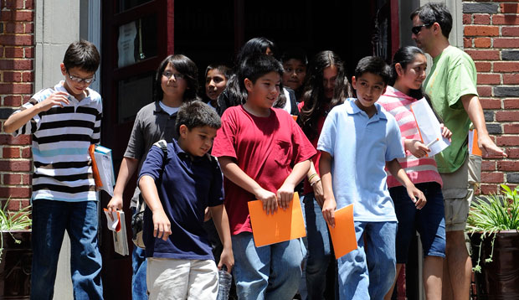
Inequities harm learning.
In many ways, coming together to learn at school mitigated some of the worst impacts of poverty and disability, because we could all access books, teachers and time to study at school. A lot of people depend on school for internet access and a good meal. A lot of this support disappeared when we went online. People in need just vanished. We need to solve this problem, and to keep solving it, even after the pandemic.

Slide 12
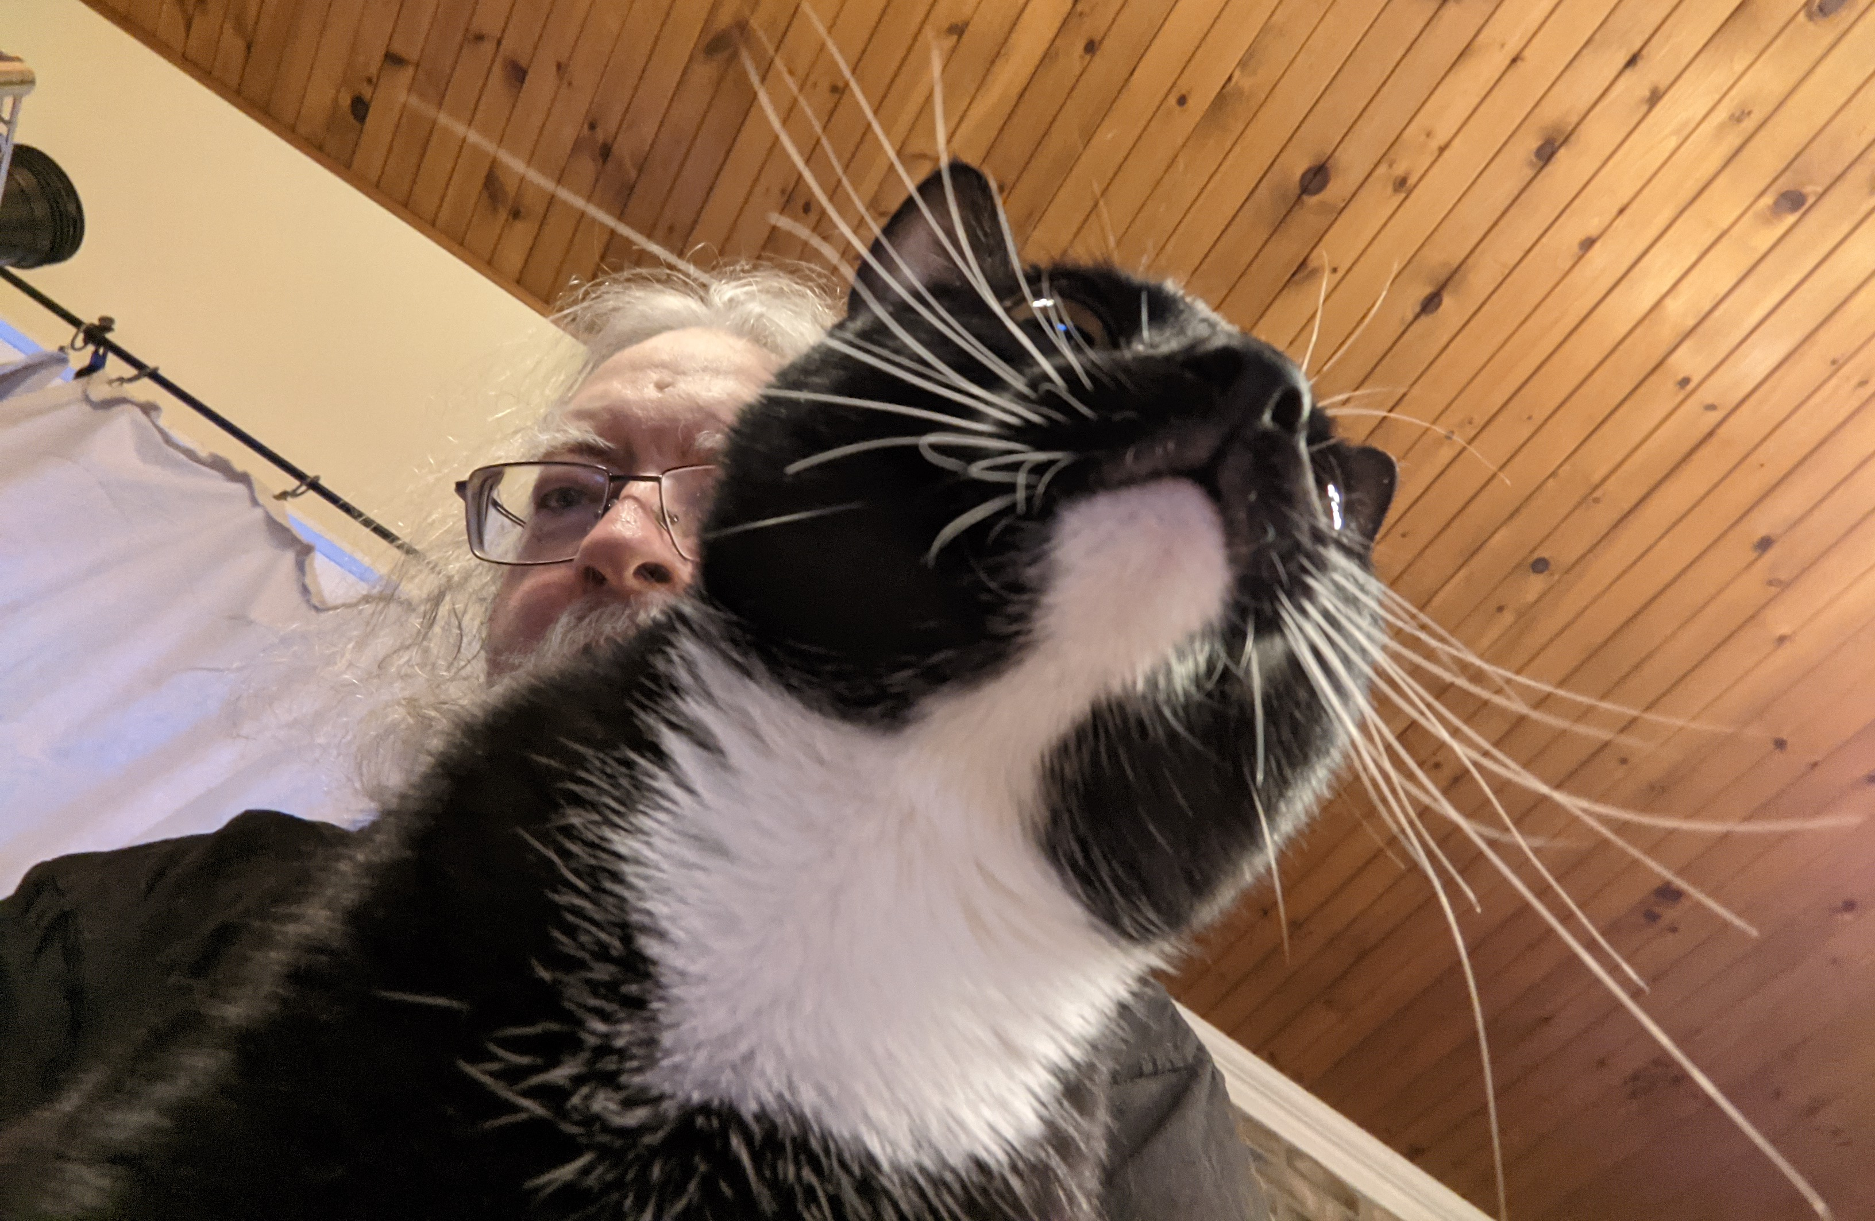
Stephen Downes https://www.downes.ca

