Slide 1
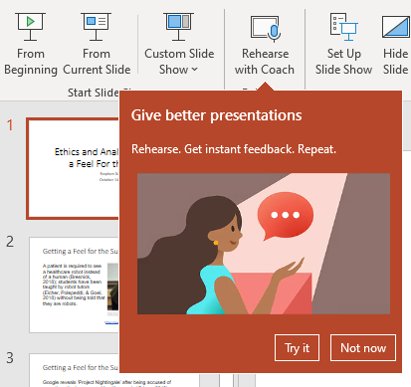
Ethics and Analytics: Getting a Feel For the Subject
Stephen Downes
October 14, 2021

Slide 2
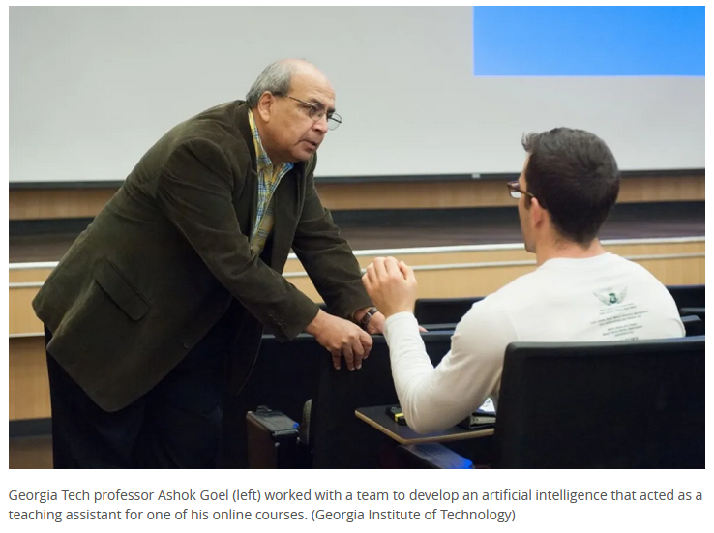
Getting a Feel for the Subject…
A patient is required to see a healthcare robot instead of a human (Bresnick, 2018); students have been taught by robot tutors (Eicher, Polepeddi, & Goel, 2018) without being told that they are robots.
https://www.cbc.ca/news/science/robot-ta-ai-1.3585801

Slide 3
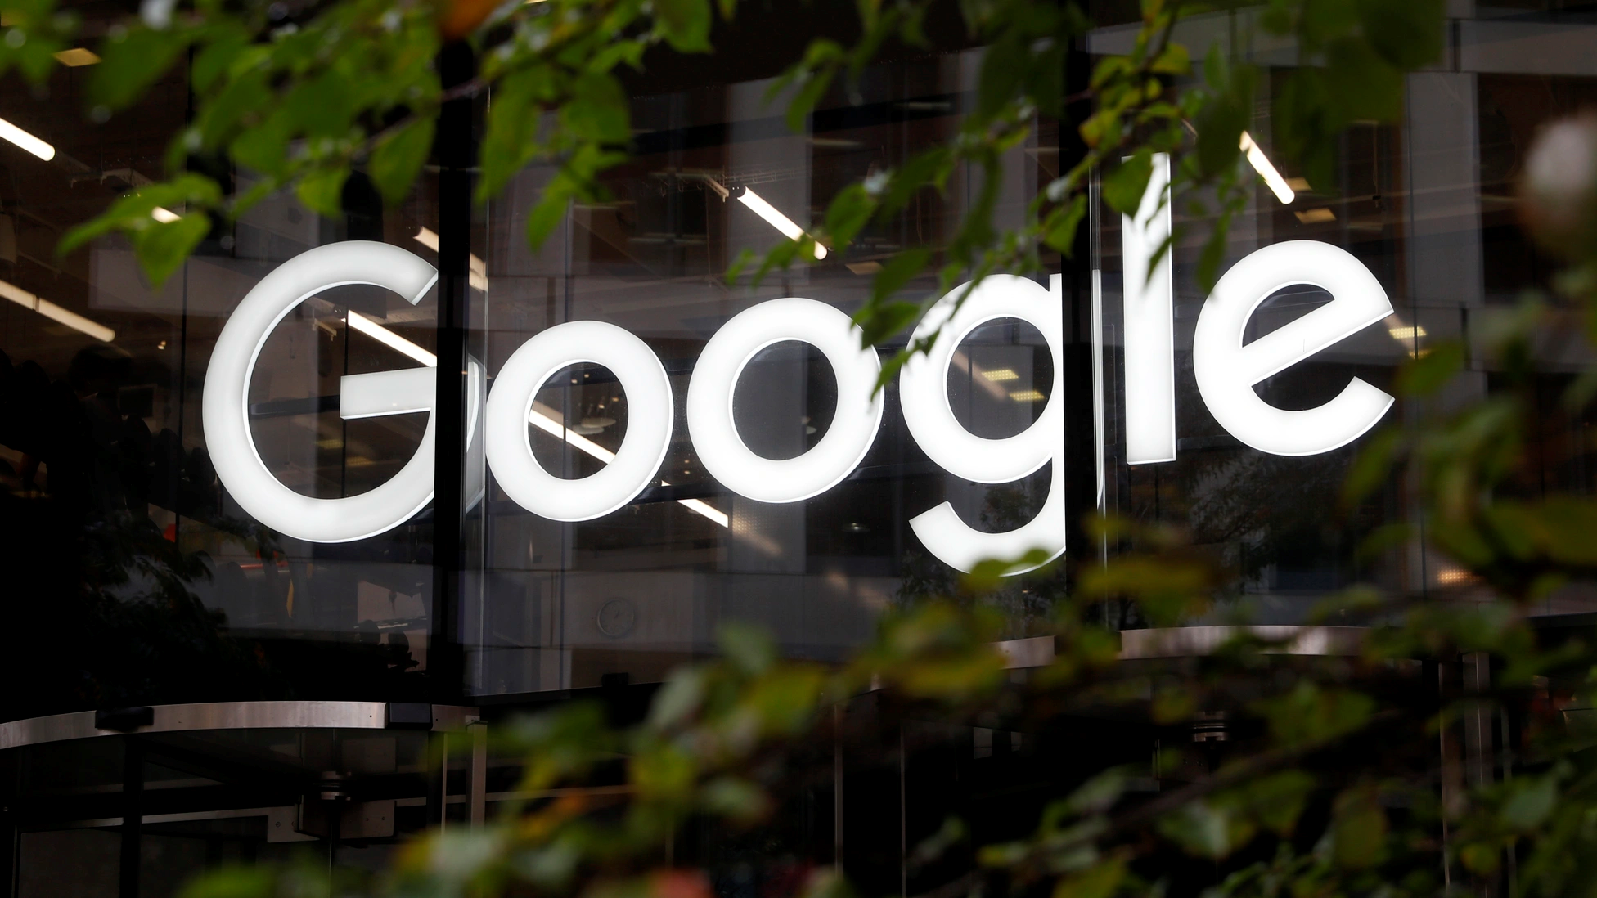
Getting a Feel for the Subject…
Google reveals ‘Project Nightingale’ after being accused of secretly gathering personal health records (Griggs, 2019); Google also offers a ‘Classroom’ application.
https://www.theatlantic.com/technology/archive/2019/11/google-project-nightingale-all-your-health-data/601999/

Slide 4
Getting a Feel for the Subject…
Analytics data is being used to adjust health insurance rates (Davenport & Harris, 2007); it is no stretch to imagine learning analytics data being used for this purpose.
https://www2.deloitte.com/us/en/insights/topics/analytics/predictive-analytics-health-care-value-risks.html

Slide 5
Getting a Feel for the Subject…
A company experiments on the use of news feeds and other data to alter the emotional states of users (Kramer, Guillory & Hancock, 2014); we can foresee similar experiments aimed at keeping classes in order.
https://www.theatlantic.com/technology/archive/2014/06/everything-we-know-about-facebooks-secret-mood-manipulation-experiment/373648/

Slide 6
Getting a Feel for the Subject…
A cafe in Delhi uses facial recognition software to bill its customers. (Sullivan & Suri, 2019); a school district in New York has started doing the same “for security” (Klein, 2020).
https://www.vox.com/recode/2019/12/20/21028124/schools-facial-recognition-mass-shootings

Slide 7
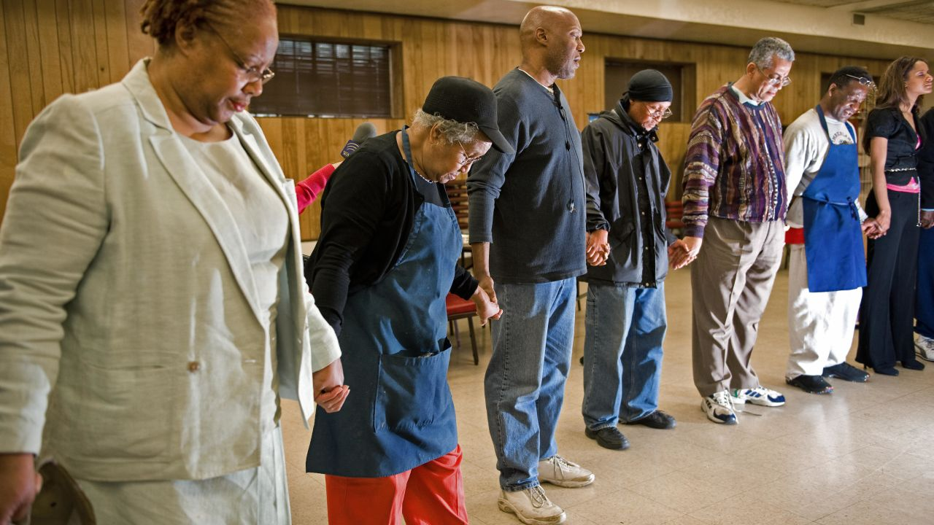
Getting a Feel for the Subject…
A physician refuses to apply a certain life-saving technology because of his religion (Kemp, 2013). Educators may refuse to use learning analytics for similar reasons.
https://www.cnn.com/2018/02/07/health/religion-medical-treatment/index.html

Slide 8
Getting a Feel for the Subject…
A cloud services company declining a contract with an abusive government or agency, or equalizing error rates across protected classes in an automated hiring system. (Moss & Metcalf, 2020)
https://medium.com/@no.gcp.for.cbp/google-must-stand-against-human-rights-abuses-nogcpforcbp-88c60e1fc35e

Slide 9
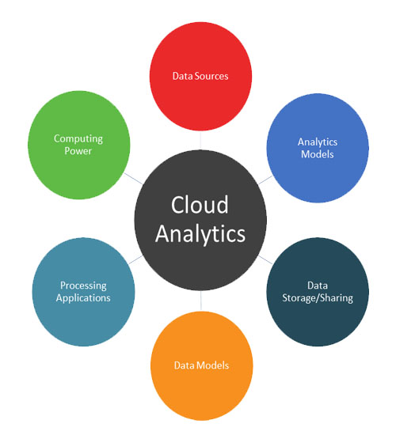
What These Cases Have in Common…
All of these are cases where advanced computing applications and learning analytics (herein called ‘analytics’ for brevity) are being used.
https://www.microstrategy.com/en/resources/introductory-guides/cloud-analytics-everything-you-need-to-know

Slide 10
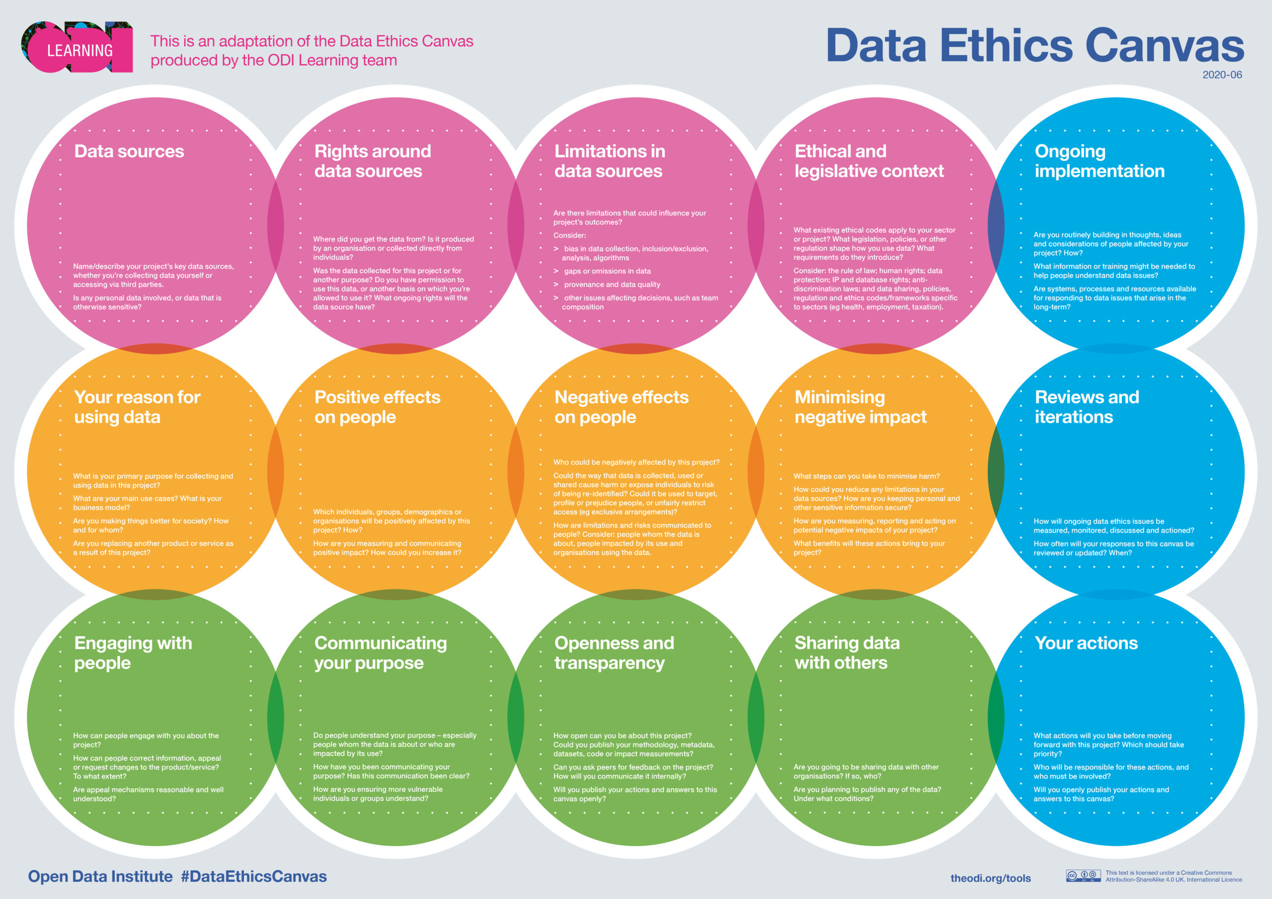
What These Cases Have in Common…
They raise similar questions. How do we address these practices? Are they ethically acceptable in education? What would constitute ‘ethically acceptable’? On what basis should we decide, one way or another?
https://theodi.org/article/covid-19-identifying-and-managing-ethical-issues-around-data/

Slide 11
What These Cases Have in Common…
The use of analytics and the infrastructure that supports them may be pushing society in a direction that educators, among others, find uncomfortable.
https://www.pewforum.org/2017/07/26/findings-from-pew-research-centers-2017-survey-of-us-muslims/

Slide 12
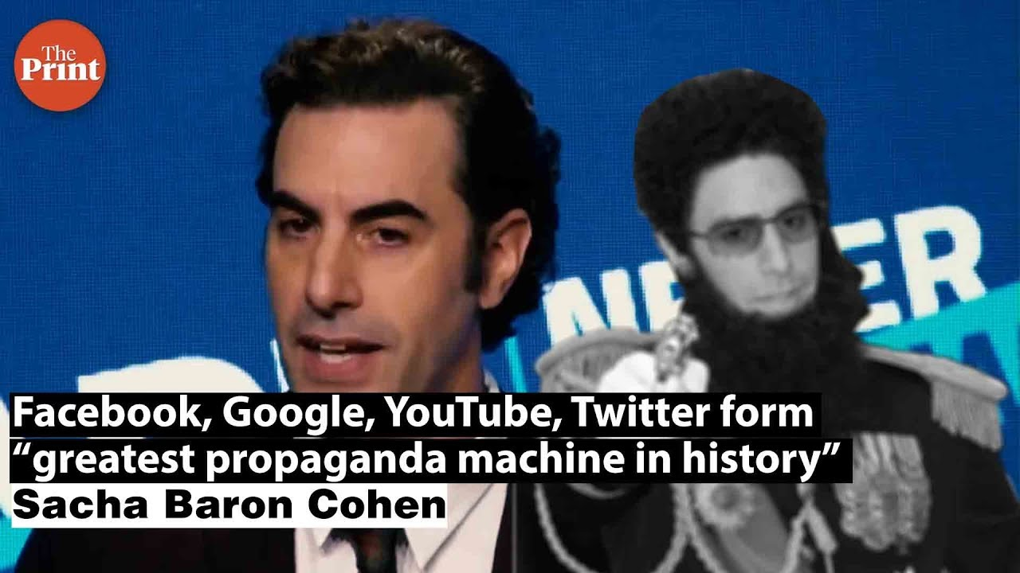
What These Cases Have in Common…
Analytics offer powerful new tools for teaching, but these tools may be misused by those with unethical intent. As Sasha Baron Cohen argued recently, the platforms created by Facebook, Google, Twitter, and other companies constitute “the greatest propaganda machine in history” (Baron Cohen, 2019).
https://www.youtube.com/watch?v=avFVp6zv4sU

Slide 13
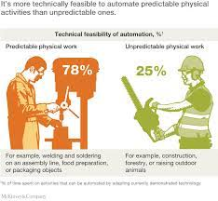
What These Cases Have in Common…
Technology today is either already able or soon to be able to perform many of the functions currently performed by humans. The examples offered in the introduction are all cases where this intervention becomes potentially risky or unwanted.
https://www.mckinsey.com/business-functions/mckinsey-digital/our-insights/where-machines-could-replace-humans-and-where-they-cant-yet

